Slide 1
Applying a Complete Approach
Matt Cauldwell

Slide 2
Applying a Complete Approach
Background
International technology brand
Graduate scheme recruitment across EMEA
Approx. 6,000 applicants for 100 roles
Experiencing high candidate drop out rates
Dropout rate especially high amongst BAME (Black, Asian, Minority Ethnic) applicants
Applicant pipeline suffering lack of diversity
Wanted process to be more reflective of the brand and utilize technology better
High stakes program so real need to boost quantity of applicant pipeline whilst maintaining quality

Slide 3
Implemented new tailored SJT as first stage screener

Slide 4
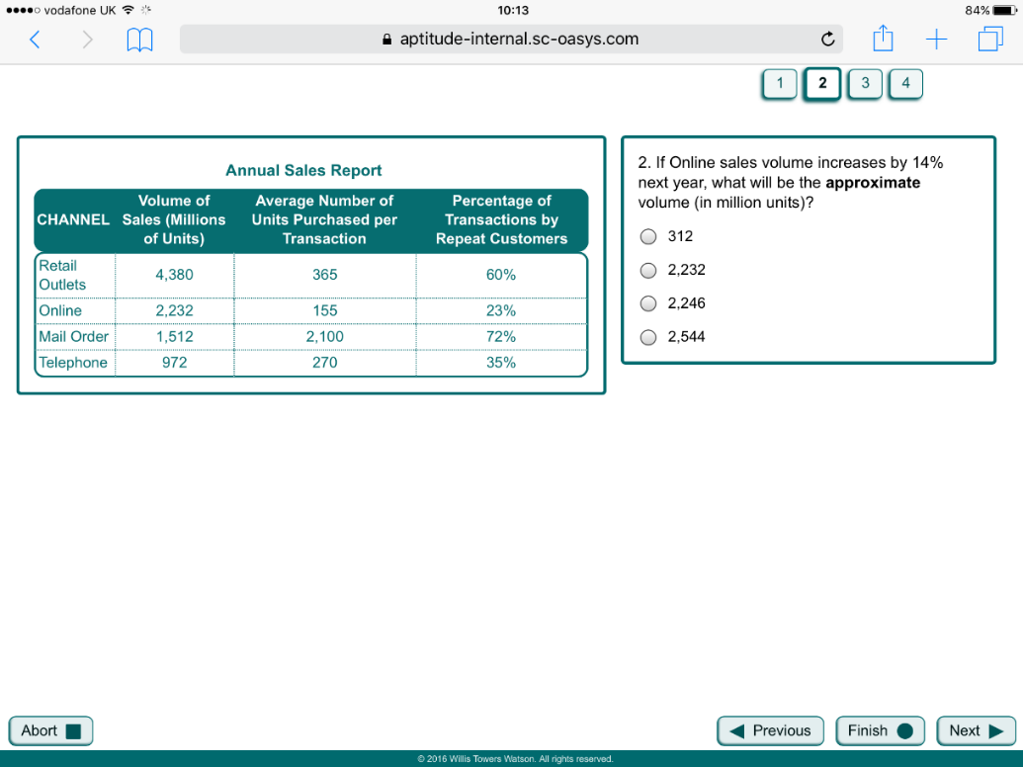
Followed by Swift Combination Aptitude

Slide 5
Improved average score across all competencies assessed at assessment centre stage

Slide 6
18% increase in the proportion of candidates seeing the process through to offer stage

Slide 7
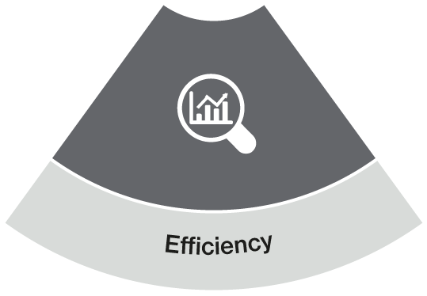
33%
estimated reduction in average candidate completion time

Slide 8
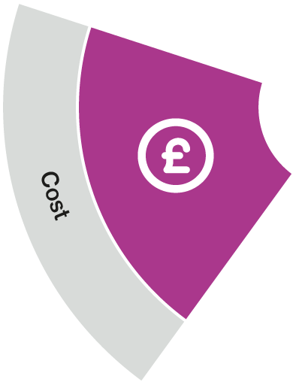
15% estimated reduction in cost per hire

Slide 9
Proportion of BAME candidates employed to the Fujitsu graduate programme doubled

