Slide 1
Breaking Boundaries
Moving beyond traditional coaching
© 2020 Saville Assessment, Willis Towers Watson. All rights reserved.

Slide 2
Breakthrough research illustrates creating a developmental culture is key for delivering a High-Performance Employee Experience. Coaching programs are a valuable method for developing capability but can be resource intensive.
The Coaching Report breaks down the barriers associated with traditional coaching, presenting organizations with a scalable solution to bring coaching in-house. It equips managers with a tailored, targeted & straightforward coaching approach and empowers individuals to create personal agency and self–coach.

Slide 3
The Coaching Report

Slide 4
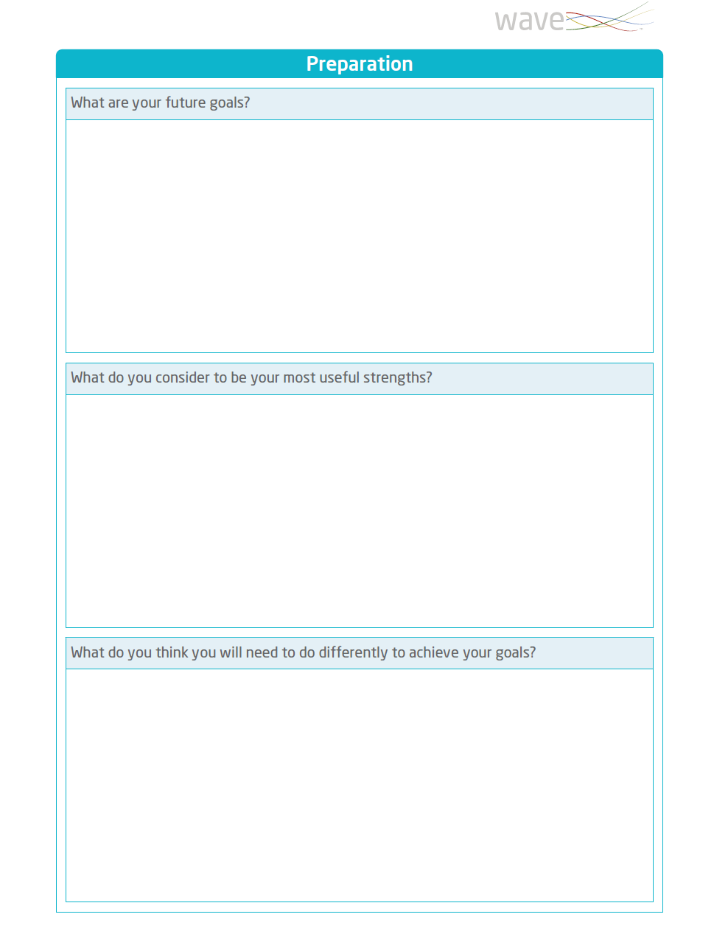
What Does the Coaching Report Cover?
Preparation Section
The Preparation section prompts individuals to think about their goals or specific outcomes (and therefore the purpose of the development intervention) they would like to achieve over the next 6,12, and 18 months.
This section can be completed by the individual before a Coaching Session or with a Coach/L&D professional as part of a development discussion.

Slide 5
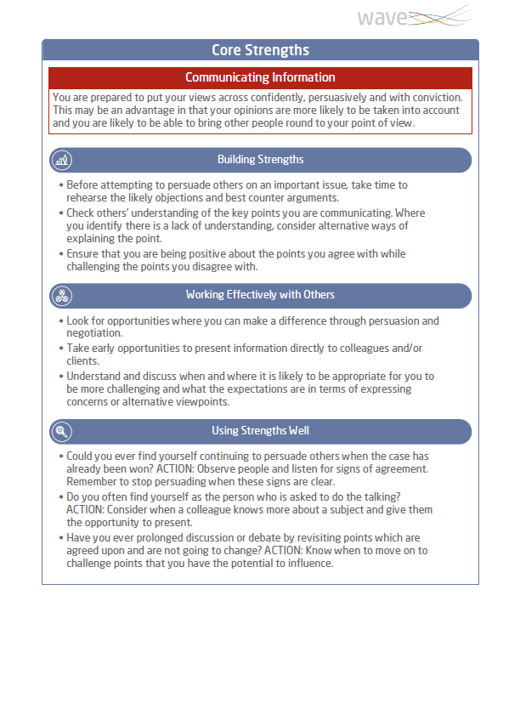
What Does the Coaching Report Cover?
Core Strengths
The report provides information on their top four strengths to help raise self-awareness and prompt actions.
Building Strengths provides tips on how an individual can build and capitalise on their strengths to match the requirements of their role.
Working Effectively with Others provides tips to help the individual and their manager find opportunities and ways for the individual to use their strengths and accelerate their development.
Using Strengths Well provides some insight to consider situations where there is a risk of the individual overplaying their strengths and the resulting consequences.

Slide 6
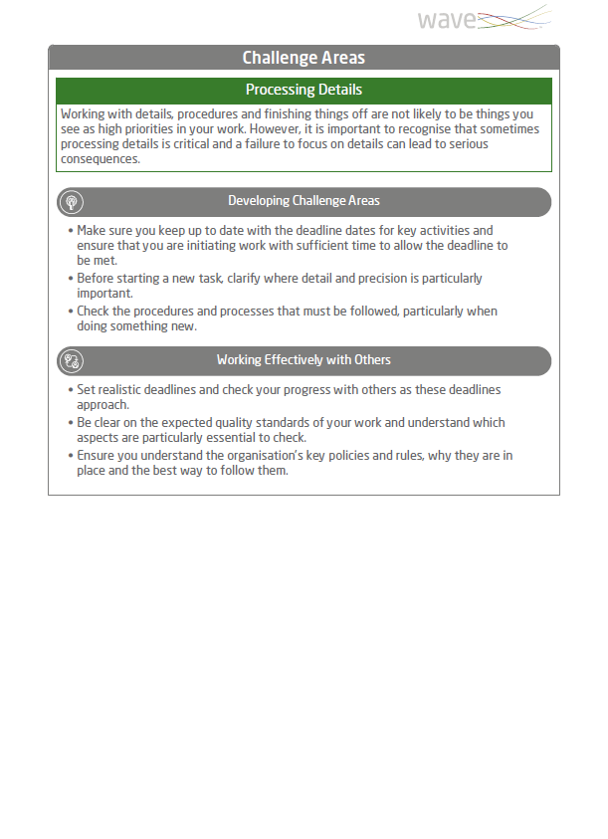
What Does the Coaching Report Cover?
Challenge Areas
This section helps individuals think about their top two challenge areas and what they need to do differently to achieve their goal or outcome. The report provides information on their top two challenge areas to help raise self-awareness and prompt actions.
Developing Challenge Areas provides tips on how to develop and manage an individual’s limitations.
Working Effectively with Others provides tips on how the manager or wider organization can help find ways to support their development.

Slide 7
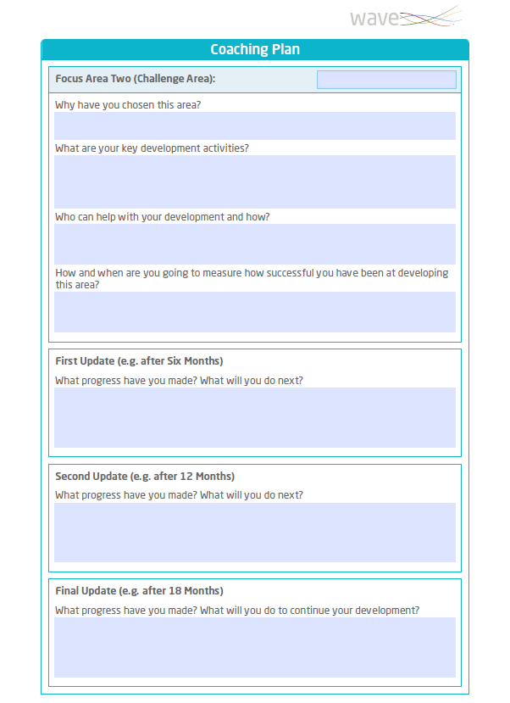
What Does the Coaching Report Cover?
Coaching Plan
The Coaching Plan section encourages the individual to reflect on the key activities they plan to undertake as part of their development across the coming months. Space is provided for three focus areas.
For each of the three Focus Areas, there is space for the individual to add their development progress over 6, 12 and 18 months and think about their next steps in their development.

Slide 8
Unleash a Coaching Culture for…

Slide 9
The Organization
Underpinned by highly valid research into the behaviors that are most predictive of workplace performance and potential, maximizing the capability of the workforce.
Creates an in-house coaching culture improving talent retention and employee motivation.
Provides quick and easy-to-deliver coaching solution suitable for large numbers, extending the power of coaching beyond the leadership team.
Encourages a High-Performance Employee Experience, elevating talent management programs to develop and improve performance.

Slide 10
Managers
Equips managers with a powerful data driven approach to coaching in an easy to deliver format.
Provides a framework to co-ordinate meaningful, targeted and tailored coaching activity that will have positive long-term impact on employees.
The interactive report format seamlessly facilitates virtual coaching and development conversations & planning.
Improves manager coaching capability helping them feel empowered and individuals invested in.

Slide 11
Individuals
Encourages individuals to develop challenge areas and capitalize on areas of strength in line with role requirements and future goals.
Improves self-awareness by shining a light on the risk of potential overplayed strengths and their resulting consequences.
Helps individuals work with their managers to find opportunities to leverage their strengths and development areas through collaboration with others.
Suitable for self-coaching with supporting user guide for continued professional development (CPD).

Slide 12
Applications

Slide 13
One-to-One Coaching
Creating and Engendering a Coaching Culture
Manager Led Coaching
Provide structured insight into building strengths and developing challenge areas.
Empower managers to have valuable coaching conversations with those they manage.
Enable tailored ongoing coaching with support tools accessible to all levels within an organization.

Slide 14
Delivering In-House Coaching Programs
Self-Coaching and Self-Development
Accessible report to bring coaching in-house to allow L&D professionals and HR professionals to conduct coaching programs.
Coaching report guides individual on a coaching cycle from preparation, to coaching planning and review.

Slide 15
Administration & Set Up

Slide 16
No accreditation training required to access the report
Available from Wave Focus Styles – 13-minute completion
Available from Wave Professional Styles – 35-minute completion
Can be administered via own Oasys platform or via the Saville Assessment Bureau Team

Slide 17
info@savilleassessment.com
+44 (0)20 8619 9000
www.savilleassessment.com
© 2020 Saville Assessment, Willis Towers Watson. All rights reserved.

