Slide 1
Talent Assessment 2020
Thursday 6th October 2016

Slide 2
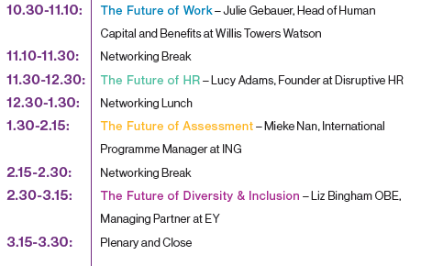
Talent Assessment 2020
Agenda

Slide 3
Training Day: Agenda
10.30-11.10: The Future of Work
Julie Gebauer, Head of Human Capital and Benefits – Willis Towers Watson
11.10-11.30: Networking Break
11.30-12.30: The Future of HR
Lucy Adams, Founder of Disruptive HR
12.30-1.30: Networking Lunch
1.30-2.15: The Future of Assessment
Mieke Nan, International Programme Manager – ING
2.15-2.30: Networking Break
2.30-3.15: The Future of Diversity & Inclusion
Liz Bingham OBE, Managing Partner – EY
3.15-3.30: Plenary & Close

Slide 4
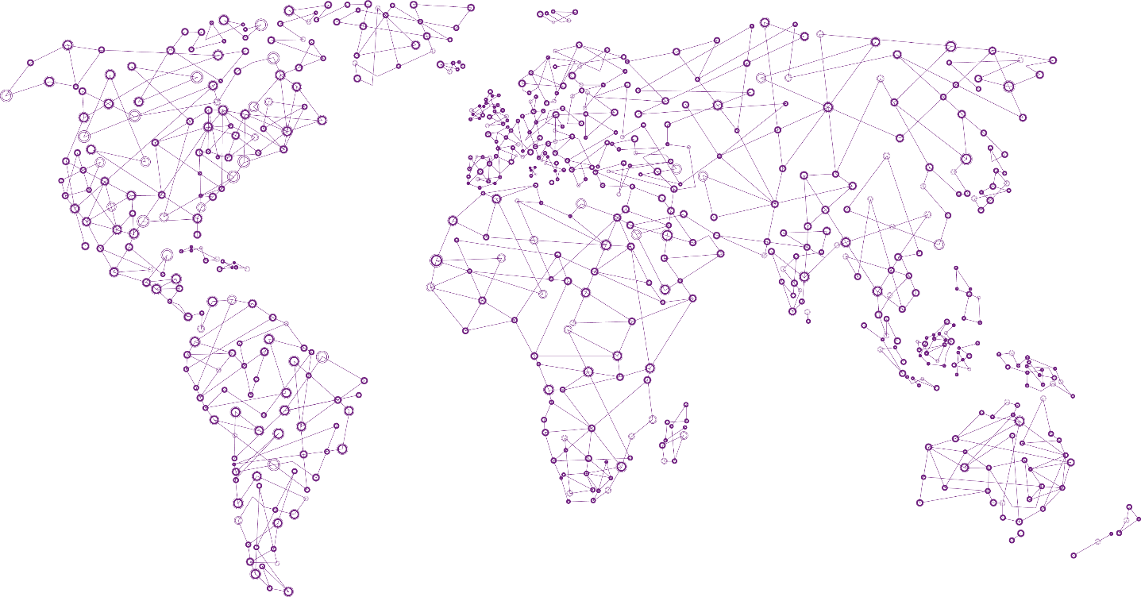
About Saville Consulting, a Willis Towers Watson Company
Who we are
Founded by Professor
Peter Saville in 2004
Global Presence, Local Focus
UK HQ in Surrey
Assessment tools in over 40 languages

Slide 5
About Saville Consulting, a Willis Towers Watson Company
Our Vision
To transform assessment across the world
Professor Peter Saville
Maximise the power of the internet
Taking seriously the need for security in testing
Tailoring our approaches to fit organisations’ needs
Deliver exceptional customer service
Exceptional prediction of work performance
Greater insight and richer feedback

Slide 6
Attracting Candidates has Gotten Tougher
Especially for Key Positions and Emerging Markets
Nearly half (48%)
of employers report
hiring activity increased
Mature Markets
Emerging Markets
Source: 2016 TM&R and GWS Surveys

Slide 7
Keeping Talent has also Intensified
Especially for High Demand Roles
One-third (35%)
of employers report
turnover activity increased
Mature Markets
Emerging Markets
Source: 2016 TM&R and GWS Surveys

Slide 8
The Financial Risk of Turnover is Real
A Combination of Cost and Probability
Lost productivity
Hiring
Financial
cost of
turnover
Probability
of turnover
Financial cost at risk
Training
Job vacancy
Job Level | Financial cost of turnover (% of annual compensation)* | % of ee’s at high risk of turnover** | Financial cost at risk***
Senior Manager/Executive | 74% | 31% | 23%
Professional | 59% | 25% | 15%
Sales & Customer/Client Management | 59% | 27% | 16%
Business Support | 48% | 27% | 13%
*FCOT measured in our proprietary benchmark database
**% at risk of turnover from 2016 Global Workforce Study
***Financial cost at risk=FCOT*% at risk of turnover
Notes:
8

Slide 9
Most Significant Cost is Lost Productivity
Best in Class Companies have Improved Ramp Up by 30 – 50%
It takes
on average, for a new employee to become
fully productive.
4-12 MONTHS
The cost of this lost
productivity averages
per employee
$20,665
Source: Financial Cost of Turnover survey, Towers Watson, 2015

Slide 10
Current Talent Acquisition Practices Falling Short
What We Have Heard
Culture Matters
We are good at recruiting for technical skills, but need to be better at understanding how folks will ‘show up’ in the office.
Missing Opportunities
We cannot get hard-to-find talent in the door fast enough and are missing clear opportunities to grow our business.
Attracting the Wrong Type
We get plenty of applications sent to us, but the quality of the applications is poor; we are not getting our fair share of talent in the market.
Cumbersome Processes
We get complaints by recruiters and managers that our hiring process is long-winded, resource heavy, and slow. There must be a better way.
Recruitment in Isolation
We do not utilize or pay attention to what our colleagues are doing throughout Talent Management; succession, learning, and talent acquisition are not tied together.
Risky Hires
We do not have a clear, consistent way to ensure that job requirements are communicated to recruiters and hiring managers to inform decisions.
Hiring for the Future
We know that our organization is changing, yet we have not taken into account what this means for how we source and hire candidates.

Slide 11
Companies Vary in their Maturity
There is Scope for Improvement
High Maturity
Medium Maturity
Proactive Applicant Sourcing
Culture of developing talent from within
Strategic relationships with suppliers
Shared recruitment service center partnering with the organization
Business seek out HR for their support
Clear roles and responsibilities between business and recruitment specialists
Line managers act in accordance with employment law
HR spend time on added value resource planning activities
Easily accessible and consistent reporting
Fully automated end to end candidate management process
Technical skills and competency framework used to consistently rate candidates
Quick lead time to recruit
Costs known and managed corporately and by managers
Some Proactive Applicant Sourcing
Over-reliance on external candidates
Preferred supplier lists for agencies and head hunters
HR approval required for hiring
Line managers demonstrate limited knowledge of recruitment practices
Some recruitment specialists
Behavioral competency framework in place to consistently rate candidates
Consistent processes but slow approval
Medium lead time to recruit
Costs known and managed corporately
Low Maturity
Reactive Applicant Sourcing
Lack of trust in HR
Ambiguous roles of HR vs line managers
Poor data quality
Long lead time to recruit
Little automation
Line managers lack knowledge
Inconsistent processes
HR focused on administrative tasks
Unknown costs

Slide 12
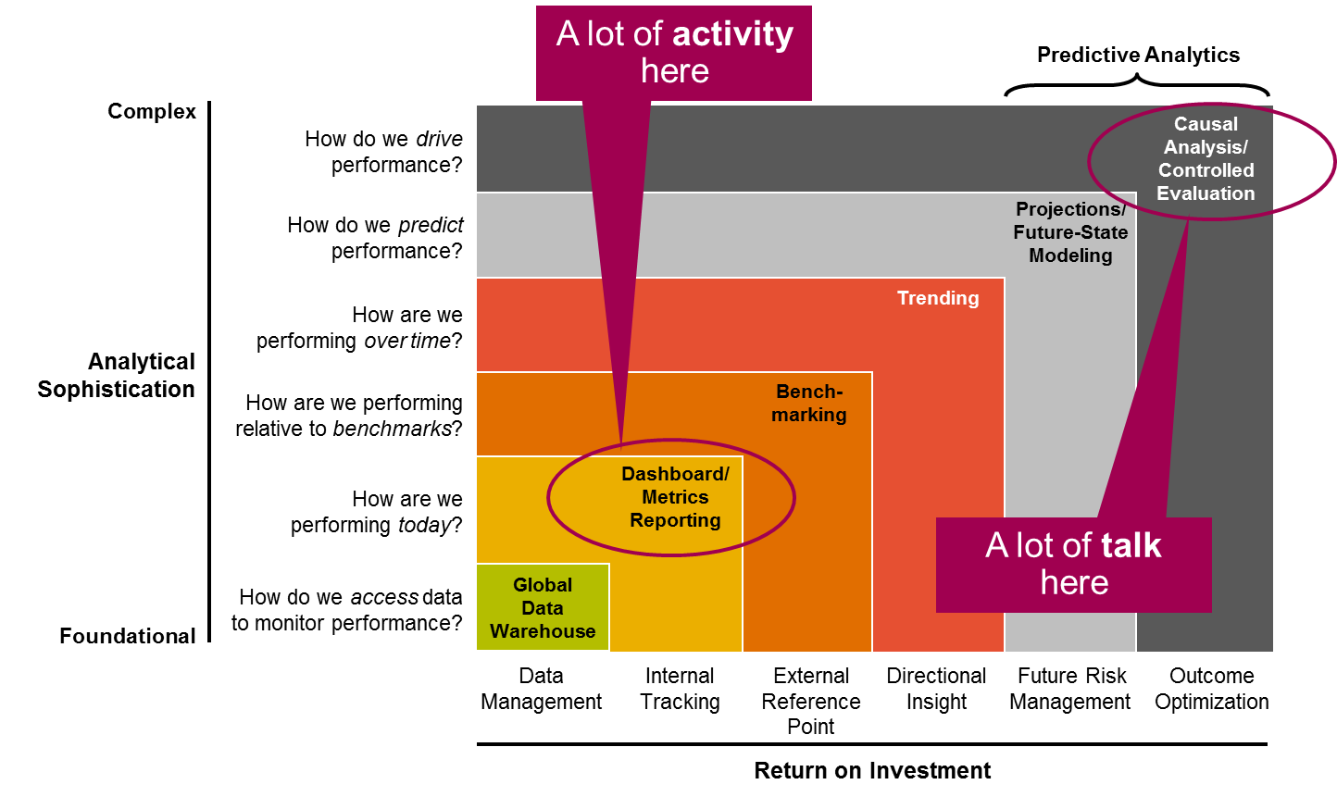
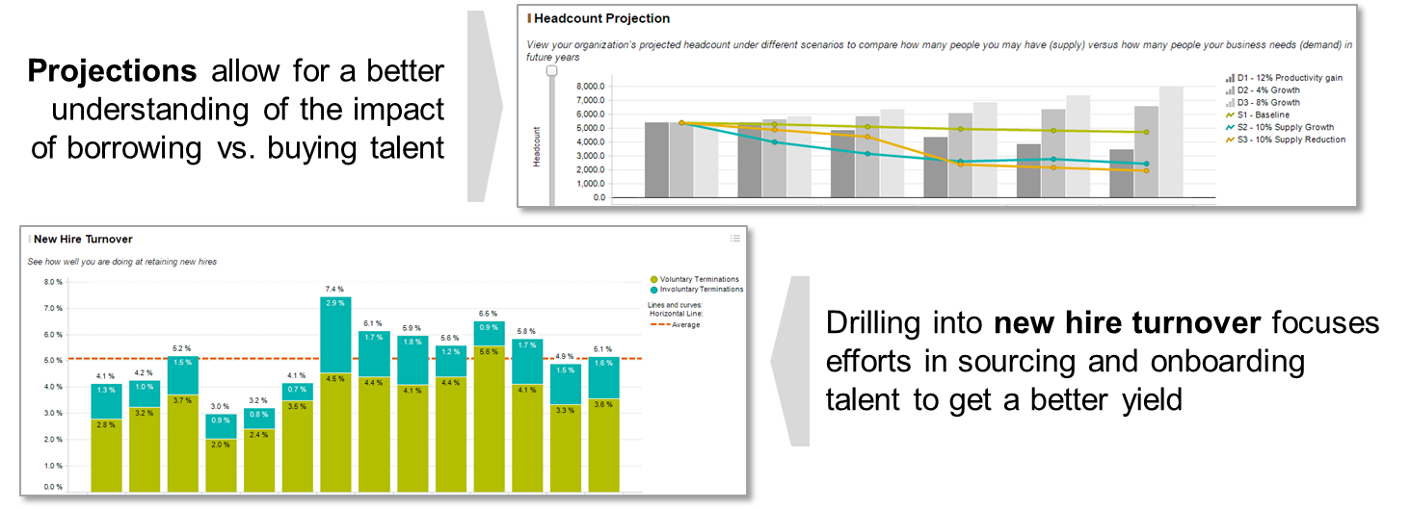
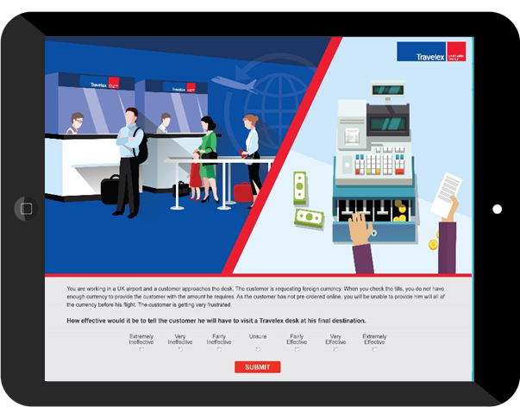
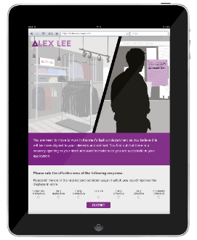
Harness Technology
Begin with the End in Mind
Harness Technology to Identify
Targeted Talent Pools
26% of companies now use automated pre-screening tools (SHRM, 2016), including word use or biodata. The rise of the algorithm is here, yet to what end…
For example, a University of Cambridge Study of 58,000 people found a very high correlation between ability and liking a Facebook page on Curly Fries
Use Validated Assessments for
Screening and Selection

Slide 13
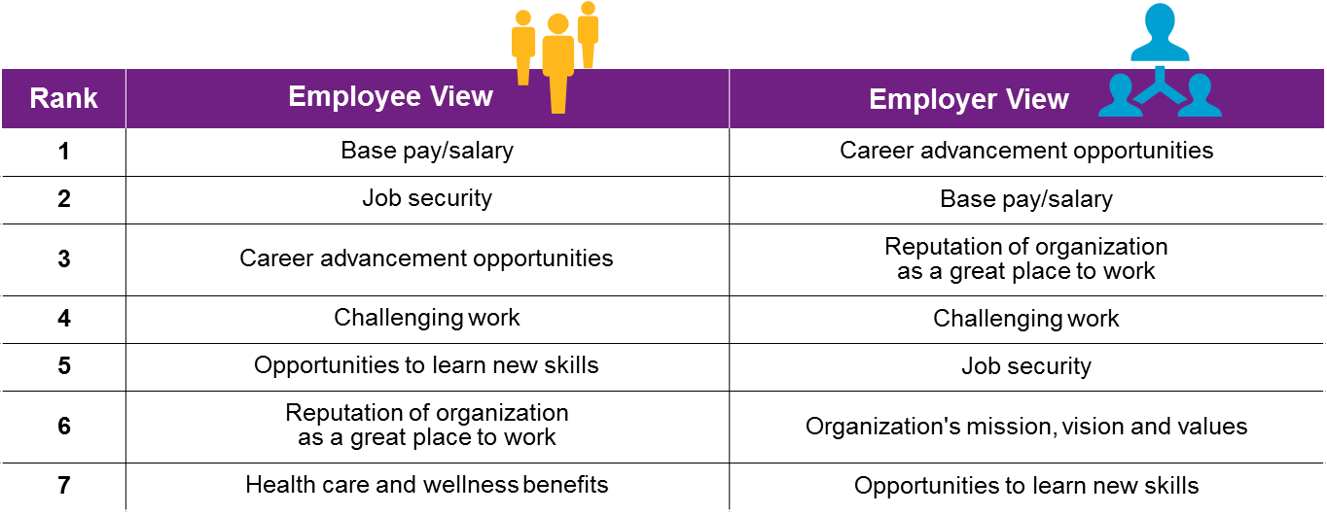
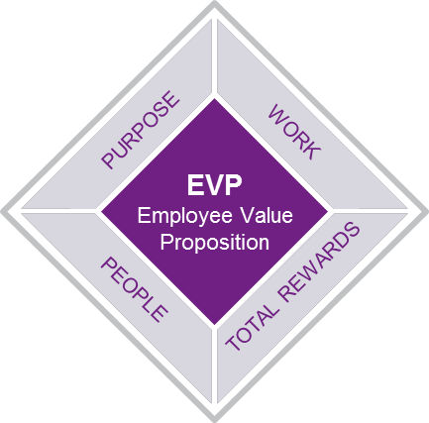
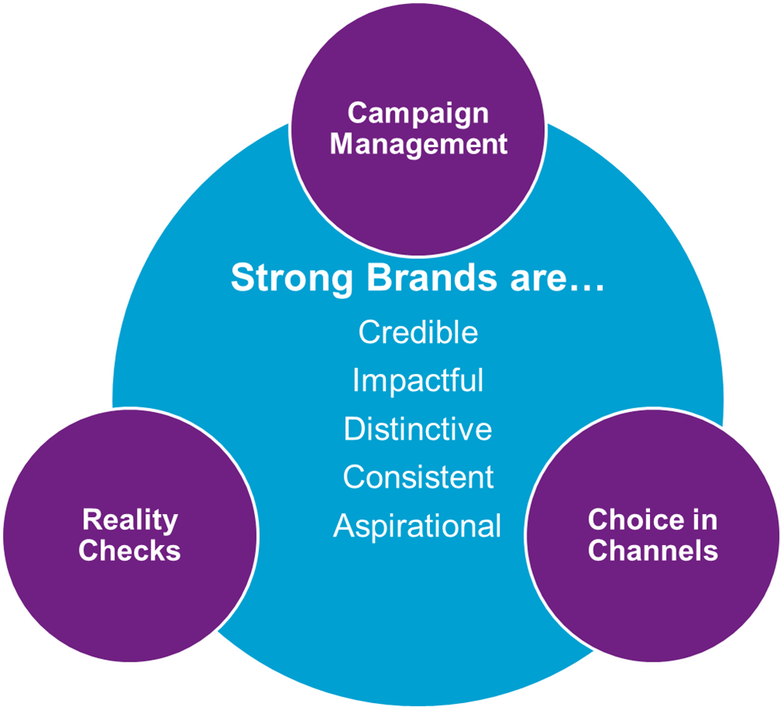
Establish a Strong Employer Brand
Know What is on Offer and Be Transparent
Top Attraction Drivers are compared to a Reality Check of the workplace to create an Employee Value Proposition (EVP)
An Employer Brand embodies the EVP and is managed across campaigns and channels, ensuring that it is complementary to other forms of branding (i.e. product, social, or goodwill)

Slide 14
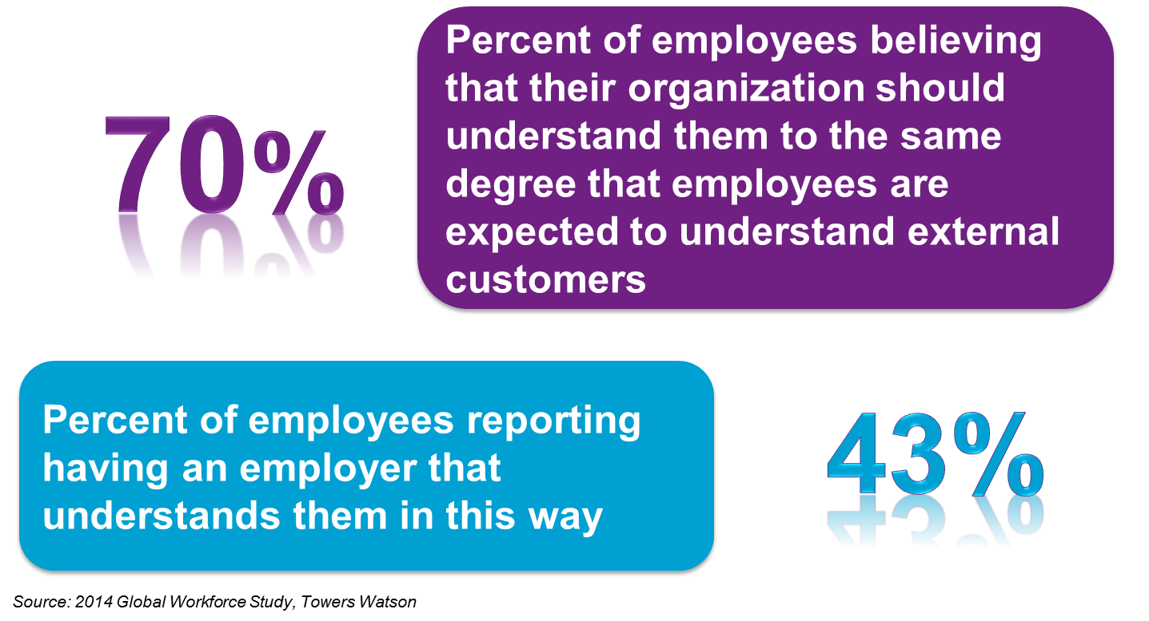
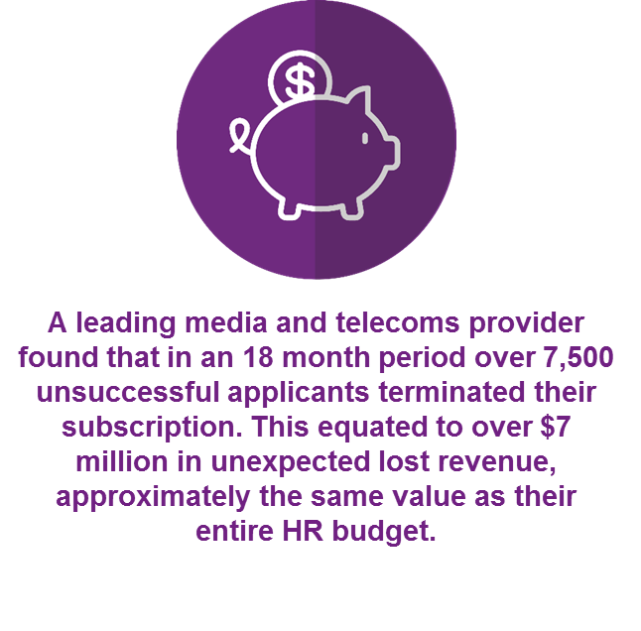
Focus on the Candidate Experience
Communicate to Candidates like Customers
The technology, branding, messaging, assessment and candidate management shapes the perception that applicants have of an organization
The role of Talent Acquisition needs to change:
Understand and advise the business on talent trends and focus areas
Be the face of the organization, balancing technology and personal contact
Provide an appropriate amount of feedback and closure on the experience
Get involved in the internal marketplace for talent

Slide 15
Willis Towers Watson Approach
To Strategic Talent Acquisition
Attraction
Bringing the CVP to life in order to attract candidates with the greatest potential fit
Workforce Planning
Helping organizations understand the internal and external factors that can influence Talent
Acquisition strategies
Talent Acquisition Baseline
Capturing firm, objective data about the effectiveness and efficiency of existing Talent Acquisition
practices to identify what needs to change
Screening and Selection
Applying valid, robust approaches and tools to identify the right talent and taking a holistic, data-driven approach to hiring decisions
Discovery
Strategy
Implementation
Talent Acquisition Strategy Development
Determining the future state of Talent Acquisition practices and making firm decisions around sourcing strategy, segmentation and approach
On-boarding
Effectively transitioning candidates into fully engaged and productive employees
Candidate Value Proposition
Turning a formally articulated, well executed, segmented Employee Value Proposition (EVP) into an effective CVP. Without understanding what an employee will experience on the job, candidates cannot be attracted effectively to the organization

Slide 16
Our Approach Drives the Practice Further
Integrating Talent Acquisition with Broader Talent Management
Too many
assessment designs
Taking a strategic view of the architecture underlying sourcing and selection allows for a cleaner design
Inconsistent
practices
Using reliable technology, valid tools and agreed workflows underlies an effective enterprise strategy
Treating all
requisitions the same
Segmenting the criticality of talent pools allows for resources to be invested in the right places
Promises don’t
match reality
Considering the candidate value proposition (CVP) and embedding it delivers on promises
Decisions made on
gut feeling
Ensuring reliability and validity is built into every design allows for quality hires and legal defensibility
Candidates get lost
in the system
Building in clean handovers between recruiters and managers ensures a strong candidate experience
New hires lose their
engagement
Following through with a robust, structured onboarding experience fosters long-term engagement

Slide 17
The Future of Work
Julie Gebauer – Willis Towers Watson

Slide 18
Help Wanted
Frontend UI/UX
London tech firm
4D Designer / Visualiser
Freelance
Permanent Secretary
Department for International Trade
Brand, Ethical & Compliance Officer
Retailer
Scrum Master
Multiple industries
Notes:
To talk about the future of work, I’ll start with a quick scan of some current job postings for professionals in London.
The list is telling for at least a couple of reasons.
First is its source. Unlike years ago, when many of us would grab a red pen and scour the tiny print of the newspaper’s Help Wanted section…these were pulled from very recent postings to indeed.com. You’ve likely heard about this and other talent platforms that are used to reach the powerfully skilled and powerfully independent new worker.
Now, in addition to source, there are the jobs themselves.
I would venture to say only one of these – Permanent Secretary – would have been recognizable ten or twenty years ago. The rest might just have seemed an odd collection of letters and words, without much meaning.
They are jobs of the Fourth Industrial Revolution…

Slide 19
Enter the
Fourth Industrial Revolution
as disruptive as its predecessors

Slide 20

The Fourth Industrial Revolution
Digital
Revolution
Compared to Previous
Industrial Revolutions
The Reshaping
of Jobs
Digital revolution
Fusion of technologies blurring lines of physical, digital, biological
Tech breakthroughs: artificial intelligence, robotics, the ‘Internet of Things’
Disrupting most industries
Disrupting most countries
Huge impact on work and jobs
    Job creation and displacement
    Heightened labor productivity
    Widening skills gaps
The most in-demand occupations or specialties did not exist 10 years ago
65% of children entering primary school today will ultimately end up working in jobs that do not yet exist

Slide 21
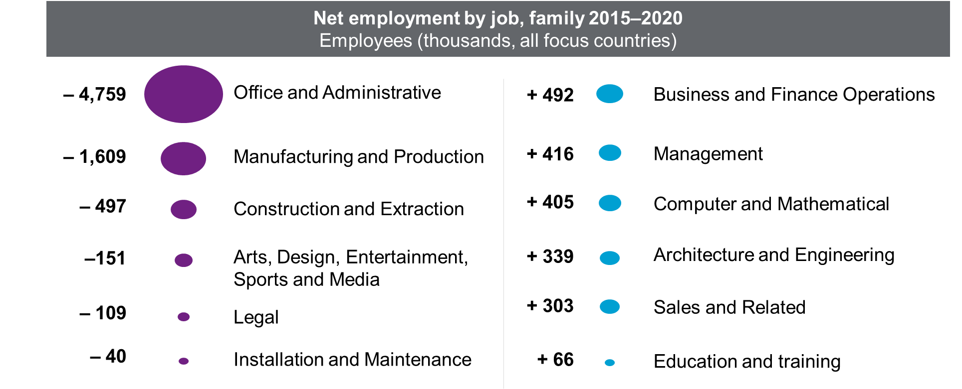
The Reshaping of Jobs

Slide 22
Are leading to democratization of work and technological empowerment
Five “Forces of Change”
Democratization of Work
New “employment” relationships
Shorter in duration
More company—individual balanced
More agile, responsive view of work
Purpose-built networks
  Social and organizational reconfiguration
  All inclusive, global talent market
  A truly connected world
  Exponential technology change
  Human-machine collaboration
Technological Empowerment
Individual empowerment through:
Machine learning
3D printing
Wearables
Algorithmic analytics
Source: CHREATE Consortium
Notes:
Social and organizational reconfiguration
The workforce’s increased autonomy and decision-making authority will make the workplace more power-balanced and less authoritative. The workplace will be structured more through social networks and less through hierarchy. Work relationships will be more freelance, gig, and project-based and less exclusively employment-based. Organizations will tap more diverse avenues for sourcing and engaging talent that extend beyond traditional employment.
All inclusive, more diverse talent market
Multiple generations will increasingly participate as workers, today’s minority segments will become majorities, older individuals will work longer, and work will be seamlessly distributed around the globe through 24/7 operations. Organizations that win will develop new employment contracts and hone new leadership styles and worker engagement approaches to address the varied cultural preferences in policies, practices, work design, rewards and benefits.
A truly connected world
Information will be more abundant, richer and more available to everyone. Work will be accomplished from anywhere, creating a truly global talent ecosystem. Seamless global and real-time communication, will lead to faster product development. Go-to-market strategies will be more diverse, and have shorter product/strategy durations. Organizational reputation will become a pivotal currency in customer and work markets.
Exponential pattern of technological change
Technological breakthroughs will force organizations to adapt and reinvent themselves more quickly. Meanwhile the workforce faces the risk of job loss and skill obsolescence, requiring that they adapt and reinvent themselves.
Human and machine collaboration
Technological breakthroughs will produce exponential disruptions in markets and business. The rapid adoption of robots, autonomous vehicles, commoditized sensors, artificial intelligence, and global collaboration will renew the thinking about work.

Slide 23


Democratization of Work
The emerging “Robo-gig” economy
3.6BN
38–40 million skilled worker deficit
90–95 million
low-skilled worker surplus
Mobile Users
Rapid increase digital robots and virtual personal assistants
850,000
Technologists on
TopCoder.com
(from 6k 10 years ago)
69%
Human & machine collaboration • A truly connected world
Use of digital media for work
Social & organization reconfiguration • All inclusive global talent market
$2.7BN
GDP boost by talent platforms
in <10 years
41%
77%
of organizations list missing skills as the single biggest impediment to digital transformation
of companies have contingent employees
Sources: Digital Media & Society, World Economic Forum in collaboration with Towers Watson; Towers Watson Research; also reference McKinsey & Co
Notes:
Let’s look a little closer at these two core themes. And let’s start with the democratization of work and what this could mean for our futures.
There’s evidence that the relationship between employees and their companies is changing and the power in that relationship is shifting to the employee. This is captured by the change in how leaders refer to their people. No longer “the biggest cost” or even “the most important asset” but now “the most important investor” in the company. In the first two descriptors, there’s an inherent imbalance of power toward the employer who is managing or using people. In the final description, there’s a suggestion that the employee is in more control and the company needs to create an environment where an employee would like to invest time and energy.
Why the change? Beyond the obvious point that nothing happens in a business if there are no people, there are other changes underway causing leaders to see a new power balance.
It starts with the position in which employers find themselves….with new competition trying to disrupt their industries, with incredibly demanding customers insisting on better experiences and lower prices, and with a deficit of skilled workers needed to achieve their business goals. Doing research with the World Economic Forum last year, we found that the gap in skilled workers totaled nearly 40 million. Further, as companies think about the need to transform themselves using new technology, over ¾ say they’re limited because of missing skills. So, employers find themselves in a position of need – driving them to consider non-traditional sources of talent.
That alone doesn’t really change the equation. An additional factor – the advanced tools and resources to which workers have access -- is what really changes the equation. Start with mobile. About half of the world’s population -- 3.6 bn people -- have access to a mobile device. A mobile device with an incredible amount of computing power. And 30% of all people on the planet are utilizing social media. Over 2 bn people are part of a virtual community, giving them access to even more information and useful connections. With these resources, they can work anywhere anytime. And they are taking that into account as they make employment decisions.
This combination of social and mobile has also enabled new digital talent platforms -- that provide networks of potential employees with easy access to an online marketplace for work. Platforms like Topcoder. How many here have heard of it? Well it is worth knowing about because it has just under 1 million members. Where software developers and graphics designers compete to solve problems in the most effective and elegant way. Sponsor companies pay the winning coder royalties for their work. As a software engineer using TopCoder, I can choose the most interesting projects to me, the one where I think I can grow the most, that I think I can do best and one that pays a reasonable royalty. And I can select a new project every week or two. It’s a great way to balance work with the rest of my life.
And then there’s UpWork. a platform for freelancers. And 12 million freelancers – software developers, designers, writers, administrators -- have joined alongside 5 million clients. Last year alone, there were 3 million jobs posted and $1 bn of revenue transacted over UpWork.

Slide 24
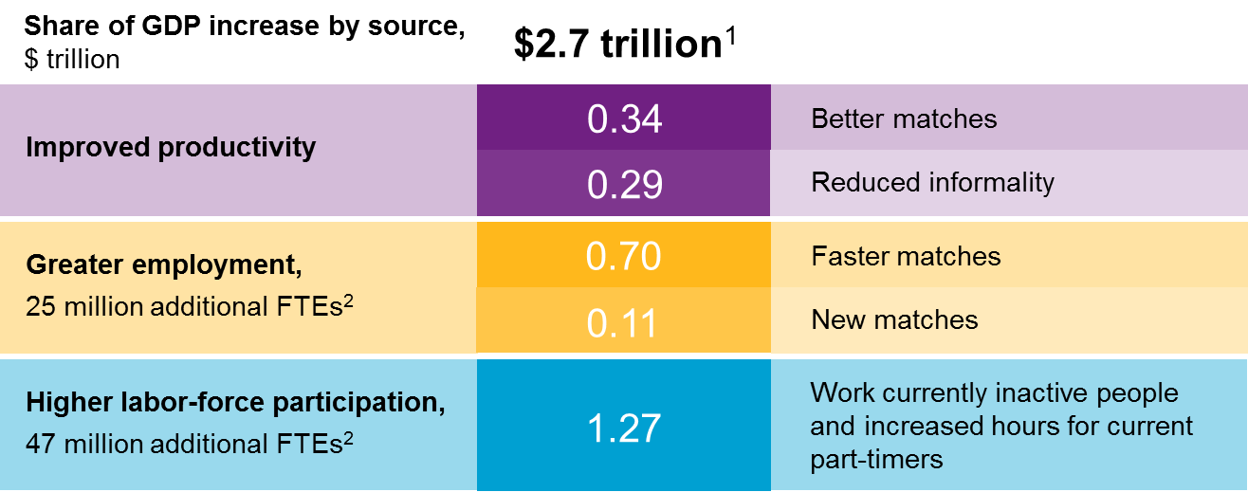
Democratization of Work
The transformative impact of talent platforms
By 2025, online talent platforms could boost global GDP by $2.7 trillion
22%
Source: McKinsey & Company
Figures do not sum to total, because of rounding.
Full-time equivalent
Notes:
With the number of people involved, these talent platforms really shouldn’t be ignored. In fact, McKinsey completed a study recently that confirmed this. They evaluated the impact of these talent marketplaces, setting out to value the impact of using these talent platforms to connect consumers of human capital –employers – with owners of human capital – employees. Beyond Upwork and TopCoder, they considered platforms like Uber connecting drivers with people that need rides and Care.com that is connecting childcare, eldercare and pet care providers with families who need these services.
These platforms are doing more than just digitizing the world of freelancers. They are filling gaps where organized commercial activity and public infrastructure have been lacking. They are providing businesses with the talent they are unable to find through traditional means, particularly where there have been skills gaps as in IT and for digital skills.
Consider the 850 million+ working age people who are not fully employed. Through a talent platform, many could find new jobs more quickly. Many could increase their part-time hours. Many could find work that suits their skills. As an example in this last area, there are lots of organizations looking for data analysts or data scientists. This is a hard job to fill … presumably because the skills are hard to come by. Indeed, there are only 84,000 people of the 433 million people on Linked In who have this job title. But, if we broke down the job into tasks or skills, we would see a different situation – and opportunity. There are more than 9.7 million people who have at least one skill required to be a data scientist and 3.9 million people who have at least two skills to do so. So, a company might find that disaggregating jobs into skills/tasks and leveraging a talent platform will enable them to address their talent gaps.
This study suggests that in total, by 2025, these talent platforms could add $2.7 trillion to the global economy.

Slide 25


Technological EMPOWERMENT
Robotics and other technology: A disruptive fusion
Robots for dangerous
and dirty work and accurate and patient work
Shared learning in the cloud may accelerate robot effectiveness and adaptability
Collaborative robots could work alongside humans
Smartphones could serve as “supercomputers” that program household robots
Main source: Rodney Brooks, Panasonic Professor of Robotics at MIT
Notes:
The next main theme is technology. Technology has been impacting work for a very long time. And there have been dire predictions about its impact for equally as long. As far back as 1589, there were concerns. Queen Elizabeth I refused to grant a patent to William Lee for his stocking knitting machine because of her concern that it would bring her subjects ruin by depriving them of employment and making them beggars. More recently, in 1965, Robert Heilbroner asserted “As machines continue to invade society, duplicating greater and greater numbers of tasks, it is human labor itself that is gradually rendered redundant.”
But the dire outcomes didn’t come to pass. That’s because in all of these prior instances, the automation has been accompanied by new employment opportunities. By the introduction of new and more complex tasks in response to the automation. So, as dock workers were replaced by cranes, new engineers and machinists were needed to operate the cranes. Every prior industrial revolution has involved this race between machine and man. And in every instance the creation of new complex tasks on the side of man has outweighed the automation of tasks.
Is the fourth industrial revolution going to be different? Historically, machines have taken over routine tasks, first manual and then cognitive, that involve explicit rules. Today, we are seeing automation of non-routine tasks. Mobile robotics with sensors and manipulators are doing things like climbing and maintaining wind turbines for GE. Foxconn is using robots to assemble products like the iPhone. Commercial service robots are helping with food preparation, health care, commercial cleaning and elderly care. And the transportation industry is also benefiting. Technology can look both forward and backward at the same time (and I can’t do that in spite of telling my children that I could), and it doesn’t get distracted. So, we are seeing the computerization of agricultural and mining vehicles. El Dulze, a Spanish food processor, uses robots to pick and pack good heads of lettuce and reject those that don’t meet company standards.
It seems every industry will be impacted as mobile robotics continue to advance.

Slide 26
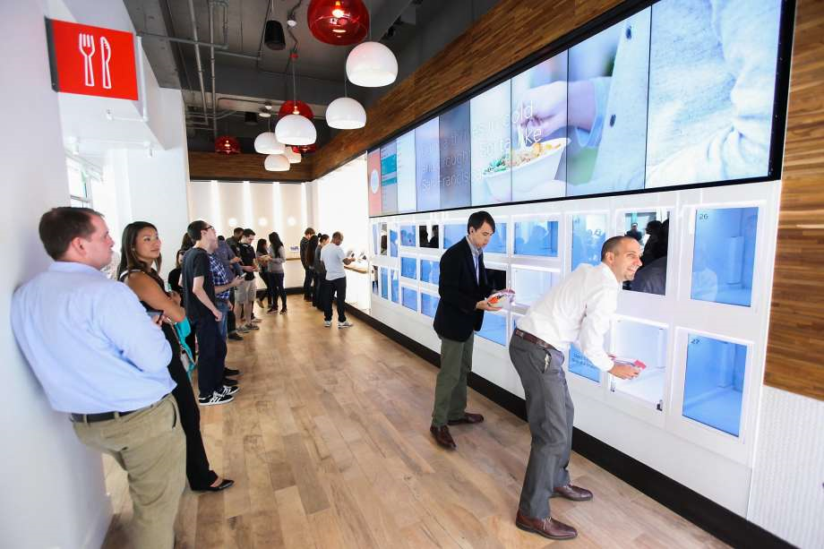
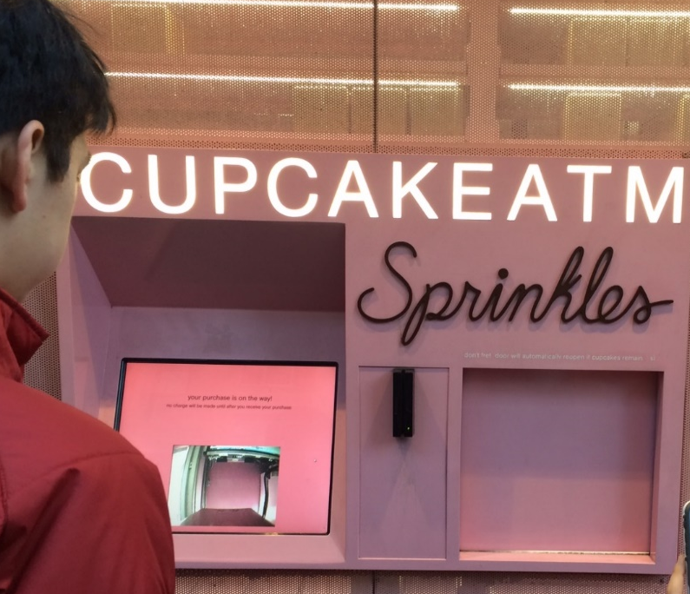
Are we approaching “peak human”?
The Configurable Lunch…
…and Self-Serve Dessert
Photo: SF Chronicle
Notes:
Silicon Valley restaurant Eatsa uses technology where once there were employees:
Diners place their orders at an ipad kiosk or by a smart phone app
Meal is delivered to a “personalized cubby”
Essentially, no “human interaction” between customer and restaurant
On a sidewalk in NYC, customers can order a cupcake like an ATM withdrawal (or they can step inside to place a traditional order at the counter of the bakery)
And while these are kind of fun examples of the reshaping of work….

Slide 27



Are we approaching “peak human”?
Machine Learning and AI have come of age, and scale, thanks to the cloud
More affordable and better care, but fewer doctors?
IBM Watson successful diagnosis rate for lung cancer is 90% compared to 50% for human doctors
Robo-advisers replace humans in banking
RBS announces the shedding of 550 jobs, to be replaced by
robo-advisers in order to cut costs
AlphaGo beats world champion Go player
Self-learning algorithms improve performance over time, and can be applied to complex cognitive problems (e.g. language translation)
Notes:
…we are seeing the larger role of Artifical Intelligence and Machine Learning that is having a very real, and very serious impact. Consider three examples.
Memorial Sloan-Kettering Cancer Center’s oncologists are using IBM’s Watson for cancer treatment diagnostics. Watson uses input from 600,000 medical evidence reports, 1.5 million patient records and clinical trials and 2 million pages of text from medical journals to benchmark and recognize patterns. Watson can compare those patterns to each patient’s symptoms, genetics, family and medical history to diagnose and develop a treatment plan with the highest probability of success. And as it (he) compares, he absorbs and analyses to continue making it smarter – better and better diagnoses and treatment plans . No human doctor can match this. It would take at least 160 hours of reading a week just to keep up with new medical knowledge as it’s published let alone apply it.
Another example is the FS sector…With AI, a machine can process more financial announcements, press releases and other information and then act on that information faster than any human trader. That’s why RBS is shedding hundreds of jobs and aiding its customers in their financial planning with roboadvisors.
And then there’s AlphaGo, the powerful computer that’s part of Google Deep Mind. Just four months ago, it made an amazing accomplishment. It won a game of Go. Go originated in China over 2500 years ago. It sounds like an easy game where players take turn placing black or white stones on a board to capture the opponents’ stones or take territory. But it’s profoundly complex because there are more possible positions than the number of atoms in the universe. AlphaGo was taught the game by memorizing the moves of human experts and correlating those moves with probability of winning … and then playing against itself and doing so. Essentially this is a machine that figured out for itself how to win at go… a game that is a googol more times complex than chess. And this machine beat the top player on the planet for a decade.
These examples just scratch the surface of all the things that can be automated -- giving companies new ways to get work done … and creating new jobs at the same time.

Slide 28
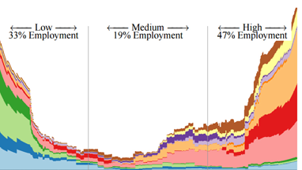
The transformative impact of technology
400M
300M
200M
100M
0M
Low
33% Employment
Medium
19% Employment
High
47% Employment
Management, Business and Financial
Computer, Engineering and Science
Education, Legal, Community Service, Arts and Media
Healthcare Practitioners and Technical
Service
Sales and Related
Office and Administrative Support
Farming, Fishing and Forestry
Construction and Extraction
Installation, Maintenance and Repair
Production
Transportation and Material Moving
Employment
0 0.2 0.4 0.6 0.8 1
Probability of Computerisation
Source: Frey, C.B. and M.A. Osborne, “The Future of Employment: How Susceptible Are Jobs to Computerisation?”, 17 September 2013
Notes:
So, are these new technological developments going to have a different impact on work than prior technology revolutions. How big will the impact of automation be?
Clearly, with MR, AI and ML, we are seeing more success in automating non-routine tasks. Every industry. Every country will be impacted. That said, there are still some challenges to automation. We hit a bottleneck in technological advancement in three main areas: manipulation tasks (like handling irregular objects) creative intelligence tasks and social intelligence tasks (like negotiation, persuasion and care. It will still be difficult to automate the tasks of an event planner or a biologist.
Taking that into account, and looking at one employment market, the US, one study estimates that 47% of employment is at high risk of automation in the next two decades.
But, no doubt there will be new and more complex tasks coming on line. There will be the equivalent of audio-visual specialist or data scientist that have recently just become job title. The question is will they be in sufficient quantity to replace the automated jobs?
And will we have enough people with the skills to do them? Skills like complex problem solving, creativity, emotional intelligence, negotiation, and cognitive flexibility that are inherent in those bottleneck areas that aren’t yet likely to be automated

Slide 29
What does this mean for the Future of Work?

Slide 30
A challenge to our core beliefs about the organization
“Outside the firm, price movements direct production, which is co-ordinated through a series of exchange transactions in the market … Within a firm, these market transactions are eliminated and, in place of the complicated market structure with exchange transactions, is substituted the entrepreneur co-ordinator, who directs production.”
Ronald Coase, The Nature of The Firm, 1937
Notes:
These two general themes -- the democratization of work and advances in technology -- are challenging the notion of a company as we’ve come to know it. Coase wrote about what made companies work well. He viewed companies essentially as centrally planned economies formed because of people’s voluntary choices. People made the choices because of marketing/transaction costs. Making a company the most efficient place to conduct a production process

Slide 31
Shifting paradigm: How work and businesses are organized
Assembly line ➔ Nikefication ➔ Uberization
Our organization is a
place containing employees doing work.
Our organization is a fixed set of functions
that work together to create value.
Supply chain | Manufacturing
Retail stores | Marketing
IT | R&D
Our organization is a malleable set of functions and deciding which ones get done inside
the organization is a big part of strategy.
Our organization organizes work and talent.
Supply chain | Manufacturing
Retail stores | Marketing
IT | R&D
Retail stores
R&D
Notes:
This notion underpinned the well-run companies of the late 19th and early 20th century. Work was organized into jobs and jobs were turned into careers.
This started to change a bit in the mid 20th Century as the computer revolution occurred. Telephone operators were made redundant. GM introduced the first industrial robot. Airline reservation systems turned to self service technology. Bar-code scanners and cash machines impacted the retail and financial industries. Computer usage increased dramatically and caused a shift in the structure of the labor market. Outsourcing and offshoring were introduced … focusing companies on their core competencies.
And now we move to the fourth industrial revolution…how will organizations change?
How will talent platforms, virtual work, new jobs emerging, new skill sets required change the nature of an organization?
We suggest that organizations focus not on creating jobs for employees, but organizing work and talent to deliver products and services. The talent to do the work may come through regular employment but may just as easily come from a talent platform. And the organization may be more agile and malleable … with some functions inside the company and some outside.

Slide 32
New work: Horrible or wonderful?
  Risk shifted to workers
  Employers stop training
  Death of the Career
  Commoditization
  Rush to lowest cost
  Worker exploitation
Horrible?
  Transportability
  On-demand training
  Boundary-less careers
  Precise work-worker matching
  Rewards segmented to match needs
  Worker Empowerment
Wonderful?
Notes:
There are two ways to look at the likely changes … Like Queen Elizabeth I … constraining innovation for a time to ensure her subjects didn’t become beggars … or like Dr Larry Norton at Memorial Sloan Kettering who is excited to have IBM Watson serving as a wise counsellor at the side of physicians to help guide decisions.
The negative view: workers are taking on lots more risk, careers are dying, everything will be commoditized, workers will be exploited…
Or think about the opportunity for on-demand training to adapt to the new and more complex tasks created as other jobs become defunct. Transportability of skills and careers that benefit from opportunities at lots of different organizations; opportunity to match skills and tasks and empowerment.

Slide 33


Lead the Work map
Jobs
Collected
Employment Relationship
Tasks
Dispersed
Virtual or Market Relationship
The Assignment
Self-contained
Detached
Insular
Rigid
Permeable
Interlinked
Collaborative
Malleable
The Organization
Permanent
Collective and Consistent
Traditional
Impermanent
Individualized & Differentiated
Imaginative
The Rewards
Source: John Boudreau, Ravin Jesuthasan and David Creelman

Slide 34
The Future of HR
Lucy Adams – Disruptive HR

Slide 35
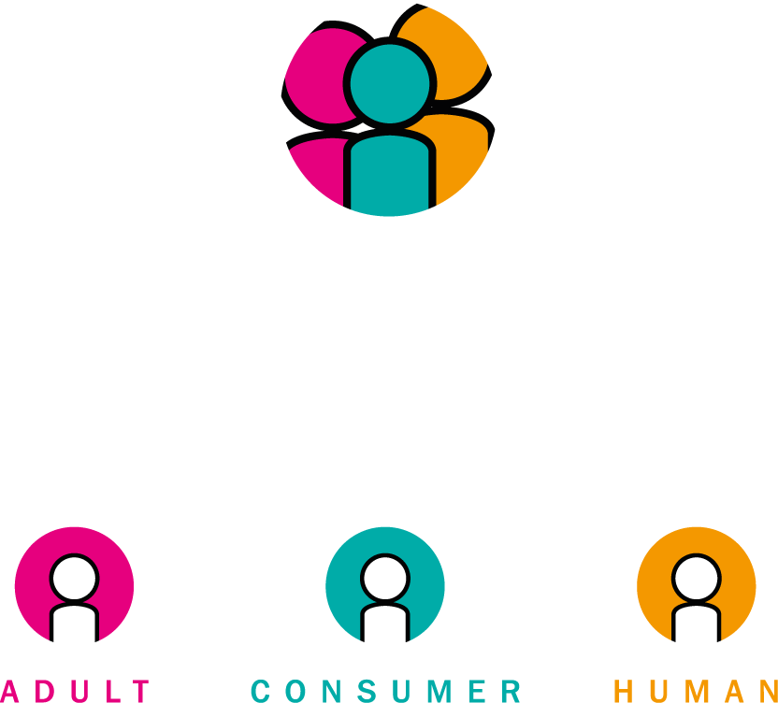

Talent Assessment 2020: The Future of HR
The EACH Model* *©The Disruptive HR Agency Ltd 2016
Each
EMPLOYEES AS:
@hr_disruptive

Slide 36
The Future of Assessment
Mieke Nan - ING

Slide 37
Future of assessments
Mieke Nan
6 October 2016

Slide 38
Future of Assessment
Can we do an image here like what was on the invite. Future of Assessment in the middle then coming out of it around it
Candidate Value Proposition (CVP)
Mobile Devices/Multimedia/Virtual Reality
Short Assessment Times
Applicants as Customers
Better Feedback

Slide 39
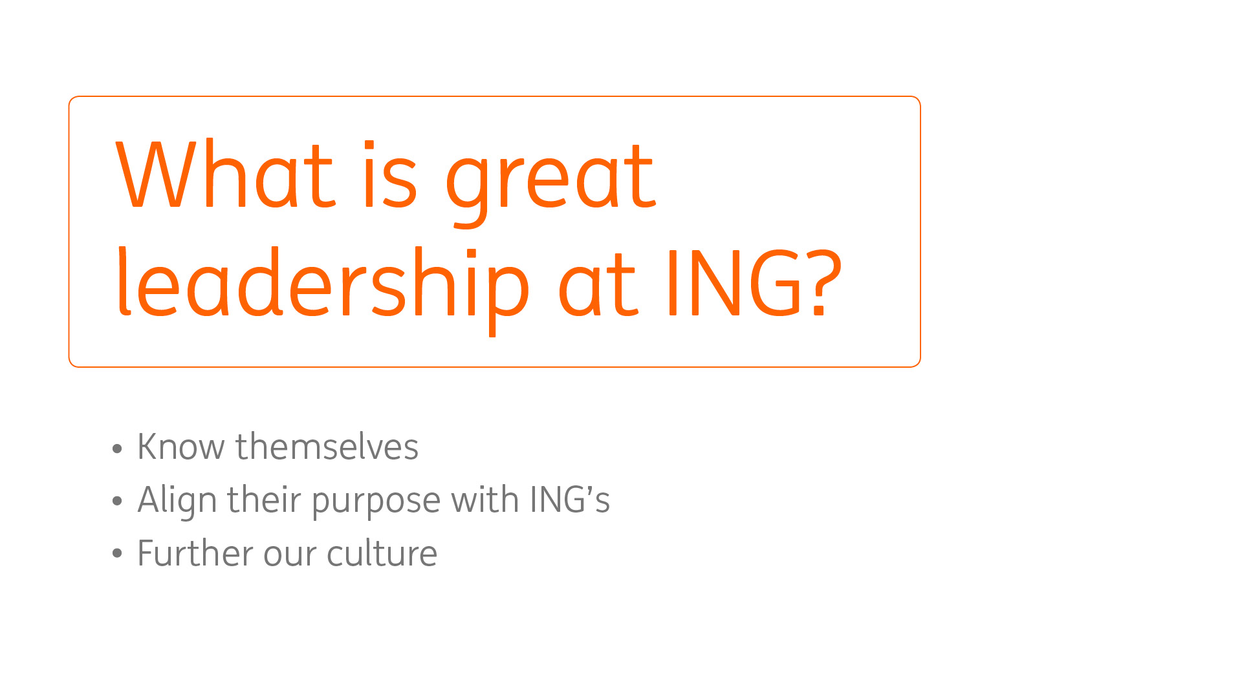

Slide 40
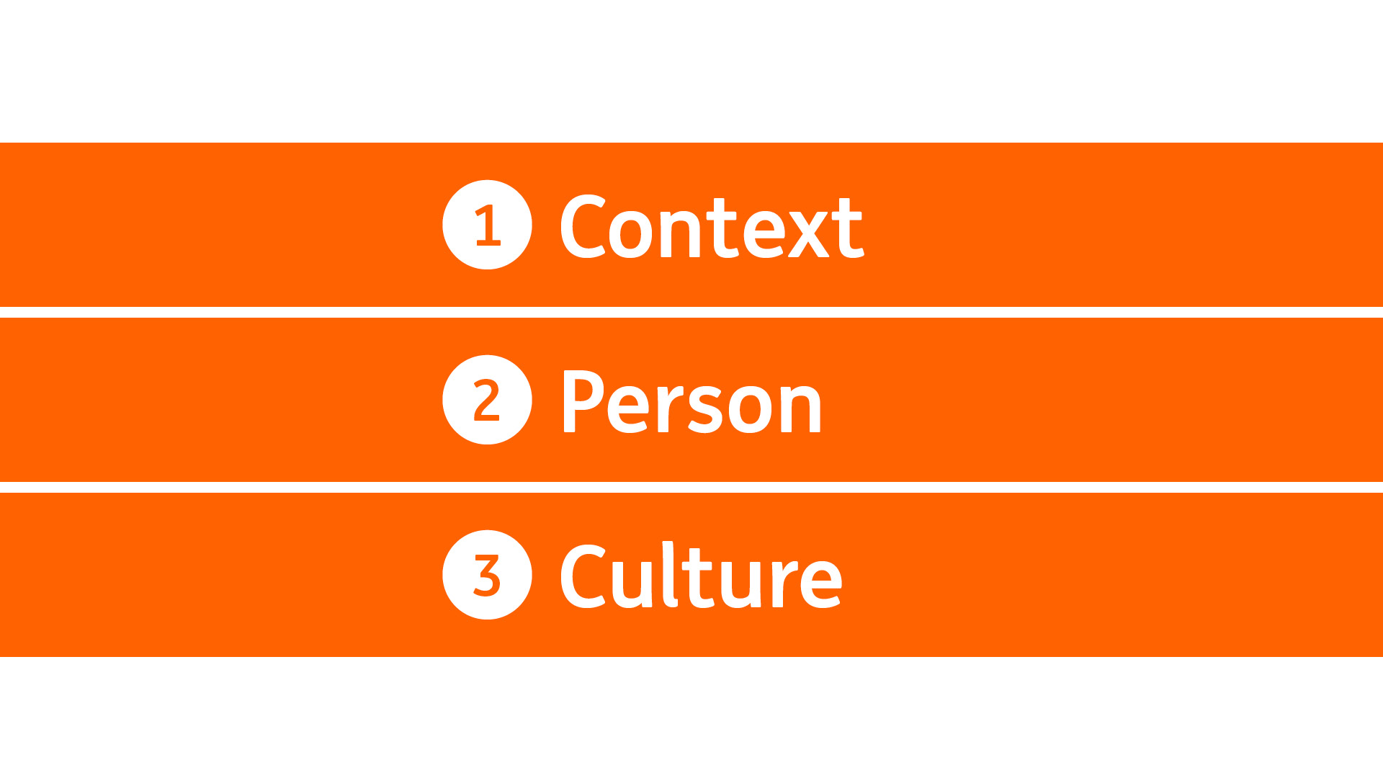

Slide 41
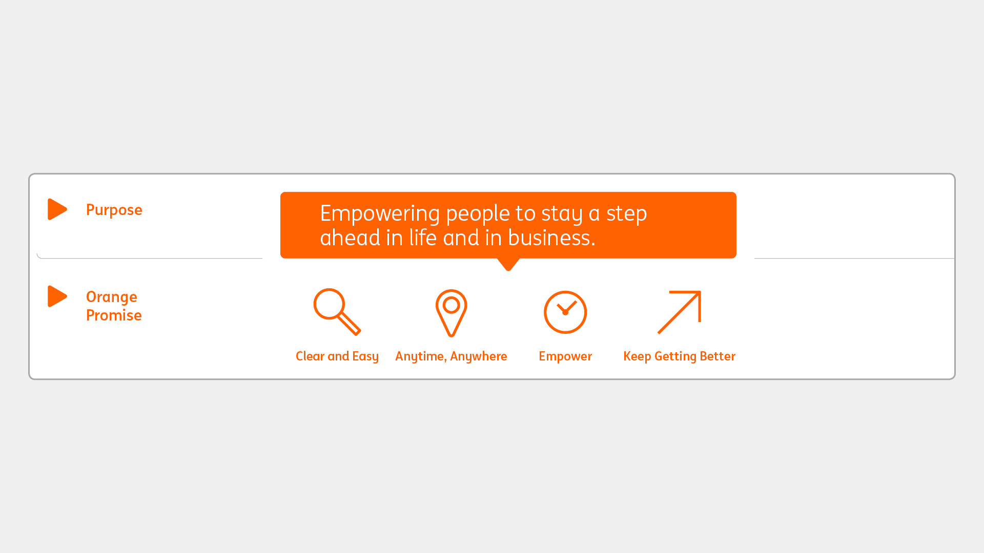

Slide 42
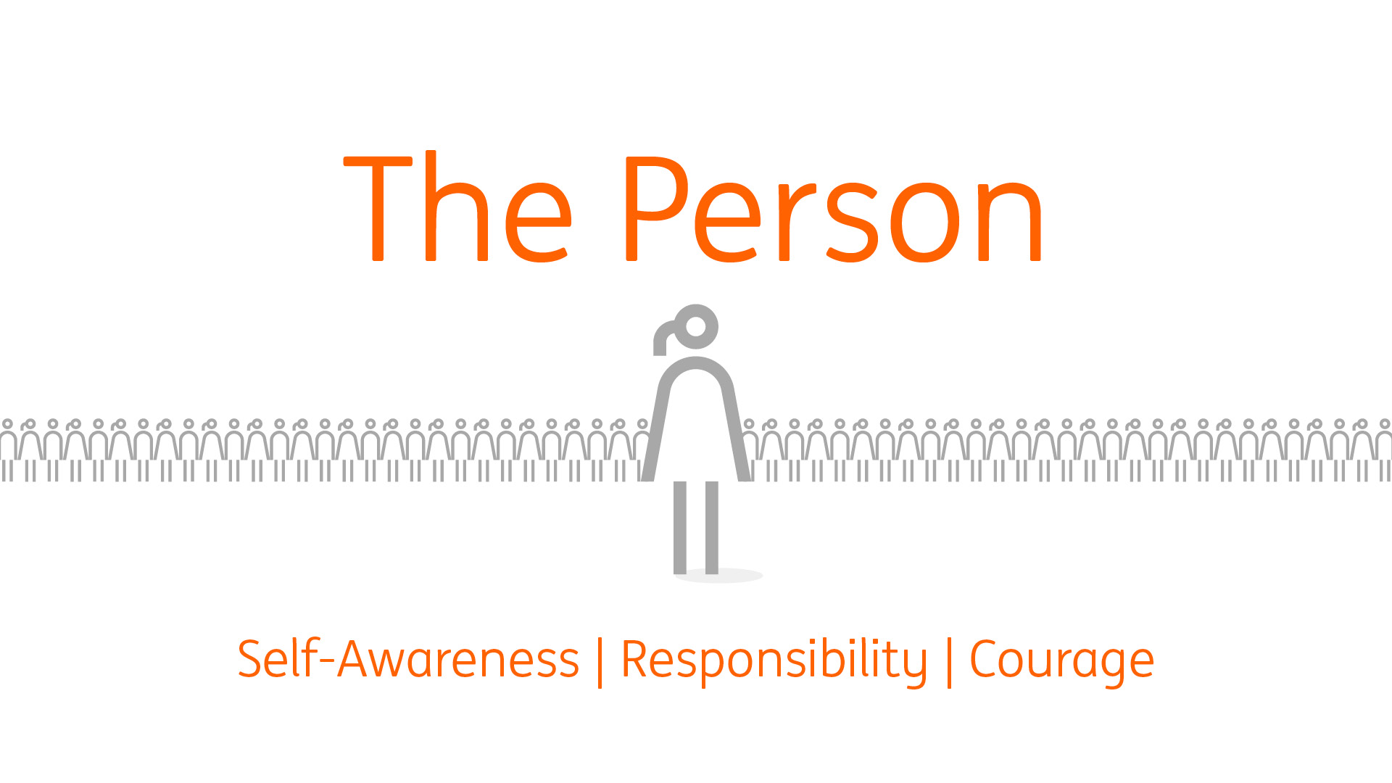

Slide 43


Slide 44
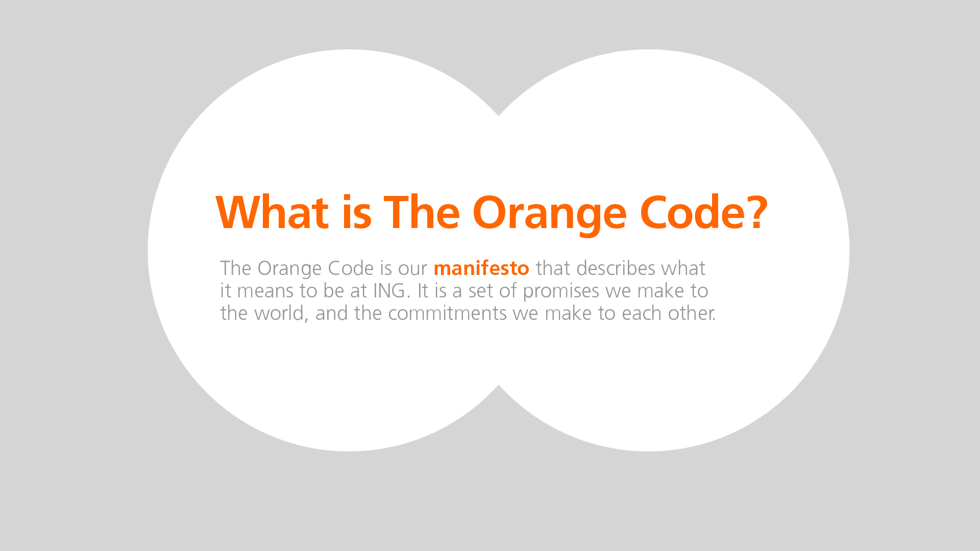

Slide 45



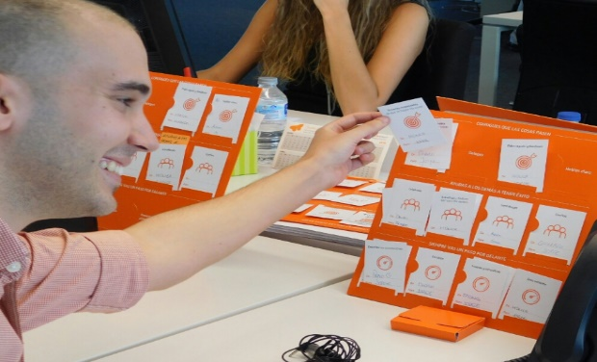
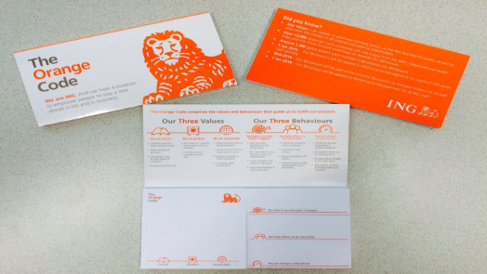
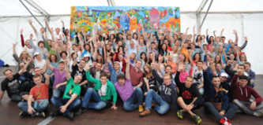
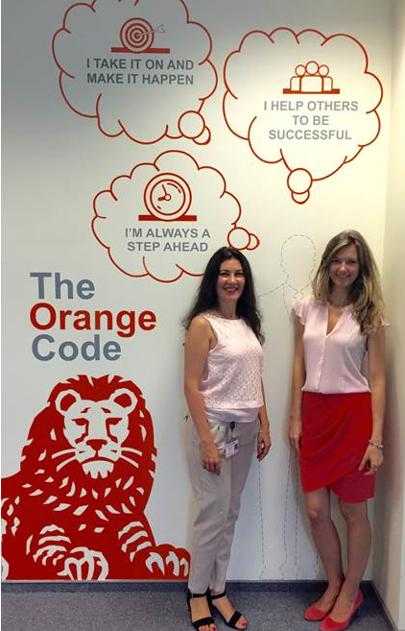
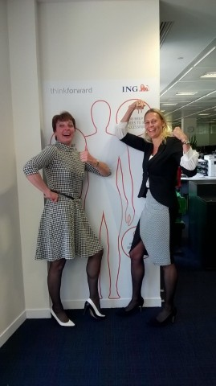
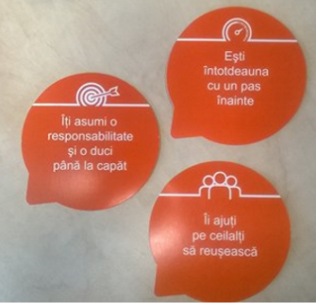
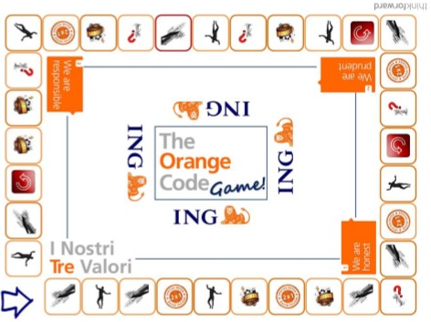

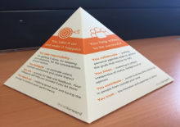
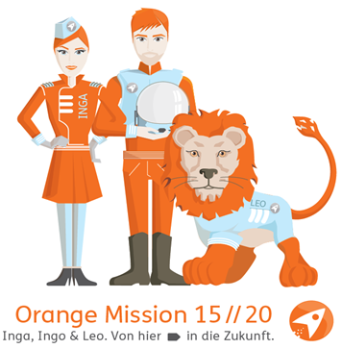
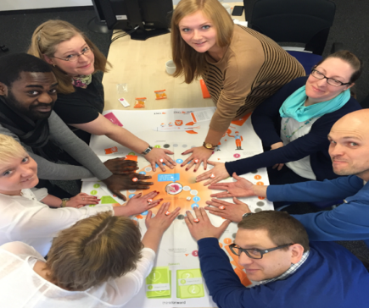

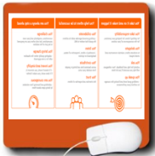

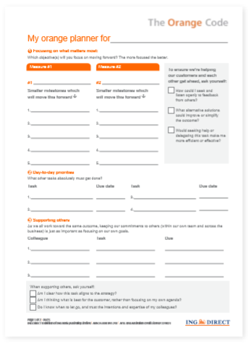

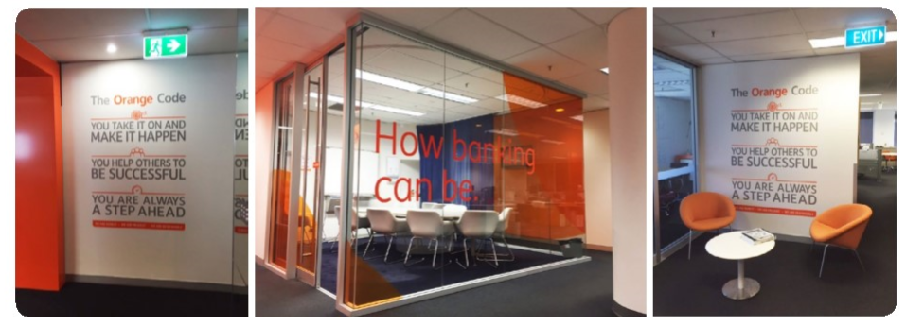
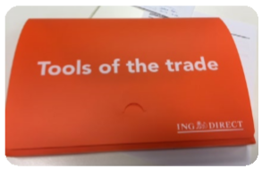

Slide 46
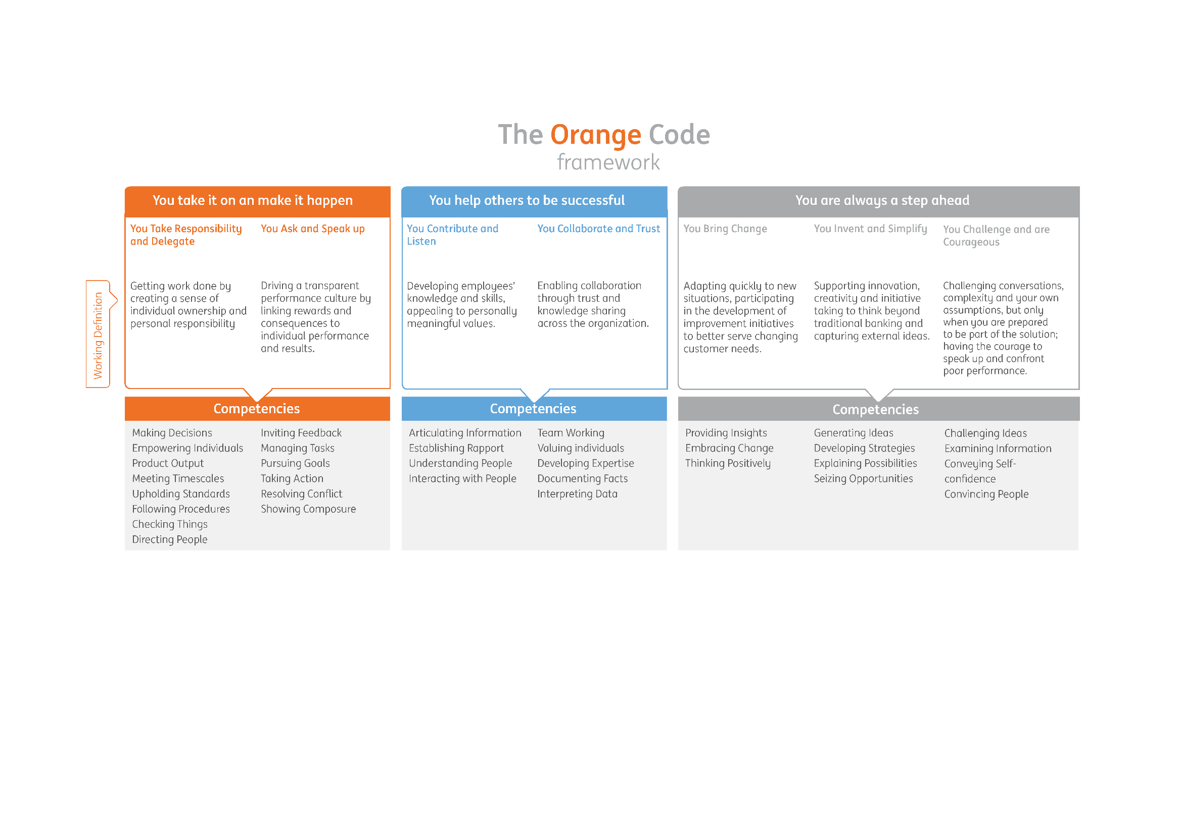

Slide 47
Key Improvements
Customized
Tailored to our
OC behaviours
Aligned to
Orange Code
Creates a better
fit with ING
Standardisation across countries
Showcases
ING Brand
Bringing work at
ING to life
Clear & Simple
Offering a clear & simple assessment process
An engaging candidate experience
Market leading
selection tools

Slide 48
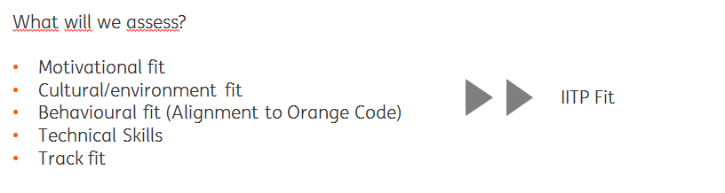

The updated IITP Selection Framework
1. Screening
2. Situational Judgement Test
Application
5. Business Panel
4. HR Interview
3. Swift Executive Aptitude Test and Work Strengths Test
Selection

Slide 49



Example Situational Judgement Test
How do I approach certain situations encountered in the workplace?
The Situational Judgement Test (SJT) is designed to assess a
IITP candidate’s suitability for a role, based on responses to a
series of decision-making scenarios IITP Trainees are likely to
face in the ING workplace. After the IITP candidate completed
the SJT, you can view the report in Taleo.

Slide 50
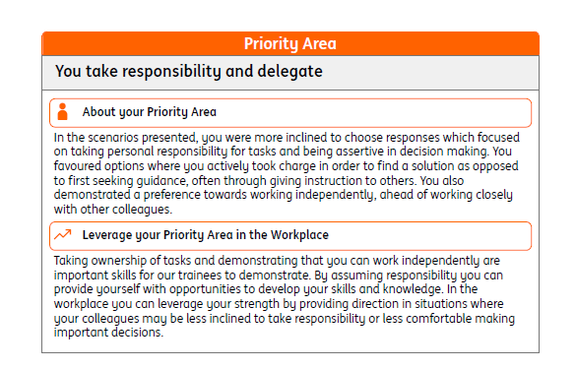
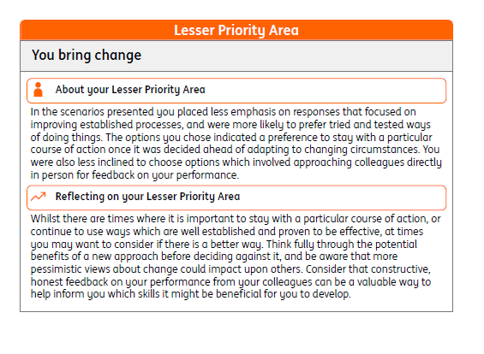
Empowering our applicants

Slide 51
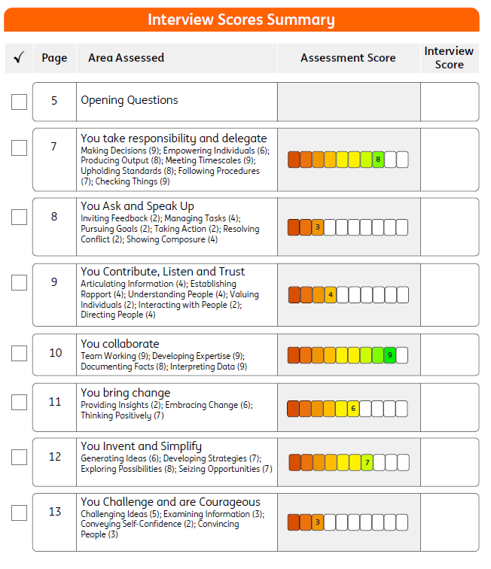
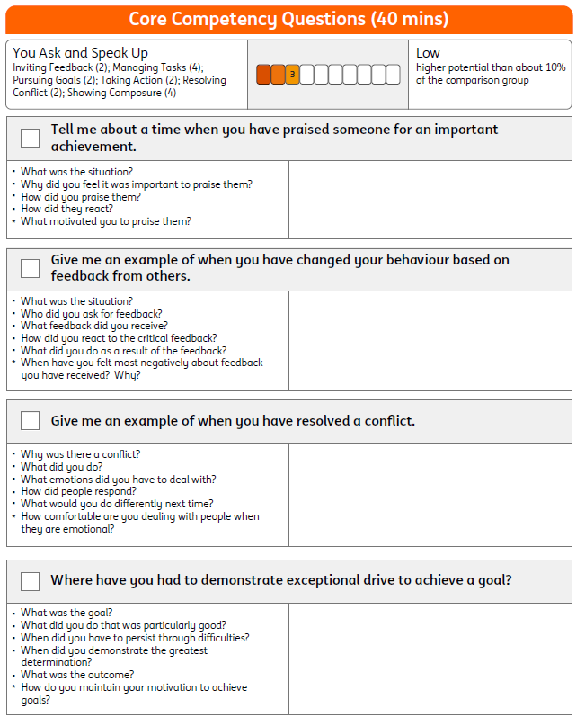
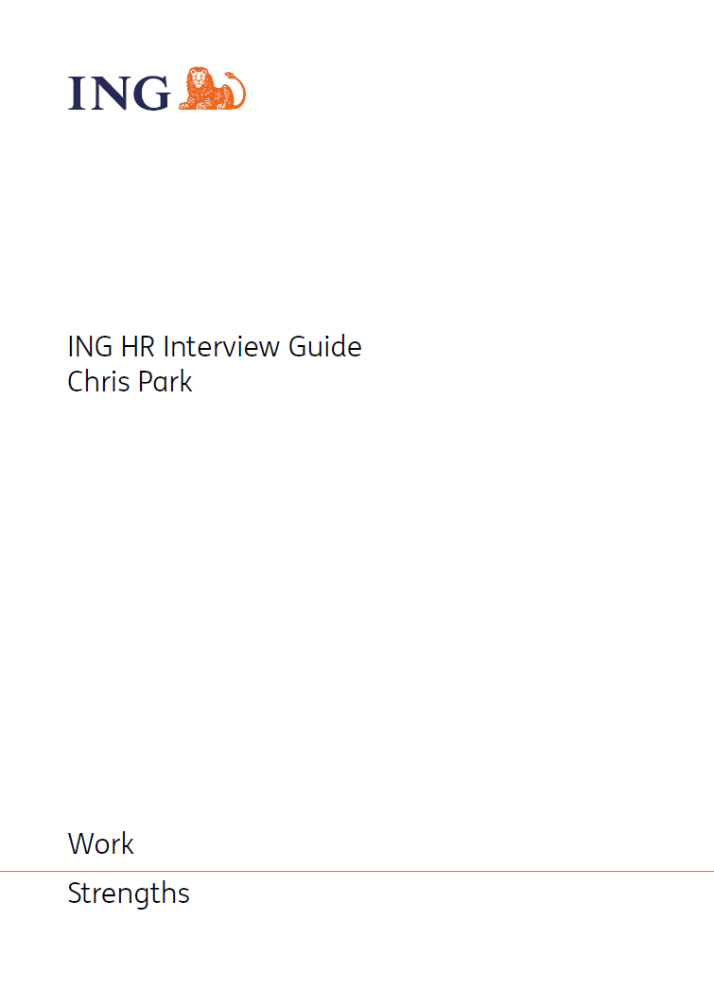
Example HR Interview Guide

Slide 52
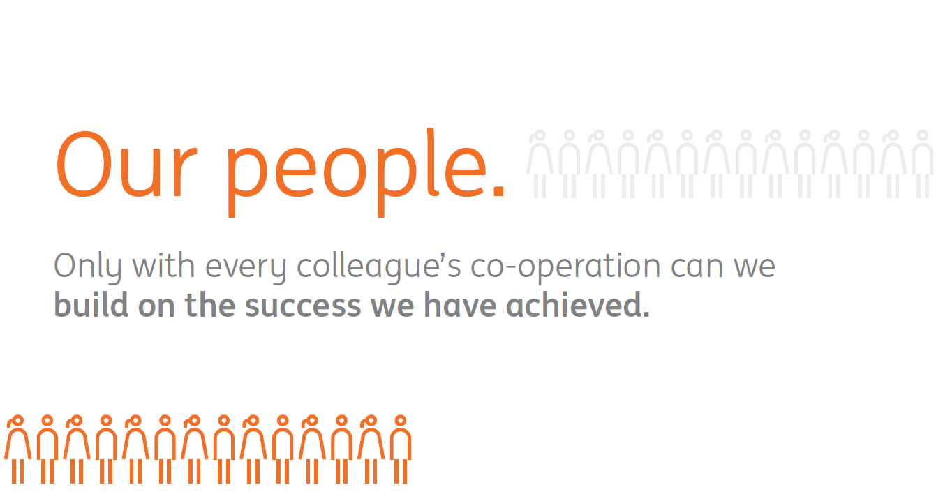

Slide 53
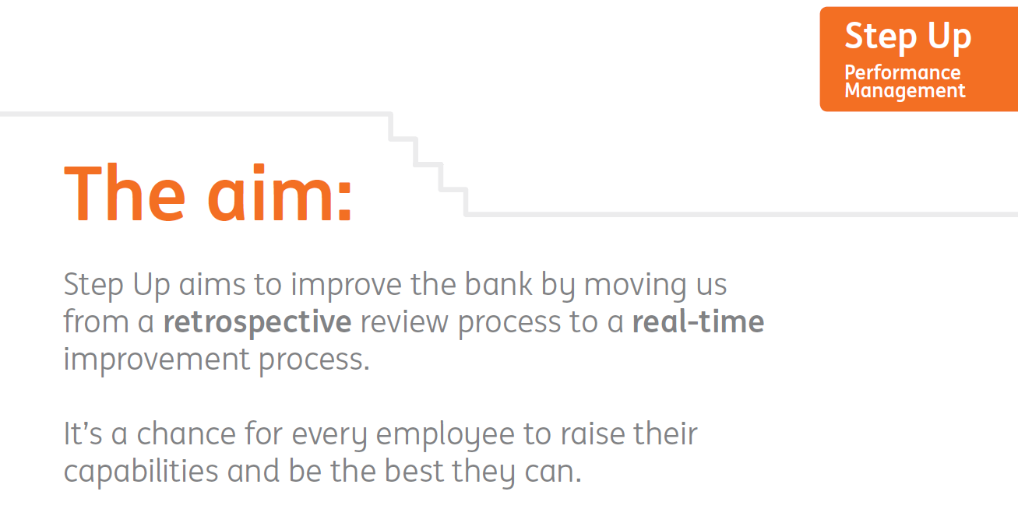

Slide 54





Slide 55
The Future of Diversity & Inclusion
Liz Bingham OBE – EY

