Slide 1
Using the PS Sales Expert Report to drive performance of SAP key account directors
Evgeny Kupriianov

Slide 2
Background & Request
The client
SAP - one of biggest IT vendors worldwide
Newly appointed General Manager for CIS + a lot of new Sales Managers
Who is a Key Account Director?
Total revenue EUR 20mln + over the course of 3 years
National and international importance of the Account
Account’s innovative agenda

Slide 3
Background & Request
Goals
To develop and implement the process of Key Account Directors’ selection, development and recognition in order to expand the Accounts’ potential
To focus employees on end-to-end work with Account: from developing long-term account strategy to expansion of their area of responsibility to all business functions and services
Questions to be answered
Who fits the KAD role in terms of competencies and potential?
Which parts of the KAD role will the employee focus on?
What kind of support should the company provide in order to boost account performance?

Slide 4
The Procedure
Wave Professional Styles / Sales Expert Report
360 Degree Survey - Manager + Virtual Account team
Competency Based Interview on account management
Feedback session - assessor, KAD and their Sales Manager

Slide 5
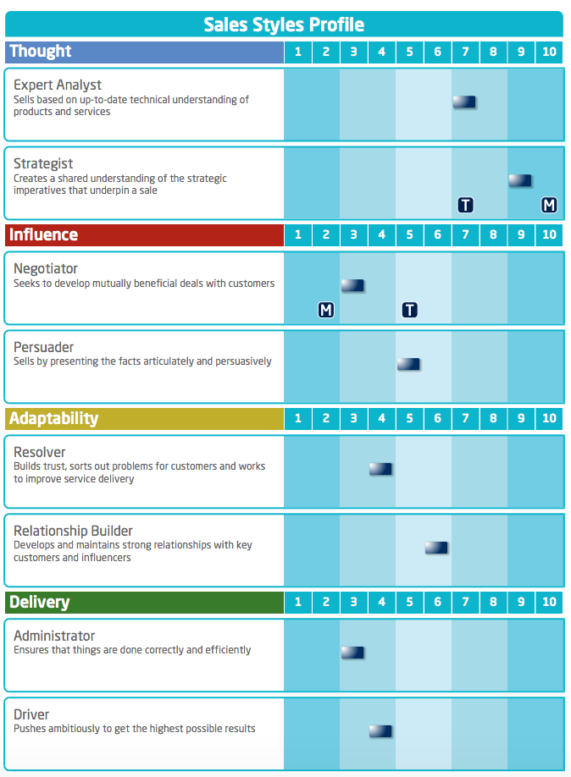
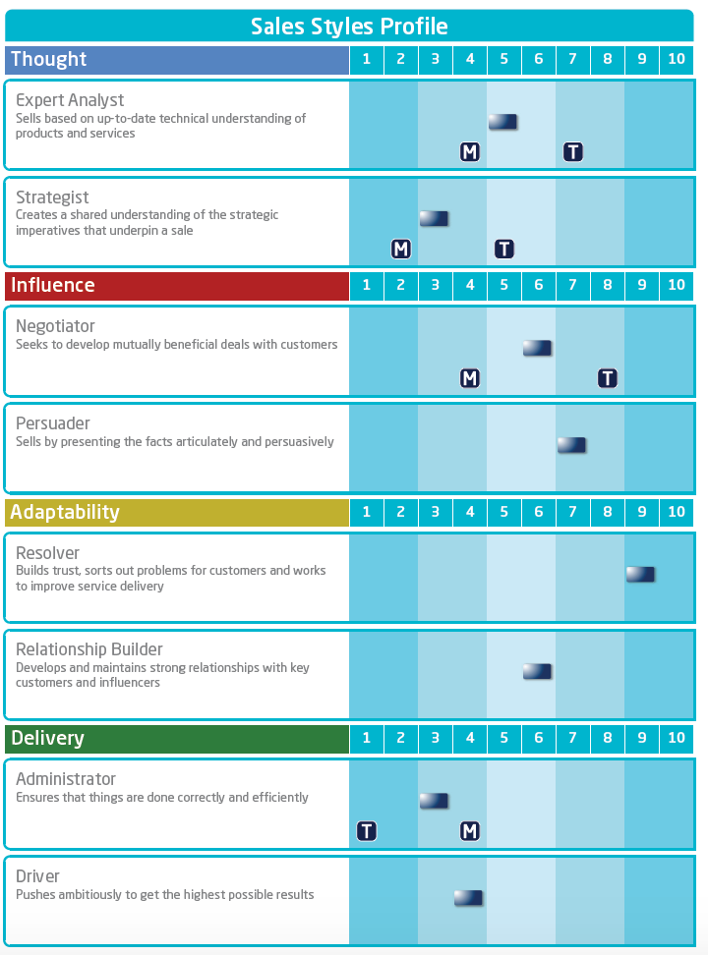
Sales Report
Gave clear understanding of employee’s talents and priorities within KAD role
Provided bases for hypothesis which were checked during CBI
Helped distinguish between development areas and limitations
Gave understanding of go/no go career tracks for employees
Provided international benchmark
Notes:
** design to add graphic**

Slide 6
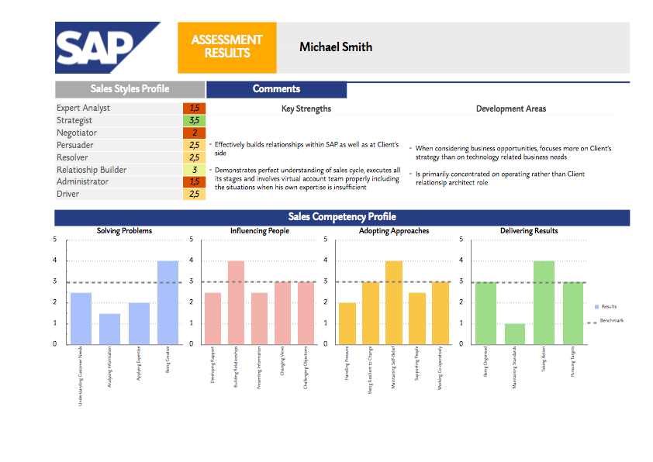
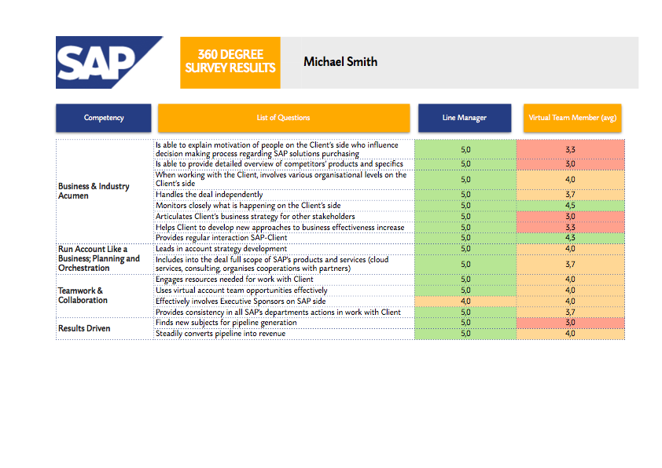
2-Page Assessment Reports
Notes:
** design to add graphic**

Slide 7
Positive Outcomes
For top management
Opportunity to discuss with a trusted provider the perspectives of the employees who are responsible for Key Accounts and substantial part of business
Vision of strengths and weaknesses in key sales skills and managerial competencies in industrial teams
For sales managers
To focus the employee on the importance of specific skills development with impact on business objectives
To deliver feedback which was hard to formulate or justify before
To understand what kind of support is needed
For the employees
Feedback in 3D mode: Sales Report + interview results + manager’s feedback

