Slide 1
Resilient Agility
Agility can help you survive.
Resilient Agility will ensure you thrive.
© 2020 Saville Assessment, Willis Towers Watson. All rights reserved.

Slide 2
Change & Transformation isn’t new…
“Change is happening at a more rapid pace now than ever and finding tools to adjust to change is critical to both business and personal success.”
…But the current pace is unparalleled & accelerating
“Smart leaders aren’t thinking about the next phase as a return to what we had before, but are talking about the opportunity to ask “How will we reimagine our organization?”
Powering an integrated talent strategy

Slide 3
Organizations are looking for more from their people…
Coping with Ambiguity
Grit
Comfortable with Complexity
Staying Agile
Emotional Resilience
Adaptability

Slide 4
Introducing
Resilient Agility
from

Slide 5
What is Resilient Agility?
A unique form of agility that is robust and can be maintained over the longer term
Individuals are more likely to be effective during change and have built-in resilience as part of the capacity to be agile
The behaviors are linked to performance & potential in the workplace

Slide 6
How did we develop our model?
10 years of big data from Wave
35,000
data
points
Explored correlations between behaviors predictive of change

Slide 7
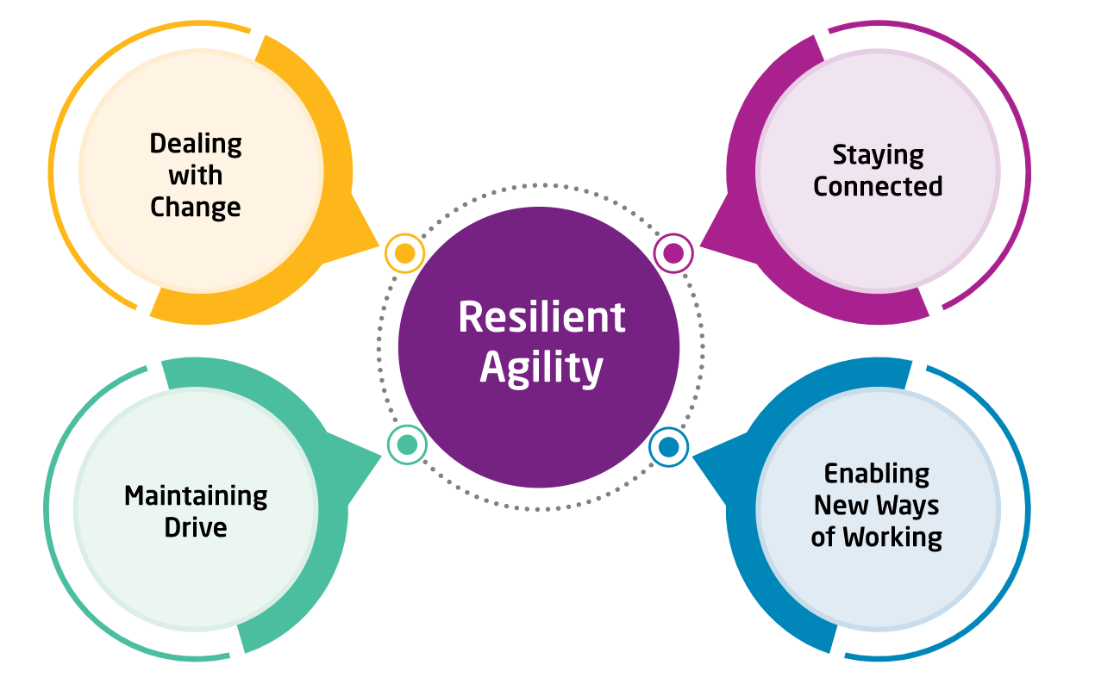
4 Key Drivers of Resilient Agility
Each underpinned by 5 behavioral dimensions
The Resilient Agility Model
Dealing with Change | Embracing change positively. Managing uncertainty with composure.
Staying Connected | Making and maintaining connections. Actively participating and communicating.
Enabling New Ways of Working | Using insights to forge new directions at work. Ensuring effective work plans are delivered.
Maintaining Drive | Capitalizing on the opportunities change presents. Keeping everyone focused on key work objectives.
Powering an integrated talent strategy

Slide 8
Building Resilient Agility Report

Slide 9
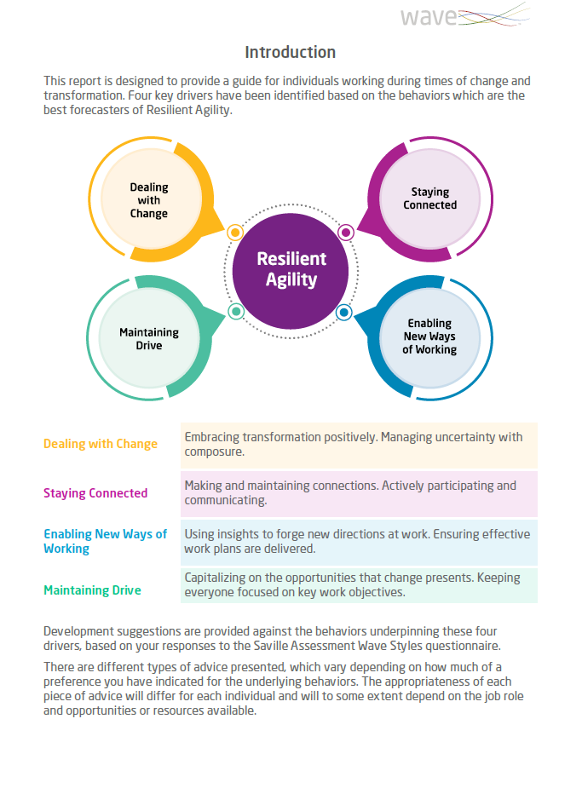
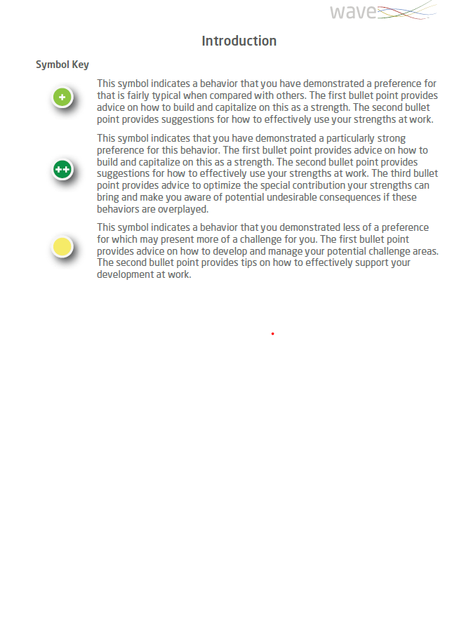
The report presents each of the four drivers of Resilient Agility.
It provides guidance for improving an individual's capacity to be effective during change & transformation.
The report indicates an individual’s greater or lesser preference for the areas under each driver using visuals icons:
This symbol indicates a typical preference
This symbol indicates a strong preference
This symbol indicates a challenge area

Slide 10
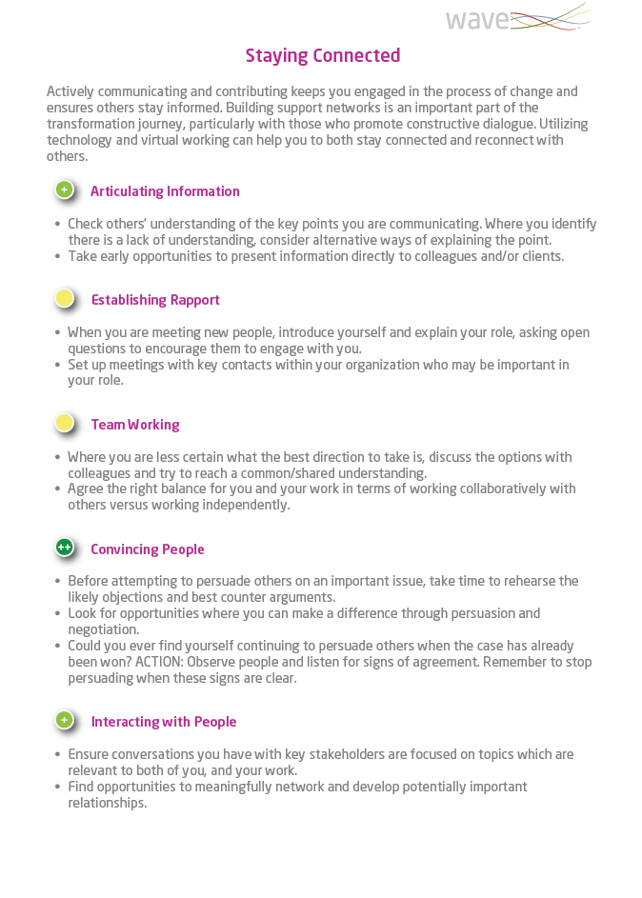
For each of the four drivers, an individual can see their preference for the behaviors that underpin it via the indicator symbols.
Where an individual has a typical preference, advice is given around how to capitalize on it as a strength and how to effectively leverage it in the workplace.
Where an individual has a strong preference, the guidance also includes how to optimize the special contribution of your strength and potential undesirable consequences if the strength is overplayed.
Where an individual has less preference, the information is focused on developing and managing the challenge area and how to support this in the workplace.

Slide 11
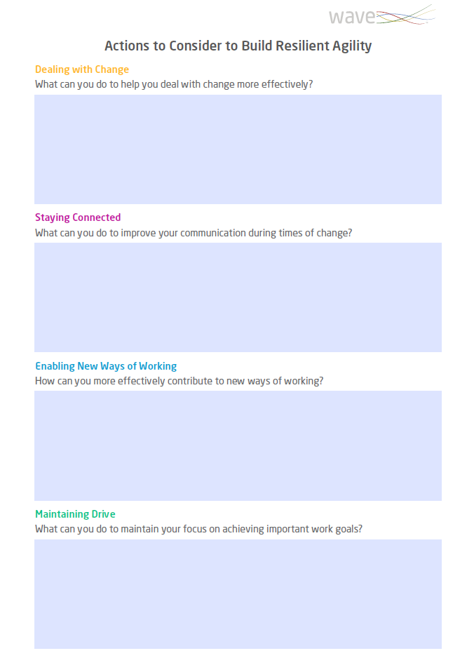
The report includes an editable ‘Actions’ page.
This gives an individual opportunity to reflect on the guidance in their profile and create a personal action plan to help build their capacity for effectiveness during change and transformation.

Slide 12
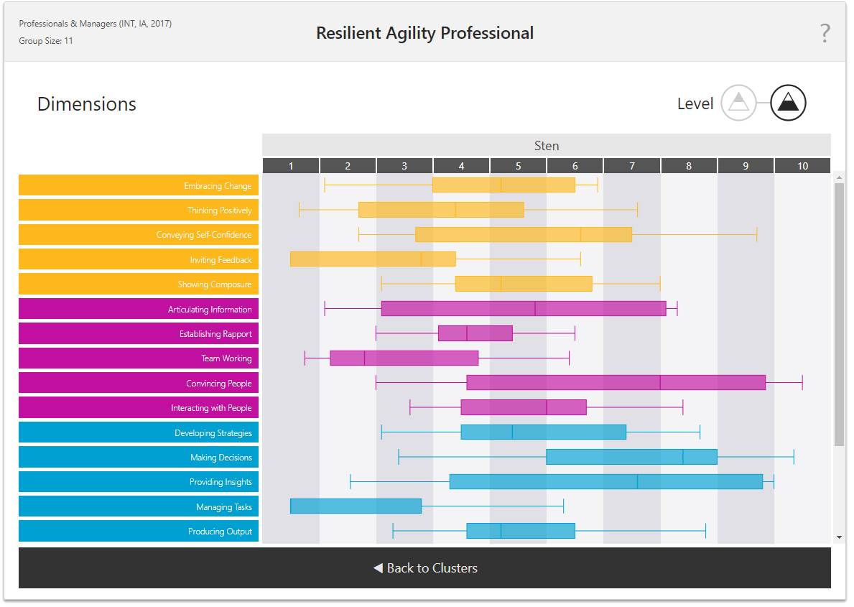
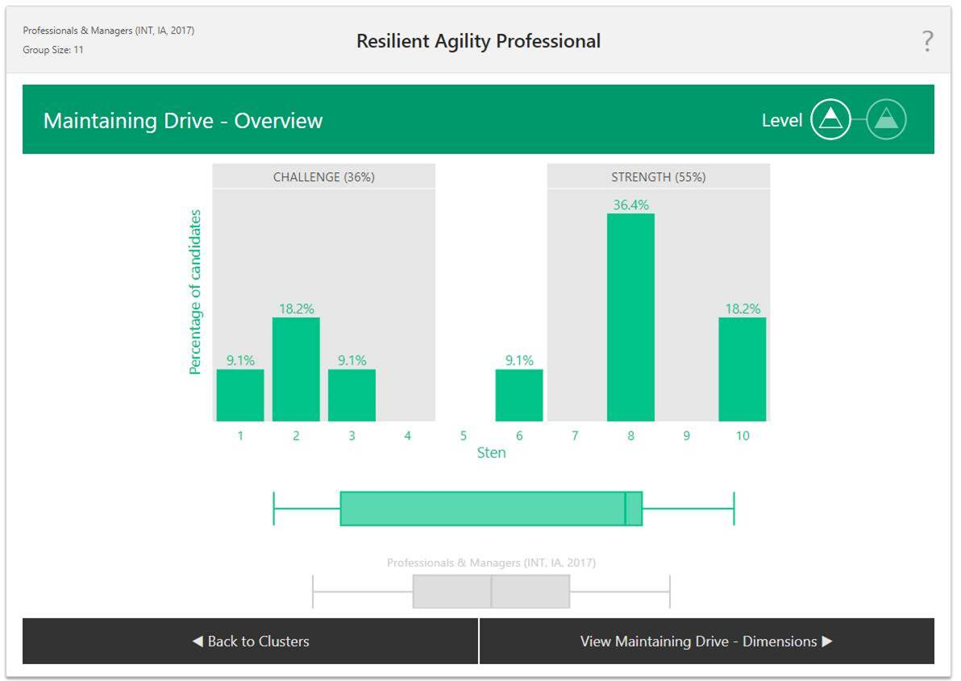
Group analytics can be generated to present the collective capacity for resilient agility in your workforce.
This provides organizations with powerful dynamic data to see the overall picture and benchmark capacity for change at a group level.

Slide 13
Applications of
Resilient Agility

Slide 14
“Two out of every three transformation programs fail.”
Harvard Business Review
Digital Transformation is a major catalyst for change and transformation
Aligning the soft skills required to enable digital transformation is important
M&A ever present despite turbulent times
Key to successful integration is facilitating, guiding and supporting people through change
The impact people can have on change programs is critical to success
Building Resilient Agility supports people during change and transformation and can be leveraged as a key part of the communication strategy
Organization Transformation
Digital Transformation
M&A Activity

Slide 15
In recent years, there has been an emerging mismatch between what organizations are looking for in early-careers joiners and the behaviors that are prevalent
Resilient Agility provides a valid, practical and user-friendly model to engage the early-careers market
Many early-careers programs are looking to build resilience and agility
Early-Careers Development
Powering an integrated talent strategy
“32% of employers voice dissatisfaction with graduate resilience.”
CBI & Pearson

Slide 16
“As jobs become increasingly more dynamic, individuals need to do more than simply reskill; they need to build resilience.”
2020 Human Capital Trends report
Increasing self-awareness for how they may respond to transformation
Providing practical tips to improve their capacity for Resilient Agility
Building their confidence for dealing with change and transformation
Individual Development
As people navigate unprecedented change in the workplace Resilient Agility can support individuals by
Understanding how to better deploy their areas of strength during change
Empowering them to feel part of the process, contributing to a better employee experience

Slide 17
Resilient Agility Analytics go beyond the individual to present the collective capacity for change and transformation in your organization.
Understand team dynamics to see what actions are needed to help them accelerate and progress
Benchmark the caliber of your workforce for dealing with change and transformation
Recognize what your starting point is to help your people better move forward
Use live data to prioritize issues and pave a path for long lasting change
Move from deep insight to targeted action for building your organization’s capacity for Resilient Agility
Team Development
Talent Auditing
& Benchmarking
“In our ever-changing world, businesses and their people need stronger agility and resilience to withstand future disruption.”
Bangkok post

Slide 18
Resilience & Agility are a critical combination
This is the only model and output looking at identifying who has the agility to respond positively to change and who has the resilience and drive to see it through.
What Makes Resilient Agility Unique?
Underpinned by Wave, those who show high capacity for Resilient Agility are also more likely to be stronger performers in the workplace.
Resilient Agility is a performance-driven model
Powering an integrated talent strategy
Powering an integrated talent strategy
Resilient Agility is a scalable solution
The combination of individual reports and group analytics support both team-based change management and large-scale transformation.

Slide 19
Administration & Set Up

Slide 20
No accreditation training required to access the report
Available from Wave Focus Styles – 13-minute completion
Available from Wave Professional Styles – 35-minute completion
Can be administered via own Oasys platform or via the Saville Assessment Bureau Team

