Slide 1
Saville Assessment International Accreditation
Swift Aptitude
© 2019 Saville Assessment, Willis Towers Watson. All rights reserved.

Slide 2
House Keeping
Desktop vs Browser
If you’re able to, we recommend using the desktop app for a better user experience
Let us know in the chat function whether you’re in browser or desktop
You will enter break out rooms slightly differently depending on whether you have joined by your browser or your desktop

Slide 3
House Keeping
Your Controls

Slide 4
House Keeping
Break-out Groups
In the app you can join the break-out group and it will automatically put this meeting on hold. You can click to “Resume” when you want to jump back.
In the web-browser version you’ll need to hang up and then join the break-out meeting, and vice versa rejoining the main group.

Slide 5
Introductions
Name
Role/company
Previous use of psychometrics
Which ones?
What did you use them for?
Likely applications of psychometrics
Interests for the course

Slide 6
About Saville Assessment, a Willis Towers Watson Company
2004: Founded by Professor Peter Saville
2005: Wave launched
2007: Swift combination tests launched
2013: Situational judgment tests launched
2015: New tests, new technology
2015: A Towers Watson Company
2016: Willis Towers Watson
2017: Saville Assessment, A Willis Towers Watson Company
2017: Leadership Impact and Risk launches
2019: Awarded Recruitment Industry Supplier of the Year at the Recruiter Awards
2019: Match 6.5 launched
Our Core Belief
To dive deeper than humanly possible and bring talent to the surface.
Deliver exceptional customer service
Passion for innovation in assessment
Greater insight and richer feedback
6

Slide 7
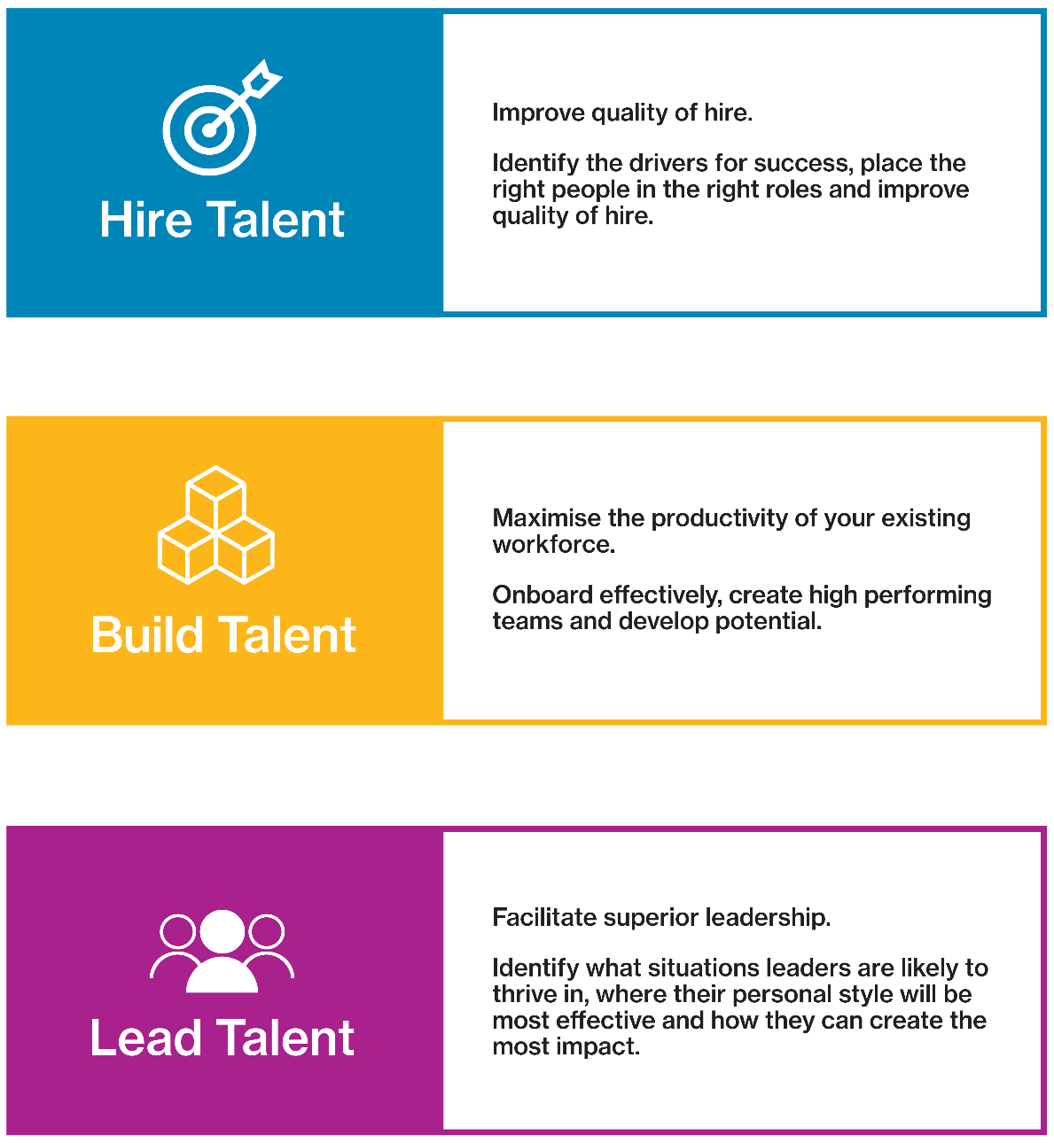
How we help organizations

Slide 8
Course Overview
01
05
Introduction to testing
Test Scores
02
06
MODULES
Job Analysis
Test Feedback
03
07
Assessment Choice
Best Practice and Ethics
04
08
Test Administration
Reliability and Validity

Slide 9
MODULE 1
Introduction to testing

Slide 10
Talent Trends and Challenges
Talent is global
Applicant numbers per role are increasing
Organizations are assessing behaviors, cultural fit, values
Emphasis on employer brand
Candidate experience is critical
Recruitment processes are speeding up
Online, mobile and remote assessment is the norm
Security of assessment materials is still a risk
Social media has implications
Selection data is increasingly used for onboarding or employability
Responsibility for development is devolved to line managers
Increasing expectation that career management is self-led
The ‘gig’ economy is emerging
Everyone’s talking about Big Data

Slide 11
Talent Trends and Challenges
Poll!
Notes:
Poll of which trends seeing – answers in chat if poll not ready

Slide 12
Projective Tests – Inkblot Test
Notes:
Practice functionality – ask delegates to raise hand if they see a bat.
Ask delegates to say what they see in the chat

Slide 13
Projective Tests – Thematic Apperception Test
Notes:
Ask delegates to say what they see in the chat

Slide 14
What is a Psychometric Test?
An assessment of a psychological attribute, typically scored using a numerical scale or category system, to describe individual differences.

Slide 15
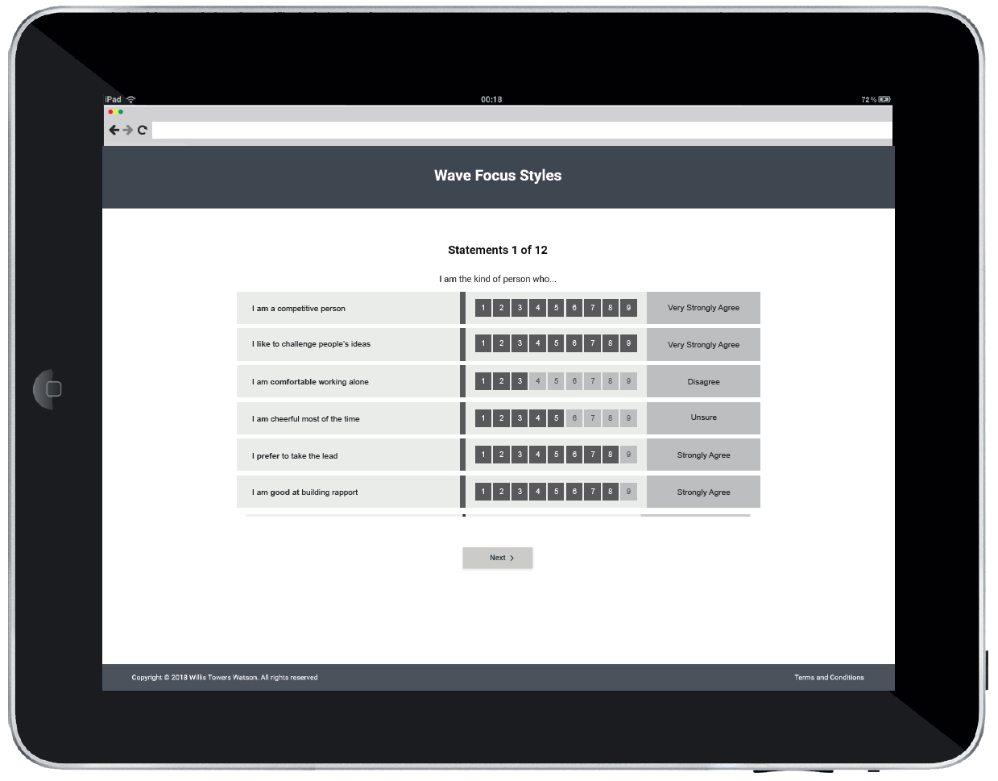
‘Will Do’ Assessments of Typical Performance
Include self-report questionnaires without time limit
‘Right’ and ‘wrong’ can vary depending on context
Wave Focus Styles example:

Slide 16
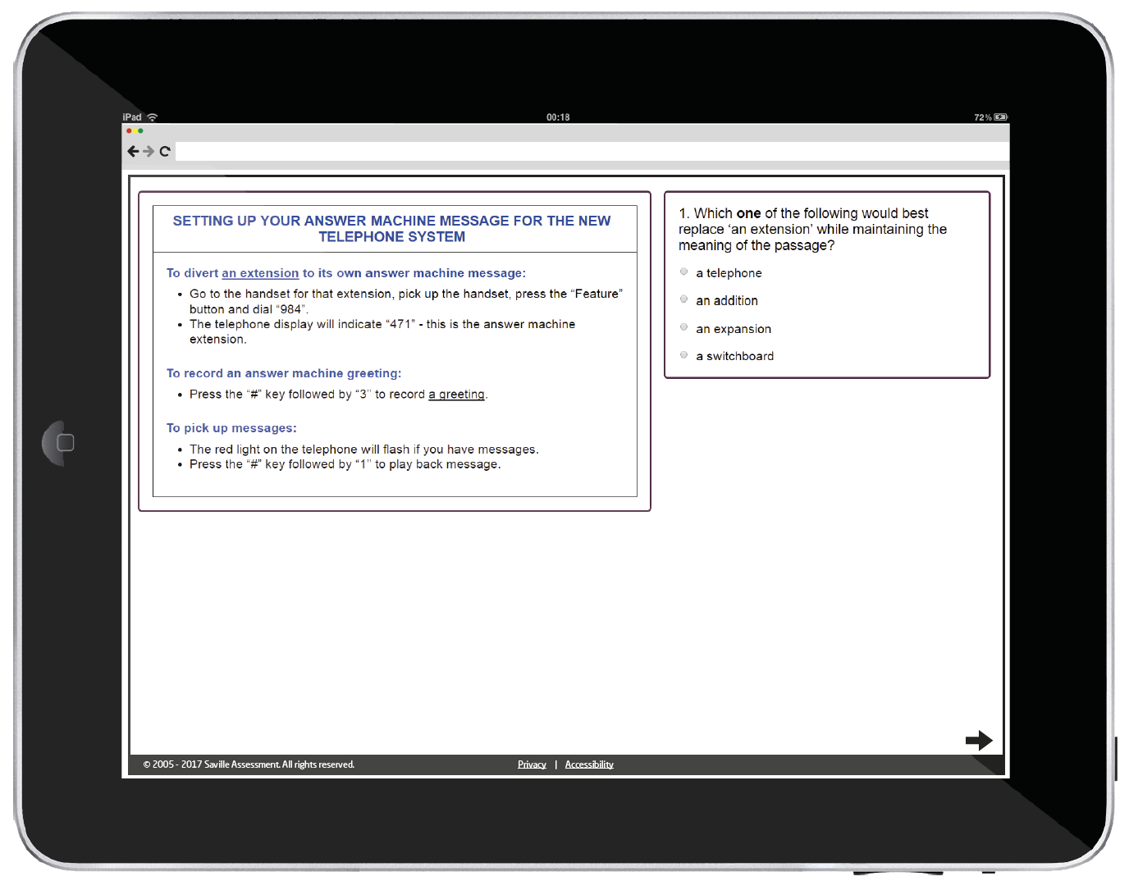
‘Can Do’ Ability Tests of Maximum Performance
Include ability tests of aptitude, IQ and attainment:
Aptitude: predict what someone will be able to learn or do in the future, e.g. Saville Assessment tests
IQ: current level of intellect/cognitive ability, e.g. Wechsler Adult Intelligence Scale
Attainment: measure current level of knowledge understanding or skill, e.g. driving test
Often with strict time limits
Clear right or wrong answers
Verbal analysis example:

Slide 17
Key Facts: Aptitude Tests
Benchmarks against external group
Single most valid predictor of work performance
Measures lots of different types of ability
Efficient online assessment
Fair and consistent treatment of candidates
Supplements other sources of information
Sophisticated question banking to counter cheating

Slide 18
MODULE 2
Job Analysis

Slide 19
Job Analysis
Job analysis is a multi-method approach that is used for different purposes including:
Defining role profiles/job descriptions/person specifications
Job sizing for pay grading
Developing a framework of criteria for assessment e.g. behavioral competencies
In assessment, good job analysis focuses on things that can be defined clearly and measured well

Slide 20
Common Methods of Job Analysis
Structured interviews
Job holders e.g. critical incident identification
Line managers e.g. repertory grid comparisons
Job content reviews
Diaries
Observing the job
Doing the job
Task/job analysis questionnaires
Validation research

Slide 21
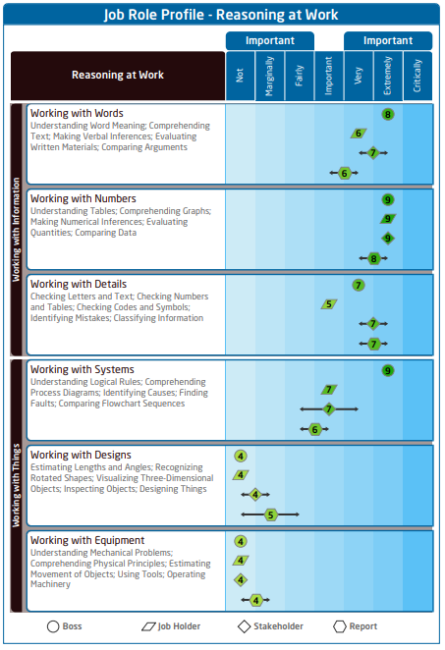
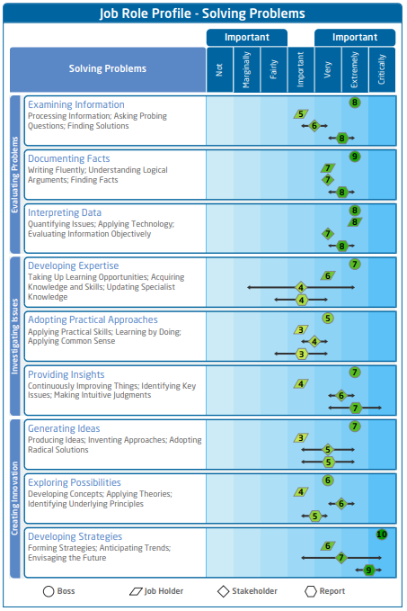
Wave Job Profiler
Online tool (15 minutes)
Survey different stakeholders
7-point ‘Importance’ rating
Can add comments

Slide 22
Wave Card Deck
‘Hire’ Card Deck – Ability Sections
Working with Information
Working with
Things

Slide 23
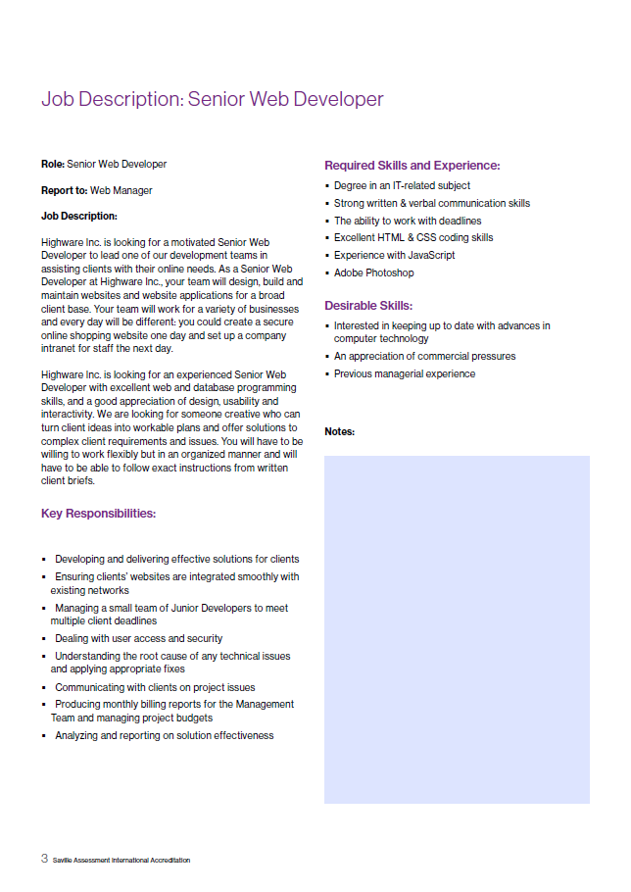
Case Study: Job Analysis
Workbook page 1
Card Sort
Review the job description on page 3 of your workbook
Use the Wave card deck to identify up to seven key competencies (four behaviors and three abilities)
List your key competencies in your workbook

Slide 24
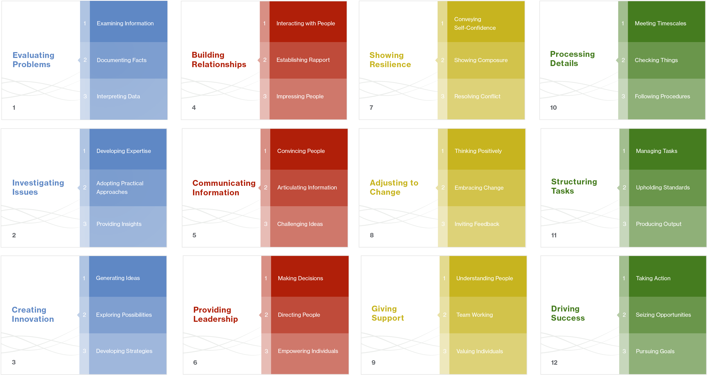
Case Study: Job Analysis
‘Hire’ Card Deck – Behavioral Sections
24

Slide 25
Case Study: Job Analysis
‘Hire’ Card Deck – Ability Sections
Working with Information
Working with
Things

Slide 26
MODULE 3
Assessment Choice

Slide 27
Considerations for Choosing Assessments
Early considerations
Do the test yourself
Does it look good?
Does it make sense?
Is the content relevant to the role?
Does the content appear fair and inoffensive?
Other considerations (to be discussed later)
Is it psychometrically sound?
How much does it cost in total?
What are the administration practicalities? (screening online, supervised final stage, number of candidates, etc.)

Slide 28
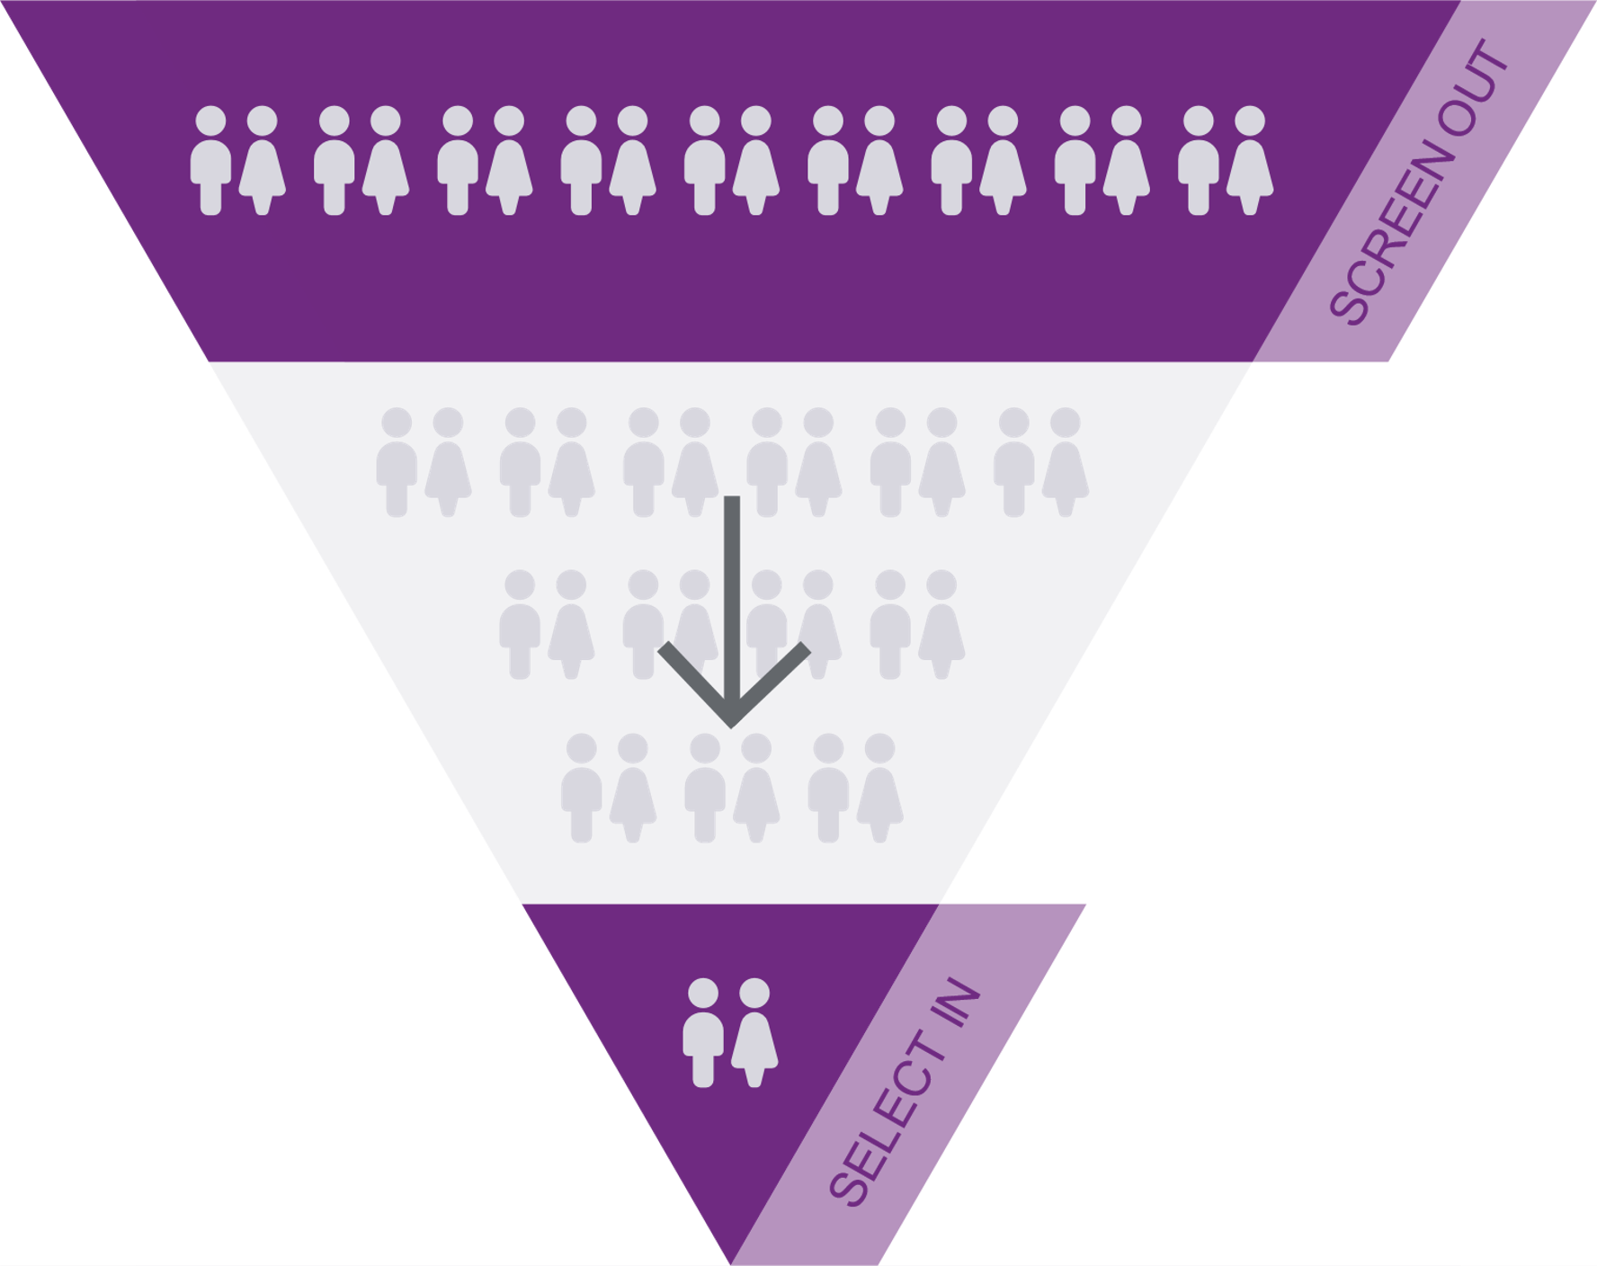
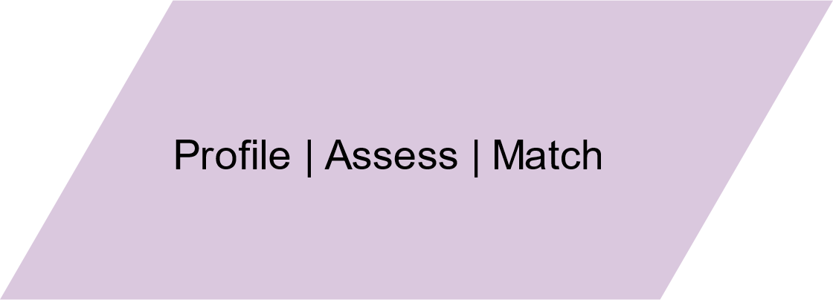
Screen Out, Select In

Slide 29
Saville Assessment Aptitude Tests

Slide 30
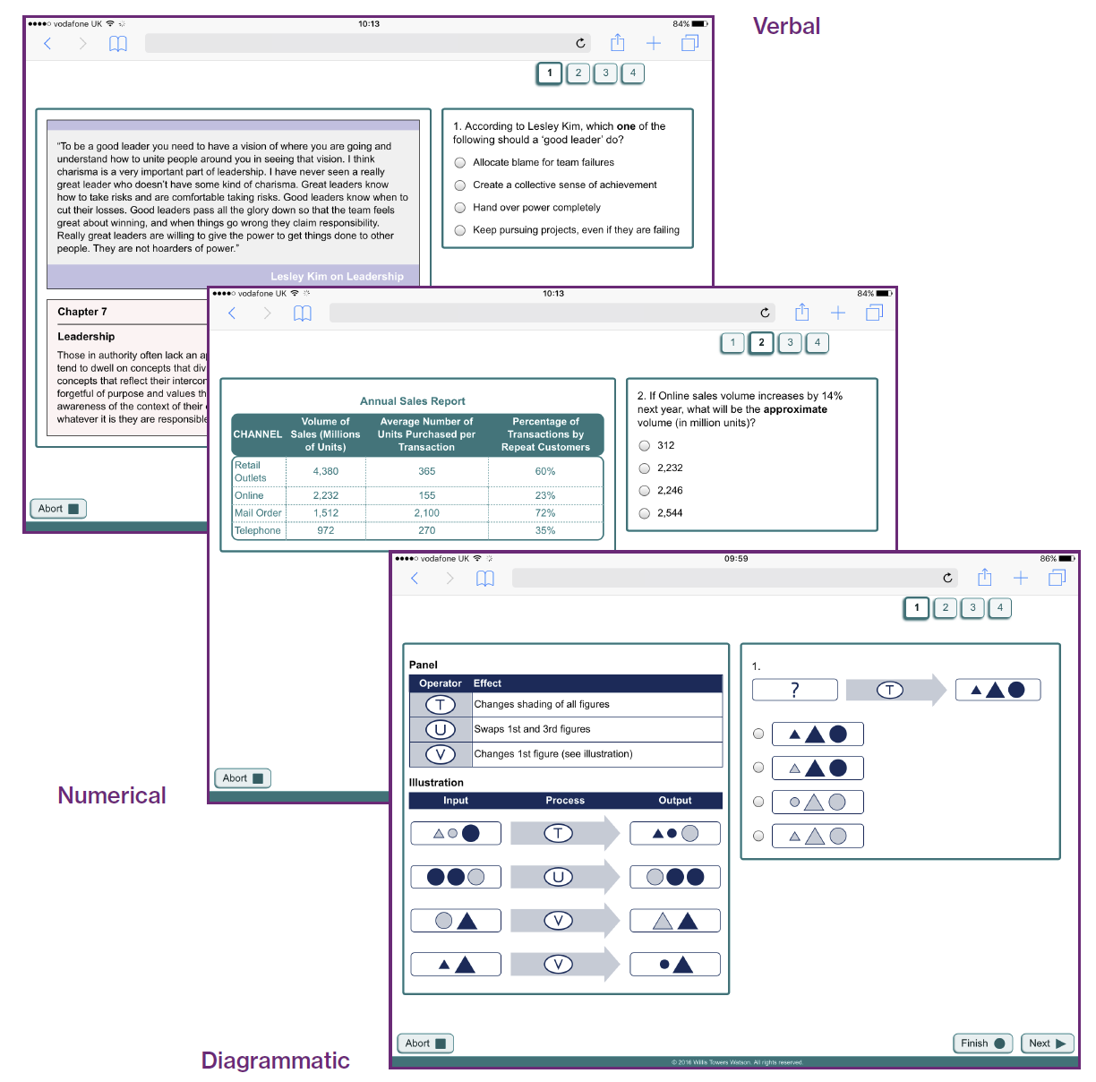
Analysis Aptitudes
Swift or single aptitudes

Slide 31
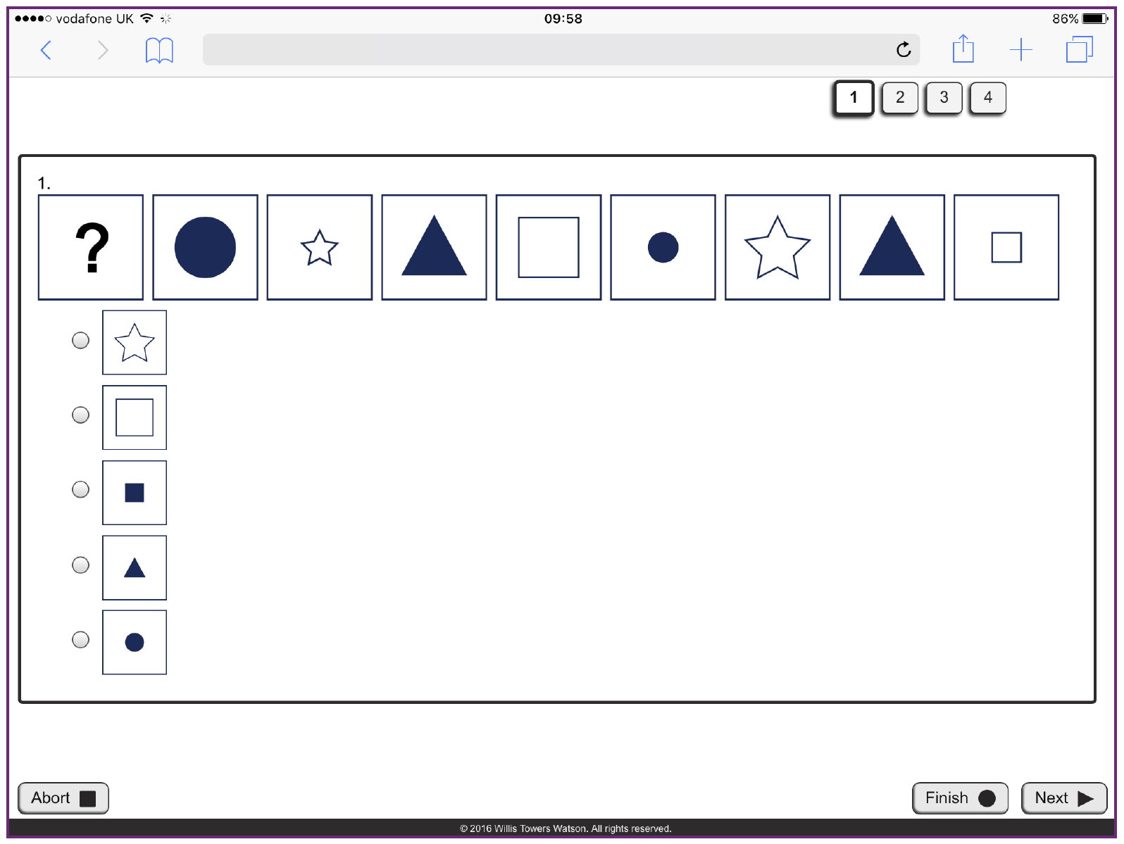
Abstract Reasoning Aptitude
Swift Executive or single aptitude

Slide 32
Saville Assessment Aptitude Tests

Slide 33
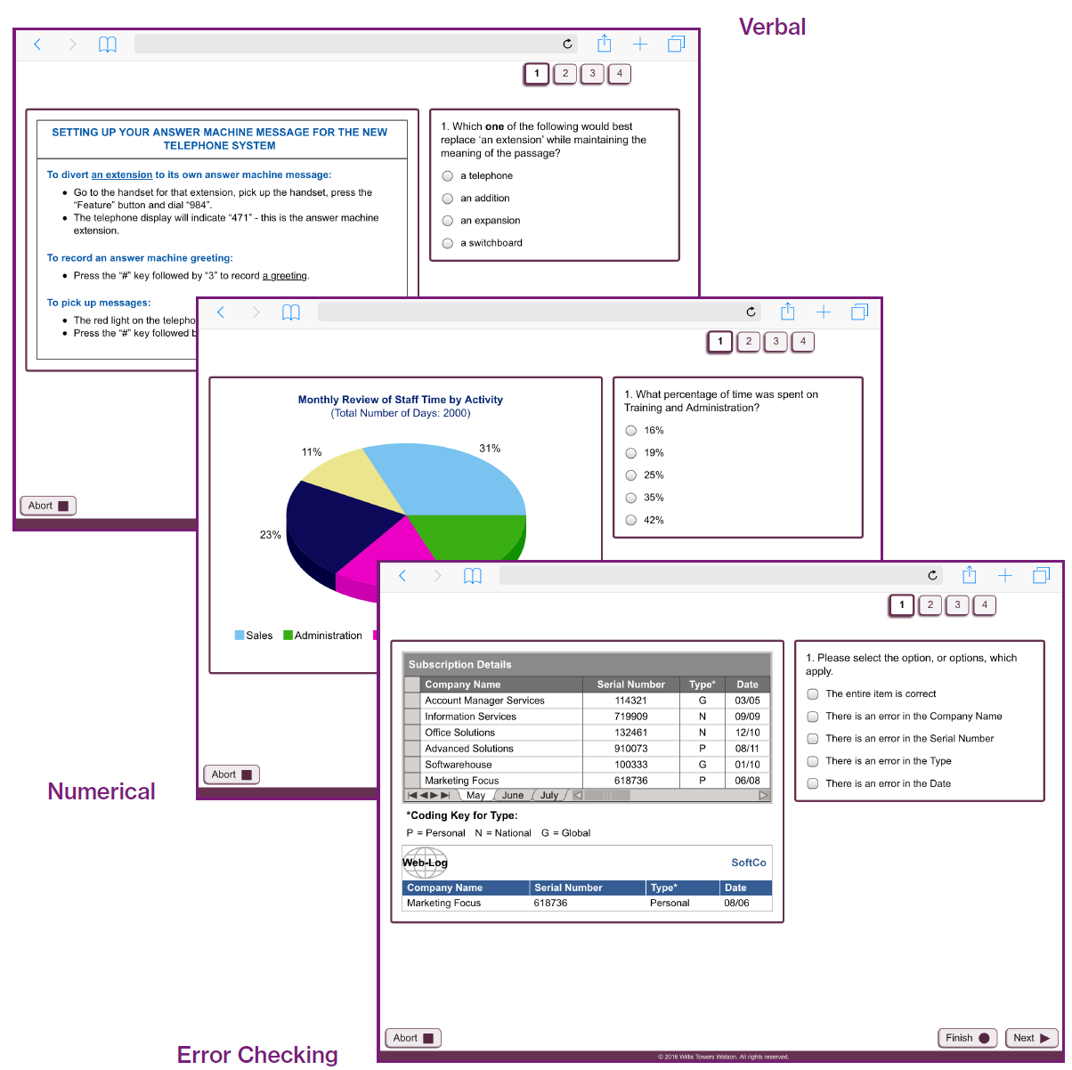
Comprehension Aptitudes
Swift or single aptitudes

Slide 34
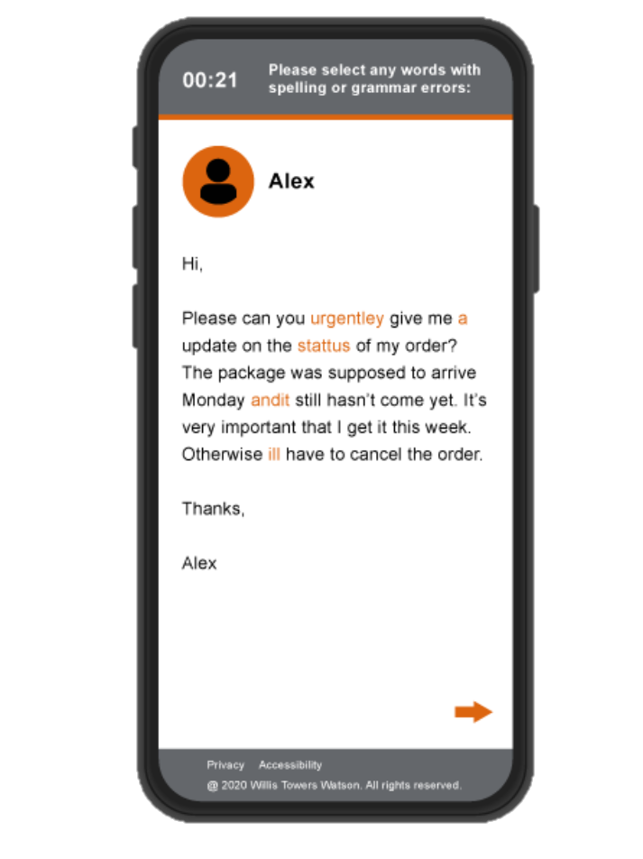
Customer Check
New online assessment identifying how well individuals will interact with customers and represent your brand on live web chats.
Highly-relevant assessment specifically designed to replicate typical customer contact.
Compatible with a range of devices, including laptops, tablets and mobiles.
Quick and engaging assessment with a 10-minute completion time.

Slide 35
Saville Assessment Aptitude Tests

Slide 36
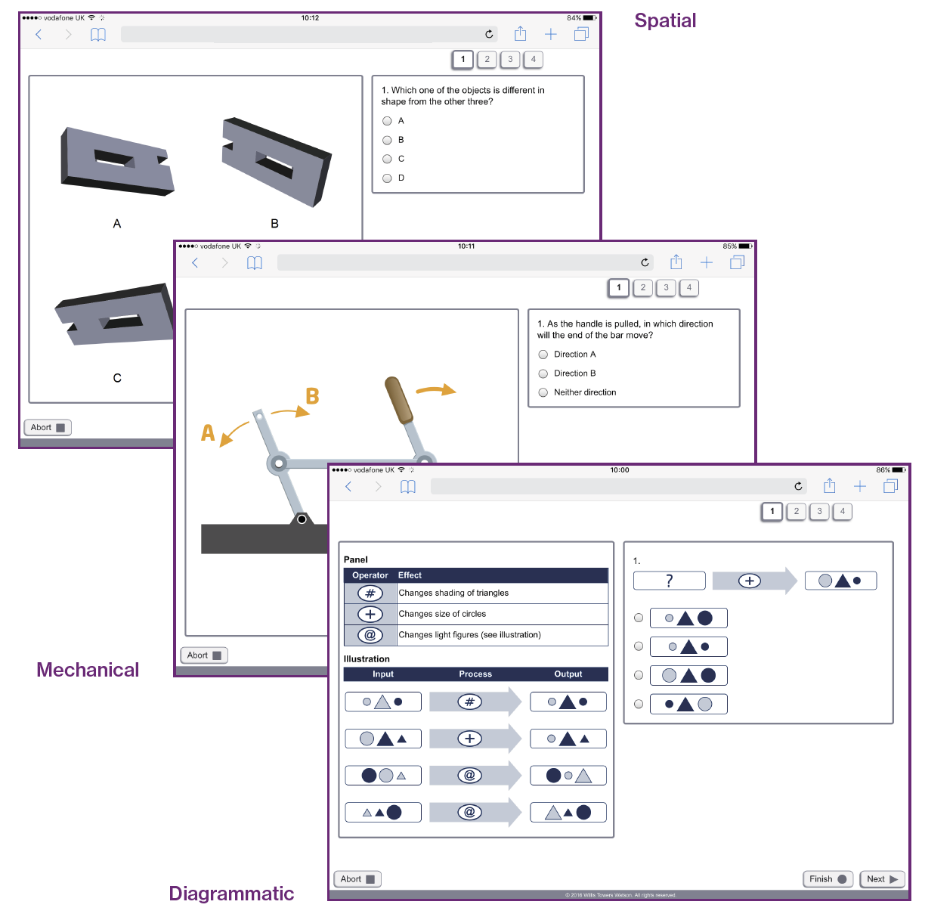
Technical Aptitudes
Swift or single aptitudes

Slide 37
Saville Assessment Aptitude Tests

Slide 38
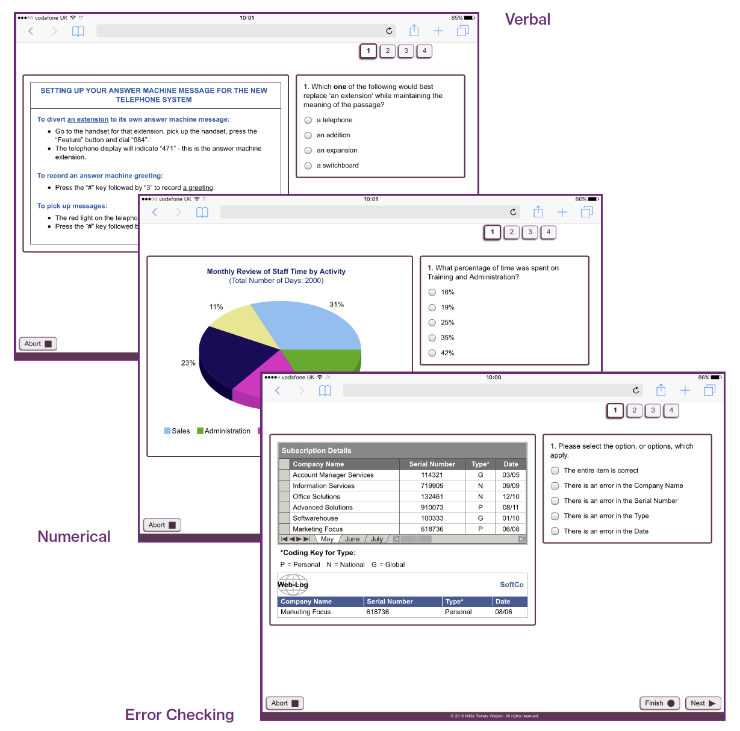
Swift Apprentice Aptitude

Slide 39
Workplace English
Assesses candidates’ ability to understand workplace English
Secure and easily administered online in less than 20 minutes
Tests for five different industry sectors:
Customer Service, Healthcare, Hospitality, Office, Operations
Each test comprises 33 items:
24 industry-specific items
Nine general workplace items
I [?] review the situation tomorrow
am
will
do
think

Slide 40
Why Use Aptitude Tests?
Hire
Aptitude tests are mostly used for recruitment, either in screening or selection
Build
Tests are used less frequently for individual development, although career guidance and planning tools often contain an aptitude component
They do predict training performance!
Lead
Despite many leaders’ avoidance of testing, cognitive ability has been shown to be especially predictive of performance at senior levels

Slide 41
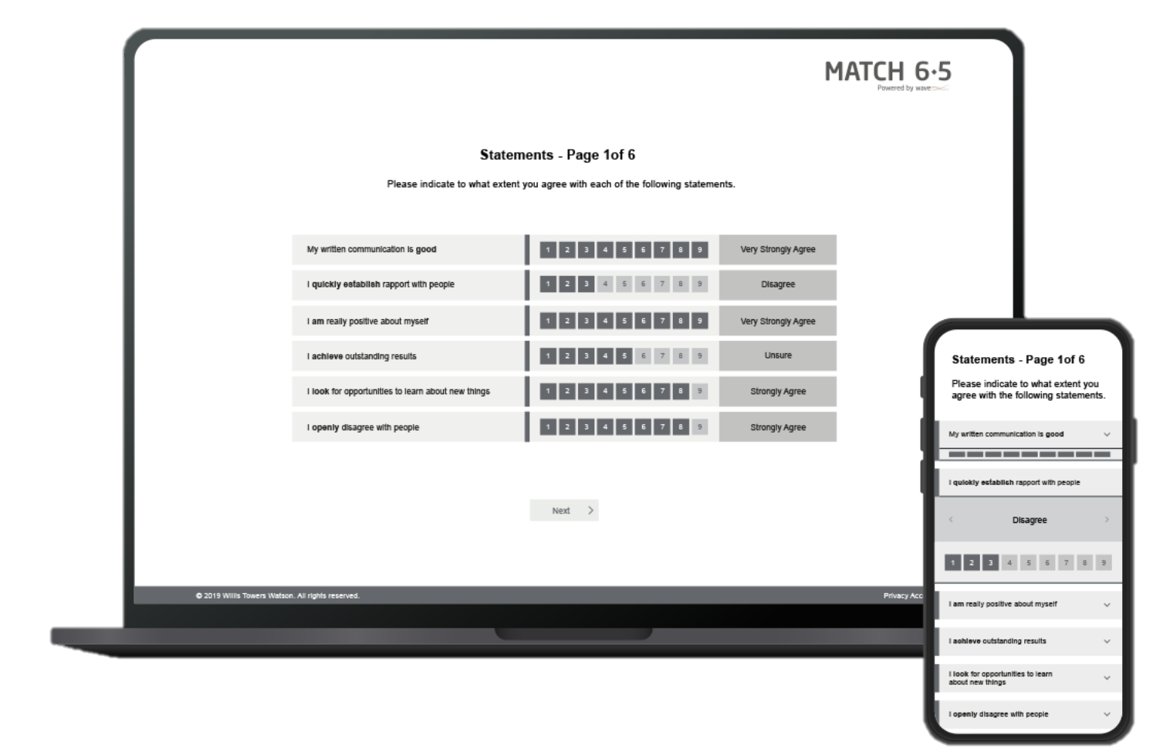
Behavioral Screening Questionnaires
Short behavioral assessments that can provide one fit score for rapid decision making in screening
Ideal for large-scale volume projects, merit lists can be created
Overall fit scores calculated with data from multiple assessments
Accurately identify the right people for the right roles based on behaviors which successfully predict performance
Improve candidate experience with short completion times and work relevant questions showcasing strengths
Work Strengths

Slide 42
Example High-Validity Assessment Process
Finance Graduates
2,000 applicants passed qualifying questions: Situational Judgement Test
1,000 candidates:
Swift Analysis Aptitude & Work Strengths combined
500 candidates:
Video / telephone interview and CV sift
200 candidates:
Face-to-face assessment
Structured interview using Work Strengths
Supervised testing: Swift Analysis Aptitude
Task-based exercise: financial case study
50 hires

Slide 43
MODULE 4
Test Administration

Slide 44
Administration Formats
Invited Access – This ‘controlled mode’ provides secure access to specific individuals to complete online tests in an unsupervised setting e.g. a password and link are emailed.
Security advice for invited access administration:
Ensure candidates are pre-qualified and cannot sit a test multiple times
Use the advice on test resets documented in your organization’s testing policy
Use item-banked tests, e.g. gradient step testing
Review candidate response patterns (‘forensic analysis’), e.g. unusually fast response times
Retest under supervised conditions
Supervised Access – This ‘managed mode’ is where a trained test administrator verifies identity and initiates the test administration online or in paper and pencil. The test administrator oversees the test environment/process throughout, e.g. at a secure testing center.

Slide 45
Overview of Aptitude Administration
Key Considerations:
Select appropriate tests based on job analysis
Review your organization's testing policy to ensure that your communication and administration are compliant with it.
Prepare your communication (email/letter):
Explain which test(s) they are being asked to complete and the timing of each
Explain why the test is used as part of the process
Check for any reasonable adjustment requirements and any anticipated problems completing the tests
Ensure candidates have access to preparation/practice materials
Inform candidates of how you will store their data and for how long, and who will have access to them (i.e. under applicable legislation)
Inform candidate of next steps, e.g. when they will receive feedback

Slide 46
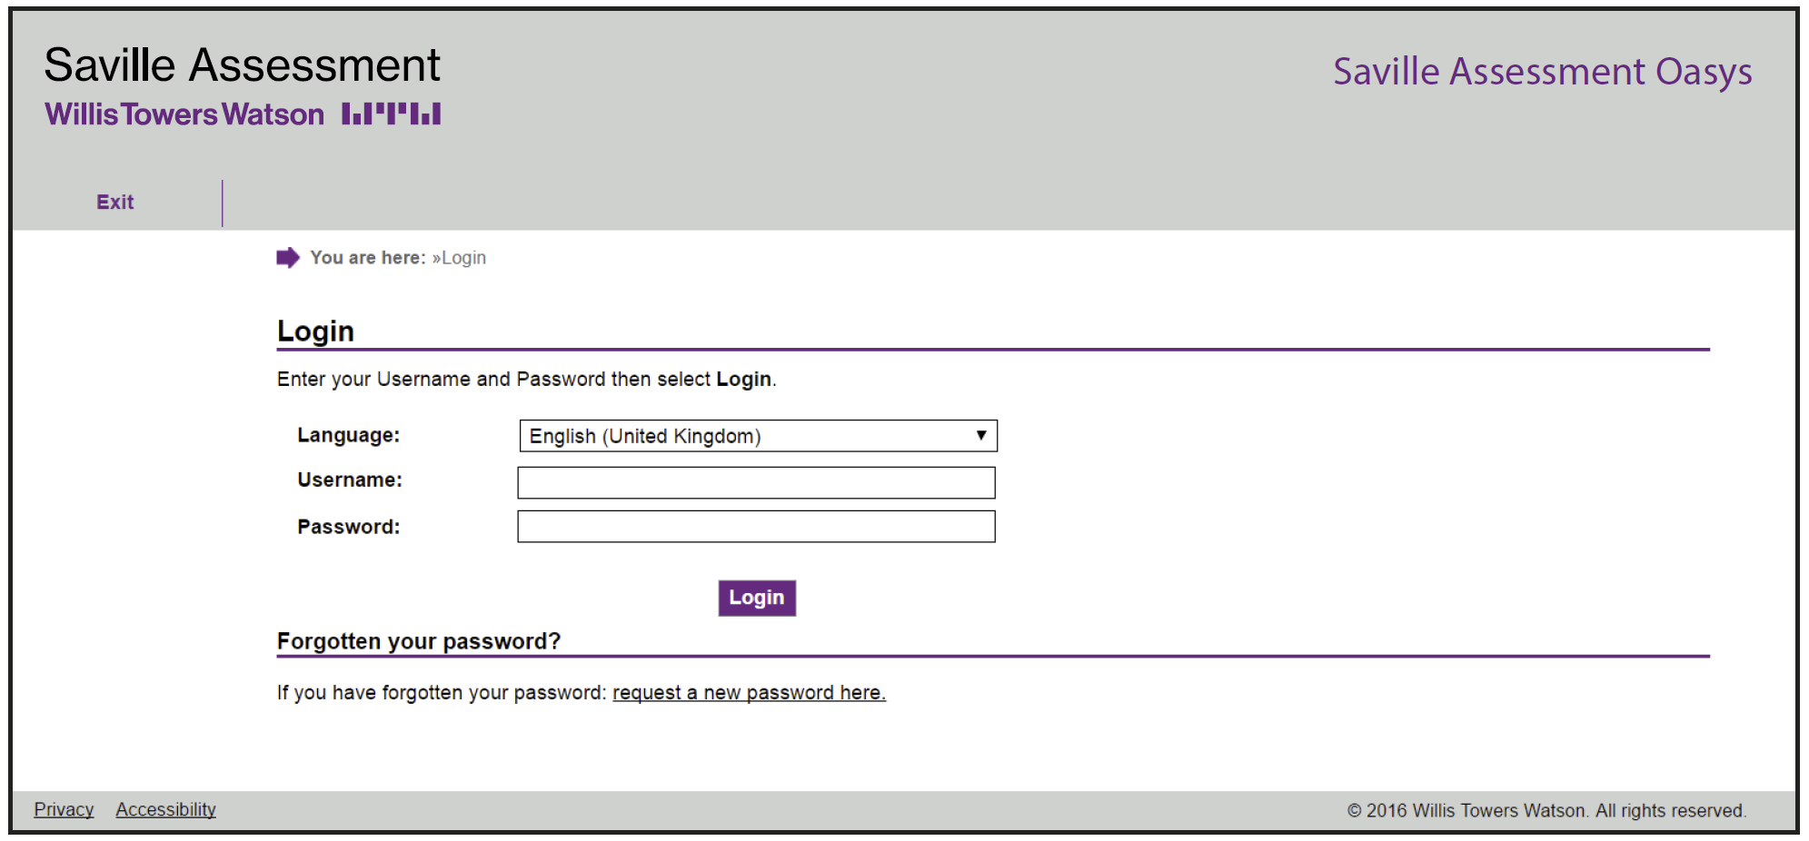
Bureau and Oasys Administration
Online assessments are delivered via our industry-leading Oasys platform.
99.9% uptime
Fully compatible with the latest internet browsers
Bureau
Complete a form – our Bureau team do the rest!
Cost-effective for small numbers
Fast turnaround within two hours
Open 8am – 6pm UK time
Oasys
You are in control of your own projects
One-off investment
Free training
Can be branded or non-branded
Discounted product costs

Slide 47
Administering Tests via an ATS Integration

Slide 48
MODULE 5
Test Scores

Slide 49
Scoring
An applicant scores 19 correct (their raw score) on a numerical test (28 items)
How well has the applicant performed?
Notes:
Delegates to share answers in the chat

Slide 50
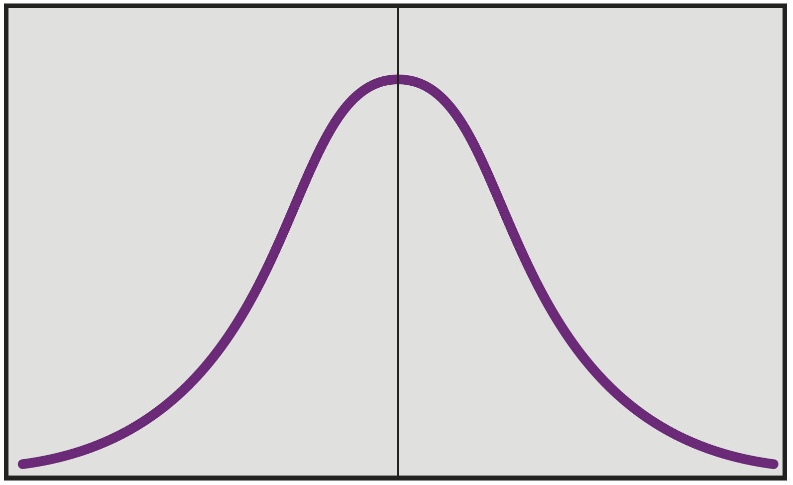
The Normal Distribution

Slide 51
Percentiles

Slide 52
Describing Percentiles
Candidate A: 56th %ile
Candidate B: 33rd %ile
Candidate C: 68th %ile
Notes:
Poll to vote or answers in chat

Slide 53
Describing Percentiles
Candidate A: 56th %ile Average
Candidate B: 33rd %ile Average
Candidate C: 68th %ile Average

Slide 54
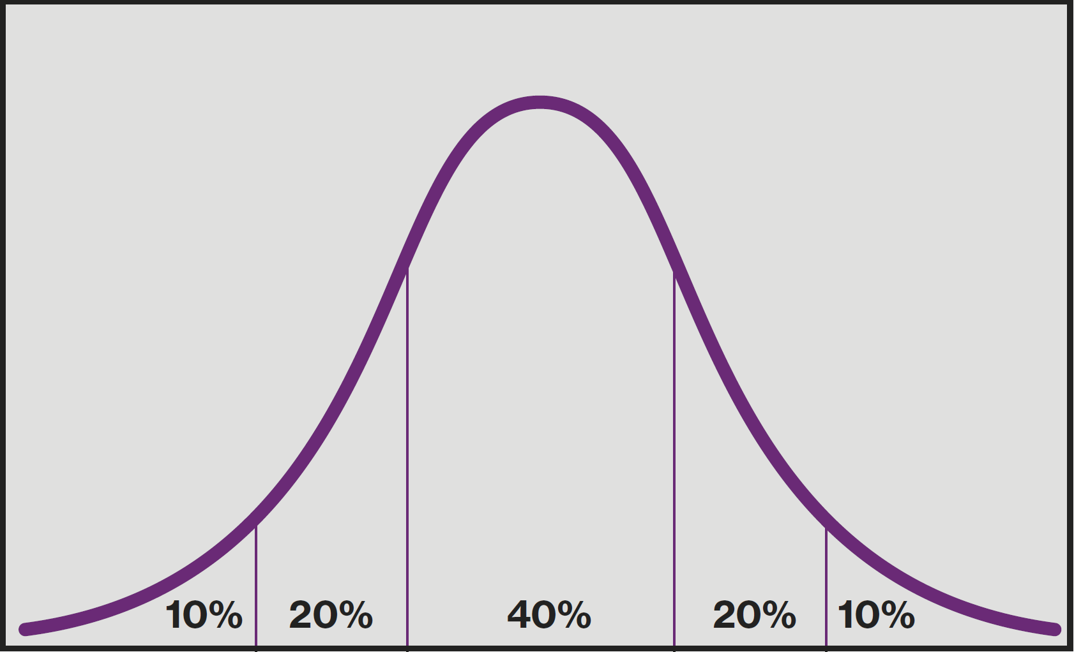
The Normal Distribution Performance Bandings
Low
Below
average
Average
Above
average
High

Slide 55
Ways of Describing Scores

Slide 56
Selecting Test Norms
Specific vs general benchmark norms
Use of specific norms which represent only one protected group, e.g. female only or white only, carries a clear risk of illegal discrimination
Should take account of:
job applied for
educational level
work experience
generalizability / representativeness
Usually 150+ people
Up to date
Different sampling methods exist, e.g. random, stratified or usage samples

Slide 57
Saville Assessment Norms
Geographies
International
Regional (e.g. Europe, Africa, Latin America)
Country (e.g. UK, China, Spain)
Levels/Roles
Senior Managers and Executives
Professionals and Managers
Individual Contributors
Graduates
Mixed Occupational Group
Apprentices
Technical Occupations
Foundation Level
English as an additional language

Slide 58
MODULE 6
Test Feedback

Slide 59
Purpose of Test Feedback
For public relations – candidates are often clients too
To assist in explaining why job offer not made
To comply with applicable legislation
To understand results by seeking examples/explanation
To understand conflicts with other assessment data
To increase recruited candidate’s self awareness
To develop individuals in key ability areas

Slide 60
Feedback of Saville Aptitude Tests
Total score is main focus in feedback and decision making
Sub-scores help to describe what the test is assessing
Item type or sub-scores also help pinpoint very specific strengths and development needs
Unsupervised online item-banked tests feature information about the combination of an individual’s Pace and Aptitude
Hard copy and supervised fixed-content tests contain information about an individual’s Speed, Accuracy and Caution
Answer forms and feedback reports give straightforward feedback and development advice for candidates, line managers and trained test users

Slide 61
Unsupervised Item-banked Profile Example

Slide 62
Unsupervised Item-Banked Profile Example
Notes:
Full report

Slide 63
Feedback Process
Introduction and purpose
Summary of tests used and comparison group
Background
Encourage self-assessment
Discuss overall performance
Review pace and sub-scores (for in-depth feedback)
Summary and review

Slide 64
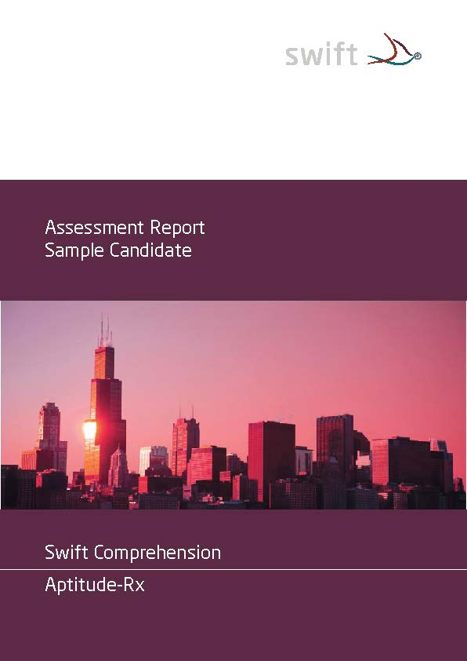
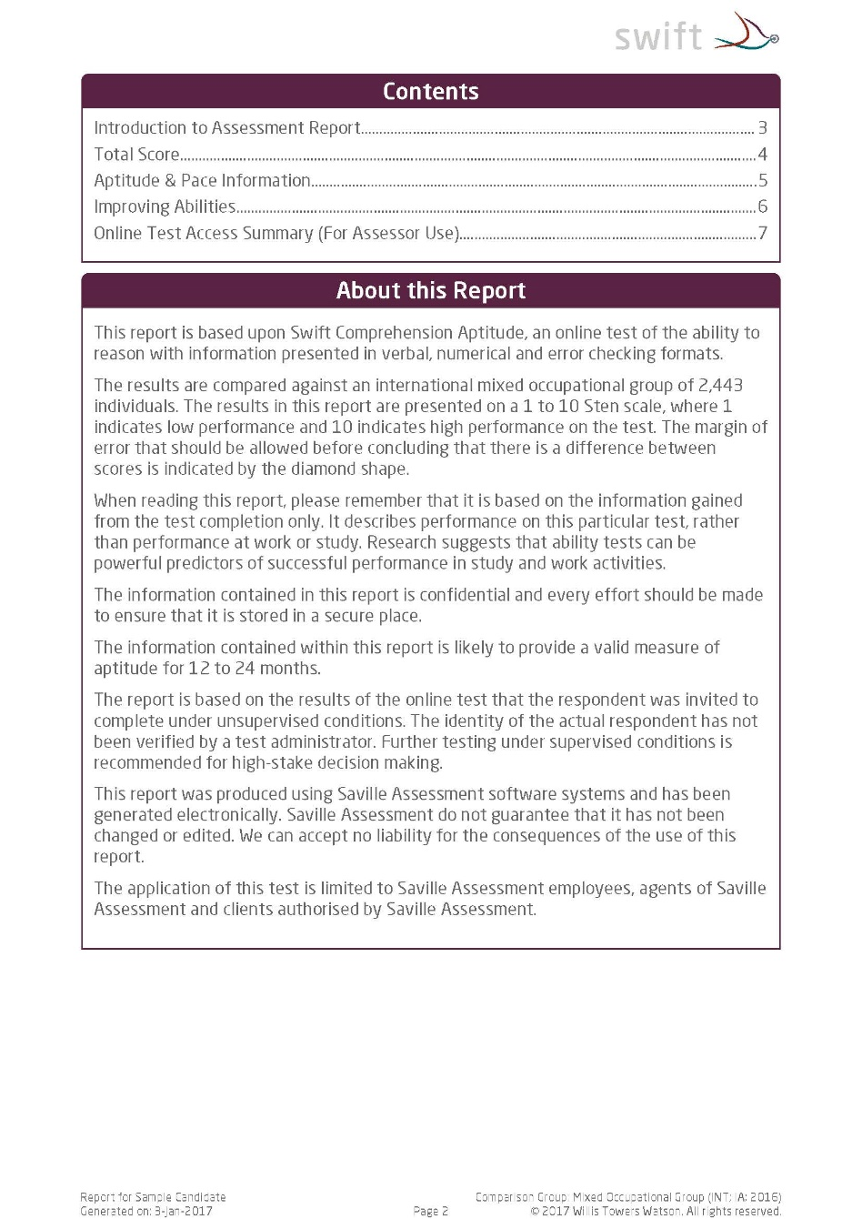
The Full Report

Slide 65
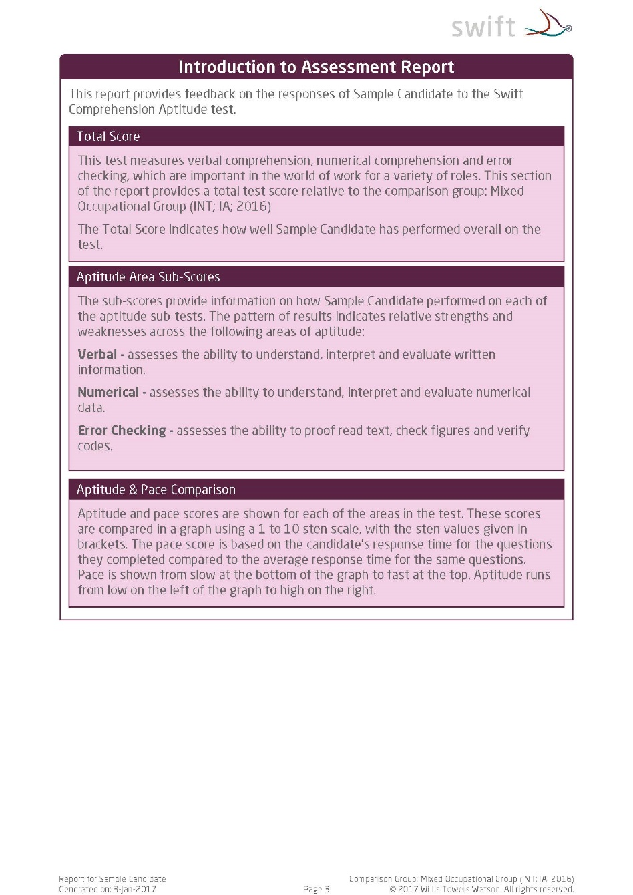
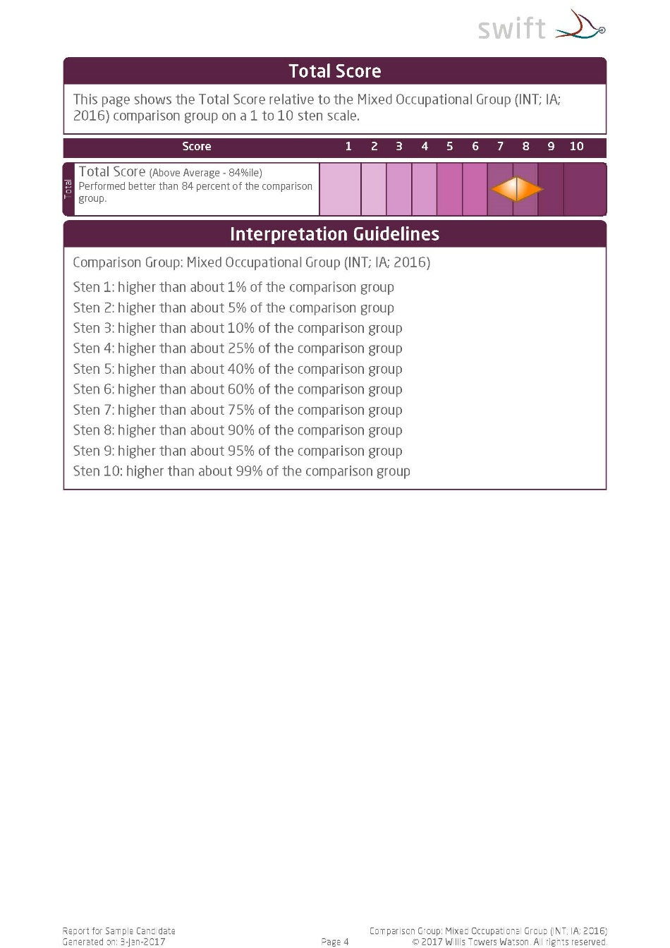
The Full Report

Slide 66
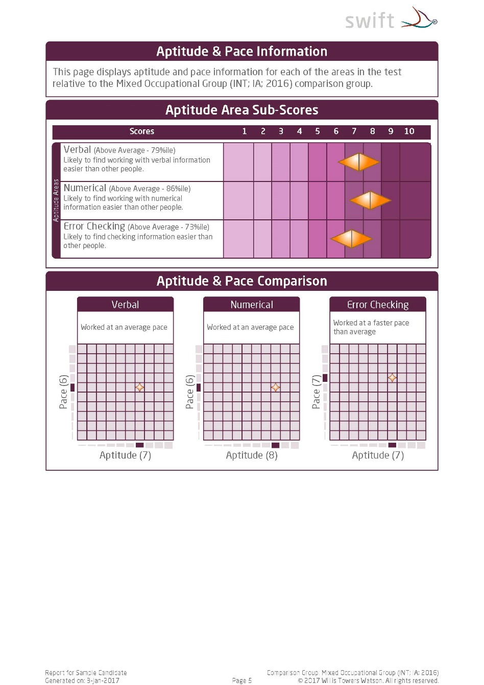
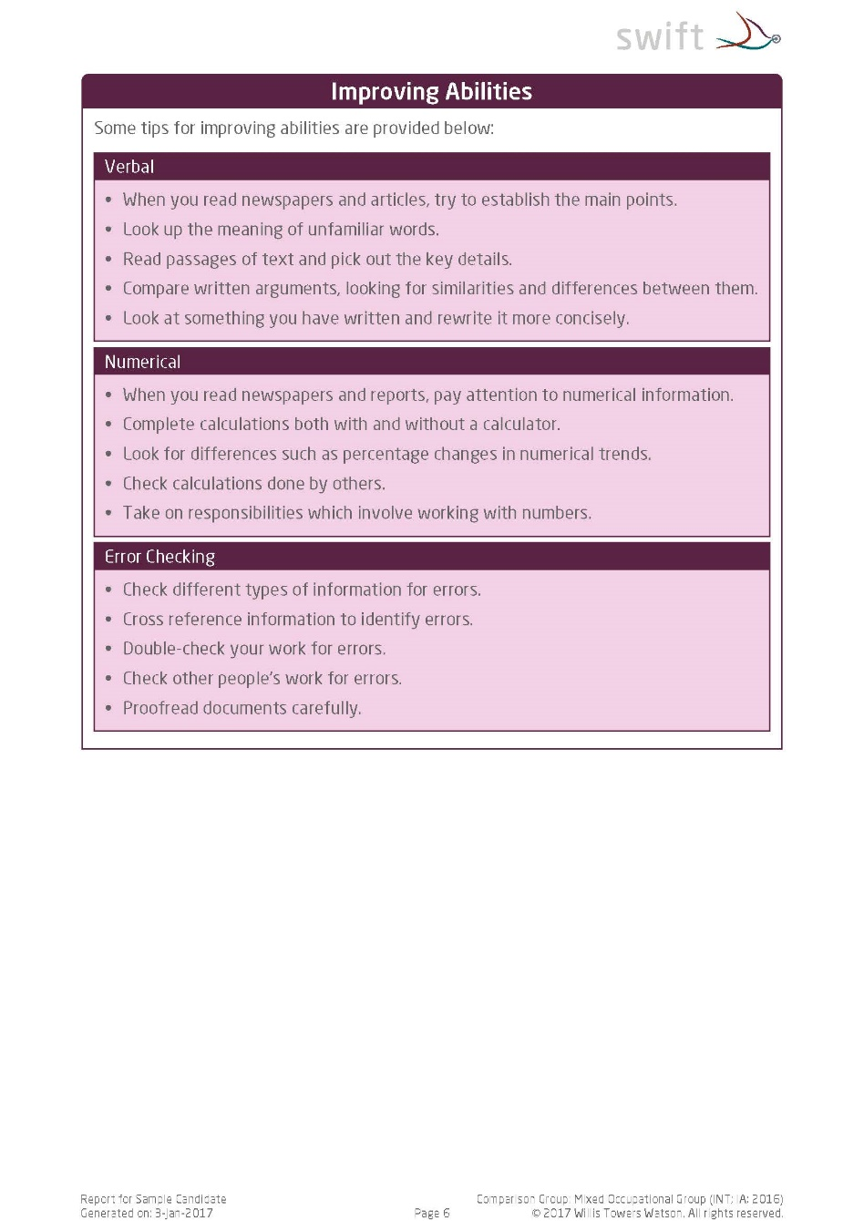
The Full Report

Slide 67
Feedback Tips – ‘Do’s and Don’ts’
Do build rapport
Do ensure two-way dialogue
Do gauge candidate reactions and impressions
Do discuss development areas if raised by candidate
Don’t give too much information or too many scores at once
Don’t use technical jargon
Don’t make value judgments
Notes:
Instructions for feedback – DL vs Apt

Slide 68
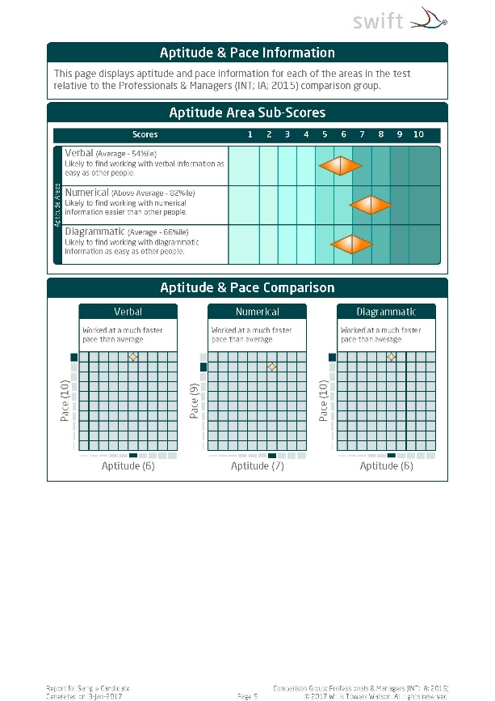
Practical Session: Feedback
Workbook page 9
Aptitude Feedback
The candidate has been unsuccessful and has requested feedback on their aptitude performance.
Prepare your feedback session, including an introduction.
Provide feedback to ‘Sample Candidate’.
Notes:
Share feedback report

Slide 69
MODULE 7
Best Practice and Ethics

Slide 70
Best Practice: Key Points
Promote proper data management
Ensure fair assessment
Consider the candidate’s needs
Make accommodation for special requirements
Review your testing policy
Test validity
Preparation materials
Monitoring differences

Slide 71
Data Implications for Testing
General Data Protection Regulation (GDPR)
Applicable when assessing for candidates and/or clients in the EU.
Six principles to ensure that information is handled properly:
Processed lawfully, fairly and in a transparent manner
Collected for specified, explicit and legitimate purposes and not further processed for an incompatible purpose
Adequate, relevant and limited to what is necessary in relation to the purpose
Accurate and, where necessary, kept up-to-date
Kept in a form which permits identification of data subjects for no longer than is necessary for the purpose
Processed in a manner that ensures appropriate security of the personal data

Slide 72
Adverse Impact in Testing
Adverse impact is where a substantially different proportion of one group is hired in comparison to another group
This is likely to occur where there is a difference between groups in terms of their average test score
As group differences exist, justification for using tests and the level of cut-off matters
A high cut-off of, for example, the 90th percentile is likely to reduce the relative percentage of Black candidates compared to White or Chinese candidates and it is likely to require strong justification to show that this level of aptitude is required

Slide 73
Setting Cut-Offs
Lower cut-offs are often effectively applied at early screening stages of volume recruitment (e.g. 30th%ile)
Still need link to job performance (job analysis and/or criterion-related validity)
Higher cut-offs can give even greater return on investment but require more justification (i.e. evidence the job is difficult or that there is strong validity)
Higher cut-offs can result in lower proportions of potentially disadvantaged groups being selected
Particular care should be taken when using top-down selection

Slide 74
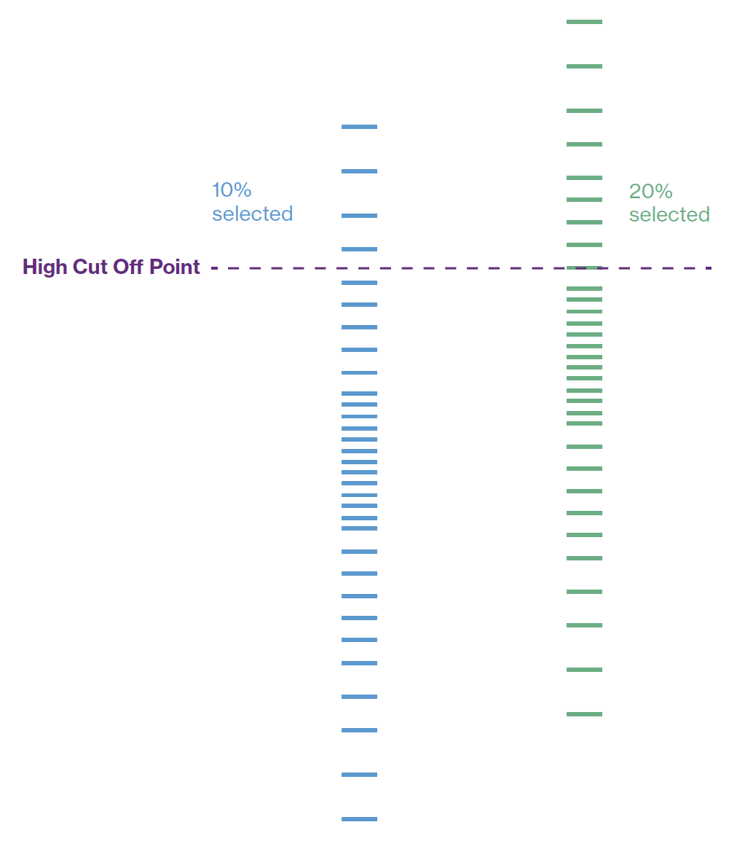
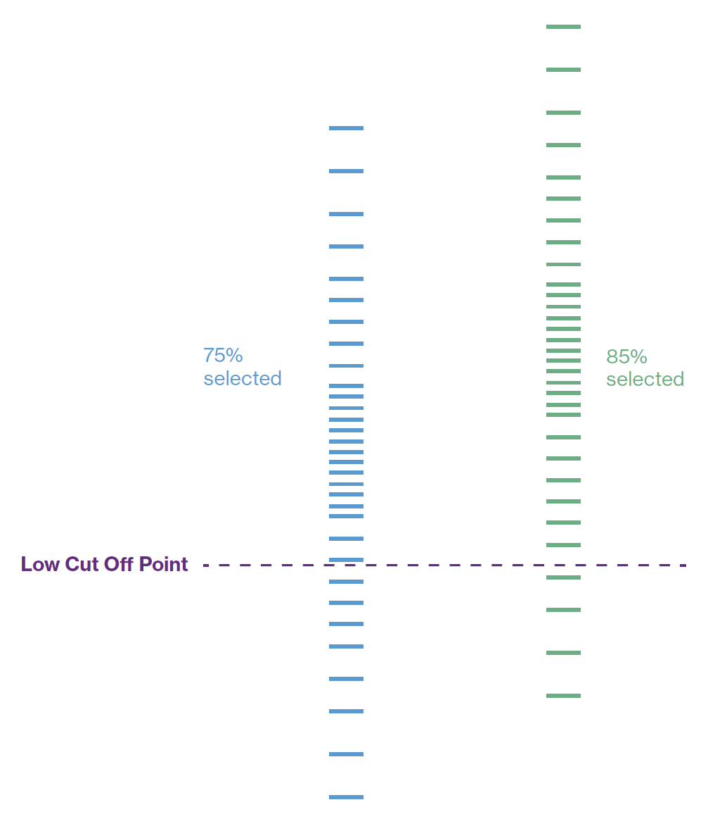
The Four-Fifths Rule
A selection rate for any protected group which is less than four-fifths (or 80%) of the rate for the group with the highest rate of selection is seen as adverse impact
This affects where we need to set cut-off scores in assessment
Blue group 50% of Green group:
Unacceptable Adverse Impact
Blue group 88% of Green group:
Acceptable Adverse Impact

Slide 75
Best Practice: Consider the Candidate
Explain the assessment process
Important for procedural justice
Provide practice/preparation material
Establish informed consent
Provide opportunities for right of reply
Establish feedback process
Promote consistency and fairness for all candidates throughout the process
Test in the most appropriate language (normally first language)
Enquire about special requirements/accommodations (e.g. disabilities)

Slide 76
Testing Candidates with Special Requirements
You are responsible for deciding upon an appropriate accommodation/adjustment and will need to:
Understand the disability
Seek test publisher advice as to what different accommodation options are available
Seek expert advice on the candidate’s disability where appropriate
Decide how to accommodate, test as standard, or not test at all
Typical accommodations include: time adjustment, screen reader technology, large screen/print version, braille, response assistance (sighted reader or person to record responses)
Conversations may be required with the disabled candidate, the assessment provider and even a suitably qualified professional for that disability
Volume testers will generally have policies in place regarding common accommodations, e.g. particular time adjustments for dyslexia upon presentation of an appropriate certificate
A larger band of error should be applied to adjusted test scores

Slide 77
MODULE 8
Reliability and Validity

Slide 78
Possible Sources of Error
Feeling unwell
Misinterpreting instructions
Severe test anxiety
Individual
Using an unreliable test
Poor candidate briefing
Misinterpreting test results
Administrator
Ambiguous items
Items measuring the wrong thing
Poor instructions
Test Developer
Notes:
Ask delegates to guess
Guess candidate, reveal candidate
Guess Admin, reveal admin
Guess developer, reveal developer

Slide 79
Methods of Assessing Reliability
Test-Retest – administering the same test twice
+ Gives indication that attribute is stable
- Candidates not willing to do it twice
Alternate Form – administering two parallel forms
+ Shows developer is clear/consistent on what is measured
- Has the expense of developing two forms
Internal Consistency – administering only 1 test once
+ Easy to do as only requires one test on one occasion
- Can be misleadingly high with repetitive item content

Slide 80
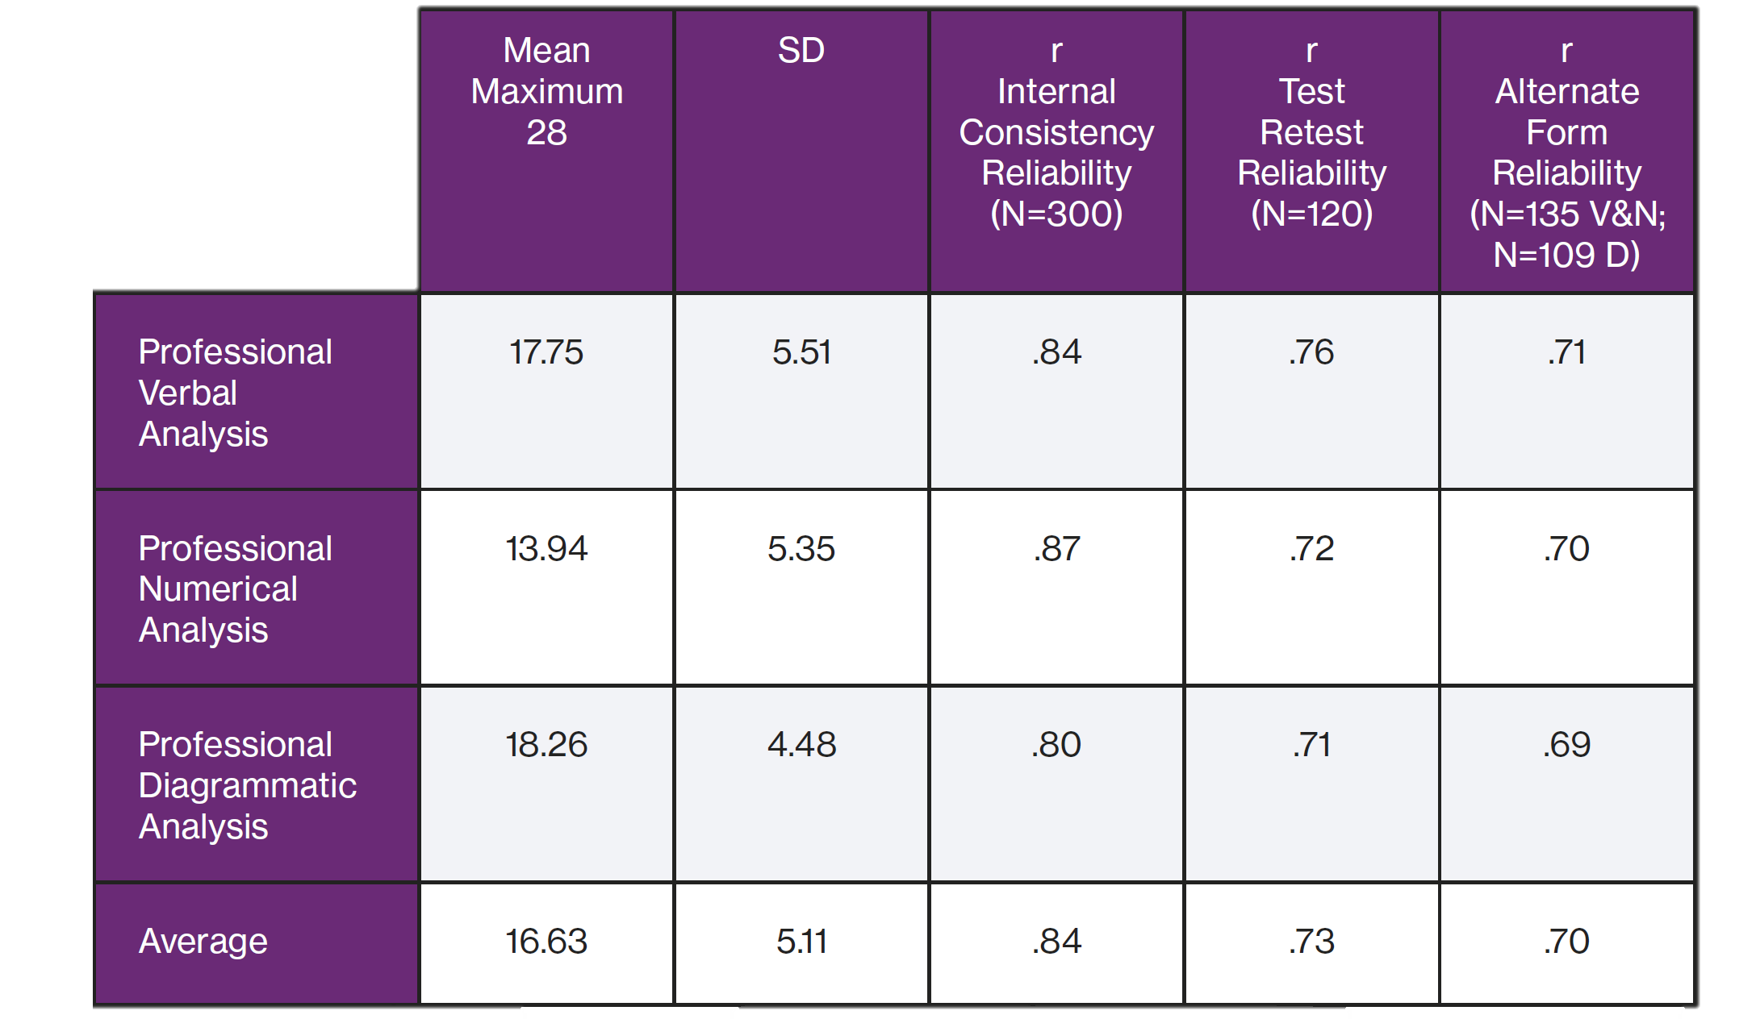
Professional Aptitudes Reliability

Slide 81
Aspects of Validity in Aptitude Tests
Face Validity: do the questions ‘look right’ i.e. appear to be appropriate/job-relevant? (And do the reports ‘look right’?)
Content Validity: the extent to which the questions are actually focused on job-relevant content
Consequential Validity: the intended and unintended consequences of using a test
Construct Validity: can refer to a wide range of different sources of evidence demonstrating that a test measures an expected underlying construct, trait or theory, e.g. evidence that the test correlates with other similar measures
In a sense, other forms of validity could be seen as aspects of construct validity – though often we need to look for more specific forms of validation evidence
Faith Validity: an unfounded belief that a test is appropriate, i.e. in the absence of evidence
Criterion-related Validity: evidence that the test predicts relevant criteria (e.g. competencies)

Slide 82
Criterion-Related Validity
Two ways of conducting criterion-related validity studies:
Concurrent criterion-related validity coefficients: the correlation of job incumbent test scores with job performance measures gathered at the same time
Pros: quick to establish
Cons: provides a link to current performance but not directly to future performance
Predictive criterion-related validity coefficients: the correlation of applicant test scores with their job performance a few months later
Pros: provides a link to future performance
Cons: have to wait until recruits have job performance data

Slide 83
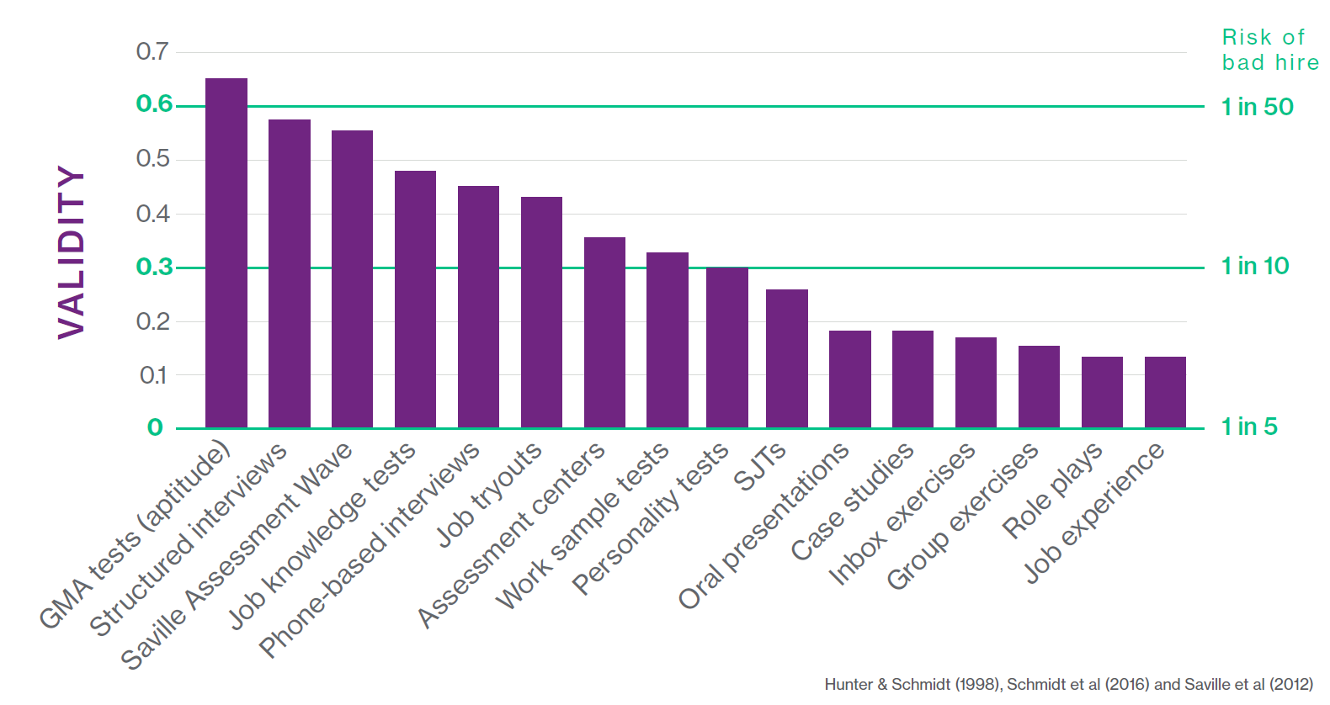
Validity of Different Selection Techniques

Slide 84
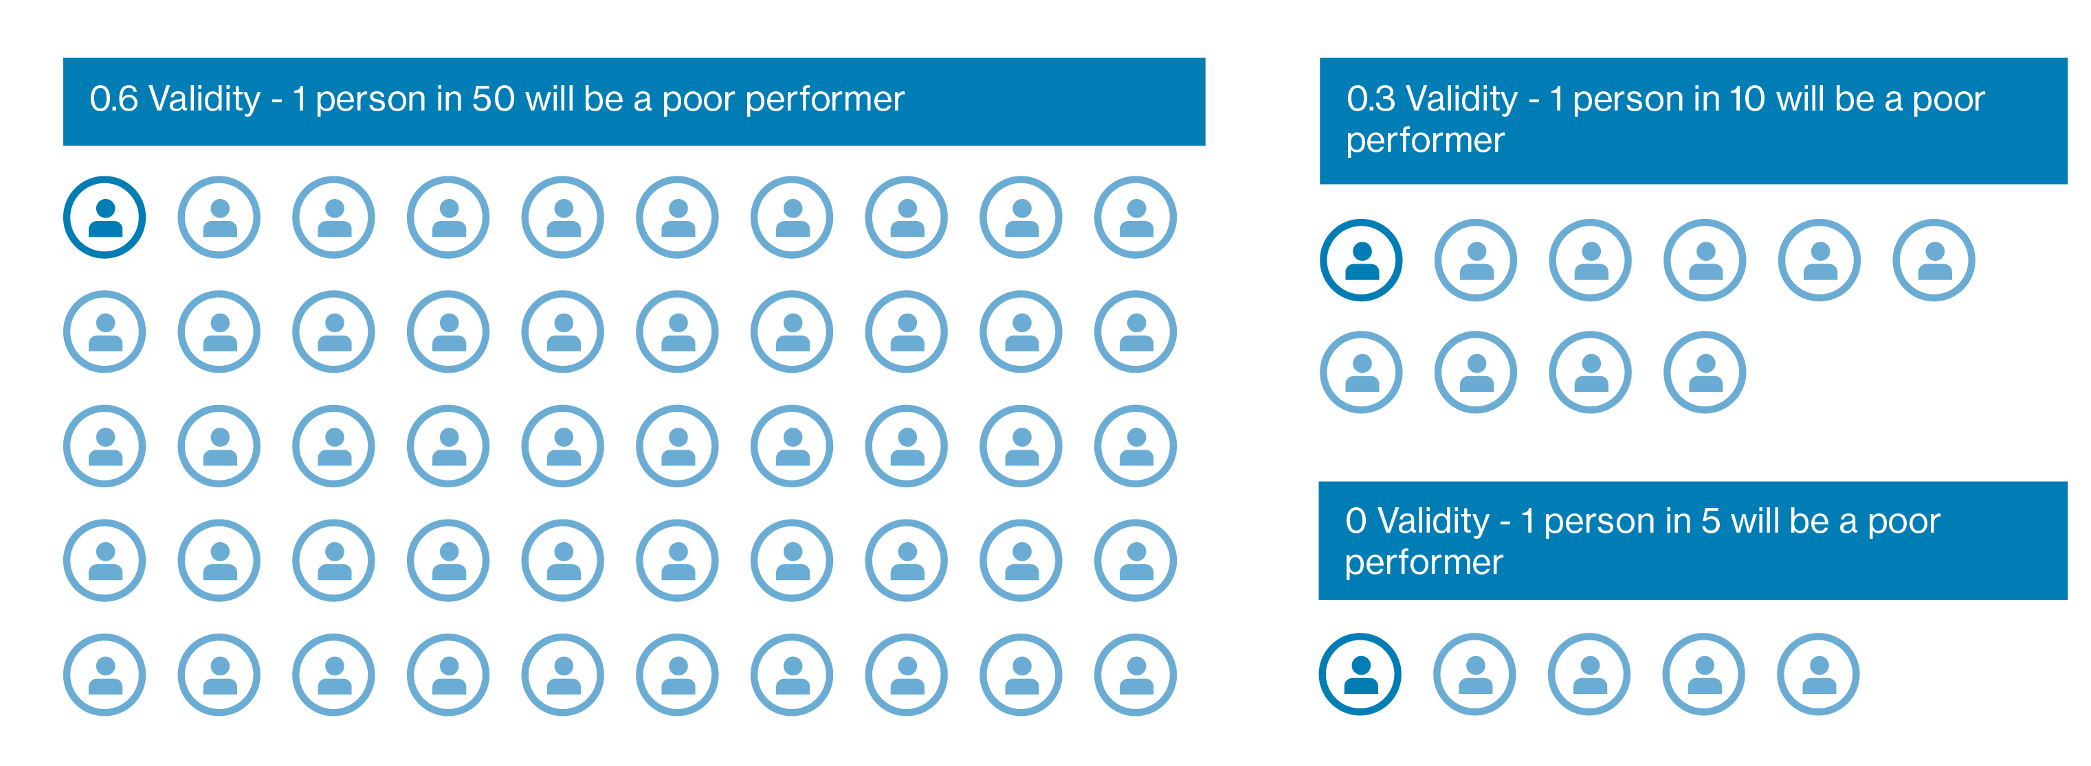
Return on Investment
Validity

Slide 85
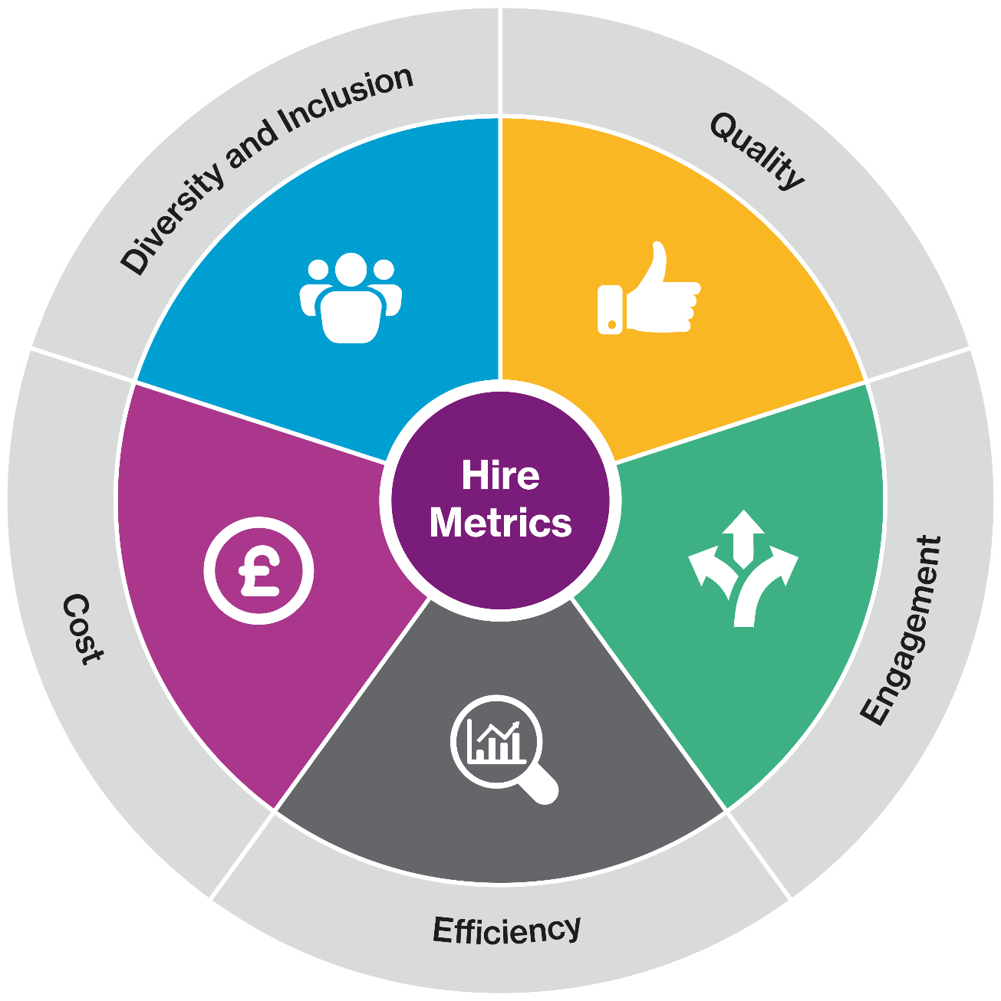
Return on Investment
Saville Assessment ROI Model

Slide 86
NEXT STEPS

Slide 87
Next Steps
Contact our Duty Consultant for additional support
Call: +44 (0)208 619 9000 Email: info@savilleassessment.com

Slide 88
Administering Tests: A Recap
No annual subscription fees to use tests
No separate administration, scoring or profiling fees
Saville Assessment Bureau – your managed service option: Complete the form and our Bureau team will set up the questionnaire and send you reports
Saville Assessment Oasys – your self-service option: One-off set up fee and then a third off report costs. Your Oasys platform can be branded

Slide 89
The Saville Assessment Community
What you can expect:
Invitations to webinars and practitioner masterclasses
Discussion on industry-specific news and topics
Networking opportunities with other professionals
Privileged offers
@savilleassess
https://www.linkedin.com/company/saville-assessment
savilleassess
www.facebook.com/SavilleAssess/

