Slide 1
Vision for Growth
Doug Friske
Global Head of Talent & Reward

Slide 2
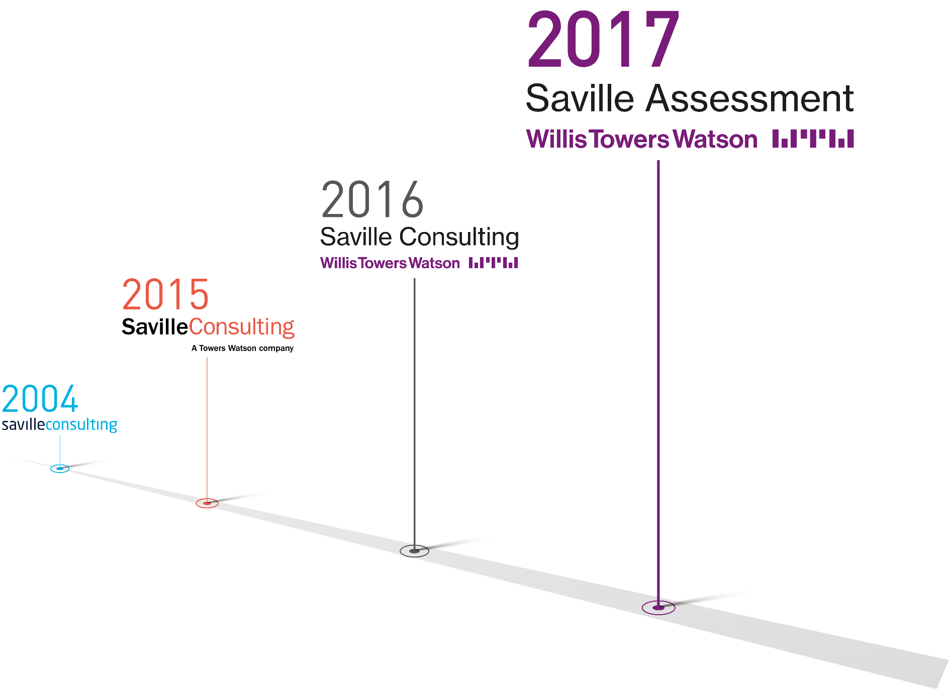
Welcome
Since 2015

Slide 3
Welcome
Where We Are Today
Human Capital and Benefits
Benefits Delivery and Administration
Corporate Risk and Broking
Investment, Risk and Reinsurance
Julie Gebauer
Talent & Reward
Doug Friske
Talent Line of Business
Suzanne McAndrew
Saville Assessment
Gabby Parry
Notes:
4 KEY BUSINESS SERVICES AREAS
Human Capital and Benefits headed up by Julie Gebauer
Within that I look after the Talent & reward
Saville falls in the talent line of business looked after Suzanne MacAndrew
Where it sits alongside TMOA, EI and CCM as Global practice headed up by Gabby

Slide 4
WTW Headlines
Our winning story resides where business and human goals meet
We believe it is people who create real competitive advantage. The ambitions of organizations are inextricably tied to those of their teams.
In Talent & Rewards, we help organizations to change, grow and thrive by engaging their individuals in a better working experience. Because whenever people flourish, organizations prosper.
We strive to listen and understand the ambitions of our clients and the individuals we serve. And through our data, insights, analytics, advice and software…we make those ambitions a reality.
We power ambition.

Slide 5
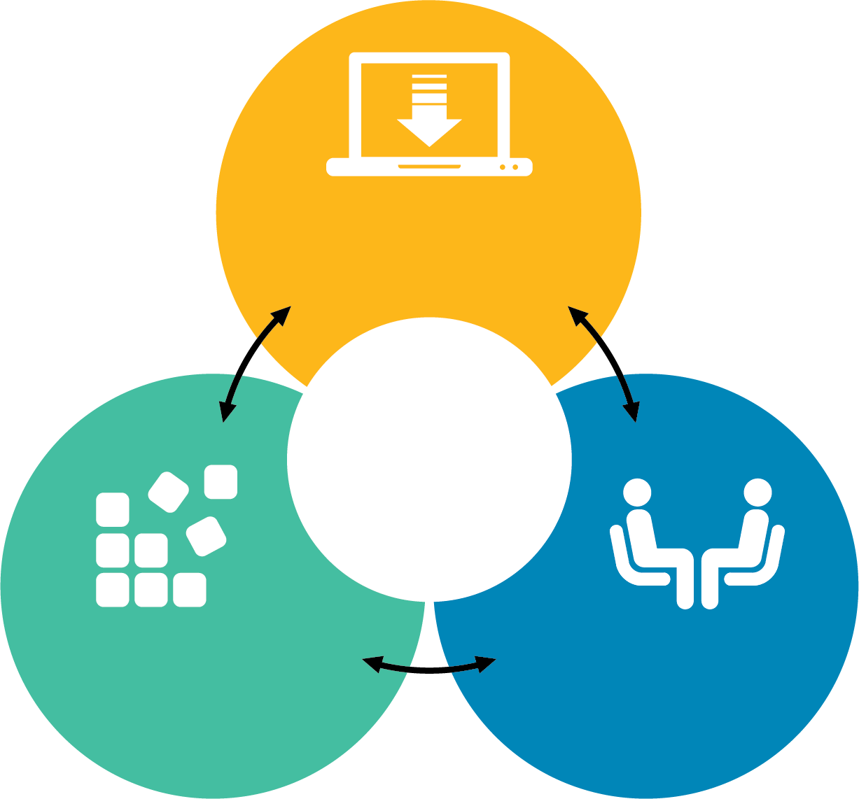
WTW Headlines
Great HR software
Unique ability to solve clients’ problems
Industry-leading data and IC
World-class consulting

Slide 6
WTW as an Assessment Client
Hire Talent
Graduate Recruitment
+
UK, USA & EMEA
ASSESSMENT CENTER DESIGN
Senior Hires

Slide 7
WTW as an Assessment Client
Build Talent
Client Acumen Global Program
Senior Promotion Global Program
Innovation Team
Work Roles
Sales and Contact Center Teams
Validation Studies

Slide 8
WTW as an Assessment Client
Lead Talent
Senior Leadership Assessment
Leadership Impact/Risk and Impact 360

Slide 9
Looking Ahead
Let’s GROW!
Powerful Partnerships
Growing Together
Notes:
Valued an important route to market for the practice, the line of business and ultimately Willis Towers Watson

