Slide 1
Meaningful Connections
Top tips for building & maintaining a collaborative culture in a changing environment
© 2021 Saville Assessment, Willis Towers Watson. All rights reserved.
Notes:
Hi Everyone
Thank you for joining us today for our webinar: Thrive, Don’t Survive – supporting managers to be a powerhouse for change and transformation. This is the 1st webinar in our new series focused on accessible and high impact HR solutions.
Let me first introduce myself, my name is Daphne van der Wielen I am a Senior Consultant at Saville Assessment. I am the consultant product lead for our new Building Resilient Agility reports, working closely with our R&D and marketing teams to support our clients with implementing this model.
During this webinar I am going to touch on change and transformation more broadly, looking at how different organisations respond to the pandemic. I am going to introduce you to our Building Resilient Agility model , a model we have developed to help employees and managers cope with change and transformation and I will finish the webinar with example applications how this model can be used to deliver scalable and high-impact solutions to develop managers and their teams and support them through different phases of change and transformation.
If you got any questions during the session please put them in the chat, where my colleague Jas is joining us, she will be monitoring the chat. We will try to pick up as many questions as possible at the end if there is more questions we can come back to you following the webinar.

Slide 2
01
The current landscape
AGENDA
02
Our People Analytics & Work Roles tools and reports
03
Supporting managers and their teams to maintain meaningful connections & collaboration
Notes:
So let me cover the agenda for todays session
First of all I am going to talk about the current landscape of change and transformation and how different are responding to the pandemic.
Then we will move on to explain how change and transformation have shaped our model and outputs around Resilient Agility. We will look at the research that sits behind the model.
We will then close by looking at how the model and outputs can be applied in organisations to help managers and their teams build resilient agility
As part of the webinar invitation we have asked you some survey question, insights and results from this survey will be presented throughout the webinar allowing us to bring insight from the group to you.
Also during the webinar we will have some quick polls, allowing some interaction during the session, Jasmin will be guiding us through those as we go.

Slide 3
01
The current landscape
Notes:
Looking at our data, we realised that at Saville we ere in a unique position because over the years we had collected a lot of data how people rated themselves and how others had rated their performance in showing resilience but also their capability to adjust to change.

Slide 4
Pre-pandemic
32% worked from home
Looking forwards
Nearly 60% want to continue to work from home
Home working isn’t new…
…but hybrid working is scaling up
The Financial Times contacted more than 20 companies, and most said they anticipated introducing hybrid models of working in which staff split their time between the office and home
Powering an integrated talent strategy
Notes:
So what is the current landscape looking like at the moment.
Over the years organisations have always been dealing with change and transformation in one form or another, these are not new concepts. It is change and transformation that has helped organisations develop, push forwards and for example speed up the pace of digitalisation and the technological enhancements organisations make.
However , looking at our current situation, the pandemic has effectively accelerated the pace at which change and transformation are happening economically. All organisations have been through significant transformations, e.g. think about the switch to virtual working, redeployment of staff and many other changes.
And we expect that the pace of change and transformation will continue, now organisations prepare for the post lockdown phases. It is perhaps not realistic or desirable to think that organisations will simply return to where they were before. Instead there is the opportunity for leaders to think about how they will reimaging their organisation.

Slide 5
Poll - With Results
What three things are your organisation most concerned with related to a shift to more hybrid-working?
Wellbeing & engagement
Cross-functional collaboration
Creating a more inclusive culture
Fostering innovation
Developing capability & achieving potential
Notes:
We are now a couple of months on from this survey of the Josh Bersin Acedmy and I am really curious to hear from you werhe you believe your organisation is currently at.
I am mindful that it could be difficult to choose, as there might be an argument that you are focusing on multiple stages at once. With employee heath remaining important in everything your organisation does. But what I would like to you to think about is what phase currently has the most strategical focus, and requires the most energy in your organisation?
Stage 2: Very interesting the core focus for many remainso n the people, keeping them healthy not only physically from Covid perhaps but also mentally supporting them in may different ways.
Stage 3: That is interesting the focus for many of you is on driving agility and culture, that focus on educating people and helping them stay resilient and positive.
Stage 4: I believe it is hopeful to see that for so many of you the key focus is on transformation and reinvention of the workplace. This is a sign that organisations are preparing for those post pandemic phases , and are making the most out of the opportunities the change is bringing.
We believe that at all these stages, it is key to support your people through the process, to help them move from hoping for the best to being a key contributor to helping the organisation transform and reinvent.
Dependent on what outcome is
Highlight how most organisations are at x stage
Still steps to go in process→ important to support employees through this process.

Slide 6
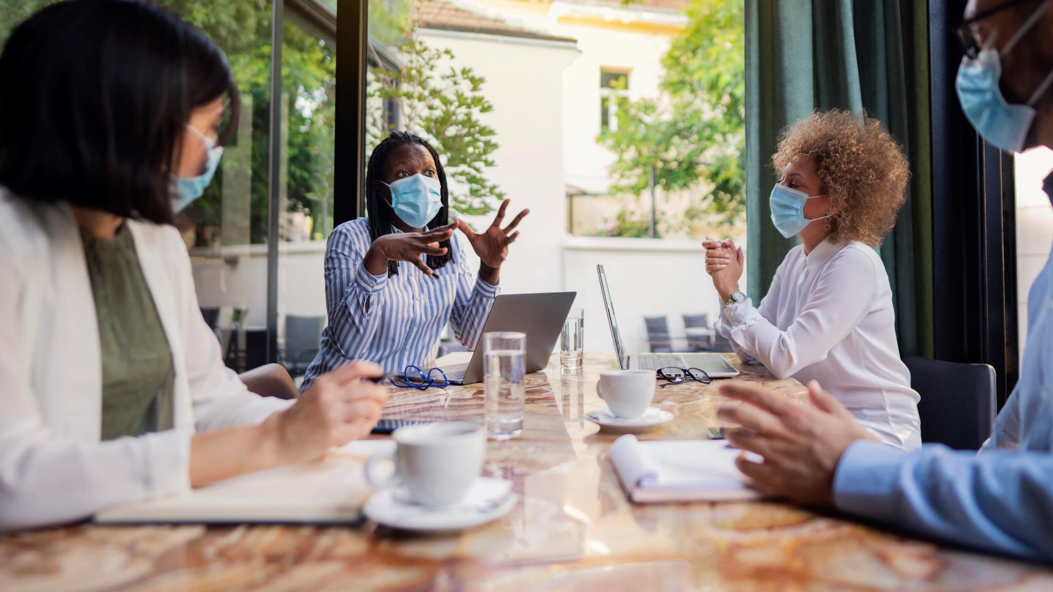
People Managers are key to making a success of a lot of these challenges of hybrid working…
Future of Work Institute (2020)
Connection & Trust
Collaboration & cohesion
Wellbeing
& engagement
Communication & knowledge-sharing
Driving Innovation
Inclusivity
Notes:
As a result of the unparalleled level of change and uncertain organisations were and are still facing, there has been a renewed focus from clients wanting to measure and build behaviours such as resilience, agility, grit and flexibility in their people.
Although the characteristics of resilience and agility are getting a lot of focus now, they have always been important. Over the years, organizations going through transformation were often asking us how, they can support their employees cope with ambiguity or deal with the complexities they are facing. How we can help their people build grit and perseverance.
Some clients asked us if we can measure employees “ agility” or “flexibility” while other clients asked us whether we can measure ‘emotional resilience’ or ‘grit’. We often pointed them to different parts of our Wave behavioural model.
However, in practice we realized that these clients were actually facing the same issues but they had just come to different conclusions on what they needed in their people.
What we realised is that they were looking for a solution to help people deal with change and transformation in a way that is sutainable in the longer term . That that both agiligy and resilience are two sides of the same coin.

Slide 7
Evidence-Based Approach to Supporting Meaningful Connections
Regularly assess the quality and quantity of team communication and switch virtual communication tools as necessary.
Regularly provide individual and team-level feedback about performance and how the team is functioning.
Create a culture in which team members feel willing and encouraged to admit their mistakes and ask for help.
Encourage regular communication (both work and non-work related) between team members
Ensure that sufficient levels of problemsolving are involved in the tasks your team works on
Adams, K., Parker, S. K., Jorritsma, K., & Griffin, M. A. (2020). How to lead virtual teams for success: A guide for managers. Future of Work Institute. November 2020.

Slide 8
02
People Analytics & Work Roles
from
Notes:
Looking at our data, we realised that at Saville we ere in a unique position because over the years we had collected a lot of data how people rated themselves and how others had rated their performance in showing resilience but also their capability to adjust to change.

Slide 9
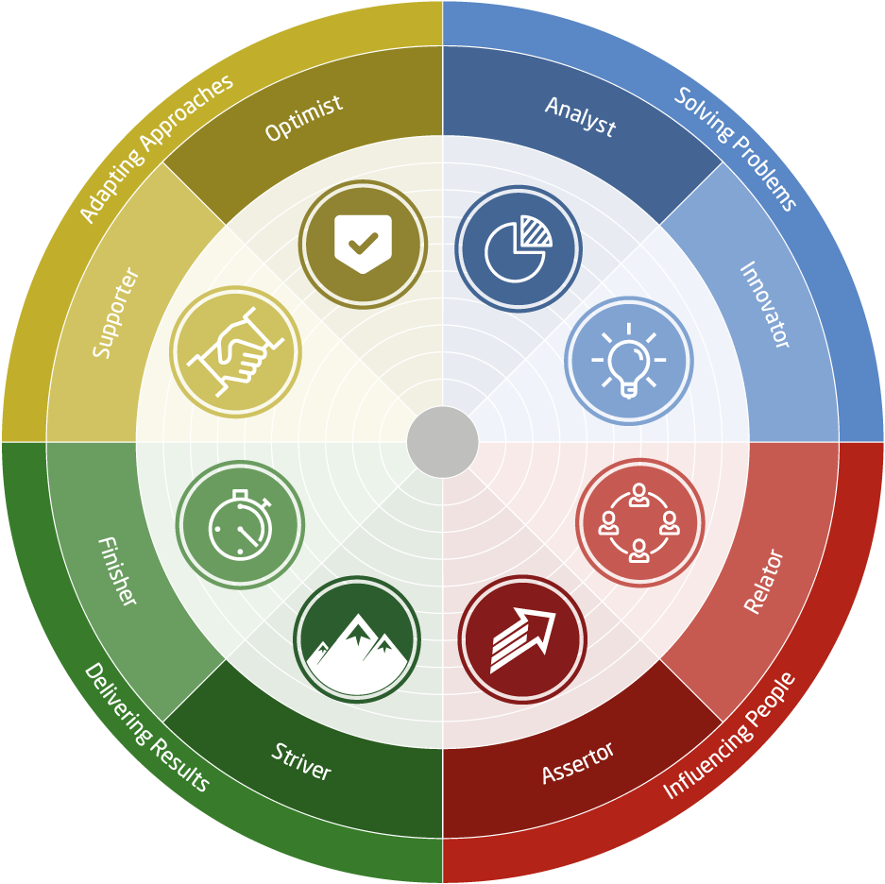
The Eight Work Roles
Notes:
Leverages the power of the Wave assessment

Slide 10
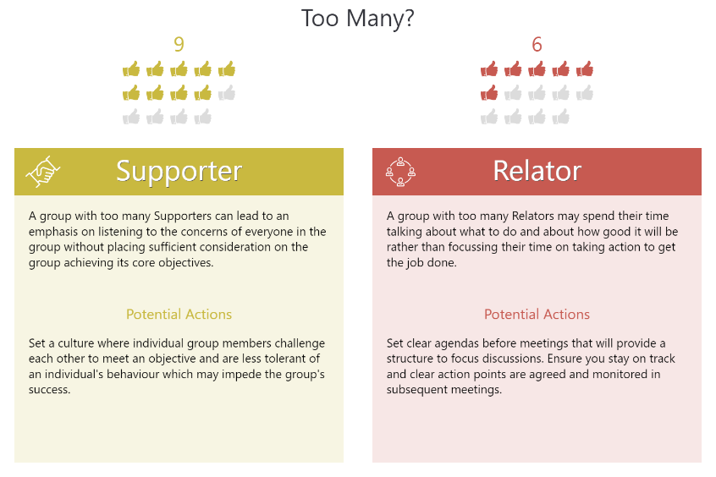
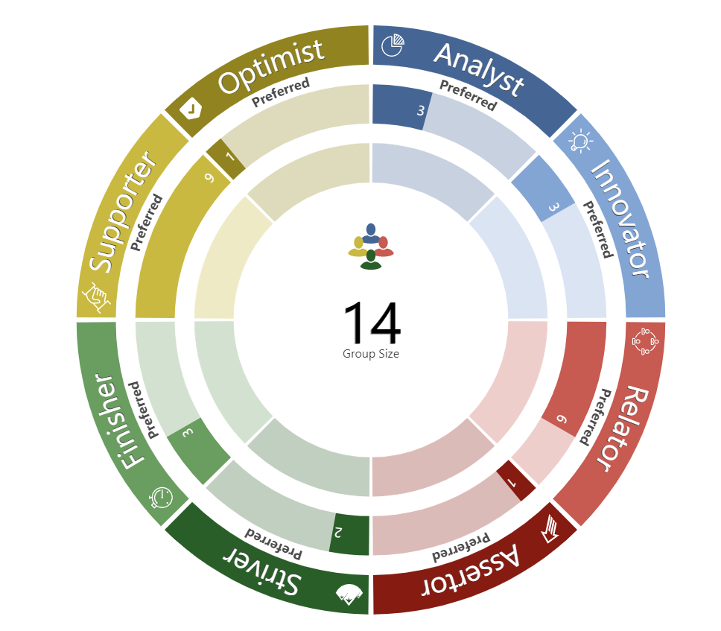
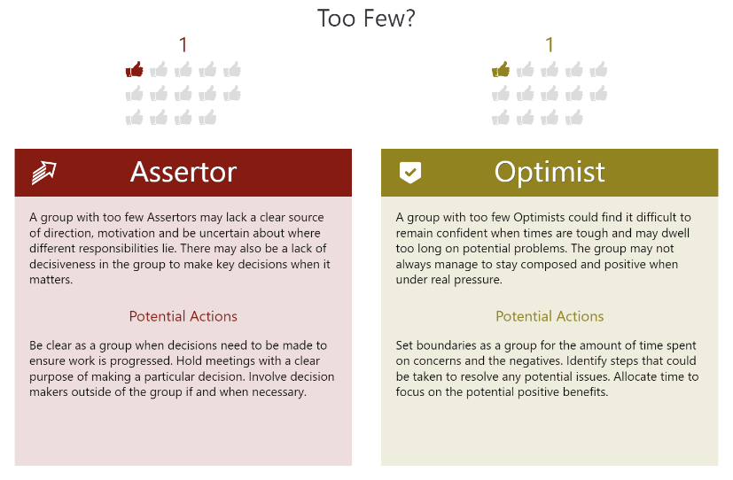
Notes:
Using the Options Tab you are able to select to show just the most preferred or just the least preferred roles within the overview.
Suggestions on how to facilitate this slide:
Some Questions:
As a team, what are your key strengths?
Where do you see these strengths making a difference at work?

Slide 11
03
Supporting managers to maintain
meaningful connections & collaboration
Notes:
Next I will take you through model and available reporting in more detail
I will do this through the lens of a Manager at an IT Organsation, to help bring to live how managers can use the BRA model and reporting to support themselves and their workforce through change and transformation. All the applications that I will present are accessible, scalable and high impact solutions that can easily be implemented.
We know that the direction and support form leadership is key to set strategy and lead their employees through the various stages of responding to the pandemic. However that it are the people managers who often deal much more directly with the employees, and that they often are the ones implementing the changes required in the different stages of response.
That therefore the squeeze on managers has never been tighter as they juggle supporting their teams, taking care of themselves, delivering results and managing multiple demands under increased pressure.
We also see this in what you told us before the webinar

Slide 12
Case Study
Large information and comms organisation
Pilot supporting managers from a range of teams from operational to corporate support functions
Notes:
Let me introduce you to our fictional manager Sam, Sam is a people manager at an IT organsiation
Sam manages a team of in total 8 members.

Slide 13
Background
Since start of the pandemic the majority of the organisation are working from home
The organisation are preparing for a move to more permanent hybrid home & office working
New employees have started in the last year, never having met their colleagues in person
Limited capacity in L&D team
Teams feeling lockdown fatigue and silo-working creeping in
Notes:
Since March last year Sam and his team are all working remotely.
As many other organisations, they are currently preparing for the return to work , however the model in which that will happened is transforming, they are moving to a more flexible model instead of return to a 5 day week in the office.
At the start of the pandemic Sam and her team have had to reinvent the way they deliver support and training to their clients. A lot of this training was happening face to face pre pandemic and since April last year they have transformed the whole model to virtual learning and support. This was something that had always been on the agenda but this change has been accelerated by the pandemic. Clients have responses very positively to this new approach which has lead to significantly more demand.
For this reasons Sam’s team is expanding and Sam has just last month hired a new team member, who is starting as an analysit supporting the wider team.
Where initially the move to online and virtual support was a way of responding to the change, it has actually now led to the launch of a totally new offering. A online more flexible online IT care package for clients. A completely digital tailored offering, that includes heaps of online resources on a learning platform and access to short more regular training sessions and 24/7 chat support. This offering will help the organisation stay comepetative and push ahead.
As you can see Sam is facing many different demands in supporting herself and the team through all of this change and transformation. So lets have a look how the Building Resilient Agility outputs can support her and the team. In the different challenges, and moving through the different stages of response to the pandemic.
.

Slide 14
Pilot
L&D offered up-skilling opportunity to people managers across the organisation
9 managers were given support to use Work Roles with their teams
Teams varied in size from 6 – 18 people
All sessions delivered virtually
All individuals took the Wave Professional Styles questionnaire and had individual Work Roles Reports generated

Slide 15
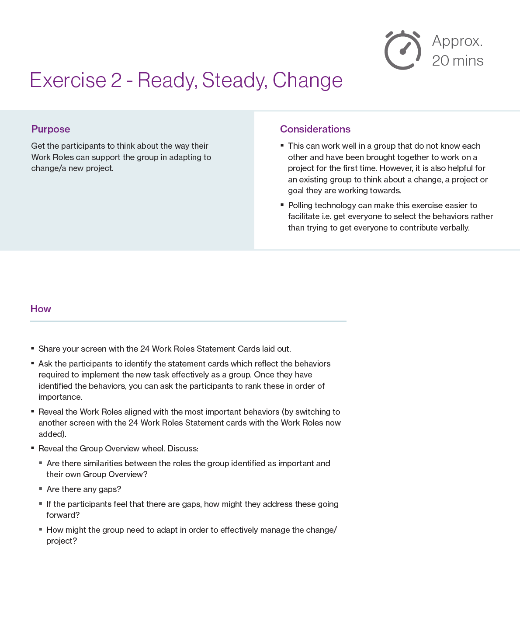
Support & Materials
Pre-session activity to support use of reports
Virtual session guide and specific exercises which work well virtually
Tips and considerations for running group sessions
Facilitator slide deck
Guide to using the online group overview and creating the overview for the team
Coming soon: Training video for managers using Work Roles
Notes:
Now that Sam has use the BRA for her own development and used it to support the onboarding of the new Hire, she realises he amount of insight it providers. She would be really curious to also get this insight on her other team members, as she as less sight on how they actually feel about and cope with change and transformation.
Especially with the change and transformation continuing as they prepare for the new product launch. She would be
really interested to get insight in the resilient agility hotspots of the team. To understand what their overall strengths and challenge areas are and how the team members compliment each other.
Therefore she decides to roll the assessments out further , all other 7 team members the opportunity to complete the Wave Focus Styles Assessment. All individuals will receive a copy of their report and Sam has asked the HR team to host a group workshop during which they will reflect on their group BRA profile, and identify action points.
Sam and the HR team will use the BRA Group Overview Talent Analytics functionality to facilitate the group workshop, you can some snippets of this on the lefthand side of the screen.
This functionality is available via the Oasys system, our platform which hosts the assessments. Once you have generated more than 3 individual reports, the complimentary group overview functionality allows you to combine the results from the different individuals in the project.
Here on the screen you only see static screenshots, but if you use the tool live it is fully interactive. Allowing you to zoom in and out of the detail of the group trends.
To support managers or the HR team with the facilitation of such workshop session, we have created a facilitator deck and guide. Which includes a pre session exercise encouraging individuals to reflect on their individual report, warm up exercises getting to get people thinking about what is required for the upcoming/current change or transformation they are facing , instructions on how to use the group overview functionality and facilitate the group through the overview, suggesting key questions to ask and finally action planning exercises to identify strehgnts and wekenesses of the group and key actions on what ht e group should stop, start and continue doing
The session has allowed Sam to get better insight in the groups ability to deal with change and transformation. It was for Sam a great opportunity of sharing their positiveyt about the change and transformation and listen to the concerns of others. They have also identified some practical actions they can immediately impelemtn and which will support the upcoming changes they are facing.
The applications I have presented,are only exaomples of how the toosl can be leveraged. Hoping that i was able to bring to live how managers might leverage the model in different ways. I am also mindful that the webnar and example applications of BRA have focused on dealing with change and transformation in context of the current global pandic (a various obvious change to us all)> however as stated previouslyand transformation are now new and it is something organsaitons are constantly faced with. : I know that you will have a great experience using this model to help employees deal change in different different contexts and in the different phases of dealing with change.

Slide 16
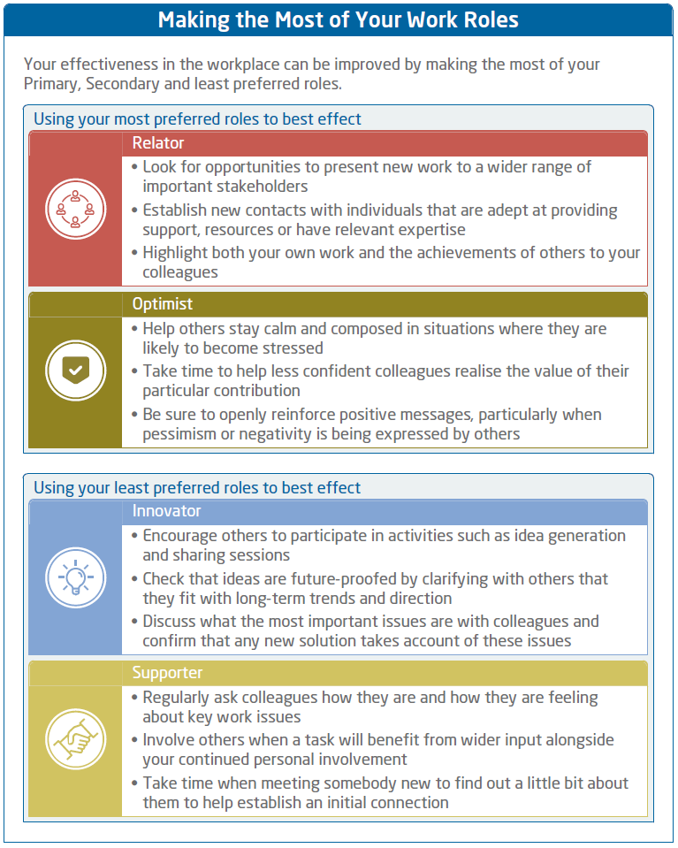
Help individuals learn about their own preferences at work
Focuses on:
how to harness your preferences to have the best effect
How your preferences might influence what you prioritise at work
how your preferences can be used to best effect in a team

Slide 17
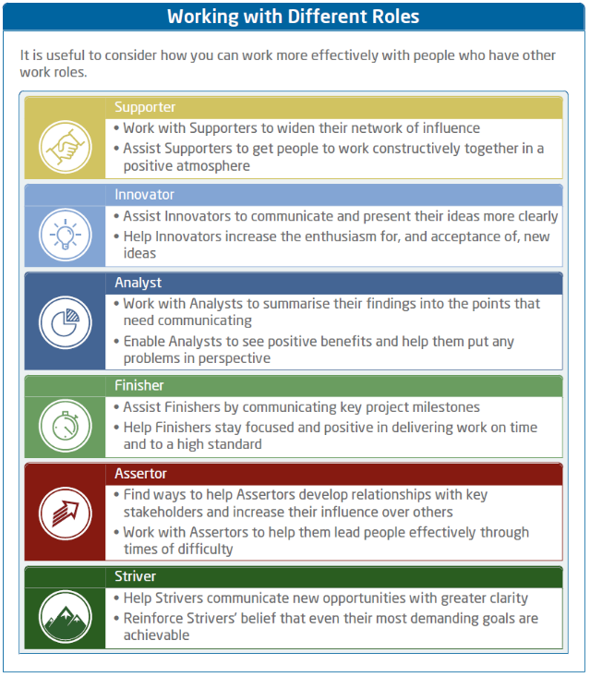
Help them think about how they work with others
Focuses on:
how individuals can work more effectively with those who have preferences different to their own
how others work and how you can use your preferences to help others
Descends from your least preferred role (those most different to you)

Slide 18
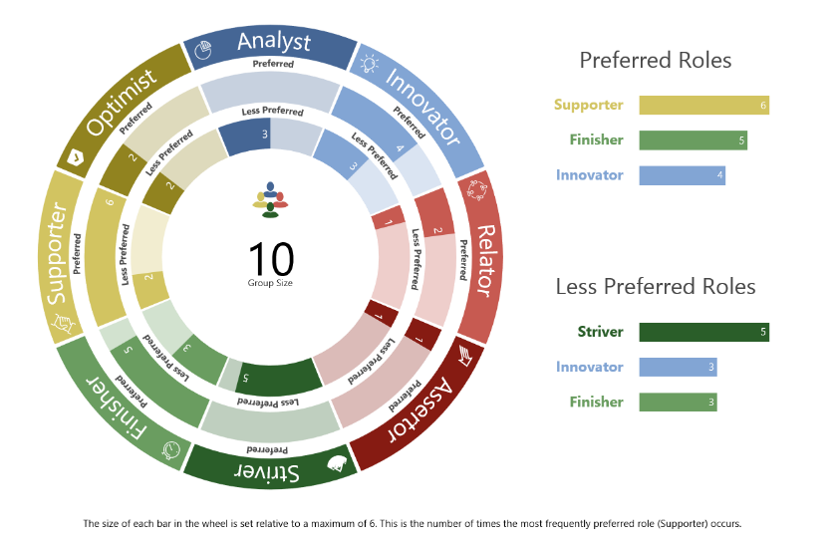
Understand how you work as a team using Team Overview Insights

Slide 19
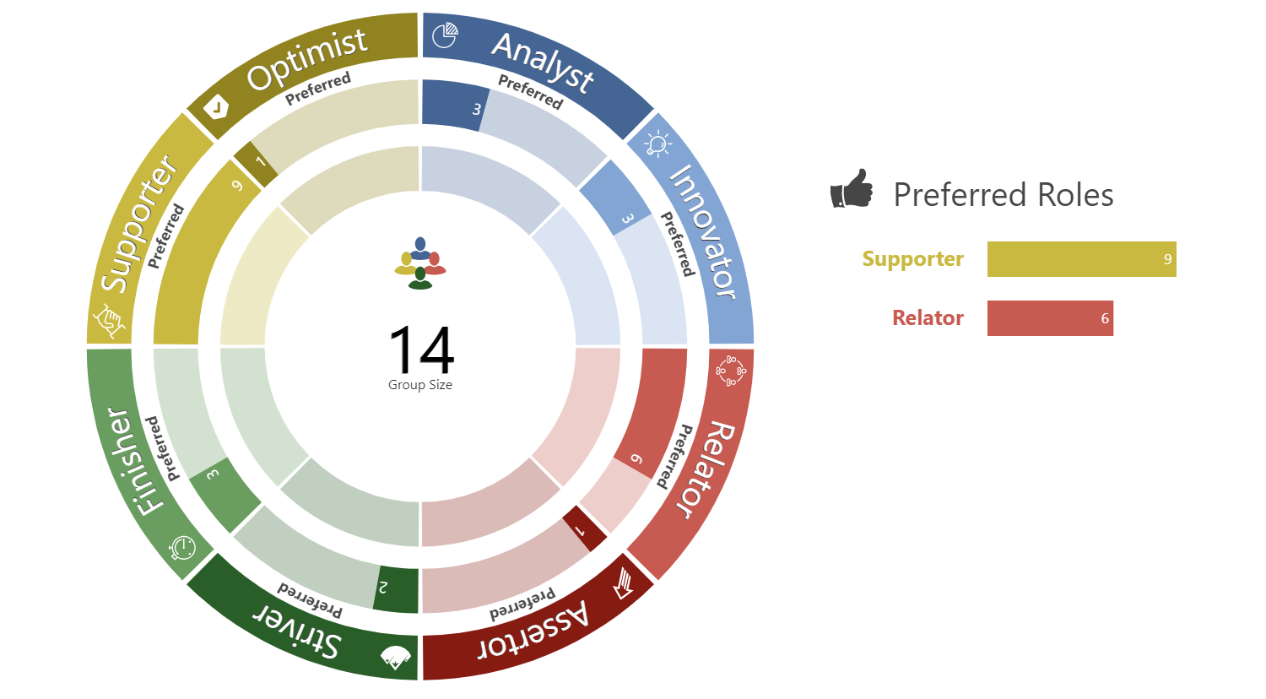
Notes:
Using the Options Tab you are able to select to show just the most preferred or just the least preferred roles within the overview.
Suggestions on how to facilitate this slide:
Some Questions:
As a team, what are your key strengths?
Where do you see these strengths making a difference at work?

Slide 20
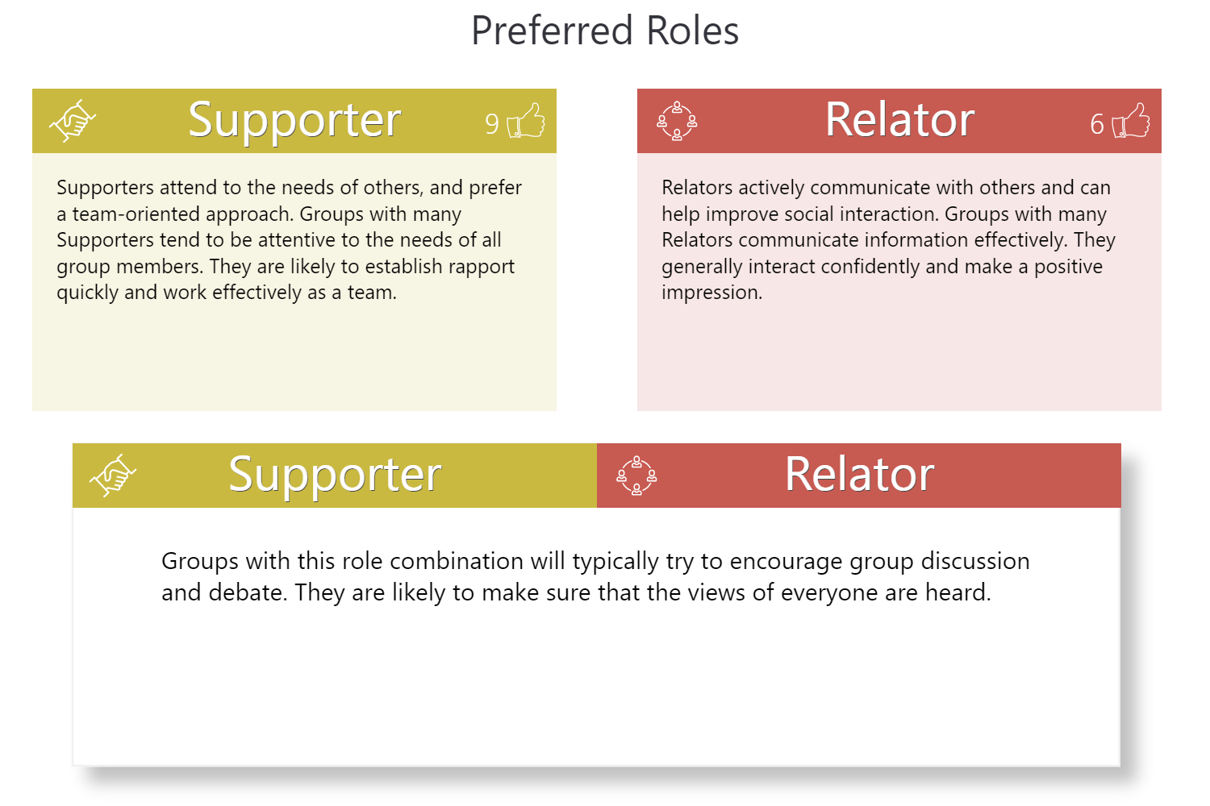
Notes:
This page shows the top two preferred roles of the group and gives specific information relating to their role combination. In a group where the numbers who prefer a role are tied, the overview will display the top two preferred roles based on the Work Roles model order.
Suggestions on how to facilitate this slide:
How can you use these strengths to make your team more effective?

Slide 21
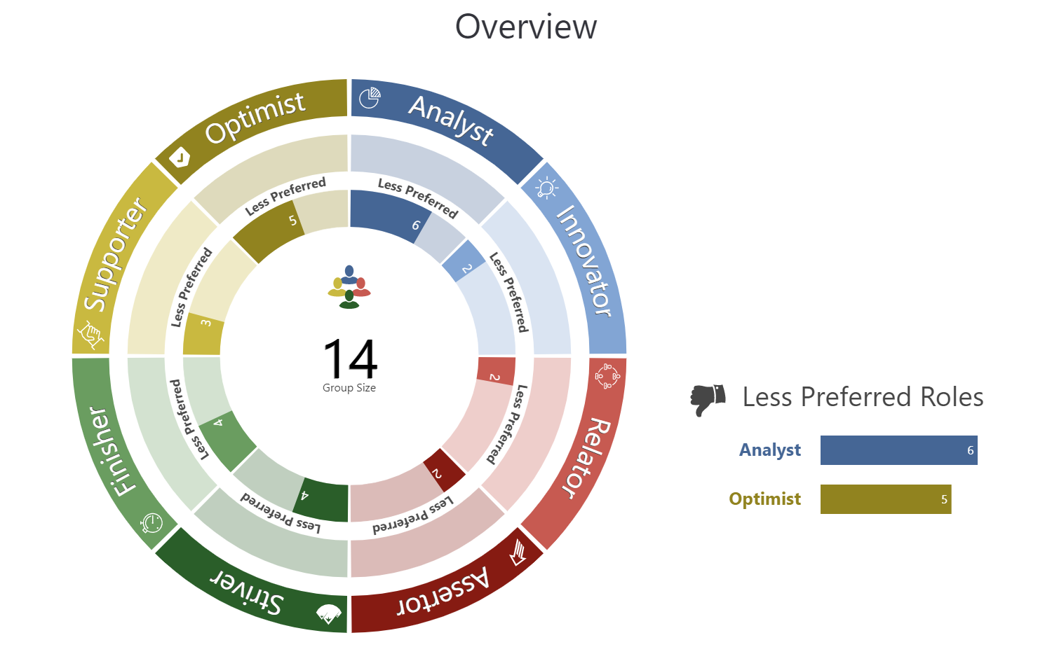
Notes:
Using the Options Tab you are able to select to show just the most preferred or just the least preferred roles within the overview.
Suggestions on how to facilitate this slide:
Some Questions:
As a team, what are your challenges?
What issues could these lead to at work?

Slide 22
Notes:
The group’s two less preferred roles are then shown. Where the numbers are tied, the overview will display the bottom two less preferred roles based on the Work Roles model order.
To display the potential actions for a group on their two less preferred roles, you must click “click to see potential actions”. This ‘reveal’ functionality allows for group developmental discussion to take place.
Suggestions on how to facilitate this slide:
Before clicking to reveal the potential actions -
How do these challenges present themselves in the workplace?
What potential actions could you take as a group to prevent them negatively impact group success?
Reveal the potential actions –
Would the potential action be useful to the group?
What action would you take to address this issue?
As a group, how can you make this work?

Slide 23
Notes:
The Potential Actions Summary page provides a useful overview of the key actions that were ‘revealed’ on each of the previous pages. In group overview sessions, this can act as a take-away for group action plans and be used as a reminder to the group of the areas discussed.
This can be useful when completing the Group Development Plan on the following slides.

Slide 24
Impact
Scalable manager-led interventions
Greater self-awareness at individual level
Focus on group dynamics and encourages equal participation for increased collaboration
Gives people a voice to share innovative ideas
Improves social relations, clarifies roles, building greater trust and cohesion
Encourages informal communication and understanding of individual differences

Slide 25
Any questions?
Notes:
I have now come to the end of the webinar and would like to take the opportunity to check if there are any questions that have come into my colleague Jasmin?
When you exit the webinar you will be presented with a couple of questions, so we can collect your feedback. WE would really appreciate if you briefly take the time to complete the feedback questions so we can ensure that we continue to deliver webinar sessions that meet our clients expectations.
Mention feedback

