Slide 1
Thrive, Don’t Survive
Supporting Managers to be a powerhouse for change & transformation
© 2021 Saville Assessment, Willis Towers Watson. All rights reserved.
Notes:
Hi Everyone
Thank you for joining us today for our webinar: Thrive, Don’t Survive – supporting managers to be a powerhouse for change and transformation. This is the 1st webinar in our new series focused on accessible and high impact HR solutions.
Let me first introduce myself, my name is Daphne van der Wielen I am a Senior Consultant at Saville Assessment. I am the consultant product lead for our new Building Resilient Agility reports, working closely with our R&D and marketing teams to support our clients with implementing this model.
During this webinar I am going to touch on change and transformation more broadly, looking at how different organisations respond to the pandemic. I am going to introduce you to our Building Resilient Agility model , a model we have developed to help employees and managers cope with change and transformation and I will finish the webinar with example applications how this model can be used to deliver scalable and high-impact solutions to develop managers and their teams and support them through different phases of change and transformation.
If you got any questions during the session please put them in the chat, where my colleague Jas is joining us, she will be monitoring the chat. We will try to pick up as many questions as possible at the end if there is more questions we can come back to you following the webinar.

Slide 2
01
The current landscape
AGENDA
02
Introducing Building Resilient Agility from Wave
03
Building Resilient Agility in managers and their teams
Notes:
So let me cover the agenda for todays session
First of all I am going to talk about the current landscape of change and transformation and how different are responding to the pandemic.
Then we will move on to explain how change and transformation have shaped our model and outputs around Resilient Agility. We will look at the research that sits behind the model.
We will then close by looking at how the model and outputs can be applied in organisations to help managers and their teams build resilient agility
As part of the webinar invitation we have asked you some survey question, insights and results from this survey will be presented throughout the webinar allowing us to bring insight from the group to you.
Also during the webinar we will have some quick polls, allowing some interaction during the session, Jasmin will be guiding us through those as we go.

Slide 3
Thought leader in HR
Change & Transformation isn’t new…
“At its core the pandemic is an economic transformation,
not just a public health problem”
…But the current pace is unparalleled & accelerating
“Smart leaders aren’t thinking about the next phase as a return to what we had before, but are talking about the opportunity to ask “How will we reimagine our organization?”
Powering an integrated talent strategy
Notes:
So what is the current landscape looking like at the moment.
Over the years organisations have always been dealing with change and transformation in one form or another, these are not new concepts. It is change and transformation that has helped organisations develop, push forwards and for example speed up the pace of digitalisation and the technological enhancements organisations make.
However , looking at our current situation, the pandemic has effectively accelerated the pace at which change and transformation are happening economically. All organisations have been through significant transformations, e.g. think about the switch to virtual working, redeployment of staff and many other changes.
And we expect that the pace of change and transformation will continue, now organisations prepare for the post lockdown phases. It is perhaps not realistic or desirable to think that organisations will simply return to where they were before. Instead there is the opportunity for leaders to think about how they will reimaging their organisation.

Slide 4
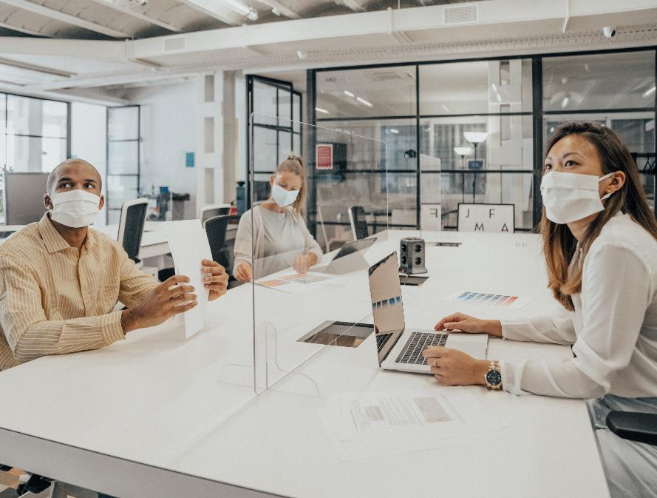
Four-levels of pandemic related response
Stage 1 – Hope for the best
18% of responses feel into this category, which is focused on financial survival, maintaining day-to-day operations, and actions related to employee furloughs or layoffs.
Stage 2 – Care for people 46% of respondents were at this stage, where organisations are focusing on keeping employees, customers and suppliers safe and healthy.
Stage 3 – Drive agility and culture
15% of respondents were at stage 3, where the emphasis is on educating and supporting employees to move fast, develop cross-functional solutions, and stay resilient and productive
Stage 4 – Transform and reinvent 21% of companies fell into the highest stage, which focuses on the reinvention of hiring, job design and pay, to transform into new business and operating models.
Source: Catalyst Magazine- Workforces built for change
Notes:
In August 2020, the Josh Bersin Academy (Josh Bersin is a world-known industry analyst, educator and thought leader in all aspects of HR, leadership and HR Technology) contacted over 1300 (1349) HR leaders and professionals around the globe, from multiple industry segments, to identify the HR and business practices with the highest impact on creating business resilience out of the current disruption.
The survey was designed to analysis 53 practices, including areas such as leadership, culture, communication, learning and talent strategies, pay and benefit, workplace configurations and HR skills and capabilities.
Based on the survey responses, the research team found four levels of pandemic-related response, ranging from the implementation of purely tactical response to those that ley the groundwork for business transformation. The stages break down as follows
Stage 1 – Hope for the best
18% of responses fell into this category, which is focused on financial survival, maintaining day-to-day operations, and actions related to employee furloughs or layoffs.
Stage 2 – Care for people: 46% of respondents indicated their organisation was at this stage, where organisations main focus is on keeping employees, customers and suppliers safe and healthy
Stage 3 – Drive agility and culture:
15% of respondents indicated their organsisation was at stage 3, where the emphasis is on educating and supporting employees to move fast, develop cross-functional solutions, and stay resilient and productive
Stage 4 – Transform and reinvent: 21% of companies fell into the highest stage, which focuses on the reinvention of hiring, job design and pay, to transform into new business and operating models.
You could say that these stages move from organisational survival through to organisation that thrive and capitalise on the opportunities the pandemic brings.

Slide 5
Poll - With Results
What stage best describes the current focus of your organisation at the moment?
Stage 1 – Hope for the best: 7%
Focus on financial survival, maintaining day-to-day operations, and actions related to employee furloughs or layoffs.
Stage 2 – Care for people: 32% Focus on keeping employees, customers and suppliers safe and healthy
Stage 3 – Drive agility and culture: 39%
Focus on educating and supporting employees to move fast, develop cross-functional solutions, and stay resilient and productive
Stage 4 – Transform and reinvent: 21% Focus on the reinvention of hiring, job design and pay, to transform into new business and operating models.
Notes:
We are now a couple of months on from this survey of the Josh Bersin Acedmy and I am really curious to hear from you werhe you believe your organisation is currently at.
I am mindful that it could be difficult to choose, as there might be an argument that you are focusing on multiple stages at once. With employee heath remaining important in everything your organisation does. But what I would like to you to think about is what phase currently has the most strategical focus, and requires the most energy in your organisation?
Stage 2: Very interesting the core focus for many remainso n the people, keeping them healthy not only physically from Covid perhaps but also mentally supporting them in may different ways.
Stage 3: That is interesting the focus for many of you is on driving agility and culture, that focus on educating people and helping them stay resilient and positive.
Stage 4: I believe it is hopeful to see that for so many of you the key focus is on transformation and reinvention of the workplace. This is a sign that organisations are preparing for those post pandemic phases , and are making the most out of the opportunities the change is bringing.
We believe that at all these stages, it is key to support your people through the process, to help them move from hoping for the best to being a key contributor to helping the organisation transform and reinvent.
Dependent on what outcome is
Highlight how most organisations are at x stage
Still steps to go in process→ important to support employees through this process.

Slide 6
Organizations are looking for more from their people and managers…
Coping with Ambiguity
Grit
Comfortable with Complexity
Staying Agile
Emotional Resilience
Adaptability
Notes:
As a result of the unparalleled level of change and uncertain organisations were and are still facing, there has been a renewed focus from clients wanting to measure and build behaviours such as resilience, agility, grit and flexibility in their people.
Although the characteristics of resilience and agility are getting a lot of focus now, they have always been important. Over the years, organizations going through transformation were often asking us how, they can support their employees cope with ambiguity or deal with the complexities they are facing. How we can help their people build grit and perseverance.
Some clients asked us if we can measure employees “ agility” or “flexibility” while other clients asked us whether we can measure ‘emotional resilience’ or ‘grit’. We often pointed them to different parts of our Wave behavioural model.
However, in practice we realized that these clients were actually facing the same issues but they had just come to different conclusions on what they needed in their people.
What we realised is that they were looking for a solution to help people deal with change and transformation in a way that is sutainable in the longer term . That that both agiligy and resilience are two sides of the same coin.

Slide 7
02
Resilient Agility
from
Notes:
Looking at our data, we realised that at Saville we ere in a unique position because over the years we had collected a lot of data how people rated themselves and how others had rated their performance in showing resilience but also their capability to adjust to change.

Slide 8
How did we develop our model?
10 years of big data from Wave
35,000
data
points
Explored correlations between behaviors predictive of change
Notes:
That meant that we were able to take a data driven approach, with over 35000 data points (35000 individual ratings) to say exactly what the characteristics are that underpin Resilience and Agility.
So what we did was we used a big data approach and used our 35000 data points and we looked at the intercorrelations between the behaviours, to look at how the behaviours relate to each other this allowed us to create a model of 4 different areas that we can assess from the Wave assessment.
For those familiar already with Wave, the new Buidling Resilient Agility model can be powered by both our 15 minute Focus Styles Assessment as well as our more indepth Professional Styles assessment which takes approximately 45 minutes to complete.

Slide 9
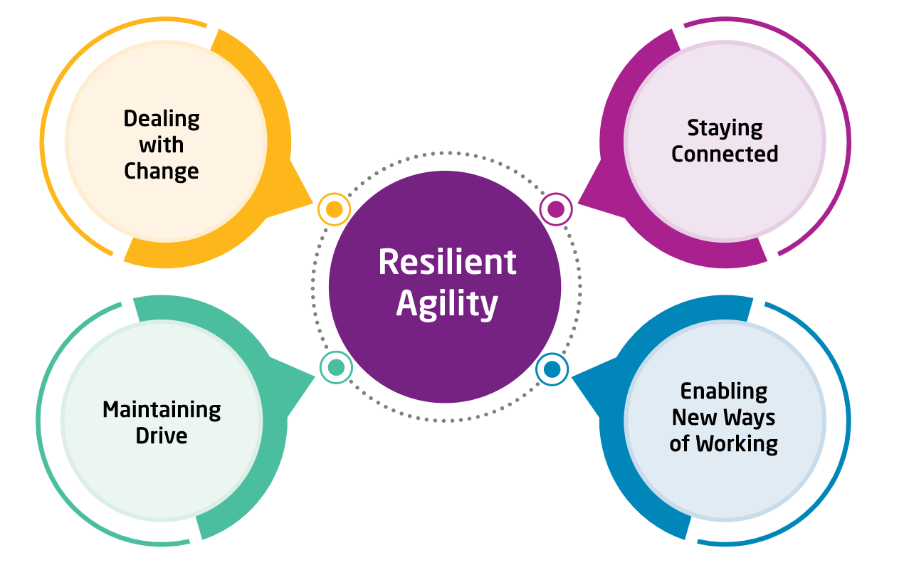
4 Key Drivers of Resilient Agility
Each underpinned by 5 behavioral dimensions
The Resilient Agility Model
Dealing with Change | Embracing change positively. Managing uncertainty with composure.
Staying Connected | Making and maintaining connections. Actively participating and communicating.
Enabling New Ways of Working | Using insights to forge new directions at work. Ensuring effective work plans are delivered.
Maintaining Drive | Capitalizing on the opportunities change presents. Keeping everyone focused on key work objectives.
Powering an integrated talent strategy
Notes:
Here we can see the actual model and the 4 Key Drivers of Resilient Agility.
The first area is the sort of emotional response and ability to deal with change and uncertainty. Being able to manage yourself emotionally through that process.
- Dealing with Change
The second area (Staying connected) focuses on the capacity to stay connected and maintain connections. So actively being a real participant in the change process.
Then we focus on peoples ability to respond to the change by doing things differently and making sure that the response to change actually results in successfully doing things. So Enabling new ways of working
Finally it is also important that people maintain their focus during periods of change, know what matters and continue to deliver on key work objectives. Whilst capitalizing on any opportunities change may bring. This is what we look at in Maintaining Drive
Each of those are underpinned by 5 individual dimension. In total there are 20 individual dimensions that underpin the resilient agility model.

Slide 10
03
Building Resilient Agility in the Workplace
Notes:
Next I will take you through model and available reporting in more detail
I will do this through the lens of a Manager at an IT Organsation, to help bring to live how managers can use the BRA model and reporting to support themselves and their workforce through change and transformation. All the applications that I will present are accessible, scalable and high impact solutions that can easily be implemented.
We know that the direction and support form leadership is key to set strategy and lead their employees through the various stages of responding to the pandemic. However that it are the people managers who often deal much more directly with the employees, and that they often are the ones implementing the changes required in the different stages of response.
That therefore the squeeze on managers has never been tighter as they juggle supporting their teams, taking care of themselves, delivering results and managing multiple demands under increased pressure.
We also see this in what you told us before the webinar

Slide 11
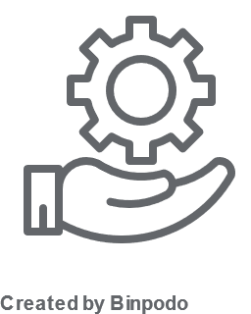
97%
37%
50%
say that it is very or extremely Important to support people managers to be effective in change and transformation
say that people managers in their organisation get the right level of development support
disagree or are unsure if people managers in their organisation are equipped to support their teams through transformation
Notes:
97% says that it is Very or Extremely Important to support people managers to be effective be effective in change and transformation
Only 37% says that people mangers in their organisation get the right level of development support
50% disagree or are unsure if people managers in their organisation are equipped to support their teams through changes and transformation. Where the other half does say their people managers are well equipped.
On the bright side, where the required skills to deal with the pressure of change and transformation don’t always come naturally to managers, they can be developed. One of the ways you can support your managers cope with the current change and transformation is through helping them build Resilient Agility in their workforce. The Building Resilient Agility Reports and outputs can support the managers in various different ways, today I will be looking at 3 sample applications but there are many more ways in which the reports and outsputs can support organsiations.

Slide 12
Meet Sam
People Manager at an IT organisation
Sam manages a team of 8 individuals
Notes:
Let me introduce you to our fictional manager Sam, Sam is a people manager at an IT organsiation
Sam manages a team of in total 8 members.

Slide 13
Background
Since start of the pandemic the entire team are working from home
The organisation and Sam are preparing for the return to work
Client support had to be transformed from face to face to digital support and training
Team expending
Now ready to launch a complete new digital service package to client
Notes:
Since March last year Sam and his team are all working remotely.
As many other organisations, they are currently preparing for the return to work , however the model in which that will happened is transforming, they are moving to a more flexible model instead of return to a 5 day week in the office.
At the start of the pandemic Sam and her team have had to reinvent the way they deliver support and training to their clients. A lot of this training was happening face to face pre pandemic and since April last year they have transformed the whole model to virtual learning and support. This was something that had always been on the agenda but this change has been accelerated by the pandemic. Clients have responses very positively to this new approach which has lead to significantly more demand.
For this reasons Sam’s team is expanding and Sam has just last month hired a new team member, who is starting as an analysit supporting the wider team.
Where initially the move to online and virtual support was a way of responding to the change, it has actually now led to the launch of a totally new offering. A online more flexible online IT care package for clients. A completely digital tailored offering, that includes heaps of online resources on a learning platform and access to short more regular training sessions and 24/7 chat support. This offering will help the organisation stay comepetative and push ahead.
As you can see Sam is facing many different demands in supporting herself and the team through all of this change and transformation. So lets have a look how the Building Resilient Agility outputs can support her and the team. In the different challenges, and moving through the different stages of response to the pandemic.
.

Slide 14
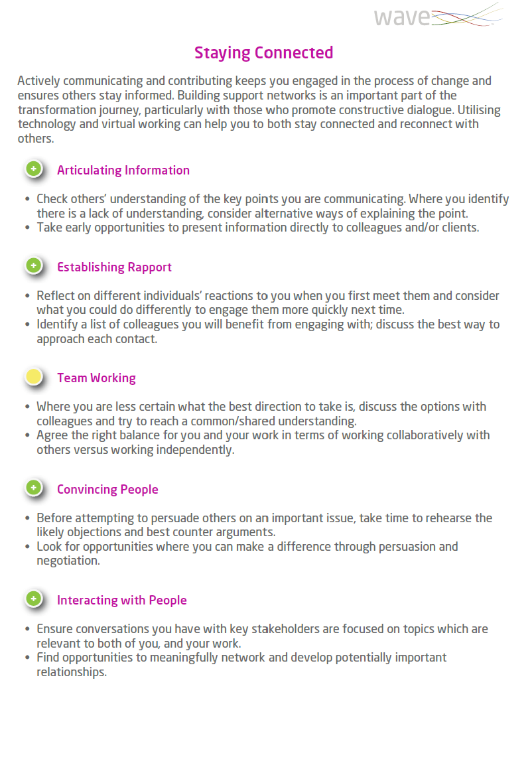
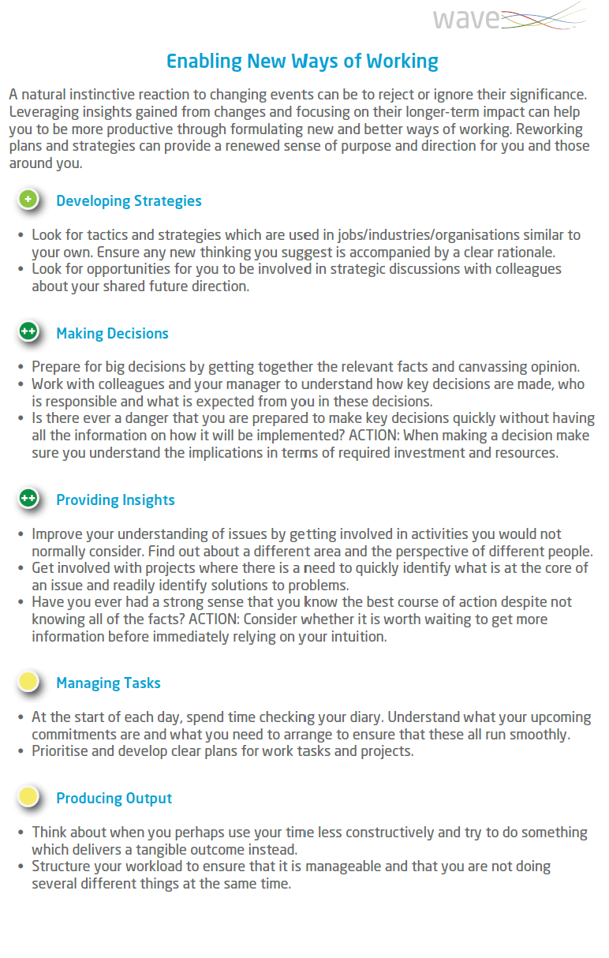
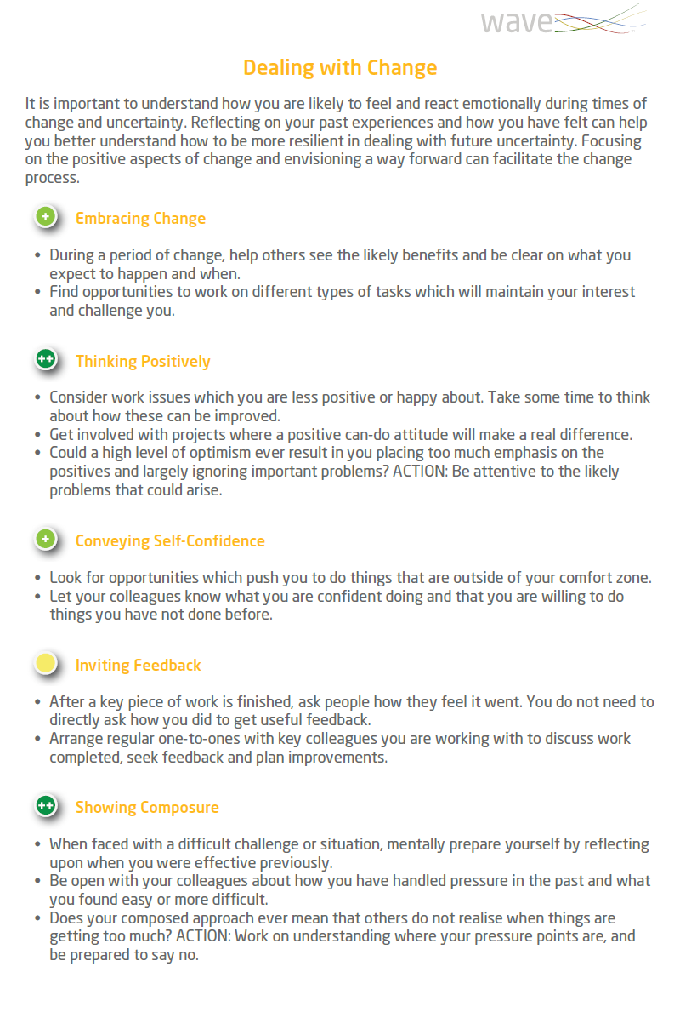
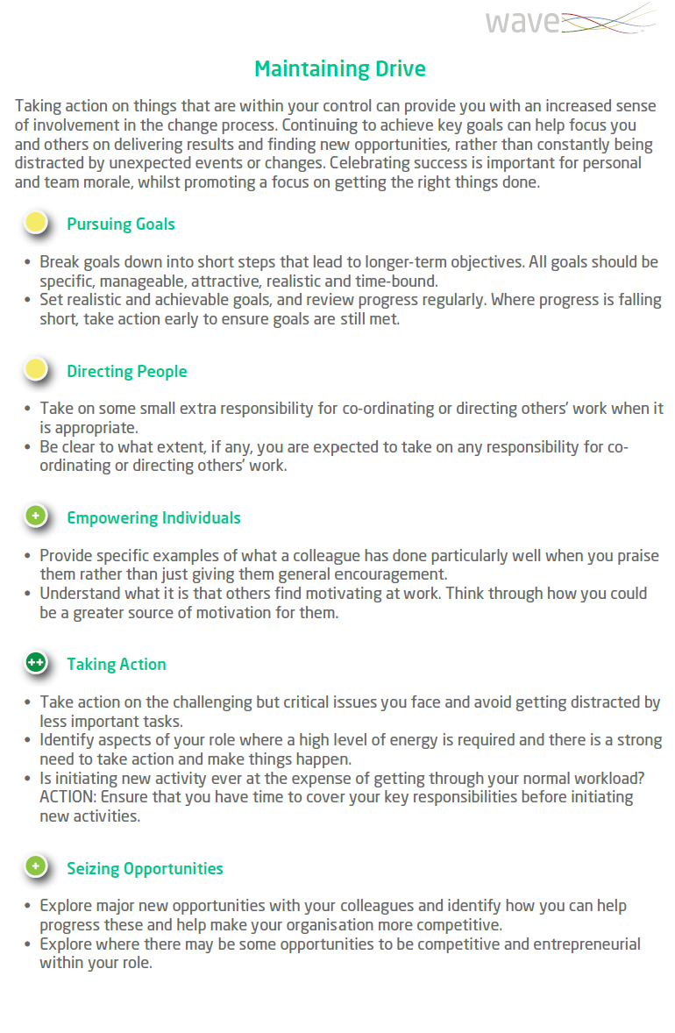
Application 1: Self Guided Development
Notes:
The first application I want to address is self guided development, which is very relevant for people managers as 97% of respondes to the pre webinar surveys indicated that resilience and agility are very or extremely important at people manager level.
As part of Sam’s own development she has completed the Wave personality assessment, which took approximately 15 minutes to complete.
From the completion of this assessment Sam’s Building Resilient Agility Report has been generated. The report is accessible to individuals without the requirement for being trained in psychometric assessments. So Sam has received a copy for for to download, which he can read through and use to reflect on her own development.
I am mindful that some of you on the webinar have not seen the Buidling Resilient Agility report before, and for those who want to see the report in more detail there is the option to request a sample copy at the end of thew ebinar and we would happily spend some time to walk you through the full report in detail.
For the purpose of our webinar today, I am just zooming in on one area of the report that is relevant for Sam. So the Building Resilient Agility report provides advice on the four key drivers of the model, and its 5 underlying dimensions.
So here on the left hand side we can see the advice on Dealing With Change – helping Sam to understand how she is likely to react emotionally during times of change and uncertainting. Helping she reflect on how he has felt and how she can, going forward, respond more resilient in dealing with uncertainty. The way the report is present really helps Sam focus on the positive aspects.
The five areas that feed into Dealing with Change are: Embracing Change, Thinking Positively, Conveying Self Confidence, Inviting Feedback and Showing Composure. Incidentally the order is important, we looked at the research and the dimension most important to Dealing with Change is shown at the top.
So Embracing change seems to be the most important factor in driving someone's ability to deal with change down to showing composure at the bottom. Which is still important but less so out of all the areas.
The narrative that the report provides is depending on the individual’s preference for the underlying behaviours. You can see here that we use three types of symbols to indicate Sam’s preference for the behaviour in comparison with the benchmarking group Sam is compared against in this case other Professionals and Managers in the UK.
The + suggesting that they are as likely as others to demonstrate the behaviours and adopt this style (5,7). They demonstrated a preference that is fairly typical when compared with others.
You can see that where we see the single green plus, the reports provides first advice on how to build and capitalize on this area of strength and the second bullet point provides suggestions for how to effectively use this strength at work.
Where we see a ++ symbol, like on Thinking positively. It means that Sam is more likely to adopt this behaviour in comparison to others and that it is a likely are of strength for Sam. For dimensions with a double ++ there is a third bullet which makes Sam aware of the potential undesirable consequences if this behaviour is overplayed.
Finally the yellow dot on for example Inviting feedback suggests Sam is less likely to adopt that behaviour and therefore if they are required to this might be more of an area for development. Here advice on how to develop and manage this potential challenge are provided in the report. The second bullet also provides tips on how to support development at work.
So a couple of interesting reflections for Sam are that Thinking Positively and Showing Composure are real areas of strength.
Reflecting on this, Sam realises that this strength in thinking positively is very important in the launch of the new digital service package to clients. The reports helps her understand that she should ensure that she is showing this positivity to his team members. However that she needs to be mindful of not ignoring some of the challenges his team members have been flagging about the launch.
It is also helpful for Sam to realise that Inviting feedback is more an area of challenge, and Sam reflects on why does she find this challeging. A key take away for Sam is that he should set up more regular one to one sessions with his team members during which they can openly provide Sam with feedback on the upcoming changes and transformation. This is particularly important now they are all working remotely, and later when return to the office might not be in all at the same time. These one to one sessions will give others the opportunity to voice their concerns, and point out challenges, whilst it gives Sam the opportunity to deal with them and also share her enthusiasm and positive thinking with the team members.
In the BRA report Sam is also provided with advice and insights on the other three key drivers of the model. At the end of the report there is an action planning page. Which helps Sam capture the actionss he is committing to build her ability in dealing with change, staying connection, enabling new ways of working and maintaining drive.
To support Sam in his self guided development we do also have a set up support materials available. Including User and Conversation Guides guiding sam through the report.

Slide 15
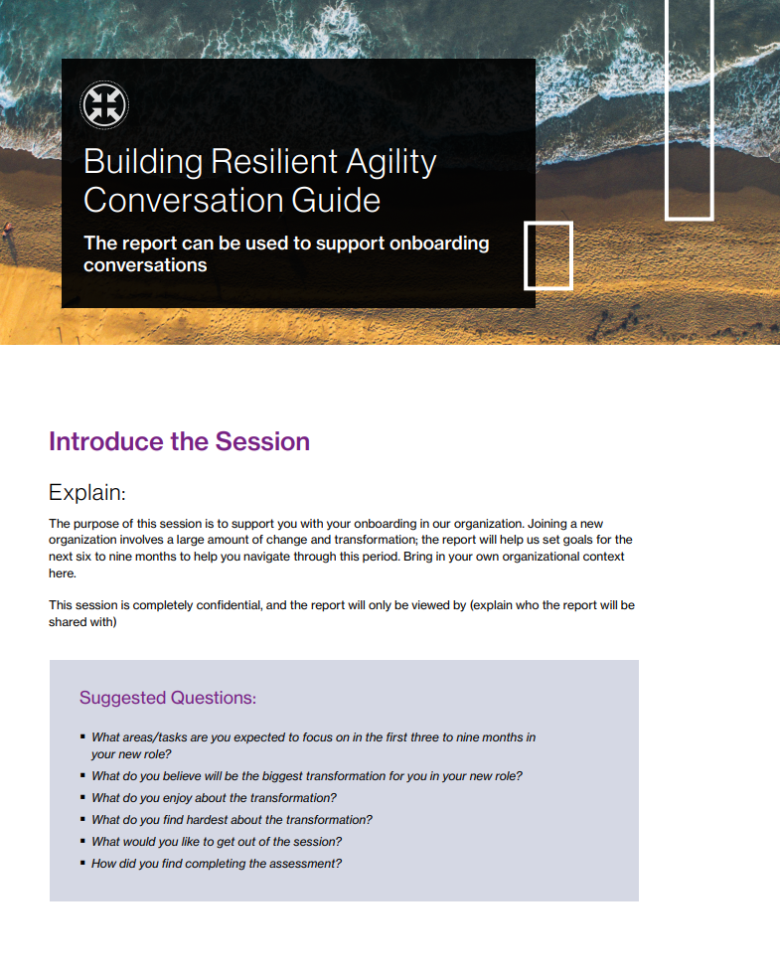
Application 2: Onboarding
What do you believe will be the biggest transformation for you in your new role?
Which areas do you need to focus on to achieve your targets during the first three to nine months in your new role?
What current strengths can you leverage to achieve your goals for your new role?
Can you give me an example of when the strengths have helped you during times of change and transformation?
How can I help you achieve this?
Notes:
The second application I want to talk about is using the report for onboarding.
As set out in the background on our fictional manager Sam, her team is expanding and Sam’s new analysit is starting this week. As part of the selection process the new hire has completed a series of assessments, including Wave and Aptitude , which have given insight in Sam’s ability and competence. The new hire has been selected based on the competencies required for the role.
Now that they have appointed the right person, Sam needs to make sure they accelerate their productivity. Sam has been thinking carefully about what she an do as part of the onboarding, to really accelerate engagement and the employee experience in this virtual onboarding setting.
A virtual onboarding is very different from normal, starting at week ones induction there is no opportunity to invite them to lunch in the first week, or gives them a tour of the office, introduce them to team members all things that would normally be part of induction. But also no opportunity to sit down together with the new employee and support someone on the job as they progress through the onboarding phase.
To help address this gap, engage the individual and provide some extra support. Sam has decided to generate their BRA report. Sam is using the report as a vehicle to talke about the individuals development, acknolweding they are joining in a challeging and rapid changing environment. Therfoere helping them understand their strengths indealing and navigating through a changing landscap and also identify some actions the individual can focus on in the three first nine monts to help reach productiveyt quicker.
This allgines with the results of the pre webinar survey , where still 69% indicate it is very or extremely important to demonstrate agility and resilience at early career level.
To support client using the BRA in various different settings like, self guided development, onboarding, development conversations, performance reviews, we have created a series of Conversation Guides which include guidance on how to walksomone through the report and some relevant probes to ask. These guides can be used by managers to facilitate high impact low effort development conversations.
Send to individual – then have conversations
Worth highlighting – New hire has been selected for the role based on competentcies required
But few unique circumstances, not going to be joining traditional team
But rapid change, due to transformations expected
Sam was thinking that as part of onboarding, ecellerate engagement and employee experience.
What wasn’t able to do was give buddy take to lunch. Has been more distanct
Help a ddress gap build engagementa as part or process and where they need extra support
Way of making sure there is integration into new role is smooth ans positive as possible, giving same a viehcle to talk to individual about their development acknoleding it is a rapid changing environment

Slide 16
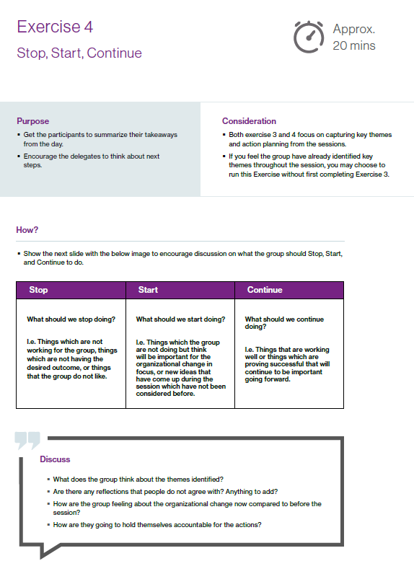
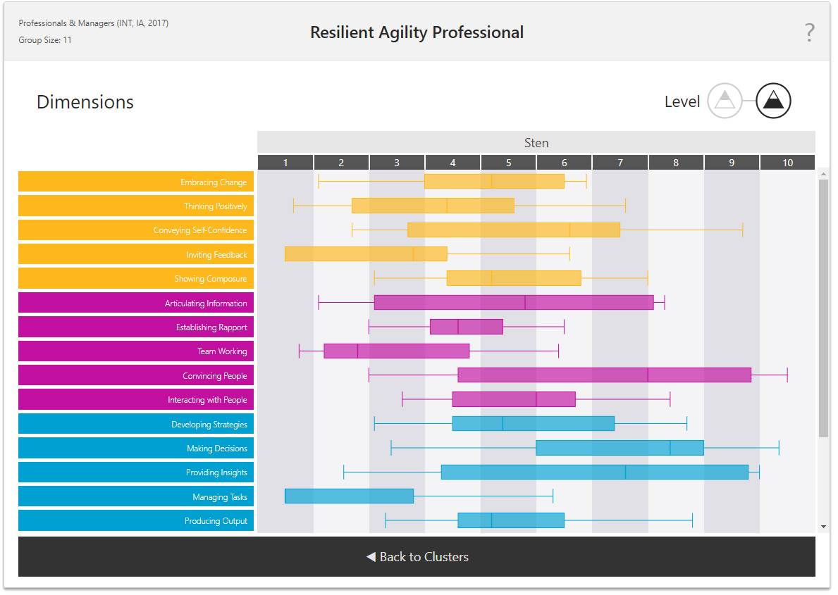
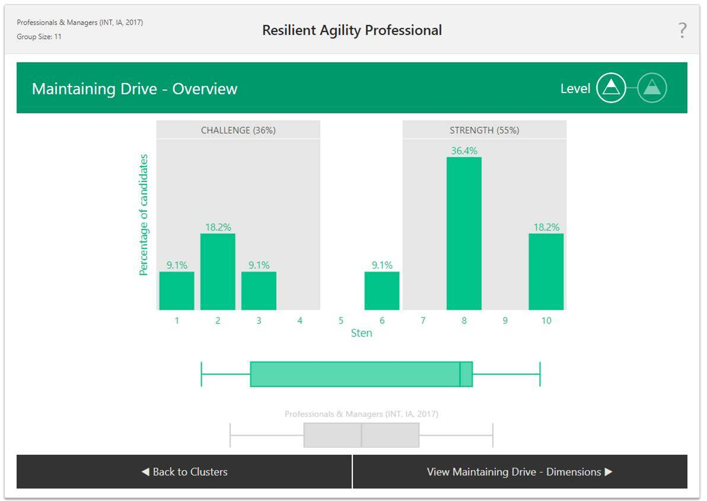
Application 3: Group Development
Notes:
Now that Sam has use the BRA for her own development and used it to support the onboarding of the new Hire, she realises he amount of insight it providers. She would be really curious to also get this insight on her other team members, as she as less sight on how they actually feel about and cope with change and transformation.
Especially with the change and transformation continuing as they prepare for the new product launch. She would be
really interested to get insight in the resilient agility hotspots of the team. To understand what their overall strengths and challenge areas are and how the team members compliment each other.
Therefore she decides to roll the assessments out further , all other 7 team members the opportunity to complete the Wave Focus Styles Assessment. All individuals will receive a copy of their report and Sam has asked the HR team to host a group workshop during which they will reflect on their group BRA profile, and identify action points.
Sam and the HR team will use the BRA Group Overview Talent Analytics functionality to facilitate the group workshop, you can some snippets of this on the lefthand side of the screen.
This functionality is available via the Oasys system, our platform which hosts the assessments. Once you have generated more than 3 individual reports, the complimentary group overview functionality allows you to combine the results from the different individuals in the project.
Here on the screen you only see static screenshots, but if you use the tool live it is fully interactive. Allowing you to zoom in and out of the detail of the group trends.
To support managers or the HR team with the facilitation of such workshop session, we have created a facilitator deck and guide. Which includes a pre session exercise encouraging individuals to reflect on their individual report, warm up exercises getting to get people thinking about what is required for the upcoming/current change or transformation they are facing , instructions on how to use the group overview functionality and facilitate the group through the overview, suggesting key questions to ask and finally action planning exercises to identify strehgnts and wekenesses of the group and key actions on what ht e group should stop, start and continue doing
The session has allowed Sam to get better insight in the groups ability to deal with change and transformation. It was for Sam a great opportunity of sharing their positiveyt about the change and transformation and listen to the concerns of others. They have also identified some practical actions they can immediately impelemtn and which will support the upcoming changes they are facing.
The applications I have presented,are only exaomples of how the toosl can be leveraged. Hoping that i was able to bring to live how managers might leverage the model in different ways. I am also mindful that the webnar and example applications of BRA have focused on dealing with change and transformation in context of the current global pandic (a various obvious change to us all)> however as stated previouslyand transformation are now new and it is something organsaitons are constantly faced with. : I know that you will have a great experience using this model to help employees deal change in different different contexts and in the different phases of dealing with change.

Slide 17
Any questions?
Notes:
I have now come to the end of the webinar and would like to take the opportunity to check if there are any questions that have come into my colleague Jasmin?
When you exit the webinar you will be presented with a couple of questions, so we can collect your feedback. WE would really appreciate if you briefly take the time to complete the feedback questions so we can ensure that we continue to deliver webinar sessions that meet our clients expectations.
Mention feedback

