Slide 1
Data, Insights, Action!
© 2021 Saville Assessment, Willis Towers Watson. All rights reserved.

Slide 2
01
Landscape
AGENDA
02
Introducing HPEX and Talent Interventions
03
Linking Employee Listening and Talent Development

Slide 3
Almost half of HR Directors believe that ensuring employees receive a consistent employee experience
will be the greatest challenge over the coming months.
01
Landscape
Comprehensive employee experience requires thinking about every minute in a workday and considering how to handle all types of employee feedback and developing a strategy for ‘signal to action’.

Slide 4
02
Introducing HPEX and Talent Interventions

Slide 5
High-performance Employee Experience (HPEX) model
INSPIRATION
DRIVE
GROWTH
TRUST
Mindset needed to succeed
Most differentiate high performance companies
“I’m totally inspired by our vision, we’re a responsible company”
“We’re agile, totally focused on our customers, with market-leading products & services”
“I’m excelling in my career and achieving my potential”
“I’m confident in leadership, they treat us with dignity & respect”
EXCELLENCE
INCLUSION
VOICE
CAPABILITY
COLLABORATION
“We support diversity, inclusion and equal opportunity”
“I have a say in what we do”
“I’m developing skills to progress my career”
“We help each other, and work across boundaries”
How to create personal agency
EMPHASIS
UNDERSTANDING
ORGANISATION
SECURITY
SUPPORT
Foundational systems and processes to support work
High risk if you get these wrong
“I get what we do, and how I fit in”
“We’re efficient, flexible, and continually improving”
“My pay & benefits are fair and offer stability”
“My supervisor supports us and builds the team”
ESSENTIALS
PURPOSE
WORK
TOTAL REWARDS
PEOPLE
5

Slide 6
Analysis of EX vs. financial performance across organizations
.
6

Slide 7
Talent Interventions

Slide 8
03
Linking Employee Listening and Talent Development

Slide 9
Example One
Public sector organization
New CEO focused on innovation
Culture not currently commercially focused
Organization needed to adapt to meet change in service user demographics
9

Slide 10
Things have been the same way for years
The organization has been stagnant
Leaders need to drive transformation
Data
What we heard
New ideas aren’t listened to
Some people do not want to change
Change is needed

Slide 11
INSPIRATION
DRIVE
GROWTH
TRUST
“I’m totally inspired by our vision, we’re a responsible company”
“We’re agile, totally focused on our customers, with market leading products & services”
“I’m excelling in my career and achieving my potential”
“I’m confident in leadership, they treat us with dignity & respect”
EXCELLENCE
INCLUSION
VOICE
CAPABILITY
COLLABORATION
Insights
Applying the Model
“We support diversity, inclusion and equal opportunity”
“I have a say in what we do”
“I’m developing skills to progress my career”
“We help each other, and work across boundaries”
EMPHASIS
UNDERSTANDING
ORGANISATION
SECURITY
SUPPORT
“I get what we do, and how I fit in”
“We’re efficient, flexible, and continually improving”
“My pay & benefits are fair and offer stability”
“My supervisor supports us and builds the team”
ESSENTIALS
PURPOSE
WORK
TOTAL REWARDS
PEOPLE
11
Notes:
Notes:
Recognize change needed (although some comfortable steady approach) (Drive)
Felt things had been done ‘the same way for years’ (Drive/Organization)
View leadership need to provide the change (Inspiration)
More could be done to listen to ideas/new viewpoints (Voice)

Slide 12
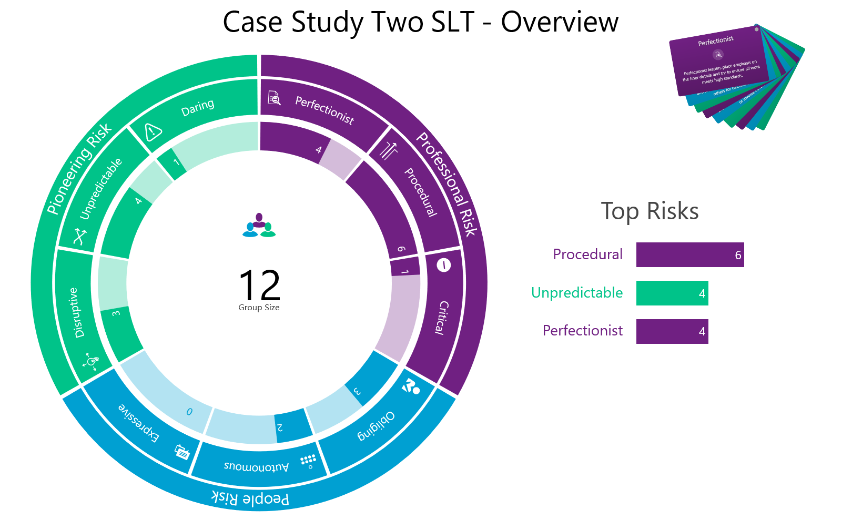
Action
Leadership Risk Workshop
Notes:
Executive leadership team
Focused on procedural and perfectionist approaches (not agile/transformative – Organization/Drive)
But were people in there more pioneering focused – more unpredictable – newer hires – so team potential to start drive if those with more procedural risks would allow.

Slide 13
Example Two
Media organization
Attract and retain talent long term
Looking at future strategy
Fulfil its objective to inspire and entertain
13

Slide 14
There is an amazing amount of talent within the organization
Employees lack agency in their work
There is a lack of direction and strategy
Data
What we heard
The work is exciting and inventive
There needs to be more delegation and trust
Things change very quickly

Slide 15
INSPIRATION
DRIVE
GROWTH
TRUST
“I’m totally inspired by our vision, we’re a responsible company”
“We’re agile, totally focused on our customers, with market leading products & services”
“I’m excelling in my career and achieving my potential”
“I’m confident in leadership, they treat us with dignity & respect”
EXCELLENCE
INCLUSION
VOICE
CAPABILITY
COLLABORATION
Insights
Applying the Model
“We support diversity, inclusion and equal opportunity”
“I have a say in what we do”
“I’m developing skills to progress my career”
“We help each other, and work across boundaries”
EMPHASIS
UNDERSTANDING
ORGANISATION
SECURITY
SUPPORT
“I get what we do, and how I fit in”
“We’re efficient, flexible, and continually improving”
“My pay & benefits are fair and offer stability”
“My supervisor supports us and builds the team”
ESSENTIALS
PURPOSE
WORK
TOTAL REWARDS
PEOPLE
15
Notes:
Product and output producing high quality – people inspired working there (Drive/Inspiration).
Talented leaders and felt they could learn and develop their capabilities and working on interesting projects (capability) however ceiling on this leadership not let them have as much agency as wanted (Growth)
Leadership set direction and expected to follow/not feeling listened too (Trust/Voice)

Slide 16
Action
360 Feedback Sessions
Leadership Impact 360 deployed for Leadership Team accompanied by one-to-one development feedbacks
1. Professional Leadership
2. Pioneering Leadership
3. People Leadership
16
Notes:
Feedback at leadership level – action for leaders how they can impact culture with their leadership style.
Variations in leadership style.
But on balance, theme that People leadership needed improving – trusting/empowering and enabling talent.
How to engage and keep talent – long term (listen to them and let them have a say) – worked with how each leader could build on this.

Slide 17
Example Three
Software company
Demerger
Change in structure
‘Drive new organization forward’
17

Slide 18
Broadly positive perception of demerger
Used to siloed working, would benefit from more collaboration
Understand mission of the company
Data
What we heard
Proud of product portfolio
Changes in teams and structure
Lack of clarity on career development

Slide 19
INSPIRATION
DRIVE
GROWTH
TRUST
“I’m totally inspired by our vision, we’re a responsible company”
“We’re agile, totally focused on our customers, with market leading products & services”
“I’m excelling in my career and achieving my potential”
“I’m confident in leadership, they treat us with dignity & respect”
EXCELLENCE
INCLUSION
VOICE
CAPABILITY
COLLABORATION
Insights
Applying the Model
“We support diversity, inclusion and equal opportunity”
“I have a say in what we do”
“I’m developing skills to progress my career”
“We help each other, and work across boundaries”
EMPHASIS
UNDERSTANDING
ORGANISATION
SECURITY
SUPPORT
“I get what we do, and how I fit in”
“We’re efficient, flexible, and continually improving”
“My pay & benefits are fair and offer stability”
“My supervisor supports us and builds the team”
ESSENTIALS
PURPOSE
WORK
TOTAL REWARDS
PEOPLE

Slide 20
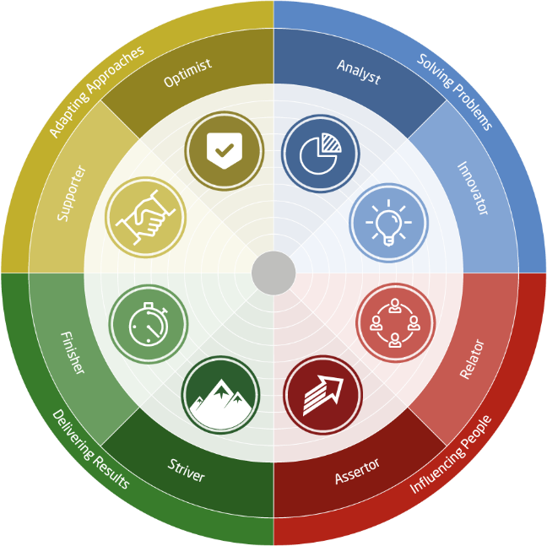
Team development workshops utilizing Work Roles model build understanding and collaboration within and across teams.
Workshops start at leadership level and cascaded down teams within the organization.
Action
Team Development Sessions
20
Notes:
Collaboration & having a voice
Work with new teams / across boundaries
Managers then cascade down with their teams
Managers ran their own – could hear from their teams/ feedback in manager meetings
Also understand from teams what they want for development.

Slide 21
Action
Team Development Sessions
21

Slide 22
Data
Understand the current situation
Insight
Make sense of data and highlight where to target action
Action
Move from data-driven insight to targeted action to deliver impactful change
Data
Insights
Action!
22

Slide 23
Any questions?

