Slide 1

Less Intuition, More Data
Leveraging Assessment Data to Better Support D&I
© 2021 Saville Assessment, Willis Towers Watson. All rights reserved.

Slide 2

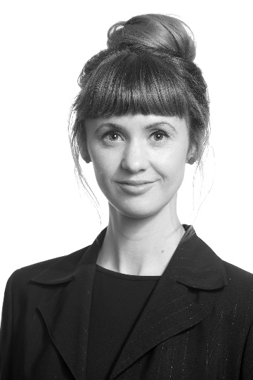

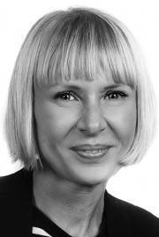


Today’s Panel
Hannah Mullaney
Managing Consultant
Rab MacIver
R&D Director
Katie Herridge
Product Project Manager
James Hollingsworth
Moderator
Jasmin Lewis
Technical Support

Slide 3
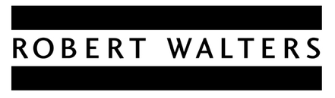
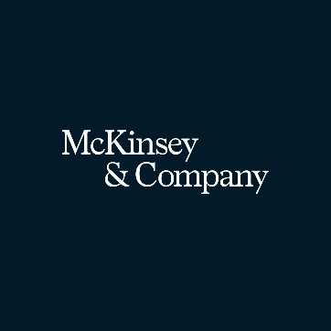

Twice as many professionals (64%) are aware of their employer’s diversity & inclusion initiatives, compared to 2019.
Robert Walters Diversity & Inclusion Strategy Report
Landscape:
D&I continues to be a major imperative
More gender-diverse and ethnically diverse organizations are respectively 15% and 35% more likely to deliver better financial returns than the industry average.
“Legal & General has demanded that all FTSE 100 companies hire a non-white director by 2022. The move echoes a call from the CBI that the biggest UK firms should have at least one black, Asian or minority ethnic member on their boards by 2021”

Slide 4
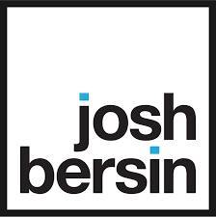
12%
of companies hold managers responsible for recruiting diverse candidates
11%
of recruiters are evaluated based on souring from underrepresented talent
Landscape:
The needle might be moving slower than we think…
75%
of companies do not have DEI included in leadership development
32%
of companies mandate any form of DEI training for employees

Slide 5

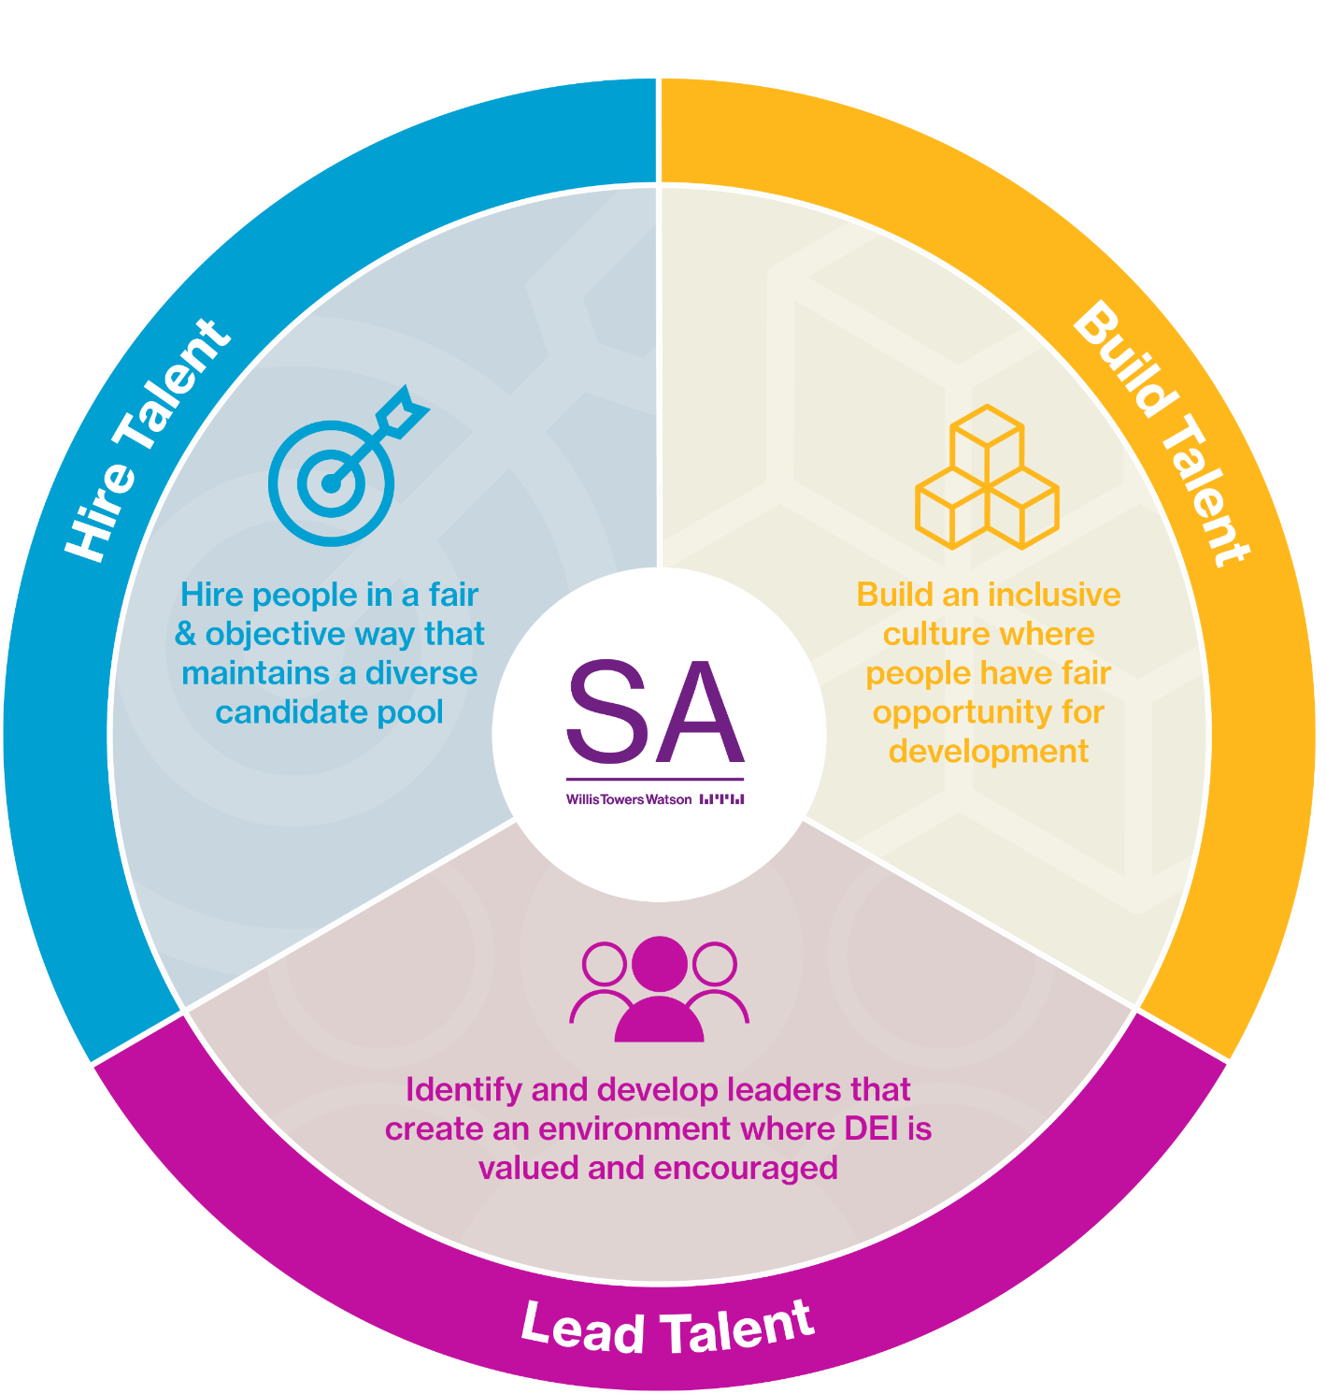
Assessment Perspective

Slide 6

Less Intuition, More Data

Slide 7

The Coffee & Chat Conundrum
These are still happening!
Disconnect between rigour and responsibility
Breeding grounds for bias
What are the blockers to success?
7
Notes:
Obs – this might not seem new but actually still one of most common things I come across at the middle level …at EY and also BP (Hannah). M&S story – shop floor vs middle manager (former has to jump through so many more hoops).
Hiring in and promotion – putting in a case for promotion vs something more objective
Problem is that bias creeps in
Similar to me
Even if you ‘think’ you are interviewing objectively… the chances are you aren’t
The more you believe you are objective and not sexist – the less objective and more sexist you are likely to be in terms of your behaviour (in invisible women p94)
Like interviewing – interviewer confidence is not a predictor of interviewer effectiveness! (Daniel K?? – see EY slides)
Study of performance reviews (n=248) in US tech companies really interesting – this is the performance review context but an excellent example of how differently women and men can be evaluated:
Women more likely to receive negative feedback than men
Words that were used in feedback for women were –
Watch your tone
Step back
Bossy
Abrasive
Strident
Aggressive
Emotional
Irrational
Only aggressive appeared in men’s reviews – an in 2 cases the messaging was to be more so
Other study - Evaluation favours dominant group – usually white male
Even if most people aren’t biased, you will still end up with a biased process if the process was unsystematic and informal …one of the problems is “we’re not like that…almost someone else’s problem. You believe that what you are doing is good and therefore everything is fine.
Everyone is aware of this (coffee and chats) – so what is the blocker?

Slide 8

Breaking Out the Comfort Zone
Shift to partnership approach between Talent Acquisition Partners & Hiring Managers
Importance of candidate experience
Be strict on the process – no exceptions
Where do you have it in the process?
Have you really thought about what you are doing and whether this will drive improvement?
8
Notes:
One of main challenges that recruitment leaders are trying to tackle
JNJ story – shift from transactional servicing to value adding servicing
EY Nordics – really strict on process
There are reasons people will say that you can’t do it – there is only one person who can do this job (the world’s best lipids scientists) – you still do the process. You can use the need for understanding of development areas as your argument.
Bring assessment forward as much as possible so that the hiring manager never sees the lower scoring areas/CVs until you’ve screened on assessments
More you can bring it forward the better it is
Biggest errors made are where people have small numbers – or where you have 2 final candidates and you don’t make the position available. Applies to fairness.
Also internal promotions vs external hires – if your pipeline is biased, then you aren’t going to be able to fix your D&I issues. Have you mandated all of the steps re hiring people who are under represented. Trickle up will never work and be really slow.
Lots of evidence to suggest that if you have a clear view of what good looks like – it is fairer
Sentinals – why haven’t you considered a women? Why not? Rather than why – got more women though (insurance business)

Slide 9

Invisibility Cloak
From incognito auditions to pseudonymized CVs
Socio-economic status and class don’t get much of the limelight
New ways of working and the hybrid model of virtual and in-office working…will this amplify the problem?
9
Notes:
New York Philamonic Orchestra – back in 70s had 0% female musicians…
Problem with CVs
However even if we make CVs blind in terms of gender and ethnicity, other information can point to things like socioeconomic factors than can then cause problems – ref study where same CVs sent out with diff hobbies. The high brow hobbies got more call backs. Schools can also show this
ICI study – number of interests actually correlates negatively with performance at work
Why would you have hobbies and interests on CV
All it does it put bias in
Other things we use also problematic – degree class
What we do currently in current practices doesn’t move towards better D&I outcomes
Practices enshrine bias
Socio-economic status and class
Why not as focused on?
Is it that the zeitgeist hasn’t got there yet? Is it a more difficult problem to solve? Or is it more uncomfortable to talk about? A bigger taboo? Different things – gender, ethnicity, sexuality …you are encouraged to be proud of these parts of identity. Socio-economic status doesn’t really work like this …fluidity and almost desire/encouragement to move in some cases
Fujitsu – been very proactive in looking at socioeconomic piece …free school meals
You may be blind to what’s there – data gaps. What do you measure?
Came up in home schooling – access to computers for example …the impact will probably be bought to the forefront as people leave education as lower classes will have missed out more on significant amount of schooling
Hybrid piece – one to think about as this new way of working will be happening. What conversations has your organisation been having? How are you planning to manage this from of D&I perspective?
EY – calls with chairing process/virtual monitor …be much more conscious of how much conversation time you have had with virtual folk as you have had with in office folk. Like in friends…the one where Rachel started smoking!
Potential to amplify D&I issues?
Will we see a gender diff in hybrid working? If women do more of the caring work/school runs – so ends up doing more flexible/virtual working.
Will women be seen less? And will this exacerbate the problems we already have?
Communication – males vs females …amount of speaking (look it up)
Could be a catalyst…like pandemic (where women were doing most of caring work).
The answer – this might not be what you want. The allowance for complete flexibility. Might not be allowed to go office. Might not be space. You might be expected to come in certain days. Rather than letting people choose completely – do you need manage/mandate it in some way. Need to think about the comms – explain why you are doing this. Letting things run flexibly and how others want to do just breeds bias.
Might get lower socio- in office more (smaller homes).
So…data even more important to help mitigate against these risks!

Slide 10



Training
Preparation
Accessibility
Ensuring a Good D&I Assessment Strategy
Reducing Differences
Validity
Monitoring

Slide 11

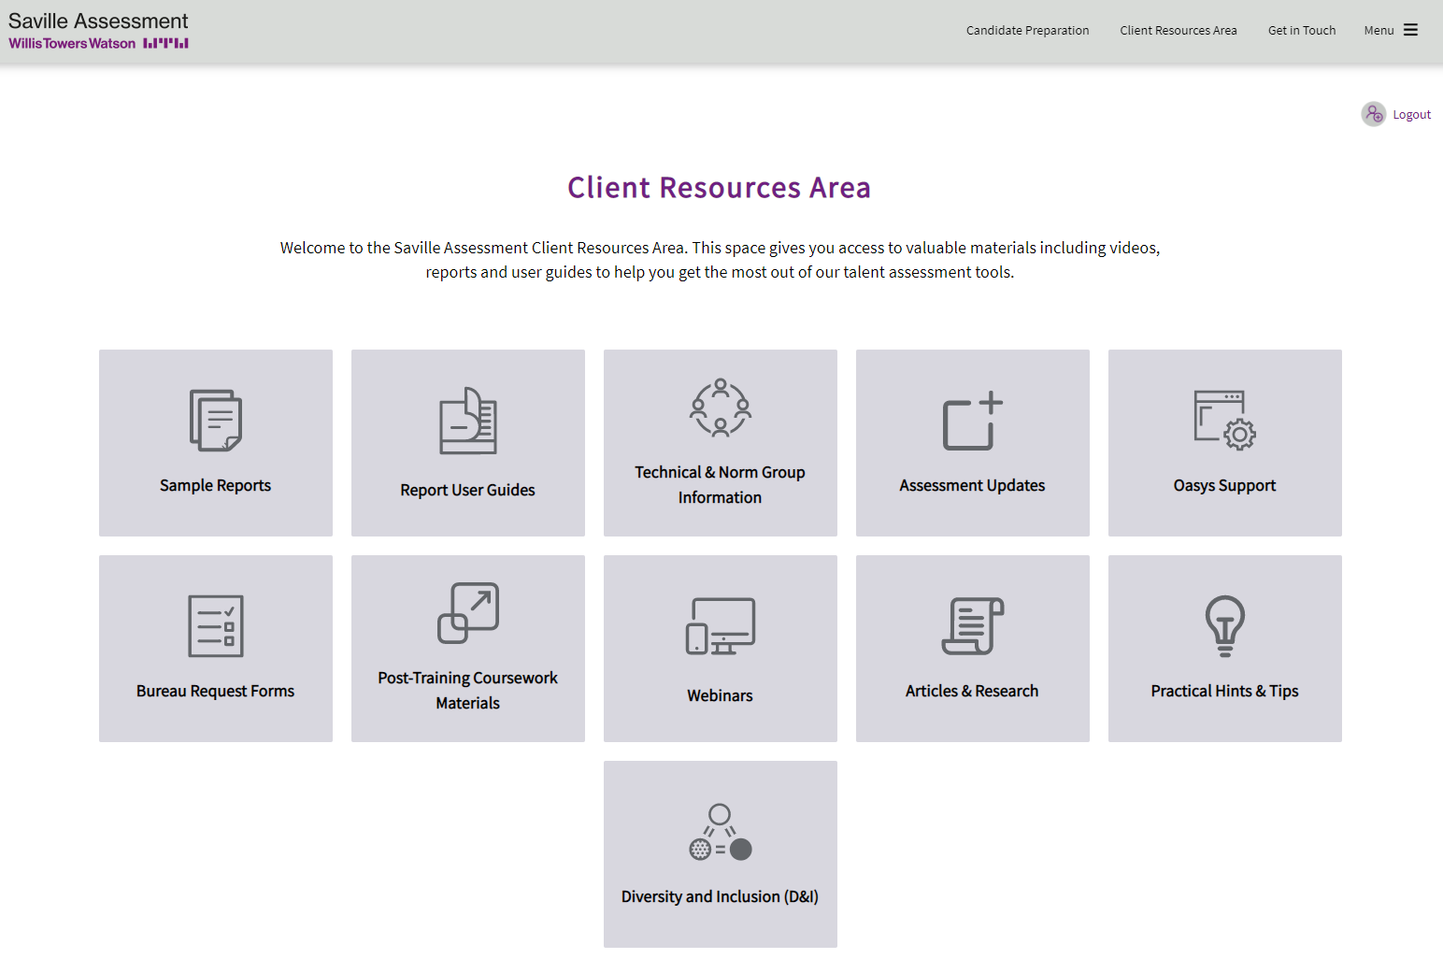
Copy of slides and recording circulated
Q&A session recorded and circulated
New D&I Tile now available on Client Resources Area
Username: SA Client
Password: Re50urc5s21!
Webinars in May & June
Next Steps
11

