Slide 1
Building Resilient
Agility
Facilitator Slide Deck

Slide 2
Building Resilient Agility Facilitator Slide Deck – How to Use
How To Use This Slide Deck
This slide is intended for Facilitator’s use only and does not form part of the group session.
This slide deck has been provided to enable facilitation of a virtual Building Resilient Agility session. The session is designed to be 60-120 minutes long, depending on your group’s availability. It aims to help individuals understand what Resilient Agility is, the Building Resilient Agility Model and their individual report as well as group dynamics.
Before starting your session, please ensure that all those attending have completed the Professional or Focus Styles assessment and that they have access to a soft copy of their Building Resilient Agility Report. Please also ensure that you have shared the pre-session activity, which provides participants with background reading and a short exercise to complete before the session.
Ensure that you have also generated the Group Overview. Either use the group overview functionality live through the Oasys platform or insert the information you wish to share with the group into this slide deck. You can find the Group Overviews User Guide by accessing the following link:
Generating-Group-Overviews.pdf (savilleassessment.com)
Make sure you hide the exercises you will not be using during the session:
2-hour sessions:
We recommend using either Exercise 3 or Exercise 4, as they both focus on capturing key themes and action planning.
If using Exercise 3, decide which SWOT format you want to use and hide the other one.
1-hour sessions:
Shorten exercise 1 to a maximum of 10-minutes
Remove exercises 2 and 3
Keep the Stop, Start, Continue exercise to a maximum of 5-minutes

Slide 3
Agenda
Building Resilient
Agility
Virtual Group Workshop

Slide 4
Introduction
Understand Resilient Agility and how you can build this within yourself and your group
Use your strengths to effectively deal with a current or upcoming organizational change
Develop the group’s challenge areas in the context of what will be important for a current or upcoming organizational change
Decide on some tangible actions to take away from the session

Slide 5
What is Resilient Agility?
A unique form of agility that is robust and can be maintained over the longer term
Individuals are more likely to be effective during change and have built-in resilience as part of the capacity to be agile
The behaviors are linked to performance & potential in the workplace

Slide 6
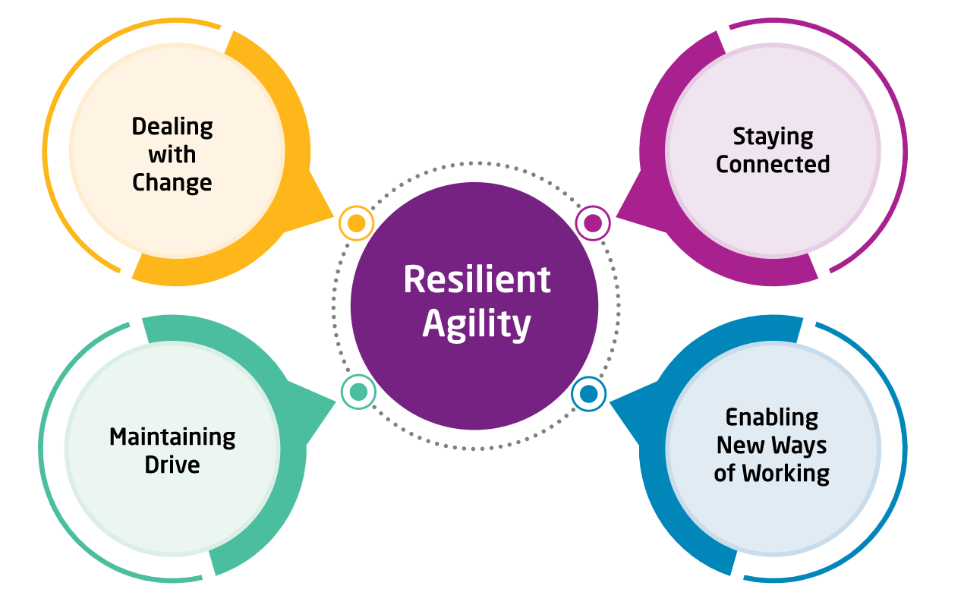
4 Key Drivers of Resilient Agility
Each underpinned by 5 behavioral dimensions
The Resilient Agility Model
Dealing with Change | Embracing change positively. Managing uncertainty with composure.
Staying Connected | Making and maintaining connections. Actively participating and communicating.
Enabling New Ways of Working | Using insights to forge new directions at work. Ensuring effective work plans are delivered.
Maintaining Drive | Capitalizing on the opportunities change presents. Keeping everyone focused on key work objectives.
Powering an integrated talent strategy

Slide 7
Building Resilient Agility
Your Report

Slide 8
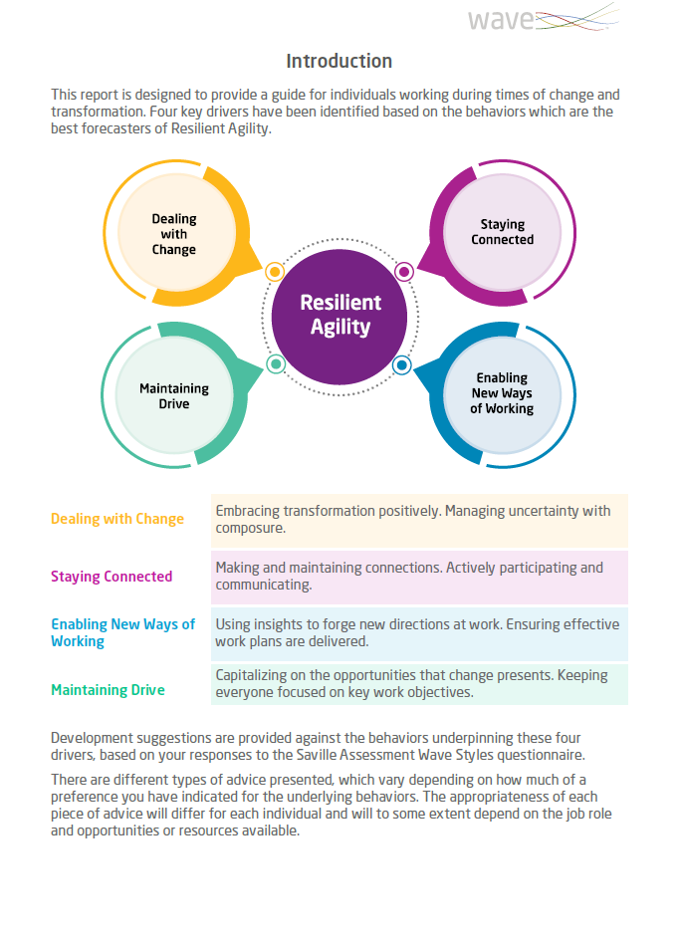
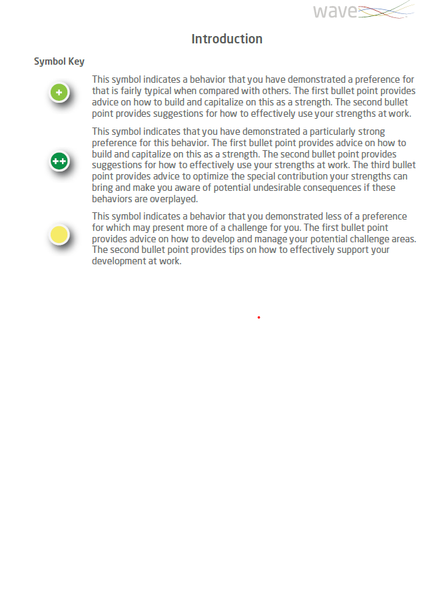
The report presents each of the four drivers of Resilient Agility.
It provides guidance for improving an individual's capacity to be effective during change & transformation.
The report indicates an individual’s greater or lesser preference for the areas under each driver using visuals icons:
This symbol indicates a typical preference
This symbol indicates a strong preference
This symbol indicates a challenge area

Slide 9
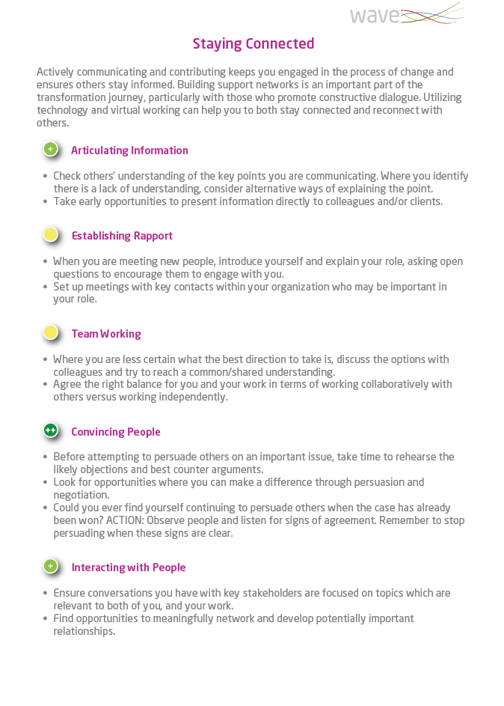
For each of the four drivers, an individual can see their preference for the behaviors that underpin it via the indicator symbols.
Where an individual has a typical preference, advice is given around how to capitalize on it as a strength and how to effectively leverage it in the workplace.
Where an individual has a strong preference, the guidance also includes how to optimize the special contribution of your strength and potential undesirable consequences if the strength is overplayed.
Where an individual has less preference, the information is focused on developing and managing the challenge area and how to support this in the workplace.

Slide 10
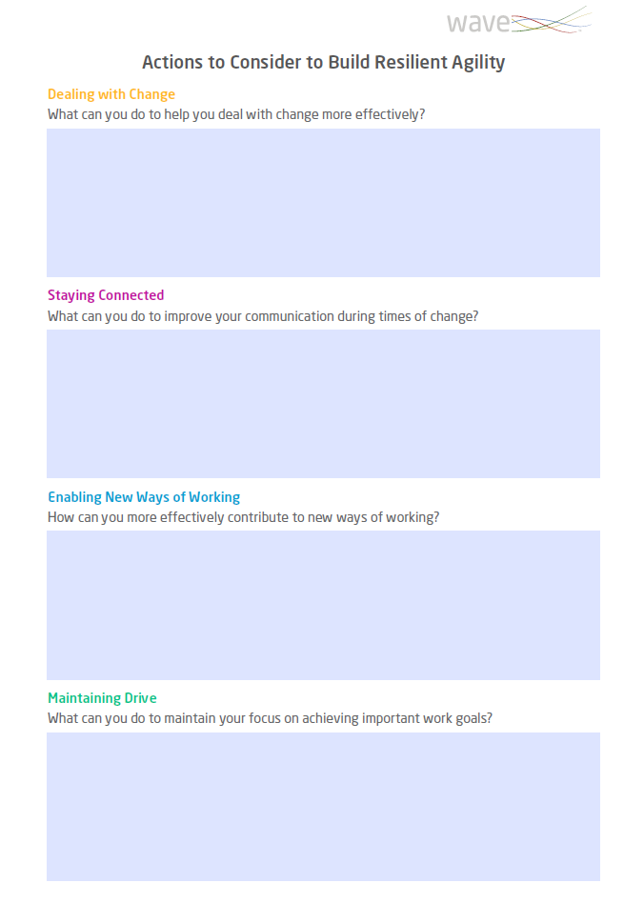
The report includes an editable ‘Actions’ page.
This gives an individual opportunity to reflect on the guidance in their profile and create a personal action plan to help build their capacity for effectiveness during change and transformation.

Slide 11
Practical – Getting to know the Group’s Individual Resilient Agility
When: After providing an overview of the Building Resilient Agility model.
Purpose: Help the group better understand each other’s strengths and challenge areas in the context of Building Resilient Agility, and start thinking about how this could be applied to organizational change.
How:
Share some of your own examples of how your strengths and challenge areas in the context of Building Resilient Agility have led to positive and less positive outcomes.
Ask someone to volunteer to read out their examples for their areas of strength and challenge from the pre-session activity. You can also ask them to share where the Key Drivers referenced could
be utilized in the organisational change in focus Repeat with the rest of the participants in the group. If you have a larger group, aim to get examples from at least three participants.
Were there any surprises when learning about others’ strengths and challenge areas?
Was there any overlap in the Key Driver identified as being important for an upcoming organizational change?
ACTION: Ask everyone to think of one action they will personally take away and send it in the chat function to the group/facilitator by the end of the session
Notes:
Please refer to the facilitator guide for more information – page 3

Slide 12
Practical Exercise: Ready, Steady, Change
When: Before you introduce the Group Overview
Purpose: Get the group to start thinking about which Key Drivers and underlying dimensions will be particularly important in the change their organization is/will be going through
How:
Share your screen with the 20 underlying dimensions.
Ask the participants to identify which underlying dimensions will be required to effectively work through the organizational change being focused on. You can ask the participants to rank order these in terms of importance.
To keep this exercise focused, you can ensure the group do not simply select all dimensions by asking them to select the top 5 most important dimensions.
Reveal the Key Drivers aligned with the most important dimensions (by switching to another screen with the 4 Key Drivers and 20 underlying dimensions listed below each of them)
These should be noted down as they will be referred to during the discussion of the Group Overview
Discuss:
If the group haven’t identified any underlying dimensions from a particular Key Driver as being important for the organizational change in focus, challenge them by asking what the impact of this might be
Notes:
Please refer to the facilitator guide for more information – page 4

Slide 13
Building Resilient Agility Dimensions
Embracing Change
Providing Insights
Establishing Rapport
Developing Strategies
Interacting with People
Thinking Positively
Convincing People
Producing Output
Articulating Information
Making Decisions
Conveying Self-Confidence
Team Working
Pursuing Goals
Showing Composure
Managing Tasks
Taking Action
Seizing Opportunities
Directing People
Empowering Individuals
Inviting Feedback
Notes:
Instructions explained on page 4 of facilitator guide

Slide 14
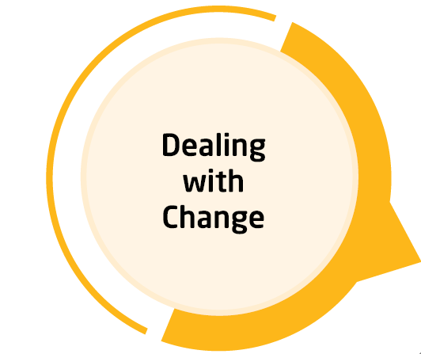
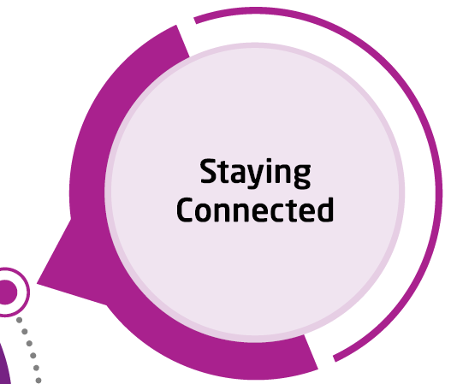
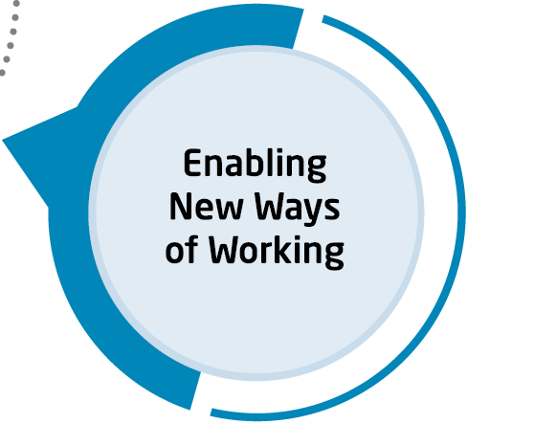
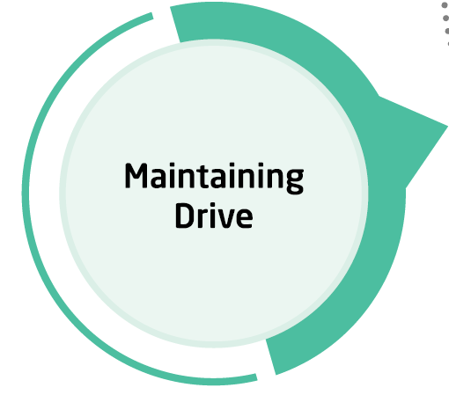
Building Resilient Agility Key Drivers and Dimensions
Embracing Change
Providing Insights
Establishing Rapport
Developing Strategies
Interacting with People
Thinking Positively
Convincing People
Producing Output
Articulating Information
Making Decisions
Conveying Self-Confidence
Team Working
Pursuing Goals
Showing Composure
Managing Tasks
Taking Action
Seizing Opportunities
Directing People
Empowering Individuals
Inviting Feedback
Notes:
Instructions explained on page 4 of facilitator guide

Slide 15
Building Resilient Agility
Group Overview
Notes:
Please refer to the facilitator guide for more information – pages 5-8

Slide 16
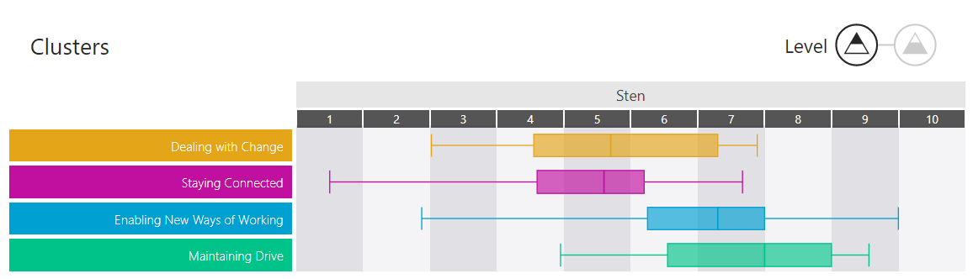
The Group Overview
Insert Group Overview images or directly share functionality live through Oasys
Notes:
Please refer to the facilitator guide for more information – pages 5-8

Slide 17
Practical Exercise: SWOT Analysis
When: Once you have gone through the Group Overview
Purpose: Start to capture the discussion from the previous exercises into key themes and learnings for the group
How:
Explain that the purpose of this exercise is to encourage the group to start thinking objectively about their group.
Share your screen and ask the group to complete a SWOT analysis (using either slide 18 or 19), summarizing the group’s discussion as you go.
You can use the Group Summary content from the Group Overview, and bring in the insights from the Group Overview walkthrough around the group’s top and bottom underlying dimensions.
Notes:
Please refer to the facilitator guide for more information – page 9

Slide 18
SWOT Analysis
Key Questions | Discussion Points
What are the strengths of the group – what aspects of Building Resilient Agility are the group best at?
What are some potential challenge areas (weaknesses) for the group – what are the areas in which the group can improve? Which of these areas are easiest to improve in?
When looking at the group’s strengths, what opportunities will the current/upcoming organizational change provide to leverage these strengths and become more effective in these areas?
When looking at the group’s challenge areas (weaknesses), what kind of threats might they pose to your group in effectively coping and adapting to the current/upcoming organizational change? What do they need to do to prevent these threats?
Notes:
Please refer to the facilitator guide for more information – page 9

Slide 19
SWOT Analysis
Strengths | Opportunities
Weaknesses | Threats
Notes:
Please refer to the facilitator guide for more information – page 9

Slide 20
Conclusion: Stop-Start-Continue
When: Towards the end of the session.
Purpose: Get the participants to summarize their takeaways from the day.
How:
Show the next slide to encourage discussion on what the group should Stop, Start, and Continue to do.
Discuss:
What does the group think about the themes identified?
Are there any reflections that people do not agree with? Anything to add?
How are the group feeling about the organizational change now compared to before the session?
How are they going to hold themselves accountable for the actions?
Notes:
Please refer to the facilitator guide for more information – page 10

Slide 21
Stop, Start, Continue
What should we stop doing? I.e. Things which are not working for the group, things which are not having the desired outcome, or things that the group do not like. | What should we start doing? I.e. Things which the group are not doing but think will be important for the organizational change in focus, or new ideas that have come up during the session which have not been considered before. | What should we continue doing? I.e. Things that are working well or things which are proving successful that will continue to be important going forward.
Notes:
Please refer to the facilitator guide for more information – page 10

Slide 22
Appendix

Slide 23
Individual Development Plan
 | Objective – what are you going to work on improving? | How will this be achieved? | Who will be involved? | How will progress be measured?
Which steps will you take?
Notes:
.

Slide 24
Group Development Plan
 | Objective – what is the group going to work at improving? | How will this be achieved? | Who will be involved? | How will progress be measured?
Which steps will you take?

