Slide 1
Global Partner Community Call
Tuesday 30th November 2021

Slide 2
Headlines
Welcoming Our Latest Partner
Awards News
Marketing Activity
Assessment Updates
Looking Ahead to 2022
Agenda

Slide 3
Life beyond Aon
Continued growth & recovery
2022 Pricing
PSI & Propel
New Partner Atria
Double Award Win
Korn Ferry client prospecting
Headlines

Slide 4
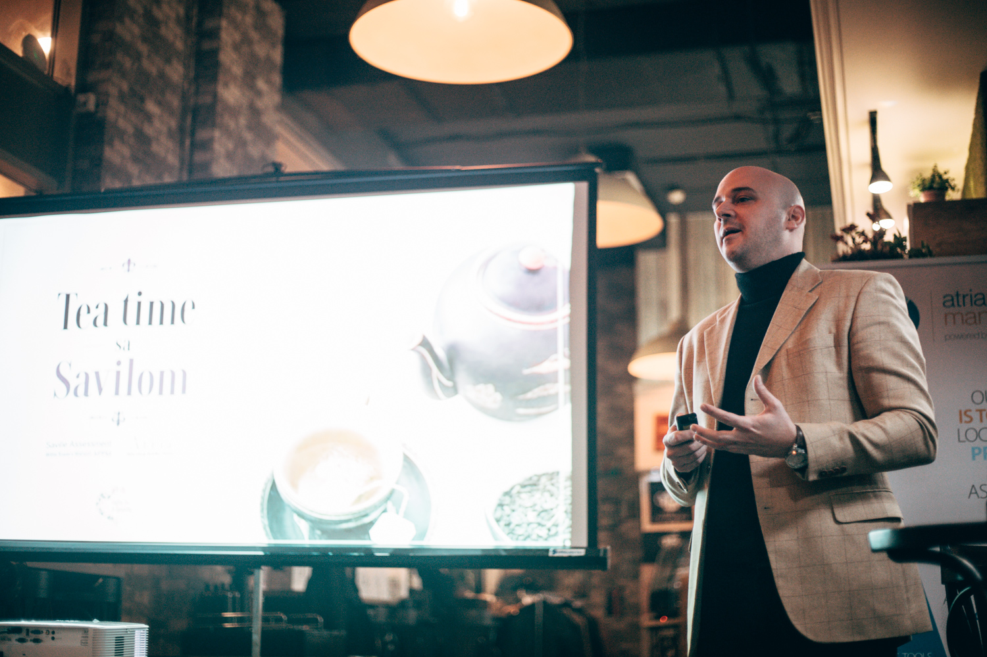
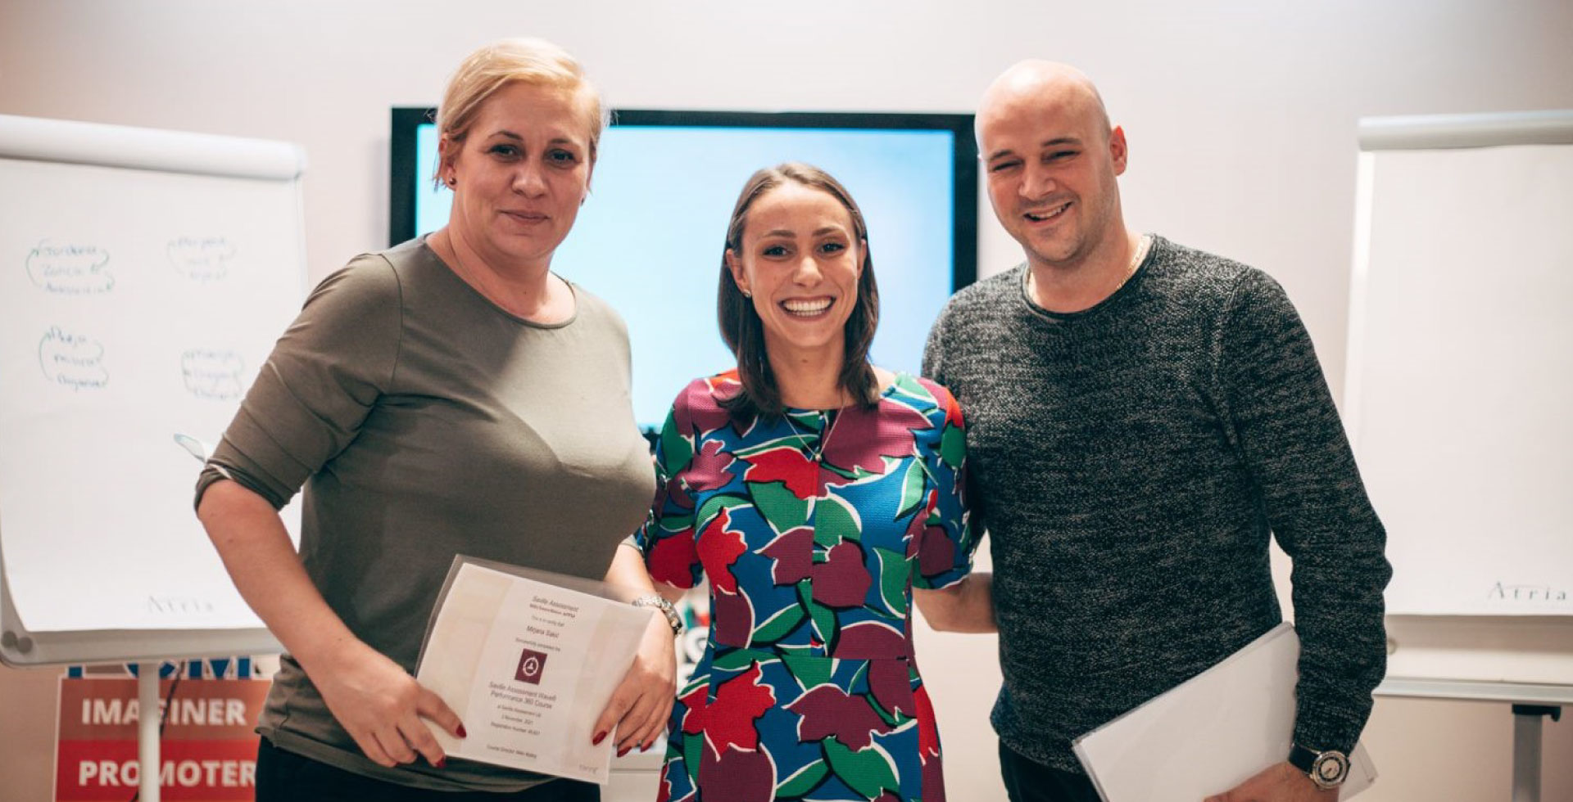
New Partner

Slide 5
Double Award Win: Personnel Today Awards
Resources
Press Release
Case Study
Webinar Recording
Social Media Post

Slide 6
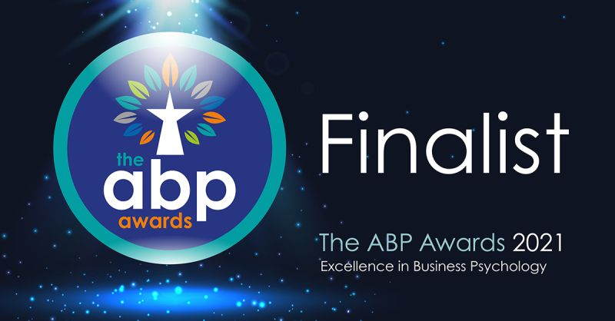
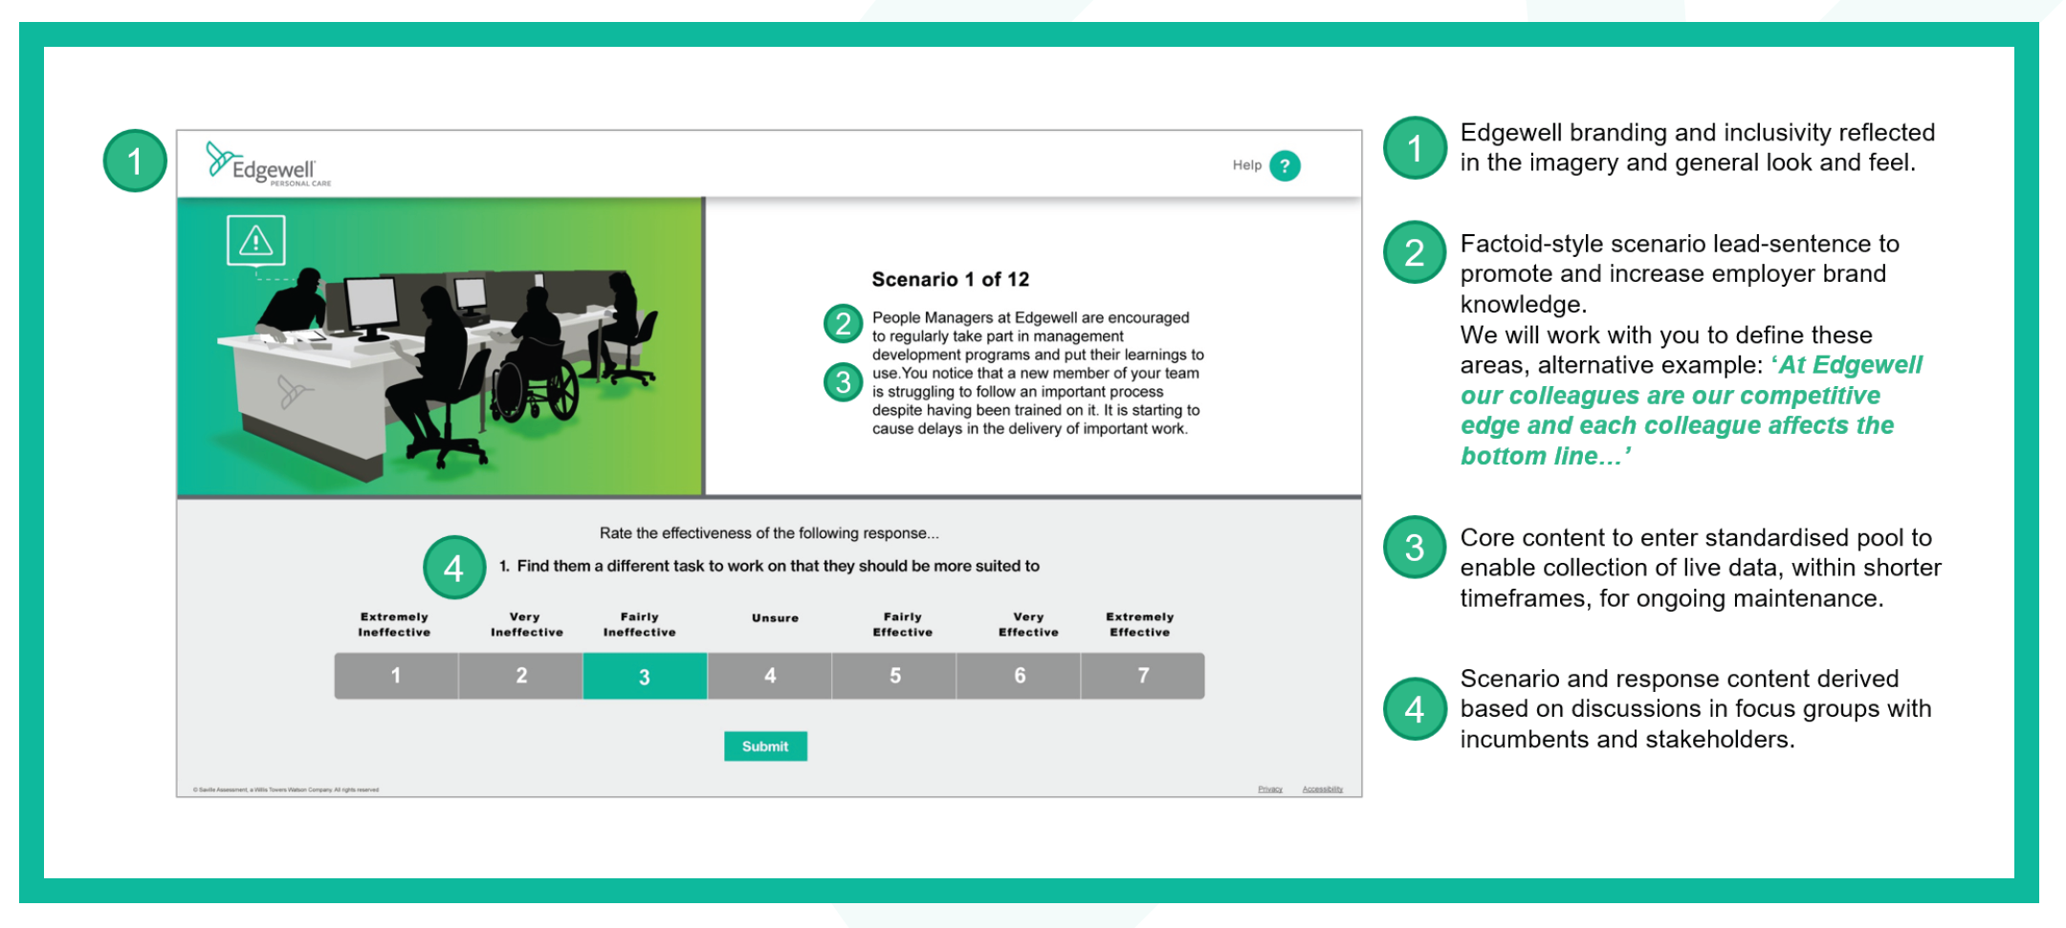
New Award Shortlist: ABP Awards

Slide 7
Marketing Activity

Slide 8
“92% of organizations say enhancing the employee experience is a priority over the next 3 years.”
Employee Experience
Attraction & Retention
The Great Resignation
“73% of organizations are having difficulty attracting employees and 61% are struggling to retain employees.”

Slide 9
Webinar Series
Assess for Success Understanding your people to improve the hiring process
Leadership in the Fast Lane Accelerating development for the new world of work Part 1: The value of empathy & impact Part 2: Leading through uncertainty & Delivering a High – Performance Employee Experience
Reskill, Redeploy & Retain Identifying & developing digital talent at Ricoh
Marketing Activity
Conferences
WTW HR Summit
HR Forum
HR Grapevine
Articles
Transforming the Great Resignation into the great hire
Less Intuition, More Data

Slide 10
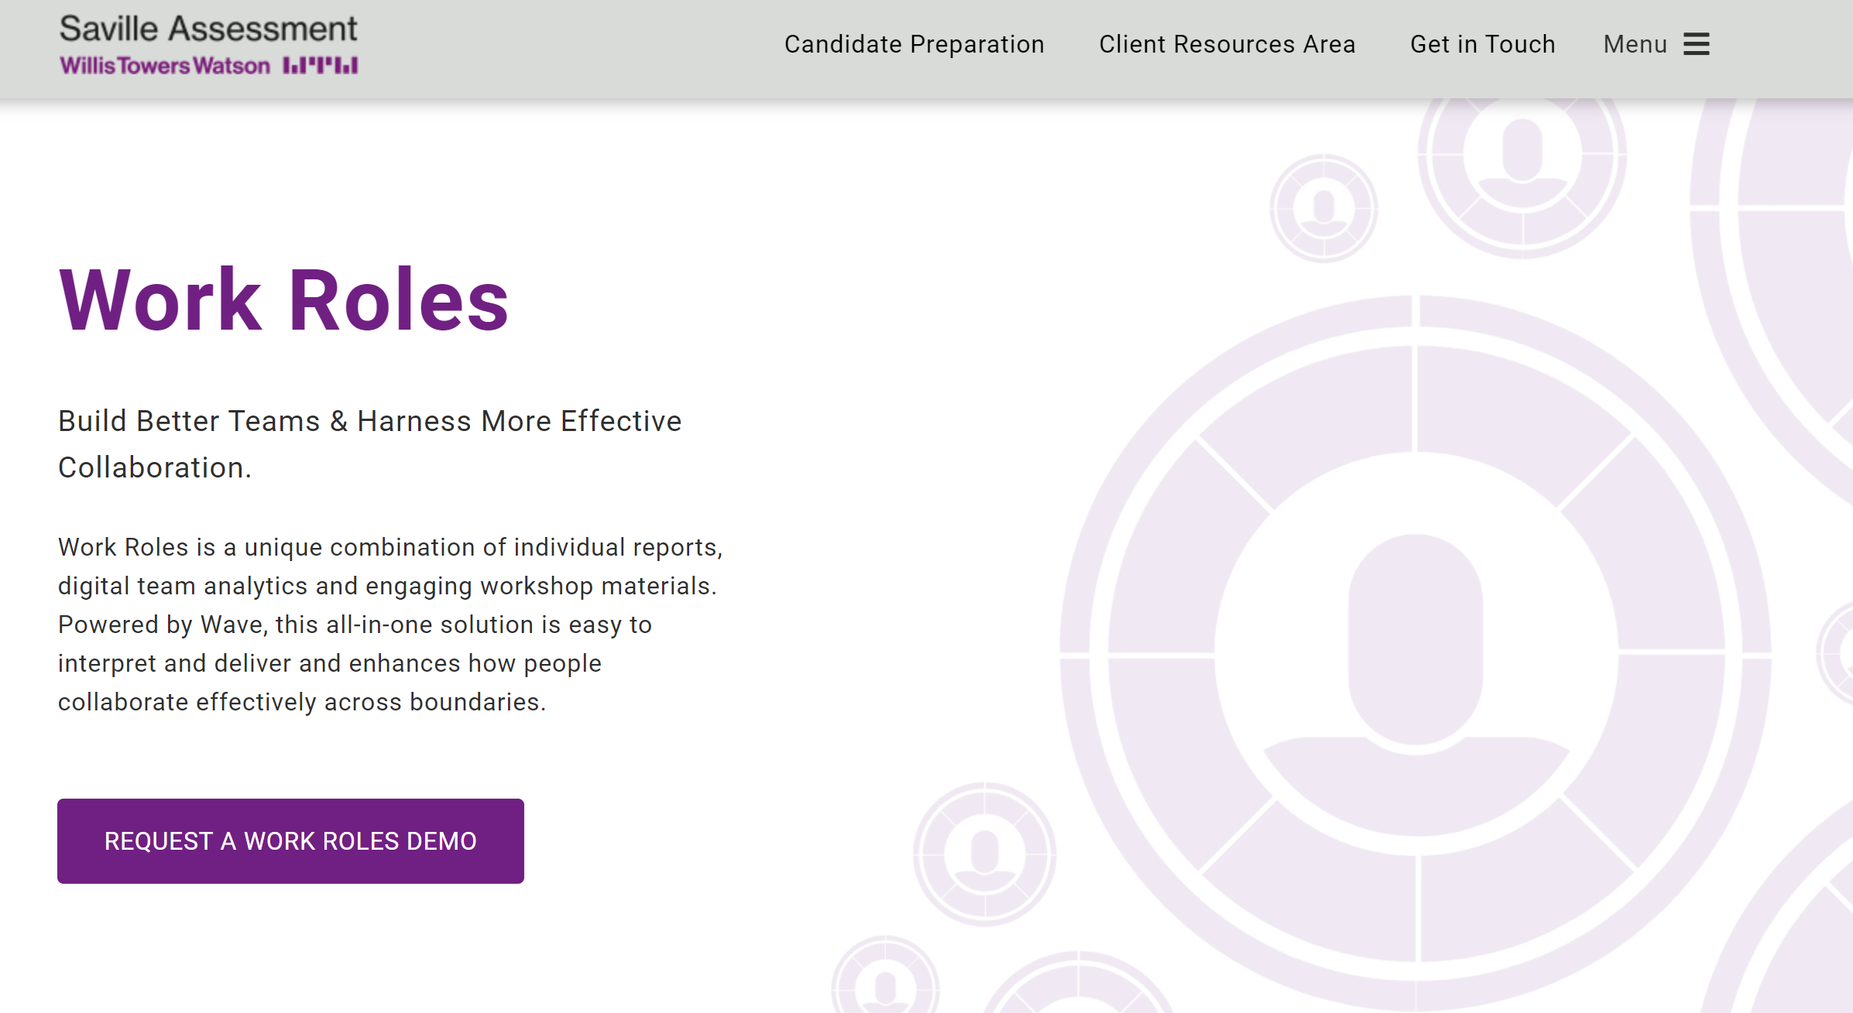
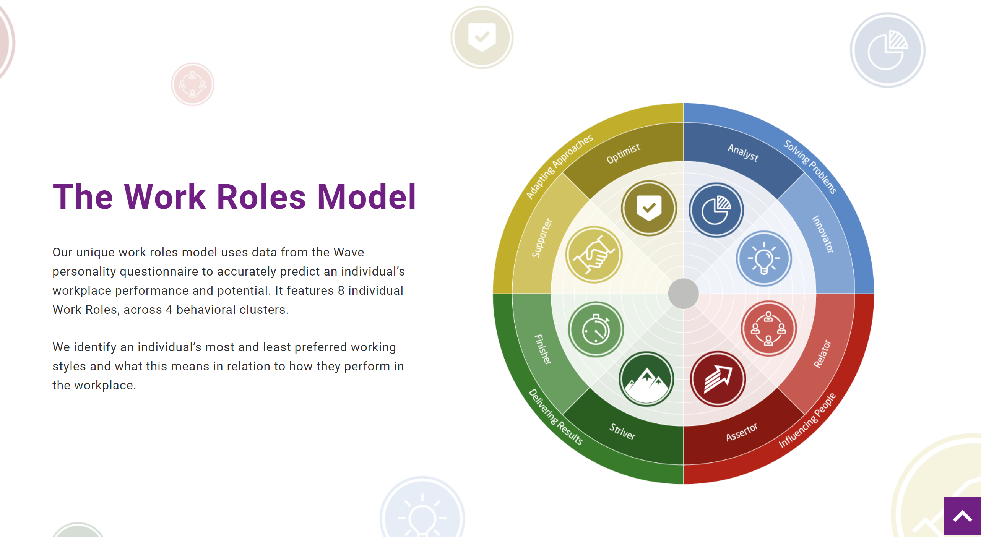
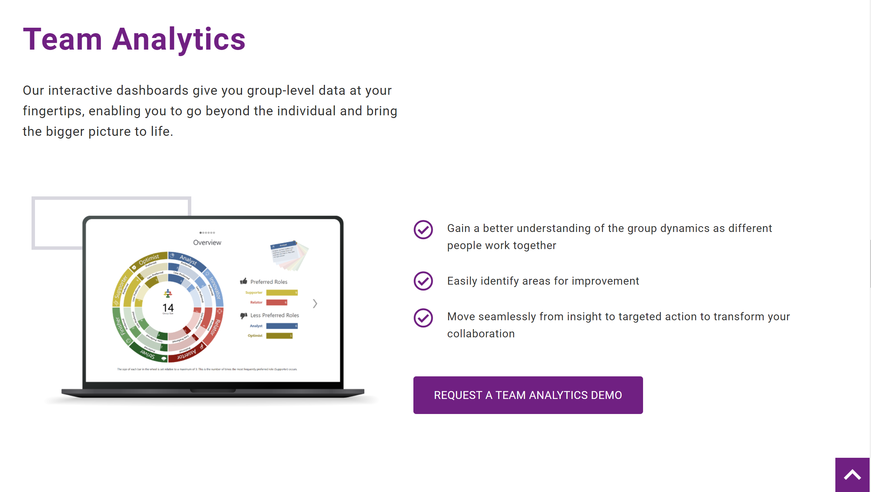
Case Studies
Enfield Council Work Roles
Teledyne Apprentice Recruitment
Sodexo Resilient Agility
Financial Services Resilient Agility
Articles
Better Personality Assessment, Better Sales
The Real Cost of a Bad Hire
Website
In review stages – new year go live
Press Releases
Personnel Today Award win
ABP award shortlist
New partner announced
Recent Content & Activity

Slide 11
Assessment Updates

Slide 12
Our 2021 norms for Leadership Impact 360 and our Comprehension Aptitude range are now live.
If you or your clients have these instruments on Oasys, the new norms will now be live automatically.
Clients using via integration will need to contact our Integration team for support on updating.
The old norms will be superseded by the new norms on 1st March 2022, meaning that all new projects must be set-up using the 2021 norms. A reminder will be sent closer to the time.
New 2021 Leadership Impact 360 Norms & Comprehension Aptitude Norms
Leadership Impact 360

Slide 13
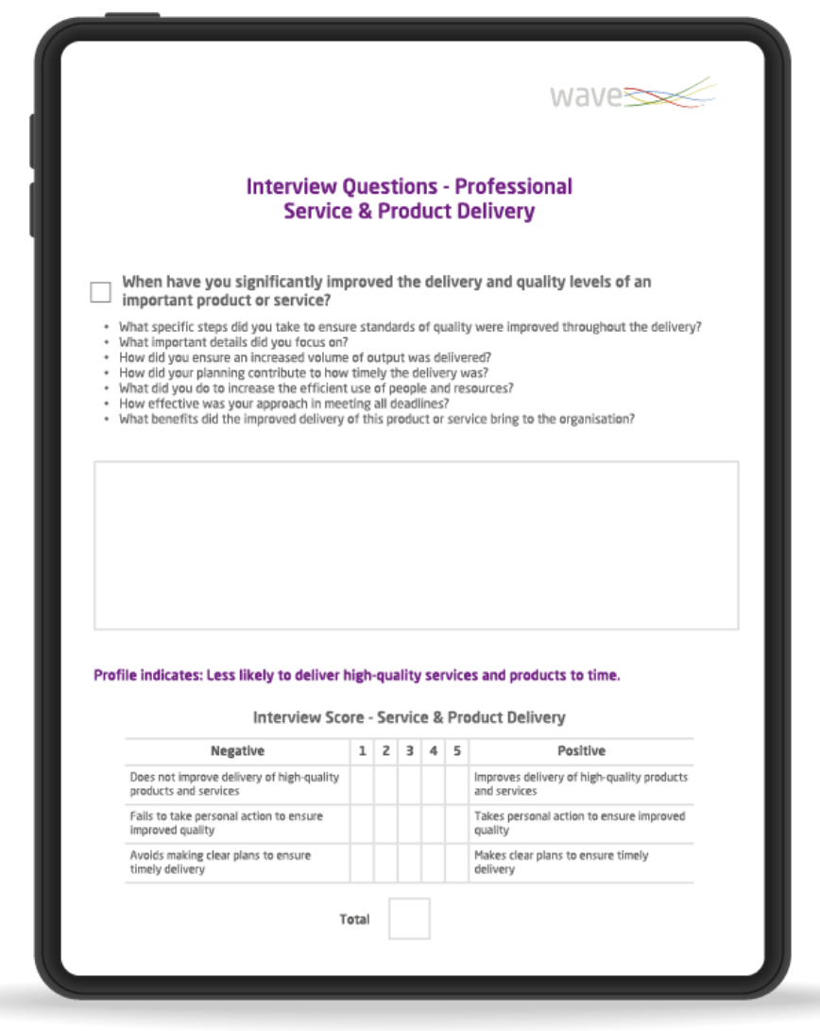
Our new Wave Leadership Impact Expert Selection report combines detailed insight of a leader's potential across 9 key impact areas with 9 interview questions focused on delivering impact across the areas of Professional, People and Pioneering Leadership.
The interview guide interacts with the individual profile, providing dynamic interview probes.
New Wave Leadership Impact Expert Selection Report
The new report is currently only available in English, however if you do wish to have the report loaded to platforms, please contact our Bureau team.

Slide 14
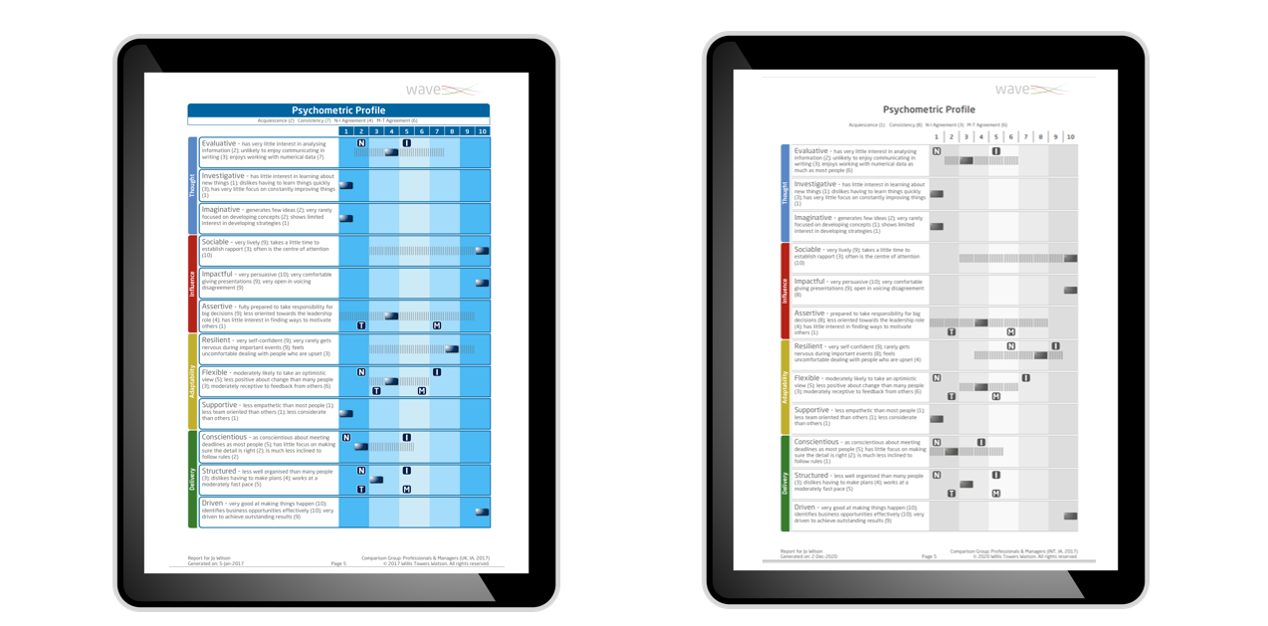
There will be some additional Wave reports benefitting from the updated styling in 2022. This will include our Interview Guides, Work Strengths, Entrepreneurial, Sales, Job Profiler, P360, LI360 Reports. There will also be some minor changes to the WPE, My Self and Aptitude report styling.
We are working with our R&D and Marketing team to batch these updates to minimize disruption to other materials and will advise a full schedule for delivery as soon as this has been agreed.
New Wave Report Styling

Slide 15
Wave-i launch
Swift Global launch
Leadership Impact Expert Selection Report launch
New website live
Tighter go to market links with WTW & Employee Experience
EAWOP Jan 2022
Looking ahead to 2022

Slide 16
30 November 2021
©

