Slide 1
Pinpoint & Power Potential
© 2021 Saville Assessment, Willis Towers Watson. All rights reserved.

Slide 2
The landscape of work is changing and so are the types of leaders we need

Slide 3
96%
“While some aspects of leadership, such as setting a vision & executing a strategy will remain, the future leaders will need to possess a new arsenal of skills & mindsets to lead effectively.”
Of organizations say the types of leadership roles they need are diversifying
Saville Assessment Pinpointing Potential webcast survey 2021

Slide 4
What does potential look like for us?
Who can lead our ‘future’ organization
How can we maintain diversity in our leadership pipelines?
Who should we put on to our development programs?
Organizations are asking us…
Who is ready? Who can be made ready?
What do we do with our consistent performers?

Slide 5
Introducing

Slide 6
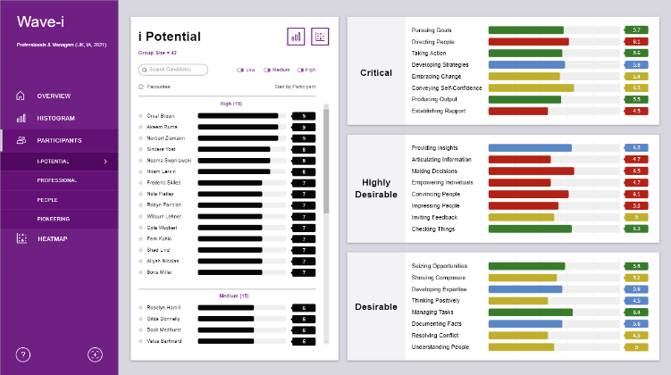
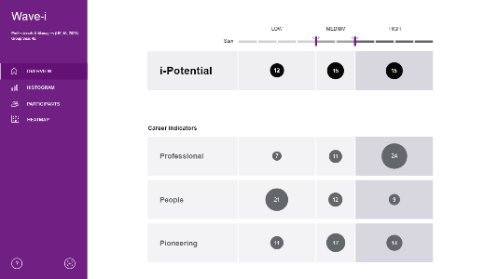
What is Wave-i?
Wave-i is an end-to-end solution for strategically identifying & developing emerging talent. It offers a new way of measuring potential to accurately reveal the types of career or leadership roles individuals will thrive in.

Slide 7
A new way of looking at potential

Slide 8
Wave-i separates the good from the great
Potential according to whom?
Potential for what?
Potential for where?
Capture the key characteristics of potential with the unique nuance required for creating impact in your organization
Explore alignment to different types of leadership roles & create career paths for consistent performers
Positively impact the diversity of pipelines with a transparent & inclusive process underpinned by uncompromising fairness & reliability

Slide 9
Backed by unrivalled data

Slide 10
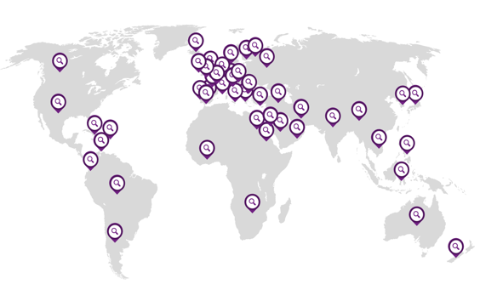
Over 10 years of big data, putting the best predictor of workplace performance in your hands.
Reduces the odds of identifying low potential from 1 in 5 to 1 in 50
Designed to increase fairness and mitigate against adverse impact
34,737
Internationally applicable and grounded in flagship research conducted across 50 countries
Ratings on potential

Slide 11
How it Works

Slide 12
Stakeholder Agreement
Organizations can select either Focus Groups, Workshops or a Validation Study where our expert team works with you to:
define the target role
define the target area
define the target program
agree core requirements & leadership behaviors
To start, we will create a project plan & communication strategy together.

Slide 13
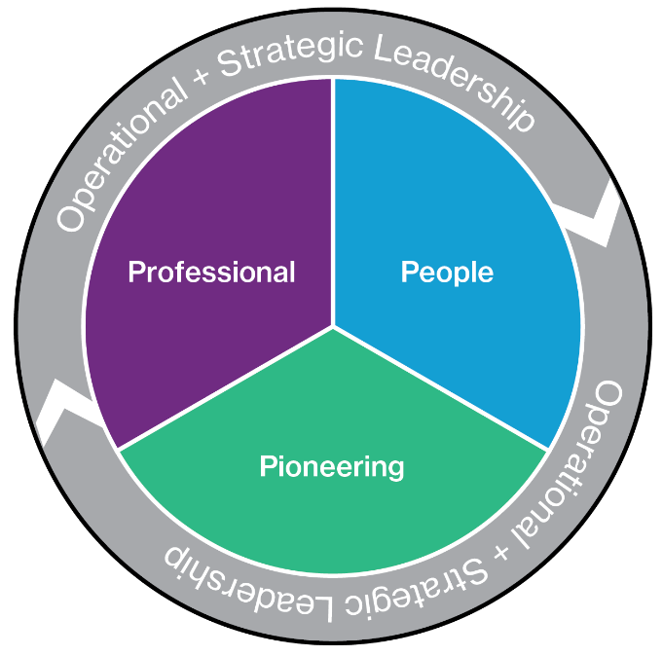
Create Algorithm
A unique algorithm is created that captures the nuance of the organization & role with our own flagship research.
This gives a highly-predictive and holistic view of an individual’s potential reflecting key behaviors, culture and future work demands.
The algorithm is designed to increase fairness and mitigate adverse impact against gender, ethnicity and age.

Slide 14
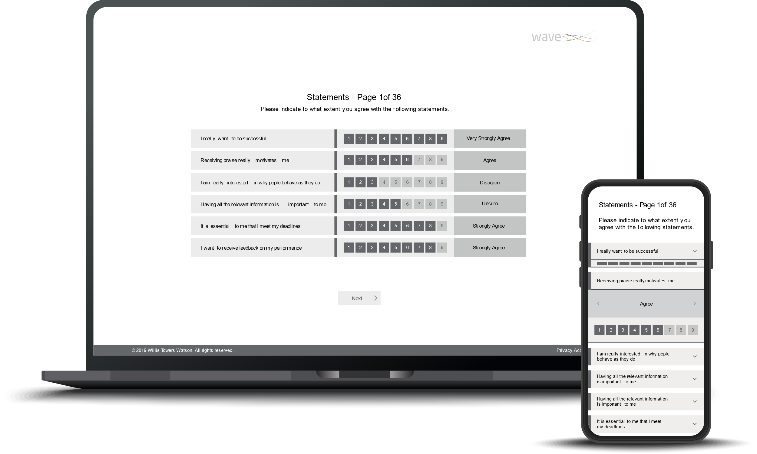
Administer Assessments
Participants will be invited to complete the 35-minute online Wave Professional Styles questionnaire and leadership experience inventory.
The questionnaire targets the behaviors proven to be most effective at predicting workplace potential, style & culture fit.
Intuitive AI interacts with the candidate in real time preventing overly positive or critical self-reporting, minimizing opportunity for participant faking.

Slide 15
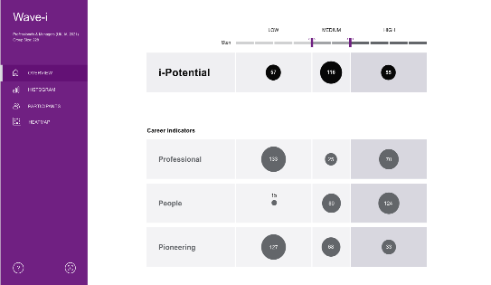
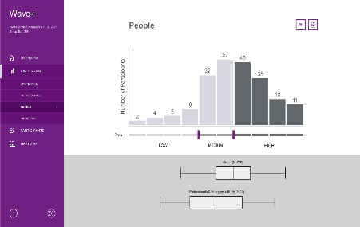
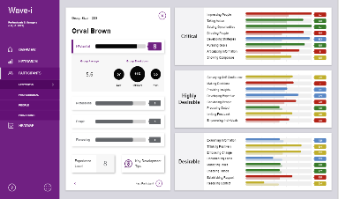
Data Generation
Two potential scores are
generated:
Dynamic dashboards & interactive data at your fingertips:
i-potential - Leadership potential benchmarked against our research flexed to the nuance of your role & organization
Dive deeper into an individual's behaviors
Benchmark the caliber of your potential pool
Career Stream Potential - Illustrates a natural orientation to a type of leadership role or type of career track
Identify group trends and patterns

Slide 16
Feedback for All
A toolkit of reports, conversation guides and webinars is available to drive powerful feedback and ongoing development.
This can be aligned and targeted to support individuals accepted on to the program and consistent performers taking an alternative development route

Slide 17
Applications of

Slide 18
Talent Audits
Succession Planning
Benchmark potential in a quick & dynamic way
Build stronger pipelines fairly, objectively & purposefully
Understand where you currently are
Recognize what is required to get where you need to be
Implement the strategy to get you there
Identify who is ready and who can be made ready
Understand what matters most when moving levels
Minimize the opportunity for bias
Career Planning
Early Potential Identification
Develop all your talent identifying the right career tracks for them
Be a step ahead of aligning future stars with future growth
Recognize everyone has potential for something
Understand an individual's natural orientation to a type of career path
Develop talent across the business not just vertically
Identify who you should be investing in
Proactively identify talent for early development opportunities
Create opportunities earlier for high potentials and consistent performers
Key Applications

Slide 19
Break free of the traditional definitions of potential with the capacity to include the nuance unique to your organization.
Freedom to Flex
Reduce the risk of making the wrong decisions with the most powerful predictor of workplace potential.
Backed by Powerful Research & Data
Wave-i goes beyond other measures of potential
Create opportunities for a wider and more diverse talent pool with efficient delivery and a broader spectrum of paths for progression.
Scalable & Inclusive

Slide 20
Client Examples

Slide 21
Helping a range of sectors identify potential for a variety of applications
Global Technology Business Identifying ‘Future Stars’ for a Leadership Development Program
Global Professional Services Firm benchmarking leadership success drivers
Healthcare & Consumer Goods Manufacturer for development of future leaders
Global Events Organization redefining what leadership looked like post transformation
UK Transport & Infrastructure Business identifying individuals for a High-Potential Development Program
UK Local Authority identifying leaders to drive forward and shape a new future

Slide 22
Administration &
Set Up

Slide 23
Getting Started
To start using Wave-i, get in touch for an initial conversation with one of our expert Consultants.
We will go through some key questions to agree the best course of action for you:
Why are you looking to measure potential?
Who are the population to be assessed?
What type of potential are you looking at?
Email: info@savilleassessment.com
23
Notes:
2mins

Slide 24
20 October 2022
©

