Slide 1
Saville Assessment International Accreditation
Wave

Slide 2
House Keeping
Your Controls

Slide 3
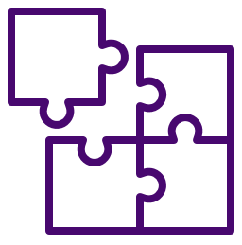
House Keeping
Break-out Groups
In the app you can join the break-out group and it will automatically put this meeting on hold. You can click to “Resume” when you want to jump back.
In the web-browser version you’ll need to hang up and then join the break-out meeting, and vice versa rejoining the main group.

Slide 4
Introductions
Name
Role/Company
Previous use of assessments
Selection or Development
Which ones?
What did you use them for?
Likely applications of aptitude assessments
Interests for the course
Notes:
Ask trainees to turn on webcams for introduction and ask them to cover these questions
You may wish to remove these or ask trainees to keep their introductions brief if you have a large group

Slide 5
About Saville Assessment, a WTW Company
2004: Founded by Professor Peter Saville
2005: Wave launched
2007: Swift combination tests launched
2013: Situational judgment tests launched
2015: New tests, new technology
2015-2017: Saville Assessment, A Willis Towers Watson Company
2017: Leadership Impact and Risk launches
2019: Match 6.5 launched
2021: Swift Global launched
2022: Wave-i launched
Our Core Belief
To dive deeper than humanly possible and bring talent to the surface.
Notes:
You can talk through this slide to introduce Saville Assessment
Peter Saville was the ‘S’ from SHL if you are familiar with their assessments, after selling SHL, he chose to start again. This time he wanted to make use of technology to dive deeper and better predict workplace performance
Before Wave was launched, there was a two-year research program exploring which behaviors and preferences best predicted workplace performance in order to create a highly-valid assessment.

Slide 6
Talent Assessment Solutions
HIRE TALENT
ENGAGE TALENT
BUILD TALENT
LEAD TALENT
Improve Quality of Hire
Understand what your people think and feel
Maximize Talent
Effectiveness
Transform
Leadership
Effectiveness
Notes:
Saville’s assessment solutions can be used across the talent lifecycle, from hiring and selection, to development and team building, through the leadership selection, development and succession planning

Slide 7
Course Overview
Introduction to testing
Job Analysis
Introducing Wave
Deep Dives
Expert Report
Feedback of Wave
Focus Styles
Applications of Wave
Reliability and Validity
Selection Case Study
Development Case Study
Notes:
You can use this slide to give an overview of the course. Depending on the course timings, you can explain which modules you expect to cover in today’s session and what time you expect to have breaks and finish.

Slide 8
Module 1
Introduction to Testing

Slide 9
Talent Trends and Challenges
Talent is global
Applicant numbers per role are increasing
Organizations are assessing behaviors, cultural fit, values
Emphasis on employer brand
Candidate experience is critical
Recruitment processes are speeding up
Online, mobile and remote assessment is the norm
Security of assessment materials is still a risk
Social media has implications
Selection data is increasingly used for onboarding or employability
Responsibility for development is devolved to line managers
Increasing expectation that career management is self-led
The ‘gig’ economy is emerging
Everyone’s talking about Big Data
Notes:
This slides covers talent trends seen over the last few years
Ask trainees if they have any experiences of these or if there are any they would like to know more about

Slide 10
Projective Tests – Inkblot Test
Notes:
Ask trainees to say what they see in the chat
You can use this as a way to practice functionality by asked them to raise their hand if they see a bat

Slide 11
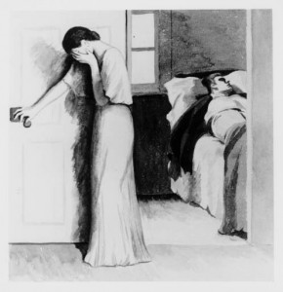
Projective Tests – Thematic Apperception Test
Notes:
Ask trainees to say what they think might be happening in this image in the chat
Ask how they would feel if these types of assessments were used to assess them for a job
These types of test can be very subjective and therefore less valid as a predictor of behavior

Slide 12
What is a Psychometric Test?
Personality
Psychometrics are tests used to measure clearly defined psychological attributes
+ -
× ÷
Ability
An assessment of a psychological attribute, typically scored using a numerical scale or category system, to describe individual differences.
Notes:
Objective and standardised
An assessment of a psychological attribute, typically scored using a numerical scale or category system
Psycho= mind
Metric= measure

Slide 13
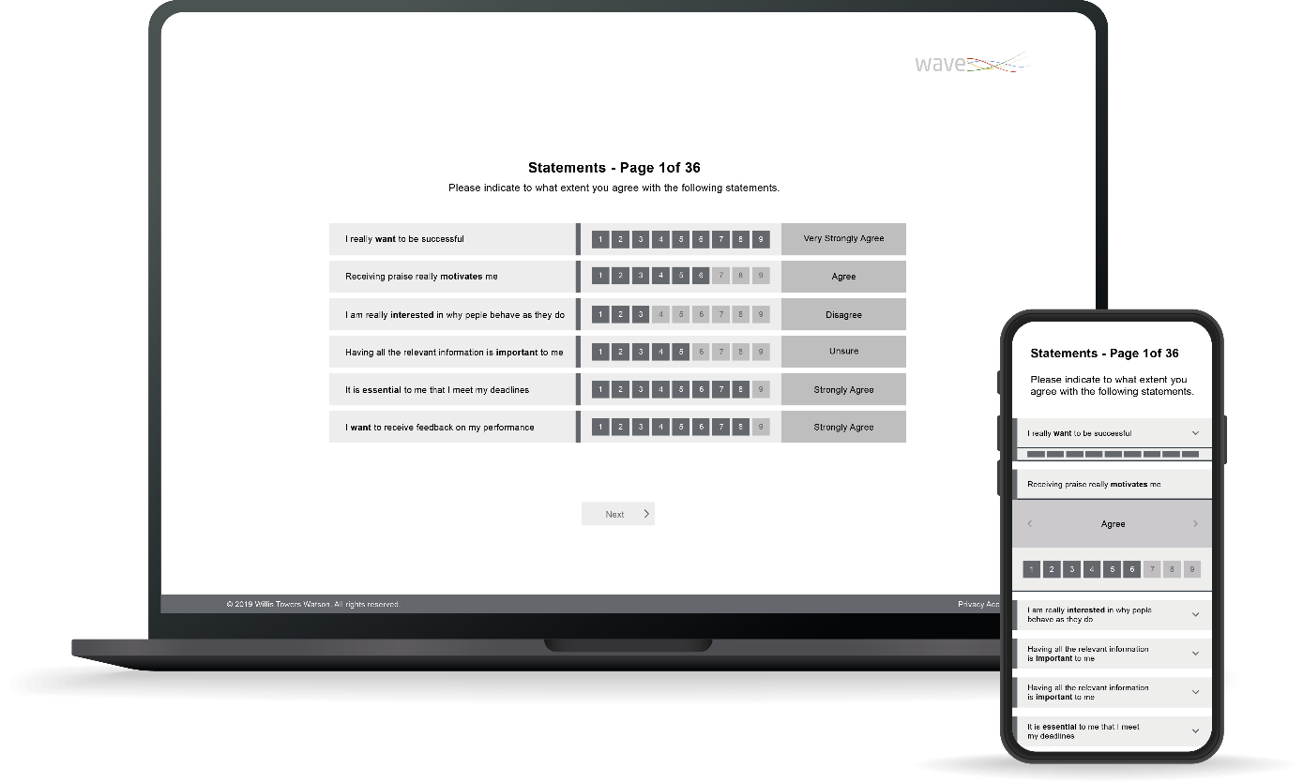
‘Will Do’ Assessments of Typical Performance
Wave Professional Styles example:
Include self-report questionnaires without time limits
‘Right’ and ‘wrong’ can vary depending on context
Notes:
2 buckets
Typical – normal day – how will you typically perform
ASK: other examples?
Interest inventories, personality questionnaires, motivational tests, attitude, 360
Has anyone done anything like this?

Slide 14
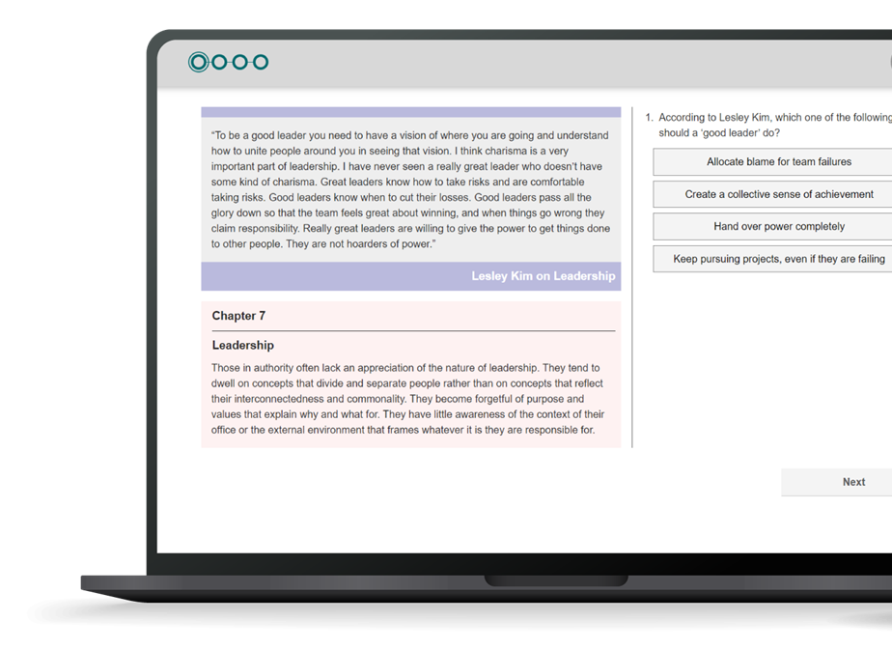
‘Can Do’ Ability Tests of Maximum Performance
Verbal Analysis Aptitude example
Include ability tests of aptitude, IQ and attainment:
Aptitude: predict what someone will be able to learn or do in the future, e.g. Saville Assessment tests
IQ: current level of intellect/cognitive ability, e.g. Wechsler Adult Intelligence Scale
Attainment: measure current level of knowledge understanding or skill, e.g. driving test
Often with strict time limits
Clear right or wrong answers
Notes:
Can do – what is the maximum you can do in these circumstances?
No subject knowledge, underlying skill
Weckler
‘to what extent can they do something in the future’
Ask: how did everyone get on with practice qs

Slide 15
Key Facts: Aptitude Tests
Benchmarks against external group
Have good validity so are a strong predictor of performance
Measures lots of different types of ability
Efficient online assessment
Fair and consistent treatment of candidates
Supplements other sources of information
Sophisticated question banking to counter cheating
Notes:
Saville Assessment aptitude tests adhere to all of the above
Question/item banking is used to increase security of the test content
This means that candidates won’t all see the same questions and that those questions will be presenting in varying orders to prevent cheating

Slide 16
Module 2
Job Analysis

Slide 17
Job Analysis
Job analysis is a multi-method approach that is used for different purposes including:
Defining role profiles/job descriptions/person specifications
Job sizing for pay grading
Developing a framework of criteria for assessment e.g. behavioral competencies
In assessment, good job analysis focuses on things that can be defined clearly and measured well
Notes:
Job analysis is the first thing you should do when starting an assessment process
It is critical for you to understand ‘what good looks like’ in a given role to be able to assess for those competencies

Slide 18
Job Analysis
Notes:
- Prerequisite
Rep grid – good vs poor
Visionary interviews
Youtube link: https://www.youtube.com/watch?v=a0Dlo0ynn-c&t=1s

Slide 19
Common Methods of Job Analysis
Traditionally, job analysis was very time consuming and involved methods to collect information from multiple sources
Structured interviews
Job holders e.g. critical incident identification
Line managers e.g. repertory grid comparisons
Job content reviews
Diaries
Observing the job
Doing the job
Task/job analysis questionnaires
Validation research
Notes:
These are a few examples of methods that are commonly used in other organizations
Structured interviews provide perspectives and allows an insight into specific circumstances. Often situations with a particularly positive or negative outcome are evaluated to understand the behaviors or skills that contributed to the particular outcome.
Critical incident identification is where job holders discuss specific difficulties they face in role, how they responded and what outcome was achieved.
Repertory grid comparisons are where a manager would the compare the behaviors and skillsets of the employees in their team to identify what helps a person perform well in the role.
Job content reviews are useful when the job remains similar or the same each day
Validation research is the gold standard and allows us to statistically analyze how predictive certain behavioral competencies or skills are of workplace performance.

Slide 20
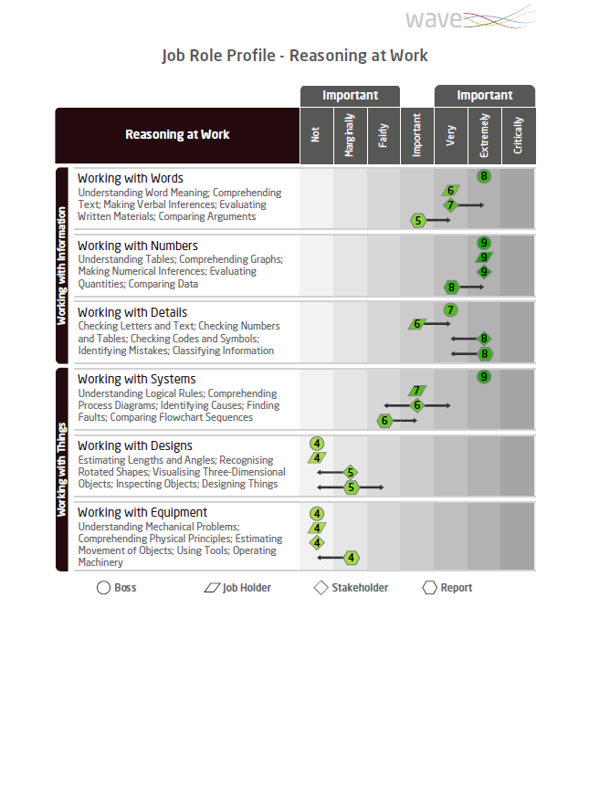
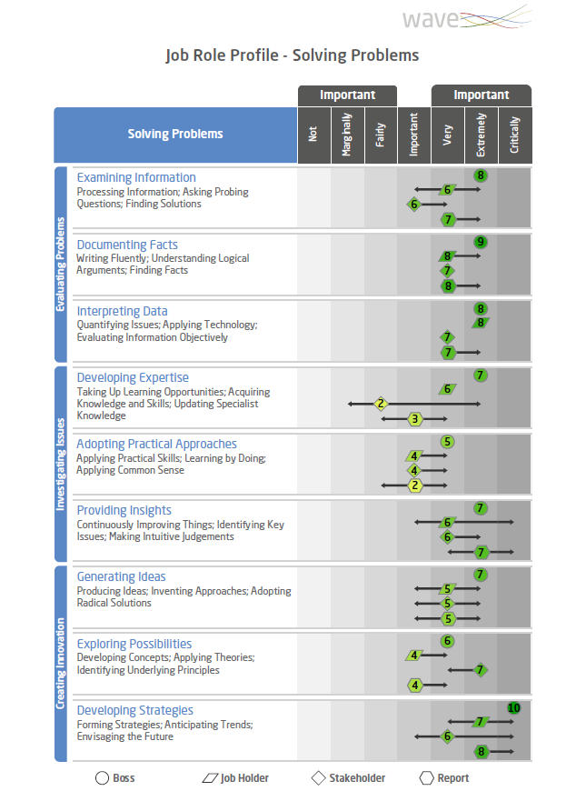
Wave Job Profiler
Online tool (15 minutes)
Survey different stakeholders
7-point ‘Importance’ rating
Can add comments
Notes:
One tool that can be used to support job analysis is our Job Profiler questionnaire
This can be sent to multiple stakeholder categories to gain their insight on how important various competencies are to the role
It is particularly useful when there is a client who would like to gain the opinions of multiple people based in different locations

Slide 21
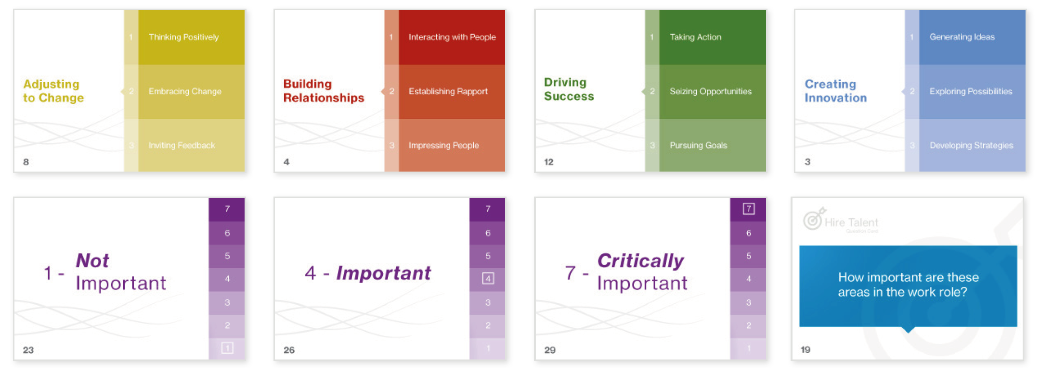
Wave Card Deck
Notes:
Alternatively, we do have card decks available to be purchased
These can be used to run in person job analysis focus groups

Slide 22
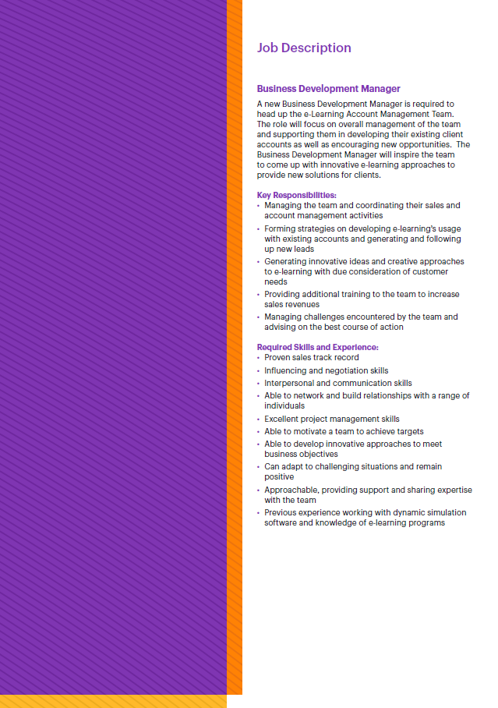
Case Study: Job Analysis
Workbook page 14
Card Sort
Review the job description on page 17 and 18 of Workbook
Use the Wave card deck on pages 15 and 16 to identify up to eight key competencies (five behaviors and three abilities)
List your key competencies in your workbook on page 14

Slide 23
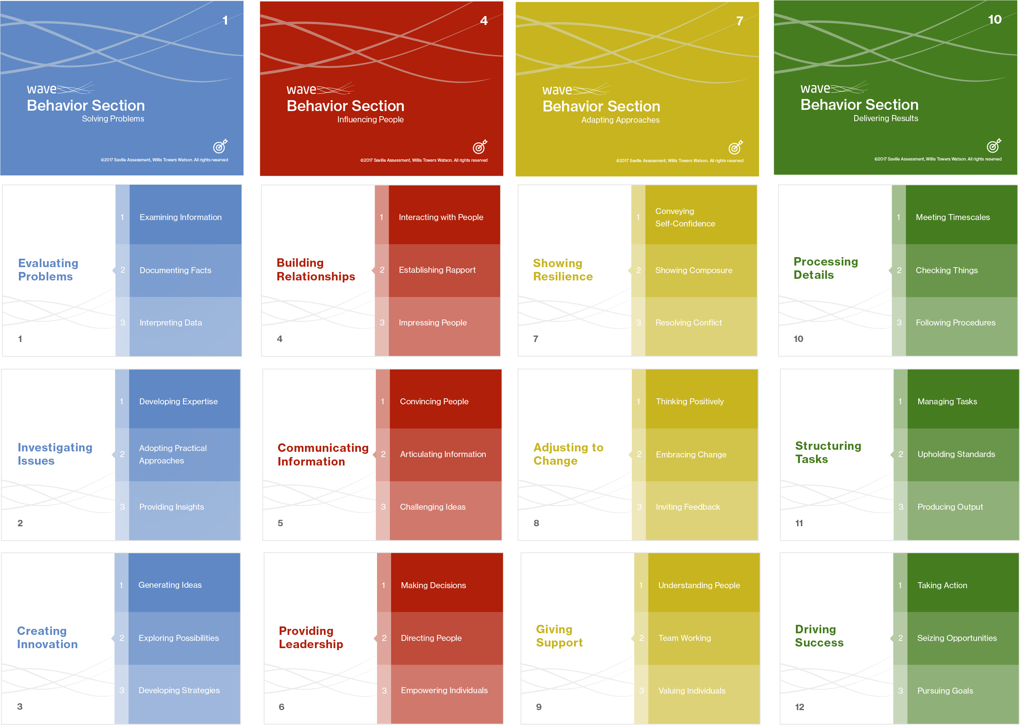
Case Study: Job Analysis
‘Hire’ Card Deck – Behavioral Sections
Notes:
Encourage trainees to discuss these 12 Wave Sections in relation to the role
The goal is to choose 4 Sections as critically important, these do not need to be split across the 4 Clusters/colors
All Sections are positively worded, making them all sound desirable, try to think of which behaviors a person could not do the job without

Slide 24
Case Study: Job Analysis
‘Hire’ Card Deck – Ability Sections
Working with Information
Working with
Things
Notes:
Encourage trainees to discuss and agree on 3 ability areas for the role

Slide 26
Module 3
Introducing Wave®

Slide 27
Introducing Wave Styles
“A suite of online questionnaires measuring personality, talent, motives, competencies and preferred culture, all combined in one dynamic instrument.”

Slide 28
Why Wave Styles?
Exceptional validity in predicting workplace outcomes
Understanding how both motives and talents drive performance
Measures preferred environment/culture fit
Online dynamic question format (rating/ranking)
Reduces potential distortion and identifies specific areas of distortion
Effectively measures other models/frameworks
One fully-integrated assessment model

Slide 29
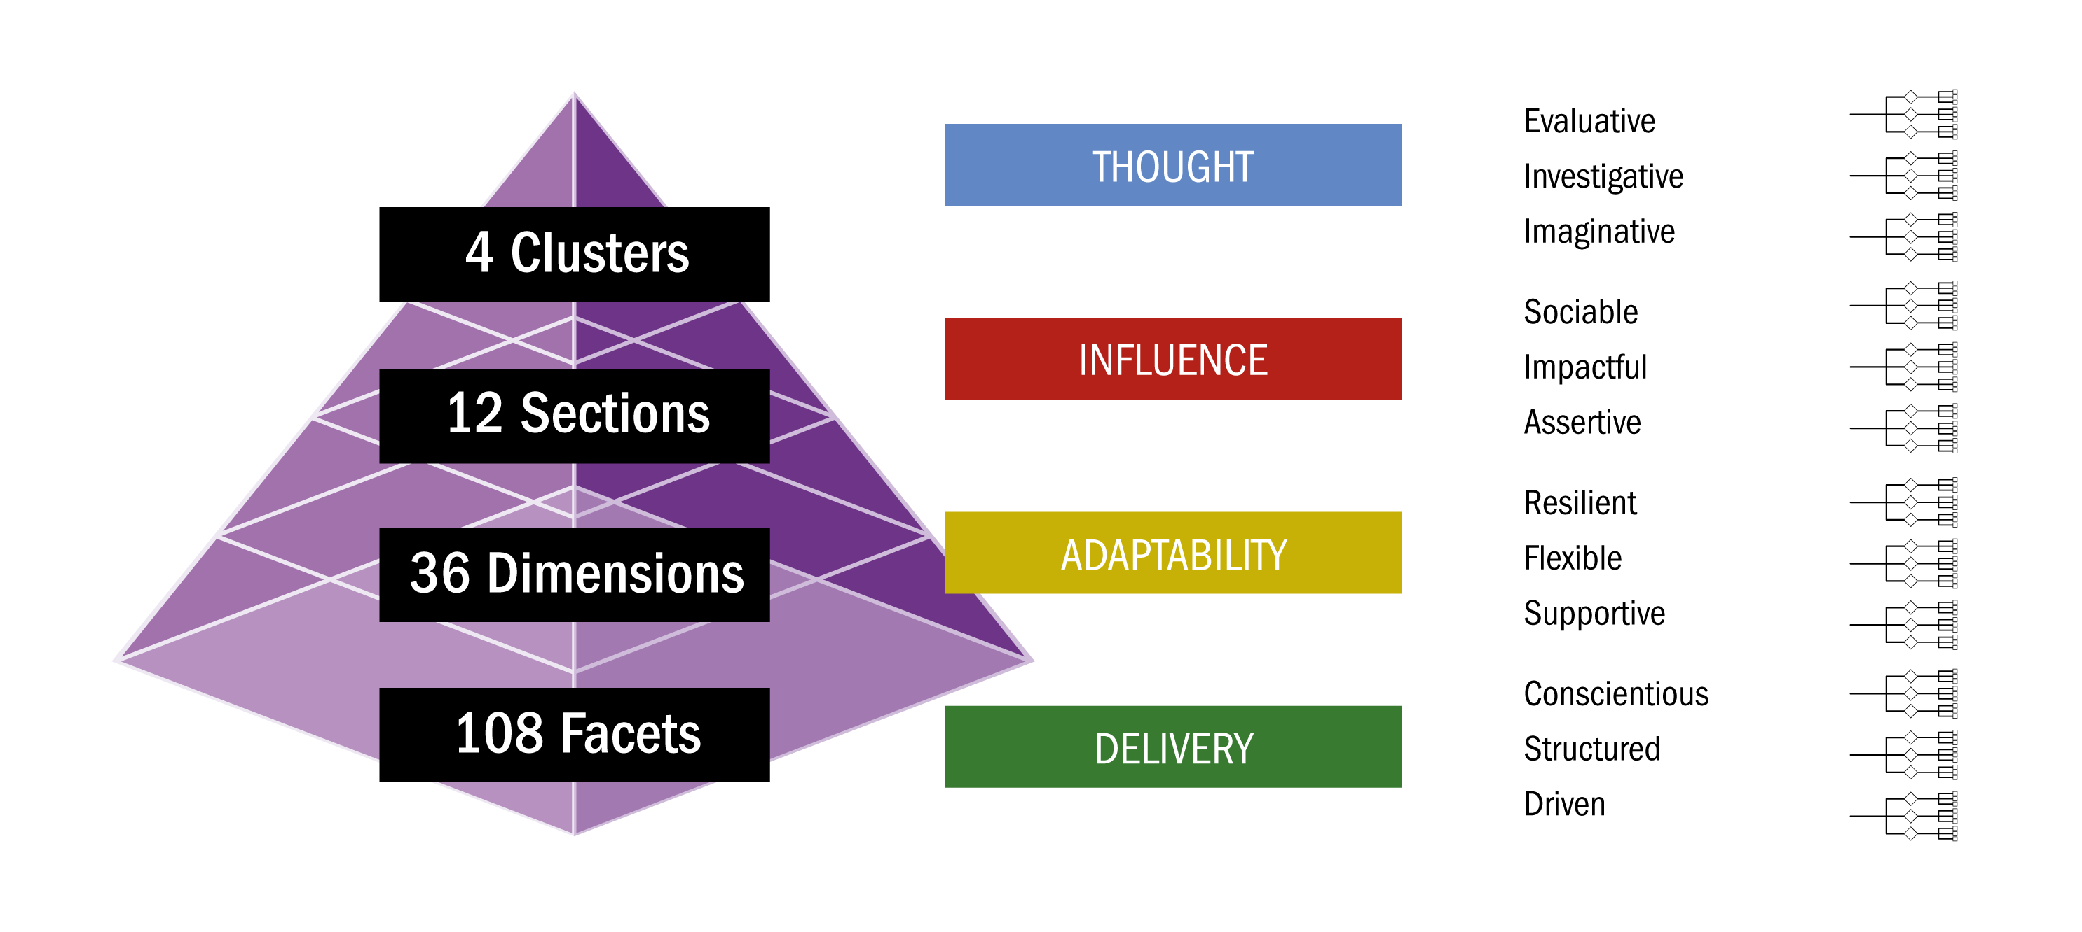
Behavior Model

Slide 30
Why Wave Styles
INFLUENCE
4 CLUSTERS
Sociable
Impactful
Assertive
12 SECTIONS
Convincing
Articulate
Challenging
36 DIMENSIONS
Presentation Oriented
Eloquent
Socially Confident
108 FACETS

Slide 31
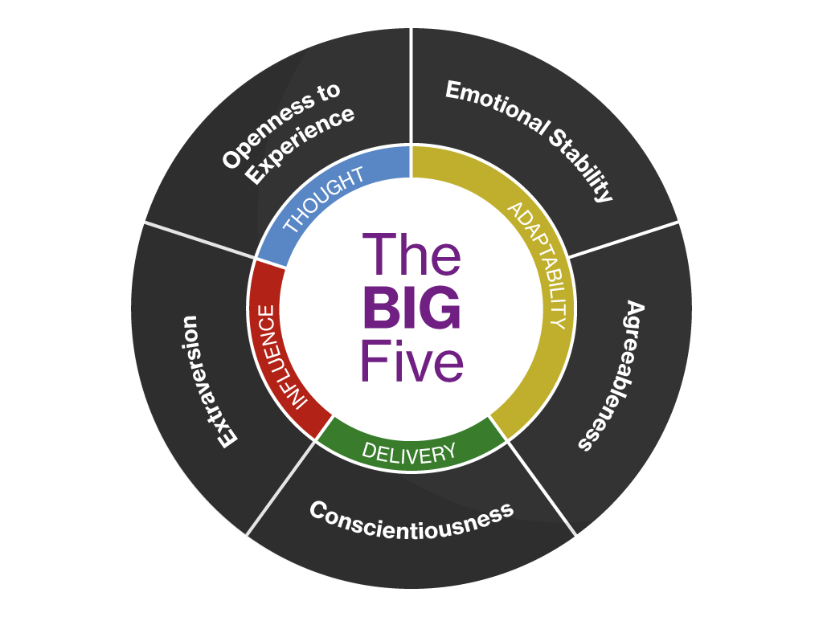
Relationship with the ‘Big Five’

Slide 32
Extensive Coverage of Work Behaviors
Comfort with IT
Speed of learning
Sticking to decisions
Building rapport
Developing strategy
Networking
Responsibility for
big decisions
Identifying business
opportunities
Encouraging others
Engaging

Slide 33
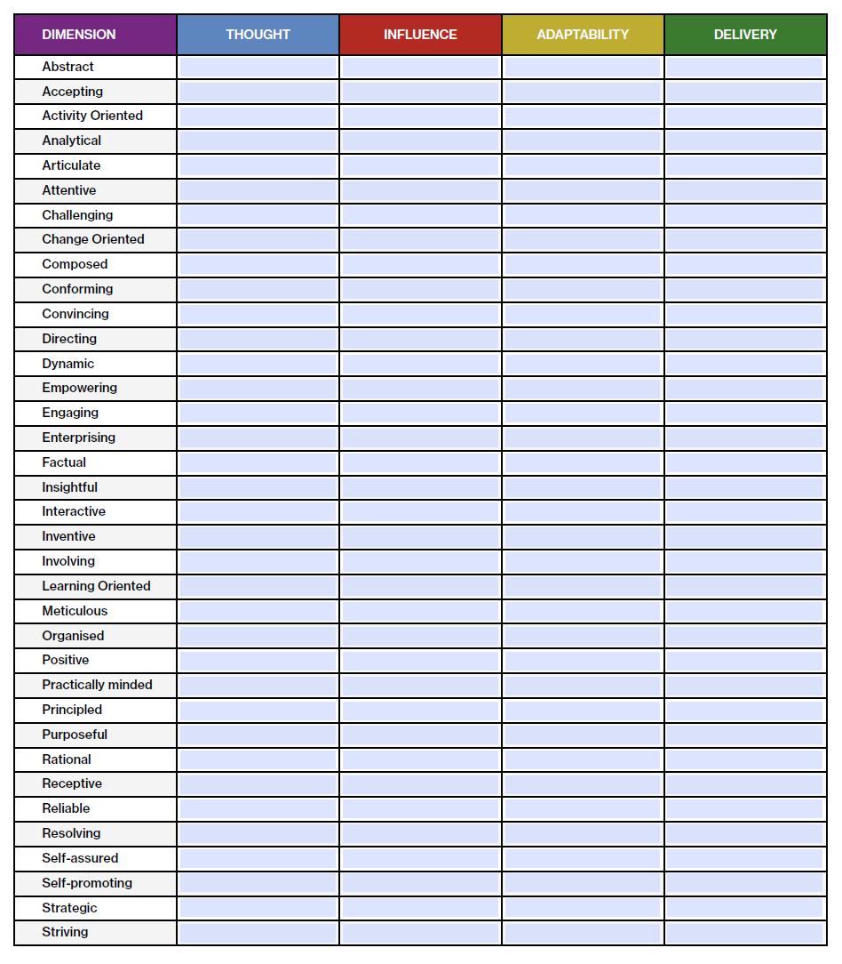
Exercise: Clusters and Dimensions
Workbook page 73
Clusters and Dimensions
The 36 dimensions are listed alphabetically in column one.
For each dimension, place a tick in the relevant column to assign the dimension to one of the four clusters.
Notes:
This is editable in their workbooks

Slide 34
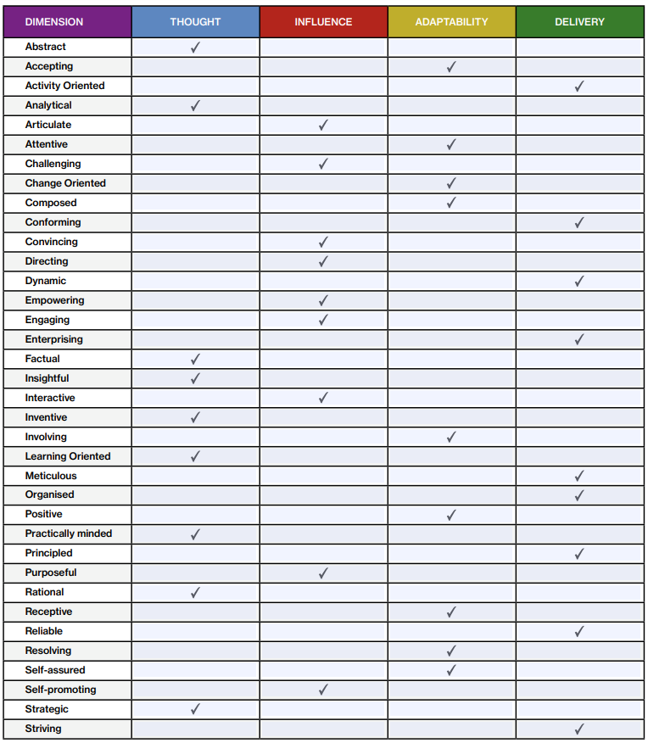
Exercise: Clusters and Dimensions

Slide 35
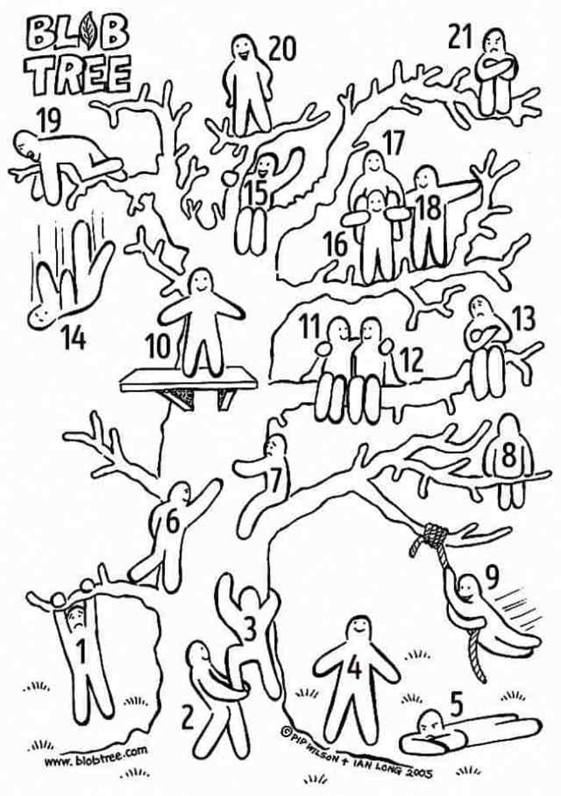
Blob Tree
Which Blob are you feeling like right now?
Notes:
Energizer – ask trainees which ‘blob’ they feel like
Use to gauge if a break is needed

Slide 36
Module 4
Deep Dives

Slide 37
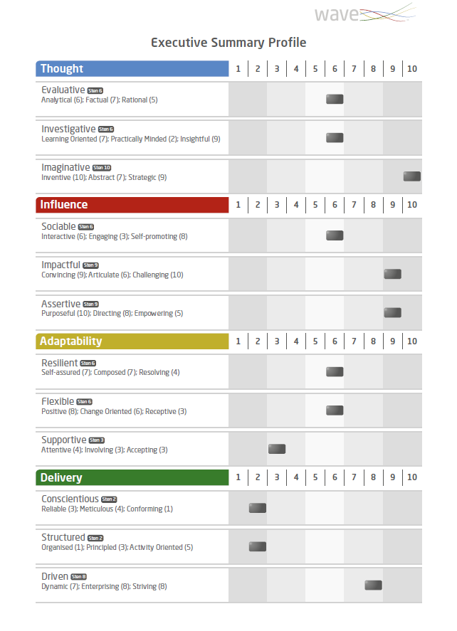
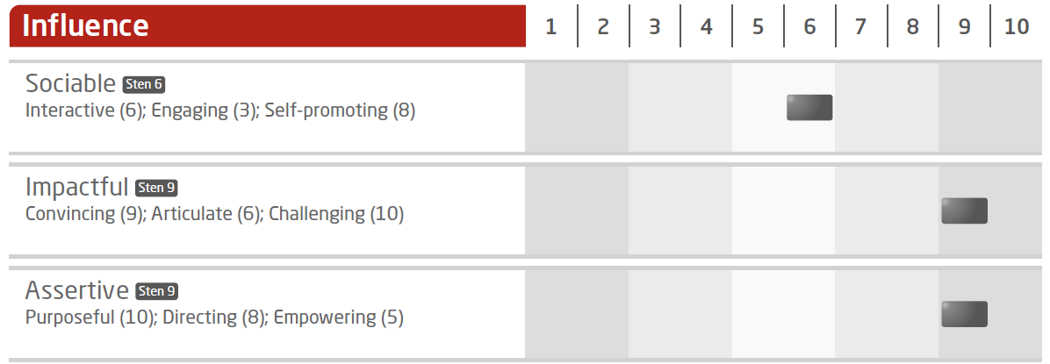
Where Most Questionnaires Stop, We Start
The Executive Summary Profile

Slide 38
Structure of the Psychometric Profile

Slide 39
Wave Facet Verbalizers
Each facet is underpinned by two questions: one motive and one talent
The facet description of the individual’s behavior changes depending upon the Sten score
In feedback, people are less comfortable accepting ‘low’ talent descriptions than ‘low’ motive descriptions
As a result, the ‘low’ facet descriptions tend to favour motive descriptions (‘cuddly lows’), and the ‘high’ facet descriptions tend to favour talent descriptions

Slide 40
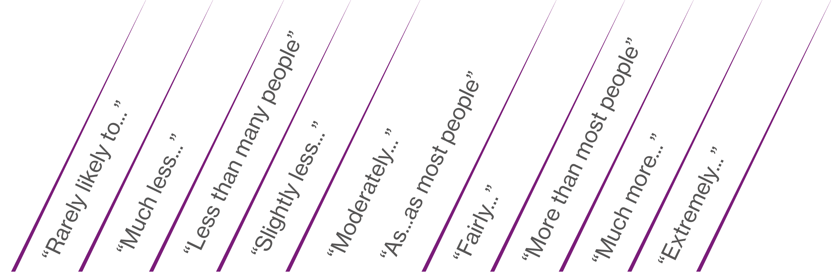
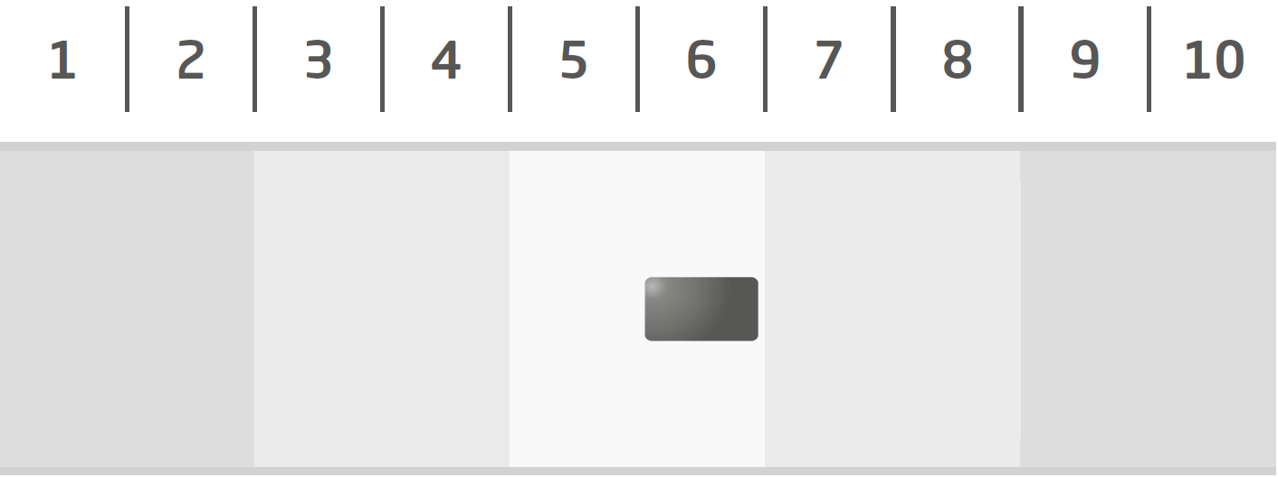
Sten Score Descriptors

Slide 41
Linking Exercise: Dimensions
Workbook page 36
1.
Notes:
Explore this combination in relation to a leadership role What might the advantages and disadvantages be?
Only slightly less Directing than others – how important is this in the specific role?

Slide 42
Linking Exercise: Dimensions
Workbook page 36
2.
Notes:
How could these style combinations play out in the role?
How important is it to be challenging?
When have they had to challenge others?
How could they use their strength in articulating to support them in being challenging?

Slide 43
Delve Deeper
Facet Range
Motive-Talent Split
Normative-Ipsative Split

Slide 44
Deep Dive 1: Facet Range
Where there is a range of facet scores within any dimension that is three Stens or more, the scores for the individual facets are shown on the profile. This often represents a point of uniqueness which goes against the general trend.
Notes:
What is the potential impact of this style combination?
How does this individual achieve outstanding results if they are less persevering than many?
Could there be an advantage to this style?

Slide 45
Linking Exercise: Facet Ranges
Workbook page 39
1.
Notes:
Explore initial reactions to these two areas – can explore one at a time then combine
How much opportunity/time does this individual have to learn about new things?
They appear to prefer learning by reading – is this possible in the role?
What does practical work look like for them/in the role?

Slide 46
Linking Exercise: Facet Ranges
Workbook page 39
2.
Notes:
How important is it to be positive in the role?
What impact could this have on others around them?
If this is a leadership/manager position, how do they bring others with them during change?
Common pattern to see people finding it difficult to cope with uncertainty

Slide 47
What are Styles?
“Styles are a combination of the motives and talents of individuals. What individuals want and what individuals see themselves as good at, are both critical to predicting the culture in which people prefer to work, and their performance at work.”
Professor Peter Saville

Slide 48
What are Motives?
Motives are the ‘need’ items of the questionnaire
They measure the individual’s needs / wants / desires / preferences
They reveal what the individual is motivated or driven by
I enjoy
I want
It is important to me

Slide 49
What are Talents?
Talents are measured by the ‘effectiveness’ items of the questionnaire
They measure the individual’s self-perception of behaviors they demonstrate and are effective at
I am good at
I am
People say I

Slide 50
Motive or Talent
Workbook page 42
I enjoy giving presentations | M
I am good at working with numerical data | T
I am considerate to others | T
People say I am energetic | T
I want to be the leader | M
I prefer to be optimistic | M
Using technology is one of my strengths | T
I need to have rules to follow | M
I work well when I am busy | T
I feel comfortable dealing with angry people | T
I have a strong sense of my own worth | T
It is important to me to feel positive about myself | M

Slide 51
Deep Dive 2: Motive-Talent Splits
Differences of three Stens or more between the motive and talent score on a dimension are highlighted and may indicate a point of interest.
The individual reports motive higher than talent.
Explore the need and potential to develop.
The individual reports talent higher than motive.
Explore the discrepancy, try to understand why motive is lower and what impact this has on performance.
Notes:
Self-assured
How important is it for them to be self-assured in their role?
How much autonomy do they have in their role/in their own development?
How might developing in this area benefit them?
Interactive
How important is it for them to be interactive in their role?
Is motivation lower as their would be a benefit to being less lively/talkative?
If being interactive is important, how might this motivation impact negatively?
What to they like/dislike about being interactive?

Slide 52
Interpreting Split Directions
Motive higher than talent
aspires to…
does less well, but with high frequency?
demonstrates with enthusiasm but potentially less skill?
Talent higher than motive
bored of…
does well, but with low frequency?
demonstrates this with ease but with less passion?

Slide 53
Linking Exercise: Motive-Talent Splits
Workbook page 45
1.
Notes:
Remember to cover facets first before exploring M-T splits
How important is it to empower others in this role?
What do they like/dislike about empowering others?
Example to gather evidence of talent
What could be the impact/risk of lower motivation?

Slide 54
Linking Exercise: Motive-Talent Splits
Workbook page 45
2.
Convincing
Sten 7
Persuasive (7); makes own point strongly (7); is focused on negotiating the best deal (7)
Articulate
Sten 1
Strongly dislikes giving presentations (1); often has difficulty explaining things clearly (2); feels less confident meeting new people than many (3)
Notes:
Remember to cover facets first before exploring M-T splits
Explore Convincing first
Why is this important to them?
How well do they feel they convince others? Any examples?
Could their responses to articulate be having an effect on their ability to convince others?
How would it benefit them to improve their articulation skills?

Slide 55
Response Bias
Most people give an accurate self-description on self-report questionnaires but some do not. For example:
Some people have a false impression of themselves
Some people are motivated to fake good or fake bad
How do we know? What can we do?

Slide 56
Distorted Results?
Prevent
Use a questionnaire with a format designed to control for response bias
Before administering such a questionnaire, indicate that:
The profile will be cross-referenced with other data
The results will be discussed during feedback/interview
There are response checks within the questionnaire
Detect
Wave uses a dynamic format which leads to both normative and ipsative scoring in the same administration
This gives an overall indication of how positive/lenient or negative/self-critical someone has been in their responses
This also highlights specific areas to the user where distortion may have occurred

Slide 57
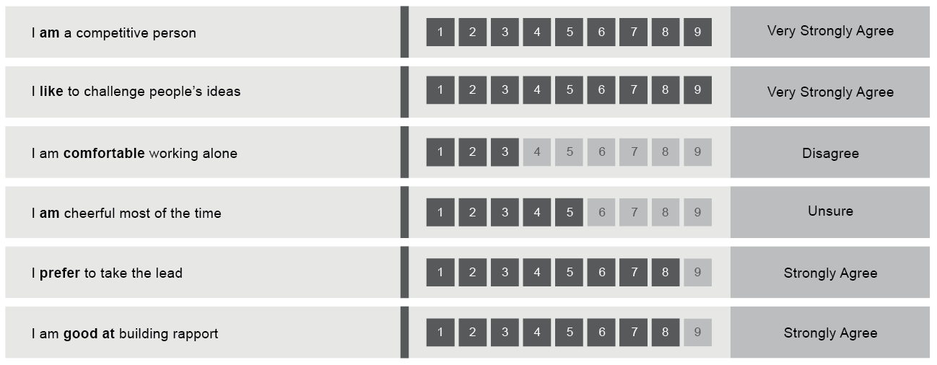
Normative Scores from Ratings
People are free to rate themselves as they like on each individual statement and the resulting normative profile could reflect a highly positive or negative self-perception.
Profiles can be high across most scores for people who are positive responders and vice versa for those who are very self-critical.

Slide 58
Ipsative Scores From Rankings
The individual is forced to choose between different statements and the resulting ipsative profile provides a balance of high and low scores.
Some individuals find ranking tasks a little bit more challenging because they are always forced to prioritize one thing over another.

Slide 59
Why Both in Wave Styles?
The dynamic rate/rank format of Wave carries a number of advantages:
Increases candidate acceptability
Creates more varied profiles
Enables reporting at facet level
Enhances reliability and validity
Makes faking more complex
Makes distortion easier to detect

Slide 60
Normative Scores from Ratings and Ipsative Scores from Rankings
 | Normative Scores from Ratings | Ipsative Scores from Rankings
Advantages | User friendly for individuals to rate themselves as they see fit | Pull greater differentiation out of profiles Controls for acquiescence
Disadvantages | Can lead to profiles that reflect overly-lenient or overly self-critical responses Can be purposefully inflated | Can be challenging for individuals to prioritise one behaviour over another

Slide 61
Deep Dive 3: Normative-Ipsative Splits
Differences of three Stens or more between an individual’s normative and ipsative response on a dimension are highlighted and could represent an area of over- or under-rating to explore.
Normative score is higher than ipsative score
Check/verify for potential exaggeration
Ipsative score is higher than normative score
Check/verify for potential modesty/self criticism
Notes:
Receptive
Is this an area they have initially overrated?
When might they be more/less receptive?
What could the risk/impact be if they become less receptive under pressure?
What are some advantages to this style?
Purposeful
Is this an area they have initially underrated?
When might they be more/less purposeful?
How important is this area in the role?
What are the advantages/disadvantages of this style?
How might this impact others involved in the decision making process?

Slide 62
Interpreting Normative-Ipsative Splits
I
N
Ipsative lower than Normative
Are you less critical/over-rating yourself in this area?
N
I
Normative lower than Ipsative
Are you critical/under-rating yourself in this area?

Slide 63
Other Hypotheses to Explore
Explore any likely impact of splits in recruitment or development, for example:
N – “Is this how they are when things are free and easy?”
I – “Is this how they are when there is more pressure?”
N – “Is this how they prefer to see themselves?”
I – “Is this the uncomfortable/unrecognized truth?”
“In which situations are they more likely to be like this?”
“In which situations are they less likely to be like this?”

Slide 64
Linking Exercise: Normative-Ipsative Splits
Workbook page 51
1.
Notes:
Remember to cover facets first before exploring N-I splits
Is this an area they have initially overrated?
When might they be more/less organized?
What is the impact of potentially becoming less organized under pressure?

Slide 65
Linking Exercise: Normative-Ipsative Splits
Workbook page 51
2.
Meticulous
Sten 8
Pays close attention to detail (8); very thorough (8); ensures a high level of quality (8)
Notes:
Remember to cover facets first before exploring N-I splits
Is this an area they have initially underrated?
When might they be more/less meticulous?
Does a naturally tendency to be detail oriented come out under pressure?
What impact might this have in their role?

Slide 66
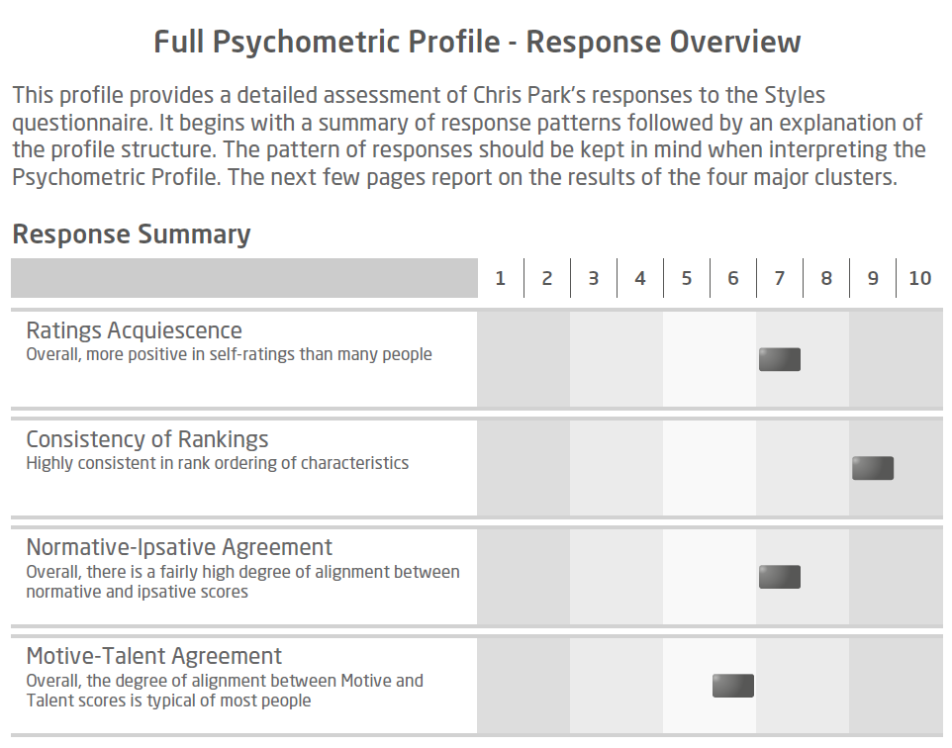
Understanding Overall Response Patterns

Slide 67
What might a low overall Ratings Acquiescence mean for a person's profile?
a) The person's overall profile is likely to be closer to the left of the Sten scale
b) The person's overall profile is likely to be closer to the right of the Sten scale
c) The person's overall profile is likely to be typical of those in the comparison group

Slide 68
What might a high Ratings Acquiescence mean for a person's overall profile?
a) The person's overall profile is likely to be closer to the left of the Sten scale
b) The person's overall profile is likely to be closer to the right of the Sten scale
c) The person's overall profile is likely to be typical of those in the comparison group

Slide 69
Where a response summary indicates Low N-I agreement, what do you expect to see in the profile?
a) Many N-I Splits
b) Not so many N-I Splits
c) You can not tell

Slide 70
Where a response summary indicates low Ratings Acquiescence and low Normative-Ipsative agreement, what would you expect to see on a profile?
a) There are a number of N-I splits across the profile varying in the Normative/Ipsative position
b) There are a number of N-I splits on the profile with Normative lower than Ipsative
c) There are a number of N-I splits on the profile with Normative higher than Ipsative

Slide 71
If a person has a high Consistency of Rankings, would you expect to see a greater or lesser number of Motive-Talent splits across their profile?
a) More M-T splits
b) Less M-T splits
c) Consistency of Rankings is independent from Motive-Talent agreement

Slide 72
Module 5
Expert Report

Slide 73
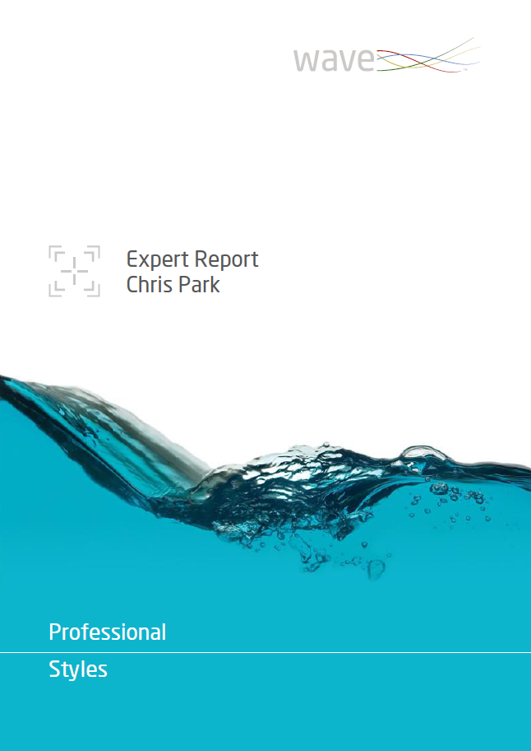
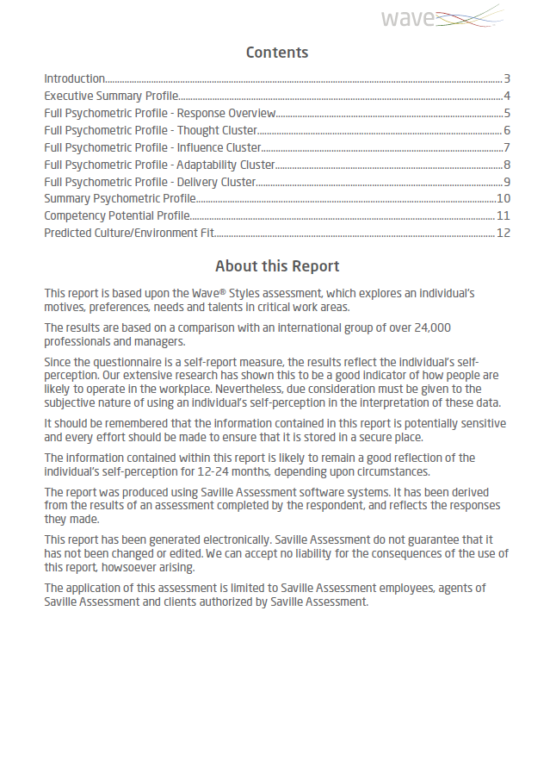
The Expert Report

Slide 74
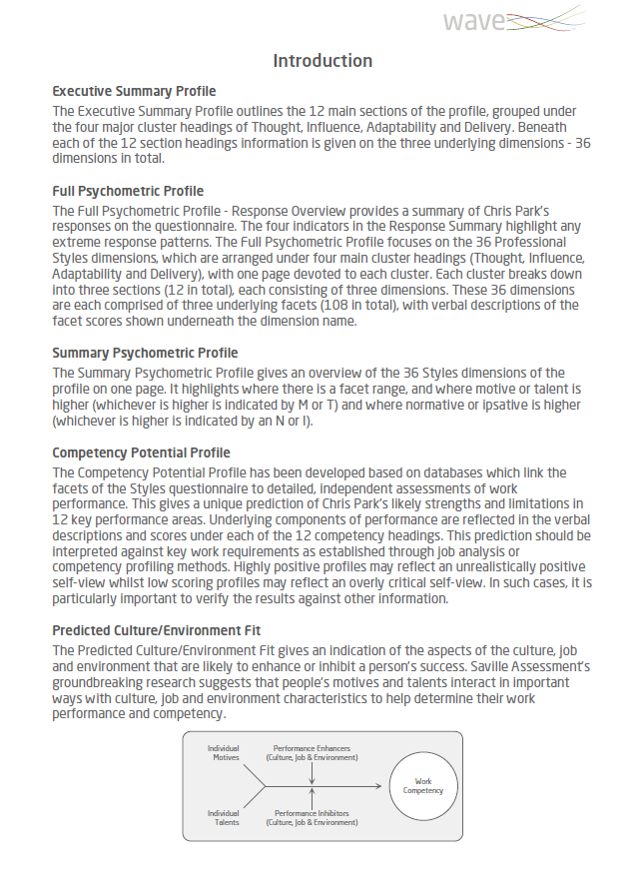
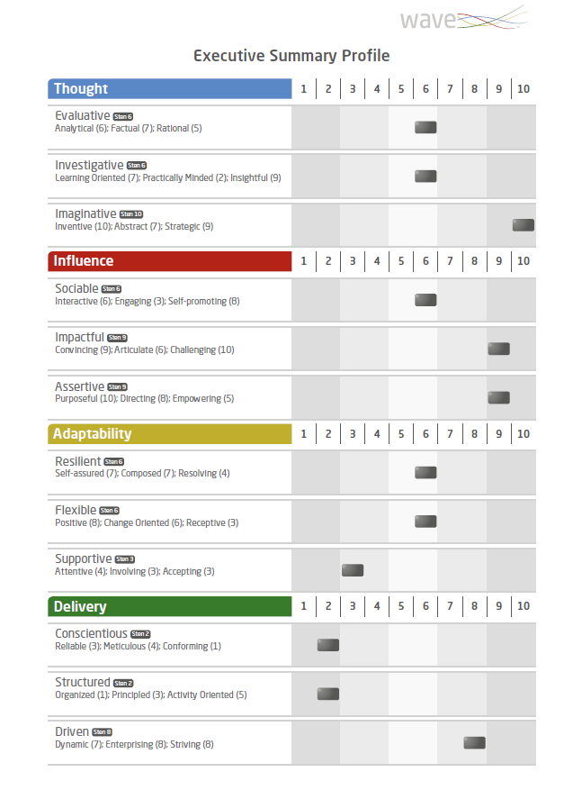
The Expert Report

Slide 75
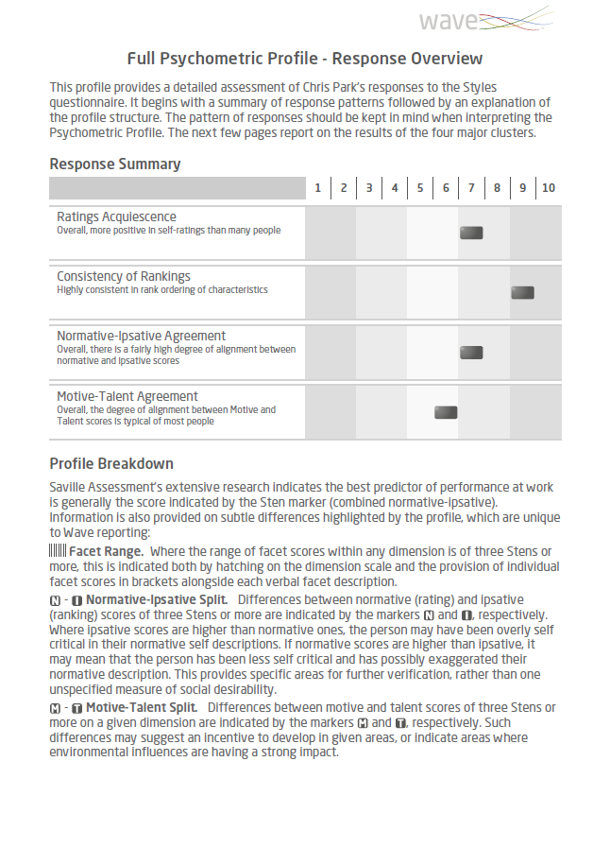
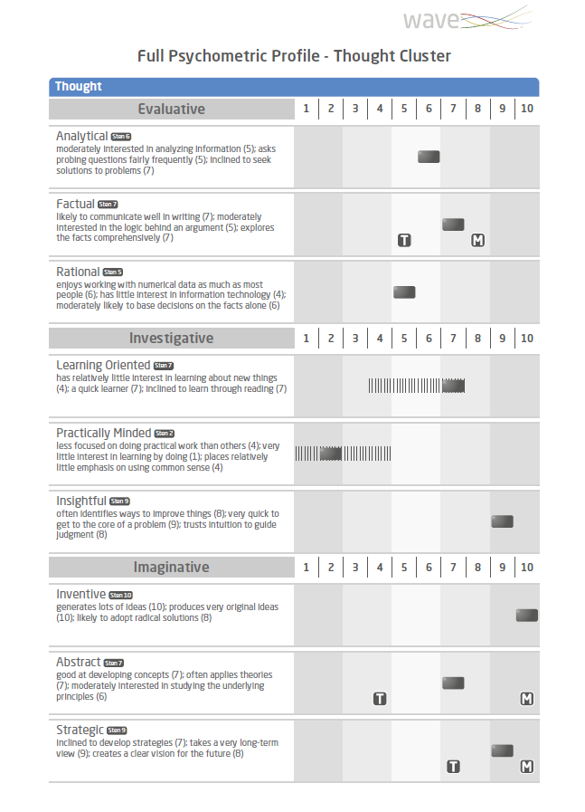
The Expert Report

Slide 76
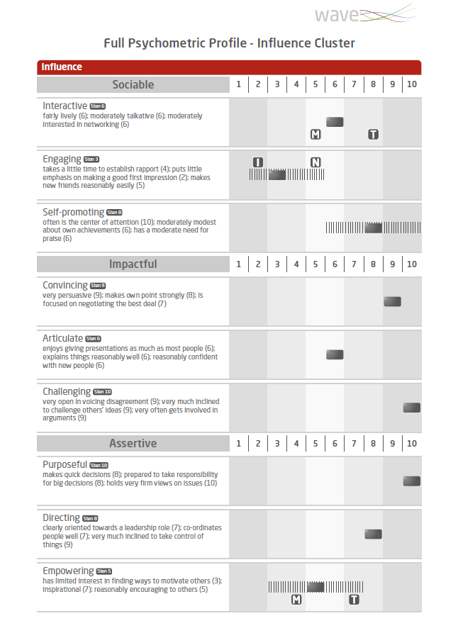
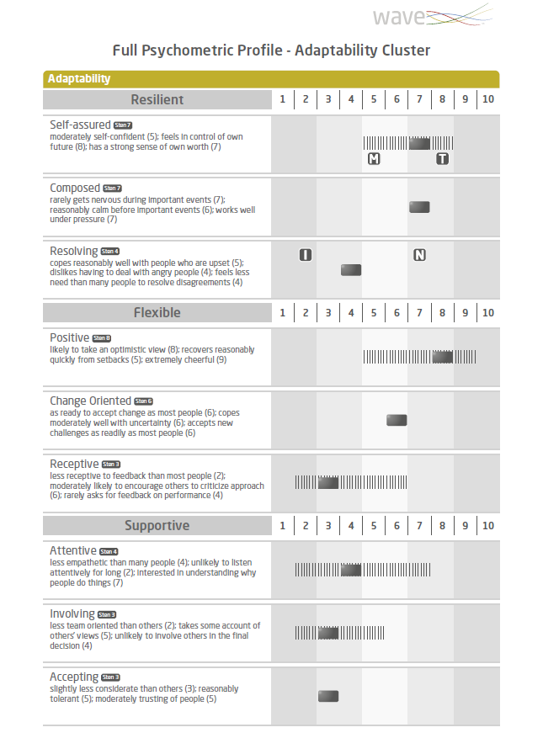
The Expert Report

Slide 77
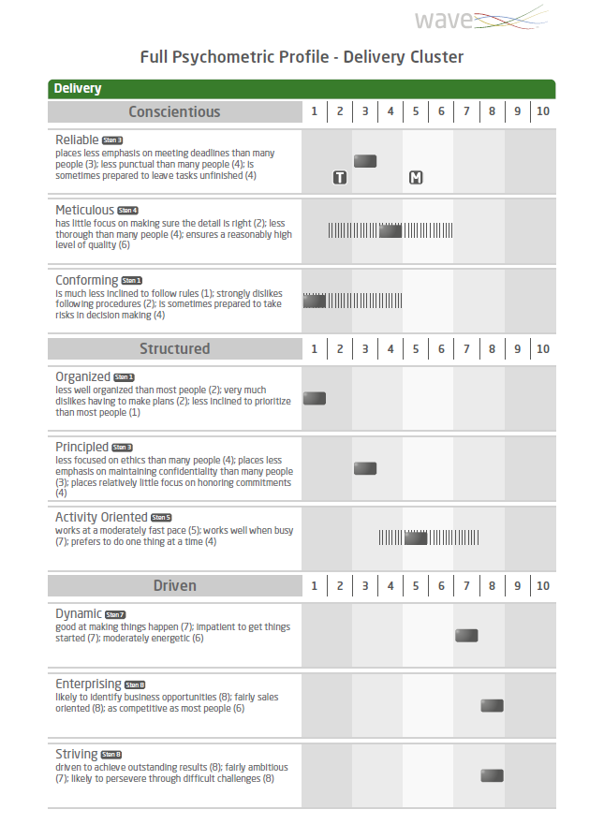
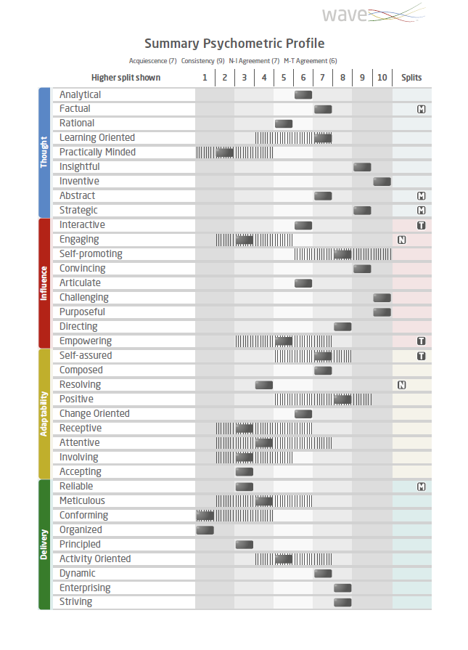
The Expert Report

Slide 78
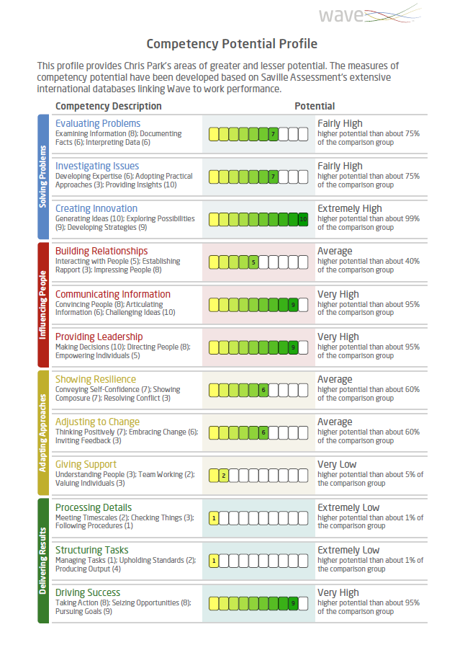
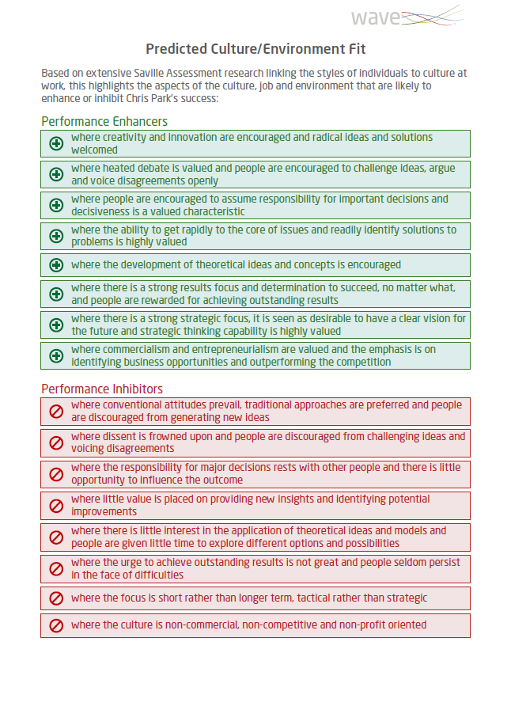
The Expert Report

Slide 79
Saville Assessment Aligned Model

Slide 80
Example of Competency Potential Equation
For example;
Identifying Business Opportunities =
Business Opportunity Oriented facet x 21
+ Leadership Oriented facet x 4
+ Deciding on Action facet x 3
+ Action Oriented facet x 2
+ Visionary facet x 1

Slide 81
Module 6
Feedback of Wave

Slide 82
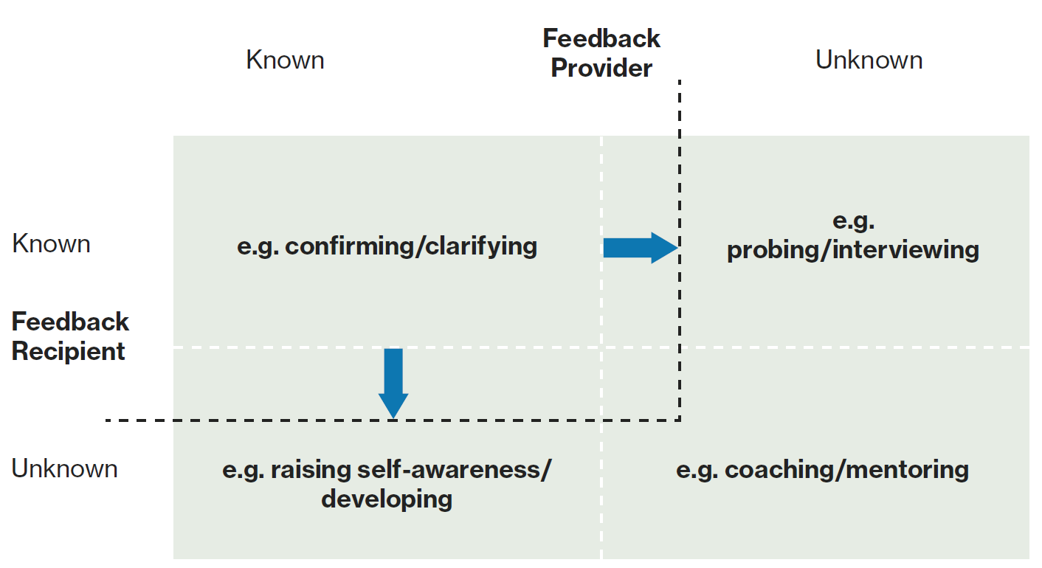
The Johari Window

Slide 83
What is the Feedback For?
Feedback normally has a clear purpose and structure depending on what you’re trying to do, e.g.:
To give information
To share understanding
To reach agreement
For public relations
To meet ethical responsibilities
To comply with applicable legislation

Slide 84
Feedback Process
Setting the scene
Explain how Wave works
Response Summary
Feedback the profile
Summarize
Discuss Deep Dives
Ask questions
Make links

Slide 85
Self-Report: Whose Data Is It?
The following self-report phrases are useful for introducing dimensions and facets:
“You describe yourself as…”
“You see yourself as…”
“Your responses suggest that…”
Avoid:
“The report says…”
“You are…”
“You’re higher than the norm on...”
“You scored…”

Slide 86
Sten Score Descriptors

Slide 87
Breaking Down the Deep Dives
Empowering
Sten 8
Is good at finding ways to motivate people (7); very inspirational (9); reasonably encouraging to others (6)
Typical Approach
Dimension
Facets & facet range – explain and explore
Motive-talent split – explain and explore
Normative-ipsative split – explain and explore

Slide 88
Breaking Down the Deep Dives
How would you interpret the overall Sten marker?
You are more empowering than others
Your responses suggest that you see yourself as more likely to be empowering than others in the comparison group
You are good at finding ways to motivate people, very inspirational and reasonably encouraging to others
The report says you are slightly more empowering than most others in the comparison group
Empowering
Sten 8
Is good at finding ways to motivate people (7); very inspirational (9); reasonably encouraging to others (6)

Slide 89
Breaking Down the Deep Dives
Which one of the statements best describes this individual's Facet Range?
There is a large spread between Dimension scores
They have been inconsistent in their responses to Empowering
There is a spread in responses to Empowering where they see themselves as very inspirational but only reasonably encouraging to others
Empowering
Sten 8
Is good at finding ways to motivate people (7); very inspirational (9); reasonably encouraging to others (6)

Slide 90
Breaking Down the Deep Dives
Which statement provides the best interpretation for the Motive-Talent split?
Their perceived interest and effectiveness at Empowering are well aligned
They perceive themselves to be as effective as most at Empowering others but have much more motivation in this area
They perceive themselves to be very effective at being Empowering but have a typical level of interest in this area
Empowering
Sten 8
Is good at finding ways to motivate people (7); very inspirational (9); reasonably encouraging to others (6)

Slide 91
Breaking Down the Deep Dives
Which statement best describes what the N-I split suggests?
The individual has not answered the questionnaire honestly
Initially, the individual has indicated that they are much more empowering than most, however when they were forced to prioritize, they deprioritized Empowering and indicated they are as focused on Empowering as others
When the individual is free to act, they see themselves as being as Empowering as others in the comparison group, however, when the individual is under pressure, they are much more Empowering than others
Empowering
Sten 8
Is good at finding ways to motivate people (7); very inspirational (9); reasonably encouraging to others (6)

Slide 92
Wave Deep Dives Video
Notes:
Say – speak quite fast on video, will put link into the Chat for future reference, focus on the sequence of events, the way deep dives are explained and the types of questions that are used.
https://youtu.be/7ghAxpMLd20

Slide 93
Questions and Probing
I keep six honest serving men (They taught me all I knew); Their names are What and Why and When and How and Where and Who.
From ‘The Elephant’s Child’ by Rudyard Kipling

Slide 94
Useful Open Questions for Feedback Sessions
“How does that sound to you?”
“How important is that area for your current role?”
“When are you more likely to do this at work?”
“Why is that important to you?” – Be sensitive!
“What impact does that style have on your performance at work?”
“What are the advantages/disadvantages of that particular style?”
“Where has this been most successful?”
“Give me an example of when you have demonstrated those behaviors recently.”
"How easy/difficult do you find it to (e.g. resolve conflict)?"

Slide 95
‘Watch-Fors’ and the Barnum Effect
A potential risk of over-reliance on non-empirical forms of validity (e.g. face and faith) is that individuals end up accepting feedback which doesn’t offer any value in predicting work performance.
When people accept general truisms that apply to most people as accurate portrayals of their own uniqueness, this is typically known as the Barnum Effect.

Slide 96
Feedback Tips
More Effective Feedback
Less Effective Feedback
Prepare
Keep the conversation two-way
Be sensitive and empathic; be objective with the profile
Actively listen and summarize
Describe behaviours, not scores or numbers
Use the Wave feedback help sheet
Making assumptions
Using technical jargon
Value judgments

Slide 97
Practical Session: Feedback
Wave Feedback
You will receive the report of another delegate. Please prepare a feedback session including:
An introduction
Response Summary
One Cluster
Please keep all data secure and confidential.
Notes:
Break into groups/pairs for feedback

Slide 98
Feedback Process
Setting the scene
Explain how Wave works
Response Summary
Feedback the profile
Summarize
Discuss Deep Dives
Ask questions
Make links

Slide 99
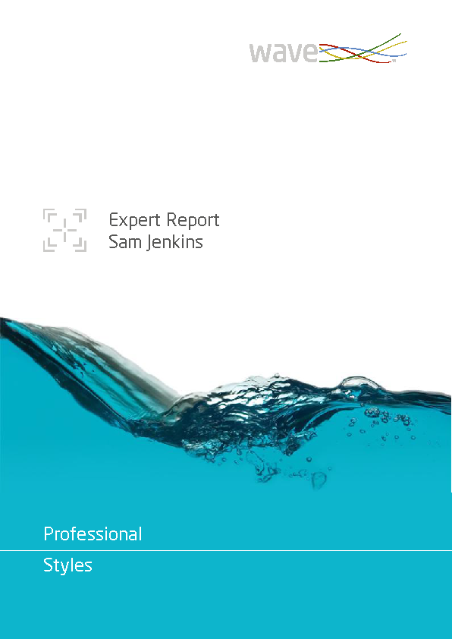
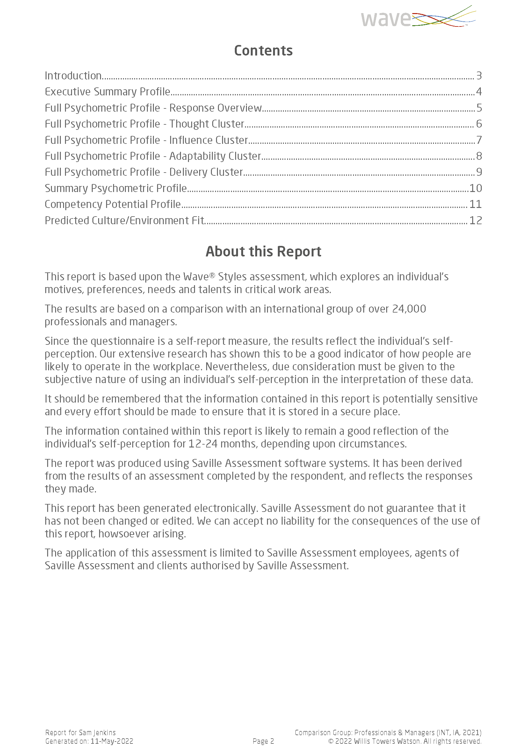

Slide 100
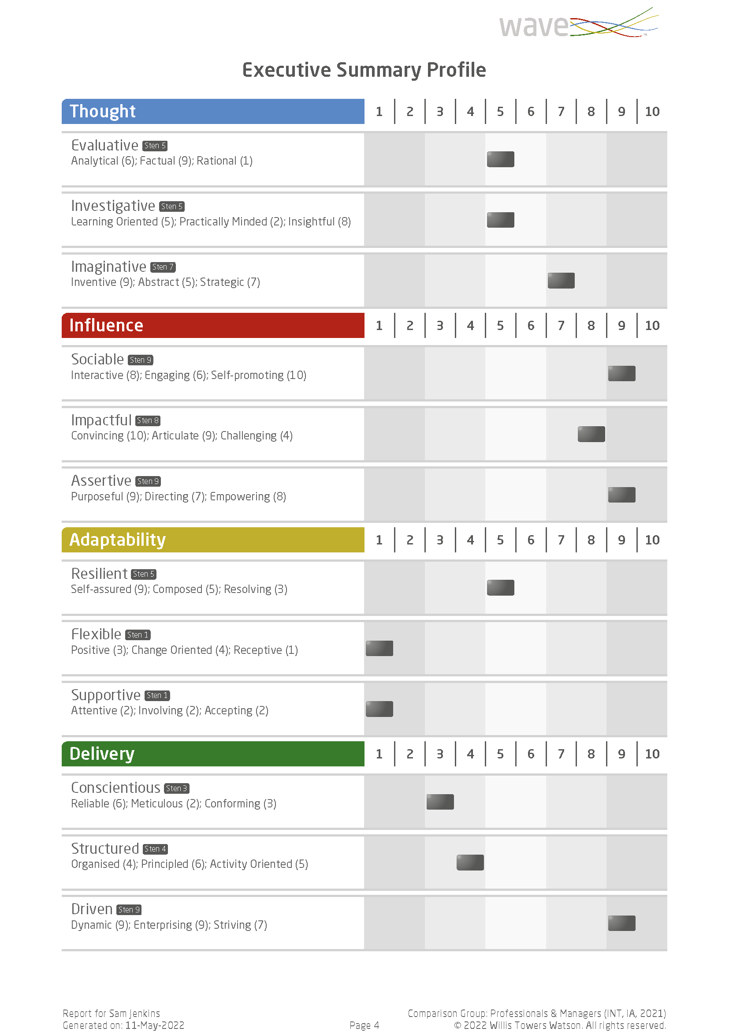
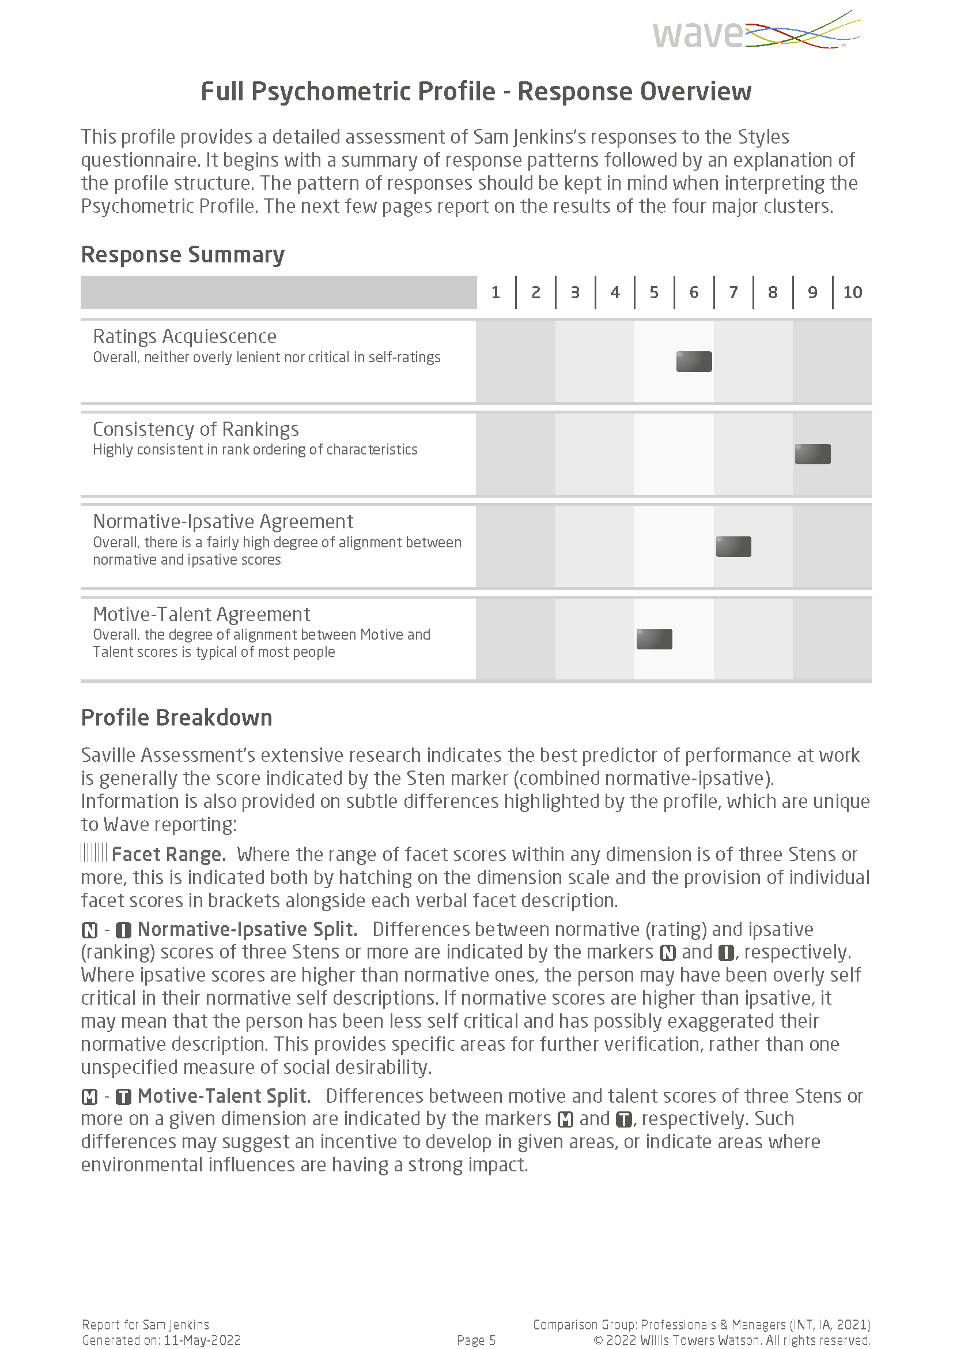

Slide 101
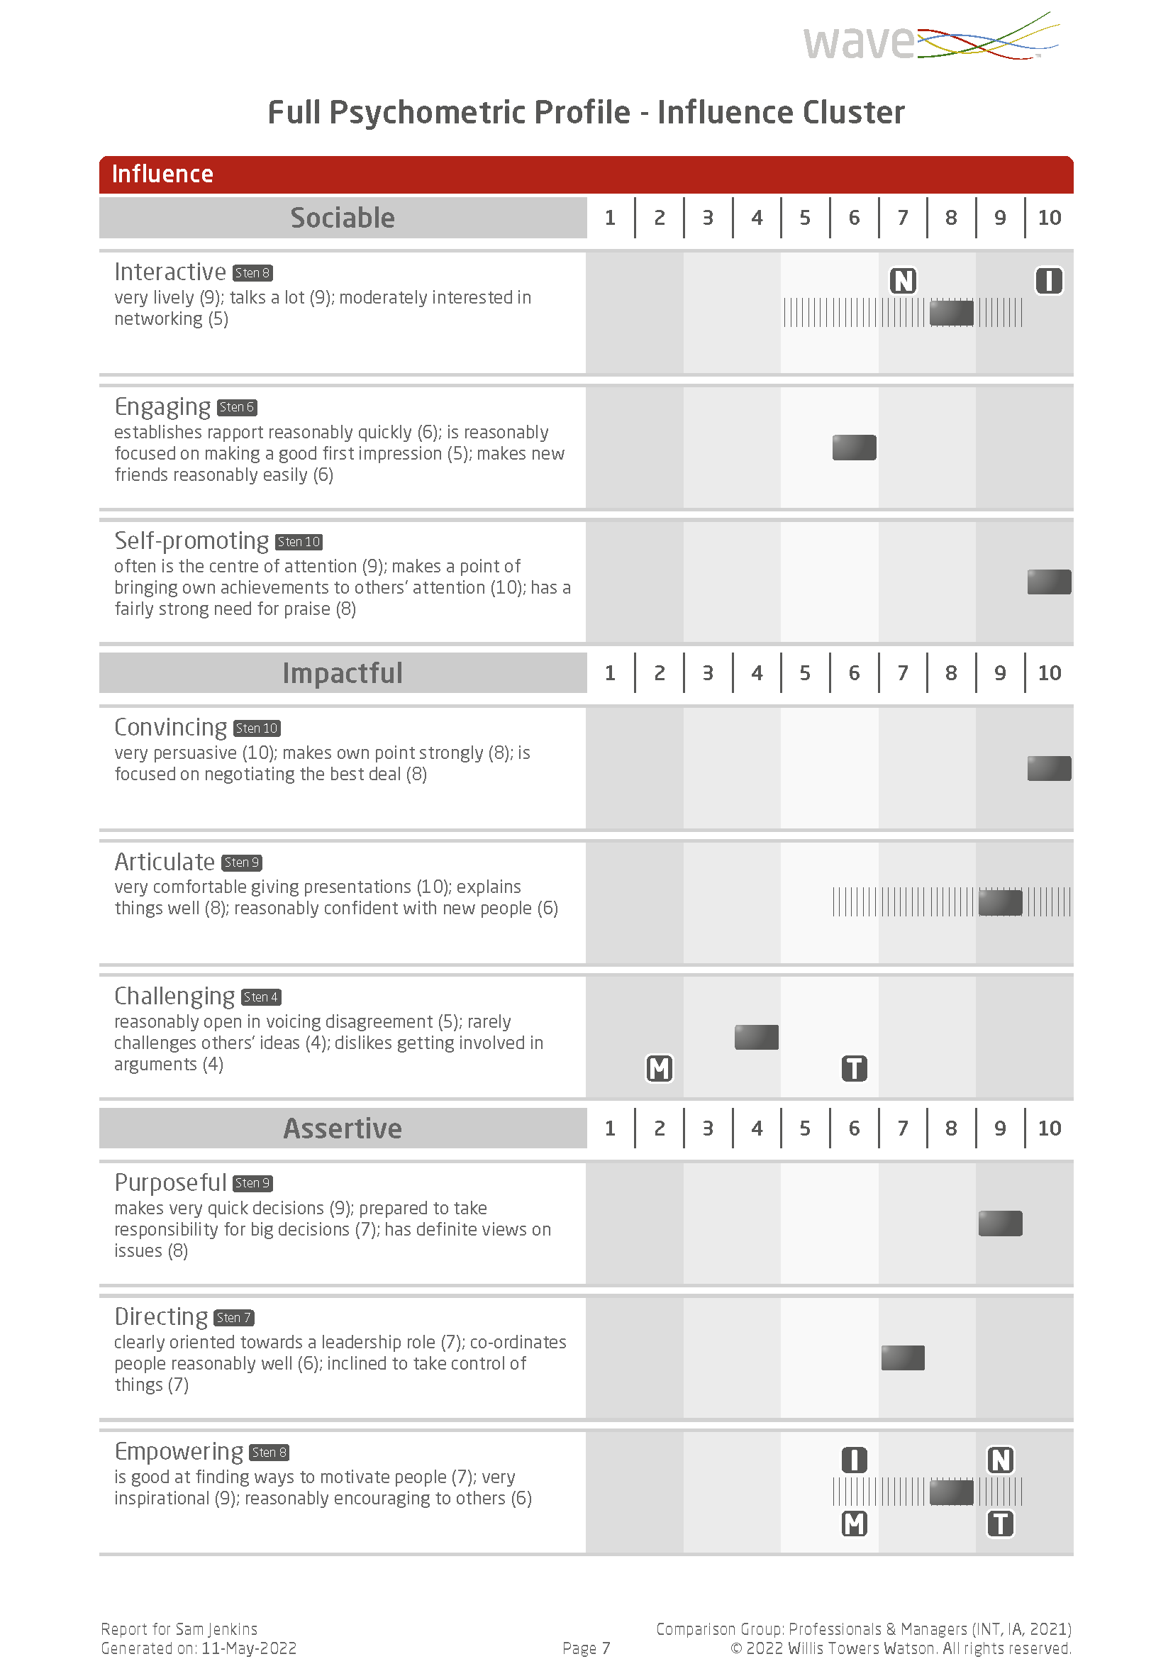

Slide 102
Practical Session: Feedback
Feedback Provider | Feedback Receiver
Anna | Camila
Camila | Thiantharit
Thiantharit | Manuel
Manuel | Anna
Tutor: Nikki | Tutor: Nikki
Feedback Provider | Feedback Receiver
James | Alessandro
Alessandro | Tatiana
Tatiana | Sofie
Sofie | James
Tutor: Maya
Notes:
Share feedback report
Split into groups / pairs and use sample reports A-D (same as old reports)

Slide 103
Practical Session: Feedback
Feedback Provider | Feedback Receiver | Cluster
Sofie
Tutor:
Feedback Provider | Feedback Receiver | Cluster
Tutor: | Tutor: Nikki | Tutor: Nikki
Feedback Provider | Feedback Receiver | Cluster
Tutor:
Feedback Provider | Feedback Receiver | Cluster
Tutor:
Notes:
Share feedback report
Split into groups / pairs and use sample reports A-D (same as old reports)

Slide 104
Module 7
Focus Styles

Slide 105
A Need to Focus
Lighter touch - quick to complete (13 mins)
Maintains exceptional validity (80% of Professional Styles)
Keeps the unique features of Wave Professional Styles
Suitable for multiple applications (Hire, Build, Lead)

Slide 106
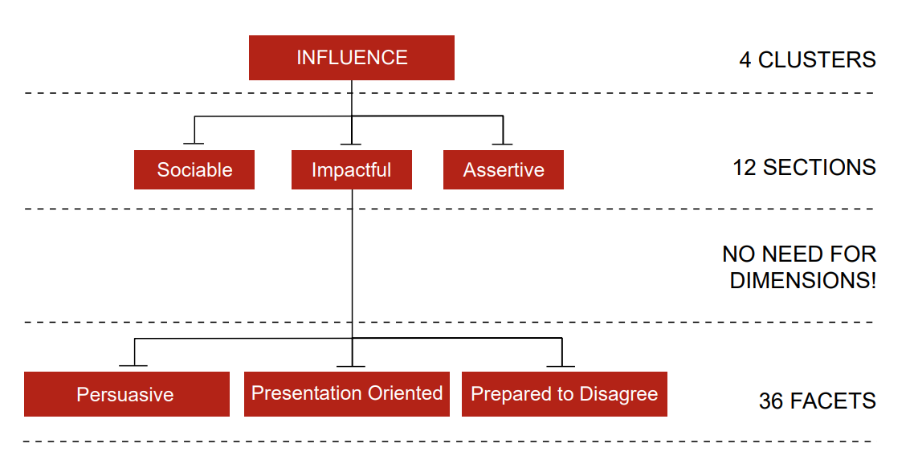
Wave Focus Styles Model Levels

Slide 107
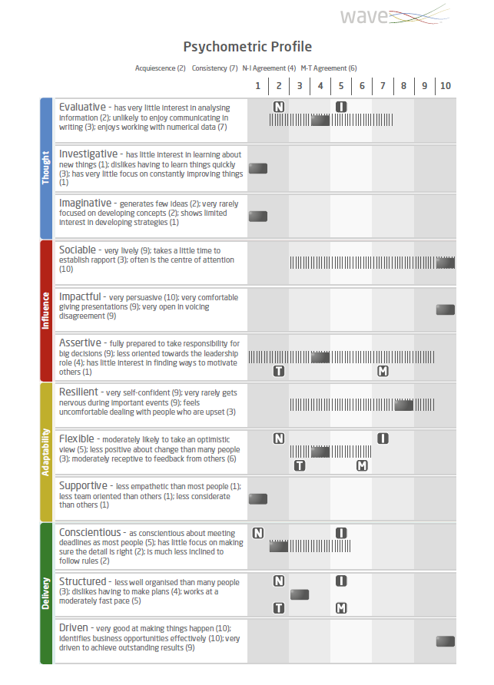
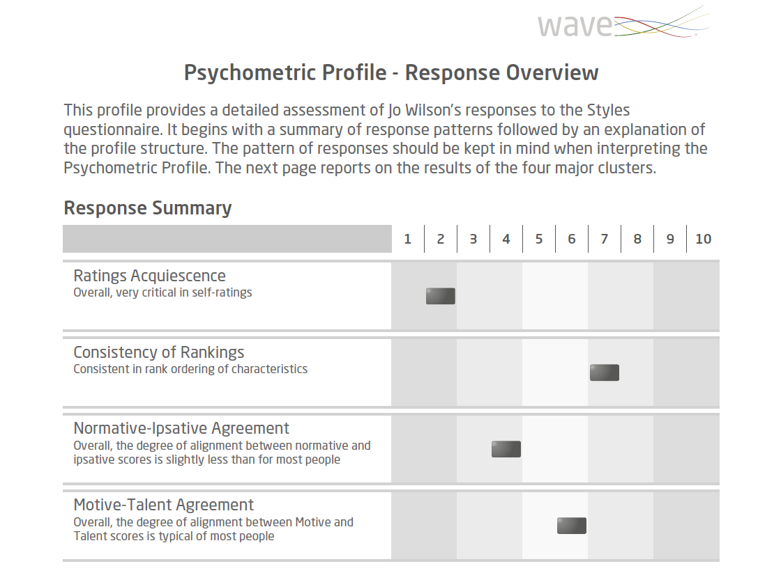
Focus Styles Expert Report

Slide 108
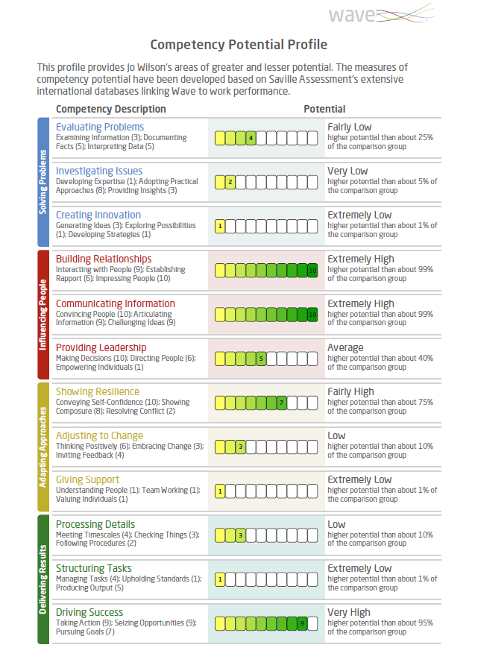
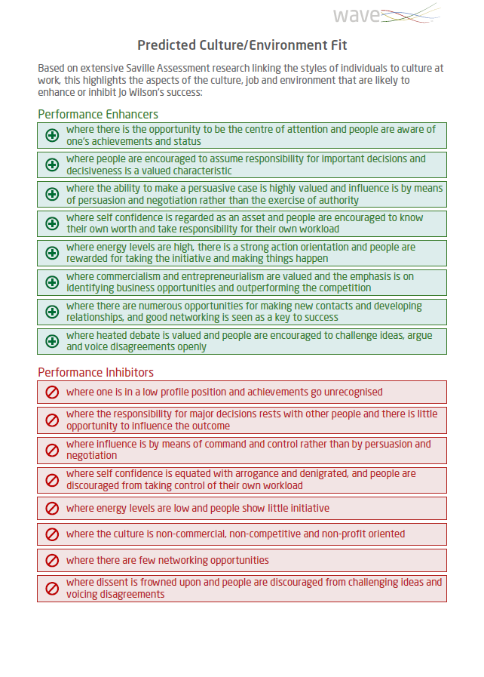
Focus Styles Expert Report

Slide 109
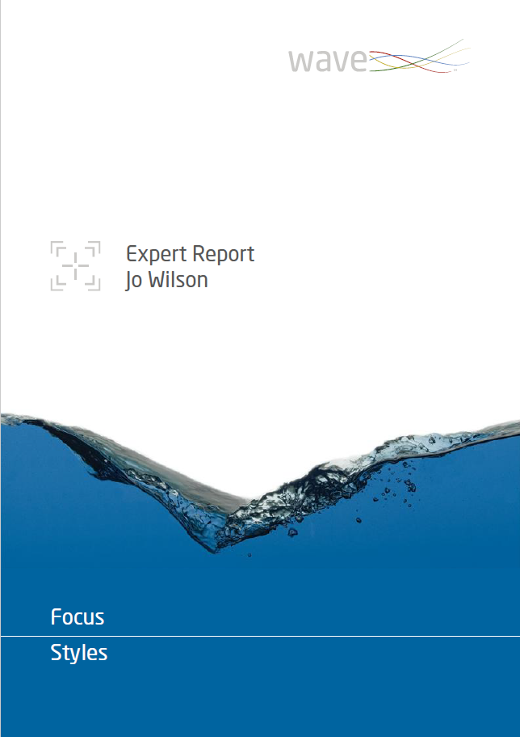
Practical Session: Feedback
Wave Feedback
You will receive the report of another delegate. Please prepare a feedback session including:
An introduction
Response Summary
Four Clusters
Please keep all data secure and confidential.
Notes:
Break into groups/pairs for feedback

Slide 110
Feedback Process
Setting the scene
Explain how Wave works
Response Summary
Feedback the profile
Summarize
Discuss Deep Dives
Ask questions
Make links

Slide 111
Practical Session: Feedback
Feedback Provider | Feedback Receiver
Manuel | Thian
Thian | Camila
Camila | Anna
Anna | Manuel
Tutor: Maya
Feedback Provider | Feedback Receiver
Sofie | Tatiana
Tatiana | Alessandro
Alessandro | James
James | Sofie
Tutor: Nikki
Notes:
Share feedback report
Split into groups / pairs and use sample reports A-D (same as old reports)

Slide 112
Module 8
Applications of Wave

Slide 113
General Process
Job analysis to identify role requirements, e.g. select report and norm group
Prepare candidates and administer Wave
Interpret results
Use results to inform process/feedback

Slide 114
Job Analysis
Profiling Requirements
Prior to using Wave it is important to understand the role requirements so that you can select the appropriate report and norm group, and focus on relevant behaviors.
Which behaviors are critical to success, and what is their relative importance?

Slide 115
For What Purpose Are You Using Wave?

Slide 116
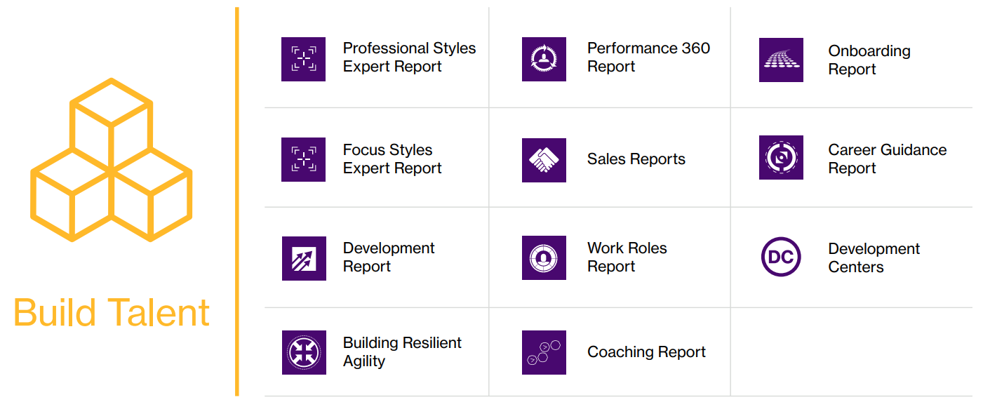
For What Purpose Are You Using Wave?

Slide 117
For What Purpose Are You Using Wave?

Slide 118
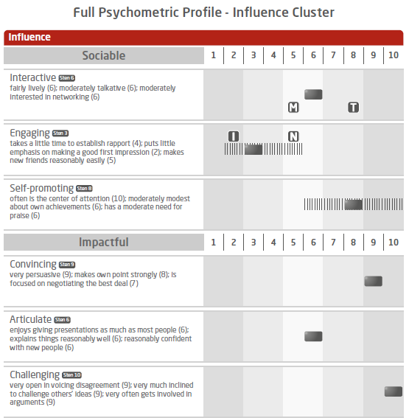
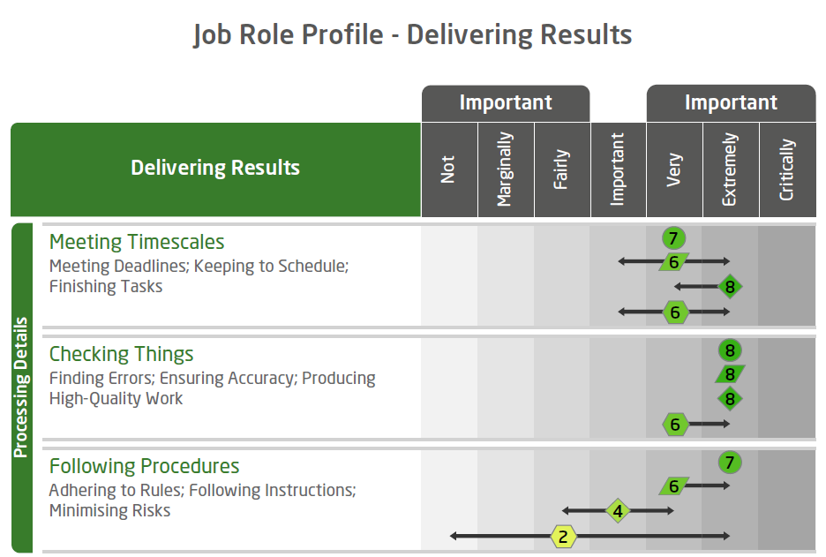
Hire Talent
Hire for Experience
Profile Requirements

Slide 119
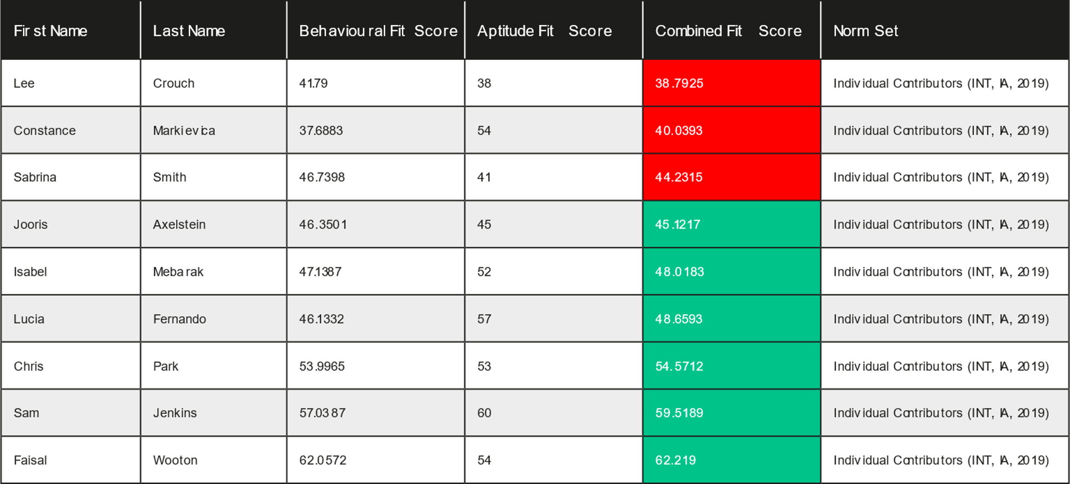
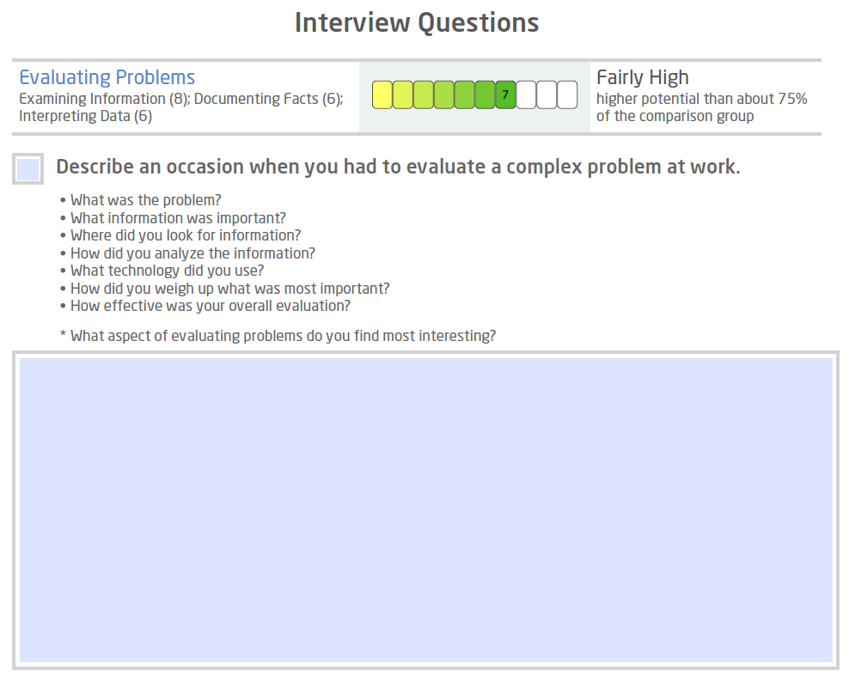
Hire Talent
Screen Volumes
Interview Candidates

Slide 120
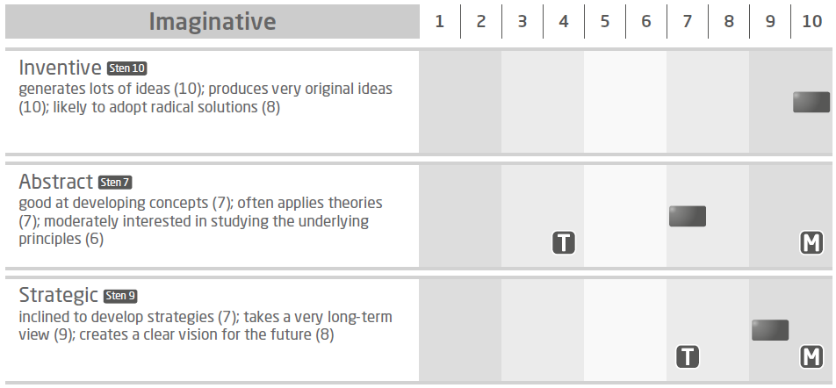
Build Talent
Audit Talent
Onboard

Slide 121
Build Talent
Coaching
Building Resilient Agility

Slide 122
Build Talent
Develop People
Drive Team Effectiveness

Slide 123
Lead Talent
Leadership Impact
Leadership Impact:
Explores how individuals lead others
Bridges the gap between behaviours and leadership outcomes
Identifies where leaders are likely to create the most impact and achieve associated results
Includes deep dives

Slide 124
Lead Talent
Leadership Risk
Applications and uses:
To assess leadership development pipelines and focus development around potential risk behaviors
To understand the potential risks in relation to the impact on the culture, the organization or the leader themselves
Where an organization is wanting to build leadership capability
To assess overall strategic risk across a leadership population
To facilitate change management through risk assessment of senior managers and executives

Slide 125
Other Role-Specific Reports

Slide 126
Why Create Custom Reports?
Harnessing the exceptional validity of the Wave framework
Wave designed to measure other models well in detail
Reporting against your model, e.g. competencies or values
We customize different types of reports (PS, FS & Work Strengths), e.g.
Expert & Line Manager
Development Report
Interview Guide
We have created over 300 custom reports

Slide 127
Appropriate Benchmarking
Choosing the Right Norm Group
Available Wave norms include:
Graduates – All
Graduates - Recent
Mixed Occupational Group
Individual Contributors
Professionals & Managers
Senior Managers & Executives
Choice of norm group should take account of:
Job, educational and work experience levels
Representativeness
Sample size

Slide 128
Prepare Candidates and Administer Wave
Unproctored Online Administration:
Invite candidates to complete the assessment (include checking for any reasonable adjustment requirements and any anticipated problems completing the questionnaire)
Ensure candidates have access to preparation materials
Ensure candidates have internet access and an email address
Inform candidate of next steps, e.g. when they will receive feedback
In some circumstances administration can be done under supervised conditions which requires a trained test administrator to be present.

Slide 129
Interpretation
Interpretation should be objective
Be clear what matters, e.g. critical behaviors and purpose of assessment
Consistency matters, e.g. across test users
Information from questionnaires should be integrated appropriately with other relevant assessment data
Do group differences exist which are meaningful for interpretation?

Slide 130
Group Differences?
Virtually all assessment methods, including personality questionnaires, have historically tended to show some differences between groups.
Wave shows no large differences and very few small to moderate differences in any group (age/gender/ethnicity).
From our data of the 36 Styles dimensions;
Only Rational shows a moderate gender difference – males score approx. 1 Sten higher than females (females are slightly higher on Attentive and Activity Oriented).
Learning Oriented, Self-assured, Striving, Receptive, Conforming – Black group scored approx. 1 Sten higher than White group (moderate difference).
Activity Oriented – White and Asian groups scored approx. 1 sten higher than Black group (moderate difference).
Sampling effects should be considered as the most likely primary reason for the majority of group differences.
NB: Full fairness data can be found in the Wave Professional Styles Handbook

Slide 131
Ethical Considerations for Using Wave
Equal opportunities legislation
Training requirements
Respect for the individual and the instrument
Data protection and privacy
e.g. data should be used only for the purposes collected unless explicit consent is given by the individual
Assessment use policy

Slide 132
Module 9
Reliability & Validity

Slide 133
Reliability & Validity
Page 100
Reliability: How consistently and precisely an assessment measures a characteristic.
Validity: Related to the relevance and predictive power of an assessment.
Notes:
Reliability – accuracy and consistency - .7
Validity – relevance and predictive power - .3

Slide 134
Reliability
Nothing can be measured with absolute accuracy
A test’s reliability concerns the precision and consistency of measurement
The more error in test scores the lower the reliability
Generally, the longer the test the greater the reliability
NB: Use total scores on Swift tests for decision making
Reliability is a prerequisite for Validity
Notes:
Loop back to nothing can be measured with absolute accuracy – forms of error we can’t always account for

Slide 135
Potential Sources of Error in Self-Report
Individual
Administrator
Test Developer
Notes:
Individual – mood, illness, distortion
Administrator – consistency, standardisation
Test Developer – ambiguous, not measuring what it’s meant to measure

Slide 136
Methods of Assessing Reliability
Test-Retest – administering the same test twice
+ Gives indication that attribute is stable
- Candidates not willing to do it twice
Alternate Form – administering two parallel forms
+ Shows developer is clear/consistent on what is measured
- Has the expense of developing two forms
Internal Consistency – administering only 1 test once
+ Easy to do as only requires one test on one occasion
- Can be misleadingly high with repetitive item content
Notes:
Test-retest
- Attribute is stable
- hard to get because candidate might not be willing to do it twice –
- wave .75
Alternate/ Parallel
- two versions of the same assessment are closely related (think of PS and FS)
- clear and consistent in terms of what is measured
- cost of having two versions to compare
- wave .86
Internal consistency
- internal correlations of measures in a questionnaire – how well the questions in one scale are related
If items are repetitive the correlations could look really really high but not actually demonstrate good underlying relationship
- Wave .74

Slide 137
Wave Professional Styles Reliability
Test-Retest Reliability
Dimension mean .75 (range from .58 to .85)
N = 100
Alternate Form Reliability
Dimension mean .86 (range from .78 to .93)
N = 1,153
Internal Consistency Reliability
Dimension mean .74 (range from .58 to .86)
N = 1,153

Slide 138
Aspects of Validity in Self-Report
Page 135
Face Validity: | do the questions ‘look right’ i.e. appear to be appropriate/job-relevant? And do the reports ‘look right’?
Content Validity: | the extent to which the questions are actually focused on job-relevant content.
Consequential Validity: | the intended and unintended consequences of using a questionnaire.
Construct Validity: | different forms of evidence that demonstrates a questionnaire measures the expected underlying construct, trait or theory.
Faith Validity: | an unfounded belief that a questionnaire is appropriate, i.e. in the absence of evidence.
Criterion-related Validity: | evidence that the questionnaire predicts relevant criteria (e.g. competencies).
Notes:
Face and Faith
Content: Focusing on relevant content (i.e. job and work-related)
Construct: Measures expected underlying value such as a trait or theory
(for example a beahvioural measure aimed at building relationships shouldn’t be more focused on anything else)
Consequential: consequences of using the assessment – do no harm, appropriate for promotion decision, etc.
Criterion: - does the questionnaire predict a particular criterion? E.g. job competency

Slide 139
The Wave Model: Validity
Performance Driven
Questions were selected on the basis of how well each facet (motive and talent) correlated with overall performance and potential.
Dynamic Rating Format
By enabling a dual dynamic rating format (‘ra-ra’) it is possible to further improve the validity.
Predictive Competencies
Competencies and self-report questions which were less correlated with overall performance were dropped.
Project Epsom
A large sample of participants (N=308) validated the Wave model, alongside other popular personality questionnaires.
Notes:
Designed with validity in mind, from the start – items written and selected to predict overall working performance
Rate/Rank – helps minimise distortion – makes profiles more reflective of people’s typical behaviour
Only the most predictive competencies were kept, those giving less prediction about performance were less useful so we didn’t keep them in
Epsom – looking at constructs of existing assessments – more information in your workbooks

Slide 140
Validity of Different Selection Techniques
Notes:
Based on our own data as well as meta-analyses
When you are building a selection process/ ac make sure you’re using the methods which will give you most value – what’s going to be giving the information you really need?

Slide 141
The Wave Model
Validity
Notes:
Anything over .3 is giving good prediction about performance, so all of these tools are good

Slide 142
Validity? So What?
0 Validity – 1 person in 5 will be a poor performer
Questionnaires with the highest validity increase the chance of selecting the best performers at work and considerably reduce selection errors
Moving from recruiting using a questionnaire with a validity of +0.3 to using a questionnaire with a validity of +0.6 can double the cost benefit to an organization
This can also reduce the number of serious selection errors five-fold
0.3 Validity – 1 person in 10 will be a poor performer
0.6 Validity – 1 person in 50 will be a poor performer
Notes:
Page 140
The greater your validity, the greater the benefit to the organization as you get more test utility or return on investment.
The greater your validity, the smaller the risk of a wrong hire, the more accurate your selection process is of hiring the right person - so the return on investment is massive

Slide 143
Return on Investment
Saville Assessment ROI Model
Notes:
Our ROI model – using rigorous, robust assessment means you’re giving candidates a Quality experience and helping engagement whilst getting what you need from the selection methods too. You can reliability screen out less suitable candidates and select in those who will support the organisation best.
Consider the cost of a poor hire, needing to go out to recruit again, administrator time and resource
Standarised, objective, less room for subjectivity and bias which could unfairly impact different groups – genders, ages, ethnicities, etc.

Slide 144
Module 10
Selection Case Study

Slide 145
Case Study: Selection
Workbook page 114
Business Development Manager: Job Analysis
Refer back to the Job Analysis section (page 14) of your workbook and note down the five behavioral competencies you identified as critical for the Business Development Manager Role
You will be carrying out a competency-based interview focusing on these competencies as part of the next stage of the selection process.

Slide 146
Case Study: Job Analysis
‘Hire’ Card Deck – Behavioral Sections
Notes:
Encourage trainees to discuss these 12 Wave Sections in relation to the role
The goal is to choose 4 Sections as critically important, these do not need to be split across the 4 Clusters/colors
All Sections are positively worded, making them all sound desirable, try to think of which behaviors a person could not do the job without

Slide 147
Saville Assessment Aligned Model

Slide 148
Case Study: Selection
Workbook page 112
Business Development Manager: Candidate Evaluation
Evaluate Sam’s potential strengths, areas of concern, and areas you would wish to probe further against the elements identified in Task One, using Sam’s Wave Professional Styles Expert Report to guide you.
You should refer to specific aspects of the Wave Professional Styles Expert Report in your summary (e.g. Psychometric Profile, Competency Potential Profile and Predicted Culture/Environment Fit Profile).
Sam’s report is on pages 117-128 in your workbook.

Slide 149
Case Study: Selection
Workbook page 129
Business Development Manager: Interview Question Generation
Generate a set of competency-based questions that will be used to probe Sam Jenkins during the interview stage, against the five key competency areas.
Aim to produce one question per competency.
Example competency-based questions from the Interview Guide can be found on page 130.

Slide 150
Module 11
Development Case Study

Slide 151
Case Study: Development
Workbook page 131 – Stage 1
Business Development Manager: Development
Now that Sam has been in the role for one year, the team are looking for ways to work more effectively together.
Which areas of strength could Sam build on or use to greater effect?
Which areas of improvement would be most likely to have the greatest impact on Sam’s performance?
Which areas may Sam be potentially overplaying and what is the potential impact on performance?
You should refer to specific aspects of the Wave Focus Styles Expert Report in your summary (e.g. Psychometric Profile, Competency Potential Profile and Predicted Culture/Environment Fit Profile).
Sam’s report is on pages 165 - 171 in your workbook.

Slide 152
Case Study: Development
Workbook page 140 – Stage 2
Business Development Manager: Work Role
Background:
The e-Learning Account Management team have been working together for a year now. Tradigital have asked you to conduct a Team Effectiveness Workshop to discuss how the team are working together.
Review Sam’s Work Roles Report and the group profile, and answer the following questions:
How do Sam’s work roles complement the team and vice versa?
What are the potential gaps in terms of roles within the team?
What actions would help Sam and the team work more effectively together?
Sam’s report is on pages 176 - 184 in your workbook.

Slide 153
Next Steps
Contact our Duty Consultant for additional support
Call: +44 (0)208 619 9000 Email: info@savilleassessment.com

Slide 154
Administering Tests: A Recap
No annual subscription fees to use tests
No separate administration, scoring or profiling fees
Saville Assessment Bureau – your managed service option: Complete the form and our Bureau team will set up the questionnaire and send you reports
Saville Assessment Oasys – your self-service option: One-off set up fee and then a third off report costs. Your Oasys platform can be branded

Slide 155
The Saville Assessment Community
What you can expect:
Support from our duty consultant, bureau team and account managers
Opportunities for continued professional development
Invitations to webinars and practitioner masterclasses
Discussion on industry-specific news and topics
Networking opportunities with other professionals, including our series of Wave User Groups
Privileged offers
Access to our Client Resource Area
@savilleassess
https://www.linkedin.com/company/saville-assessment
@savilleassess
www.facebook.com/SavilleAssess/

Slide 156
Thank You

