Slide 1
Wave Performance 360

Slide 2
Objectives
By the end of the course, you will be able to:
Understand the benefits, issues and risks in setting up a 360 project
Understand the Saville Assessment Wave Performance Culture Framework
Interpret the Saville Assessment Wave Performance 360 report accurately
Facilitate feedback and discussion and action planning around 360 data, accurately and appropriately
Link 360 with other data sources

Slide 3
Introductions
Name
Role/company
Experience of using 360 tools
Positive?
Negative?
Plans for 360 in the future
Interests for the course

Slide 4
About Saville Assessment, A Willis Towers Watson Company
2004: Founded by Professor Peter Saville
2005: Wave launched
2007: Swift combination tests launched
2013: Situational Judgment Tests launched
2015: New tests, new technology
2015: A Towers Watson Company
2016: Willis Towers Watson
“
“Our goal is to transform assessment across the world”

Slide 5
Course Overview
Introducing the Wave Performance Culture Framework
Introducing Wave Performance 360
Interpretation Exercise
Applying Wave Performance 360
Interpretation Exercise
Feedback of Wave Performance 360
Case Study
Leadership Impact 360
Administration and Project Management

Slide 6
Introducing the Wave Performance Culture Framework

Slide 7
Wave Performance Culture Framework
Extensively researched model of key characteristics underpinning success at work across different occupations
Encompasses elements of performance that validation evidence indicates as most important and predictive
Underpins all of Saville Assessment’s core products (Wave, Strengths, 360, Aptitude)
The framework is made up of Behavior, Ability & Global areas, each built on a hierarchy of general areas breaking down into greater detail

Slide 8
Saville Assessment B-A-G Framework

Slide 9
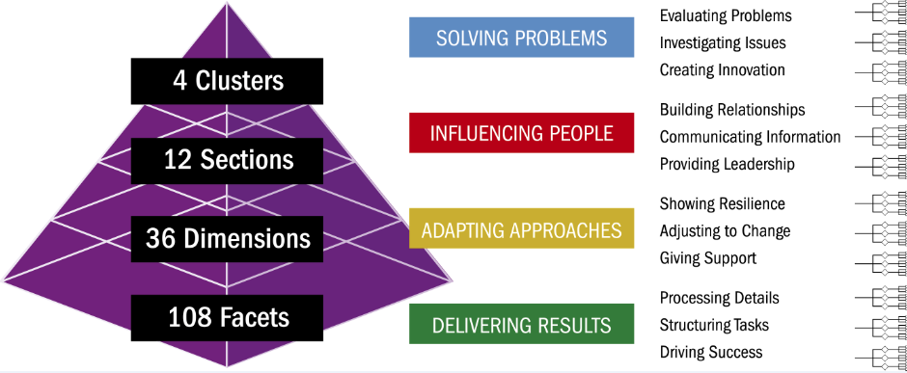
B-A-G Framework: Behavior Aspects

Slide 10
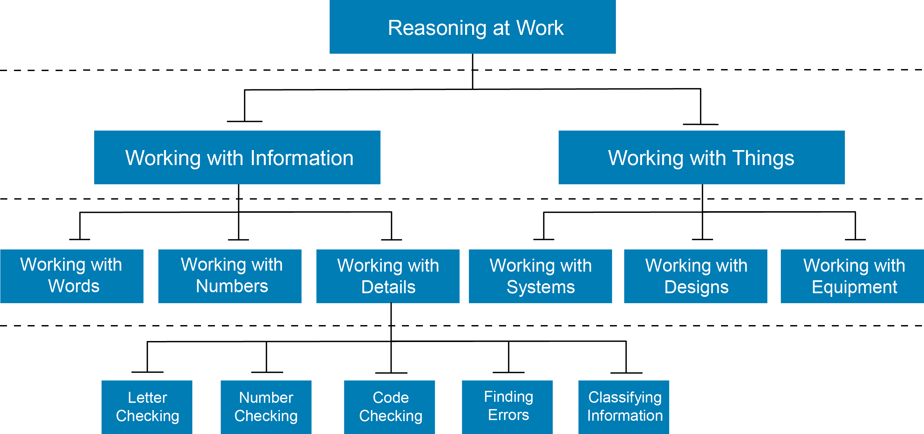
B-A-G Framework: Ability Aspects
1 CLUSTER
2 SECTIONS
6 DIMENSIONS
30 FACETS

Slide 11
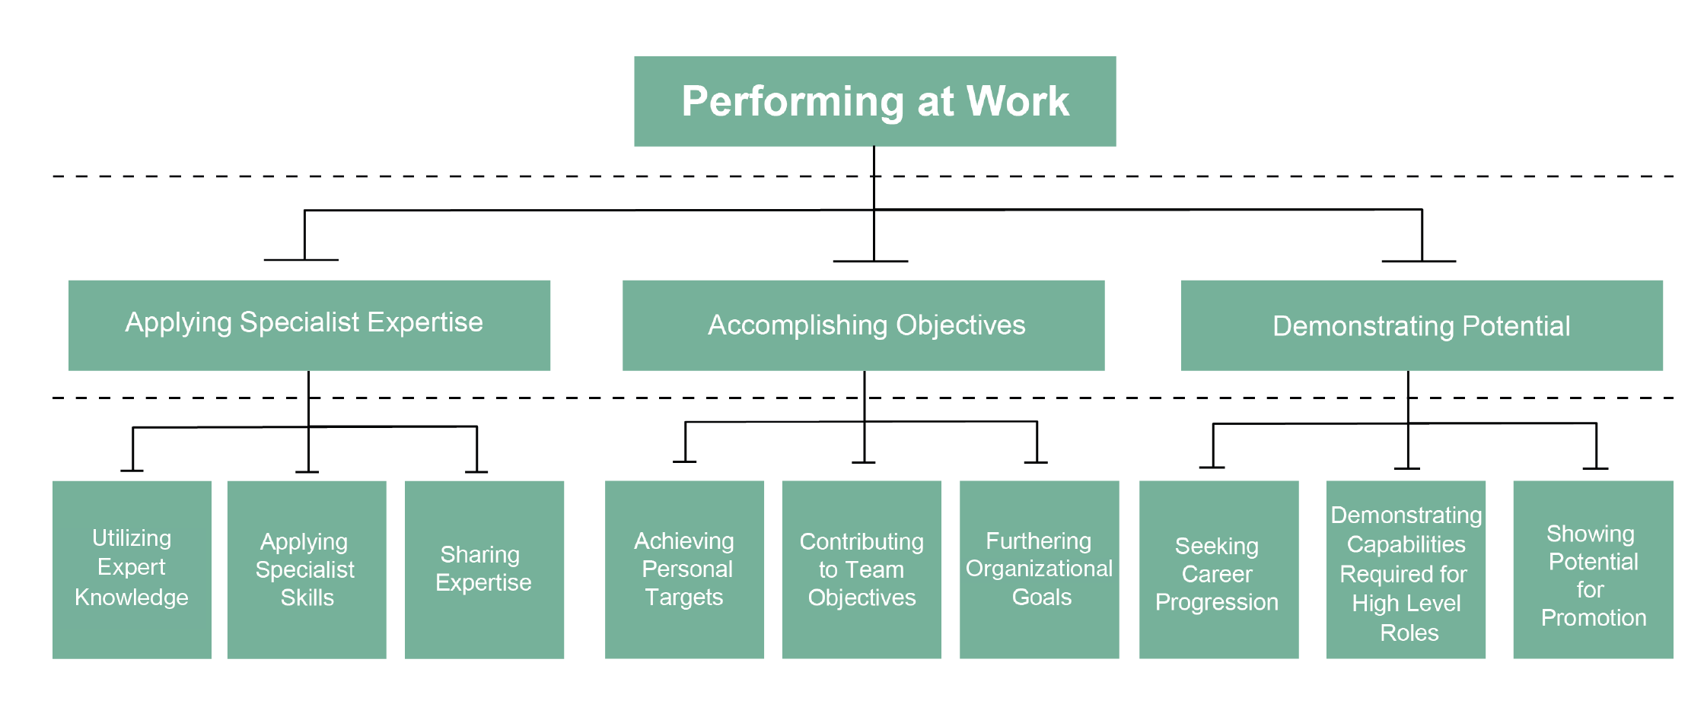
B-A-G Framework: Global Aspects
1 CLUSTER
3 SECTIONS
9 DIMENSIONS

Slide 12
Introducing Wave Performance 360

Slide 13
What is 360 Assessment?

Slide 14
Why Undertake 360 Assessments?
Feedback processes should affect self-awareness in a positive way
Bring ‘blind spots’ into open arena
Encourage learning and development through feedback from various sources that is compared with self-assessment
Have the capacity to explore performance and potential together
Build confidence in areas of strength
Audit skill areas
Improve Return on Investment (ROI) on development activities
Improve organizational leadership

Slide 15
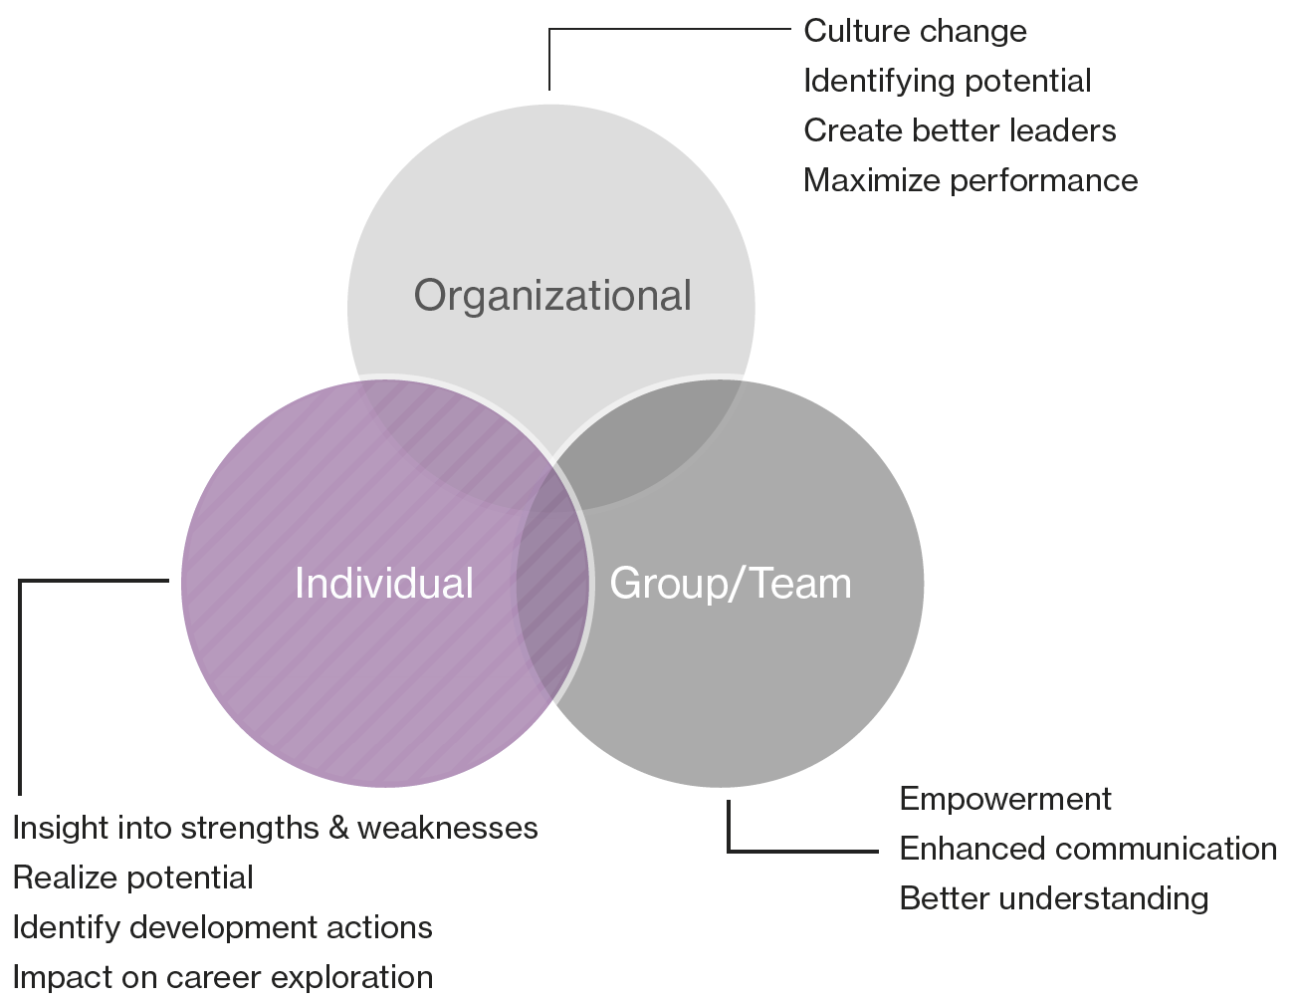
What are the Benefits?

Slide 16
Wave Performance 360
Individual feedback delivered in the most powerful way
Valid - Based on the Wave Performance and Culture Framework™
Visual - Different rater groups clearly displayed
Configurable - Can be tailored to organizational frameworks
Free Text - Adds richness to numerical scores
Four rater category + ability
Four rater category
Five rater category + ability
Five rater category

Slide 17
Completion Experience
10-minute online questionnaire completed by each rater
Seven-point normative ‘Effectiveness’ rating scale
Choose to include/exclude Ability Ratings at project outset

Slide 18
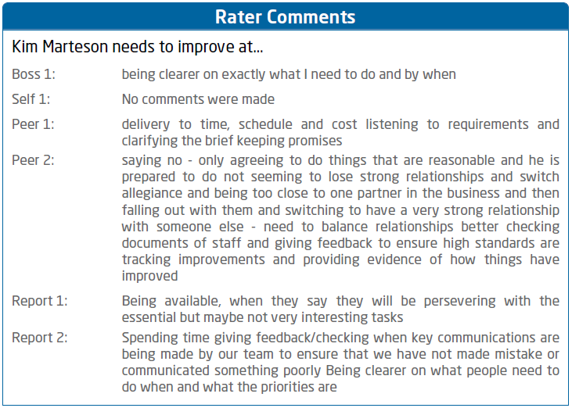
Free Text Option
Free text boxes add richness to numerical scores and identify strengths and development issues
For everyone (including self), there is an open narrative section at the end of the questionnaire which asks you to reflect on things that will help the individual to understand the impact that they have at work and to help them to think about their personal development.
The specific questions are:
“What to keep doing well?”
“What to do less of?”
“What to Improve?”

Slide 19
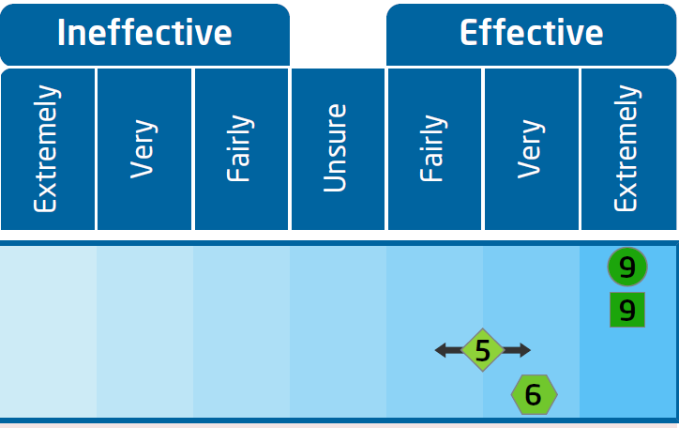
Dual Reporting
Primary Reporting:
Seven effectiveness categories
Directly based on the online questionnaire scale
Performance-centric terminology
Easy and generally positive to feed back
Secondary Reporting:
1-10 colour-coded Sten scale
Norm-referenced external benchmarking
Enables comparison with Styles self-report
Highlights extremes

Slide 20
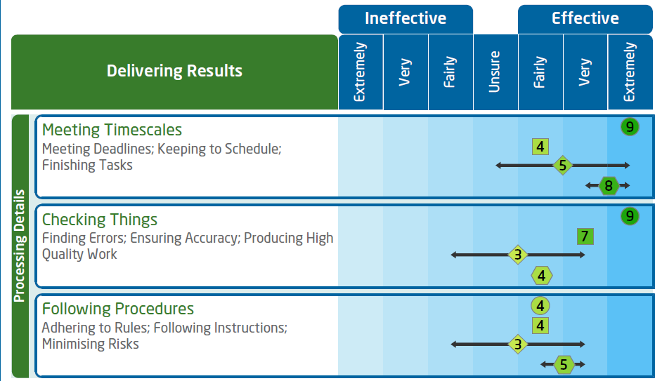
Dual Reporting

Slide 21
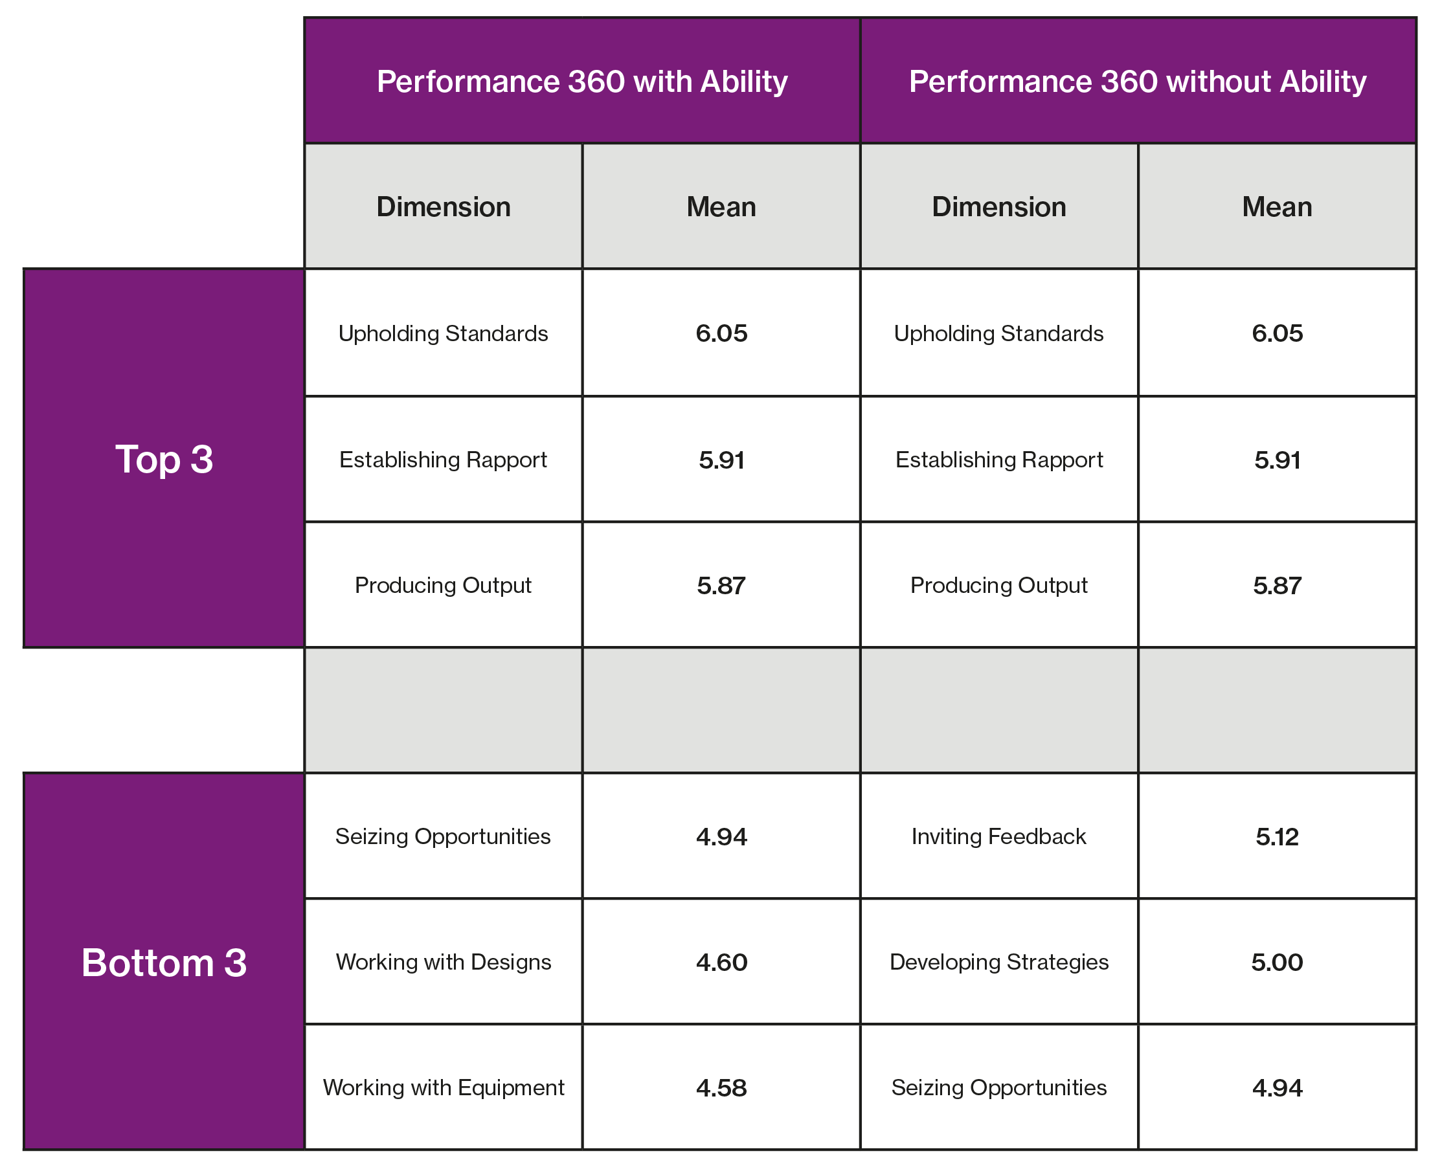
Performance 360 Dimensions

Slide 22
Interpretation Exercise

Slide 23
Interpretation Exercise
For each example provide a brief interpretation of how the assessee was rated by their boss, peers, reports and how they rated themselves.
1.
2.

Slide 24
Interpretation Exercise
Provide a brief interpretation of how the assessee was rated compared to other individuals who have previously completed the assessment.
3.
Provide a brief interpretation of the assessee’s performance taking into account 1) the different rater groups and 2) comparison to others.
4.

Slide 25
Applying Wave Performance 360

Slide 26
Available Tools
Wave Performance 360
Leadership Impact 360

Slide 27
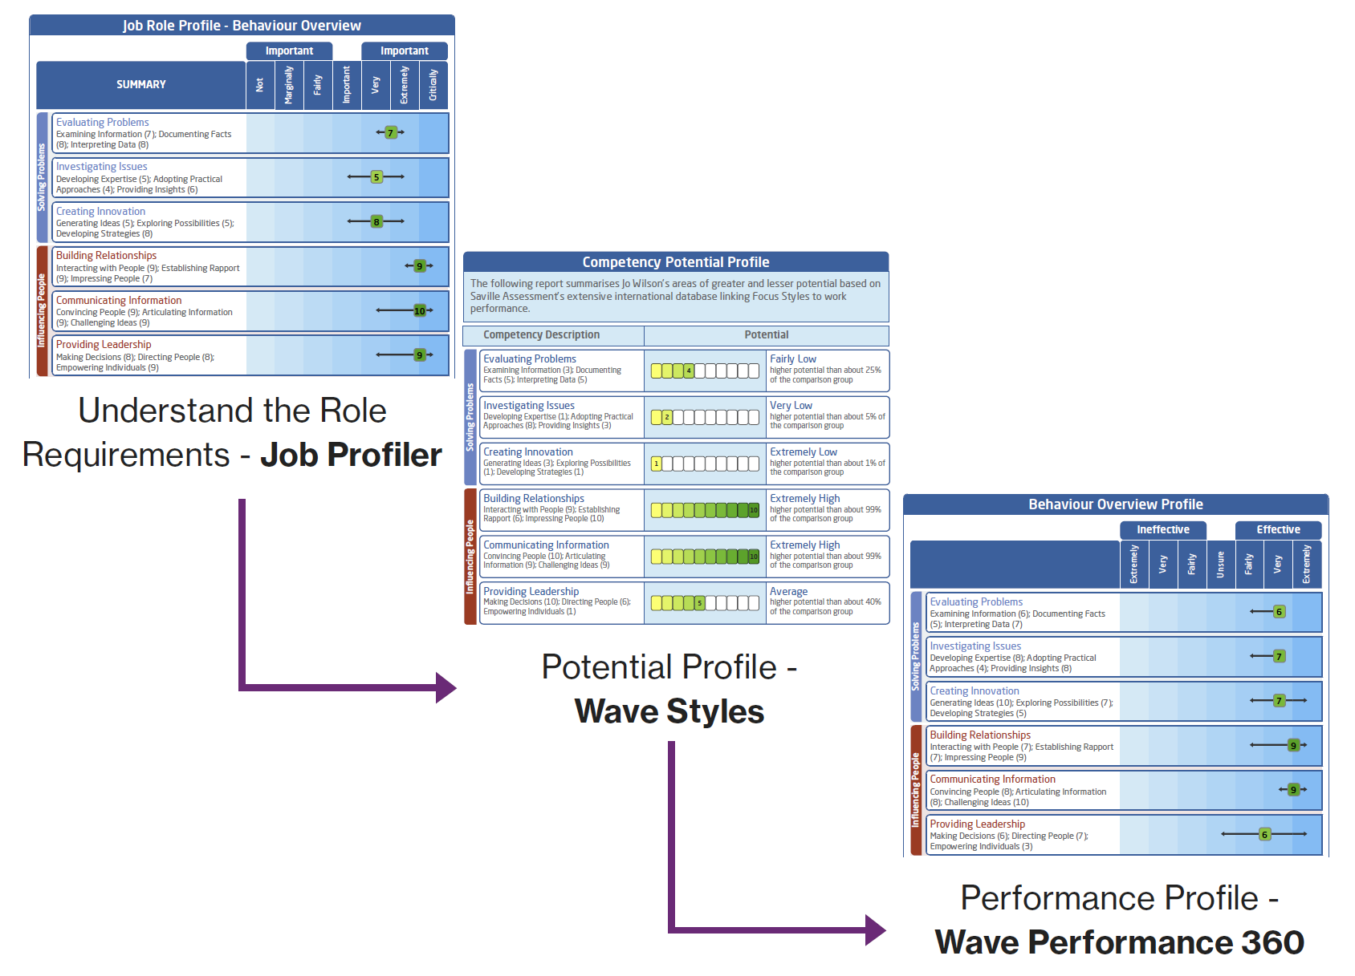
Matched Model

Slide 28
Performance Vs Potential
Performance 360 gives the raters’ aggregated assessment of an individual’s performance
Wave Styles questionnaires (Professional and Focus) indicate where an individual should or could be – given the combination of their motives and talents – or their competency potential
Putting the two questionnaires together allows not just performance coaching but coaching individuals to realise their potential
What does this look like?

Slide 29
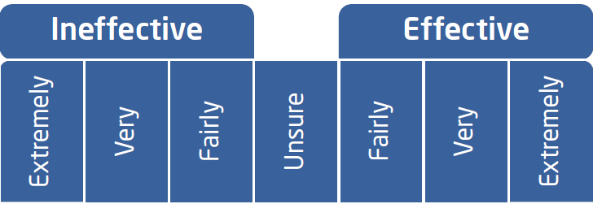
Performance Vs Potential
Use in conjunction with Wave Professional Styles or Wave Focus to explore possible gaps between performance and potential
Wave Performance 360
Very effective overall but average when compared to others
Wave Professional Styles
Indicates high potential

Slide 30
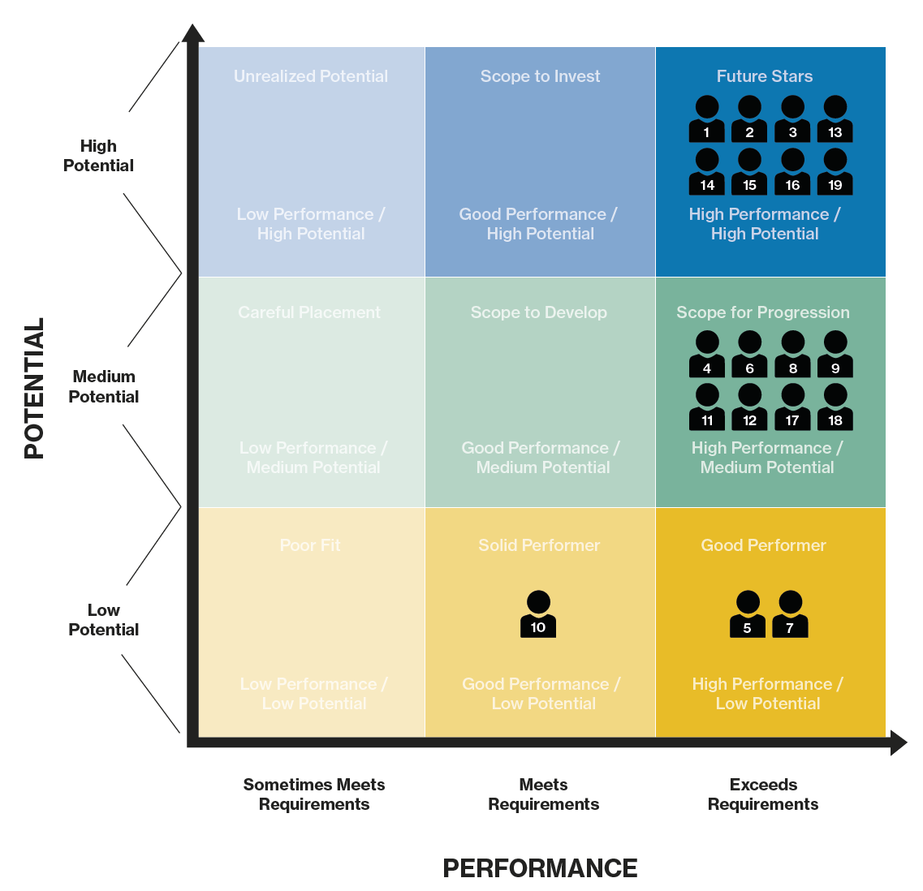
Nine-Box Grid

Slide 31
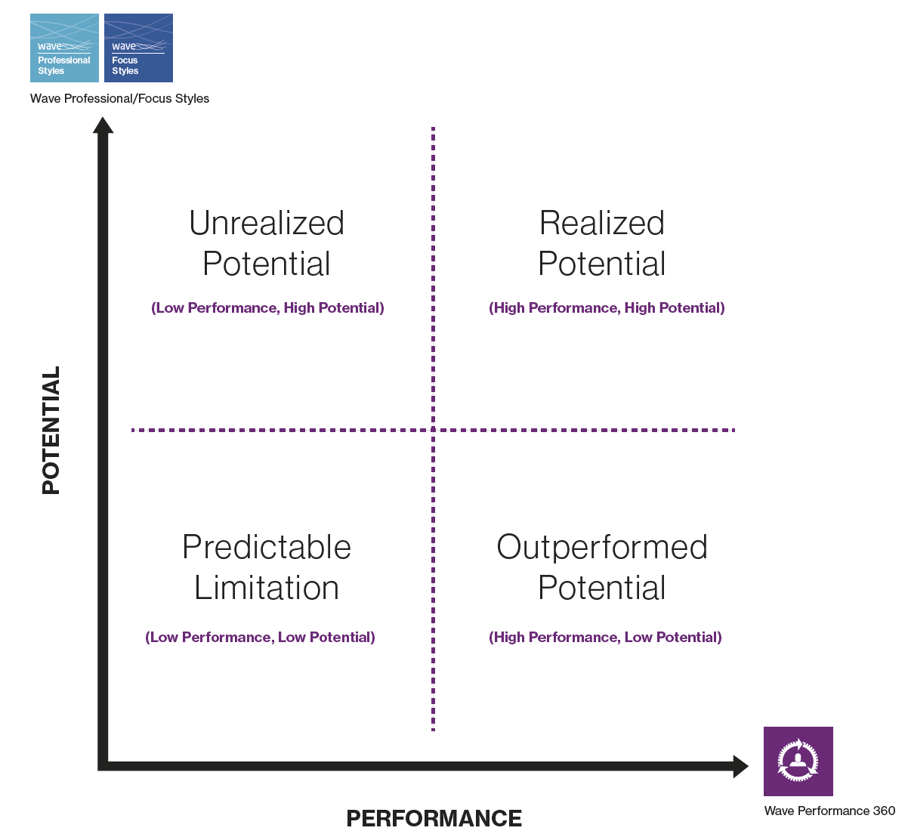
Performance and Potential

Slide 32
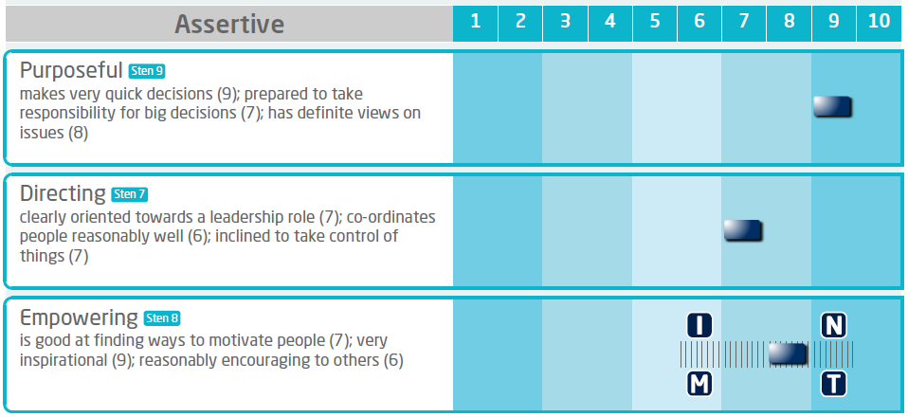
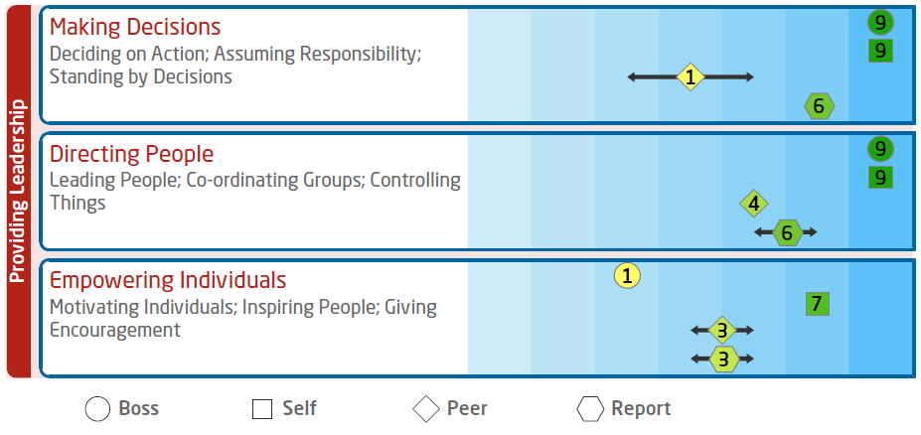
Incorporating Styles
What are the links?
Feels effective at empowering but less motivated in this area – impact on Performance?
Reports to place a strong emphasis on decision-making and directing and feels extremely effective in these areas
To explore…
How often do you empower your team?
How do you encourage your team?
When have you found empowering others more challenging?
How do you ensure your team are on-board with your direction?
What impacts on your motivation to empower?
How could you enhance your leadership style?

Slide 33
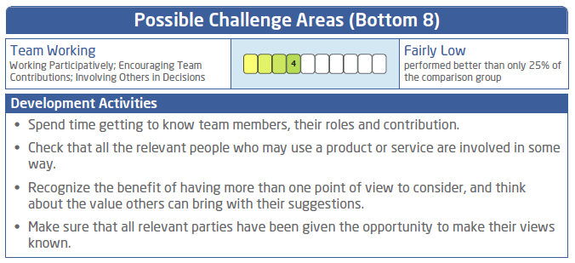
Incorporating the Development Report

Slide 34
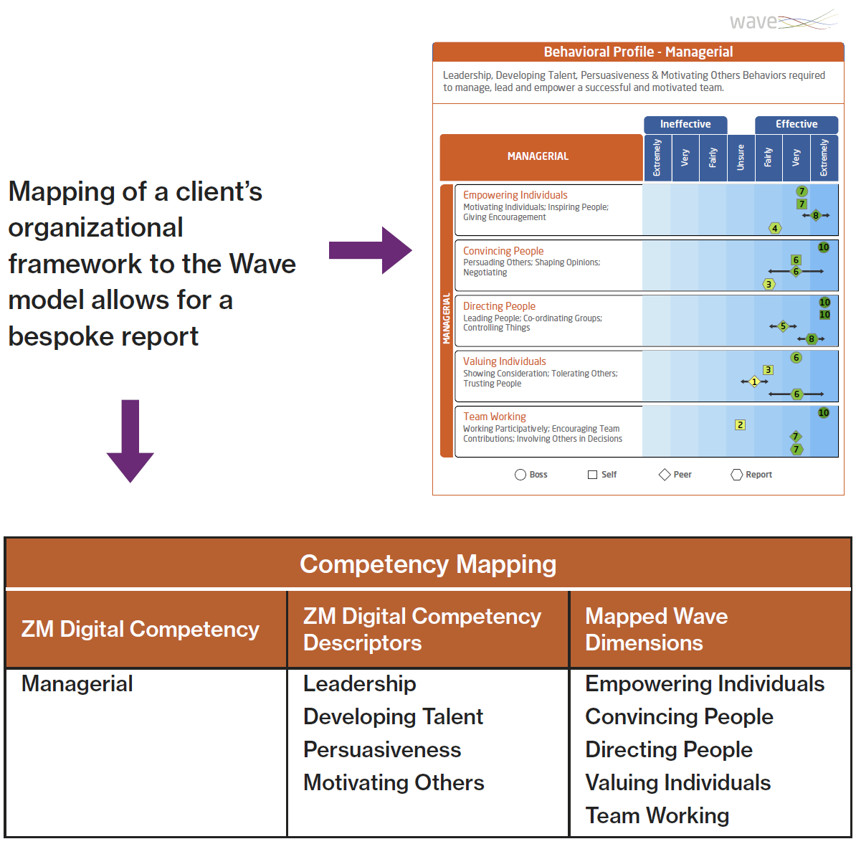
Configurable

Slide 35
Interpretation Exercise

Slide 36
Interpretation Exercise
Example 1
Importance
Potential

Slide 37
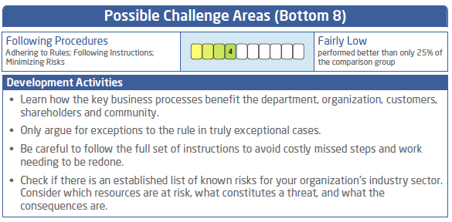
Interpretation Exercise
Example 1
3. Performance
4. Development Action

Slide 38
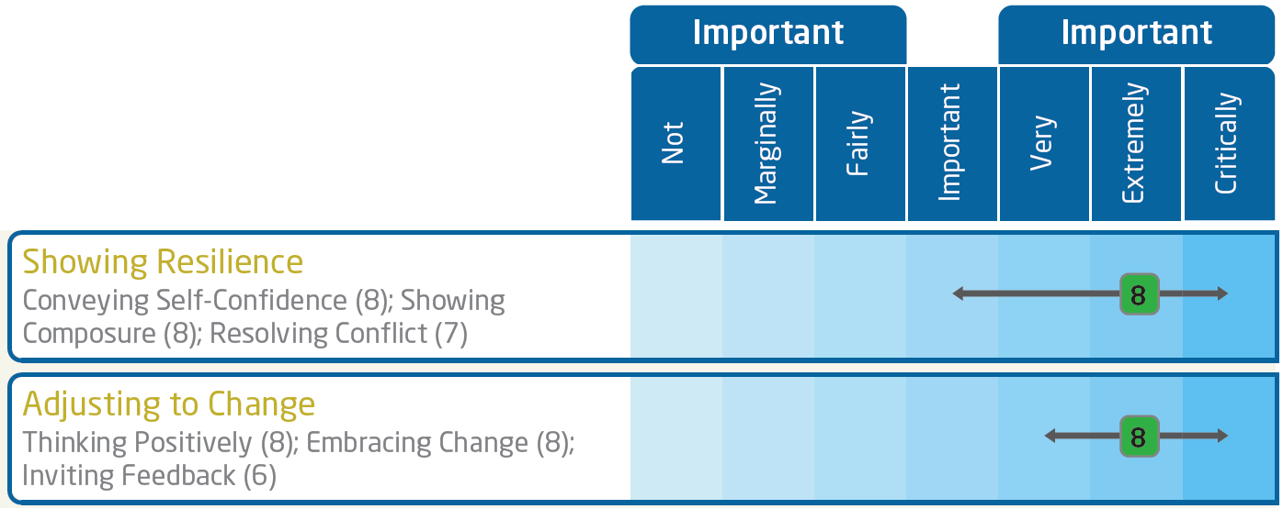
Interpretation Exercise
Example 2
Importance
Potential

Slide 39
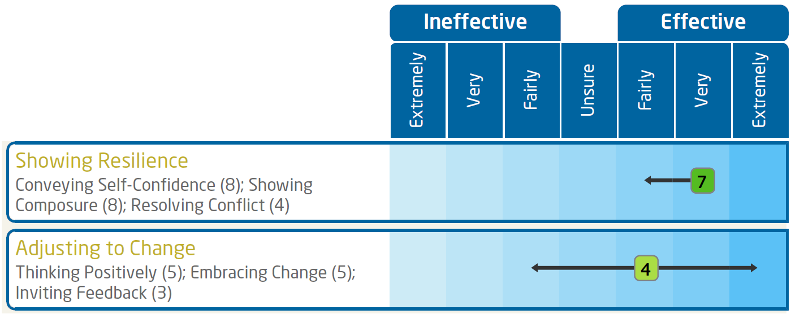
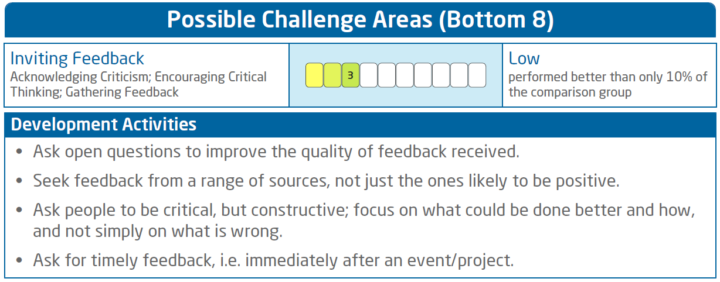
Interpretation Exercise
Example 2
3. Performance
4. Development Action

Slide 40
Feedback of Wave Performance 360

Slide 41
Maximizing the Benefits of 360 Feedback
Raise their self-insight
Relate back to the role requirements
Focus on action planning – how will they improve?
Recognize individual steps to behavior change:
Understanding the key messages
Accepting the feedback
Readiness to change
Focus on strengths but do not overlook development areas
Encourage them to follow-up with their Line Manager
Encourage a team follow-up group activity

Slide 42
Structure of Feedback
Preparation: review differences between raters, look for links and themes
Introduction:
Scene setting – purpose, objectives, core behaviors, background, aspirations
About this report – comparison group, perceptions of performance, confidentiality, discuss raters, 360 model, explain dual reporting
Discuss Profile: differences between raters, areas of strength to build, potential limitations, link in comments
Summarize key points
Conclusion: next steps, action plan, development activities, follow up

Slide 43
Preparation for Feedback
When reviewing results, aim to focus on the following:
Difference in scores between the different groups providing feedback – how well does the person work with others?
Differences between self-perception and the viewpoints of other raters – indicator of self-awareness
Overall strengths and limitations – how do these relate to the person’s role?
Boss ratings – identify consistent messages as an indictor of their relationship or performance issue?
Look for differences in scores for Task (Solving Problems and Delivering Results) and People (Influencing Others and Adapting Approaches) performance areas
Links between competencies – any patterns of strength or limitations?

Slide 44
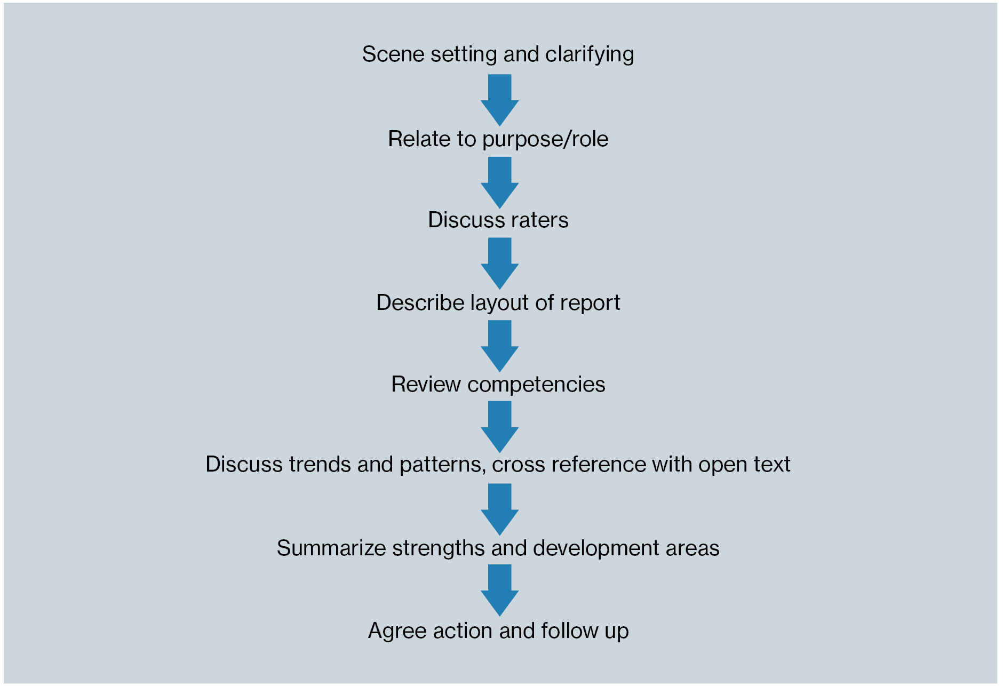
Feedback Flow

Slide 45
Question Style
Open questions
“Tell me about…”, “How does that resonate with you?”
“Describe…” “What does that look like at work?”
Follow-up questions
“What exactly did you do?” “What approach did you use?” “How effective was your response?”
What, where, when, who, why and how?
Impact of actions
“What impact did that have on others?” “What are the implications of…on your team?”
“What feedback did you get from others?”

Slide 46
Action Planning
Maximizing behavior change:
Goal setting
Encouraging openness to change
Raising self-awareness
Encouraging ownership
Questions
What development areas do you feel will have the greatest impact on your performance?
What are you going to do differently?
What opportunities exist to support your development?
What are the perceived challenges? What could you do about these?
Who else will support?
When will you review progress?
How will you measure progress?

Slide 47
Example Action Plan
COMPETENCY | BEHAVIORAL DESCRIPTION | REASON FOR CHOOSING THIS | WHAT OTHERS OBSERVE | DEVELOPMENT ACTIVITIES | WHO/HOW OTHERS CAN HELP | TARGET DATE MEASURES
Team Working | Working Participatively Encouraging Team Contributions Involving others in Decisions | Some negative feedback on 360 Personal dissatisfaction with team meetings | Impatience Closing discussion down Time management seen as the overriding priority Lack of action on difficult issues | Set clear timescales for consultation and decision making Make sure that all relevant parties have been given the opportunity to make their views known Work out who are the stakeholders impacted by a decision and use others to facilitate their input | Review meetings Regular and open feedback Pulse survey feedback | Quarterly reviews

Slide 48
Risks
Raters
Lack of honesty in ratings
Lack of differentiation in ratings
Lack of real knowledge about individuals
Cultural differences
Individuals
Defensiveness
Obsession with who said what
Lack of ownership
Cultural differences
Lack of follow-up

Slide 49
Dealing with Difficult Reactions
People who get emotional
Let them work through their tears or anger
Listen and continually show you understand
Start asking open-ended questions
People who stop talking
Ask open-ended questions
Give the person time to respond – do not interrupt
Encourage them to talk through their thoughts
People who argue
Give the feedback coolly and firmly
Underplay the anger with calm gestures
Paraphrase to show the impact their reactions have

Slide 50
Important Considerations for a Feedback Session
Effectiveness rating scale
Dual reporting format
Unsure rating
Comments
Strengths perspective
Global areas
Integrated model

Slide 51
Case Study

Slide 52
Case Study
Wave Performance 360 – Kim Marteson
Background Information
Kim Marteson is HR Director at QN Express. Kim has been in the role for nearly four years during which time he has overseen a large change program including a senior management development program and restructure.
Kim has previously worked for his current line manager some years before in a previous organization in a more junior role. At the time of this assessment Kim was going to leave QN Express to set up a consultancy business within six months.
Before QN Express Kim worked for four years for an HR consultancy firm and was involved in developing and designing some creative change programs and workshops for his clients.
QN Express is a leading broker in the financial services sector.
Your Task
Using the reports provided to you, please answer the case study questions.
Please make reference to specific aspects of the provided reports in your responses.

Slide 53
Leadership Impact Performance 360

Slide 54
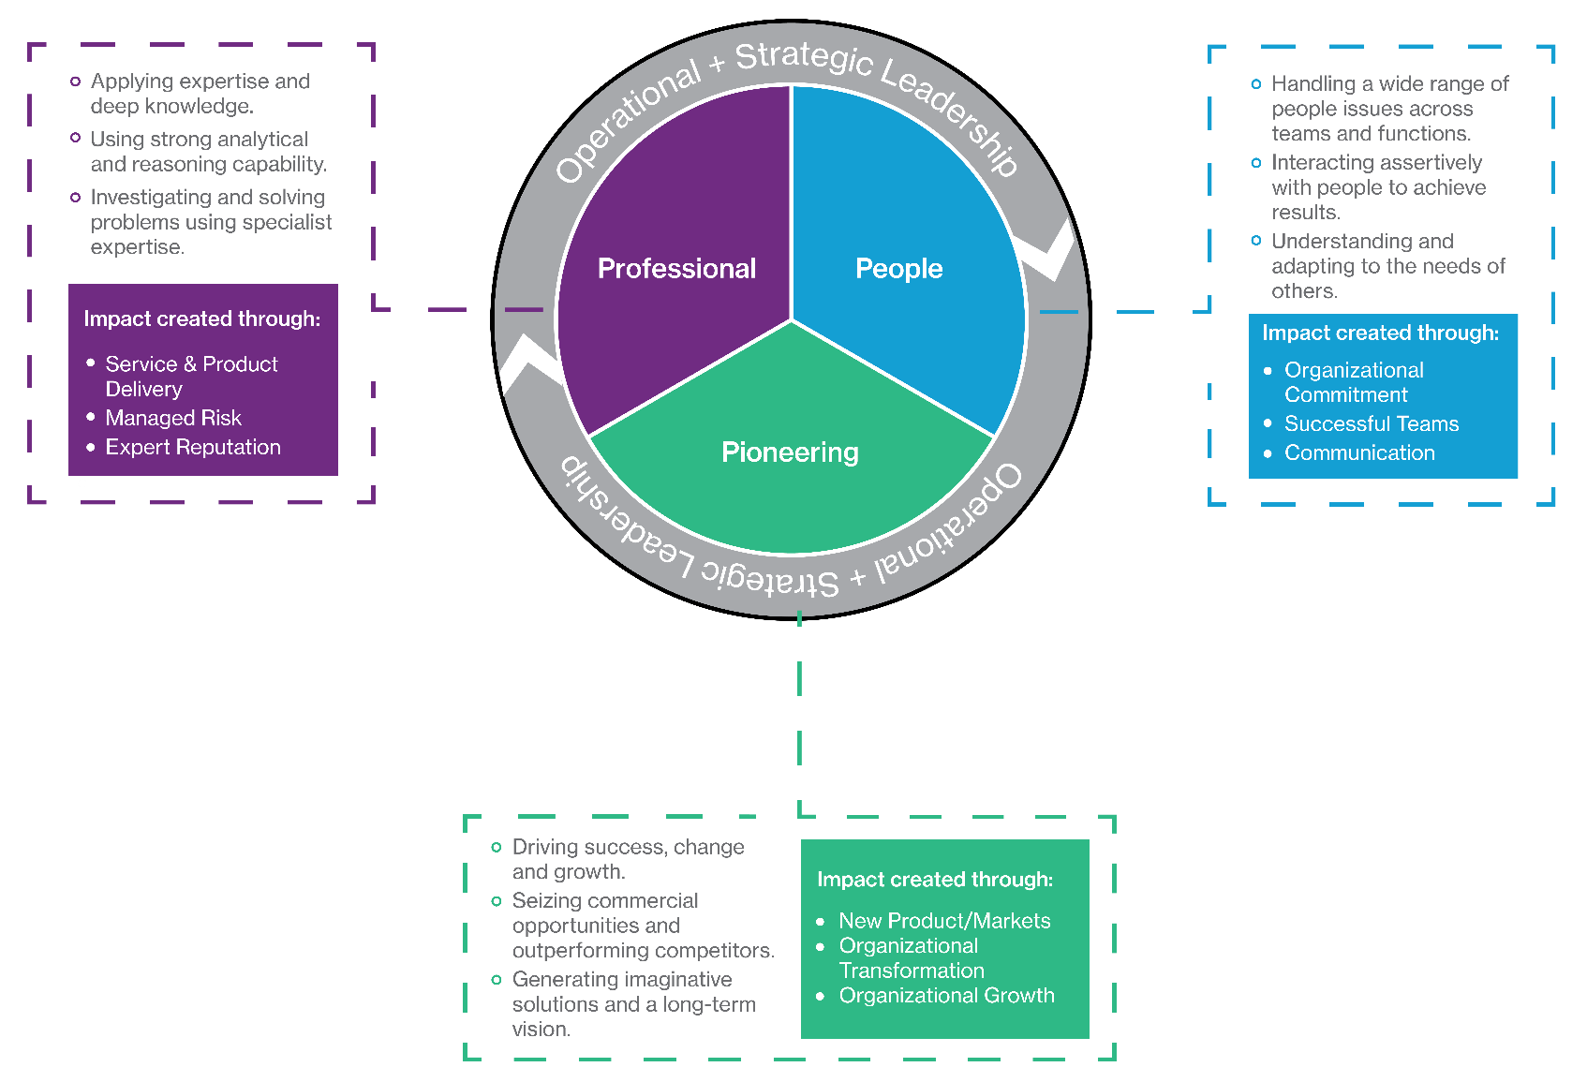
Leadership Impact Model

Slide 55
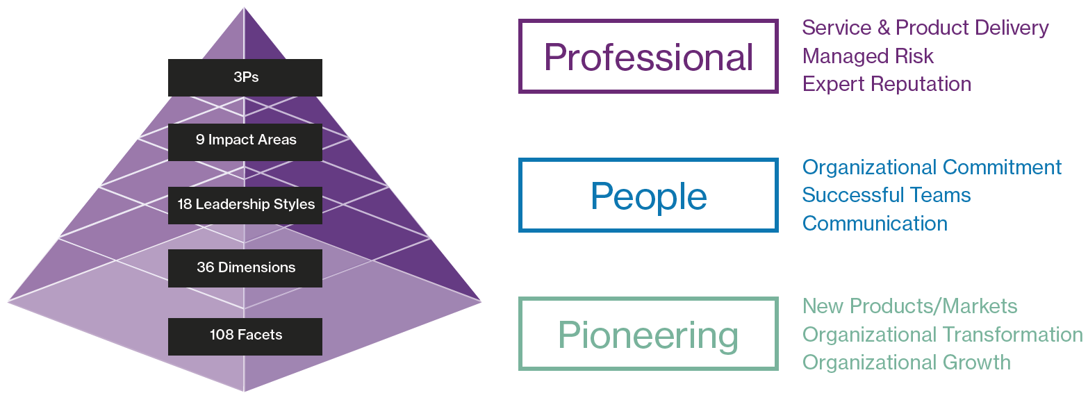
Leadership Impact Model

Slide 56
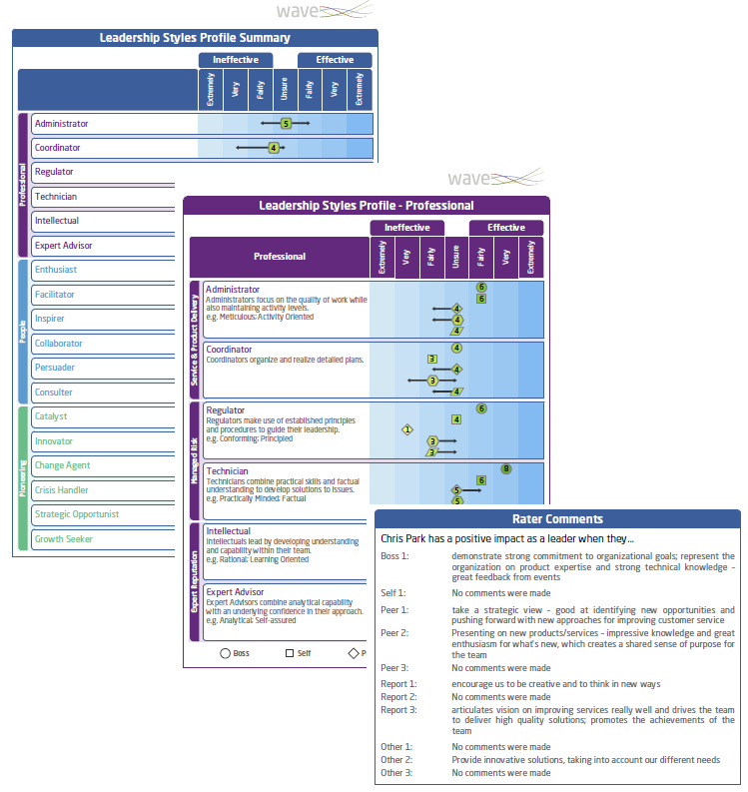
Leadership Impact 360
Leadership Impact 360 gives users a valid and comprehensive way to assess impact in their senior managers and executives
Direct match to 3P model and Wave Professional Styles Leadership Impact Expert Report
Clearly differentiated from Wave Performance 360
Organizational perspective of leadership impact

Slide 57
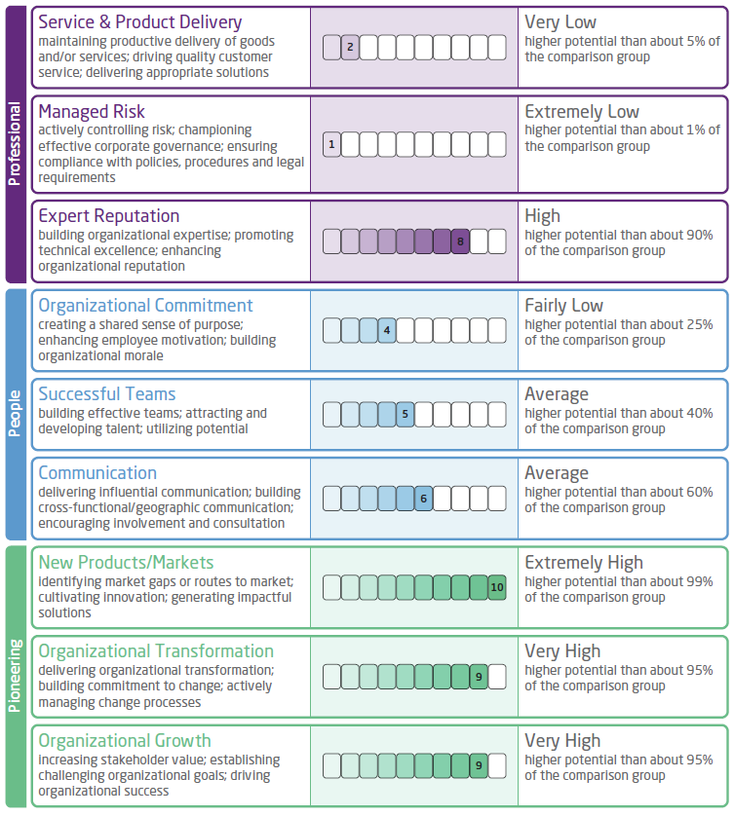
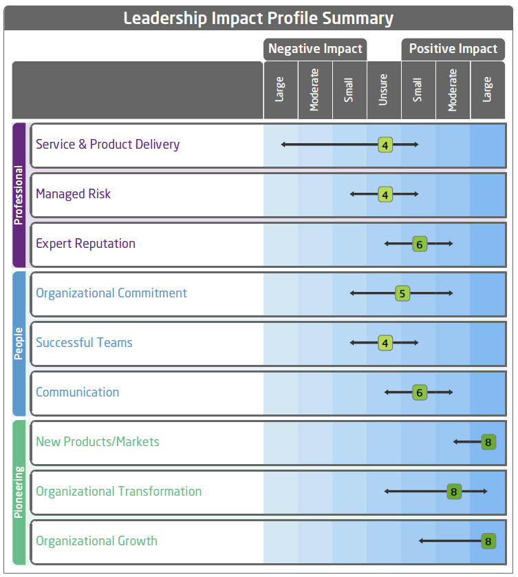
Impact Potential Prediction & Impact 360 Potential Summary
Potential Profile –
Wave Styles Leadership Impact
Performance Profile –
Wave Leadership Impact 360

Slide 58
Administration and Project Management

Slide 59
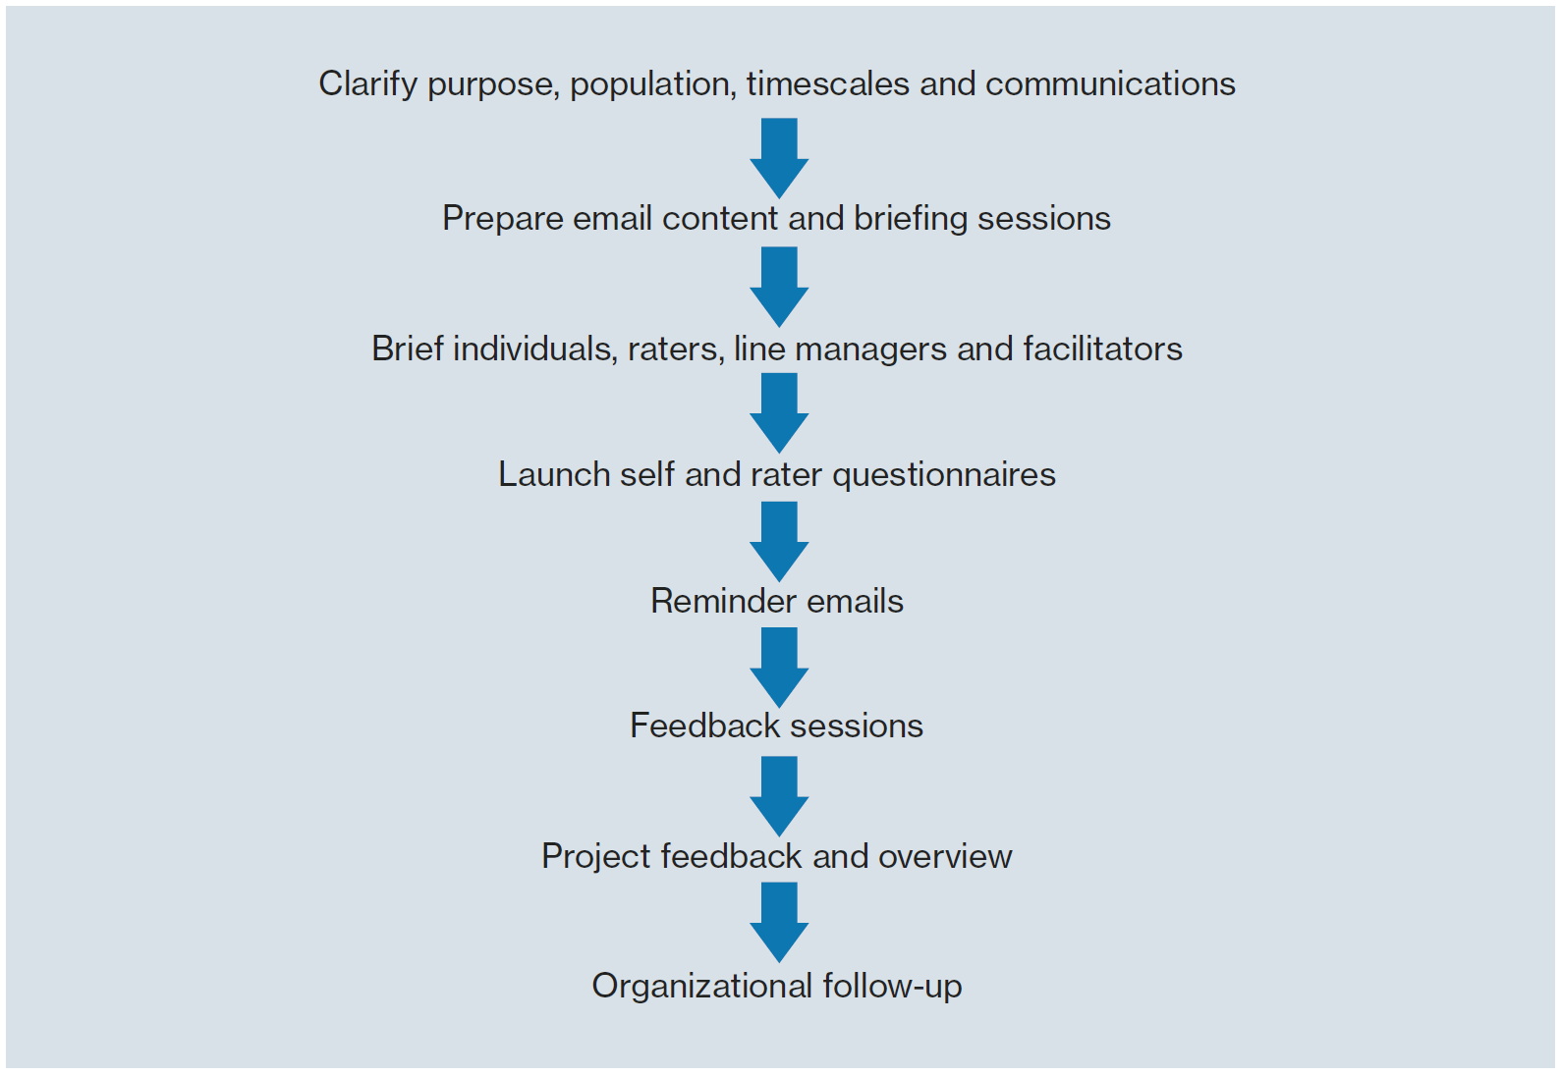
Setting up a 360 Project

Slide 60
Setting up a 360 Project
Understand role requirements
Assessee Briefing:
Purpose of the exercise
Outline of full process – administration to feedback
Timescales
Feedback outcomes
Choosing raters – providing rater details
Confidentiality
Rater selection:
Who chooses
Number of raters: aim for three (with a minimum of two) in all categories except Boss and Self
Work relationship with raters

Slide 61
Rater Briefing
Purpose
Questionnaire timings
Try to use the full range of the scale as much as possible
You may find some of the ratings difficult, but please try to respond to every area
If you really feel you cannot provide a rating on a particular area, please select the ‘Unsure’ option
Unless you are completing as “Self” or “Manager”, your responses will be aggregated with other peoples’ and will therefore be confidential
Please answer honestly and straightforwardly
Think about the individual in a work environment
Try to differentiate between those behaviors which you see as very strong/weak and those which are average
Support your ratings with examples in the open text boxes

Slide 62
Watch Fors
Positioning of the process
Completion rates – invite more than minimum
Raters using the scales incorrectly
Assessees have not been in the role for long
Raters do not work closely with assessee

Slide 63
Project Set-up – Bureau
Step 1: You send out briefing emails and advice to assessees
Step 2: Assessees nominate their raters and send them information and guidance on the process
Step 3: You complete Performance 360 Bureau Request Form send to Saville Assessment’s Bureau team
Step 4: Bureau team set up project - Oasys emails and login details sent
Step 5: We can send updates and reminders
Step 6: If appropriate completions rates are achieved we generate and send you reports

Slide 64
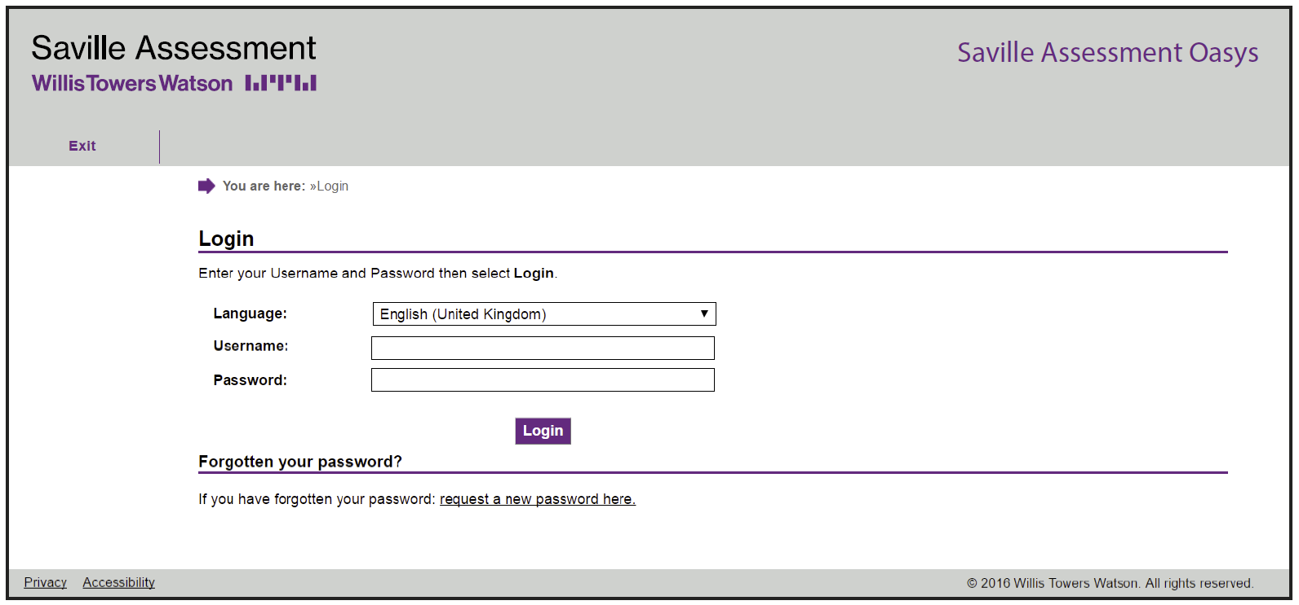
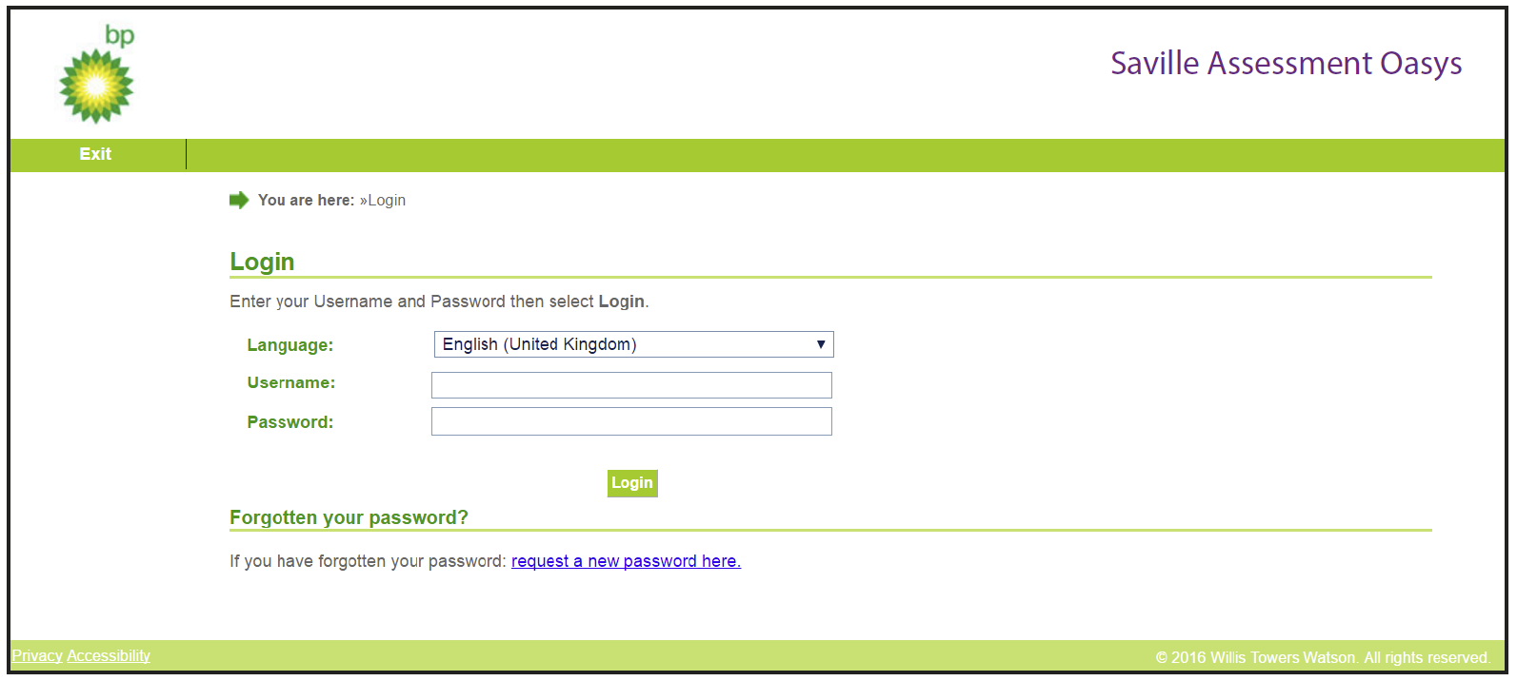
Oasys
One-off investment
Free training to use Oasys
Better value for larger numbers
You are in control of your own projects
Can be branded or non-branded
99.9% uptime

Slide 65
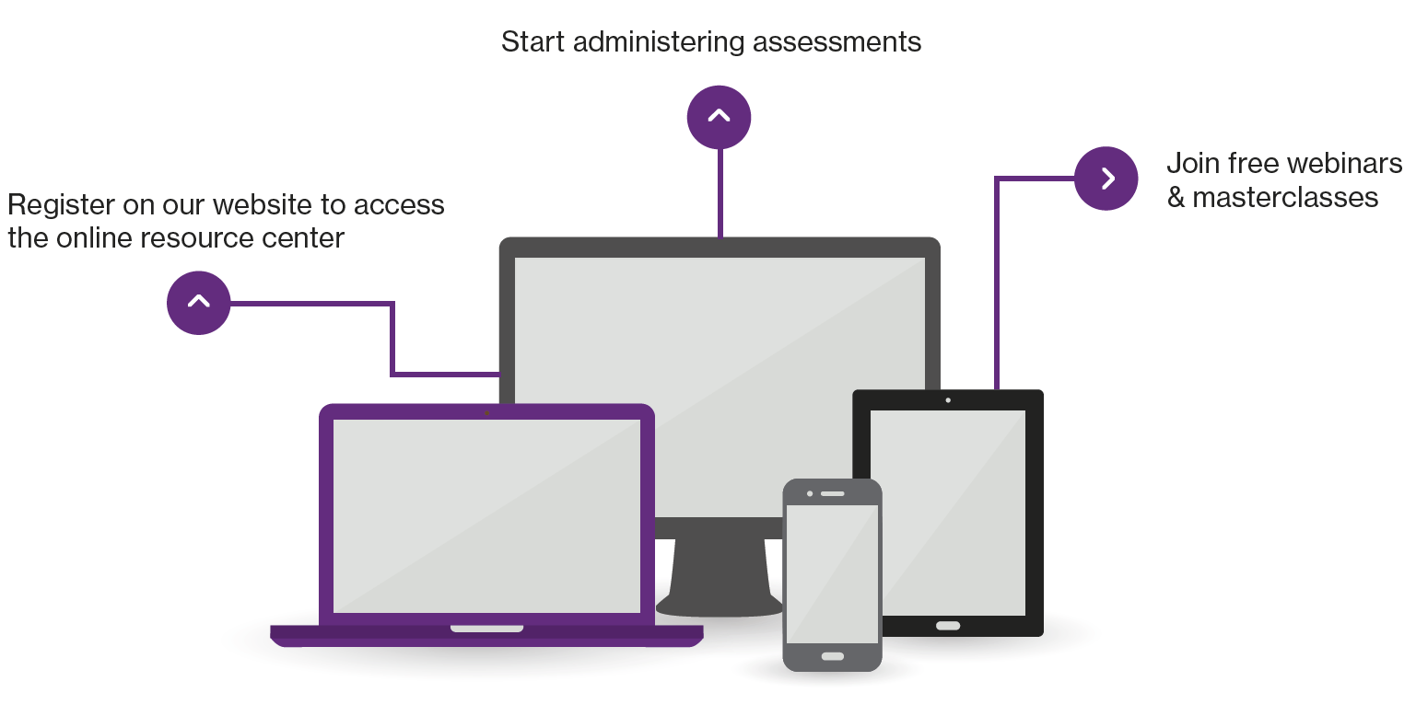
Next Steps
Contact our Duty Consultant for additional support
Call: +44 (0)208 619 9000 Email: info@savilleassessment.com

Slide 66
The Saville Assessment Community
What you can expect:
Invitations to webinars and practitioner masterclasses
Discussion on industry-specific news and topics
Networking opportunities with other professionals
Privileged offers
@savilleassess
www.linkedin.com/company/saville-assessment

Slide 67
Performance 360 Norm Group Description Professionals & Managers (2011)
The sample consisted of 12,592 professionals employed in a range of job functions across a wide range of industry sectors.
Gender: 66% female / 34% male
Age: 24 to 67 years, median age 39 years
Cultural Background: 45% UK White and 35% from other White backgrounds (including European, American, Australian and New Zealander). 20% were of other (e.g. Indian, Hispanic, Black African) or mixed origin (e.g. White and Asian, White and Black African)
Education: 18% had a professional qualification, 34% had a postgraduate degree, 33% had a degree, 14% were educated to high school, and the remaining 1% of the group stated ‘Not applicable’ or ‘other’
Level of Responsibility: 35% at senior management level (including board or executive directors, vice-presidents and senior managers), 38% were managers, 13% were supervisors or team leaders and the remaining 15% were professional individual contributors
Work Experience: overall work experience of the group ranged from 1-2 years (2%) to more than 20 years (41%). 8% had 3-5 years of work experience, 13% had between 6 and 9 years, and 36% had between 10 and 20 years.

Slide 68
Performance 360 Norm Group Description Senior Managers & Executives (2011)
The sample consisted of 5,334 individuals employed in a range of job functions across a wide range of industry sectors.
Gender: 29% female / 71% male
Age: 27 to 63 years, median age 43 years
Cultural Background: 54% UK White and 31% from other White backgrounds (including European, American, Australian and New Zealander). 16% were of other (e.g. Indian, Hispanic, Black African) or mixed origin (e.g. White and Asian, White and Black African)
Education: 20% had a professional qualification, 40% had a postgraduate degree, 28% had a degree, 11% were educated to high school, and the remaining 1% of the group stated ‘Not applicable’ or ‘other’
Level of Responsibility: 9% of the sample were at board or executive level, 17% at director or vice-president level and the remaining 75% were senior managers
Work Experience: overall work experience of the group ranged from 3-5 years (1%) to more than 20 years (52%). 7% had 6-9 years of work experience, 40% had between 10 and 20 years.

