Slide 1
Assessment Solutions
Client Name
July 2023

Slide 2
Agenda
x
x
x
x

Slide 3






Our assessments elicit truly unique people insights, helping them to achieve their full potential.
Talent Acquisition Partner of the Year
Best Internal Recruitment Strategy
Talent Management & Resourcing Supplier of the Year
Excellence in Assessment
Recruitment Industry Supplier of the Year
27 / 30 stars
3

Slide 4
We earn the trust of our clients with 4 key client commitments
Skill
Science
Service
Security
Products you can trust
Technology you can trust
Support you can trust
Experts you can trust
4

Slide 5

We have been innovating how organizations Hire, Build and Lead Talent since 2004
Delivering the fastest & most powerful solutions for an effective & engaging experience
Unlocking the collective potential of your workforce to thrive in a changing workplace
Recognizing everyone has potential for something & linking leadership to organizational outcomes
Hire Talent
Build Talent
Lead Talent

Slide 6
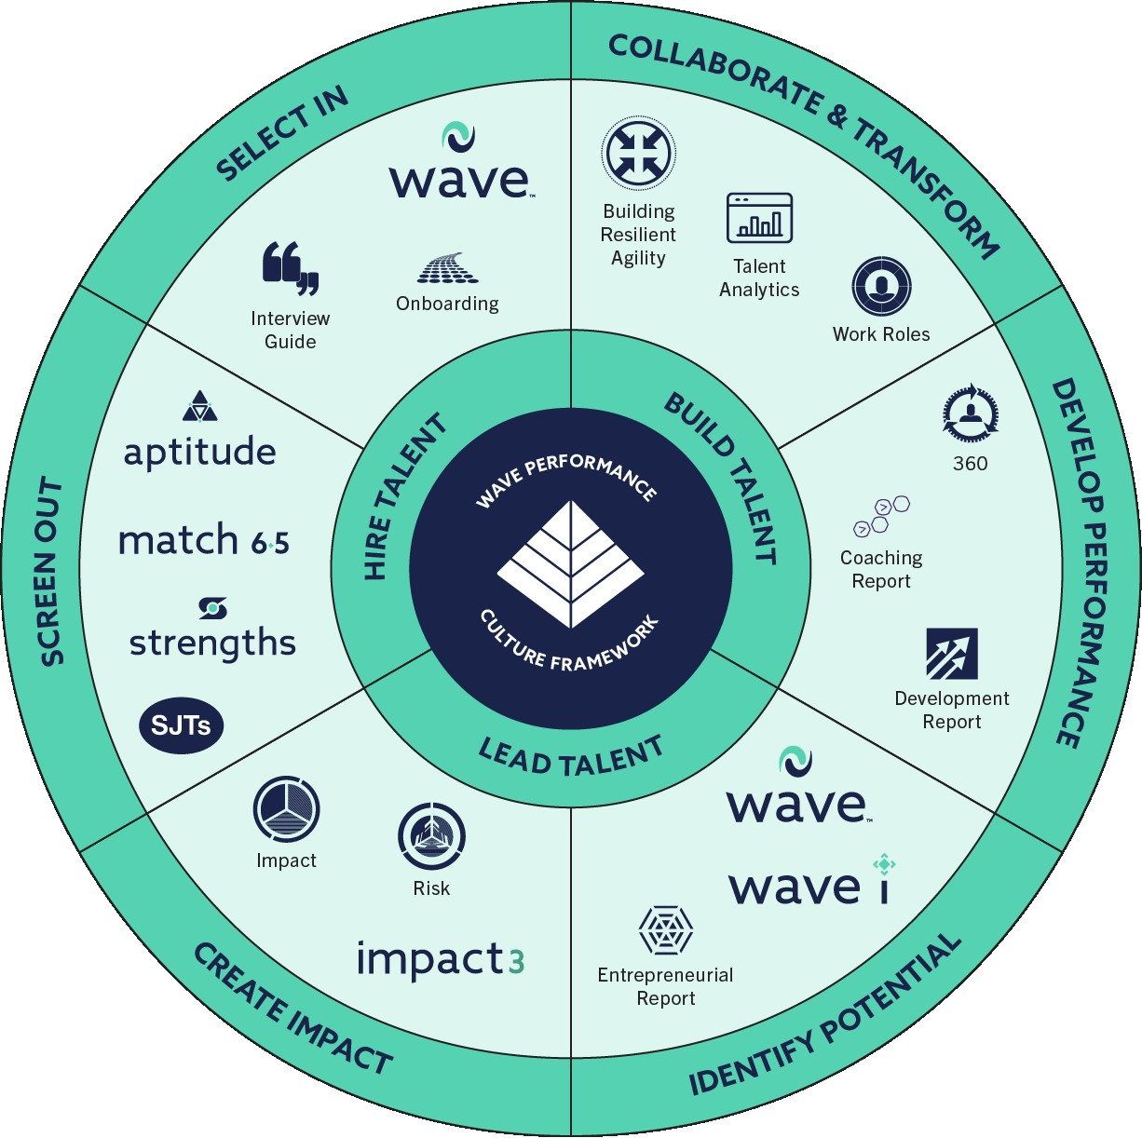
We offer a fully integrated talent strategy allowing you to speak the same language across the talent cycle

Slide 7
Proposed Solution for x
Hire Talent

Slide 8
Our Understanding of Your Needs
Client Name
We understand that your vision is to….
The assessment process should:
x
x
x
x
x
x

Slide 9
Overview of Proposed Solution
We are proposing a different assessment process for selection of the various populations in scope:
Role |  | Proposed Solution | Proposed Solution
Population 1 – |  | Instrument | Reports
Job Role/Level | E-Assessments only
Population 2 - Office Roles |  | Instrument | Reports
Job Role/Level | E-Assessments only
Job Role/Level | E-Assessments only
Job Tole/Level | Combination of E-Assessments and In-Person (Day) Assessment

Slide 10
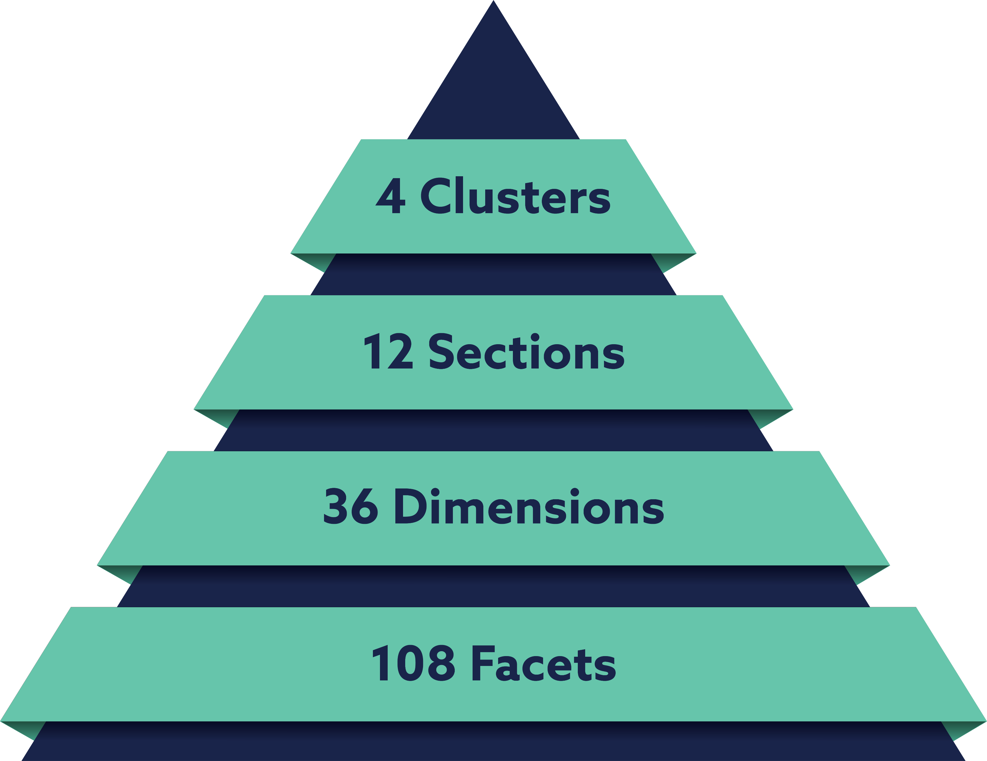
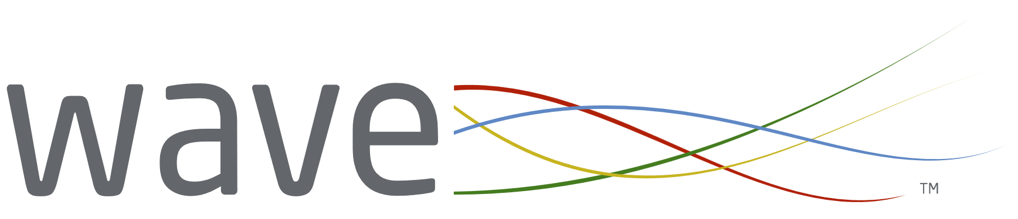
Introduction to Wave
Our dynamic Wave® Personality Questionnaires put the most powerful predictor of workplace performance in your hands, ensuring market-leading validity.
Underpinned by 15 years of big data and global research.
27 out of 30 stars from the BPS (British Psychological Society) independent review.
Culture-neutral and timeless design.
Notes:
understand how to build resilience and agility).

Slide 11






Introduction to Cognitive Tests
Why use our Cognitive Tests?
Current and work-relevant items measuring the core abilities required for the role
Short completion times - Swift combination tests measuring 3 to 6 key areas in one test
High-quality practice and preparation materials available in over 28 languages
Dynamic group reporting driving faster and more reliable decisions underpinned by accurate data
Varied and modern range of questions offering a breadth of measurement and positive candidate experience
Fixed-length format ensures a fairer experience for candidates with a gradual increase in difficulty

Slide 12

Population 1: Store Managers
E-Assessment Instruments
Measuring a candidate's potential, culture fit and identifying development opportunities
Swift Comprehension Aptitude
Our pioneering Swift Aptitude tests efficiently assess the core cognitive ability areas required for the role.
Swift Comprehension is a 9.5-minute combination test, measuring Verbal, Numerical, and Error Checking.
&
6.5-minute powerful behavioural screener for identifying a candidate's potential to be successful in the role.

Slide 13


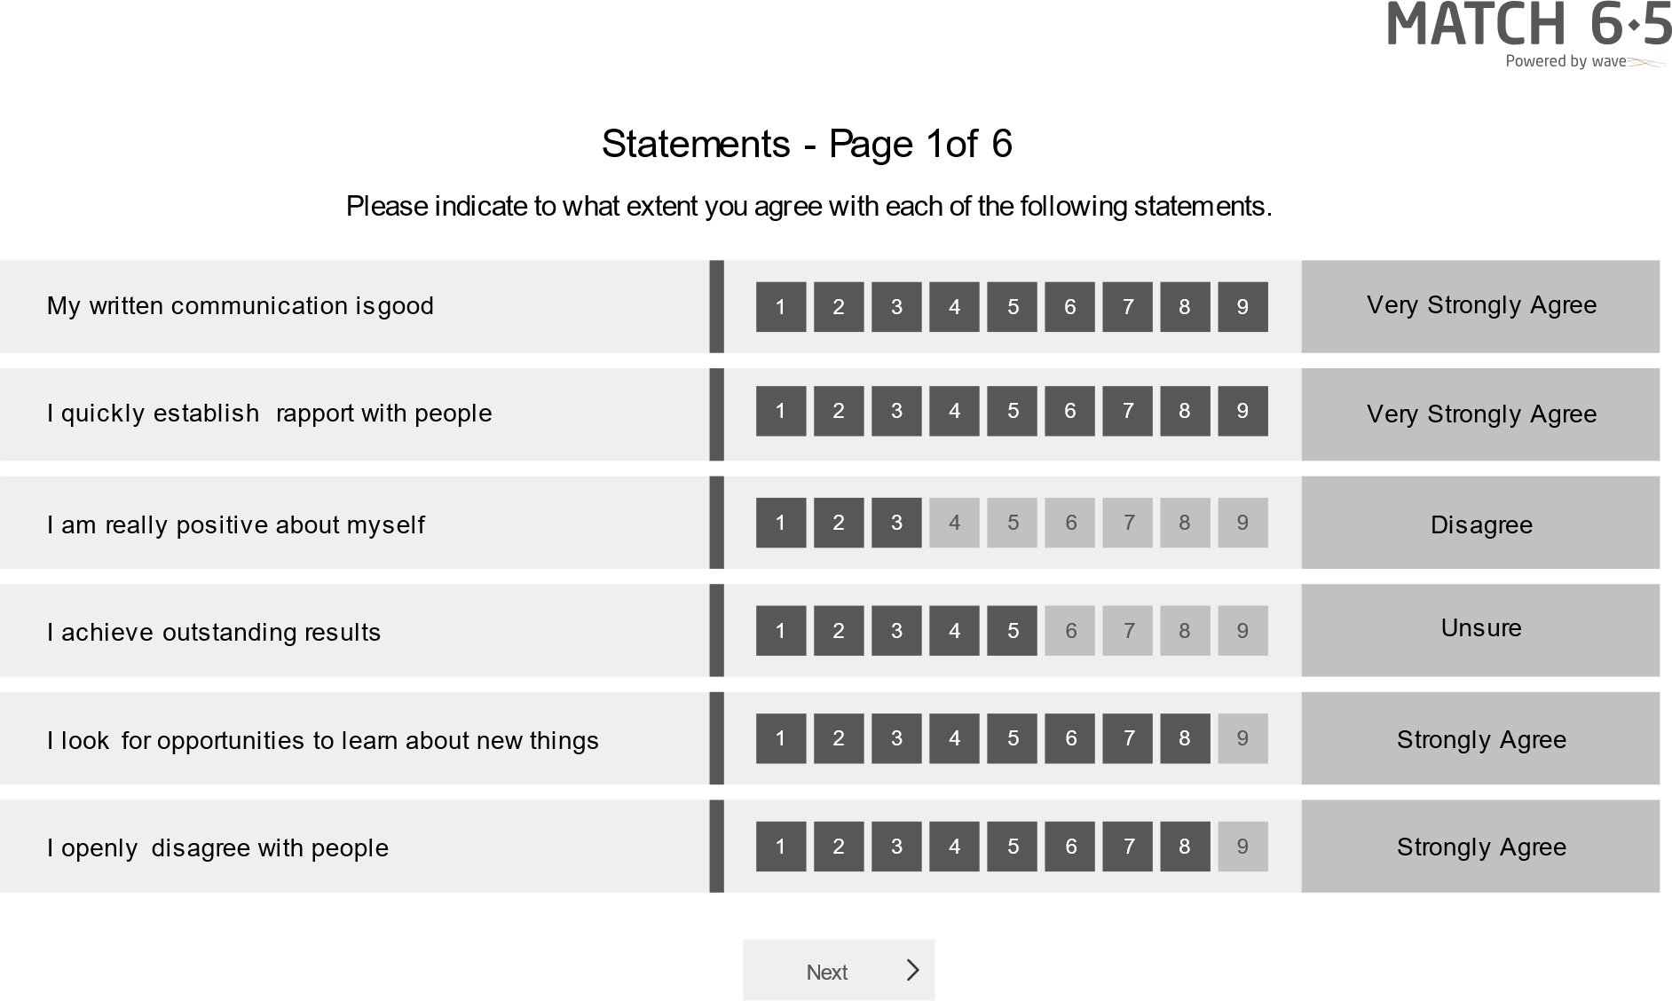
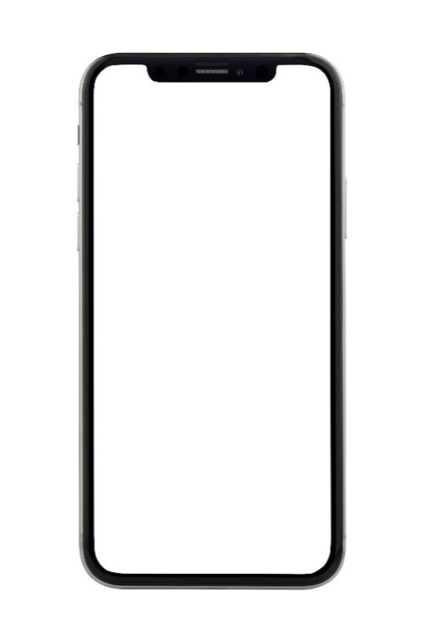
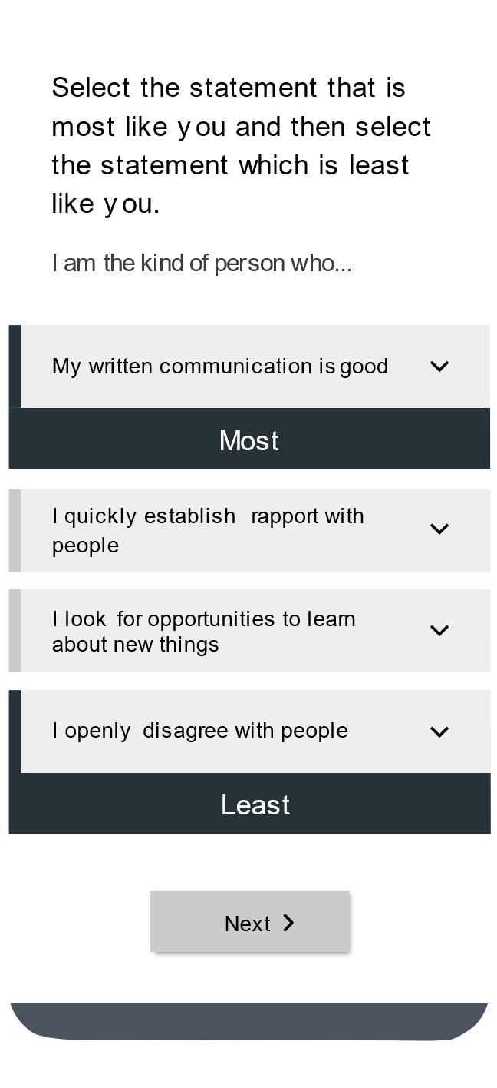
Match 6.5 uses the power and validity of the Saville Assessment Wave model to understand a candidate’s suitability for a role in 6.5 minutes.
Using work-relevant language.
Using the most predictive items from the Wave Personality Questionnaire. Validity = 0.44
Using Wave’s unique rate and rank methodology to maximize the power of the assessment.
The reporting options available are:
Role-fit
Score
Candidate Report
Candidate Report
Onboarding Report
Interview
Guide

Slide 14
Role Fit Score
Creating the Match 6.5 algorithm based on what is key to success in the retail store management roles, e.g., Giving Support, Building Relationships, Providing Leadership, Driving Success, etc.
Ranking Example
1st
Giving Support
2nd
Building Relationships
The 12 Match 6.5 behaviors:
High
3rd
Providing Leadership
Evaluating Problems
Building Relationships
4th
Driving Success
Investigating Issues
Communicating Information
Rank the 12 behaviors
Structuring Tasks
Medium High
Creating Innovation
Providing Leadership
Communicating Information
Medium Low
Investigating Issues
Showing Resilience
Processing Details
Showing Resilience
Adjusting to Change
Structuring Tasks
Adjusting to Change
Giving Support
Driving Success
Evaluating Problems
Low
Creating Innovation
Processing Details

Slide 15

Combined Fit Score
Combine the cognitive ability and behavioral results
Quickly and objectively identify those who are most suited to the requirements of the job.
First Name | Last Name | Behavioral Fit | Cognitive Ability Fit | Combined Fit | NormSet
Lee | Crouch | 41.79 | 38 | 38.7925 | Individual Contributors (INT, IA, 2021)
Constance | Markievica | 37.6883 | 54 | 40.0393 | Individual Contributors (INT, IA, 2021)
Sabrina | Smith | 46.7398 | 41 | 44.2315 | Individual Contributors (INT, IA, 2021)
Jooris | Axelstien | 46.3501 | 45 | 45.1217 | Individual Contributors (INT, IA, 2021)
Isabel | Mebarak | 47.1387 | 52 | 48.0183 | Individual Contributors (INT, IA, 2021)
Lucia | Fernando | 46.1332 | 57 | 48.6593 | Individual Contributors (INT, IA, 2021)
Chris | Park | 53.9965 | 53 | 54.5712 | Individual Contributors (INT, IA, 2021)
Sam | Jenkins | 57.0387 | 60 | 59.5189 | Individual Contributors (INT, IA, 2021)
Faisal | Wooton | 62.0572 | 54 | 62.219 | Individual Contributors (INT, IA, 2021)

Slide 16
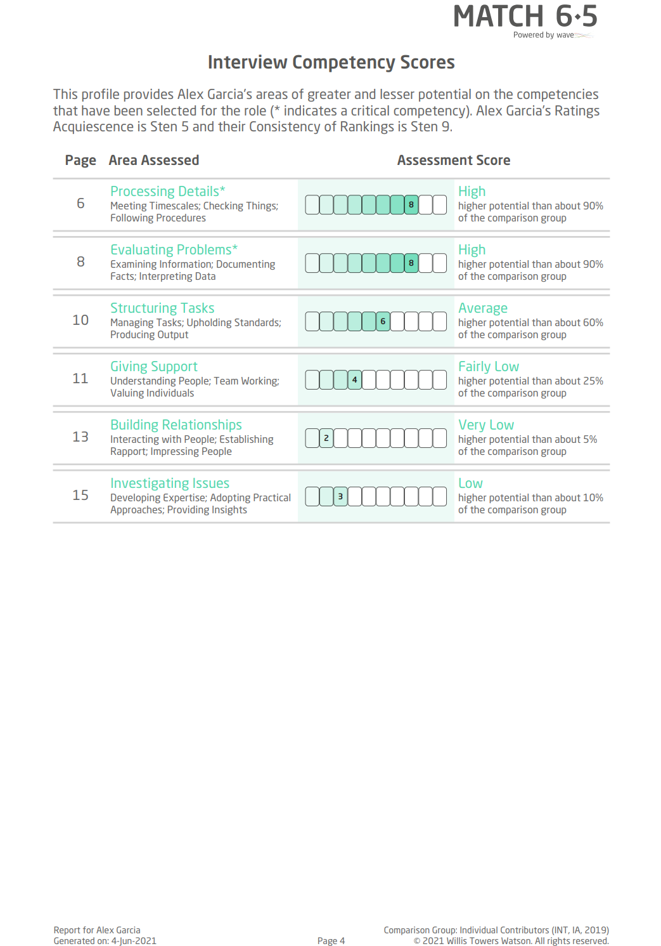
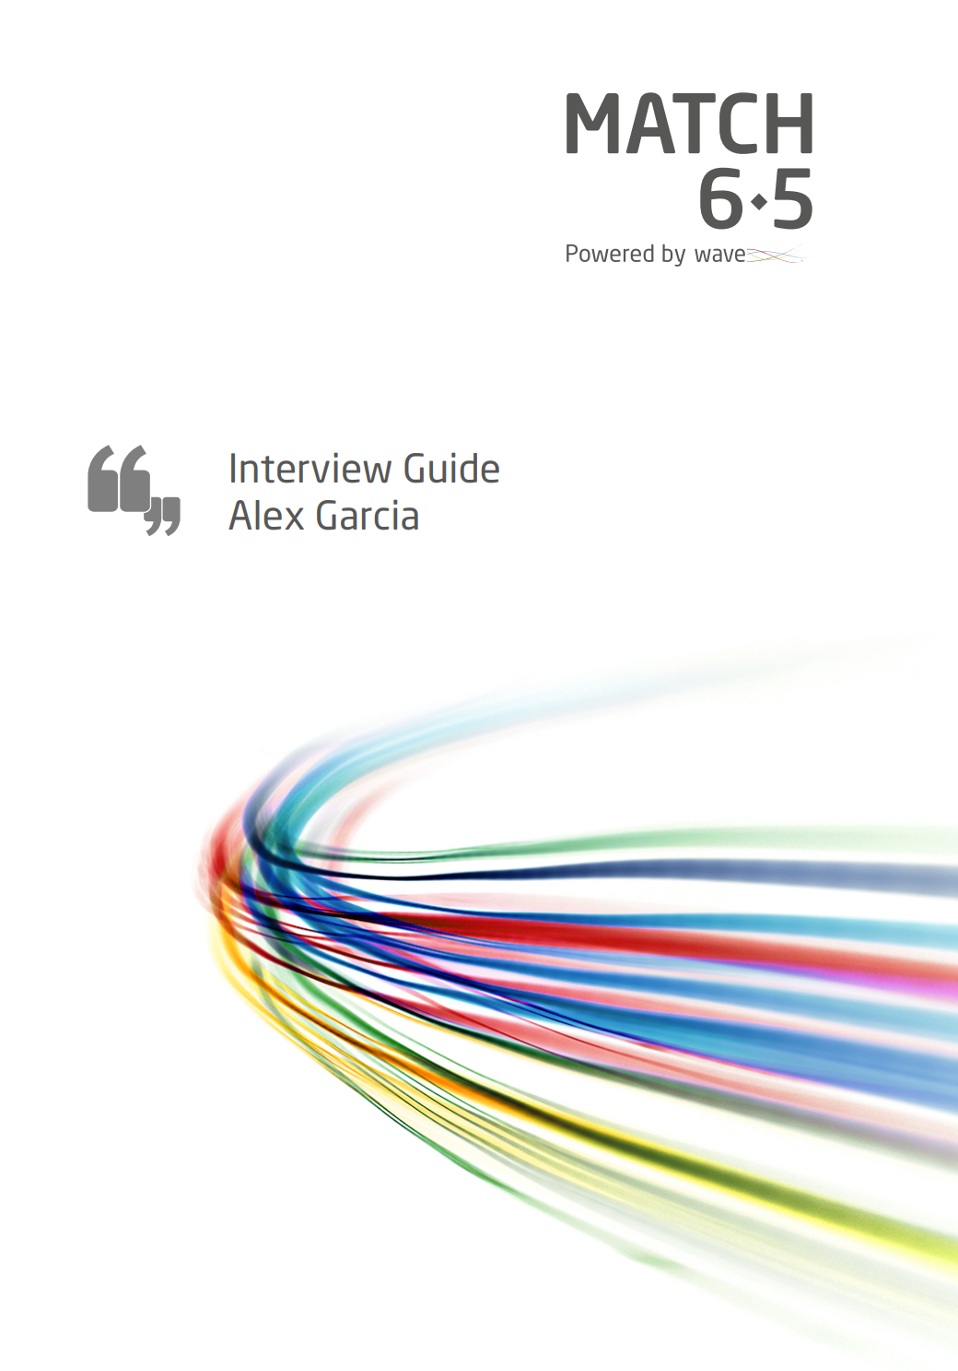
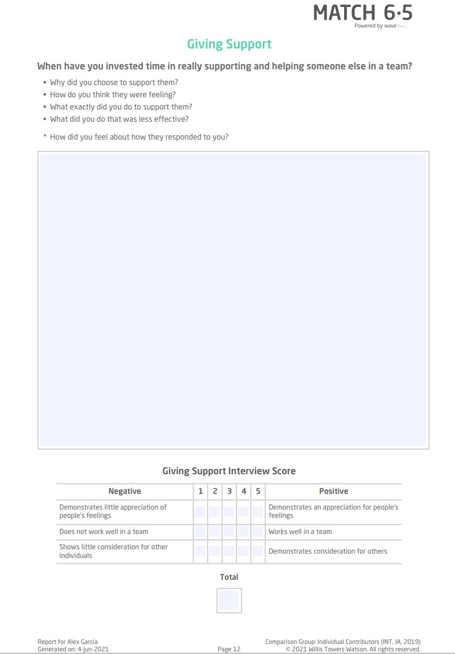
Match 6.5 Interview Guide
Powered by a competency selector, configured question generation rules, and an individual’s responses to the Match 6.5 questionnaire.
Ensures A.S. Watson is ready to:
Run a highly structured interview
Record answers and score the interview objectively
Deliver a relevant and fair interview process

Slide 17
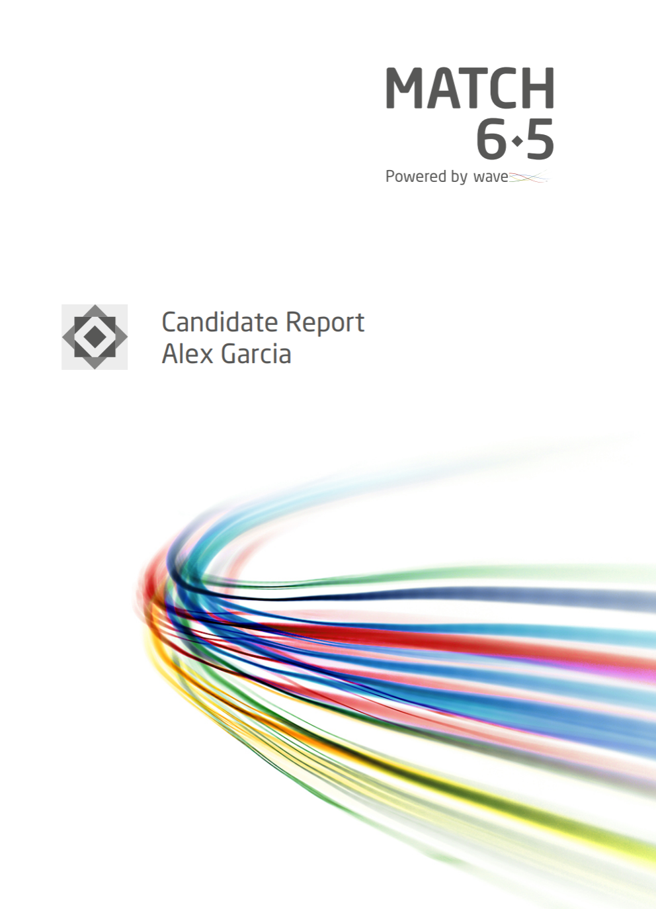
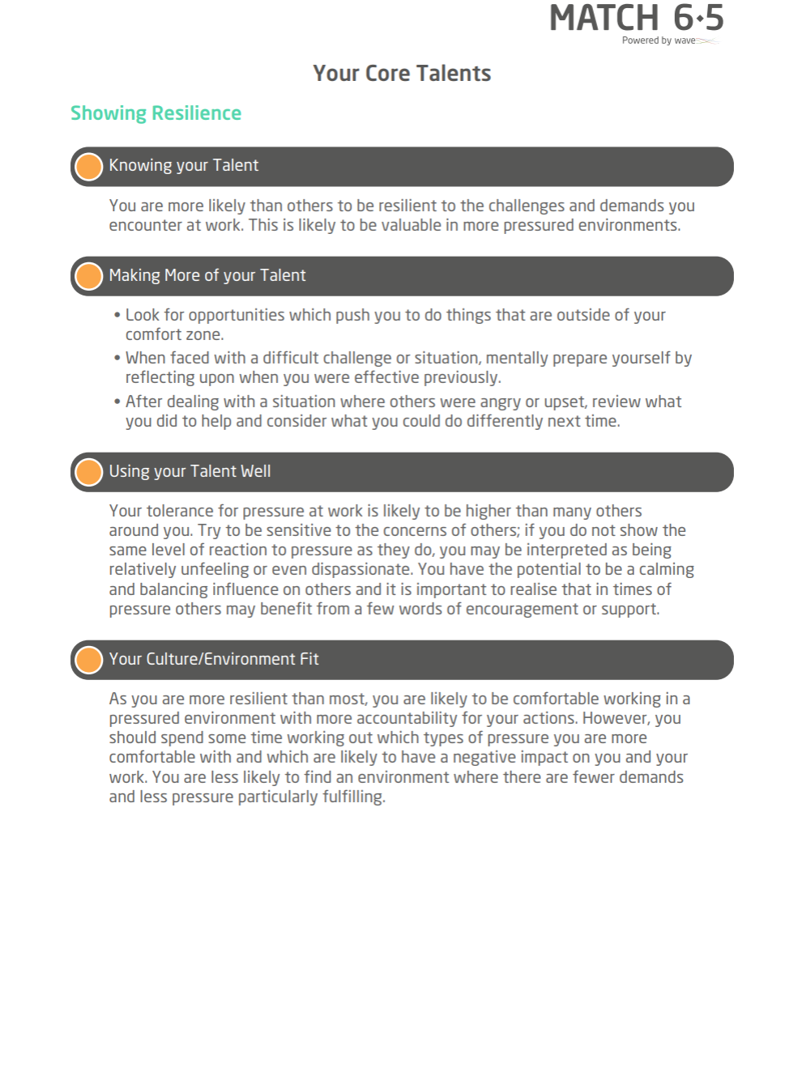
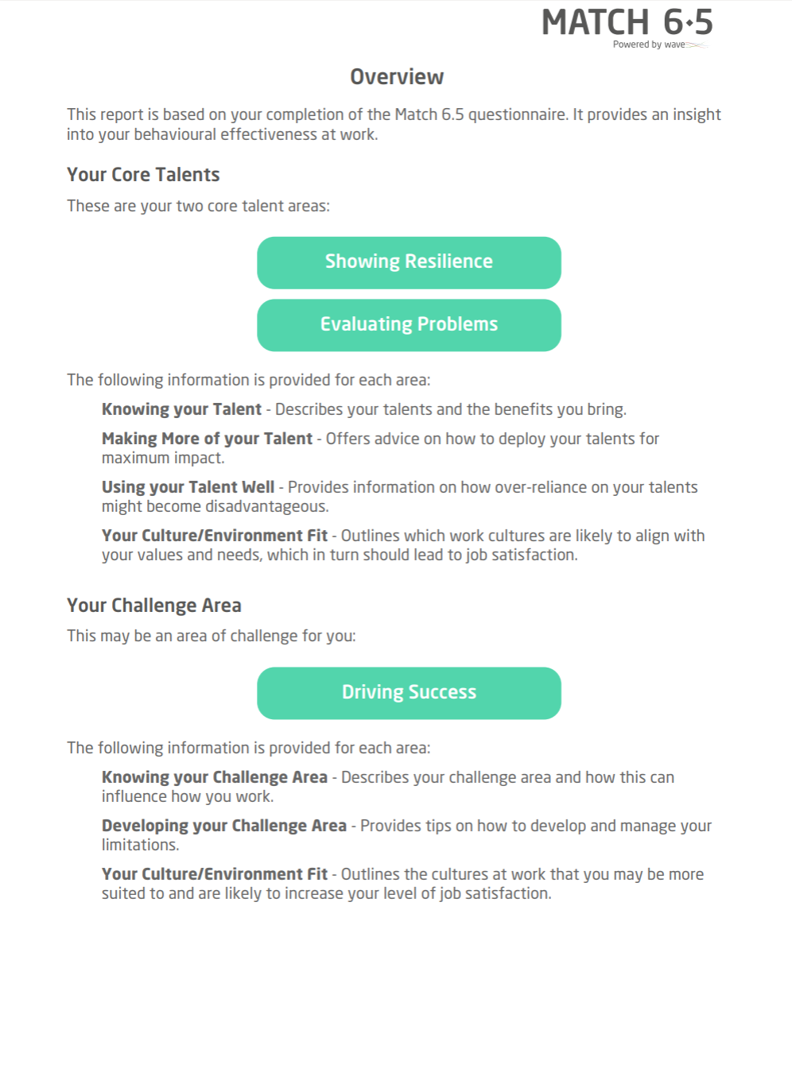
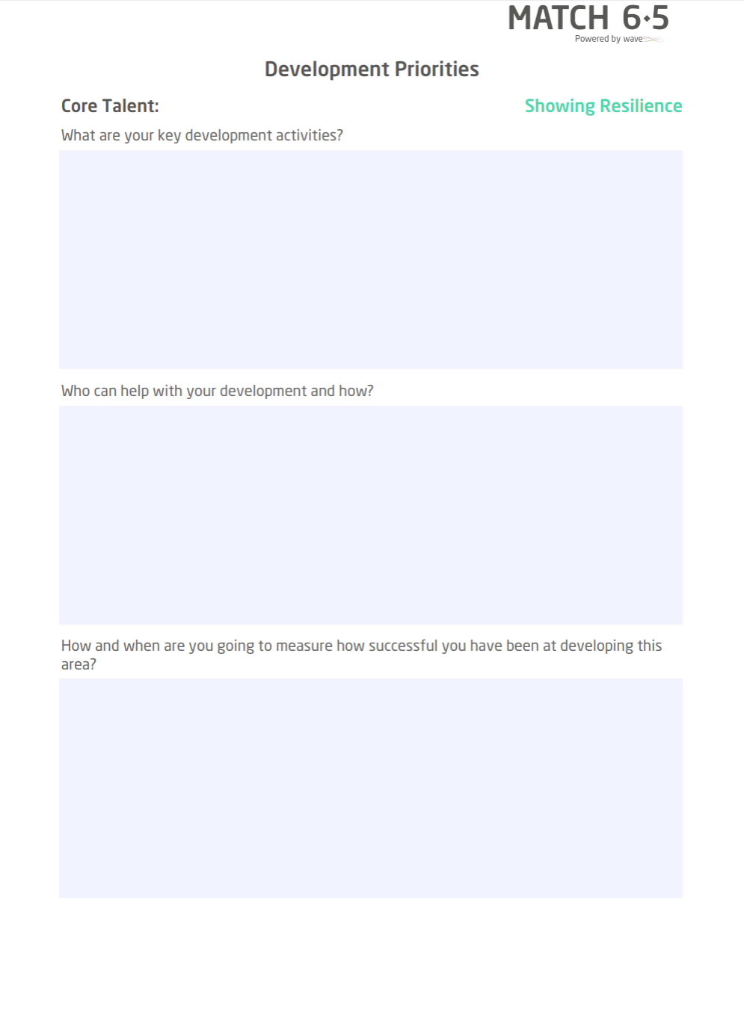
Match 6.5 Candidate Feedback Report & Onboarding Report
Provides insight in:
The candidate’s top two core talent areas and their challenge area.
How the candidate could deploy their talents for maximum impact and how an over-reliance on them might become a problem.
How the candidate could develop their challenge area.

Slide 18
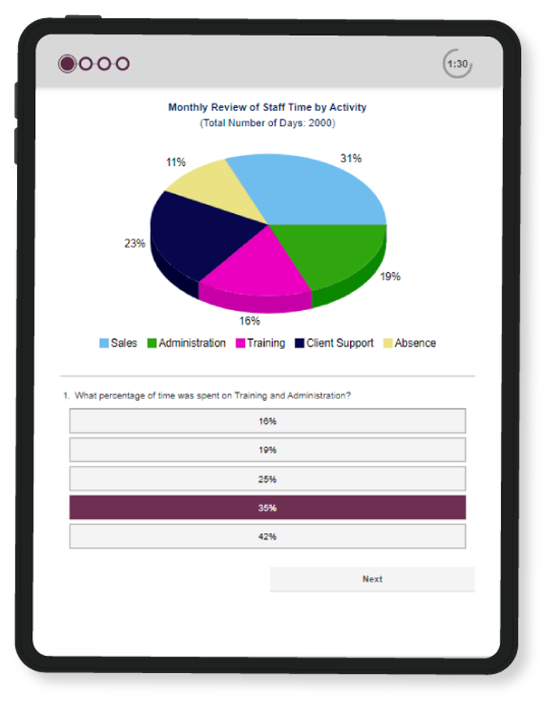
Swift Comprehension
Combination aptitude test popular for assessing administrative roles, customer service roles, retail roles, operational roles and commercial roles.
A 9.5-minute combination test measures 3 areas:​
​
Verbal – assesses the ability to understand, interpret and evaluate written materials.​
Numerical – assesses the ability to understand, interpret and evaluate numerical data.​
Error Checking – assesses the ability to proofread text, check figures and verify codes.​
Notes:
The report provides comprehensive candidate feedback in a visual and easy-to-interpret format.
Contains unique information illustrating the accuracy and speed with which a candidate completed the assessment against a relevant benchmark.
Development tips presented to improve for the future, creating an inclusive development space for all.
Create a combined fit score to screen candidates on both the Match 6.5 and aptitude elements

Slide 19
Population 2: Office Roles
Cohort 1: Junior Roles – E-Assessment Instruments
Measuring a candidate's potential, culture fit and identifying development opportunities
Focus Styles
Swift Executive
The Wave Focus Styles Assessment is a 13-minute questionnaire measuring both individual’s motivation and talents in 36 key work areas.
Range of report options can be generated to support with selection and onboarding of the candidate.
Validity = 0.44
Swift Executive is an 18-minute combination test popular for assessing professional , managers and executives.
The test measures 3 core aptitude areas- Verbal, Numerical, and Abstract
&

Slide 20
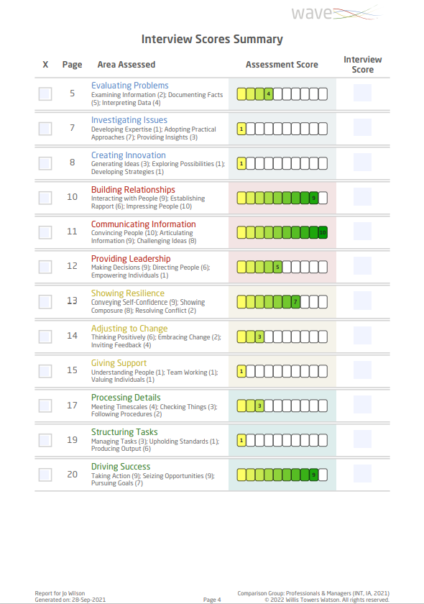
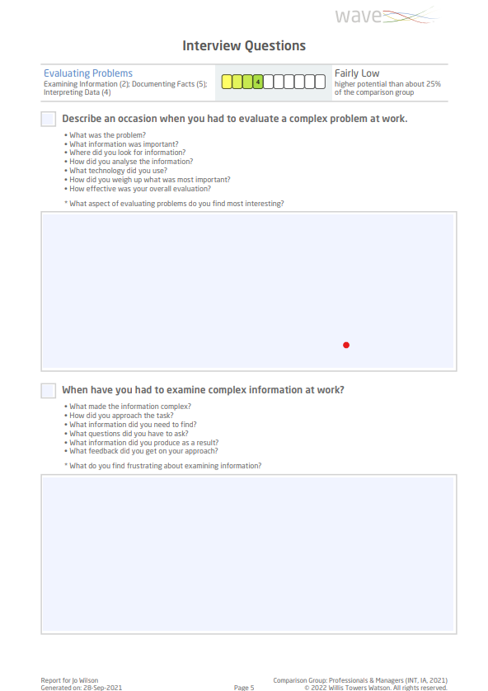
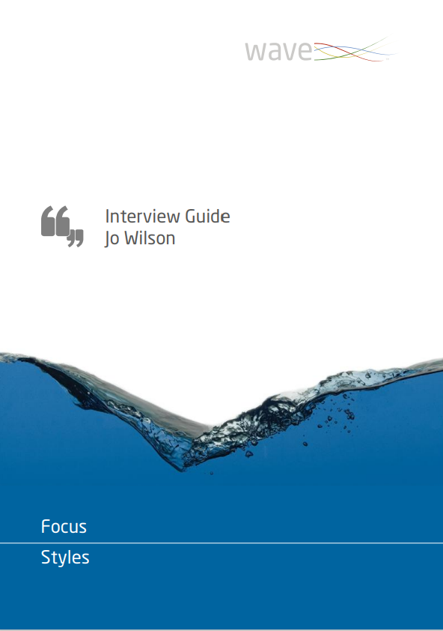
Focus Styles Interview Guide
Interview questions and probes provided for all 12 sections of the Wave model ensuring a highly structured interview.
Space and guidance are provided for recording answers
Improves interview content and structure
Guides a detailed exploration of both motives and talents.

Slide 21
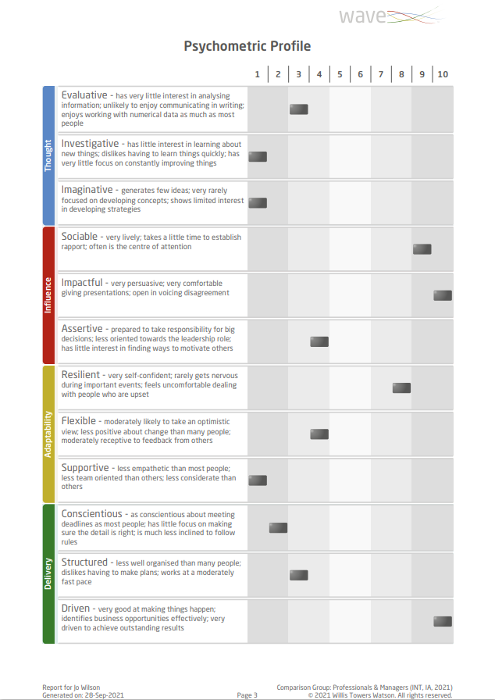
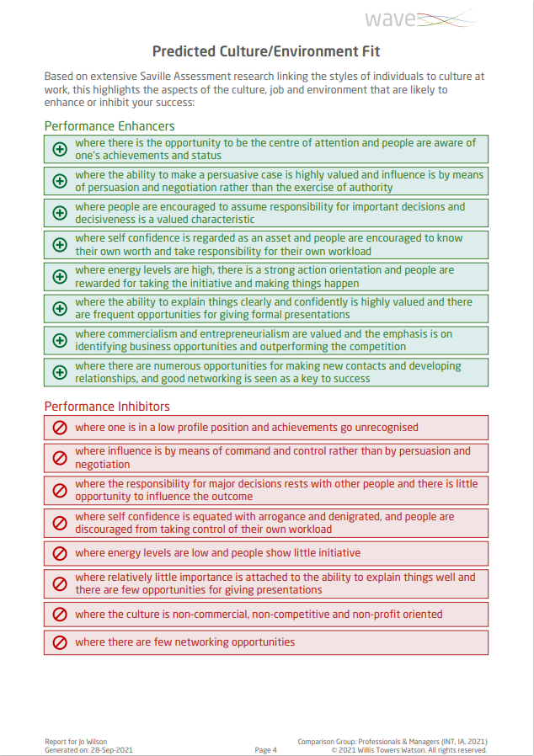
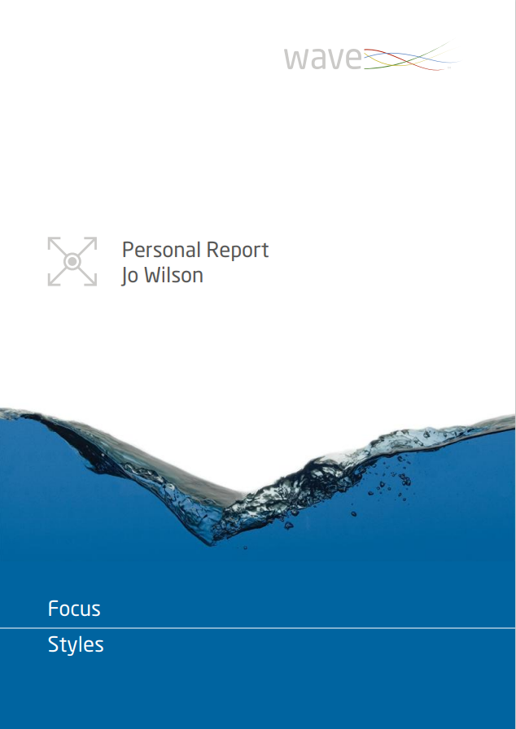
Focus Styles Personal Report
A candidate-friendly, narrative feedback report that can be shared with all candidates without the need for a 1-1 feedback session.
Provides each candidate with:
A one-page Psychometric Profile highlighting key strengths and challenge areas and their Predicted Culture/Environment Fit.
Feedback of 36 facets of the Wave model in an easy-to-digest format.

Slide 22
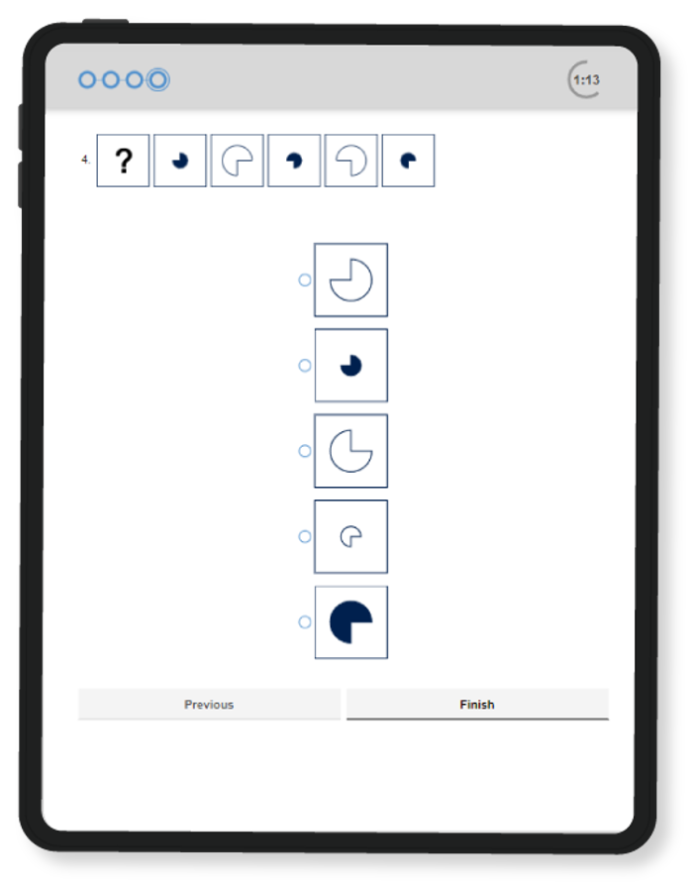
Swift Executive
Combination aptitude test popular for assessing professionals, managers and executives. ​
The 18-minute combination test measuring three core ​
aptitude areas: ​
​
Verbal – assesses the ability to understand, interpret and evaluate written materials.​
Numerical – assesses the ability to understand, interpret and evaluate numerical data.​
Abstract – assesses inductive reasoning by determining patterns in sequences of shapes.​

Slide 23
Population 2:
Senior & Leadership Roles – E-Assessment Instrument
Measuring a candidate's potential, culture fit and identifying development opportunities
Professional Styles
The Wave Professional Styles Questionnaire is a 35- minute questionnaire measuring both an individual’s motivation and talents at the level of the 12 sections, 36 dimensions and 180 facets of the Wave model.
Our flagship expert report, available from Professional Styles, explores personality at depths other tools simply don’t offer.
Validity = 0.57

Slide 24
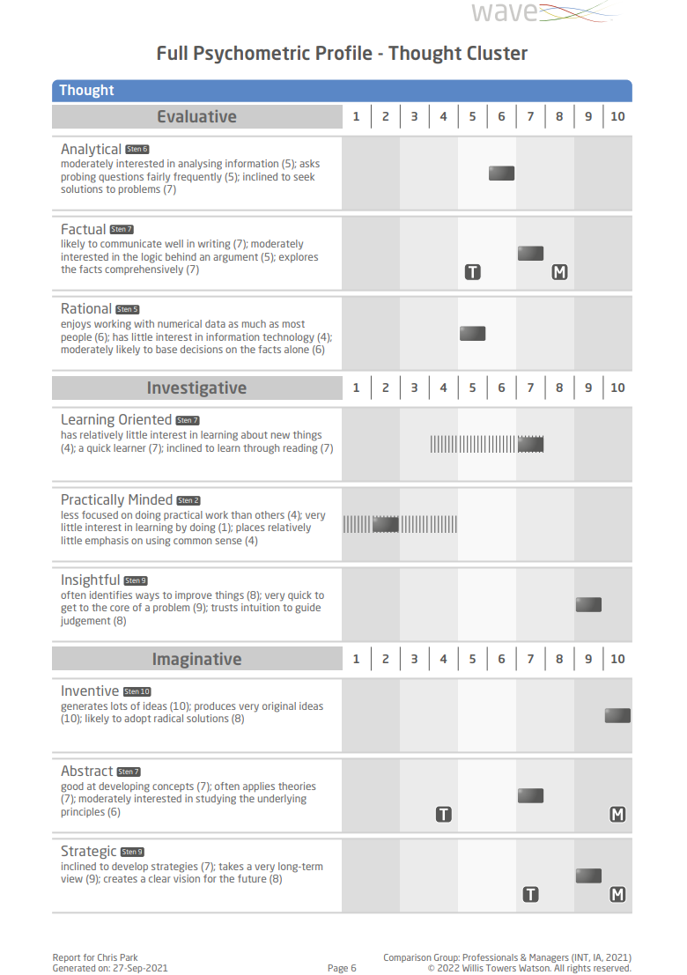
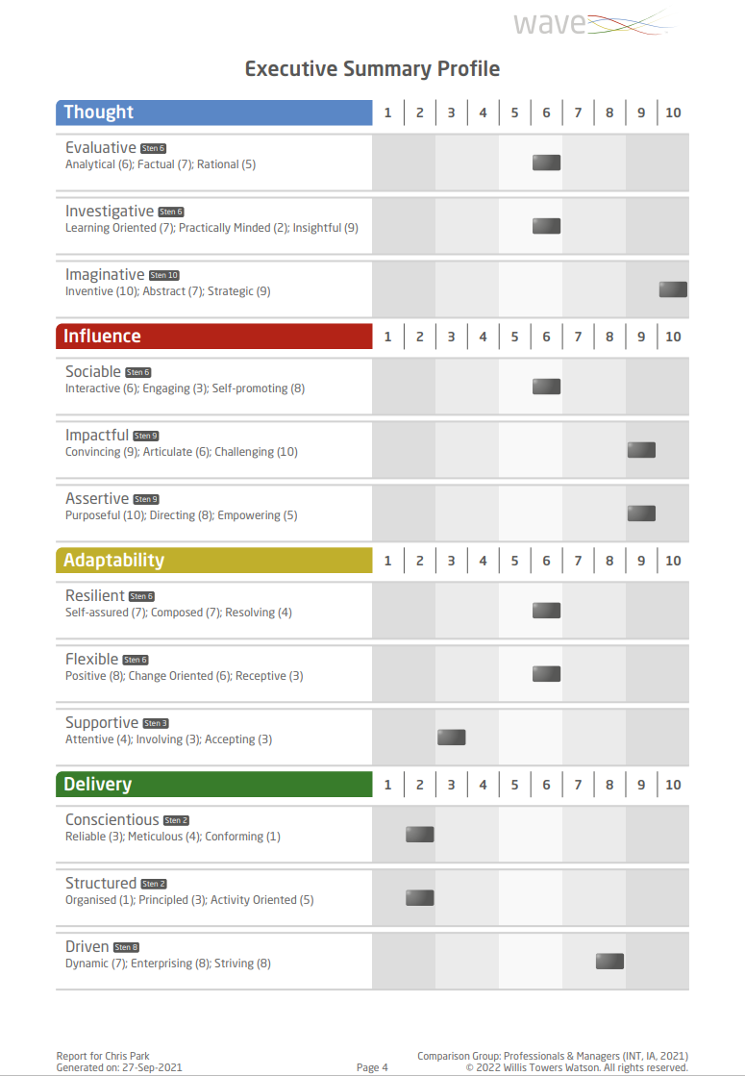
Professional Styles Expert Report
Provides in-depth information across Wave’s four clusters: Thought, Influence, Adaptability and Delivery.
Dive deeper into differences between motivation and self-perceived effectiveness.
Explore differences between free choice and forced choice responses to understand how that relates and impacts them in their role.

Slide 25
Population 2: Office Roles
Leadership Roles – In-Person (Day) Assessment
Validation interviews for individuals in leadership roles.
Process:
Discuss with key stakeholders to identify the key behaviors important for success in the role.
Using the Professional Styles Expert Report, we conduct 60-minute validation interview sessions gathering examples to validate the key strength and challenge areas highlighted in the report.
Following the interviews, we will deliver a 30-minute debrief to the A.S. Watson key stakeholders to discuss the key reflections/themes.
Add some text

Slide 26
Additional Instruments
Hire Talent

Slide 27

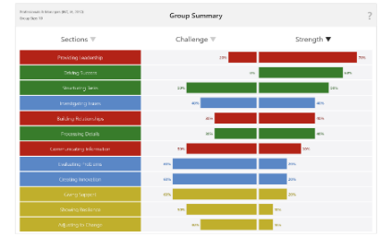

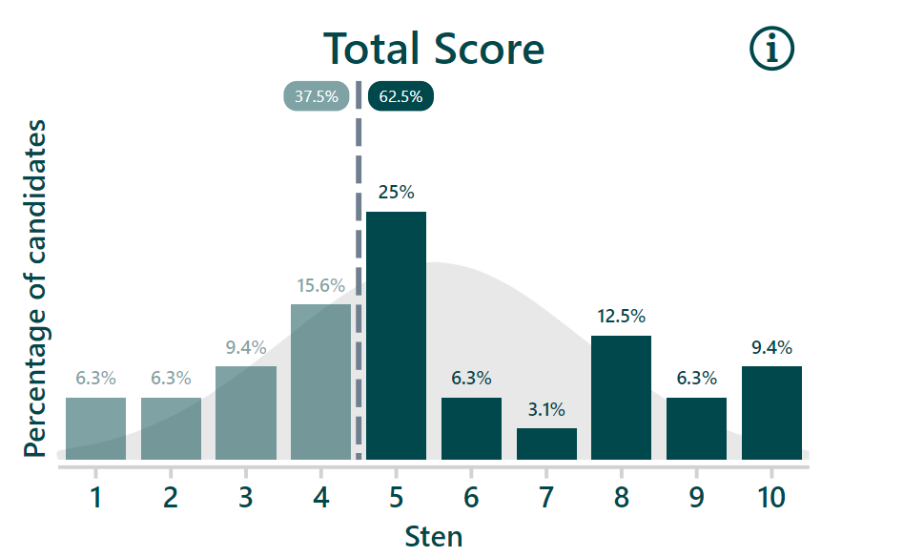
Group Overviews
Interactive Analytics
Overviews allow you to view trends in the group data in a simple and engaging way.
Data presented at different levels of the Wave model and following the completion of Swift assessments.
Dynamic display of different candidate groups.
Use insights to drive improvements in the selection and development process and form lasting change.

Slide 28
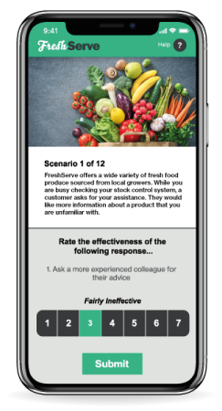
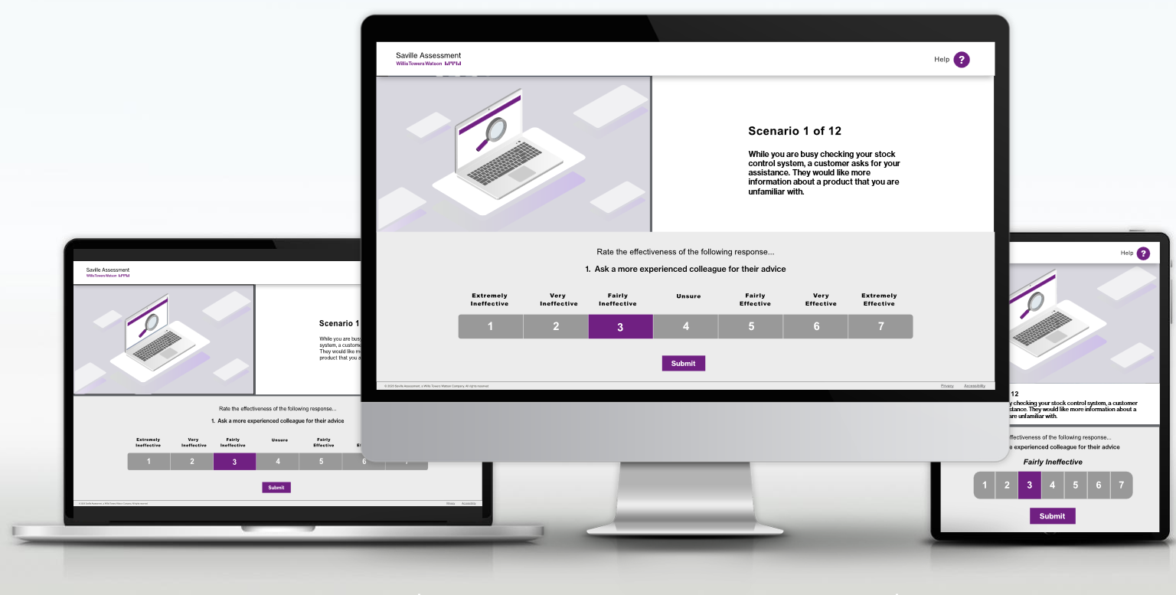
Retail Situations
Retail Situations provides:
Engaging content that gets your future Store Managers excited about the role
A situational-based screening tool for use within the retail industry
A positive candidate experience and short 15-minute completion time
*Currently only available in English

Slide 29





Week In the Life Of (WILO)
Why WILO?
A uniquely immersive ‘Week In the Life Of’ assessment experience that takes candidates on a journey where they learn as much about you as you learn about them.
Market leading robustness
Customizable, consumer-grade candidate experience
Meaningful assessment through storytelling
Democratizing assessment
Real-time feedback
29

Slide 30
Pricing, Set up & Implementation

Slide 31
Pricing Breakdown
Role | Service | Cost per unit (+ applicable tax) | Estimated Units | Estimated Total Cost (+ applicable tax)

Slide 32
Pricing Breakdown
Implementation | Cost (+ applicable tax)

Slide 33
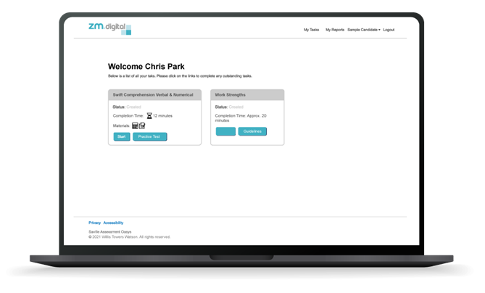



Oasys Online Platform
A self-managed service
Saves you 33% on assessment costs and includes options for your own branding
24-hour access for administrators, practitioners and candidates
Trained administrators can self-sufficiently set up assessment projects, add/monitor completion and generate reports

Slide 34
Your Account Management Team
Photo
Photo
Photo
Photo
Consultant
Consultant
Consultant
Consultant
Job Title
Project Role
Description of role in project
Job Title
Project Role
Description of role in projec
Job Title
Project Role
Description of role in project
Job Title
Project Role
Description of role in project

Slide 35




Additional Support
Service
Record Responsiveness
7-Day Service
We have a 2-hour turnaround window for all support queries
Our outstanding bureau team are available 7 days a week
Transparent
Pricing
First-class Resources
Our straightforward pay-as-you go model gives you the freedom to create the package you want with no hidden costs
A wealth of materials are available to support best-practice use of our assessments

Slide 36




Skill
Duty Consultants
Global Reach
Get access to our team of expert business psychologist for help & advice
Our knowledgeable practitioners span over 30 countries internationally
Accreditation Training
Consultancy Services
We offer a range of flexible virtual and in-person courses delivered by our skilled practitioners
Utilize our experts to support with interpretation, debriefs and feedbacks

Slide 37
Language Availability
Service | English (UK) | Dutch | French (Fr)
Oasys Platform (Candidate)
Privacy Policy
PS - Wave Professional Styles Questionnaire
PS - Expert Report (including Personal & Line Manager Reports)
FS - Wave Focus Styles Questionnaire
FS - Interview Guide (including Personal Report)
M6.5 - Match 6.5 Questionnaire
M6.5 - Match 6.5 Candidate Report
M6.5 - Match 6.5 Onboarding Report
M6.5 - Match 6.5 Interview Guide
Analysis Range - Swift Executive Aptitude-Rx (IA) Test
Analysis Range - Swift Executive Aptitude & Pace Report (Rx)
Comprehension Range - Swift Comprehension Aptitude-Rx (IA) Test
Comprehension Range - Swift Comprehension Aptitude & Pace Report (Rx)

Slide 38

Training
Flexible Online Learning to Upskill Client Name
No previous psychometric testing experience required.
Suitable for HR, recruitment and talent professionals.
The Swift Ability course content focuses on best practice use of aptitude assessments.
The Wave personality course section teaches you how to confidently apply Wave personality questionnaires in the workplace.
2 full days of Virtual Tutored Online Training at a date and time that works for you

Slide 39
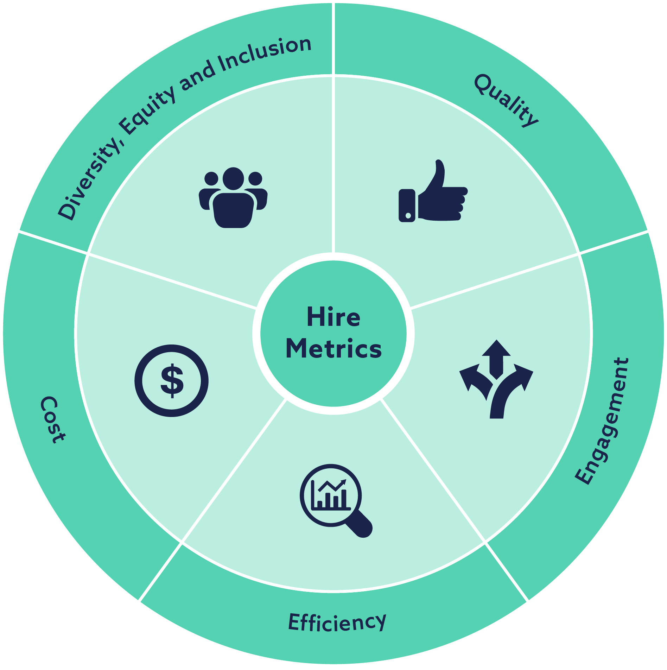
Return on Investment

Slide 40
Conclusion
Notes:
We understand that your vision is to improve the fit between employer and employee, operate objectively and strengthen your role as an attractive employer, using quick-to-complete online assessments, supported by in-depth consultant input at the very senior level. The assessment process should: ​
- Improve both the culture and role fit by understanding strengths, potential, and development opportunities for every candidate. ​
- Include results that provide predictive value, allowing you to increase the success rates of new hires, reduce the outflow and establish clear links between the assessment outcomes. ​
- Build an inclusive experience that enhances diversity, equity, and inclusion (DE&I). ​
- Reduce the amount of time candidates spend completing online assessments and decrease the number of candidates dropping out at this stage.
- Provide a user-friendly experience for both candidates and A.S. Watson.
As our portfolio spans the full employee life cycle, we envision a partnership with A.S. Watson, working to deliver expertise, industry insight and trends, and excellence in our work together. We wish to provide assistance in A.S. Watson’s mission to Hire new talent, Build and develop their existing talent, and identify and develop individuals who can Lead within the organization.
From our suggested proposal here, we see the opportunity to continue data-driven assessment and development. Beyond using our tools for selection, our Wave model and insights can be utilized to ensure successful onboarding and coaching plans, as well as equip employees to explore how to Build Resilient Agility. We have already been having conversations with other A.S. Watson regions on using our tools to identify and develop leadership potential.
There is also an opportunity for the solution we have proposed here to evolve over time. We are currently working on a very exciting piece of technology that will allow clients to build better candidate experiences that provide a two-way learning journey for candidates and organizations, enhancing employer brand and increasing candidate engagement. We are anticipating this would be ready for clients to adopt in late 2024 and we would be more than happy to talk to you about this in more detail.

