Slide 1
Pre-hire Assessment Solutions for Enter Client Name
Date

Slide 2
Agenda
x
x
x

Slide 3
Our assessments elicit truly unique people insights, helping them to achieve their full potential.
Talent Acquisition Partner of the Year
Best Internal Recruitment Strategy
Talent Management & Resourcing Supplier of the Year
Excellence in Assessment
Recruitment Industry Supplier of the Year
27 / 30 stars
3

Slide 4
We earn the trust of our clients with our 4 client commitments
4

Slide 5
We earn the trust of our clients with 4 key differentiators
Skill
Science
Service
Security
Products you can trust
Technology you can trust
Support you can trust
Experts you can trust
5

Slide 6
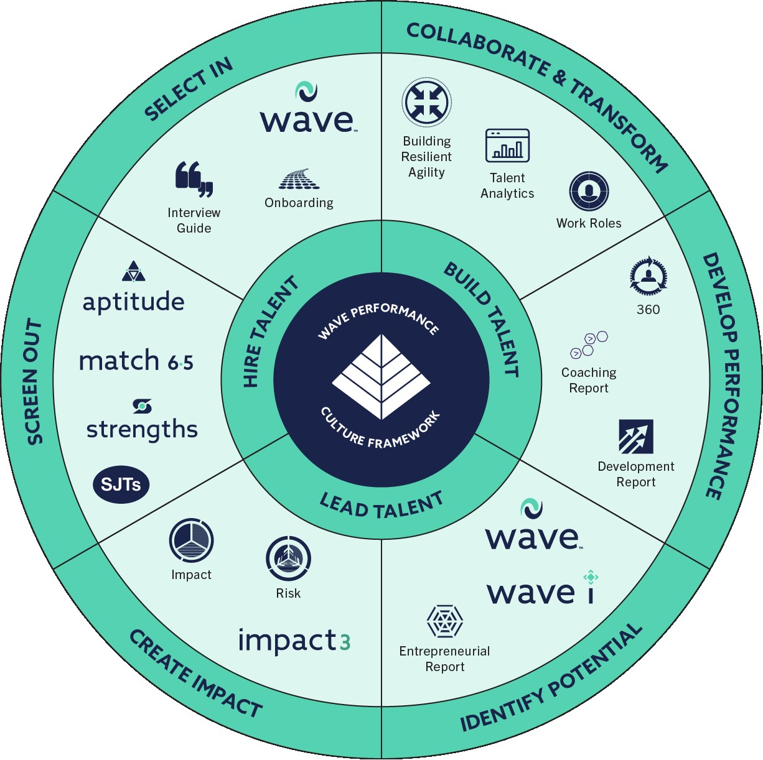
A fully integrated talent strategy powered by the market leader for validity

Slide 7
We have been innovating how organizations Hire, Build and Lead Talent since 2004
Delivering the fastest & most powerful solutions for an effective & engaging experience
Unlocking the collective potential of your workforce to thrive in a changing workplace
Recognizing everyone has potential for something & linking leadership to organizational outcomes
Hire Talent
Build Talent
Lead Talent

Slide 8
Hire Talent Solution
for x
8

Slide 9
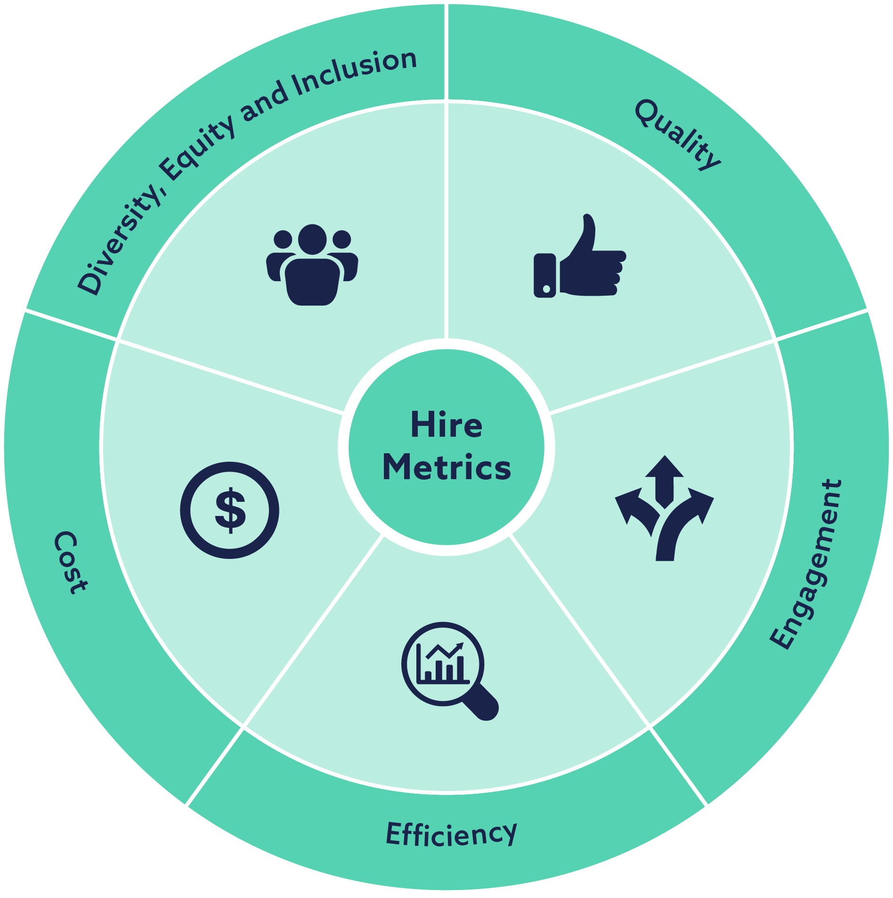
Diversity, Equity & Inclusion
Quality
Introducing our assessments saw a 400% increase in the number of successful candidates with a disability
Salespeople who performed well on our assessments sold an extra $248k per year
Engagement
Efficiency
Introducing our assessments at the screening stage of the process improved candidate completions by 18%
Decision making time reduced from 3 weeks to 48 hours having used our assessments
Cost
67% Saving in screening costs while using our assessments

Slide 10
An engaging & customizable assessment experience
Measuring a candidate's full potential for the roles at Verizon
Situations
The most accurate measure of a candidates judgment against scenarios they are likely to face in the role they are applying for
&
or
The most powerful behavioral screener for identifying a candidates potential to be successful in the role
Custom SJT
The fully customized scenario assessment, showcasing the Verizon brand at a consumer grade level
Collecting the most powerful candidate data for Verizon to screen & select against

Slide 11
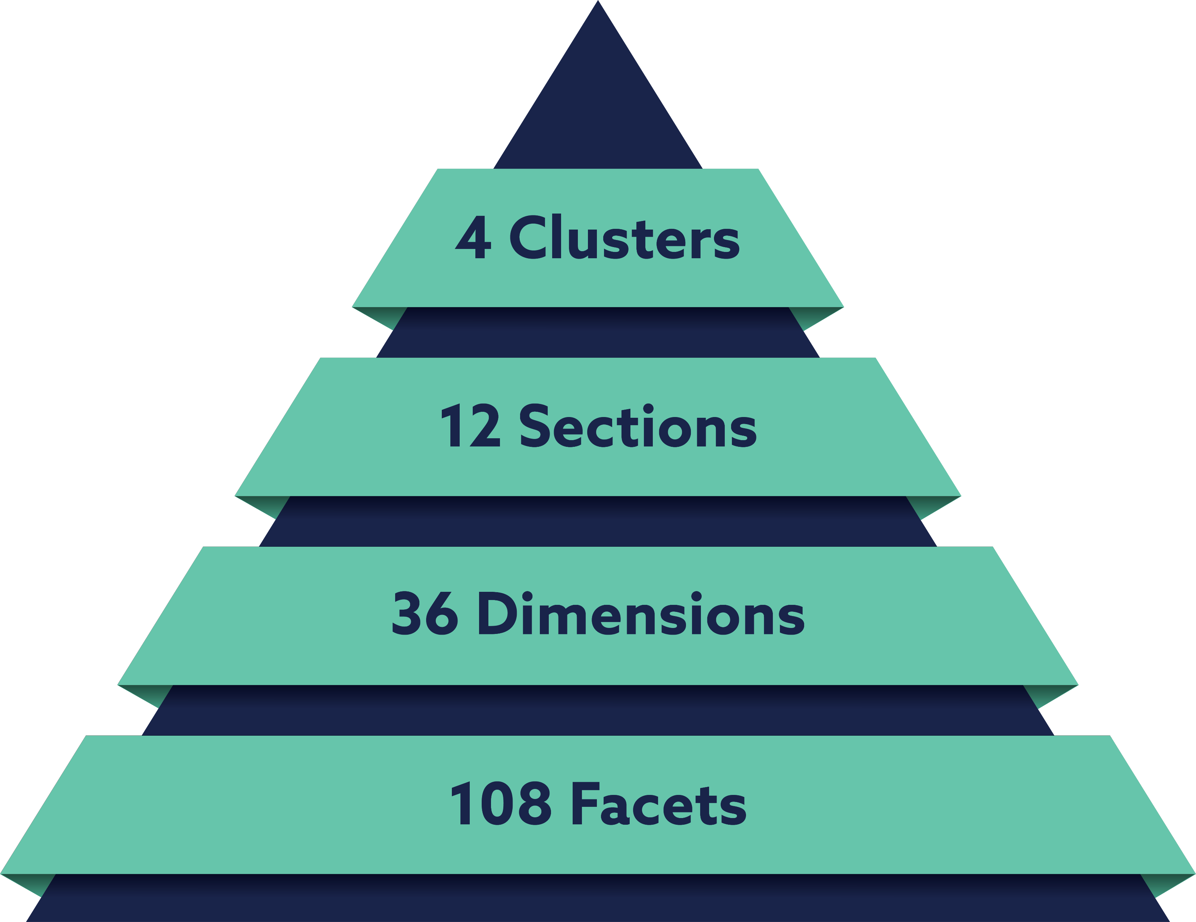
Science
Powerful Research
The most refined & powerful model for predicting performance & potential
Intelligent Design
The most intuitive format for revealing true potential
Smart Reporting
The most extensive report suite, eliciting truly unique insights
Interactive Analytics
The most innovative presentation of group-level data

Slide 12
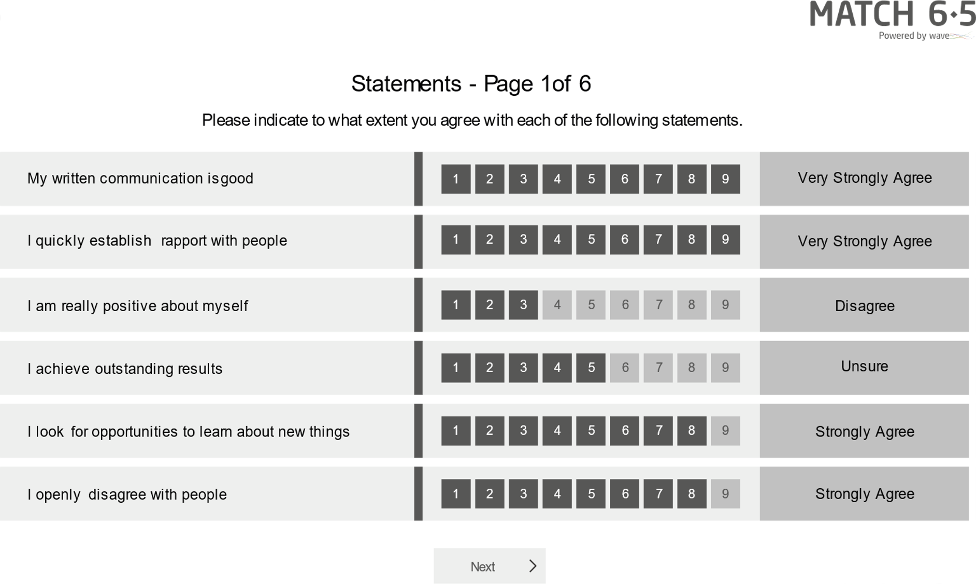
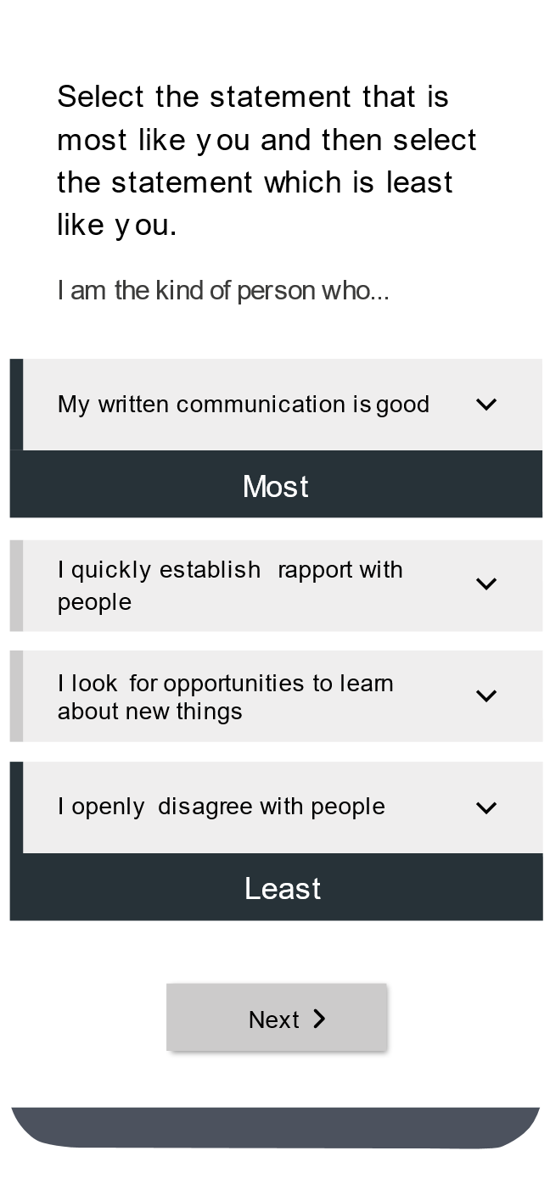
Match 6.5 is an online behavioral questionnaire which uses the power and validity of the Saville Assessment Wave model to understand a candidate’s suitability for a role in just 6.5 minutes.
Using work-relevant language.
Using the most predictive items from the Wave Personality Questionnaire.
Using Wave’s unique rate and rank methodology to maximize the power of the assessment.
The reporting options available are:
Role-fit
Score
Candidate Report
Interview
Guide
Onboarding
Report

Slide 13
Role Fit Score
We would work with you to create the Match 6.5 algorithm based on what is key to success in the entry-level retail associate and retail store manager roles e.g. Giving Support, Building Relationships, Providing Leadership, Driving Success, etc.
Ranking Example
1st
2nd
The 12 Match 6.5 behaviors:
High
3rd
Evaluating Problems
Building Relationships
4th
Investigating Issues
Communicating Information
Rank the 12 behaviors
Medium High
Creating Innovation
Providing Leadership
Medium Low
Showing Resilience
Processing Details
Adjusting to Change
Structuring Tasks
Giving Support
Driving Success
Low

Slide 14
Role Fit Score
We would work with you to create the Match 6.5 algorithm based on what is key to success in the entry-level retail associate and retail store manager roles e.g. Giving Support, Building Relationships, Providing Leadership, Driving Success, etc.
Ranking Example
1st
Giving Support
2nd
Building Relationships
The 12 Match 6.5 behaviors:
High
3rd
Providing Leadership
Evaluating Problems
4th
Driving Success
Investigating Issues
Communicating Information
Rank the 12 behaviors
Medium High
Creating Innovation
Medium Low
Showing Resilience
Processing Details
Adjusting to Change
Structuring Tasks
Low

Slide 15
Role Fit Score
We would work with you to create the Match 6.5 algorithm based on what is key to success in the entry-level retail associate and retail store manager roles e.g. Giving Support, Building Relationships, Providing Leadership, Driving Success, etc.
Ranking Example
1st
Giving Support
2nd
Building Relationships
The 12 Match 6.5 behaviors:
High
3rd
Providing Leadership
Evaluating Problems
4th
Driving Success
Rank the 12 behaviors
Structuring Tasks
Medium High
Creating Innovation
Communicating Information
Medium Low
Investigating Issues
Processing Details
Showing Resilience
Adjusting to Change
Low

Slide 16
Role Fit Score
We would work with you to create the Match 6.5 algorithm based on what is key to success in the entry-level retail associate and retail store manager roles e.g. Giving Support, Building Relationships, Providing Leadership, Driving Success, etc.
Ranking Example
1st
Giving Support
2nd
Building Relationships
The 12 Match 6.5 behaviors:
High
3rd
Providing Leadership
4th
Driving Success
Rank the 12 behaviors
Structuring Tasks
Medium High
Communicating Information
Medium Low
Investigating Issues
Showing Resilience
Adjusting to Change
Evaluating Problems
Low
Creating Innovation
Processing Details

Slide 17
Combined Fit Score
The algorithm can combine the SJT score and the behavioral score to produce a combined fit score for each candidate, helping you quickly and objectively identify those who are most suited to the requirements of the job. This information can be easily extracted into an Excel spreadsheet to help the recruiters and HR team to efficiently select the best candidates to interview. We can complete a validation study with you to ensure the combined fit score is predicting success in the role.
First Name | Last Name | Behavioral Fit Score | SJT Score | Combined Fit Score | NormSet
Lee | Crouch | 41.79 | 38 | 38.7925 | Individual Contributors (INT, IA, 2021)
Constance | Markievica | 37.6883 | 54 | 40.0393 | Individual Contributors (INT, IA, 2021)
Sabrina | Smith | 46.7398 | 41 | 44.2315 | Individual Contributors (INT, IA, 2021)
Jooris | Axelstien | 46.3501 | 45 | 45.1217 | Individual Contributors (INT, IA, 2021)
Isabel | Mebarak | 47.1387 | 52 | 48.0183 | Individual Contributors (INT, IA, 2021)
Lucia | Fernando | 46.1332 | 57 | 48.6593 | Individual Contributors (INT, IA, 2021)
Chris | Park | 53.9965 | 53 | 54.5712 | Individual Contributors (INT, IA, 2021)
Sam | Jenkins | 57.0387 | 60 | 59.5189 | Individual Contributors (INT, IA, 2021)
Faisal | Wooton | 62.0572 | 54 | 62.219 | Individual Contributors (INT, IA, 2021)

Slide 18
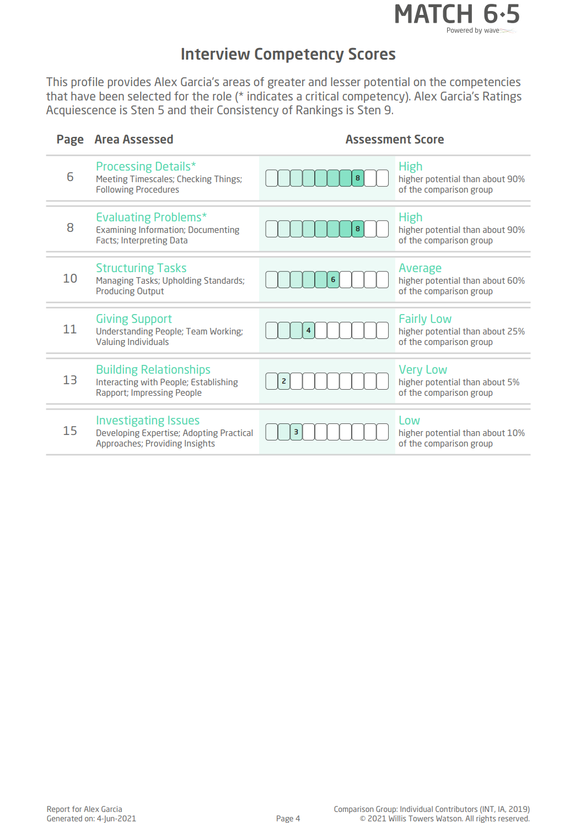
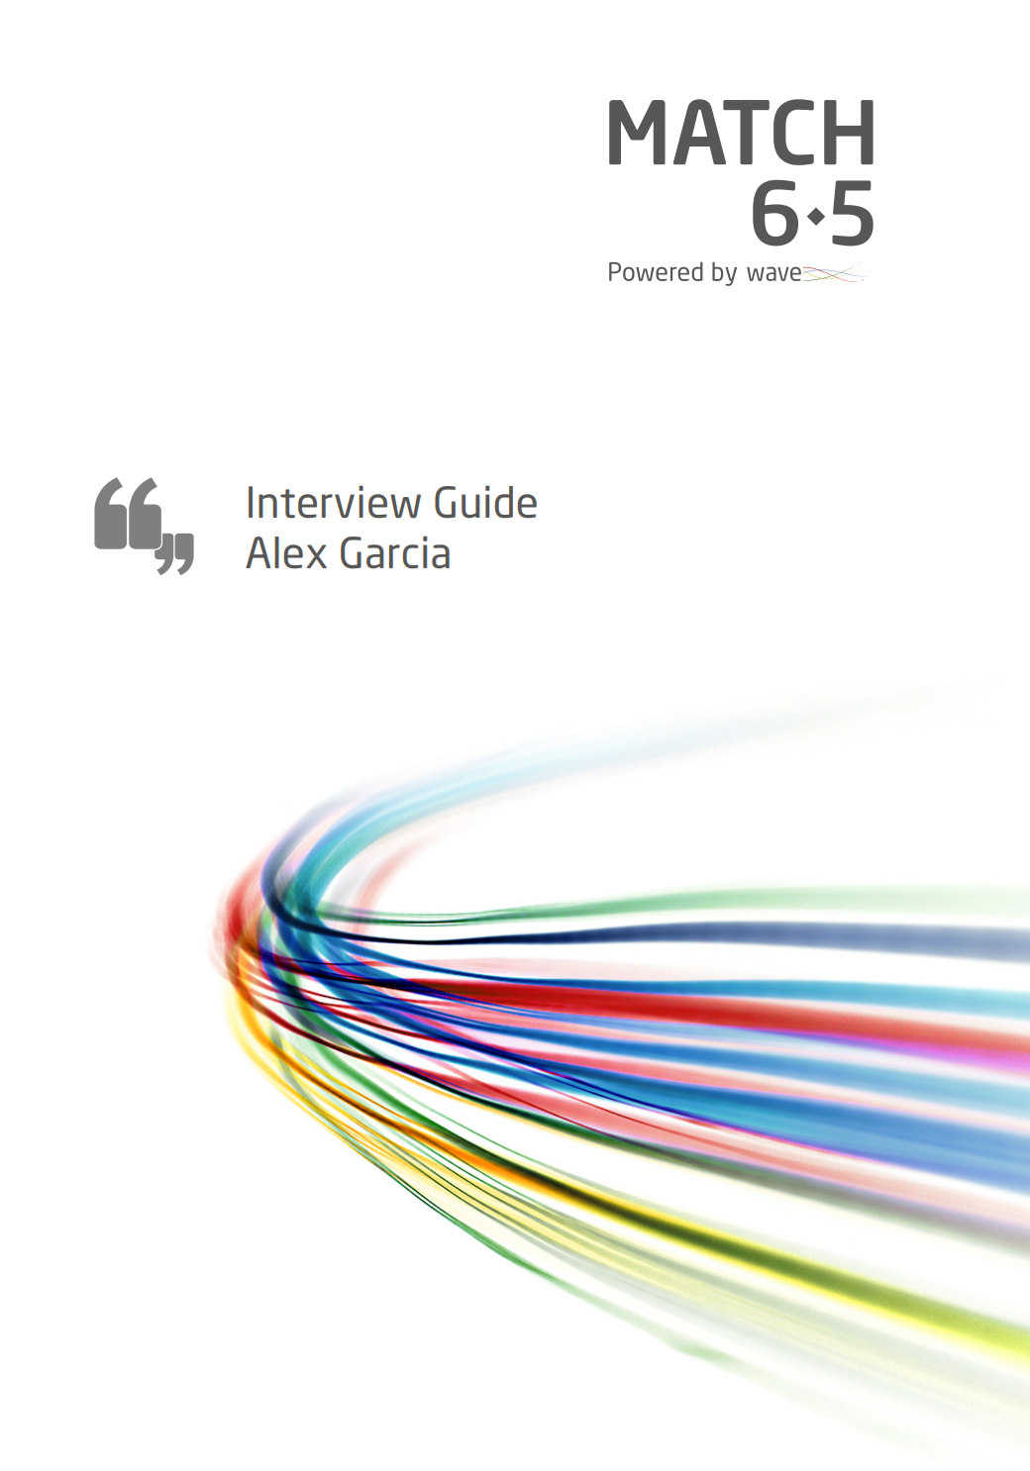
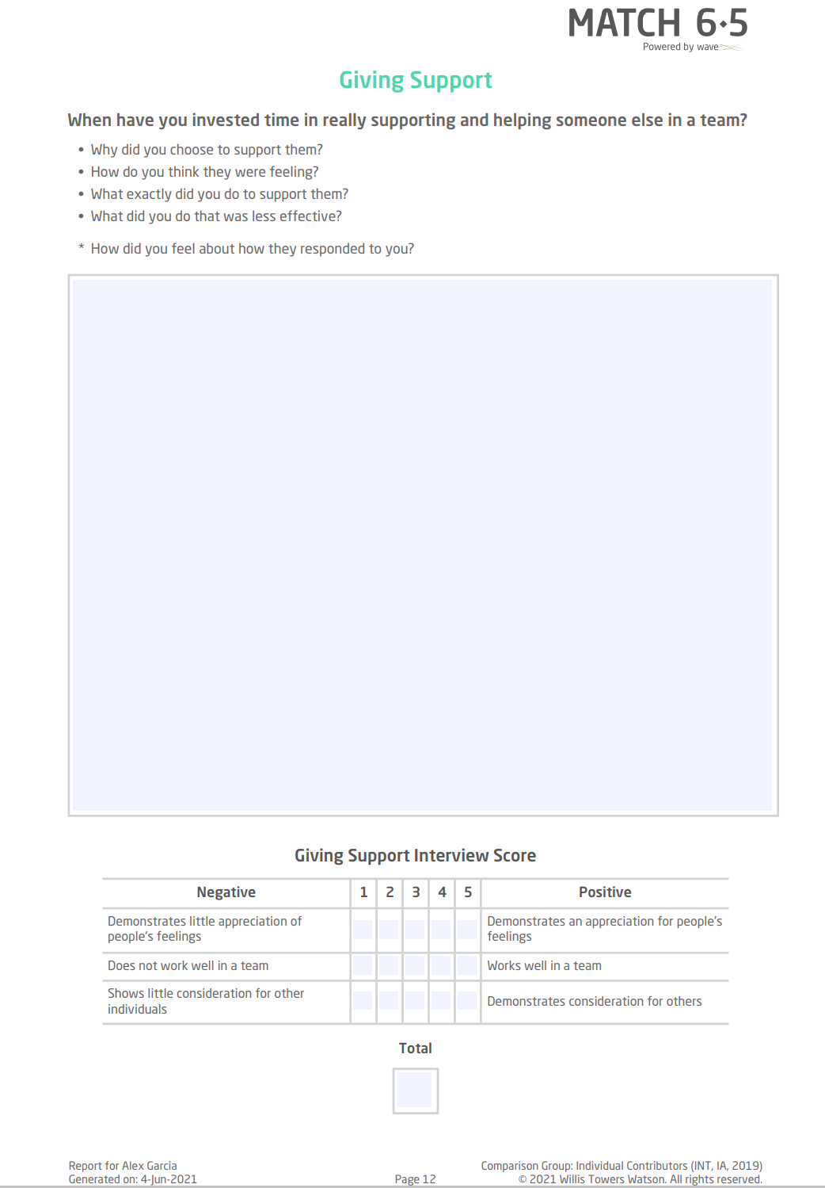
Match 6.5 Reports
An Interview Guide can be generated from a Match 6.5 completion helping recruiters and hiring managers run high quality, highly structured interview processes.

Slide 19
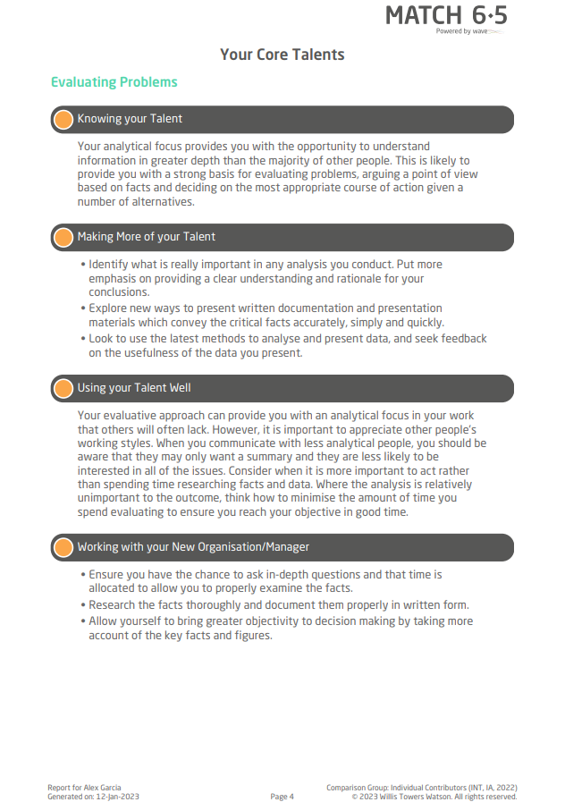
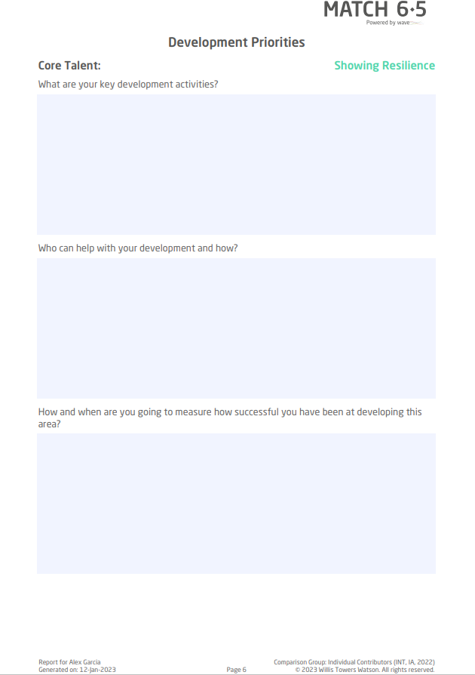
Match 6.5 Reports
The Onboarding Report accelerates the productivity of new hires by capitalizing on strengths and targeting an areas for development

Slide 20
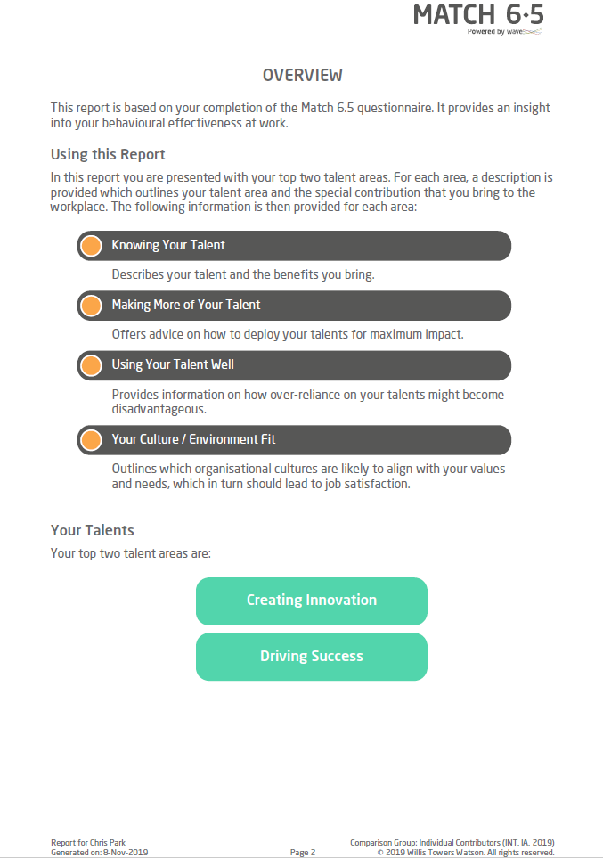
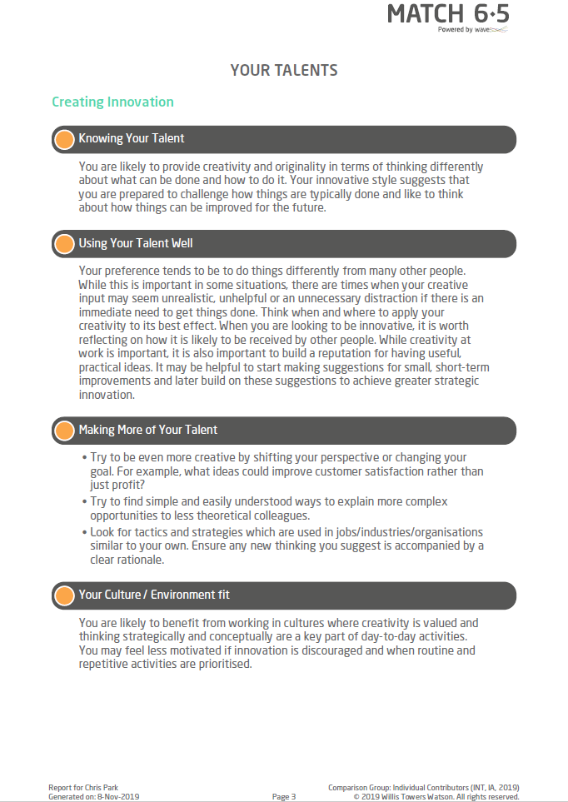
Match 6.5 Reports
A detailed Candidate Feedback Report is generated which can be shared without the need for a feedback call.

Slide 21
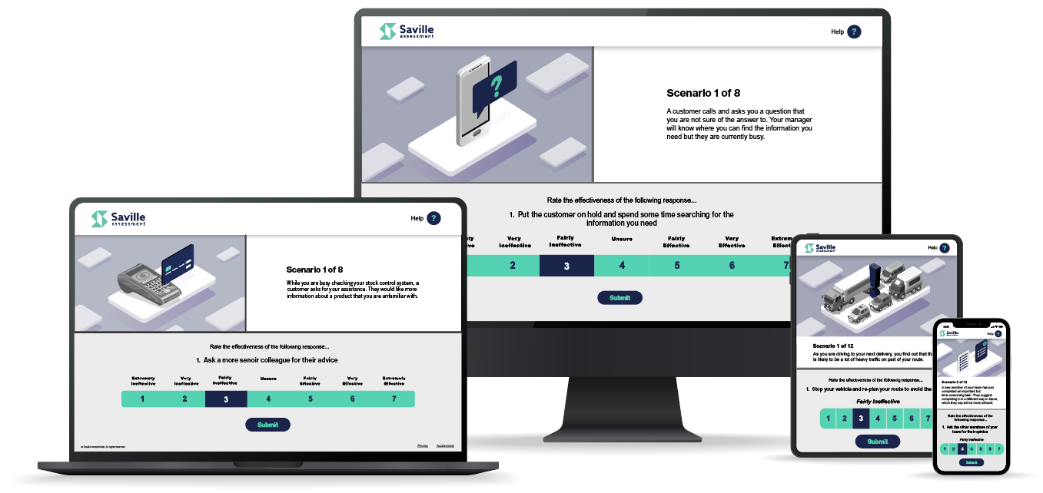
Situations Assessments
Situations includes standard item question content, images and scoring
Developed from content that is applicable across a variety of sectors
Context-free images that work across clients and different workplace environments

Slide 22
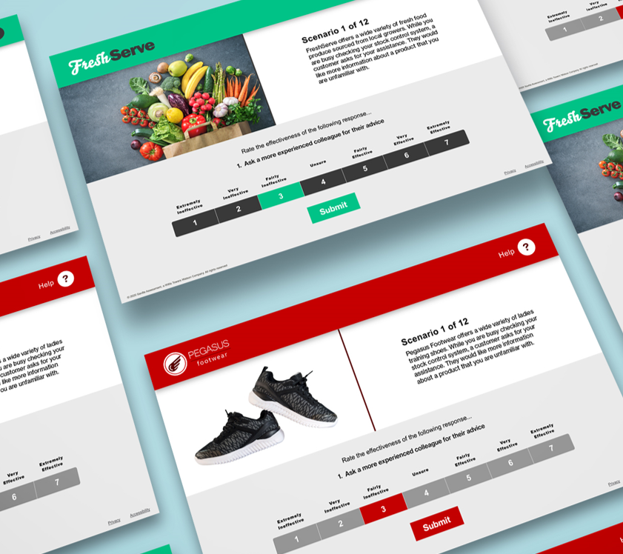
Customized Situations
All Situations assessments have the opportunity to be customized with additional content, images and color to reflect an organization’s brand, products and services
Uses core Situations content, with the ability to add a bespoke lead sentence at the start of each scenario for additional context and branding opportunity
Custom images can be included to exhibit client branding and product examples to increase impact and candidate engagement.

Slide 23
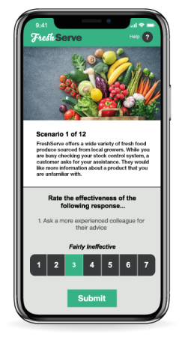
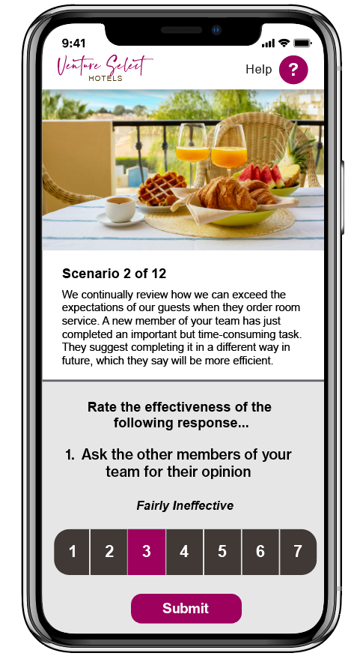
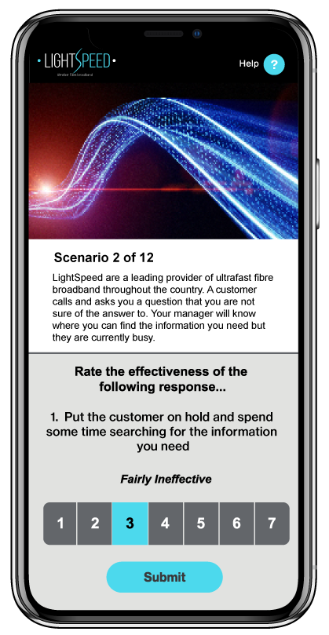
Industry Situations Examples
8
Retail
Manager
Customer
Engaging content that gets your candidates excited about your retail role
Engaging content targeted at managers, supervisors & team leaders
Engaging content that gets your candidates excited about your contact center roles

Slide 24
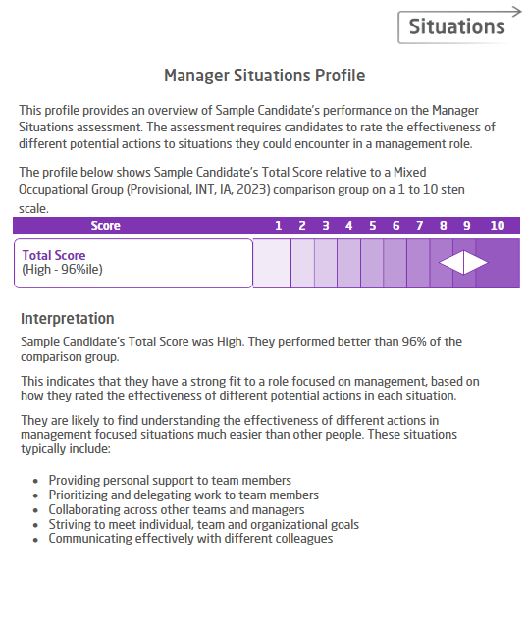
Outputs that elevate your whole hiring cycle
Situations Assessment Reports provide insight about a candidate’s fit to your manager role based on their situational judgment.
Easy interpretation enables you to understand the managerial situations that a candidate is likely to perform effectively in.

Slide 25
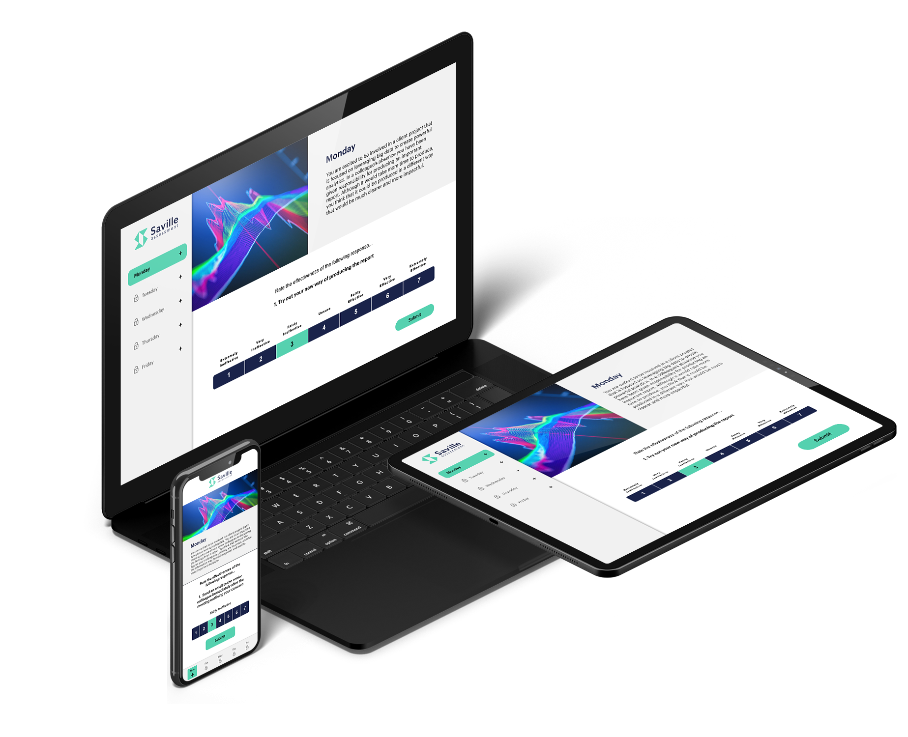
The Benefits
Unrivalled Prediction
Swiftly collect the most powerful data points & build stronger applicant pipelines
Engaging & Efficient
Retain the best candidates with a swift and positive assessment experience
Mitigate Bias
Build more diverse applicant pipelines with objective, fair & robust assessments
Smarter Selection
Reduce the odds of a bad hire from one in five to one in fifty
Notes:
The benefits of this blended assessment solution can help address the challenges Verizon Wireless are looking to over come
A long seat time to collect the data you need to make accurate hiring decisions (unrivalled prediction)
The risk of losing applicants to competitors with a poor and lengthy assessment experience and turnaround time (engaging and efficient)
Lack of diversity (mitigate bias)
Low validity assessment not distinguishing poor performers from good ( Low quality)

Slide 26
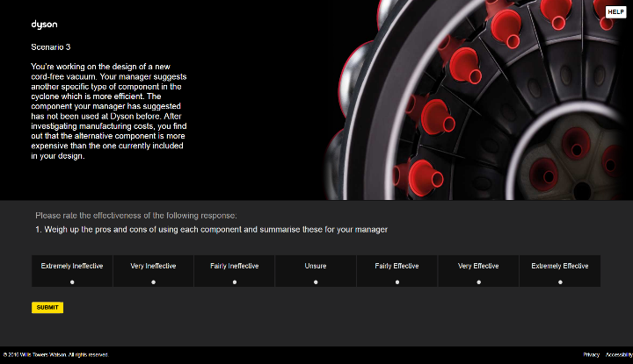
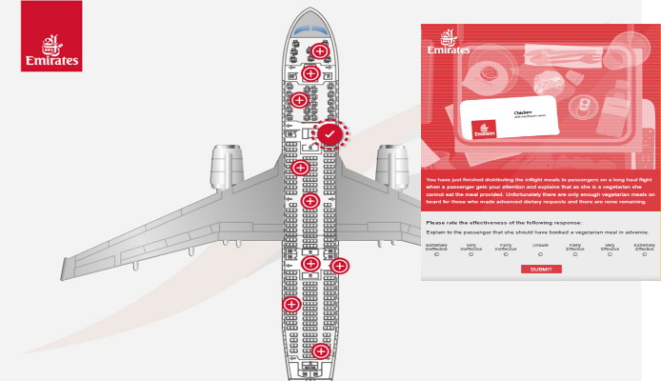
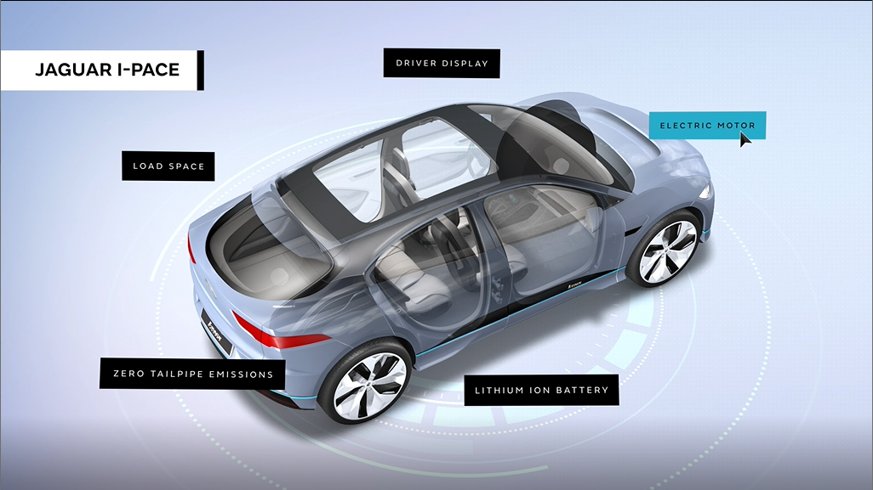
Our SJTs are designed to be realistic, relevant, brand-led and, most importantly, predictive of later assessment stages and job performance.
We offer SJTs in three different formats:
Image-Based
Immersive
Multi-media
A combination of branded images and scenarios. We ensure that our SJTs show no adverse impact regarding gender or ethnicity and are typically used to screen 50% of candidates.
In 2019 we built on this methodology and enhanced our SJTs by changing the style of content delivery. Candidates navigate via hotspots around virtual environments to further enhance the candidate experience.
Scenarios in our multi-media SJTs are presented in a video format with a voiceover and 3D graphics, increasing the “wow” factor associated with the assessment. This helps promote your position in the market as an employer of choice.

Slide 27
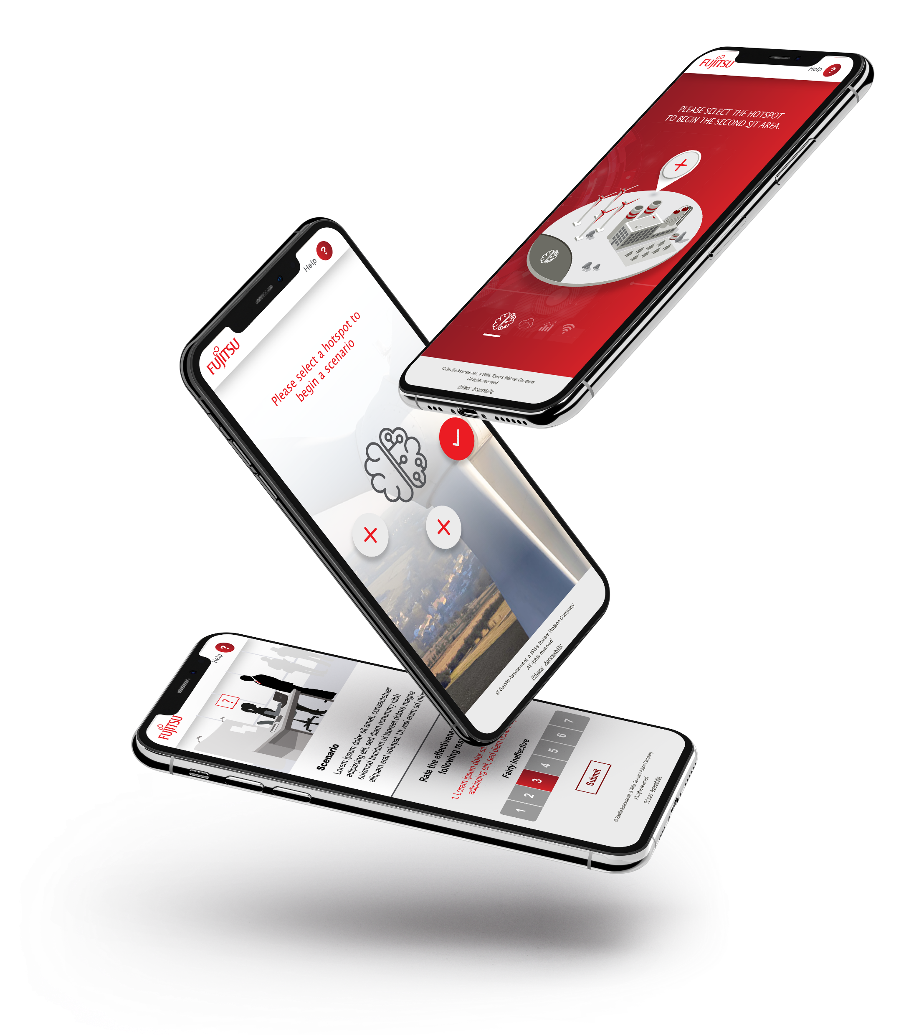
Immersive Candidate Journey
With Hotspots and Factoids

Slide 28
Next Steps

Slide 29
Example Implementation Steps
x
x
x
x
Notes:
Implementation / Project set up
Work with our team to define the requirements of the role and create the match 6.5 algorithm
Tailor situations branding and wording (optional)
Partner with our consultants and design team to create fully customized SJT (Optional and time frame)
Validation study with current incumbents
Team share validation study and revise
Launch Verizon assessment experience for pre hire roles

Slide 30
Key Stakeholder Experience
Candidates
One swift & seamless completion experience with a personalized candidate feedback report on completion.
Recruiters
Hiring Managers
One single fit score passed back through the ATS for fast, fair and reliable decision making.
Preparation time minimized with structures interview guides and performance accelerated with targeted onboarding reports.

Slide 31
Conclusion
x
x
x

Slide 33
Security
Unrivalled Uptime
Robust Reliability
Be confident your candidates will have an uninterrupted completion experience
Our systems are regularly tested for high resilience and fast performance.
99.7% Oasys platform uptime
Stress-free Integration
Our expert technical team ensure a seamless project implementation process
Secure Data
All our data centers are ISO 27001 certified

Slide 34
Service
Unparalleled Responsiveness
7-Day Service
We have a 2-hour turnaround window for all support queries
Our outstanding bureau team are available 7 days a week
Transparent Pricing
First-class Resources
Our straightforward model has no hidden charges, maintenance fees or unused credits
A wealth of materials are available to support best-practice use of our assessments

Slide 35
Skill
Expert Consultants
Global Reach
Get access to our team of expert Industrial Occupational Psychologists for help & advice
Our knowledgeable practitioners span over 30 countries internationally
Consultancy Services
Expert Team
We work with you to create algorithms based on what is key to success for the role you are recruiting for
Our expert teams go beyond psychology giving you access to leading designers and IT Consultants for end-to-end delivery

Slide 36
Science
“Great reports. Phenomenal Science”.
Security
“Saville have a modern tech stack and have made good decisions and technology choices.”
Senior Vice President Global Talent
Chief Technology Officer
“Saville’s team is extremely responsive. I do not think we have ever gone more than 30 minutes for a response even on a weekend.”
“Some assessment companies are very salesy. It’s the last thing you want, you want to be talking about the psychology & how we can get better results. Saville is very good at that.”
Service
Skill
Senior Manager, Learning & Development
Senior Talent Acquisition Manager

