Slide 1
Open the Door to Your Potential
An introduction to Saville Assessment

Slide 2
Our assessments have been recognized for many awards over the years, including:
Excellence in Early Careers Assessment & Selection
Talent Acquisition Partner of the Year
Best Internal Recruitment Strategy
Talent Management & Resourcing Supplier of the Year
Recruitment Industry Supplier of the Year
Excellence in Assessment
27 / 30 stars

Slide 3
We have been innovating how organizations Hire, Build and Lead Talent since 2004
Delivering the fastest & most powerful solutions for an effective & engaging experience
Unlocking the collective potential of your workforce to thrive in a changing workplace
Recognizing everyone has potential for something & linking leadership to organizational outcomes
Hire Talent
Build Talent
Lead Talent

Slide 4
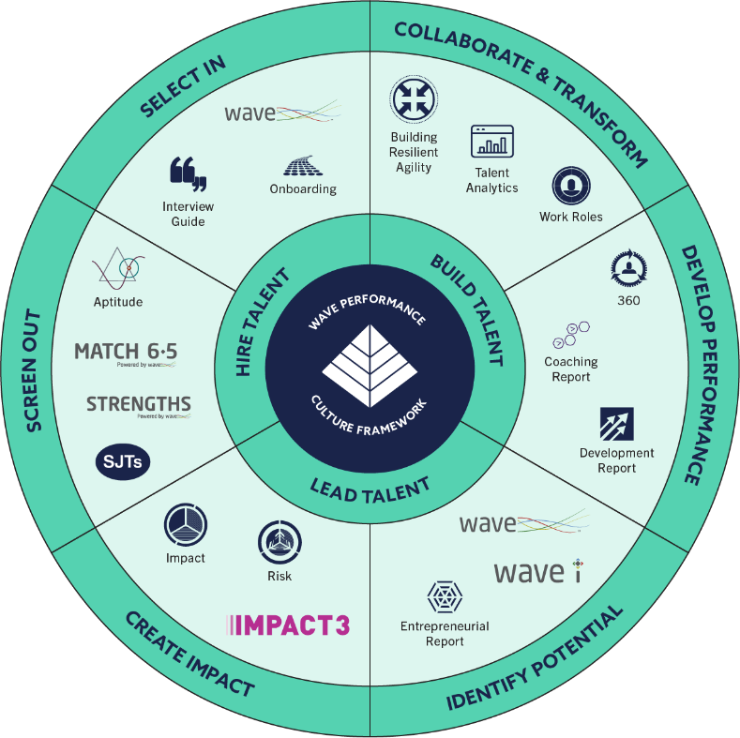
A fully integrated talent strategy

Slide 5
“The fact that we are talking the same language at onboarding and development means our approach to talent management is consistent and better aligned. This presents a powerful force for the business”
Regional HR Director
RICOH EUROPE

Slide 6
We earn the trust of our clients with 4 key differentiators
6

Slide 7
We earn the trust of our clients with 4 key differentiators
Skill
Science
Service
Security
Products you can trust
Technology you can trust
Support you can trust
Experts you can trust
7

Slide 8
Open the door to superior science

Slide 9
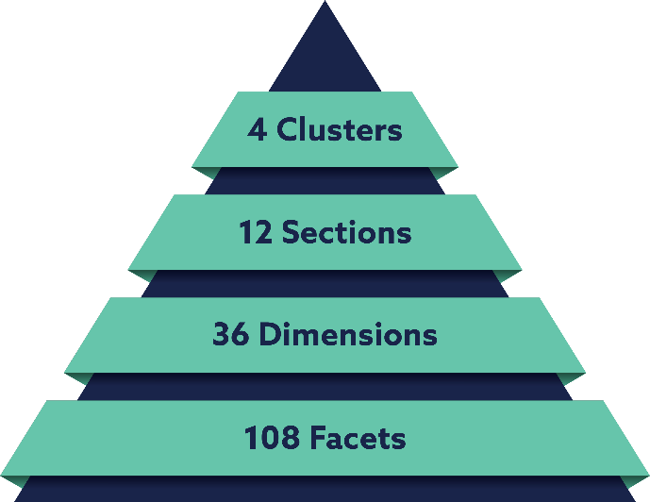
Powerful research
Science
The most refined & powerful model for predicting performance & potential

Slide 10
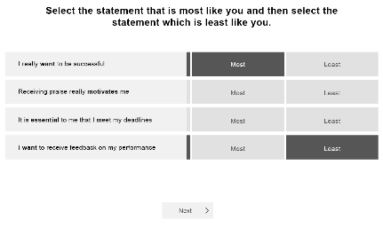
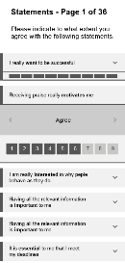
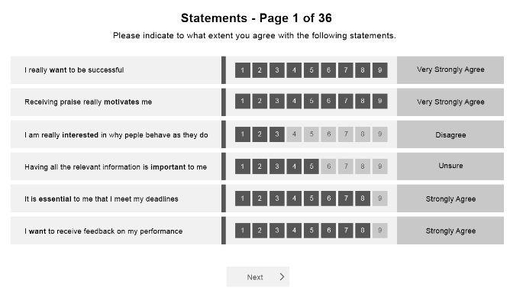
Intelligent design
Science
The most intuitive format for revealing true potential

Slide 11
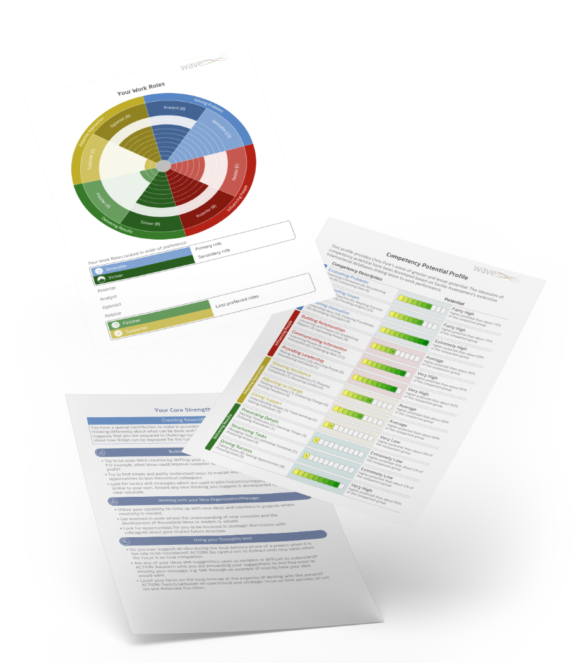
Smart Reporting
Science
The most extensive report suite, eliciting truly unique insights

Slide 12
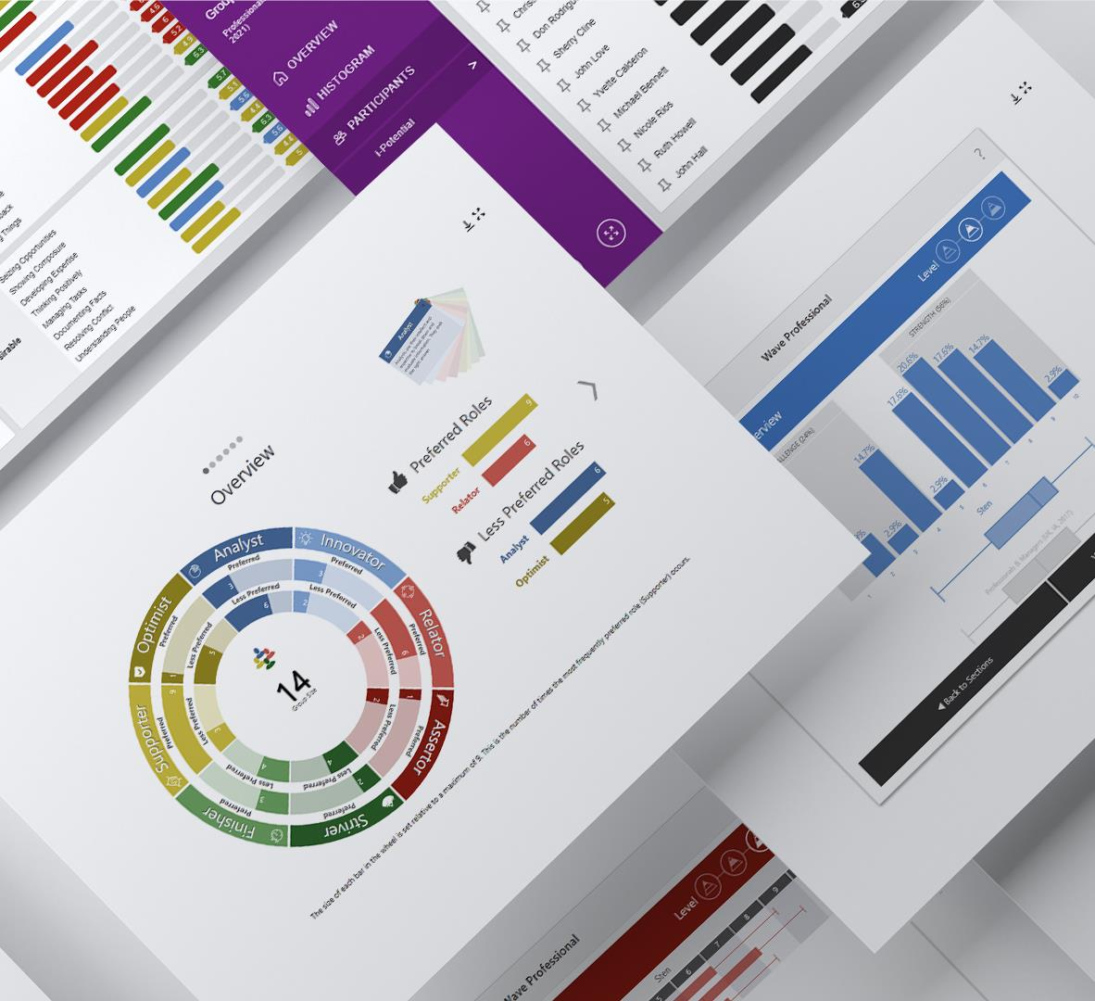
Interactive Analytics
Science
The most innovative presentation of group-level data

Slide 13
Science
“Saville have produced a range of Wave reports that are truly innovative and insightful.”
Senior Talent Acquisition Manager
VIRGIN MEDIA

Slide 14
Science
A higher caliber of candidates

Slide 15
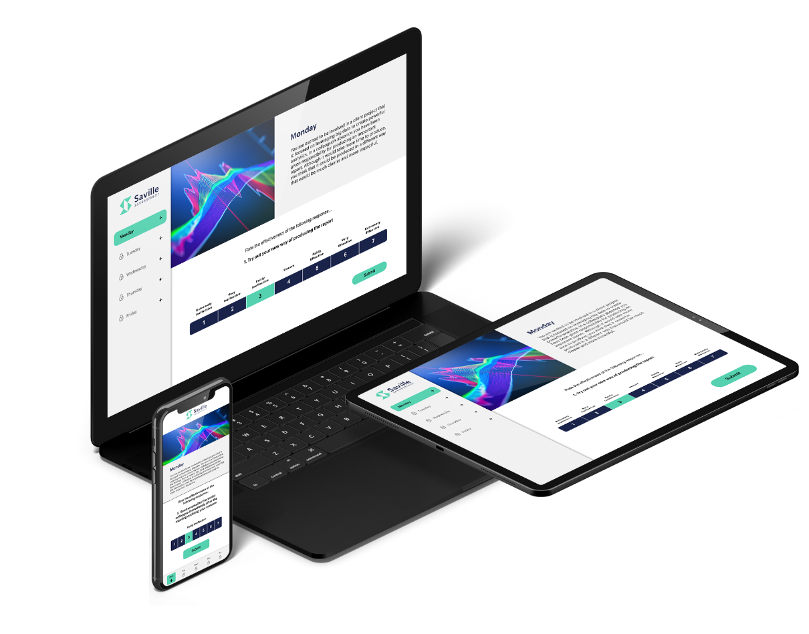
Science
Pacey Prediction
Swiftly collect the most powerful data points & build stronger applicant pipelines
Engaging Efficiency
Retain the best candidates with a swift and positive assessment experience
Real Representation
Build more diverse applicant pipelines with objective, fair & robust assessments
Smarter Selection
Reduce the odds of a bad hire from one in five to one in fifty

Slide 16
Science
“This has blown me away!”
Global Head of Talent Acquisition
MULTINATIONAL INSURANCE & RISK COMPANY

Slide 17
Science
Build Talent
More pathways for talent development

Slide 18
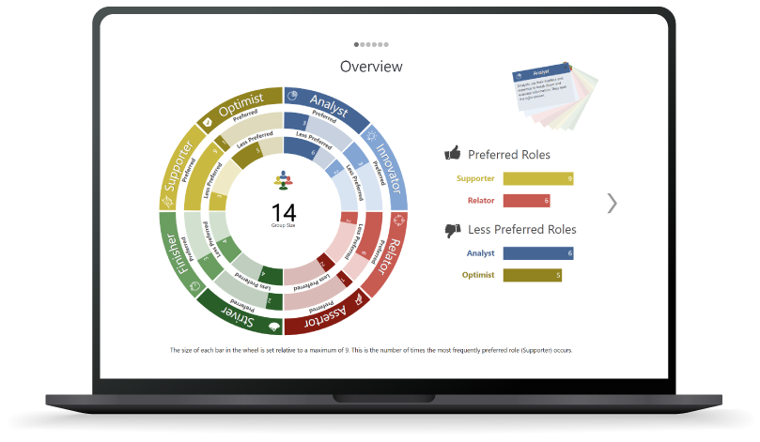
Science
Scalable Solutions
Development tools designed for the many, not the few
Group Insights
Support people to work better collectively
Digital Development
Deliver development activity across boundaries
Meaningful Data
Focused development activity that helps people thrive in the modern workplace

Slide 19
Science
“It has helped the team in relation to recognizing, valuing and respecting individual work preferences so people can bring their whole selves to work.”
Senior Learning & Development Adviser
LOCAL GOVERNMENT

Slide 20
Science
Lead Talent
A new generation of leaders

Slide 21
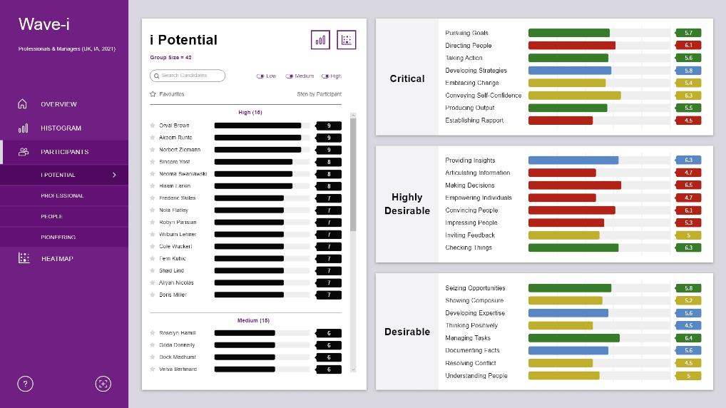
Science
Power Progression
Break free of traditional methods for identifying potential
Smarter Succession
Build stronger pipelines and plug skills gaps with broader pathways
Create Impact
Bridge the gap between leadership behaviors & organizational outcomes
Manage Risk
Take a more holistic view of possible derailers
21

Slide 22
Science
“I’m so pleased we partnered with Saville Assessment as an early adopter of Wave-i. It transforms how organizations identify, measure, benchmark and develop talent in a fair and unbiased way. We now have the data to champion and develop that potential.”
National Customer Service Director
RICOH UK

Slide 23
Open the door to a platform with outstanding reliability

Slide 24
Security
Robust Reliability
Our systems are regularly tested for high resilience and fast performance.
Unrivalled Uptime
Be confident your candidates will have an uninterrupted completion experience. We achieve 99.7% Oasys platform uptime.
Secure Data
All our data centers are ISO 27001 certified.

Slide 25
Stress-free Integration
Our expert technical team ensure a seamless project implementation process

Slide 26
Security
“Saville have a modern tech stack and have made good decisions and technology choices.”
Chief Technology Officer
PPSG

Slide 27
Open the door with exceptional service

Slide 28
Service
Record Responsiveness
7-Day Service
We have a 2-hour turnaround window for all support queries
Our outstanding bureau team are available 7 days a week
Customer Commitment
First-class Resources
We are committed to responding to all customer enquiries within 30 minutes
A wealth of materials are available to support best-practice use of our assessments

Slide 29
Service
“From the moment we started our relationship with Saville, we have been given weekly support all the way through the implementation process. Saville’s team is extremely responsive; I do not think we have ever gone more than 30 minutes for a response, even on a weekend. “
Senior Manager, Learning & Development
QUOTIENT

Slide 30
Open the door to a wealth of expertise

Slide 31
Skill
Duty Consultants
Global Reach
Get access to our team of expert business psychologist for help & advice
Our knowledgeable practitioners span over 30 countries internationally
Accreditation Training
Consultancy Services
We offer a range of flexible virtual and in-person courses delivered by our skilled practitioners
Utilize our experts to support with interpretation, debriefs and feedbacks

Slide 32
“Some assessment companies are very salesy. It’s the last thing you want; you want to be talking about the psychology aspect and how we can get better results. Saville is very good at that.“
Senior Talent Acquisition Manager
VIRGIN MEDIA

Slide 33
We open the door to potential for the world’s leading brands
33

