Slide 1
A New Way of Looking at Potential

Slide 2
transform tomorrow with your talent of today

Slide 3
We believe everyone has potential for something

Slide 4
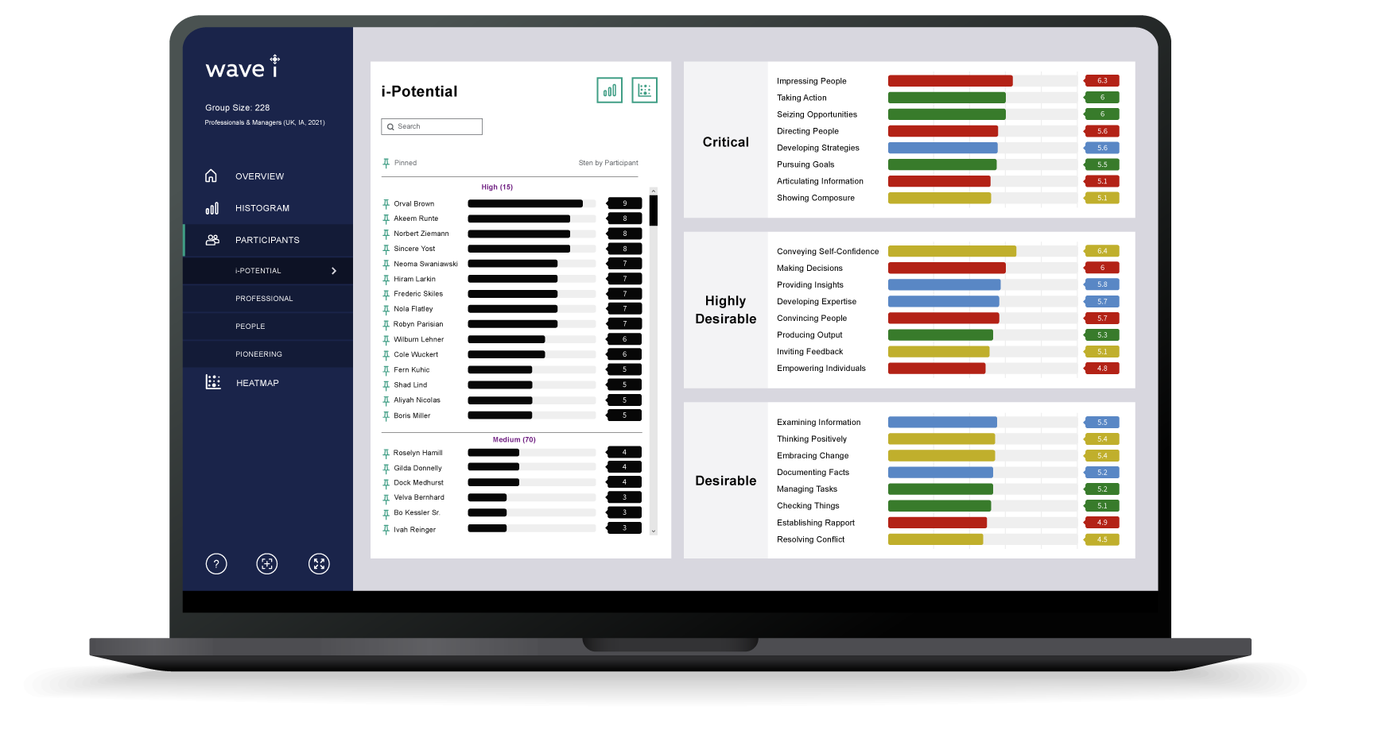
Wave-i is an end-to-end solution for strategically identifying & developing talent.
It offers a new way of measuring potential to accurately reveal the types of career or leadership roles individuals will thrive in.

Slide 5
Discover a new way of looking at potential
Wave-i goes beyond the constraints of the traditional one universal lens
Picks up on the nuances of leadership in your organization
Accurately reveals the types of career or leadership role individuals will thrive in
Helps build and maintain diversity in leadership pipelines
Dashboard scores & Career Potential Development reports give a dual insight of potential for the organization and the individual
Mobilizes a wider pool of potential
Engages the many, not the few: everyone has potential for something

Slide 6
Discover a new way of looking at potential
Wave-i goes beyond the constraints of the traditional one universal lens
Picks up on the nuances of leadership in your organization
Accurately reveals the types of career or leadership role individuals will thrive in
Helps build and maintain diversity in leadership pipelines
Dashboard scores & Career Potential Development reports give a dual insight of potential for the organization and the individual
Mobilizes a wider pool of potential
Engages the many, not the few: everyone has potential for something

Slide 7
Amplify the science
Reduce subjective bias

Slide 8
Over 15 years of research and big data, putting the best predictor of performance and potential in your hands
Grounded in research across
Underpinned
by
55,000
50 countries
data points
8

Slide 9
Over 15 years of research and big data, putting the best predictor of performance and potential in your hands
Grounded in research across
Underpinned
by
55,000
50 countries
data points
9

Slide 10
Reducing the odds of wrongly identifying high-potential from 1 in 5 to 1 in 50
to 1 in 50
10

Slide 11
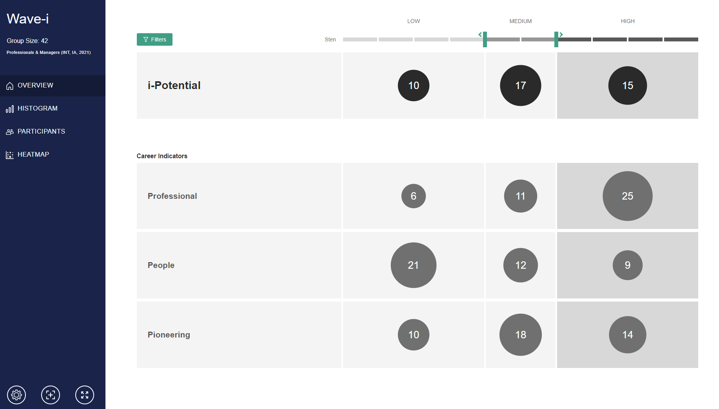
Wave-i helps talent teams shape a stronger future by:
IDENTIFYING
FINDING
BUILDING
UNDERSTANDING
leaders fairly and objectively
individuals for reskilling programs
more pathways for internal mobility
the potential of your talent pool
CREATING
RECOGNIZING
development opportunities for all
potential for talent acceleration programs
UNLOCKING
more diverse talent pipelines for succession planning
Notes:
Notes need to say about most predictive items and rate and rank format

Slide 12
How it works

Slide 13
Stakeholder Agreement
Algorithm Creation
Assessment Administration
Organizations can select either Focus Groups, Workshops or a Validation Study where our expert team works with you to:
define the target role
define the target area
define the target program
agree core requirements & leadership behaviors
A unique algorithm is created that captures the nuance of the organization & role with our own flagship research.
Participants will be invited to complete the 35-minute online Wave Professional Styles questionnaire and leadership experience inventory.
This gives a highly-predictive and holistic view of an individual’s potential, reflecting key behaviors, culture and future work demands whilst mitigating adverse impact against gender, age and ethnicity.
The questionnaire targets the behaviors proven to be most effective at predicting workplace potential, style & culture fit.
Open the door to your own dynamic dashboard and interactive data at your finger tips…

Slide 14
The Wave-i dashboard

Slide 15
Clearly view overall leadership potential of your talent pool
See the types of leaders in your pipeline and proactively close any gaps

Slide 16
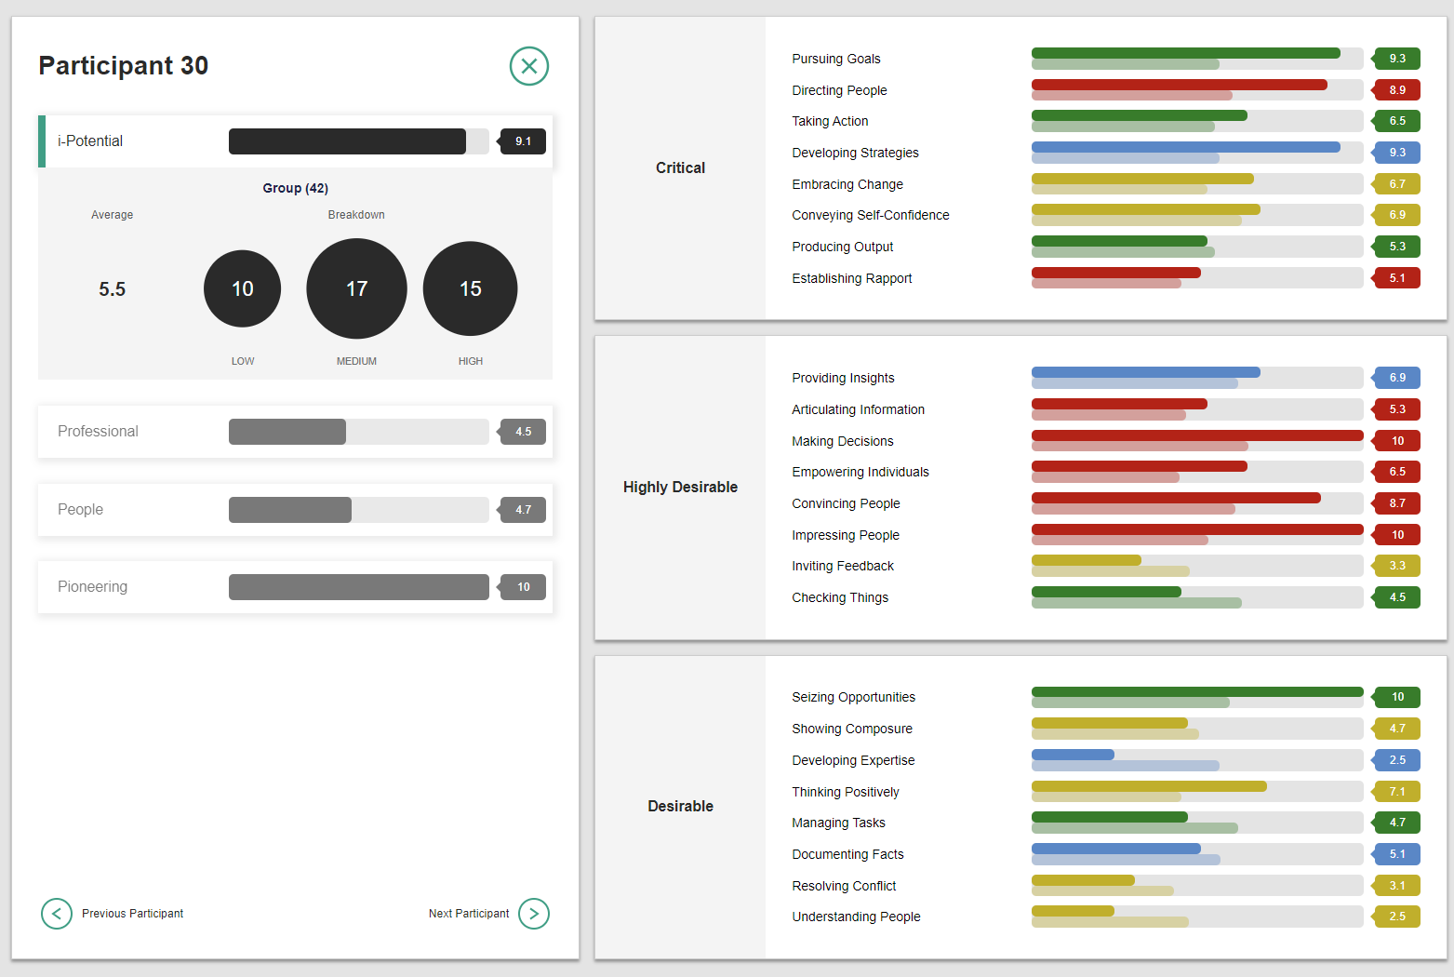
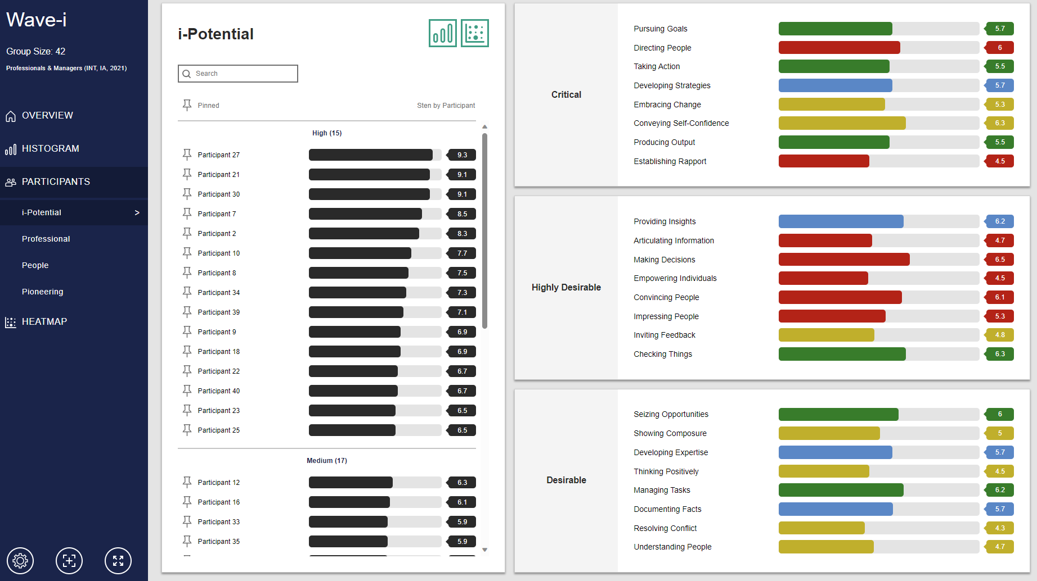
Dive deeper into a person's potential with an individual and group perspective

Slide 17
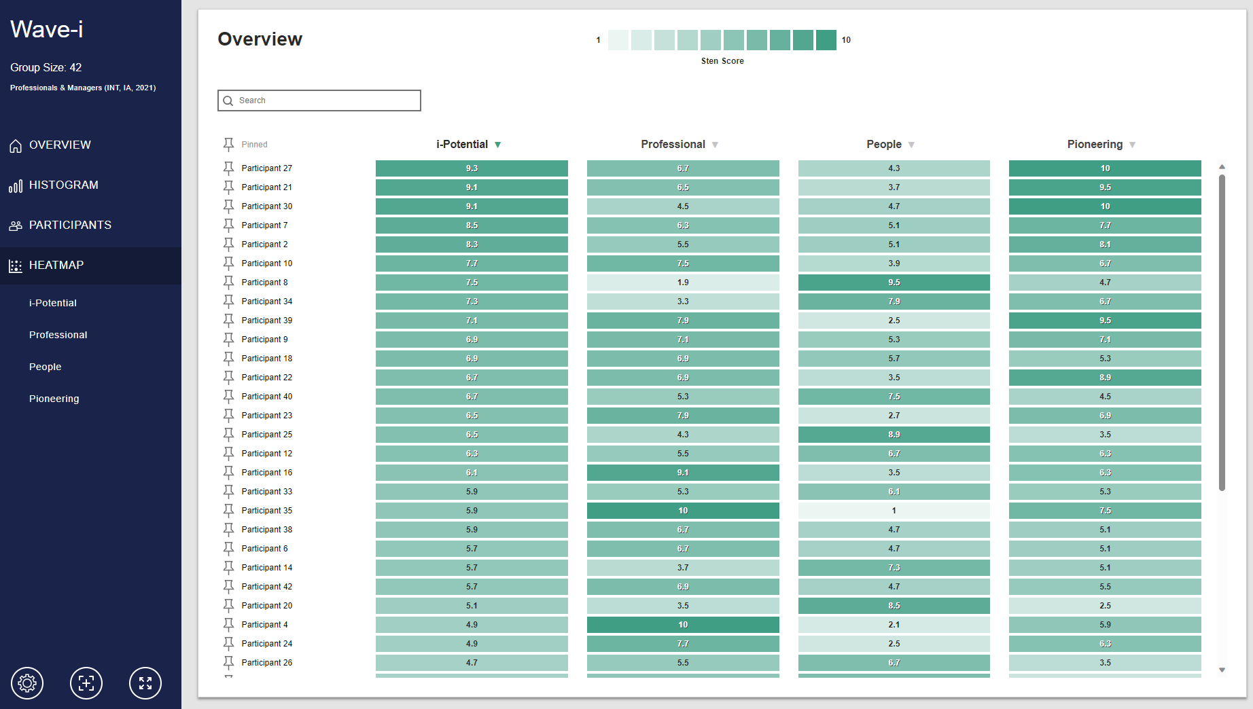
Map talent to where it is needed in real time

Slide 18
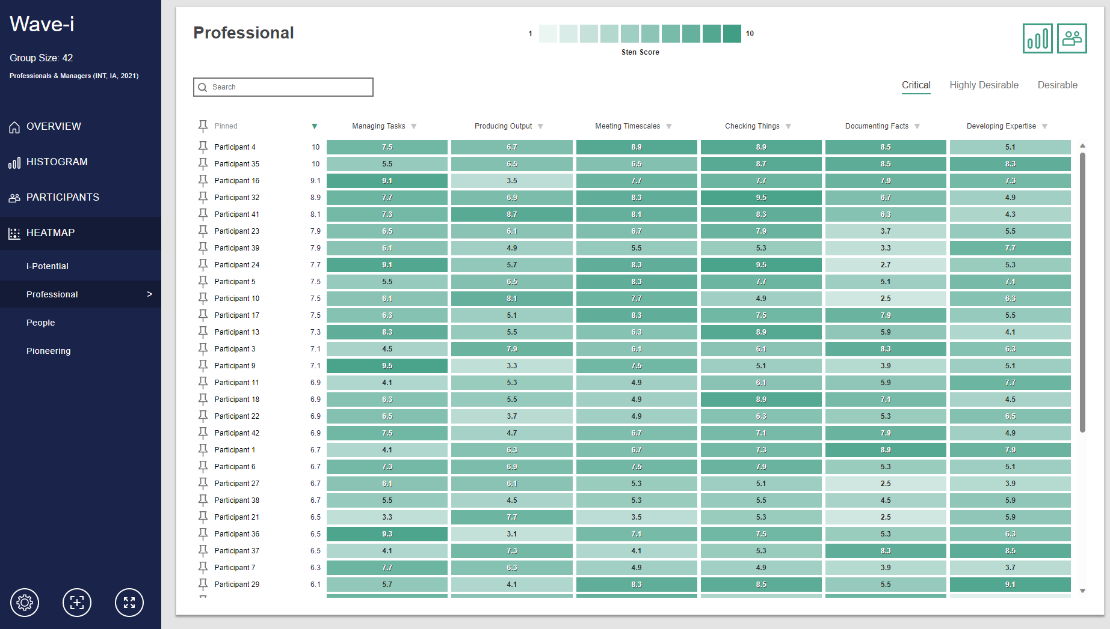
Take a targeted approach to development and assign peer coaching

Slide 19
Career Potential Development Report

Slide 20
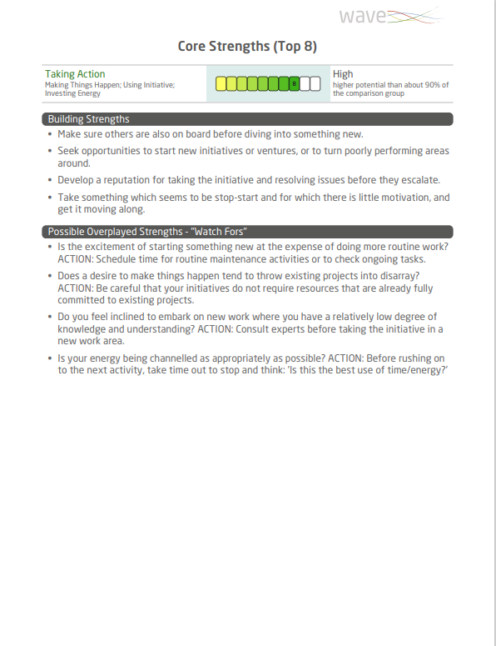
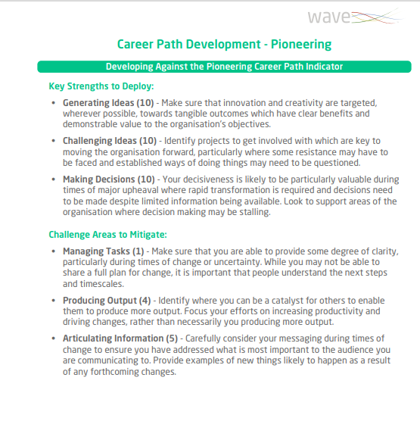
Engaging Development for Everyone
All individuals receive a Career Potential Development Report.
This gives them a starting point to map their own development against the key leadership and career indicators they demonstrate potential for.
All Wave-i participants are engaged and invested in, with the opportunity to grow and develop their potential.
Notes:
Notes need to say about most predictive items and rate and rank format

Slide 21
Why organizations love Wave-i

Slide 22
Discovering & retaining hidden talent
“One of our greatest success stories from using Wave-i is that a colleague who was seen as low potential by his line manager was identified through the data provided in Wave-i. We were told they shouldn’t be invested on in this program.
They have since progressed through the development program with flying colors and are adding serious value in an incredibly strategically important role. If it weren’t for using Wave-i, this person would certainly have left”
Director of Talent
Global IT Organization

Slide 23
Women in leadership program
“We aimed to test new concepts and try out new ways of identifying talent, and couldn’t have asked for a better partner in this journey. It was very important for us that all of the women that took part in this process felt supported throughout the experience and Saville really helped us achieve that.”
Director of OD & Talent Management
Local Government
23

Slide 24
Engaging a wider talent pool
“The way Wave-i allows organizations to apply the ‘everyone has potential for something philosophy’ makes it easier to run an open and transparent process without the risk of disengaging a large proportion of participants.”
Senior Manager, L&D
Global Pharmaceuticals Firm
24

Slide 25
Reducing the opportunity for bias in development programs
“I’m so pleased that we’ve partnered with Saville Assessment as an early adopter of their brand new Wave-i solution. It seeks to transform how organizations identify, measure, benchmark and develop talent in a fair and unbiased way. We now have the data to identify, champion and develop that potential.”
National Customer Service Director
Global IT Organization
25

Slide 26
Refocusing conversations on what people have potential for
“The process wasn’t about telling people what they are going to be, rather about facilitating change and instigating conversations about potential with individuals and what leadership development would look like to them.”
Apprentice & Talent Development Manager
Global IT Organization
26

Slide 27
Global IT Organization
UK Local Government
Identifying individuals with the potential to be placed on a digital transformation reskilling program
Supporting the delivery of a women in leadership development program
Global Electronics Organization
UK Construction Organization
Helping leaders work together more effectively as part of a leadership transformation program
Succession planning for numerous boards across multiple business units

Slide 28
Global IT Organization
UK Local Government
Identifying individuals with the potential to be placed on a digital transformation reskilling program
Supporting the delivery of a women in leadership development program
Global Electronics Organization
UK Construction Organization
Helping leaders work together more effectively as part of a leadership transformation program
Succession Planning for numerous boards across multiple business units

Slide 29
Global Pharmaceuticals Organization
Middle East Utilities Organization
Identifying future leaders and developing potential for all
Identifying individuals to place on a talent acceleration program to support a massive period of growth
European Construction Organization
Global IT Organization
Improving the quality of performance reviews
Identifying and developing a broad spectrum of leadership talent

Slide 30
Global Pharmaceuticals Organization
Middle East Utilities Organization
Identifying future leaders and developing potential for all
Identifying individuals to place on a talent acceleration program to support a massive period of growth
European Construction Organization
Global IT Organization
Improving the quality of performance reviews
Identifying and developing a broad spectrum of leadership talent

Slide 31
Industry recognition
WINNERS
Talent Management & Resourcing Supplier of the Year
Best Internal Recruitment Strategy
SHORTLISTED
Industry Supplier of the Year
Talent Management Award
Supplier Innovation of the Year
Recruiter Awards 2023
Personnel Today Awards 2023
The Firm Awards 2022

