Slide 1
Saville Assessment International Accreditation

Slide 2
Housekeeping
Microsoft Teams: your controls
Notes:
- Note: we’re not using the square break out button here as it can display differently on app vs browser

Slide 3
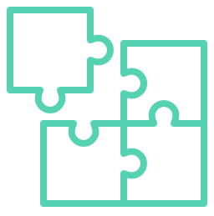
House Keeping
Break-out Groups
In the app you can join the break-out group and it will automatically put this meeting on hold. You can click to “Resume” when you want to jump back.
In the web-browser version you’ll need to hang up and then join the break-out meeting, and vice versa re-joining the main group.

Slide 4
Introductions
Name
Role
Previous use of assessments
Selection or Development
Which ones?
What did you use them for?
Likely applications of aptitude assessments
Interests for the course
Notes:
Ask trainees to turn on webcams for introduction and ask them to cover these questions
You may wish to remove these or ask trainees to keep their introductions brief if you have a large group

Slide 5
About Saville Assessment
Open the door to your potential
Saville Assessment acquired by Tenzing
Founded by Professor Peter Saville
Swift combination tests launched
New tests, new technology
Leadership Impact and Risk launches
Swift Global launched
2004
2005
2007
2013
2015
2017
2019
2021
2022
2023
Wave launched
Situational judgment tests launched
Saville Assessment, A Willis Towers Watson Company
Match 6.5 launched
Wave-i launched
Notes:
You can talk through this slide to introduce Saville Assessment
Peter Saville was the ‘S’ from SHL if you are familiar with their assessments, after selling SHL, he chose to start again. This time he wanted to make use of technology to dive deeper and better predict workplace performance
Before Wave was launched, there was a two-year research program exploring which behaviors and preferences best predicted workplace performance in order to create a highly-valid assessment.

Slide 6
Talent assessment solutions
Delivering the fastest & most powerful solutions for an effective & engaging experience
Unlocking the collective potential of your workforce to thrive in a changing workplace
Recognizing everyone has potential for something & linking leadership to organizational outcomes
Hire Talent
Build Talent
Lead Talent

Slide 7
01
02
03
Introduction to testing
Job Analysis
Introducing Wave
04
05
06
Deep Dives
Expert Report
Feedback of Wave
07
08
09
Focus Styles
Applications of Wave
Reliability and Validity
10
11
Selection Case Study
Development Case Study
Notes:
You can use this slide to give an overview of the course. Depending on the course timings, you can explain which modules you expect to cover in today’s session and what time you expect to have breaks and finish.

Slide 8
Module 1
Introduction to Testing

Slide 9
Talent Trends and Challenges
Talent is global
Applicant numbers per role are increasing
Organizations are assessing behaviors, cultural fit, values
Emphasis on employer brand
Candidate experience is critical
Recruitment processes are speeding up
Online, mobile and remote assessment is the norm
Security of assessment materials is still a risk
Social media has implications
Selection data is increasingly used for onboarding or employability
Responsibility for development is devolved to line managers
Increasing expectation that career management is self-led
The ‘gig’ economy is emerging
Everyone’s talking about Big Data
Notes:
This slides covers talent trends seen over the last few years
Ask trainees if they have any experiences of these or if there are any they would like to know more about

Slide 10
Projective Tests
Inkblot Test
Notes:
Ask trainees to say what they see in the chat
You can use this as a way to practice functionality by asked them to raise their hand if they see a bat

Slide 11
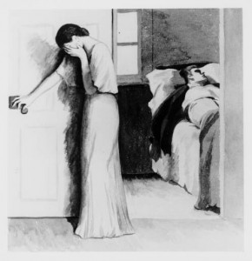
Projective Tests
Thematic Apperception Test

Slide 12
Psychometrics
Personality
Psychometrics are tests used to measure clearly defined psychological attributes
Ability
Typically use numerical or category scoring systems to describes individual differences
Notes:
Objective and standardised​
​
An assessment of a psychological attribute, typically scored using a numerical scale or category system​
​
Psycho= mind​
Metric= measure​

Slide 13
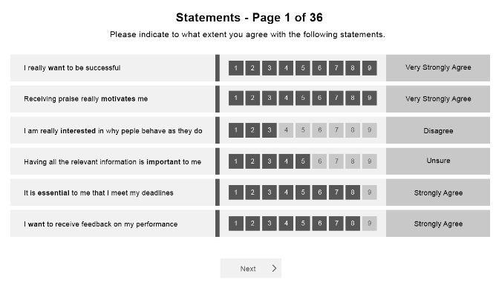
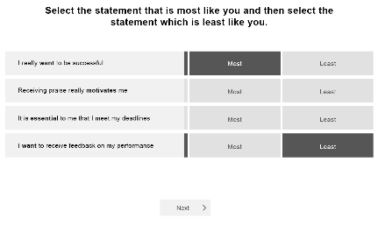
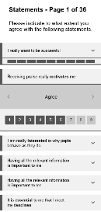
‘Will Do’ Assessments of Typical Performance
Include self-report questionnaires without time limits
‘Right’ and ‘wrong’ can vary depending on context
Wave Professional Styles example:
Notes:
2 buckets
Typical – normal day – how will you typically perform
ASK: other examples?
Interest inventories, personality questionnaires, motivational tests, attitude, 360
Has anyone done anything like this?

Slide 14
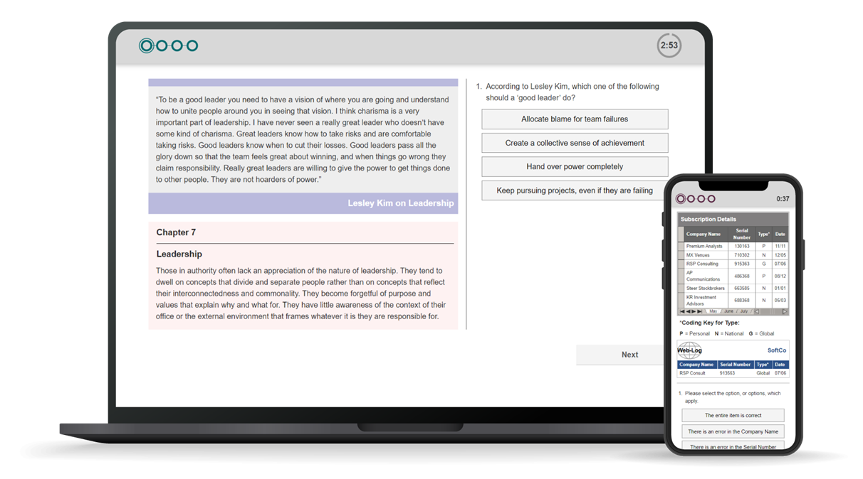
‘Can Do’ Ability Tests of Maximum Performance
Verbal Analysis Aptitude example
Include ability tests of aptitude, IQ and attainment:
Aptitude: predict what someone will be able to learn or do in the future, e.g. Saville Assessment tests
IQ: current level of intellect/cognitive ability, e.g. Wechsler Adult Intelligence Scale
Attainment: measure current level of knowledge understanding or skill, e.g. driving test
Often with strict time limits
Clear right or wrong answers
Notes:
Can do – what is the maximum you can do in these circumstances?
No subject knowledge, underlying skill
Weckler
‘to what extent can they do something in the future’
Ask: how did everyone get on with practice qs

Slide 15
Module 2
Job Analysis

Slide 16
Job Analysis
Job analysis is a multi-method approach that is used for different purposes including:
Defining role profiles/job descriptions/person specifications
Job sizing for pay grading
Developing a framework of criteria for assessment e.g. behavioral competencies
In assessment, good job analysis focuses on things that can be defined clearly and measured well
Notes:
Job analysis is the first thing you should do when starting an assessment process
It is critical for you to understand ‘what good looks like’ in a given role to be able to assess for those competencies

Slide 17
Job Analysis

Slide 18
Common Methods of Job Analysis
Traditionally, job analysis was very time consuming and involved methods to collect information from multiple sources
Structured interviews
Job content reviews
Job holders e.g. critical incident identification
Line managers e.g. repertory grid comparisons
Visionary interviews can be conducted in a structured way with a mixture of stakeholders to establish the key requirements for a role going forwards
Diaries
Observing the job
Doing the job
Task/job analysis questionnaires
Validation research
Validation research
Large samples of job holders or applicants
Establishing statistical links between test scores and job performance
Notes:
These are a few examples of methods that are commonly used in other organizations
Structured interviews provide perspectives and allows an insight into specific circumstances. Often situations with a particularly positive or negative outcome are evaluated to understand the behaviors or skills that contributed to the particular outcome.
Critical incident identification is where job holders discuss specific difficulties they face in role, how they responded and what outcome was achieved.
Repertory grid comparisons are where a manager would the compare the behaviors and skillsets of the employees in their team to identify what helps a person perform well in the role.
Job content reviews are useful when the job remains similar or the same each day
Validation research is the gold standard and allows us to statistically analyze how predictive certain behavioral competencies or skills are of workplace performance.

Slide 19
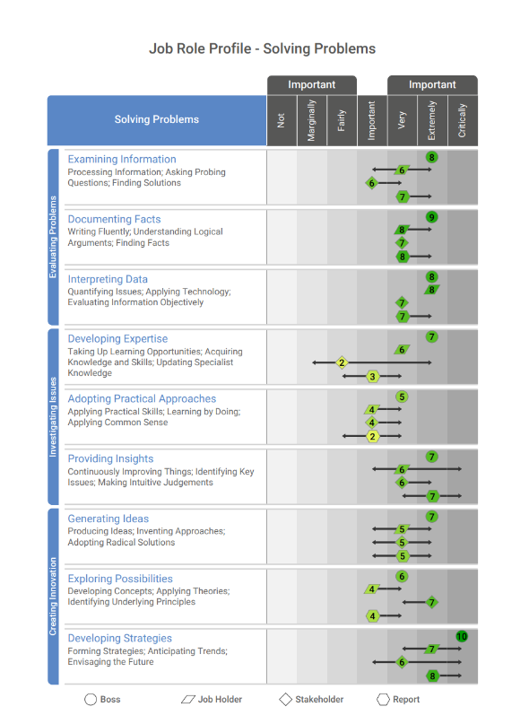
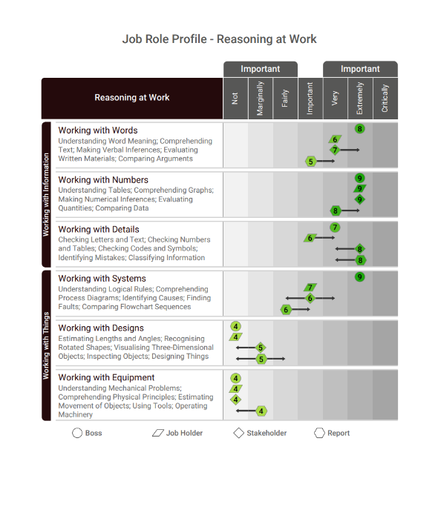
Wave Job Profiler
Online tool (15 minutes)
Survey different stakeholders
7-point ‘Importance’ rating
Can add comments
Notes:
One tool that can be used to support job analysis is our Job Profiler questionnaire
This can be sent to multiple stakeholder categories to gain their insight on how important various competencies are to the role
It is particularly useful when there is a client who would like to gain the opinions of multiple people based in different locations

Slide 20
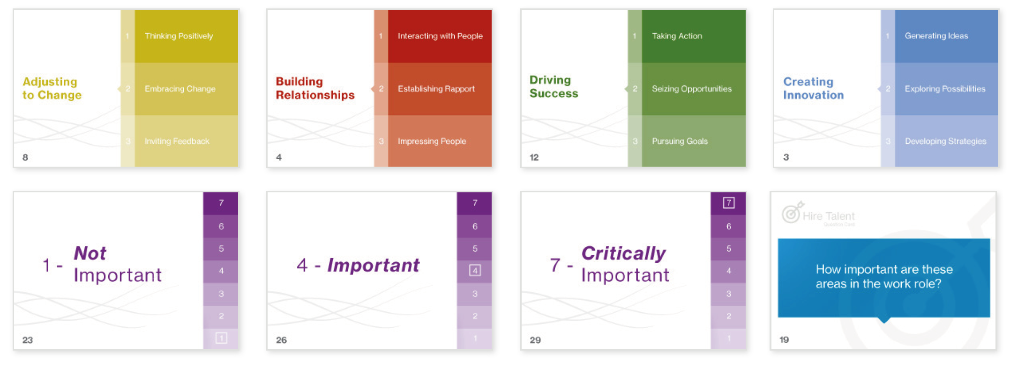
Wave Card Deck
Notes:
Alternatively, we do have card decks available to be purchased
These can be used to run in person job analysis focus groups

Slide 21
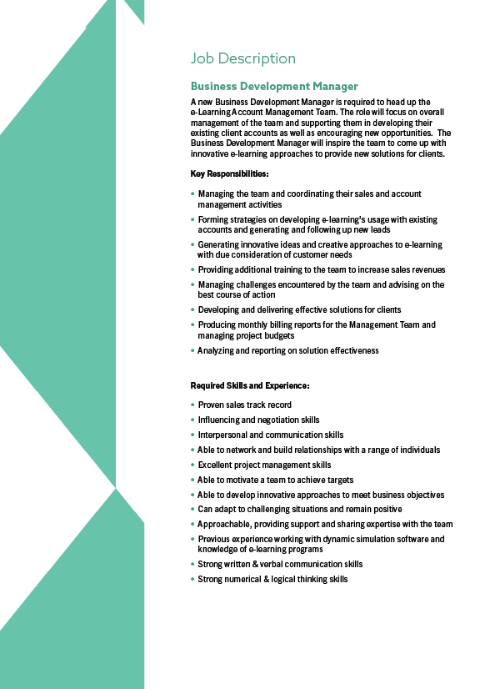
Case Study: Job Analysis
Workbook page 13
Card Sort
Review the job description on page 16 and 17 of Workbook
Use the Wave card deck on pages 14 and 15 to identify up to eight key competencies (five behaviors and three abilities)
List your key competencies in your workbook on page 13

Slide 22
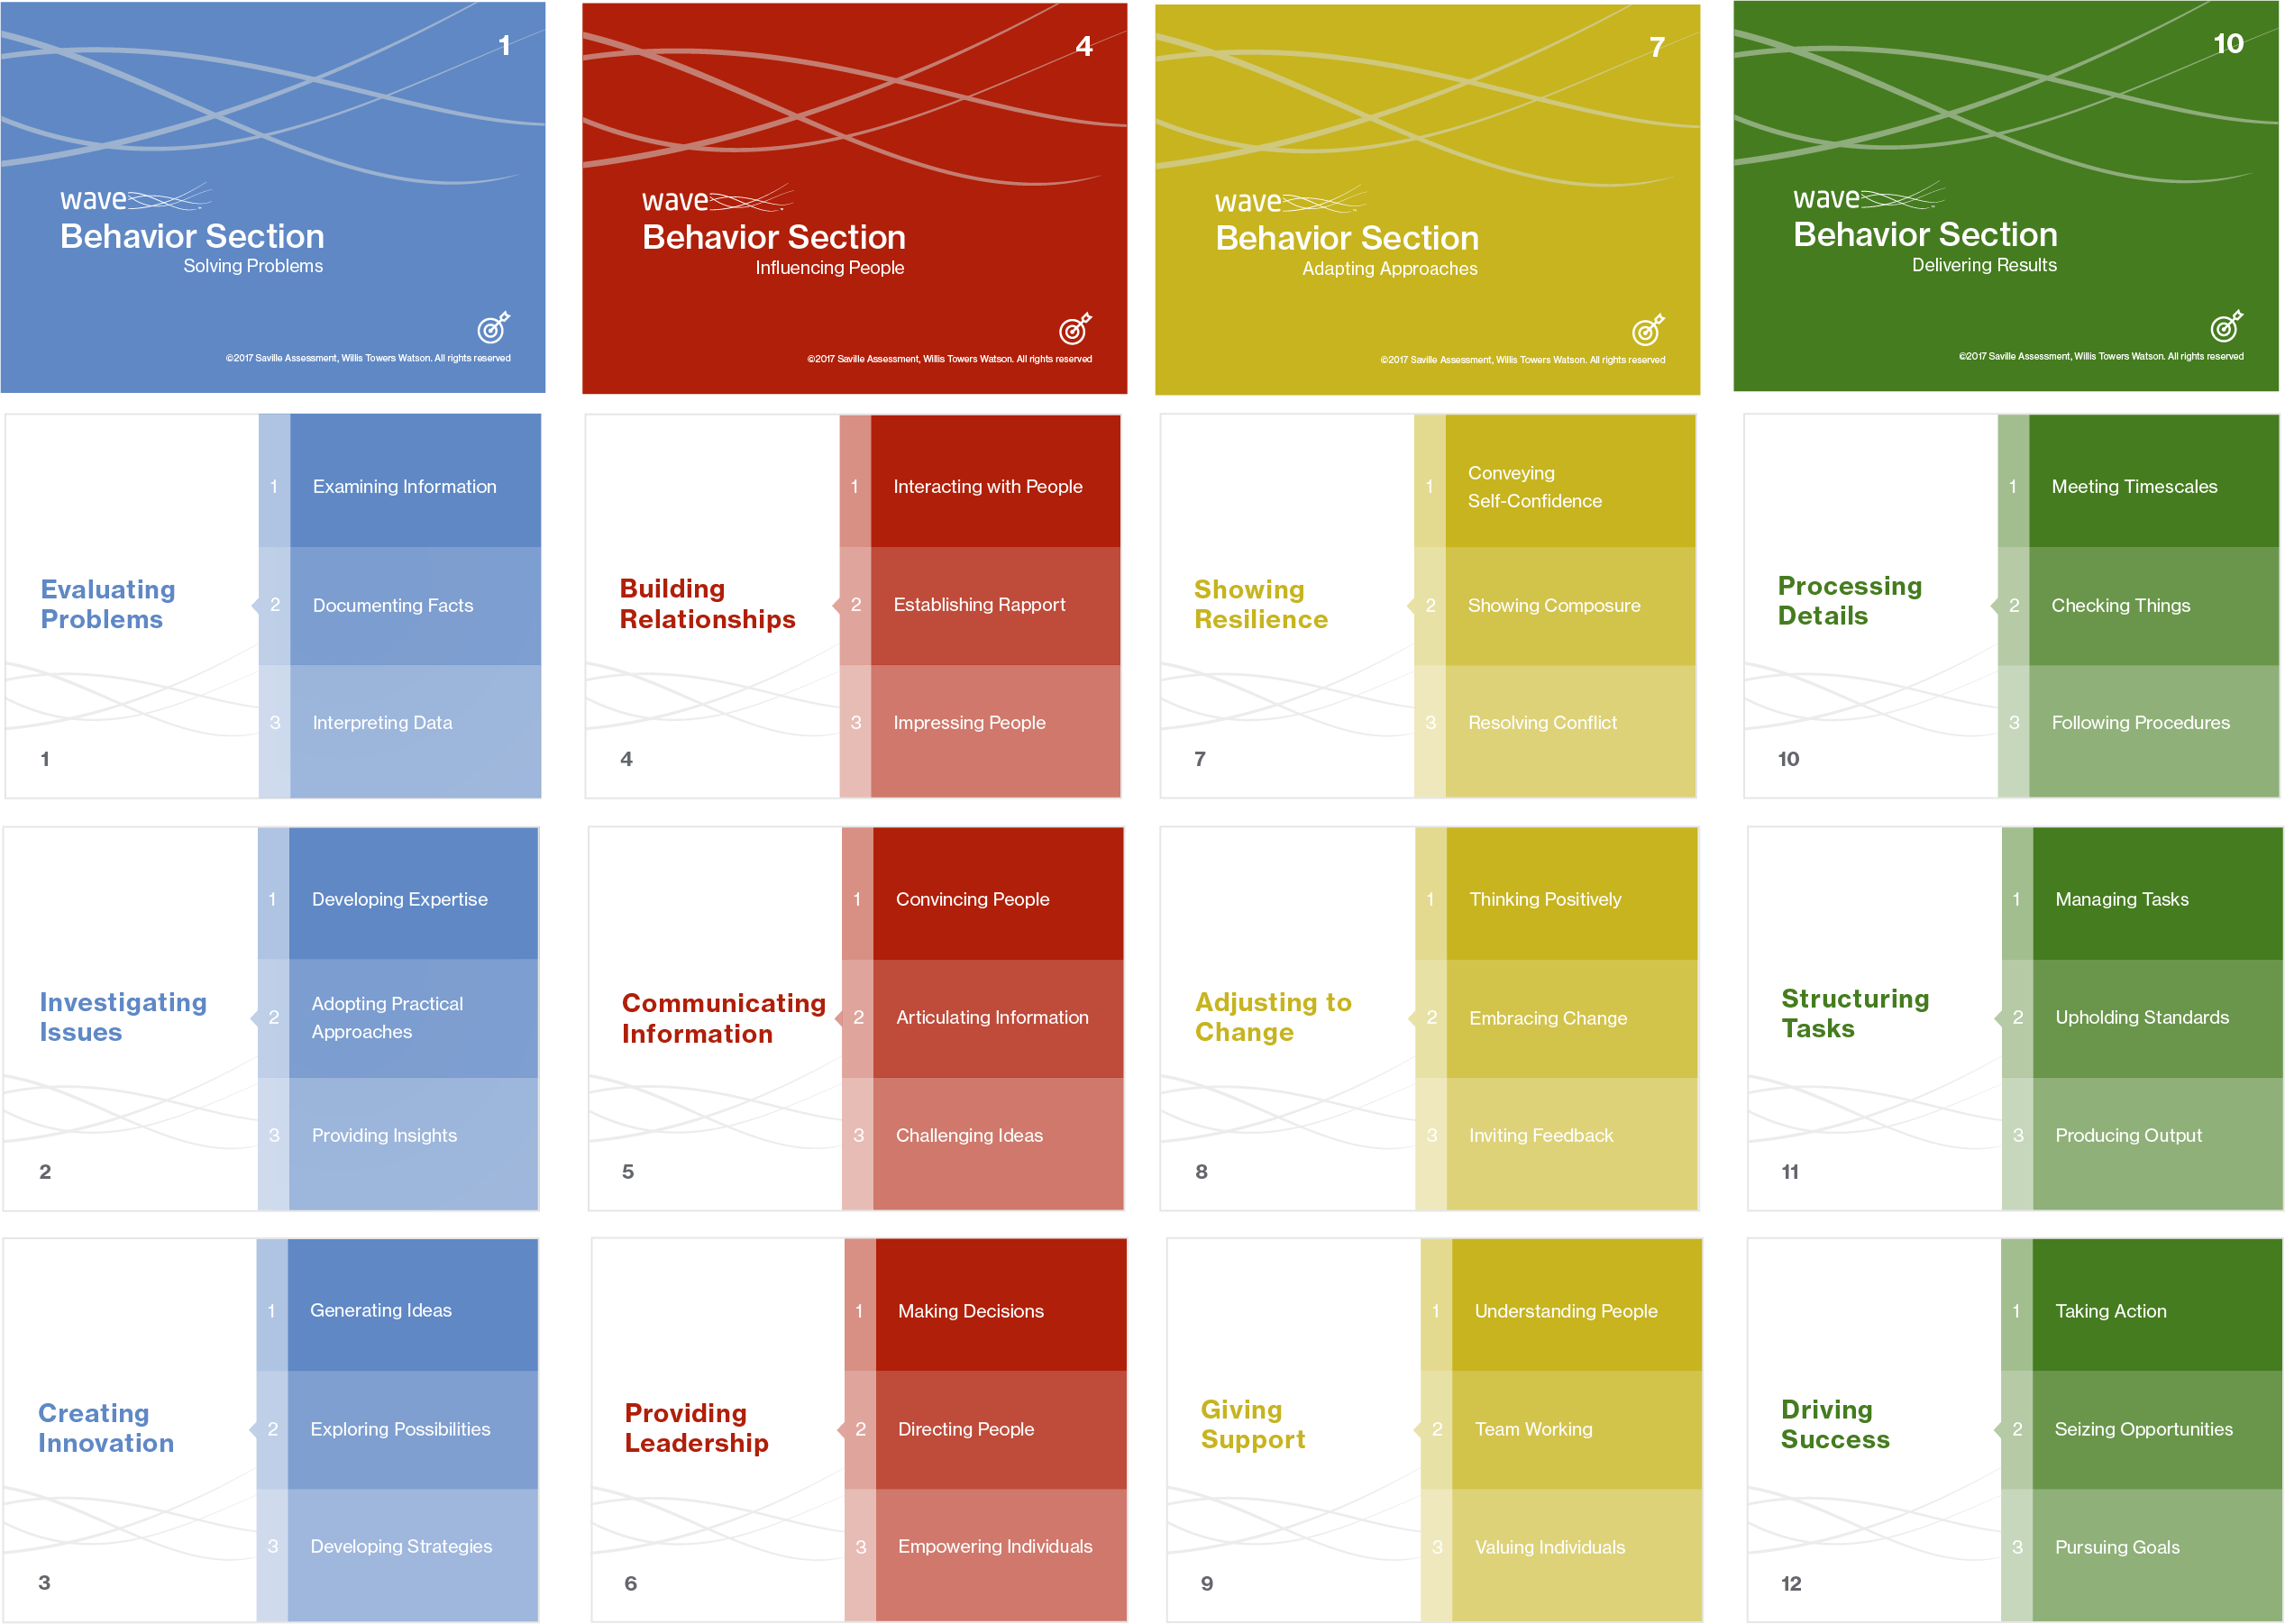
Case Study: Job Analysis
‘Hire’ Card Deck – Behavioural Sections
Notes:
Encourage trainees to discuss these 12 Wave Sections in relation to the role
The goal is to choose 4 Sections as critically important, these do not need to be split across the 4 Clusters/colors
All Sections are positively worded, making them all sound desirable, try to think of which behaviors a person could not do the job without
Creating Innovation – Generating innovative ideas and creative approaches to e-learning with due consideration of customer needs / Able to develop innovative approaches to meet business objectives
Providing Leadership - Managing the team and coordinating their sales and account management activities
Driving Success - Able to motivate a team to achieve targets/ Pursuing goals etc
Building Relationships - Able to network and build relationships with a range of individuals
Adjusting to change - Resolving Conflict - Managing challenges encountered by the team and advising on the best course of action

Slide 23
Case Study: Job Analysis
‘Hire’ Card Deck – Ability Sections
Working with Information
Working with
Things
Notes:
Encourage trainees to discuss and agree on 3 ability areas for the role
Working with numbers - Monthly reports –
Working with Words
Working with Systems/Logic
• Strong written & verbal communication skills
• Strong numerical & logical thinking skills

Slide 25
Module 3
Introducing Wave®

Slide 26
Introducing Wave Styles
Professional Styles
Focus Styles
A suite of online questionnaires measuring personality, talent, motives, competencies and preferred culture, all combined in one dynamic instrument.
35
13

Slide 27
Why Wave Styles?
Exceptional validity in predicting workplace outcomes
Understanding how both motives and talents drive performance
Measures preferred environment/culture fit
Online dynamic question format (rating/ranking)
Reduces potential distortion and identifies specific areas of distortion
Effectively measures other models/frameworks
One fully-integrated assessment model

Slide 28
Behavior Model

Slide 29
Why Wave Styles?
INFLUENCE
4 CLUSTERS
Sociable
Impactful
Assertive
12 SECTIONS
Convincing
Articulate
Challenging
36 DIMENSIONS
Presentation Oriented
Eloquent
Socially Confident
108 FACETS

Slide 30
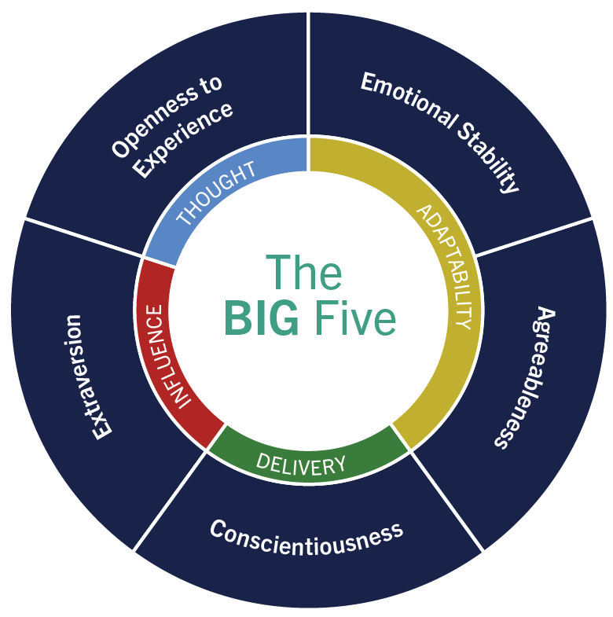
Relationship with the ‘Big Five’

Slide 31
Extensive Coverage of Work Behaviors
Comfort with IT
Speed of learning
Sticking to decisions
Building rapport
Developing strategy
Networking
Responsibility for
big decisions
Identifying business
opportunities
Encouraging others
Engaging

Slide 32
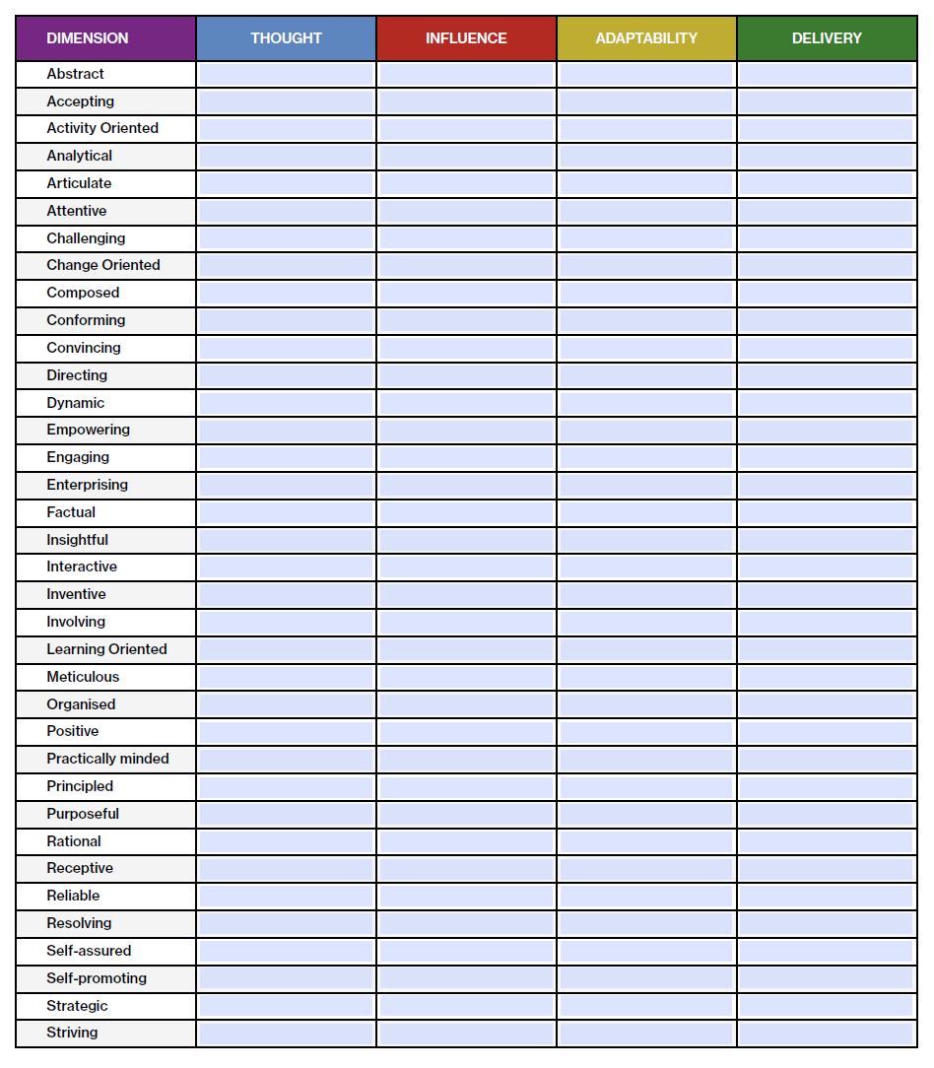
Exercise: Clusters and Dimensions
Workbook page 23
Clusters and Dimensions
The 36 dimensions are listed alphabetically in column one.
For each dimension, place a tick in the relevant column to assign the dimension to one of the four clusters.
Notes:
This is editable in their workbooks

Slide 33
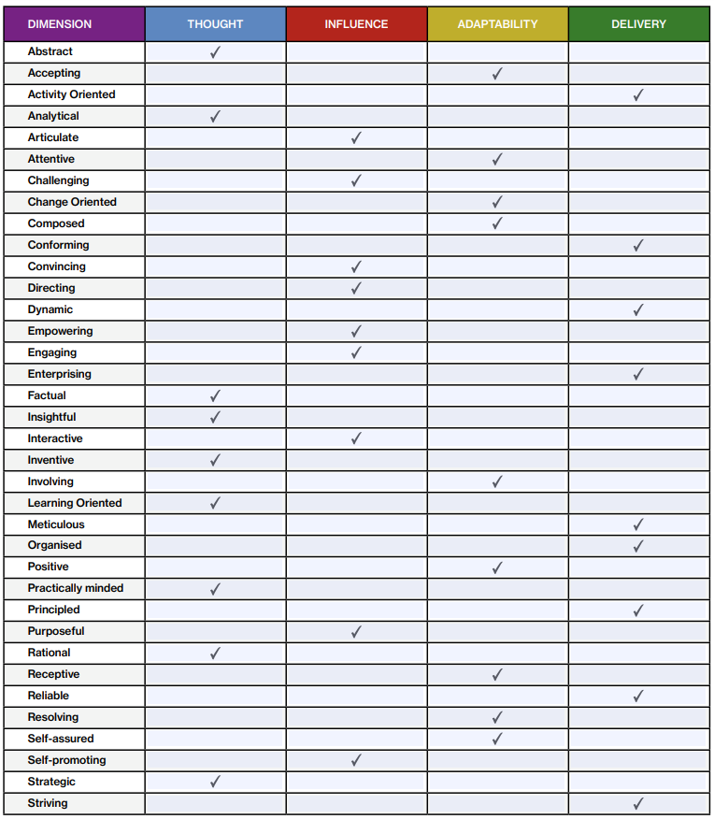
Exercise: Clusters and Dimensions

Slide 34
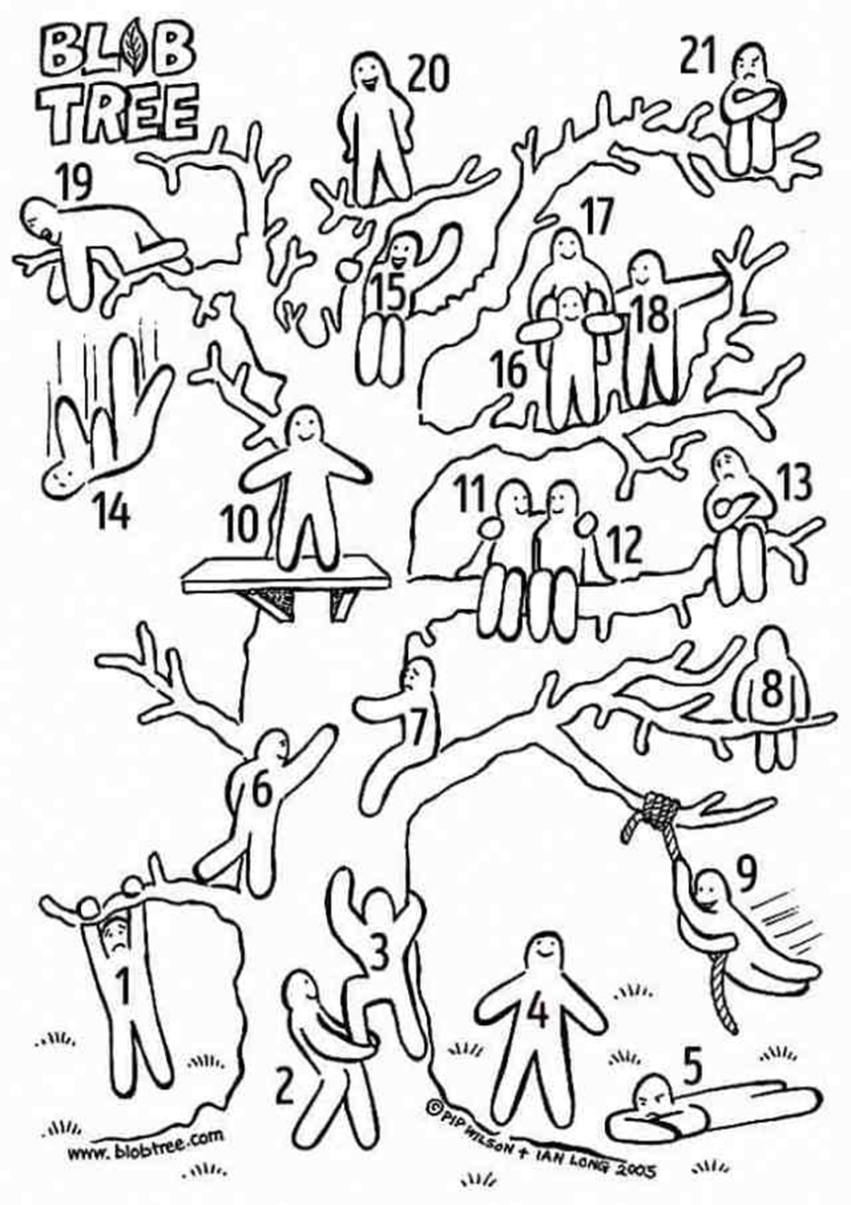
Blob Tree
Which Blob are you feeling like right now?
Notes:
Energizer – ask trainees which ‘blob’ they feel like
Use to gauge if a break is needed

Slide 35
Module 4
Deep Dives

Slide 36
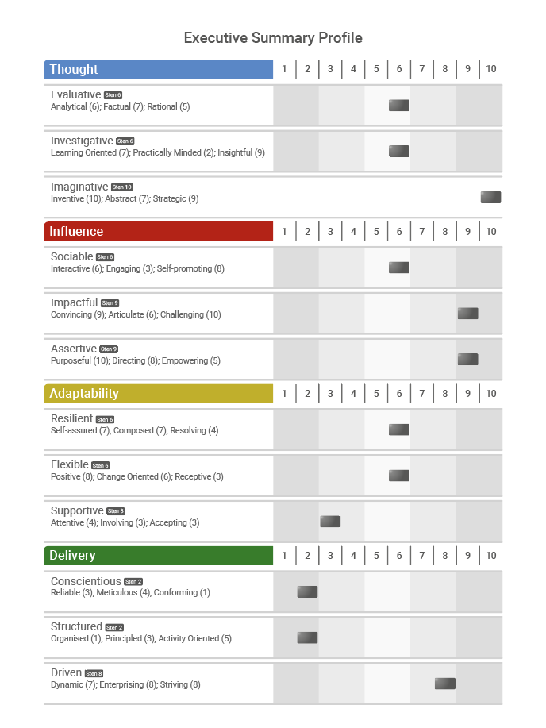
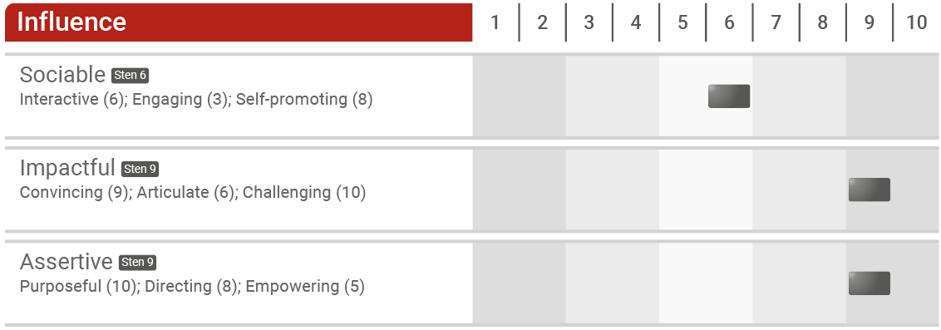
Where Most Questionnaires Stop, We Start
The Executive Summary Profile

Slide 37
Structure of the Psychometric Profile

Slide 38
Wave Facet Verbalizers
Each facet is underpinned by two questions: one motive and one talent
The facet description of the individual’s behavior changes depending upon the Sten score
In feedback, people are less comfortable accepting ‘low’ talent descriptions than ‘low’ motive descriptions
As a result, the ‘low’ facet descriptions tend to favor motive descriptions (‘cuddly lows’), and the ‘high’ facet descriptions tend to favor talent descriptions

Slide 39
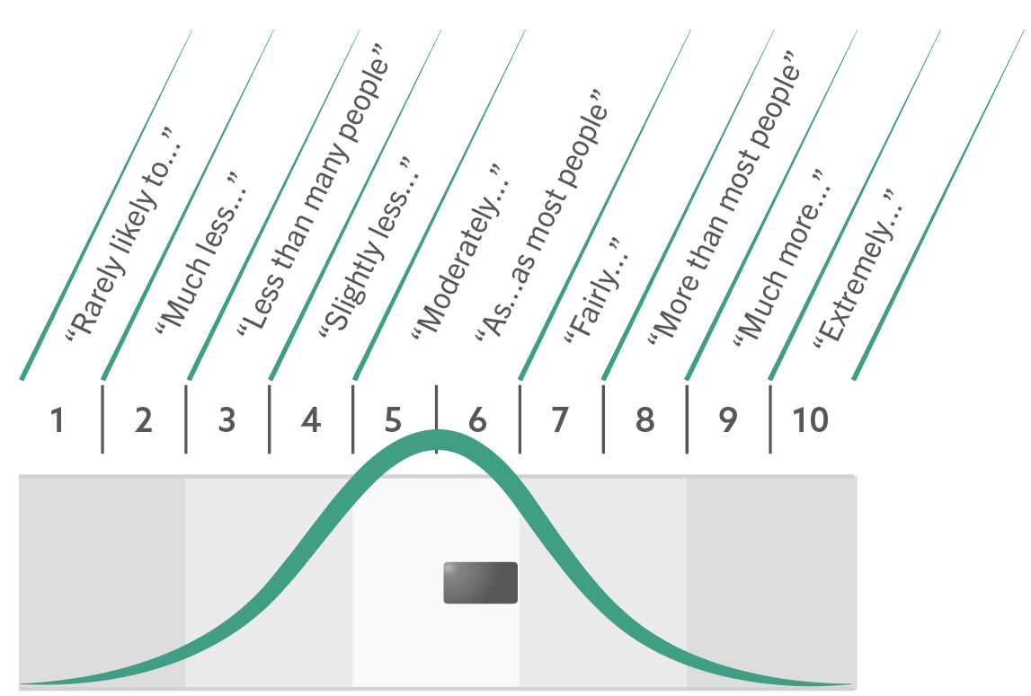
Sten Score Descriptors

Slide 40
Linking Exercise: Dimensions
Workbook page 28
Notes:
Explore this combination in relation to a leadership role What might the advantages and disadvantages be?
Only slightly less Directing than others – how important is this in the specific role?

Slide 41
Linking Exercise: Dimensions
Workbook page 28
Notes:
How could these style combinations play out in the role?
How important is it to be challenging?
When have they had to challenge others?
How could they use their strength in articulating to support them in being challenging?

Slide 42
Delve Deeper
Facet Range
Motive-Talent Split
Normative-Ipsative Split

Slide 43
Deep Dive 1: Facet Range
Where there is a range of facet scores within any dimension that is three Stens or more, the scores for the individual facets are shown on the profile. This often represents a point of uniqueness which goes against the general trend.

Slide 44
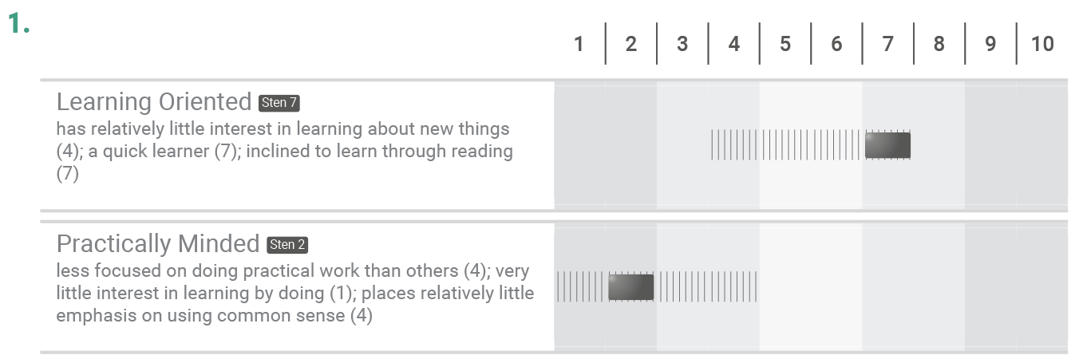
Linking Exercise: Facet Ranges
Workbook page 31
Notes:
Explore initial reactions to these two areas – can explore one at a time then combine
How much opportunity/time does this individual have to learn about new things?
They appear to prefer learning by reading – is this possible in the role?
What does practical work look like for them/in the role?

Slide 45
Linking Exercise: Facet Ranges
Workbook page 31
Notes:
How important is it to be positive in the role?
What impact could this have on others around them?
If this is a leadership/manager position, how do they bring others with them during change?
Common pattern to see people finding it difficult to cope with uncertainty

Slide 46
“Styles are a combination of the motives and talents of individuals. What individuals want and what individuals see themselves as good at, are both critical to predicting the culture in which people prefer to work, and their performance at work.”
Professor Peter Saville
Notes:
What are styles?

Slide 47
What are Motives?
Motives are the ‘need’ items of the questionnaire
They measure the individual’s needs / wants / desires / preferences
They reveal what the individual is motivated or driven by
I enjoy
I want
It is important to me

Slide 48
What are Talents?
Talents are measured by the ‘effectiveness’ items of the questionnaire
They measure the individual’s self-perception of behaviors they demonstrate and are effective at
I am good at
I am
People say I

Slide 49
Motive or Talent
Workbook page 34
I enjoy giving presentations | M
I am good at working with numerical data | T
I am considerate to others | T
People say I am energetic | T
I want to be the leader | M
I prefer to be optimistic | M
Using technology is one of my strengths | T
I need to have rules to follow | M
I work well when I am busy | T
I feel comfortable dealing with angry people | T
I have a strong sense of my own worth | T
It is important to me to feel positive about myself | M

Slide 50
Deep Dive 2: Motive-Talent Splits
Differences of three Stens or more between the motive and talent score on a dimension are highlighted and may indicate a point of interest.
The individual reports motive higher than talent.
The individual reports talent higher than motive.
Explore the need and potential to develop.
Explore the discrepancy, try to understand why motive is lower and what impact this has on performance.
Notes:
Self-assured
How important is it for them to be self-assured in their role?
How much autonomy do they have in their role/in their own development?
How might developing in this area benefit them?
Interactive
How important is it for them to be interactive in their role?
Is motivation lower as their would be a benefit to being less lively/talkative?
If being interactive is important, how might this motivation impact negatively?
What to they like/dislike about being interactive?

Slide 51
Interpreting Split Directions
Motive higher than talent
Talent higher than motive
aspires to…
does less well, but with high frequency?
demonstrates with enthusiasm but potentially less skill?
bored of…
does well, but with low frequency?
demonstrates this with ease but with less passion?

Slide 52
Linking Exercise: Motive-Talent Splits
Workbook page 37
Notes:
Remember to cover facets first before exploring M-T splits
How important is it to empower others in this role?
What do they like/dislike about empowering others?
Example to gather evidence of talent
What could be the impact/risk of lower motivation?

Slide 53
Linking Exercise: Motive-Talent Splits
Workbook page 37
2.
Convincing
Sten 7
Persuasive (7); makes own point strongly (7); is focused on negotiating the best deal (7)
Articulate
Sten 1
Strongly dislikes giving presentations (1); often has difficulty explaining things clearly (2); feels less confident meeting new people than many (3)
Notes:
Remember to cover facets first before exploring M-T splits
Explore Convincing first
Why is this important to them?
How well do they feel they convince others? Any examples?
Could their responses to articulate be having an effect on their ability to convince others?
How would it benefit them to improve their articulation skills?

Slide 54
Response Bias
Most people give an accurate self-description on self-report questionnaires but some do not. For example:
Some people have a false impression of themselves
Some people are motivated to fake good or fake bad
How do we know? What can we do?

Slide 55
Distorted Results?
Prevent
Detect
Use a questionnaire with a format designed to control for response bias
Before administering such a questionnaire, indicate that:
The profile will be cross-referenced with other data
The results will be discussed during feedback/interview
There are response checks within the questionnaire
Wave uses a dynamic format which leads to both normative and ipsative scoring in the same administration
This gives an overall indication of how positive/lenient or negative/self-critical someone has been in their responses
This also highlights specific areas to the user where distortion may have occurred

Slide 56
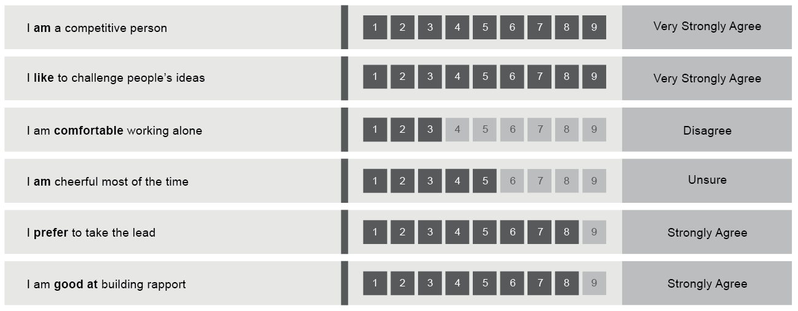
Normative Scores from Ratings
People are free to rate themselves as they like on each individual statement and the resulting normative profile could reflect a highly positive or negative self-perception.
Profiles can be high across most scores for people who are positive responders and vice versa for those who are very self-critical.

Slide 57
Ipsative Scores From Rankings
The individual is forced to choose between different statements and the resulting ipsative profile provides a balance of high and low scores.
Some individuals find ranking tasks a little bit more challenging because they are always forced to prioritize one thing over another.

Slide 58
Why Both in Wave Styles?
The dynamic rate/rank format of Wave carries a number of advantages:
Increases candidate acceptability
Creates more varied profiles
Enables reporting at facet level
Enhances reliability and validity
Makes faking more complex
Makes distortion easier to detect

Slide 59
Normative Scores from Ratings and Ipsative Scores from Rankings
 | Normative Scores from Ratings | Ipsative Scores from Rankings
Advantages | User friendly for individuals to rate themselves as they see fit | Pull greater differentiation out of profiles Controls for acquiescence
Disadvantages | Can lead to profiles that reflect overly-lenient or overly self-critical responses Can be purposefully inflated | Can be challenging for individuals to prioritise one behaviour over another

Slide 60
Deep Dive 3: Normative-Ipsative Splits
Differences of three Stens or more between an individual’s normative and ipsative response on a dimension are highlighted and could represent an area of over- or under-rating to explore.
Normative score is higher than ipsative score
Ipsative score is higher than normative score
Check/verify for potential exaggeration
Check/verify for potential modesty/self criticism
Notes:
Receptive
Is this an area they have initially overrated?
When might they be more/less receptive?
What could the risk/impact be if they become less receptive under pressure?
What are some advantages to this style?
Purposeful
Is this an area they have initially underrated?
When might they be more/less purposeful?
How important is this area in the role?
What are the advantages/disadvantages of this style?
How might this impact others involved in the decision making process?

Slide 61
Interpreting Normative-Ipsative Splits
I
N
Ipsative lower than Normative
Are you less critical/over-rating yourself in this area?
N
I
Normative lower than Ipsative
Are you self-critical/under-rating yourself in this area?

Slide 62
Other Hypotheses to Explore
N
“Is this how they are when things are free and easy?”
“Is this how they prefer to see themselves?”
I
“Is this how they are when there is more pressure?”
“Is this the uncomfortable/unrecognized truth?”
“In which situations are they more likely to be like this?”
“In which situations are they less likely to be like this?”

Slide 63
Linking Exercise: Normative-Ipsative Splits
Workbook page 43
Notes:
Remember to cover facets first before exploring N-I splits
Is this an area they have initially overrated?
When might they be more/less organized?
What is the impact of potentially becoming less organized under pressure?

Slide 64
Linking Exercise: Normative-Ipsative Splits
Workbook page 43
Notes:
Remember to cover facets first before exploring N-I splits
Is this an area they have initially underrated?
When might they be more/less meticulous?
Does a naturally tendency to be detail oriented come out under pressure?
What impact might this have in their role?

Slide 65
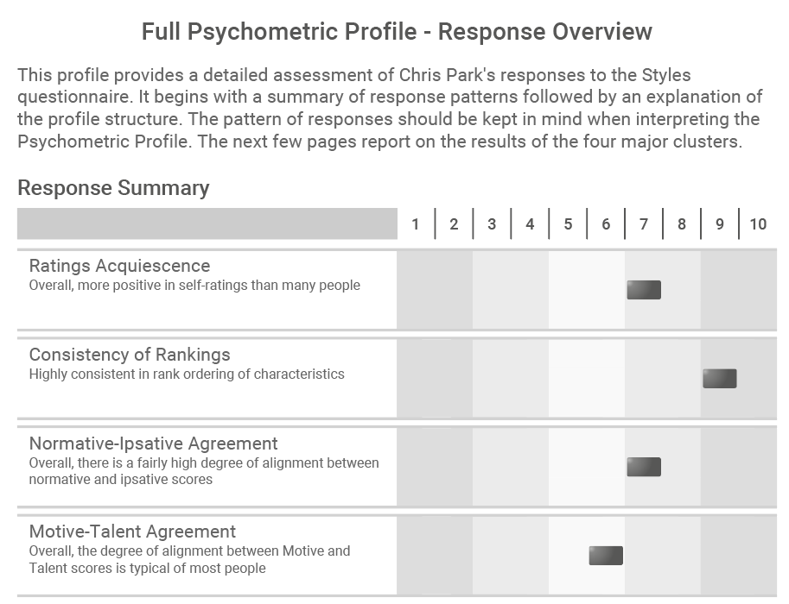
Understanding Overall Response Patterns

Slide 66
Blob Tree
Which Blob are you feeling like right now?
Notes:
Energizer – ask trainees which ‘blob’ they feel like
Use to gauge if a break is needed

Slide 67
What might a low overall Ratings Acquiescence mean for a person's profile?
The person's overall profile is likely to be closer to the left of the Sten scale
The person's overall profile is likely to be closer to the right of the Sten scale
The person's overall profile is likely to be typical of those in the comparison group
67

Slide 68
What might a high Ratings Acquiescence mean for a person's overall profile?
The person's overall profile is likely to be closer to the left of the Sten scale
The person's overall profile is likely to be closer to the right of the Sten scale
The person's overall profile is likely to be typical of those in the comparison group
68

Slide 69
Where a response summary indicates Low N-I agreement, what do you expect to see in the profile?
Many N-I Splits
Not so many N-I Splits
You can not tell
69

Slide 70
Where a response summary indicates low Ratings Acquiescence and low Normative-Ipsative agreement, what would you expect to see on a profile?
There are a number of N-I splits across the profile varying in the Normative/Ipsative position
There are a number of N-I splits on the profile with Normative lower than Ipsative
There are a number of N-I splits on the profile with Normative higher than Ipsative
70

Slide 71
If a person has a high Consistency of Rankings, would you expect to see a greater or lesser number of Motive-Talent splits across their profile?
a) More M-T splits
b) Less M-T splits
c) Consistency of Rankings is independent from Motive-Talent agreement
71

Slide 72
Module 5
Expert Report

Slide 73
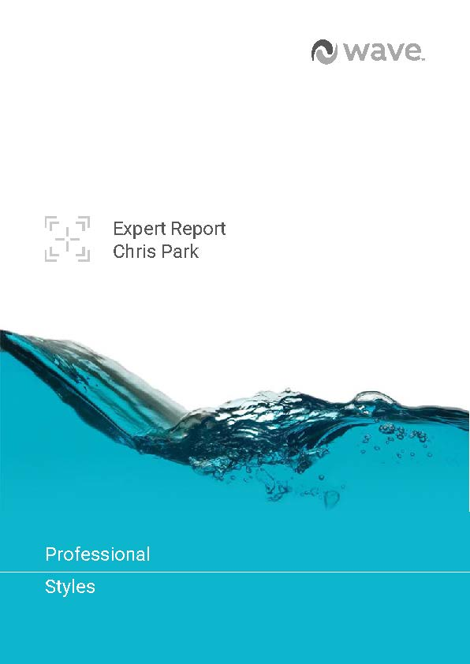
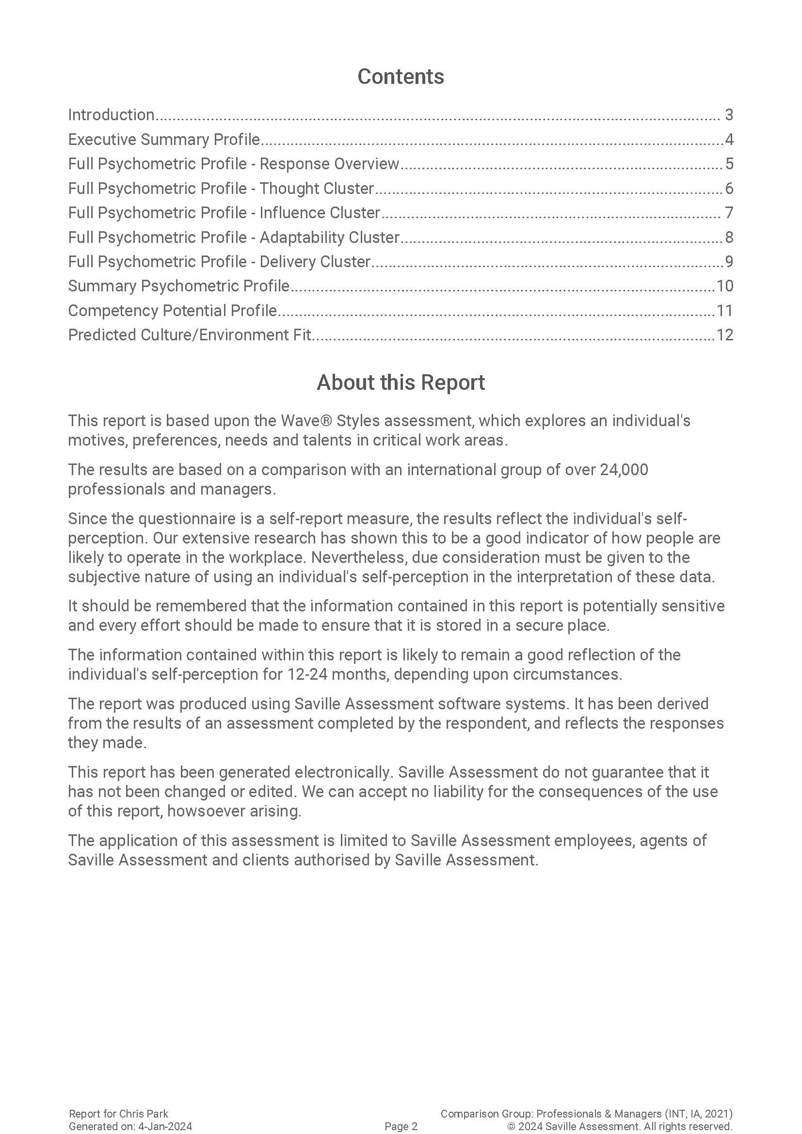
The Expert Report

Slide 74
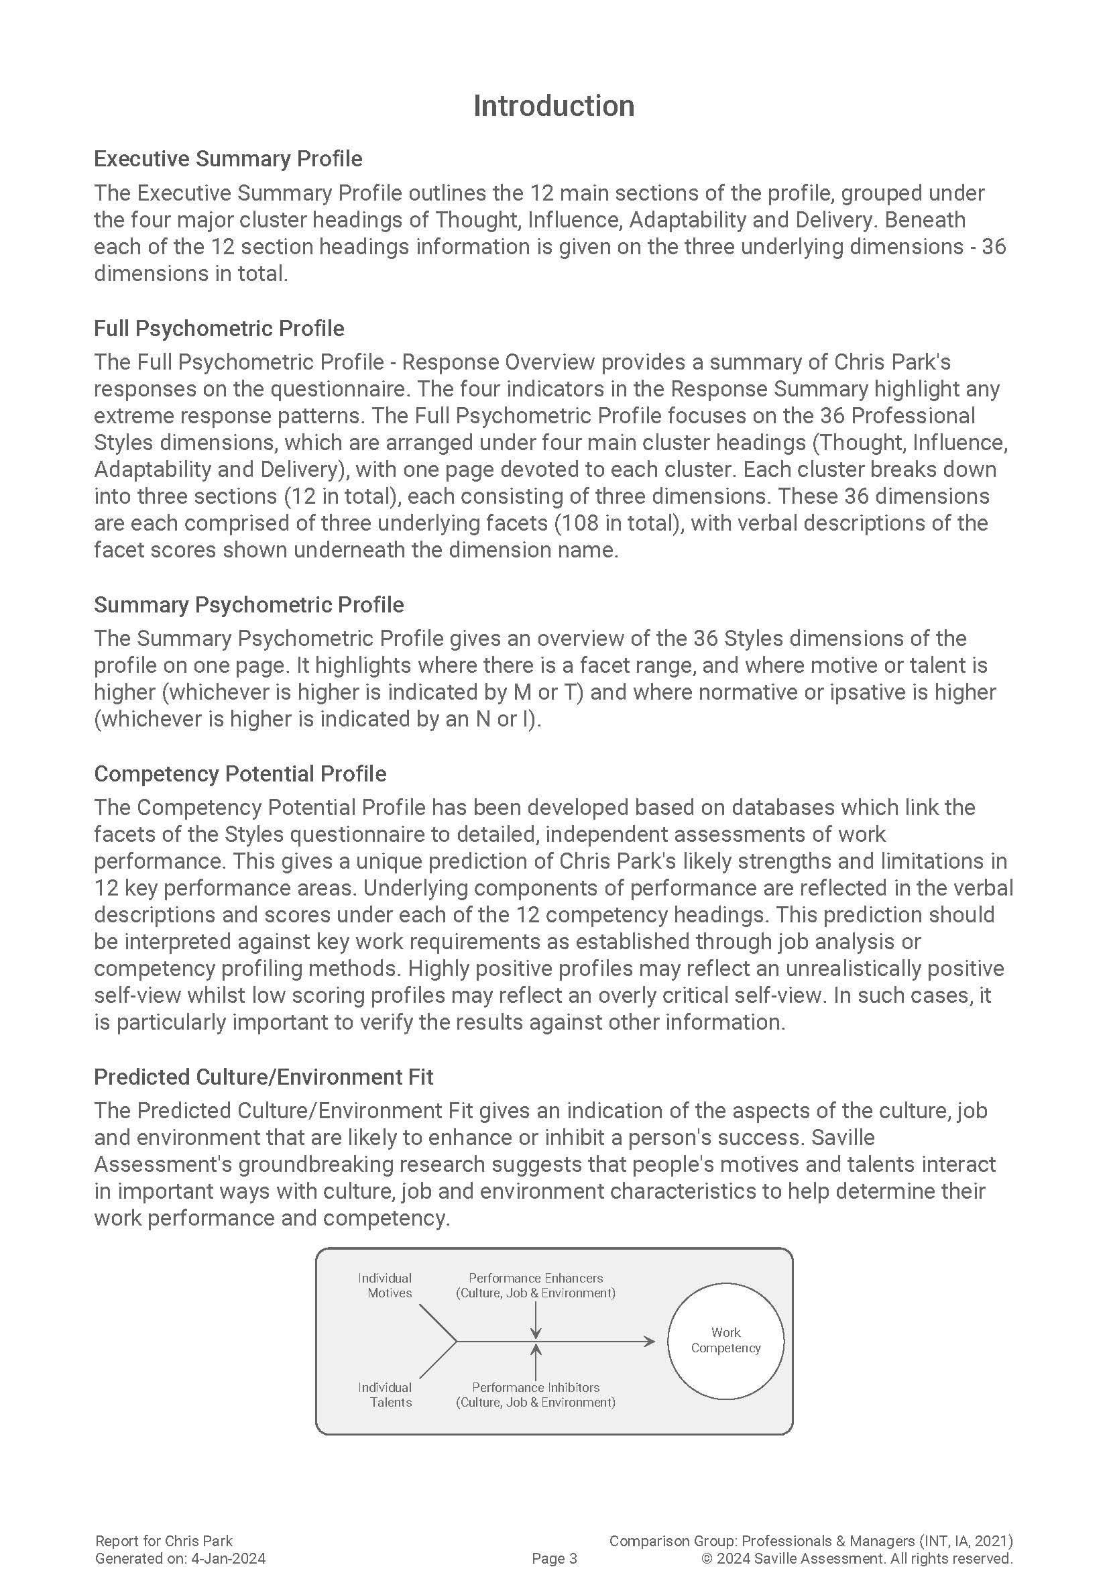
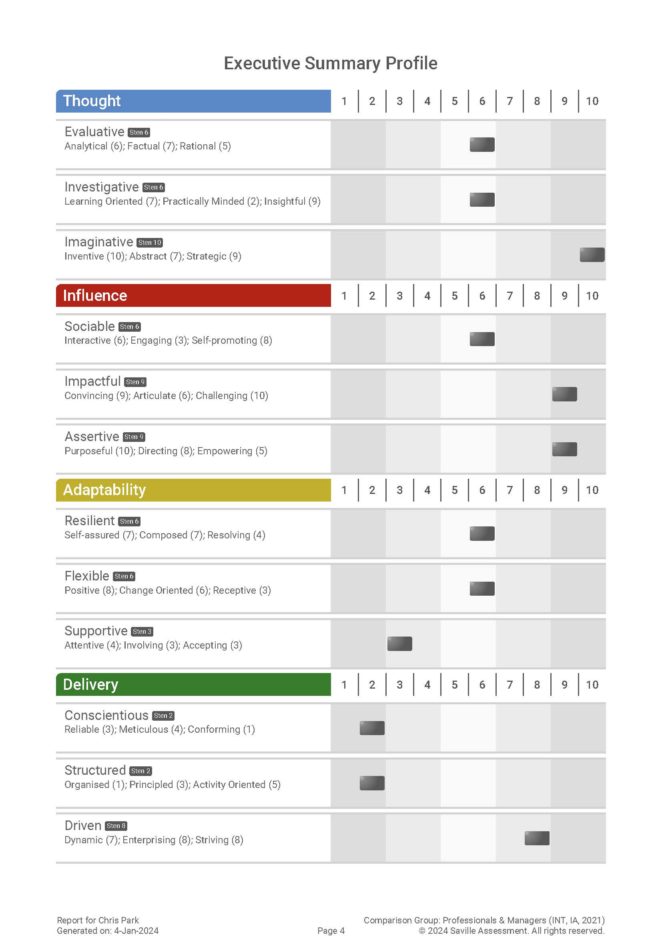

Slide 75
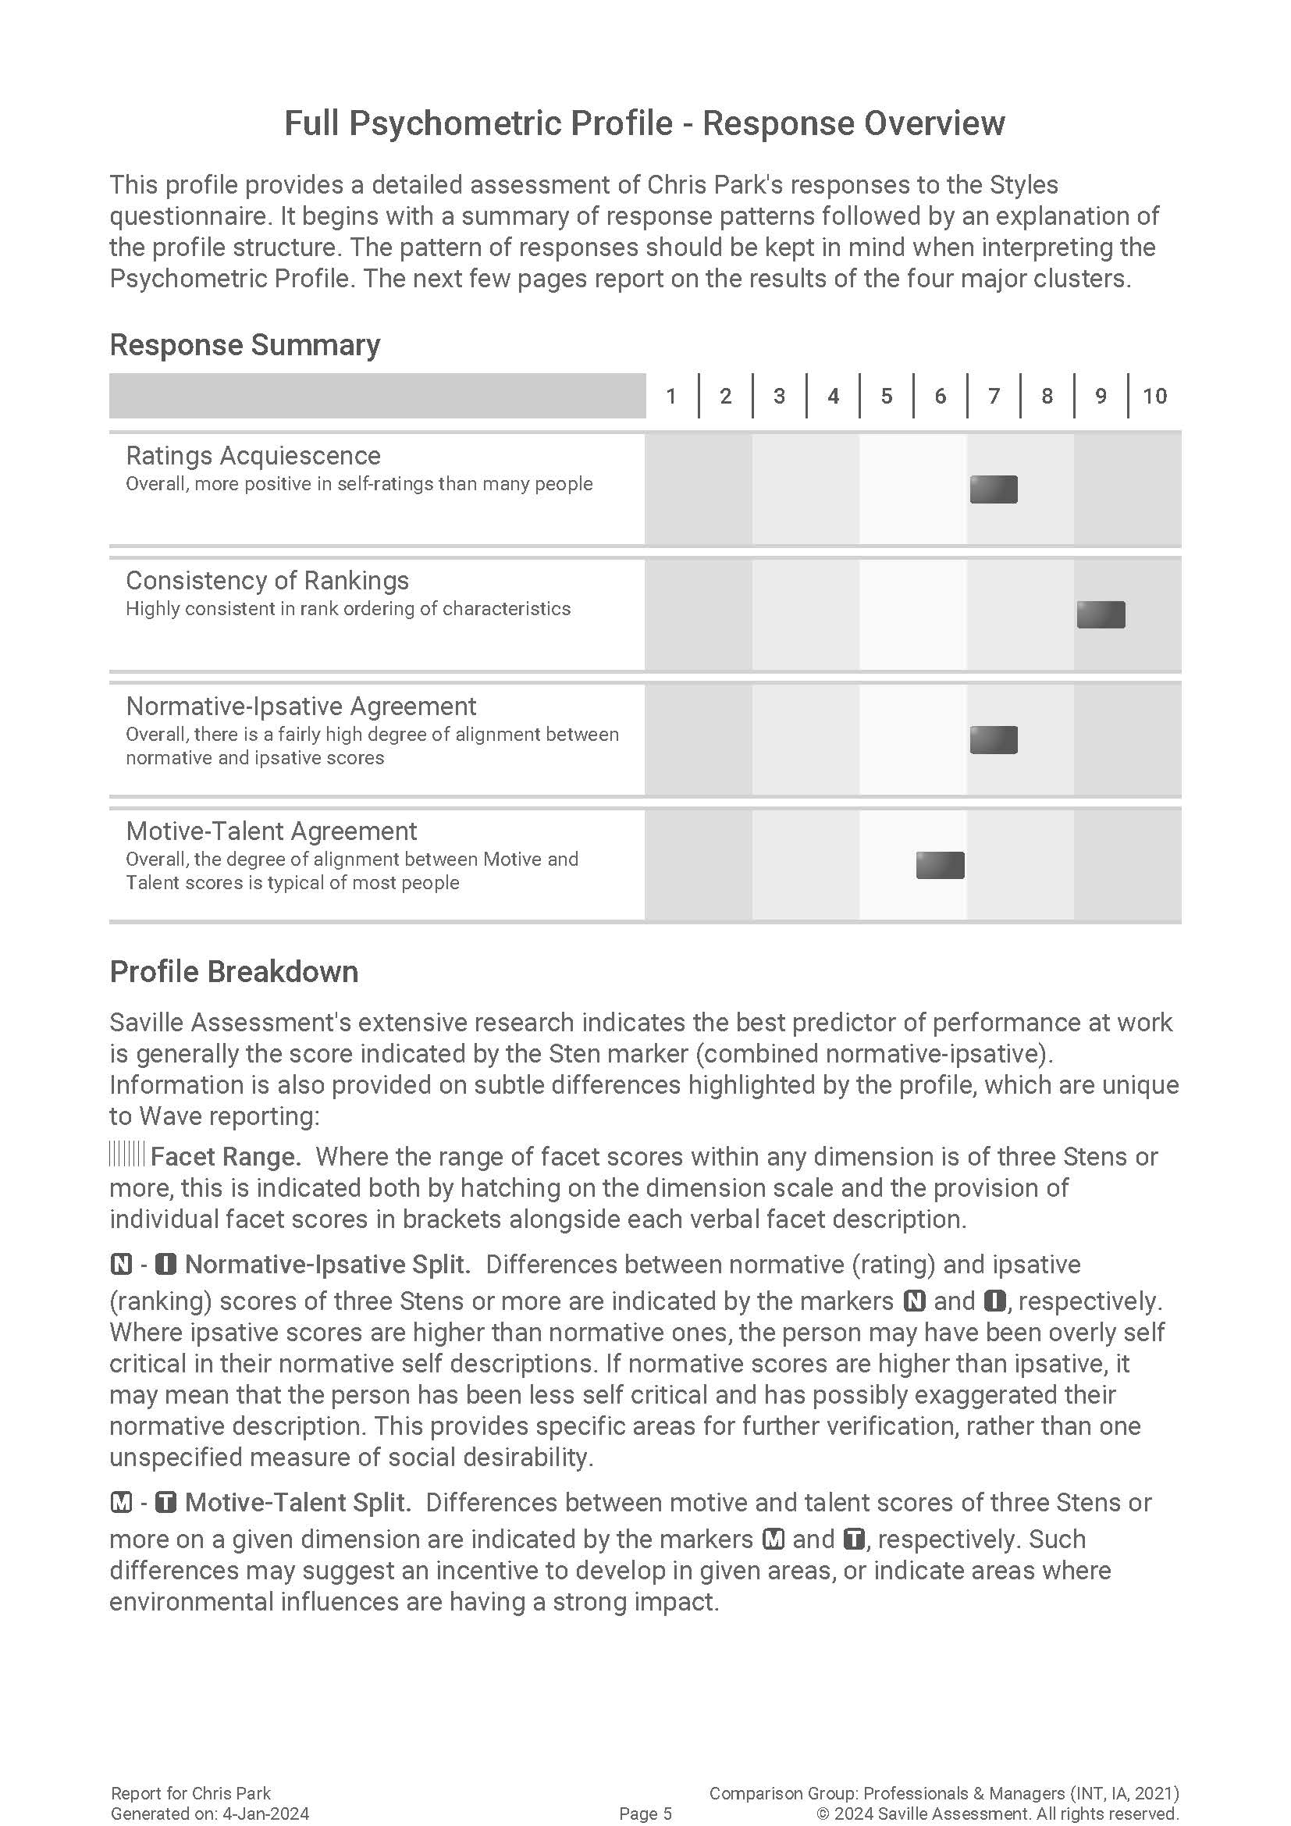
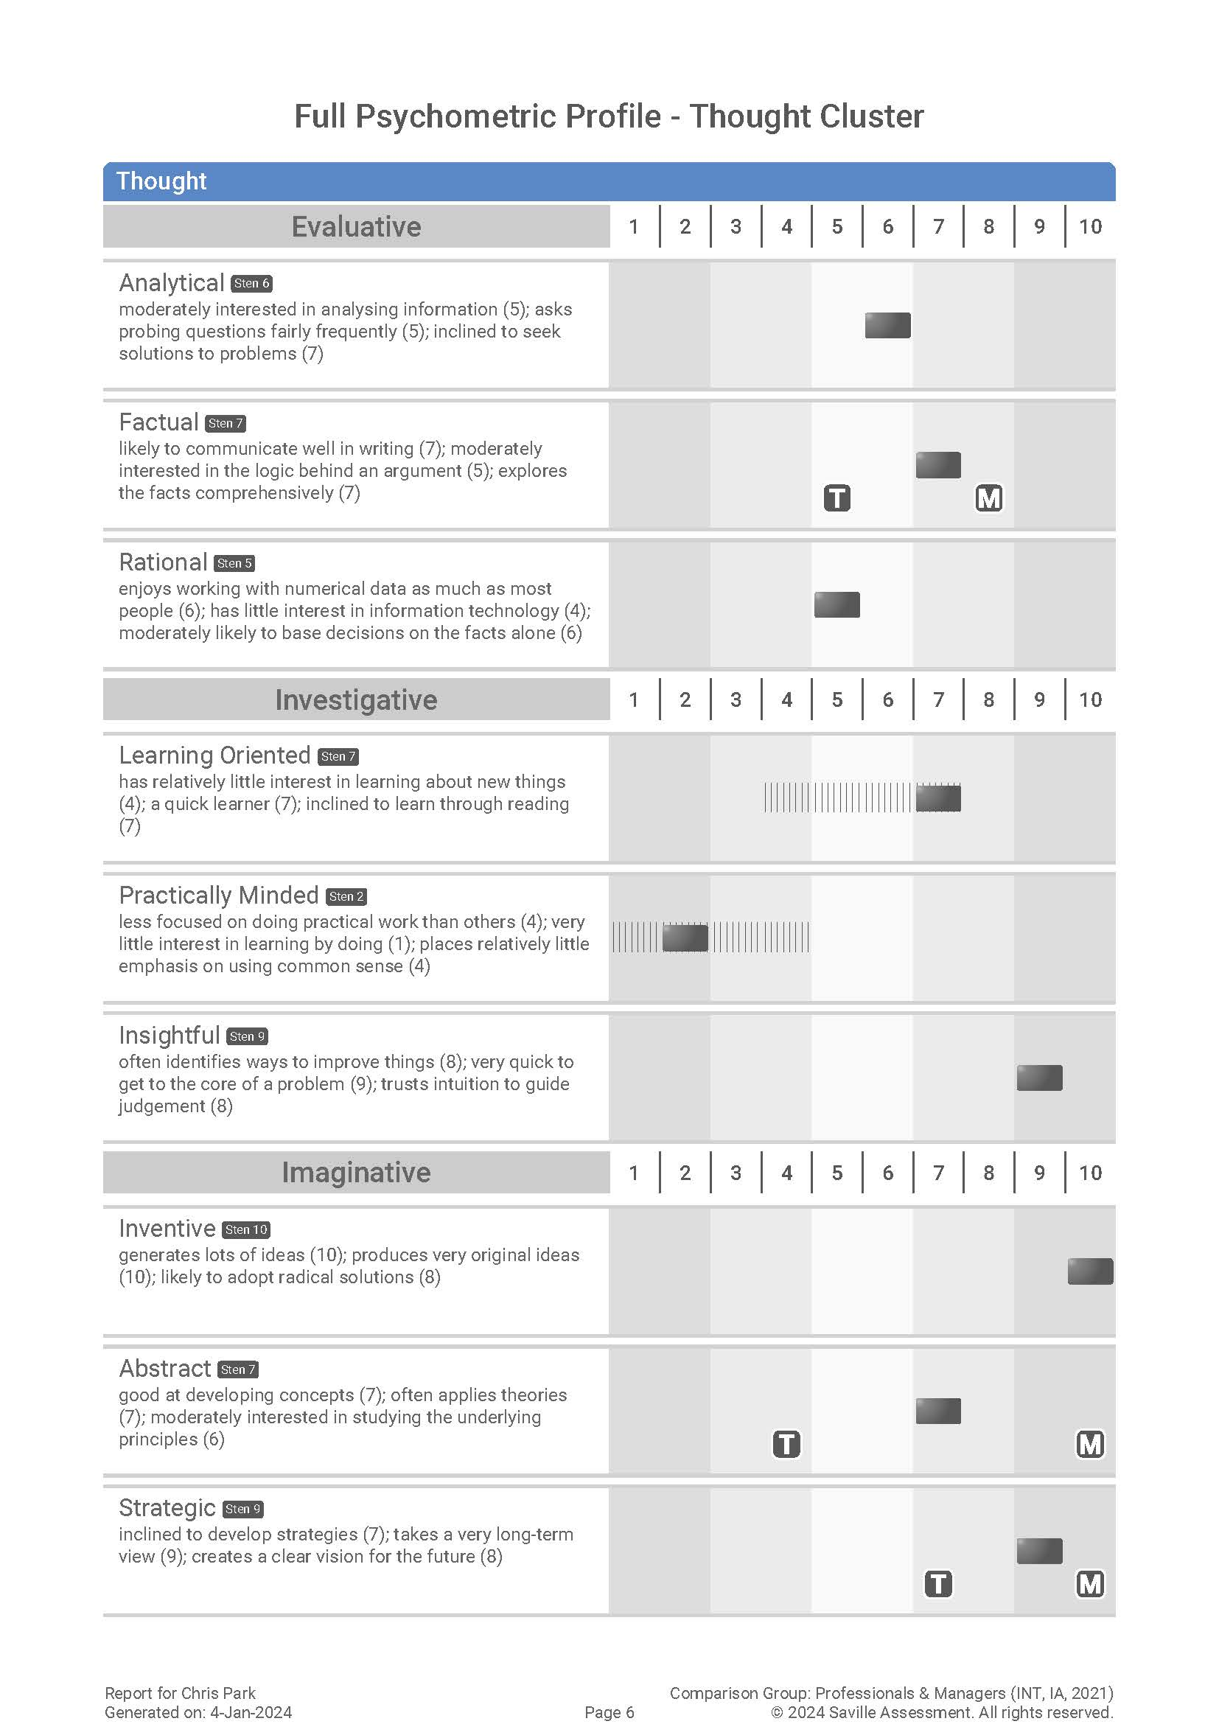

Slide 76
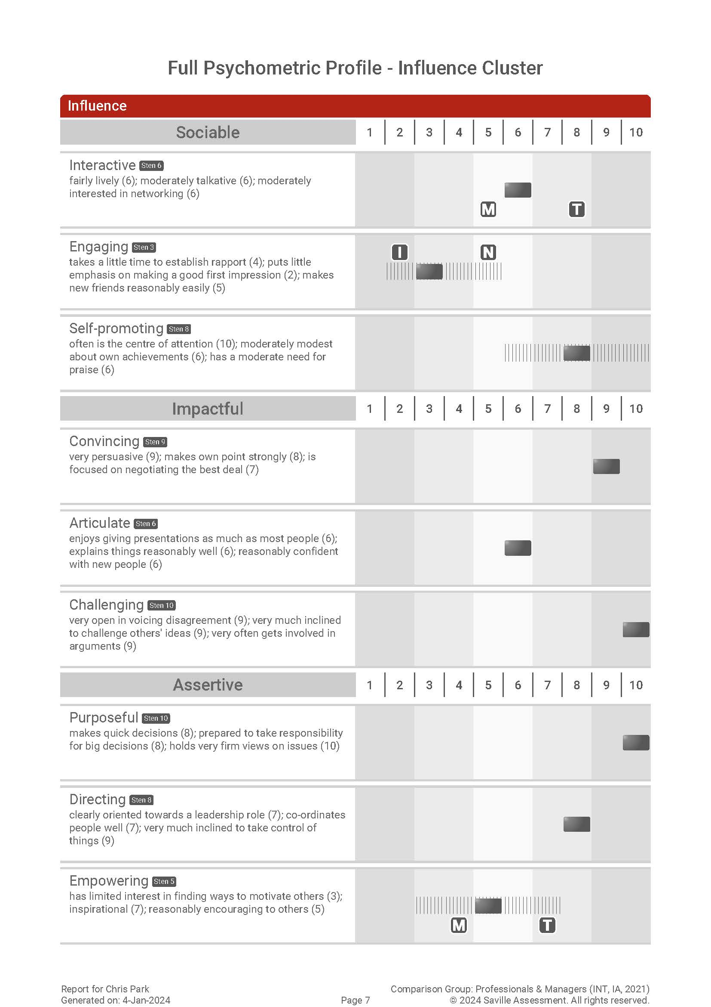
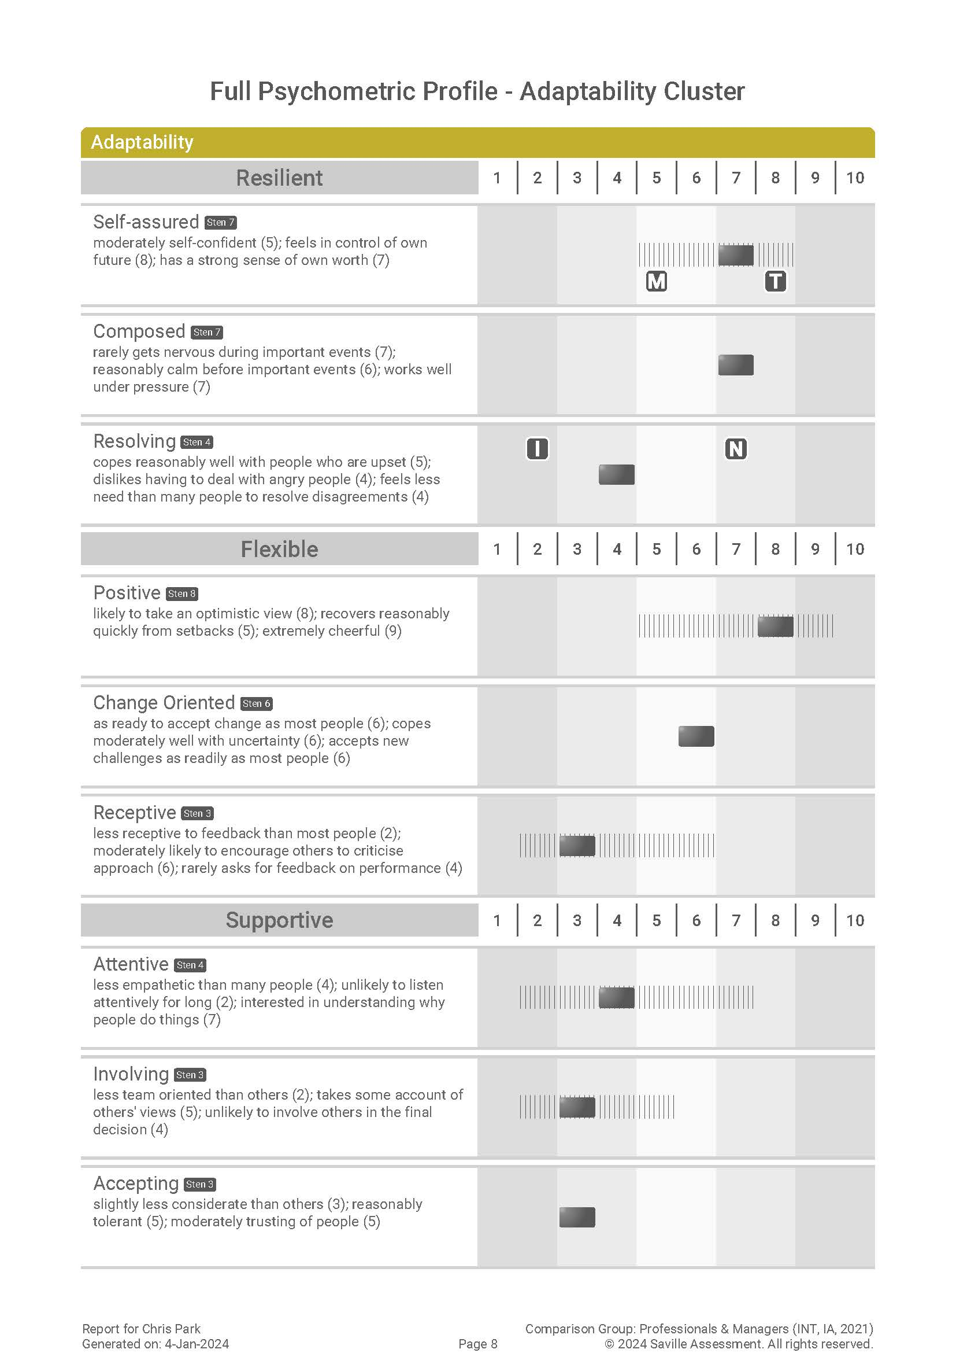

Slide 77
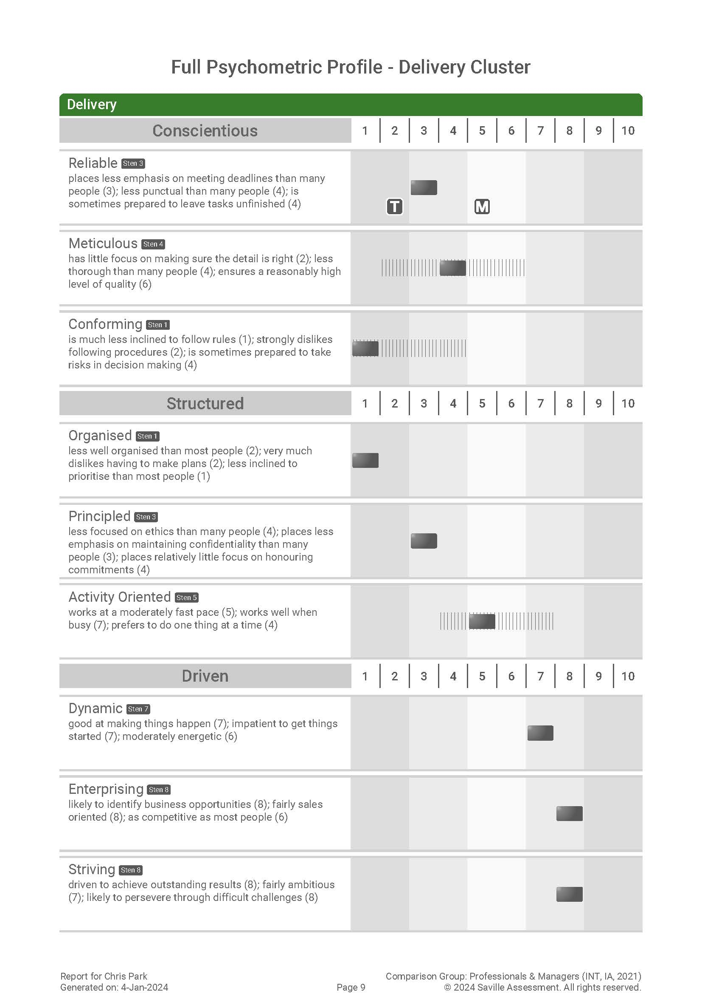
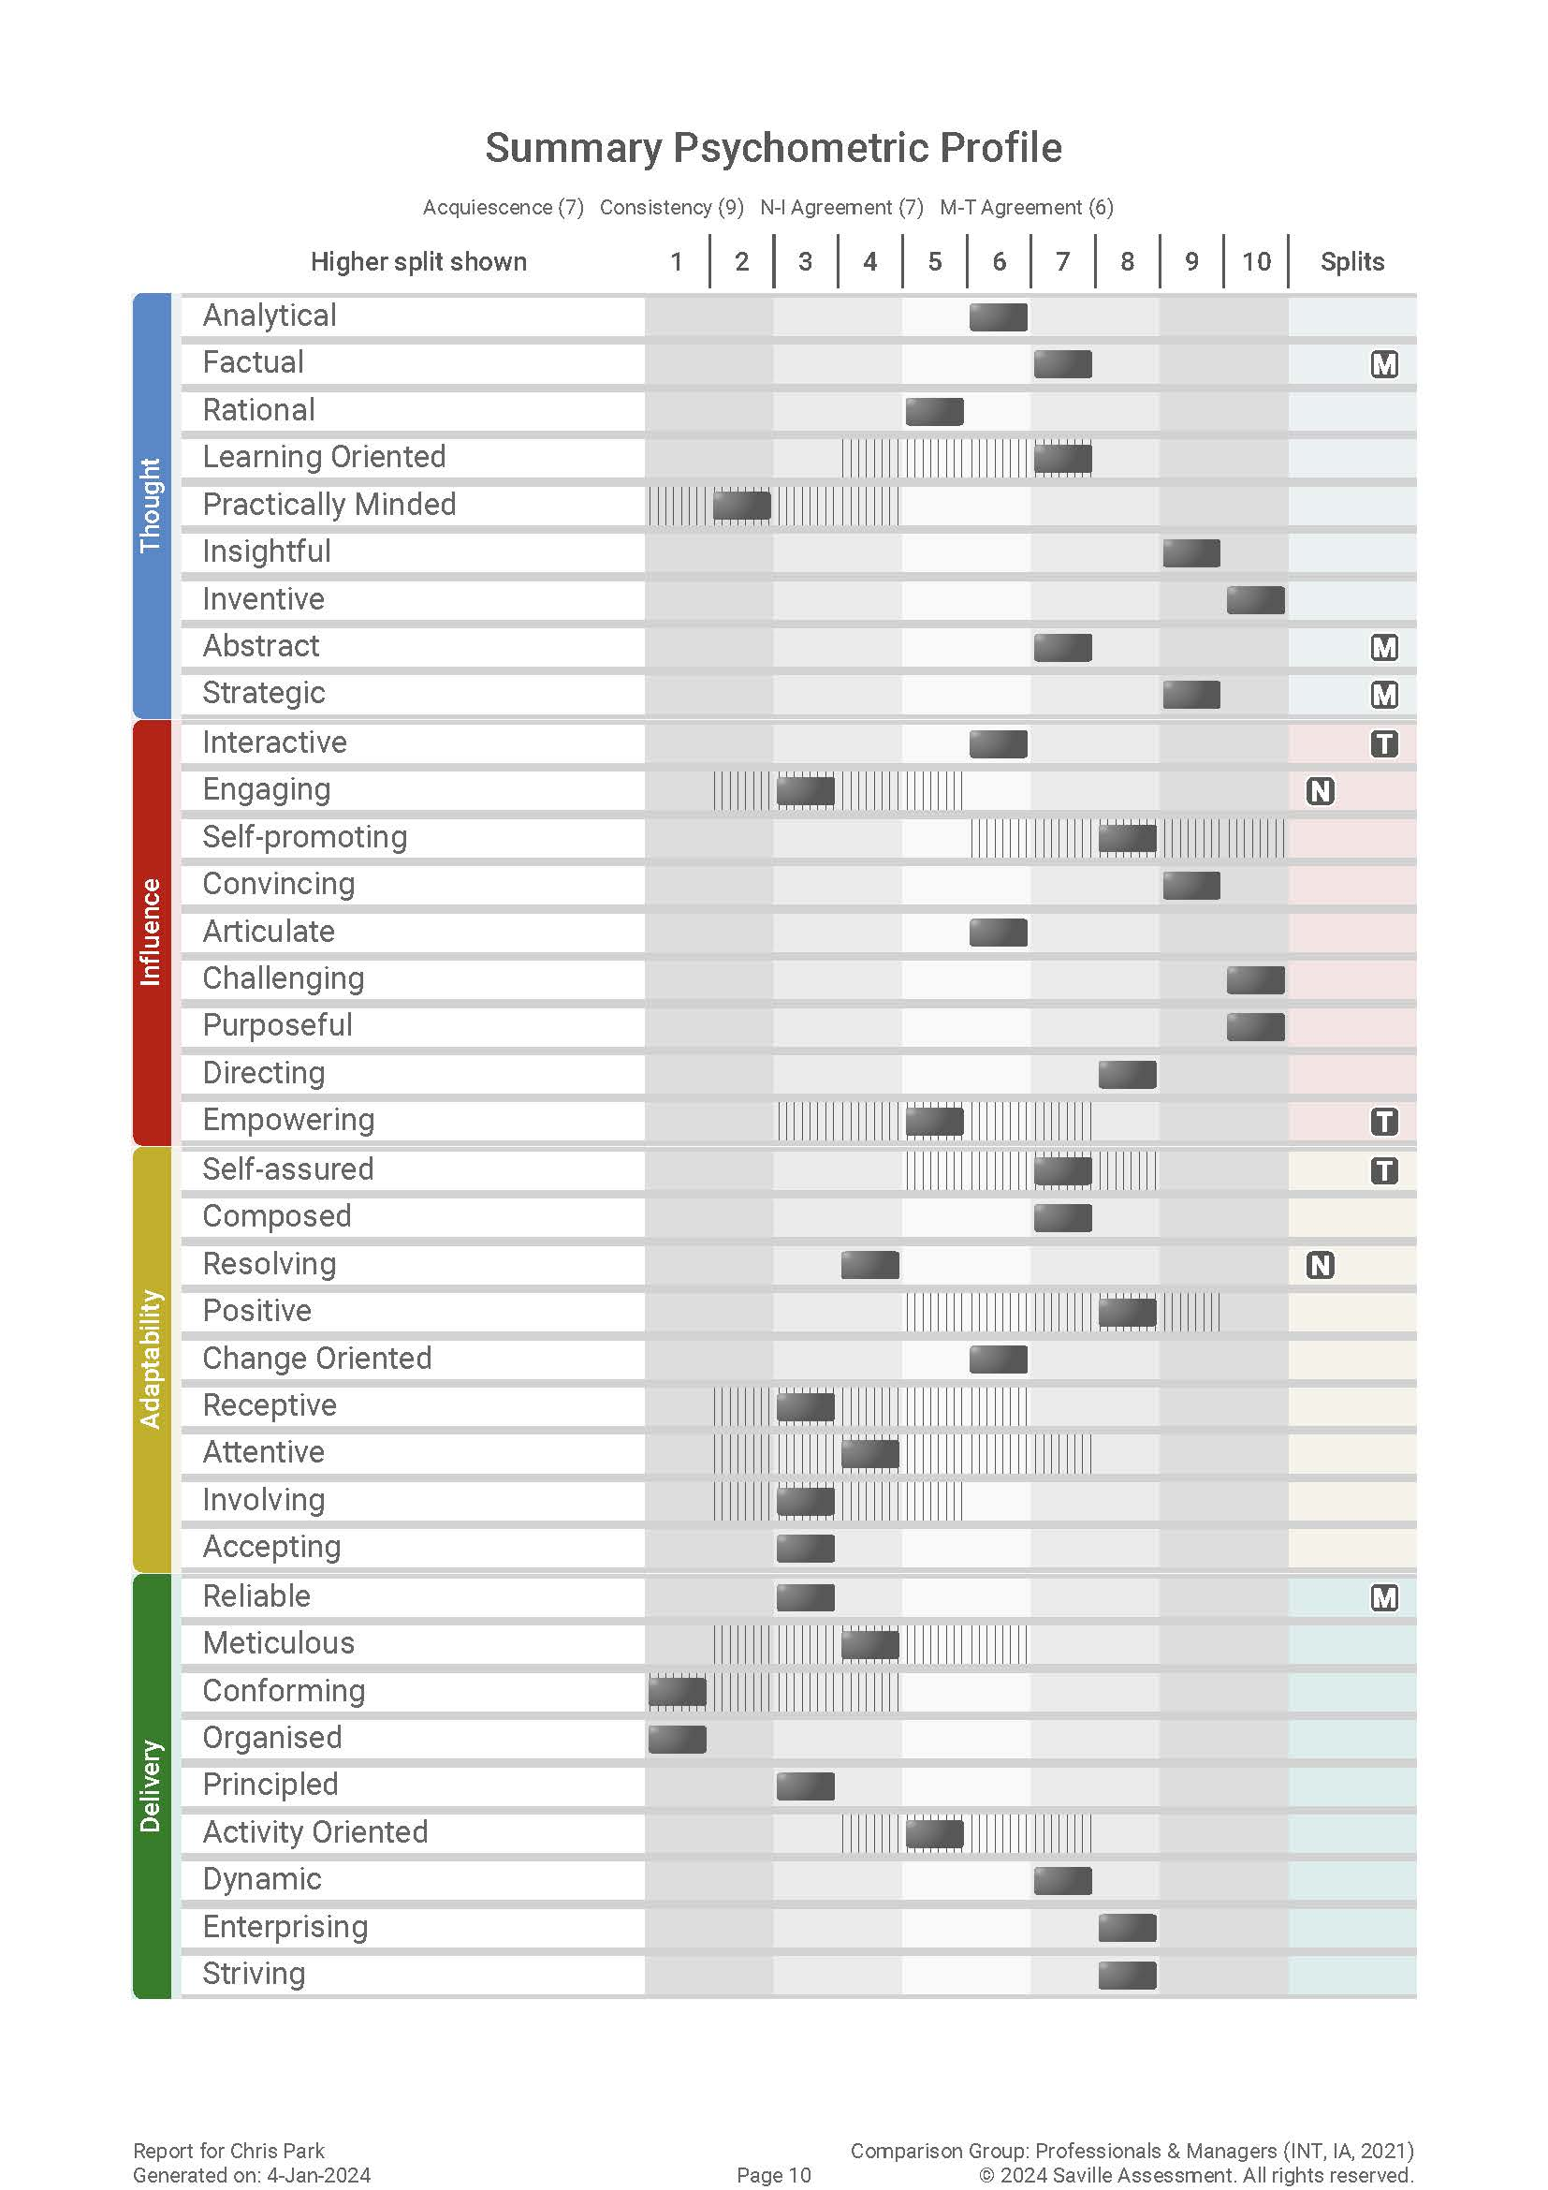

Slide 78
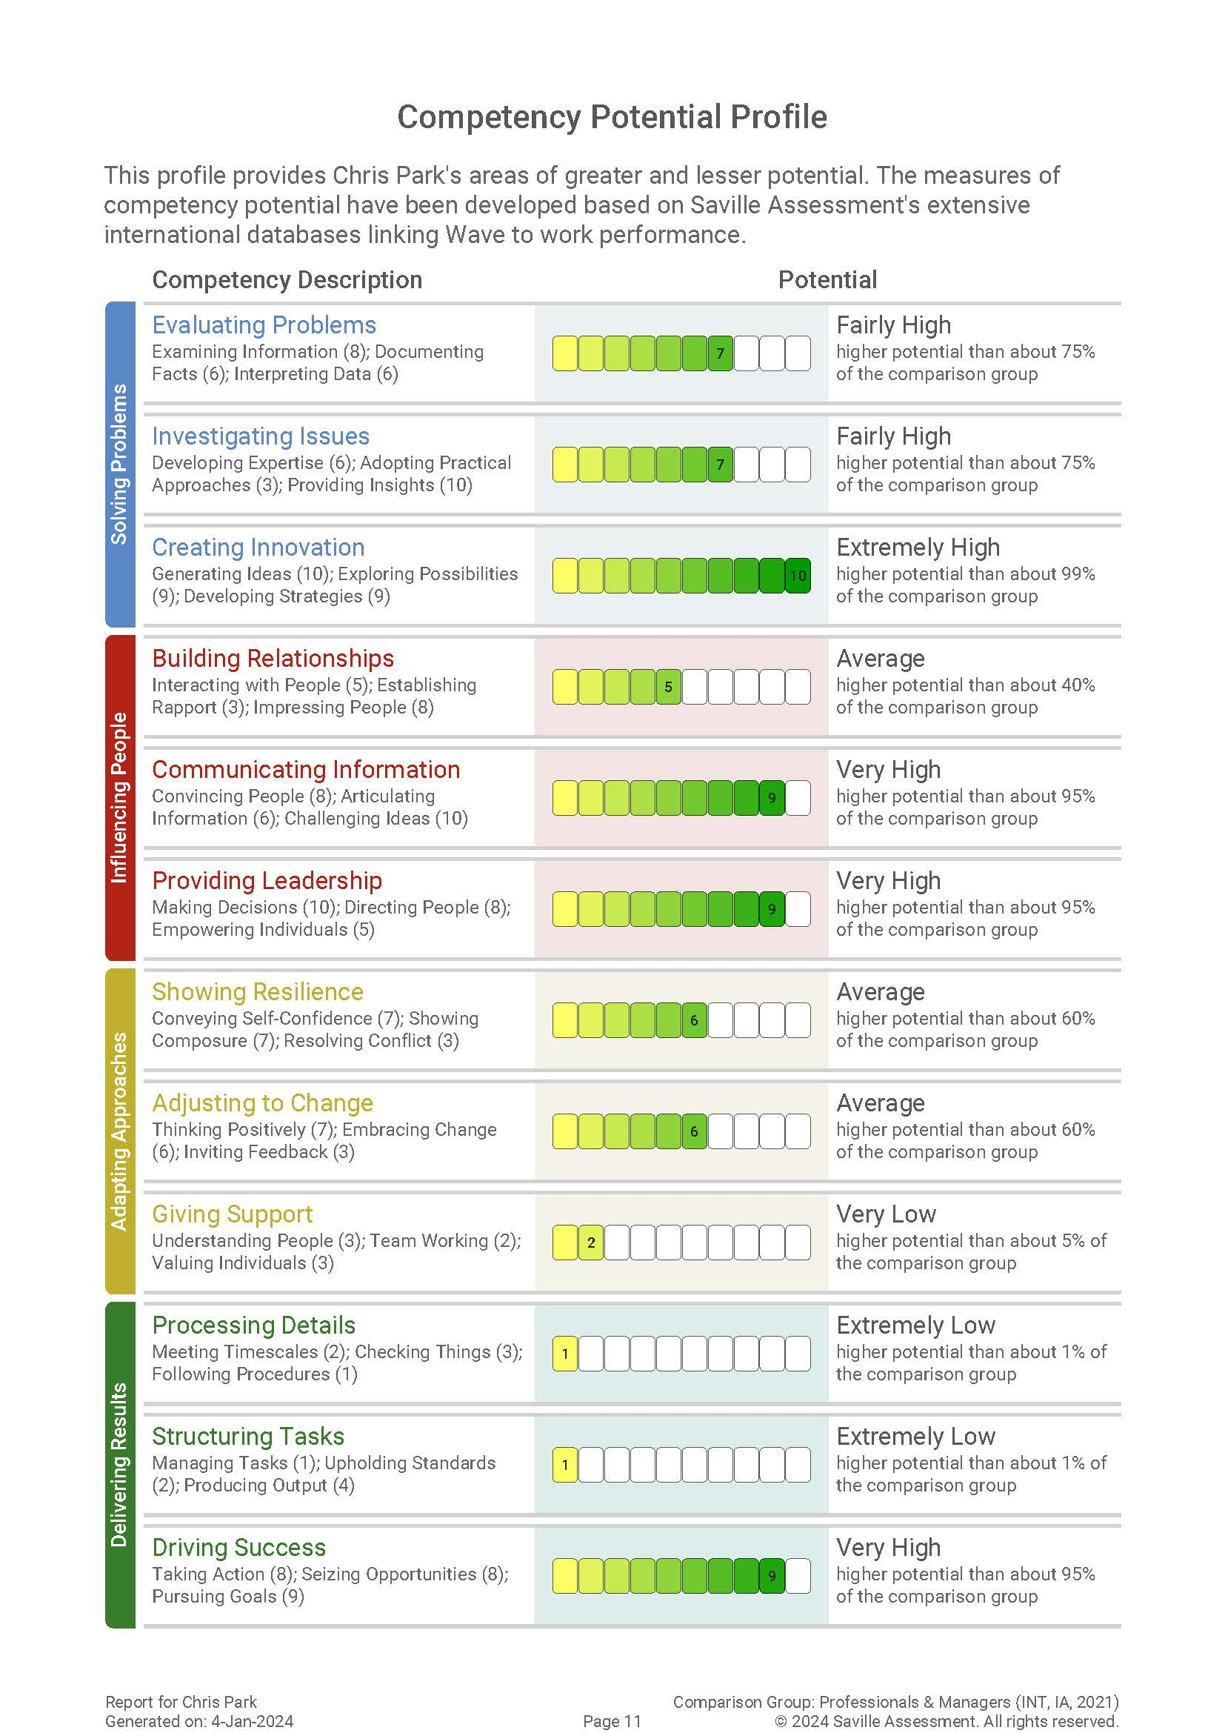
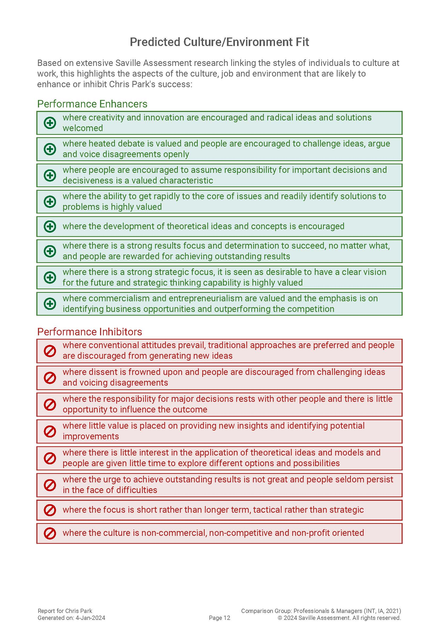

Slide 79
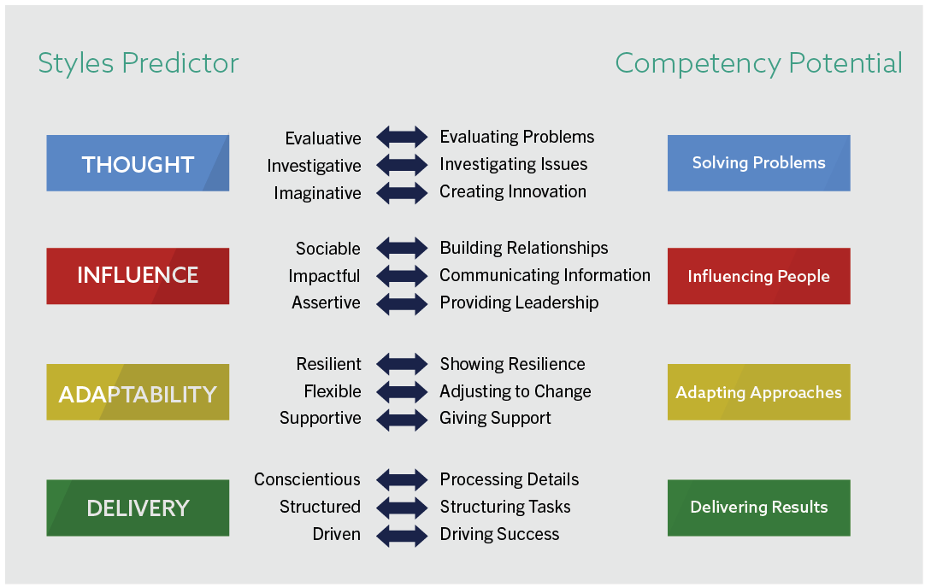
Saville Assessment Aligned Model

Slide 80
Example of Competency Potential Equation
For example;
Identifying Business Opportunities =
Business Opportunity Oriented facet x 21
+ Leadership Oriented facet x 4
+ Deciding on Action facet x 3
+ Action Oriented facet x 2
+ Visionary facet x 1

Slide 81
Module 6
Feedback of Wave

Slide 82
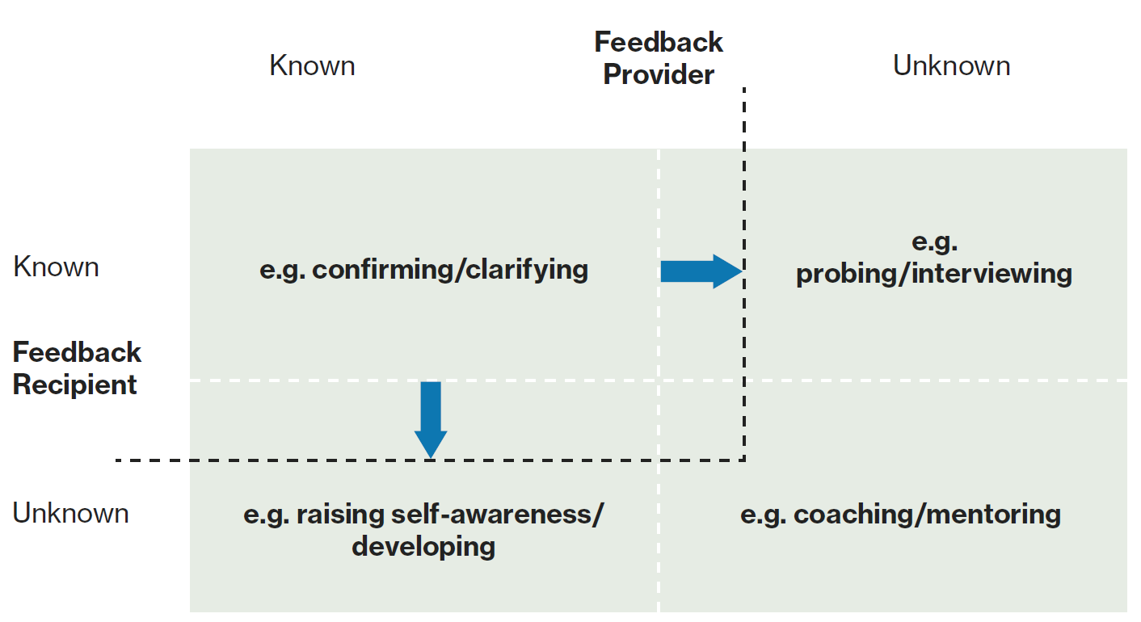
The Johari Window

Slide 83
Feedback Process
Setting the scene
Explain how Wave works
Response Summary
Feedback the profile
Summarize
Discuss Deep Dives
Ask questions
Make links
Notes:
​

Slide 84
Self-Report: Whose Data Is It?
The following self-report phrases are useful for introducing dimensions and facets:
Avoid
“The report says…”
“You are…”
“You’re higher than the norm on...”
“You scored…”
“You describe yourself as…”
“You see yourself as…”
“Your responses suggest that…”

Slide 85
Sten Score Descriptors

Slide 86
Breaking Down the Deep Dives
Empowering
Sten 8
Is good at finding ways to motivate people (7); very inspirational (9); reasonably encouraging to others (6)
Typical Approach
Dimension
Facets & facet range – explain and explore
Motive-talent split – explain and explore
Normative-ipsative split – explain and explore
Notes:
Workbook page 64

Slide 87
How would you interpret the overall Sten marker?
You are more empowering than others
Your responses suggest that you see yourself as more likely to be empowering than others in the comparison group
You are good at finding ways to motivate people, very inspirational and reasonably encouraging to others
The report says you are slightly more empowering than most others in the comparison group
Empowering
Sten 8
Is good at finding ways to motivate people (7); very inspirational (9); reasonably encouraging to others (6)
87

Slide 88
Which one of the statements best describes this individual's Facet Range?
There is a large spread between Dimension scores
They have been inconsistent in their responses to Empowering
There is a spread in responses to Empowering where they see themselves as very inspirational and reasonably encouraging to others
Empowering
Sten 8
Is good at finding ways to motivate people (7); very inspirational (9); reasonably encouraging to others (6)
88

Slide 89
Which statement provides the best interpretation for the Motive-Talent split?
Their perceived interest and effectiveness at Empowering are well aligned
They perceive themselves to be as effective as most at Empowering others but have much more motivation in this area
They perceive themselves to be very effective at being Empowering but have a typical level of interest in this area
Empowering
Sten 8
Is good at finding ways to motivate people (7); very inspirational (9); reasonably encouraging to others (6)
89

Slide 90
Which statement best describes what the N-I split suggests?
The individual has not answered the questionnaire honestly
Initially, the individual has indicated that they are much more empowering than most, however when they were forced to prioritize, they deprioritized Empowering and indicated they are as focused on Empowering as others
When the individual is free to act, they see themselves as being as Empowering as others in the comparison group, however, when the individual is under pressure, they are much more Empowering than others
Empowering
Sten 8
Is good at finding ways to motivate people (7); very inspirational (9); reasonably encouraging to others (6)
90

Slide 91
Wave Deep Dives Video

Slide 92
I keep six honest serving men (They taught me all I knew); Their names are What and Why and When and How and Where and Who.
From ‘The Elephant’s Child’ by Rudyard Kipling

Slide 93
Useful Open Questions for Feedback Sessions
“How does that sound to you?”
“How important is that area for your current role?”
“When are you more likely to do this at work?”
“Why is that important to you?” – Be sensitive!
“What impact does that style have on your performance at work?”
“What are the advantages/disadvantages of that particular style?”
“Where has this been most successful?”
“Give me an example of when you have demonstrated those behaviors recently.”
"How easy/difficult do you find it to (e.g. resolve conflict)?"

Slide 94
‘Watch-Fors’ and the Barnum Effect
A potential risk of over-reliance on non-empirical forms of validity (e.g. face and faith) is that individuals end up accepting feedback which doesn’t offer any value in predicting work performance.
When people accept general truisms that apply to most people as accurate portrayals of their own uniqueness, this is typically known as the Barnum Effect.

Slide 95
Feedback tips
Most Effective Feedback
Less Effective Feedback
Prepare
Keep the conversation two-way
Be sensitive and empathic; be objective with the profile
Actively listen and summarize
Describe behaviours, not scores or numbers
Use the Wave feedback help sheet
Use self-report language throughout, for example, “your responses suggest…”
Making assumptions
Using technical jargon
Value judgments
Barnum statements: The Barnum Effect is where individuals accept general truisms as accurate portrayals of their own uniqueness

Slide 96
Practical Session: Wave Feedback
You have the report of another delegate. Please prepare a feedback session including:
An introduction
Response Summary
One Cluster
Please keep all data secure and confidential.
Notes:
Break into groups/pairs for feedback

Slide 97
Feedback Process
Setting the scene
Explain how Wave works
Response Summary
Feedback the profile
Summarize
Discuss Deep Dives
Ask questions
Make links
Notes:
​

Slide 98
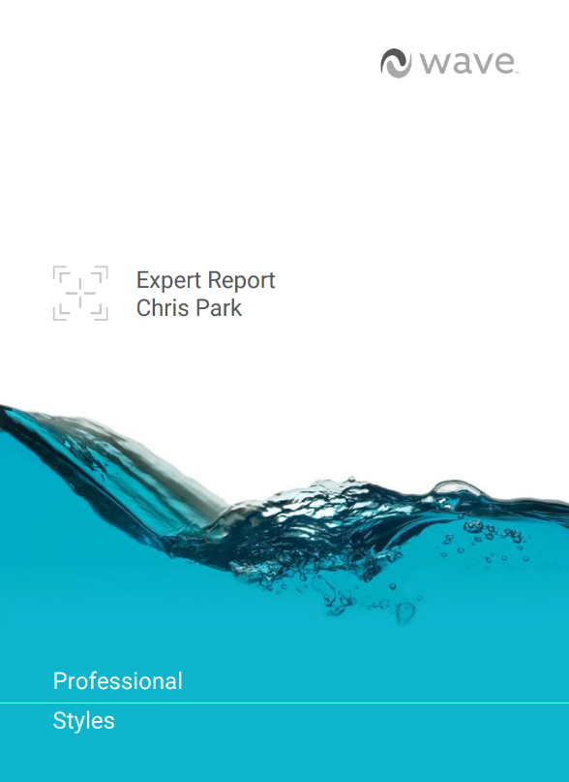
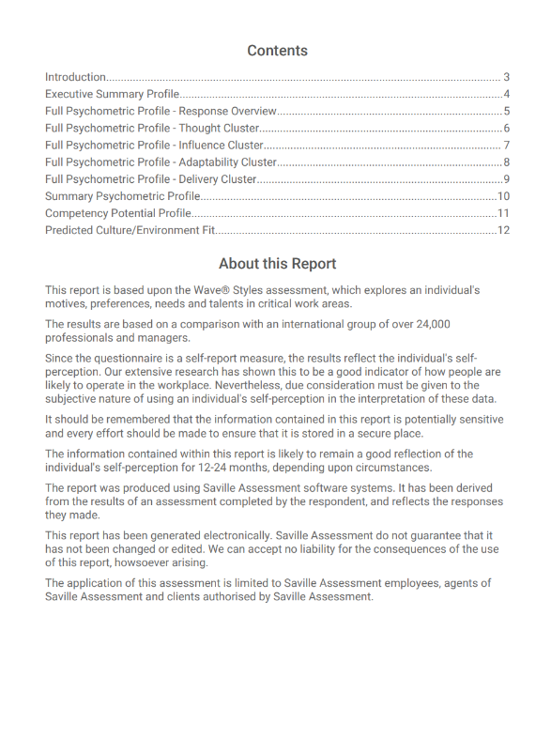

Slide 99
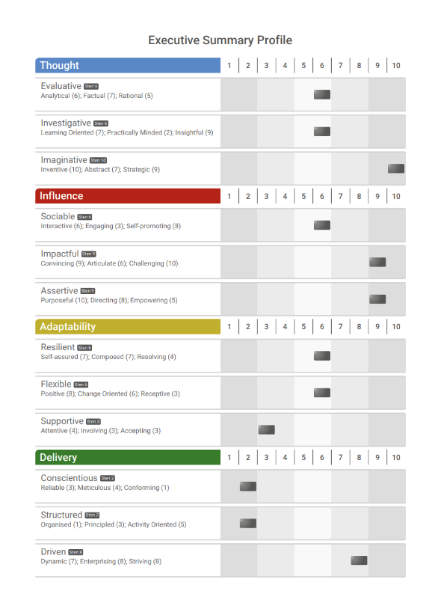
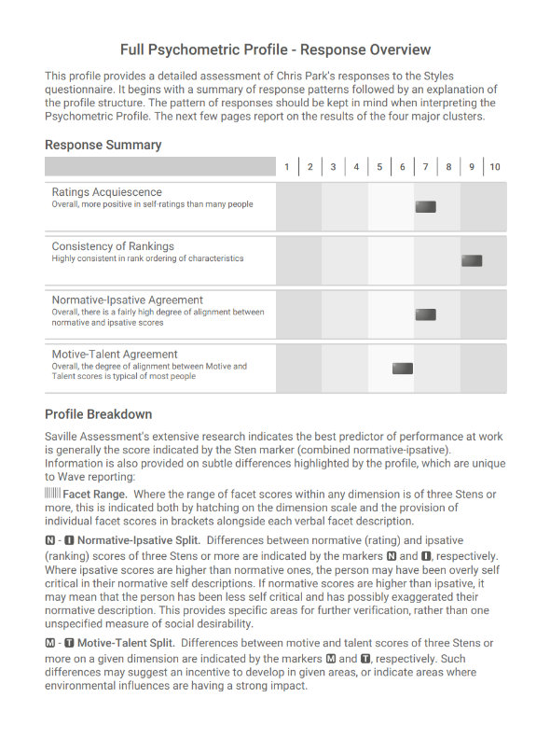

Slide 100
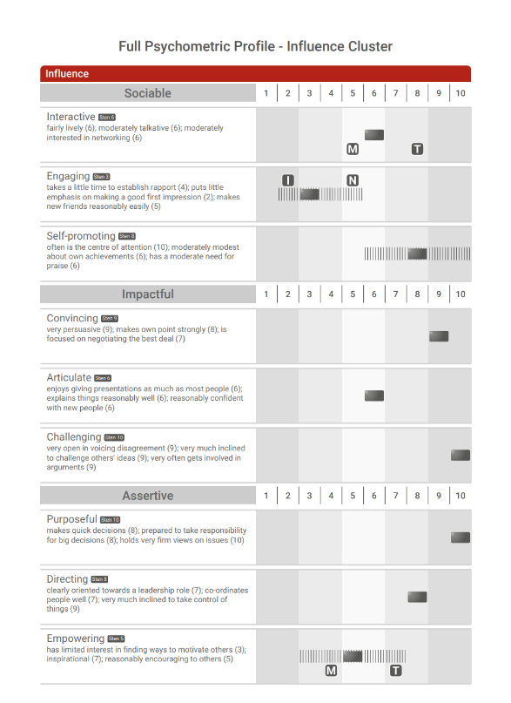

Slide 101
Practical Session: Feedback
Feedback Provider | Feedback Receiver
Ana (Influence Cluster) | Nancy
Nancy (Influence Cluster) | Ana
Tutor: Lucy | Tutor: Nikki
Feedback Provider | Feedback Receiver
Caragh (Influence Cluster) | Ana Cassinelli
Ana Cassinelli (Adaptability Cluster) | Caragh
Tutor: Karen and Camille
Notes:
Share feedback report
Split into groups / pairs and use sample reports A-D (same as old reports)

Slide 102
Practical Session: Feedback
Feedback Provider | Feedback Receiver | Cluster
Tutor:
Feedback Provider | Feedback Receiver | Cluster
Tutor: | Tutor: Nikki | Tutor: Nikki
Feedback Provider | Feedback Receiver | Cluster
Tutor:
Feedback Provider | Feedback Receiver | Cluster
Tutor:
Notes:
Share feedback report
Split into groups / pairs and use sample reports A-D (same as old reports)

Slide 103
Module 7
Focus Styles

Slide 104
A Need to Focus
Maintains exceptional validity (80% of Professional Styles)
Lighter touch - quick to complete (13 mins)
Keeps the unique features of Wave Professional Styles
Suitable for multiple applications
(Hire, Build, Lead)

Slide 105
Wave Focus Styles
INFLUENCE
4 CLUSTERS
Sociable
Impactful
Assertive
12 SECTIONS
NO NEED FOR DIMENSIONS!
Persuasive
Presentation Oriented
Prepared to Disagree
36 FACETS

Slide 106
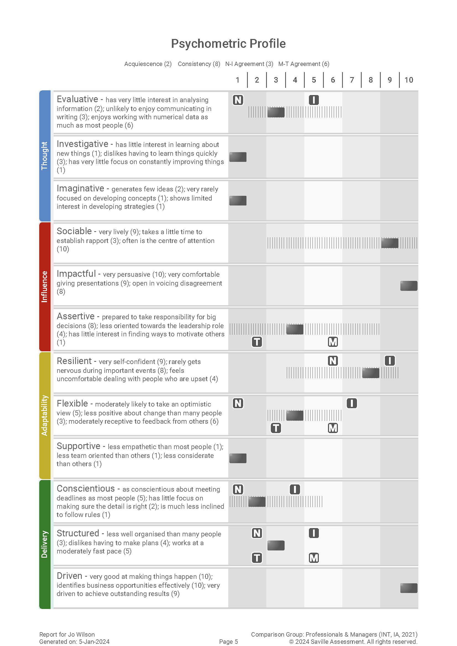
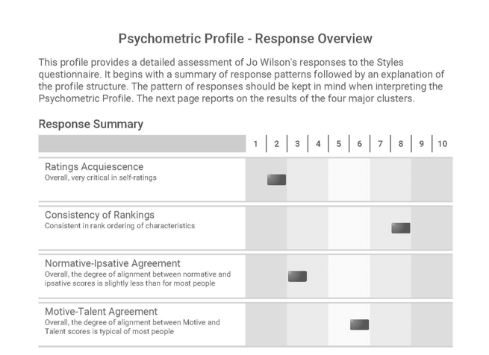
Focus Styles Expert Report

Slide 107
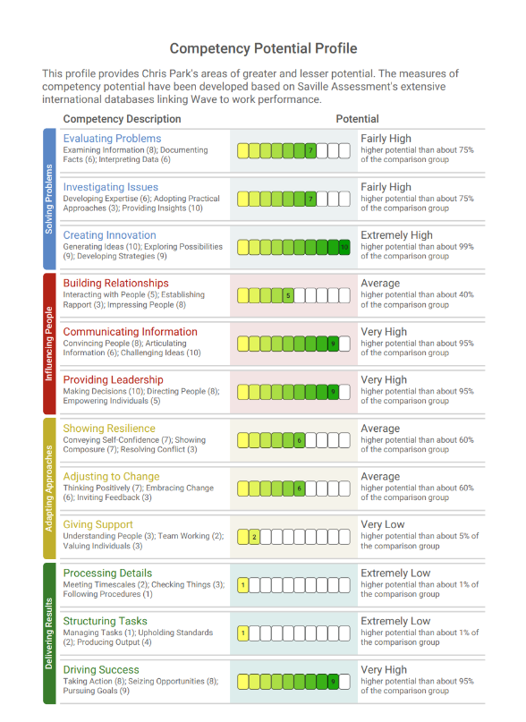
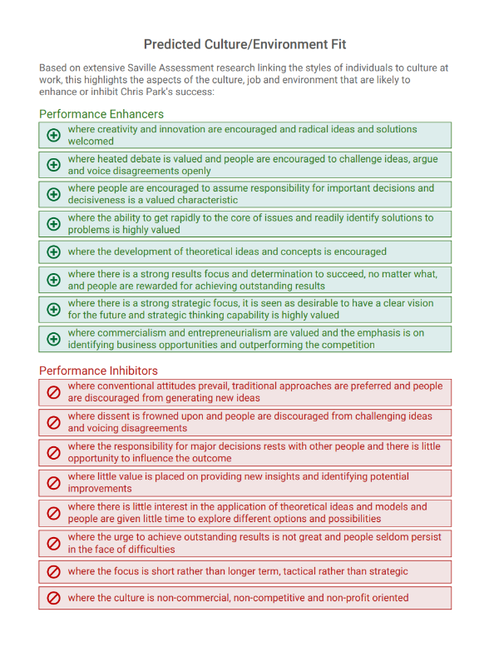

Slide 108
Practical session:
Focus Styles feedback
Wave feedback
You have the report of another delegate. Please prepare a feedback session including:
An introduction
Response Summary
All the clusters – if you don’t get through everything in the allotted time don’t worry; we’re aiming for depth not breadth
Please keep all data secure and confidential.
Notes:
Break into groups/pairs for feedback

Slide 109
Feedback Process
Setting the scene
Explain how Wave works
Response Summary
Feedback the profile
Summarize
Discuss Deep Dives
Ask questions
Make links
Notes:
​

Slide 110
Module 8
Applications of Wave

Slide 111
General Process
Job analysis to identify role requirements, e.g. select report and norm group
Prepare candidates and administer Wave
Interpret results
Use results to inform process/feedback

Slide 112
Job Analysis
Profiling Requirements
Prior to using Wave it is important to understand the role requirements so that you can select the appropriate report and norm group, and focus on relevant behaviors.
Which behaviors are critical to success, and what is their relative importance?

Slide 113
For What Purpose Are You Using Wave?
Hire Talent
Professional Styles
Expert Report
Interview Guide
Focus Styles
Expert Report
Job Profiler
AC
Assessment Centers
Line Manager Report
Sales Reports
Personal Report
Onboarding Report
Notes:
Workbook page 77

Slide 114
For What Purpose Are You Using Wave?
Build Talent
Professional Styles
Expert Report
Performance 360 Report
Resilient Agility Report
Focus Styles
Expert Report
Work Roles Report
DC
Development Centers
Coaching Report
Sales Reports
Personal Report
Development Report
Onboarding Report
Career Guidance Report
Notes:
Workbook page 77

Slide 115
For What Purpose Are You Using Wave?
Lead Talent
Professional Styles
Expert Report
Leadership Risk Report
Performance 360 Report
Leadership Impact 360 Report
AC
Assessment Centers
Entrepreneurial Report
Leadership Impact Reports
DC
Development Centers
Notes:
Workbook page 77

Slide 116
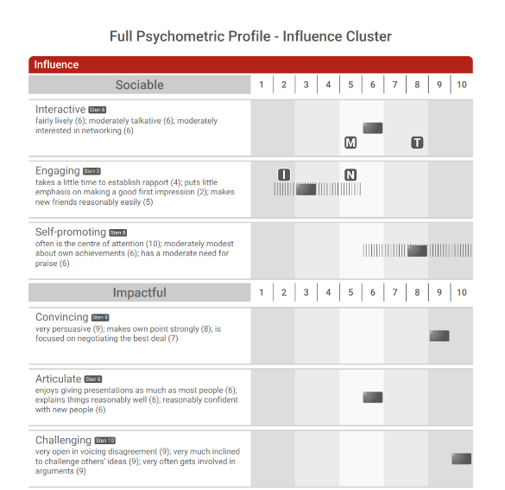
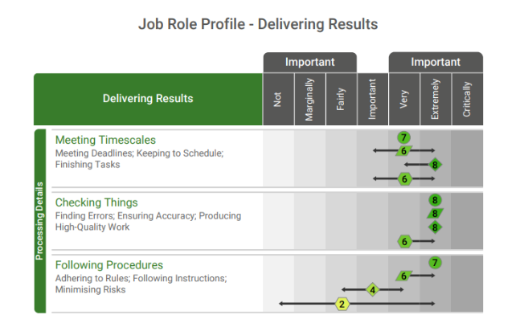
Hire Talent
Profile Requirements
Hire for Experience

Slide 117
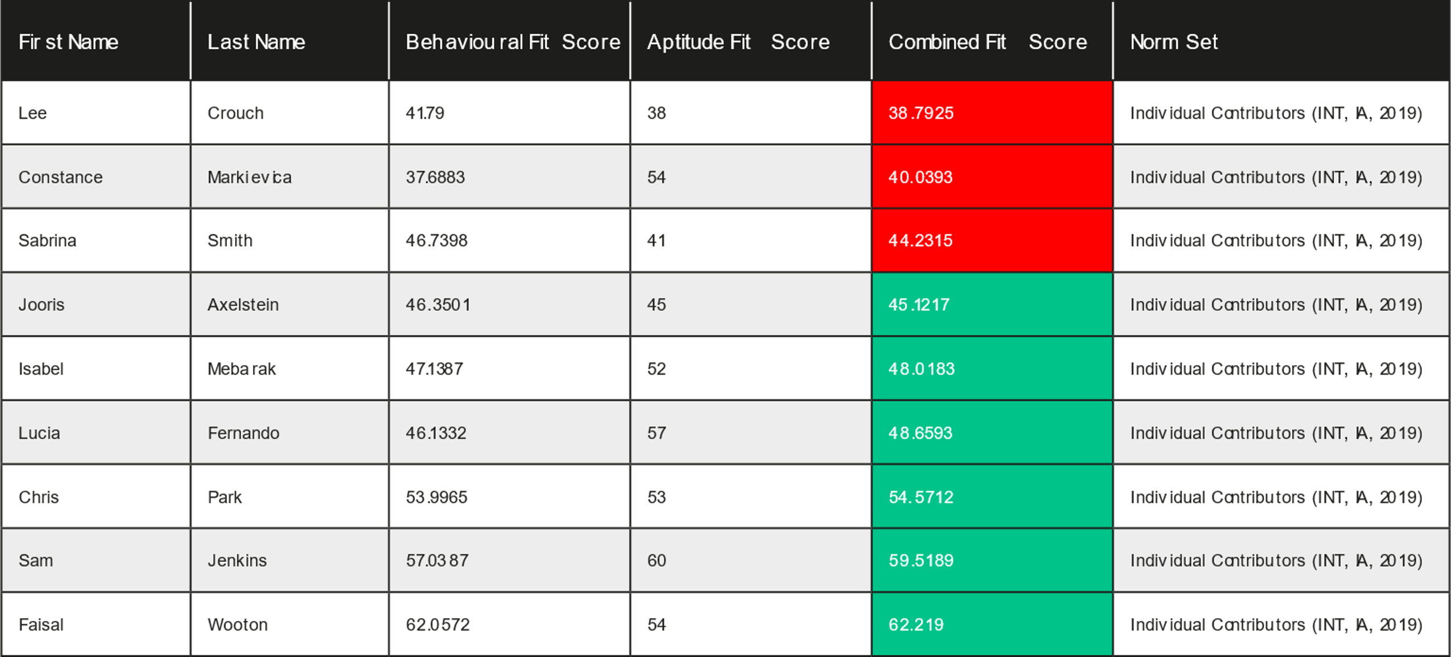
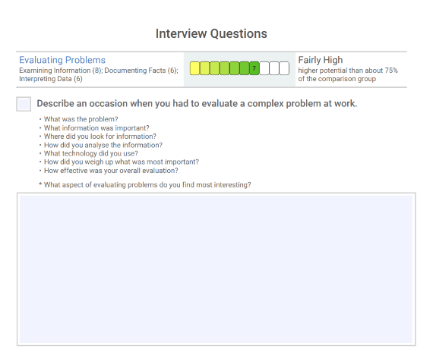
Hire Talent
Screen Volumes
Interview Candidates

Slide 118
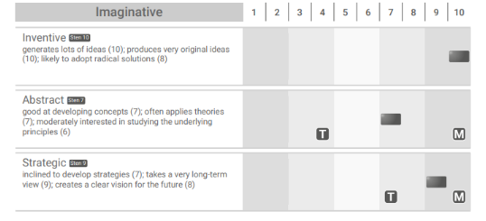
Build Talent
Audit Talent
Onboard

Slide 119
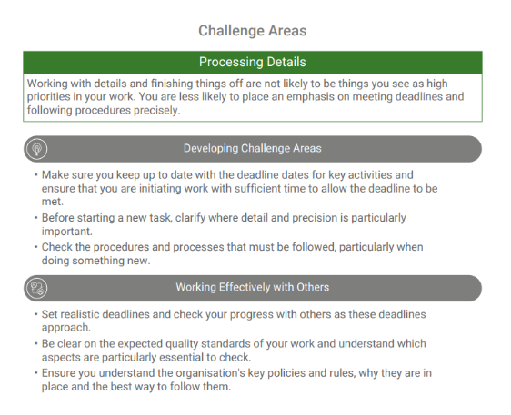
Build Talent
Coaching
Building Resilient Agility

Slide 120
Build Talent
Drive Team Effectiveness
Develop People

Slide 121
Lead Talent
Leadership Impact
Explores how individuals lead others
Bridges the gap between behaviours and leadership outcomes
Identifies where leaders are likely to create the most impact and achieve associated results
Includes deep dives

Slide 122
Lead Talent
Leadership Risk
Applications and uses:
To assess leadership development pipelines and focus development around potential risk behaviors
To understand the potential risks in relation to the impact on the culture, the organization or the leader themselves
Where an organization is wanting to build leadership capability
To assess overall strategic risk across a leadership population
To facilitate change management through risk assessment of senior managers and executives

Slide 123
Other Role-Specific Reports

Slide 124
Why Create Custom Reports?
Harnessing the exceptional validity of the Wave framework
Wave designed to measure other models well in detail
Reporting against your model, e.g. competencies or values
We customize different types of reports (Professional Styles, Focus Styles & Work Strengths), e.g.
Expert & Line Manager
Development Report
Interview Guide
Onboarding Report
We have created over 300 custom reports

Slide 125
Prepare Candidates and Administer Wave
Unproctored Online Administration:
Invite candidates to complete the assessment (include checking for any reasonable adjustment requirements and any anticipated problems completing the questionnaire)
Ensure candidates have access to preparation materials
Ensure candidates have internet access and an email address
Inform candidate of next steps, e.g. when they will receive feedback
In some circumstances administration can be done under supervised conditions which requires a trained test administrator to be present

Slide 126
Interpretation
Interpretation should be objective
Be clear what matters, e.g. critical behaviors and purpose of assessment
Consistency matters, e.g. across test users
Information from questionnaires should be integrated appropriately with other relevant assessment data
Do group differences exist which are meaningful for interpretation?

Slide 127
Group Differences
Virtually all assessment methods, including personality questionnaires, have historically tended to show some differences between groups.
Wave shows no large differences and very few small to moderate differences in any group (age/gender/ethnicity).
From our data of the 36 Styles dimensions;
Only Rational shows a moderate gender difference – males score approx. 1 Sten higher than females (females are slightly higher on Attentive and Activity Oriented).
Learning Oriented, Self-assured, Striving, Receptive, Conforming – Black group scored approx. 1 Sten higher than White group (moderate difference).
Activity Oriented – White and Asian groups scored approx. 1 sten higher than Black group (moderate difference).
Sampling effects should be considered as the most likely primary reason for the majority of group differences.
NB: Full fairness data can be found in the Wave Professional Styles Handbook

Slide 128
Ethical Considerations for Using Wave
Equal opportunities legislation
Training requirements
Respect for the individual and the instrument
Data protection and privacy
Assessment use policy
e.g. data should be used only for the purposes collected unless explicit consent is given by the individual

Slide 129
Module 9
Reliability & Validity

Slide 130
Reliability and Validity
Workbook page 91
Reliability
Validity
is about getting the TEST RIGHT – consistent and precise
is about getting the RIGHT TEST – related to its intended purpose
Notes:
Reliability: How consistently and precisely an assessment measures a characteristic.
accuracy and consistency - .7
Validity: Related to the relevance and predictive power of an assessment.
relevance and predictive power - .3

Slide 131
Reliability
Nothing can be measured with absolute accuracy
A test’s reliability concerns the precision and consistency of measurement
The more error in test scores the lower the reliability
Generally, the longer the test the greater the reliability
NB: Use total scores on Swift tests for decision making
Reliability is a prerequisite for Validity

Slide 132
Potential Sources of Error in Self-Report
Individual
Administrator
Test Developer

Slide 133
Methods of Assessing Reliability
Test-Retest – administering the same test twice
Alternate Form – administering two parallel forms
Internal Consistency – administering only 1 test once
+
Gives indication that attribute is stable
-
Candidates not willing to do it twice
+
Shows developer is clear/consistent on what is measured
-
Has the expense of developing two forms
+
Easy to do as only requires one test on one occasion
-
Can be misleadingly high with repetitive item content
Notes:
Test-retest
- Attribute is stable
- hard to get because candidate might not be willing to do it twice –
- wave .75
Alternate/ Parallel
- two versions of the same assessment are closely related (think of PS and FS)
- clear and consistent in terms of what is measured
- cost of having two versions to compare
- wave .86
Internal consistency
- internal correlations of measures in a questionnaire – how well the questions in one scale are related
If items are repetitive the correlations could look really really high but not actually demonstrate good underlying relationship
- Wave .74

Slide 134
Wave Professional Styles Reliability
Test-Retest Reliability
Dimension mean .75 (range from .58 to .85)
N = 100
Alternate Form Reliability
Dimension mean .86 (range from .78 to .93)
N = 1,153
Internal Consistency Reliability
Dimension mean .74 (range from .58 to .86)
N = 1,153

Slide 135
Aspects of Validity in Self-Report
Workbook page 94
Face Validity: | do the questions ‘look right’ i.e. appear to be appropriate/job-relevant? And do the reports ‘look right’?
Content Validity: | the extent to which the questions are actually focused on job-relevant content.
Consequential Validity: | the intended and unintended consequences of using a questionnaire.
Construct Validity: | different forms of evidence that demonstrates a questionnaire measures the expected underlying construct, trait or theory.
Faith Validity: | an unfounded belief that a questionnaire is appropriate, i.e. in the absence of evidence.
Criterion-related Validity: | evidence that the questionnaire predicts relevant criteria (e.g. competencies).
Notes:
Face and Faith
Content: Focusing on relevant content (i.e. job and work-related)
Construct: Measures expected underlying value such as a trait or theory
(for example a beahvioural measure aimed at building relationships shouldn’t be more focused on anything else)
Consequential: consequences of using the assessment – do no harm, appropriate for promotion decision, etc.
Criterion: - does the questionnaire predict a particular criterion? E.g. job competency

Slide 136
The Wave Model: Validity
Performance Driven
Dynamic Rating Format
Questions were selected on the basis of how well each facet (motive and talent) correlated with overall performance and potential.
By enabling a dual dynamic rating format (‘ra-ra’) it is possible to further improve the validity.
Predictive Competencies
Project Epsom
Competencies and self-report questions which were less correlated with overall performance were dropped.
A large sample of participants (N=308) validated the Wave model, alongside other popular personality questionnaires.
Notes:
Designed with validity in mind, from the start – items written and selected to predict overall working performance
Rate/Rank – helps minimise distortion – makes profiles more reflective of people’s typical behaviour
Only the most predictive competencies were kept, those giving less prediction about performance were less useful so we didn’t keep them in
Epsom – looking at constructs of existing assessments – more information in your workbooks

Slide 137
Validity of Different Selection Techniques
Notes:
Based on our own data as well as meta-analyses
When you are building a selection process/ ac make sure you’re using the methods which will give you most value – what’s going to be giving the information you really need?

Slide 138
The Wave Model
Validity
Notes:
Anything over .3 is giving good prediction about performance, so all of these tools are good

Slide 139
Validity? So What?
0 Validity – 1 person in 5 will be a poor performer
Questionnaires with the highest validity increase the chance of selecting the best performers at work and considerably reduce selection errors
Moving from recruiting using a questionnaire with a validity of +0.3 to using a questionnaire with a validity of +0.6 can double the cost benefit to an organization
This can also reduce the number of serious selection errors five-fold
0.3 Validity – 1 person in 10 will be a poor performer
0.6 Validity – 1 person in 50 will be a poor performer
Notes:
Page 140
The greater your validity, the greater the benefit to the organization as you get more test utility or return on investment.
The greater your validity, the smaller the risk of a wrong hire, the more accurate your selection process is of hiring the right person - so the return on investment is massive

Slide 140
Return on Investment
Saville Assessment ROI Model
Notes:
Our ROI model – using rigorous, robust assessment means you’re giving candidates a Quality experience and helping engagement whilst getting what you need from the selection methods too. You can reliability screen out less suitable candidates and select in those who will support the organisation best.
Consider the cost of a poor hire, needing to go out to recruit again, administrator time and resource
Standarised, objective, less room for subjectivity and bias which could unfairly impact different groups – genders, ages, ethnicities, etc.

Slide 141
Module 10
Selection Case Study

Slide 142
Case Study: Selection
Workbook page 103
Business Development Manager: Job Analysis
Refer back to the Job Analysis section (page 13) of your workbook and note down the five behavioral competencies you identified as critical for the Business Development Manager Role
You will be carrying out a competency-based interview focusing on these competencies as part of the next stage of the selection process.

Slide 143
Case Study: Job Analysis
‘Hire’ Card Deck – Behavioural Sections
Notes:
Encourage trainees to discuss these 12 Wave Sections in relation to the role
The goal is to choose 4 Sections as critically important, these do not need to be split across the 4 Clusters/colors
All Sections are positively worded, making them all sound desirable, try to think of which behaviors a person could not do the job without

Slide 144
Saville Assessment Aligned Model
Notes:
Encourage trainees to discuss these 12 Wave Sections in relation to the role
The goal is to choose 4 Sections as critically important, these do not need to be split across the 4 Clusters/colors
All Sections are positively worded, making them all sound desirable, try to think of which behaviors a person could not do the job without

Slide 145
Case Study: Selection
Workbook page 104
Business Development Manager: Candidate Evaluation
Evaluate Sam’s potential strengths, areas of concern, and areas you would wish to probe further against the elements identified in Task One, using Sam’s Wave Professional Styles Expert Report to guide you.
You should refer to specific aspects of the Wave Professional Styles Expert Report in your summary (e.g. Psychometric Profile, Competency Potential Profile and Predicted Culture/Environment Fit Profile).
Sam’s report is on pages 107 - 118 in your workbook.

Slide 146
Case Study: Selection
Workbook page 119
Business Development Manager: Interview Question Generation
Generate a set of competency-based questions that will be used to probe Sam Jenkins during the interview stage, against the five key competency areas.
Aim to produce one question per competency.
Example competency-based questions from the Interview Guide can be found on page 120.

Slide 147
Module 11
Development Case Study

Slide 148
Case Study: Development
Workbook page 121 – Stage 1
Business Development Manager: Development
Now that Sam has been in the role for one year, the team are looking for ways to work more effectively together.
Which areas of strength could Sam build on or use to greater effect?
Which areas of improvement would be most likely to have the greatest impact on Sam’s performance?
Which areas may Sam be potentially overplaying and what is the potential impact on performance?
You should refer to specific aspects of the Wave Focus Styles Expert Report in your summary (e.g. Psychometric Profile, Competency Potential Profile and Predicted Culture/Environment Fit Profile).
Sam’s report is on pages 123 - 129 in your workbook.

Slide 149
Case Study: Development
Workbook page 130 – Stage 2
Business Development Manager: Work Role
The e-Learning Account Management team have been working together for a year now. Tradigital have asked you to conduct a Team Effectiveness Workshop to discuss how the team are working together.
Review Sam’s Work Roles Report and the group profile, and answer the following questions:
How do Sam’s work roles complement the team and vice versa?
What are the potential gaps in terms of roles within the team?
What actions would help Sam and the team work more effectively together?
Sam’s report is on pages 133 - 141 in your workbook

Slide 150
Next Steps

Slide 151
Next steps
Contact our Duty Consultant for additional support
Call: +44 (0)208 619 9000 Email: expert@savilleassessment.com

Slide 152
Administering Tests: A Recap
No annual subscription fees to use tests
No separate administration, scoring or profiling fees
Administering via the Bureau
Complete a form – our Bureau team do the rest
Cost-effective for small numbers
Fast turnaround within two hours
Open 8am – 6pm UK time
Administering Using Oasys
One-off investment
Free training to use Oasys
Better value for larger numbers
You are in control of your own projects
Can be branded or non-branded
99.9% uptime
Notes:
Look at current price list for notes around pricing

Slide 153
The Saville Assessment Community
What you can expect:
Support from our duty consultant, bureau team and account managers
Opportunities for continued professional development
Invitations to webinars and practitioner masterclasses
Discussion on industry-specific news and topics
Networking opportunities with other professionals, including our series of Wave User Groups
Privileged offers
Access to our Client Resource Area
@savilleassess
@savilleassess
https://www.linkedin.com/company
/saville-assessment
www.facebook.com/SavilleAssess/

