Slide 1

Wave Performance 360
Accreditation Training

Slide 2


Introductions
Name
Role
Previous use of assessments
Which ones?
What did you use them for?
Likely applications of self/360 assessments
Interests for the course
Notes:
Perceptions of challenges from 360

Slide 3
Objectives
By the end of the course, you will be able to:
Understand the benefits, issues and risks in setting up a 360 project
Link 360 with other data sources
Understand the Saville Assessment Wave Performance Culture Framework
Facilitate feedback and discussion and action planning around 360 data, accurately and appropriately
Interpret the Saville Assessment Wave Performance 360 report accurately

Slide 4
About Saville Assessment
Open the door to your potential
Saville Assessment acquired by Tenzing
Founded by Professor Peter Saville
Swift combination tests launched
New tests, new technology
Leadership Impact and Risk launches
Swift Global launched
2004
2005
2007
2013
2015
2017
2019
2021
2022
2023
Wave launched
Situational judgment tests launched
Saville Assessment, A Willis Towers Watson Company
Match 6.5 launched
Wave-i launched
Notes:
You can talk through this slide to introduce Saville Assessment
Peter Saville was the ‘S’ from SHL if you are familiar with their assessments, after selling SHL, he chose to start again. This time he wanted to make use of technology to dive deeper and better predict workplace performance
Before Wave was launched, there was a two-year research program exploring which behaviors and preferences best predicted workplace performance in order to create a highly-valid assessment.

Slide 5
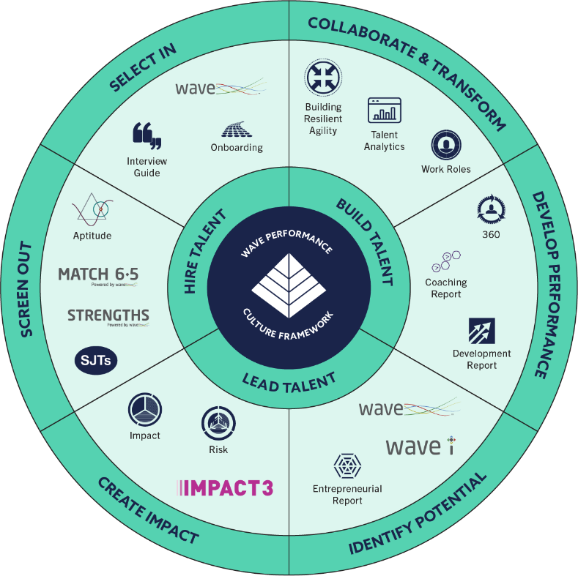
A fully integrated talent strategy

Slide 6
“The fact that we are talking the same language at onboarding and development means our approach to talent management is consistent and better aligned. This presents a powerful force for the business”
Regional HR Director
RICOH EUROPE

Slide 7
01
02
03
Introducing the Wave Performance Culture Framework
Introducing Wave Performance 360
Interpretation Exercise
04
05
06
Applying Wave Performance 360
Interpretation Exercise
Wave Performance 360 Report
07
08
09
Feedback of Wave Performance 360
Administration and Project Management
Leadership Impact 360

Slide 8
Introducing Wave Performance Culture Framework

Slide 9
Wave Performance Culture Framework
Extensively researched model of key characteristics underpinning success at work across different occupations
Encompasses elements of performance that validation evidence indicates as most important and predictive
The Framework is made up of Behaviour, Ability & Global areas, each built on a hierarchy of general areas breaking down into greater detail
Underpins all of Saville Assessment’s core products (Wave, Strengths, 360, Aptitude)

Slide 10




Saville Assessment B-A-G Framework
B
A
G
Behavior
Ability
Global

Slide 11
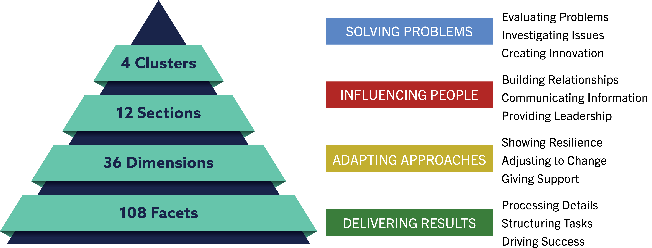
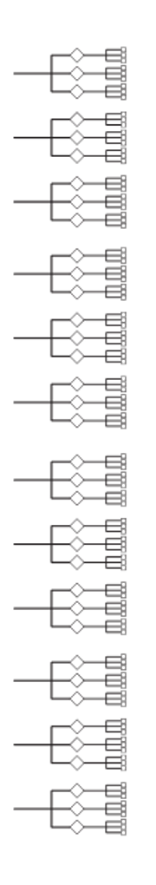
B-A-G Framework:
Behaviour Aspects

Slide 12
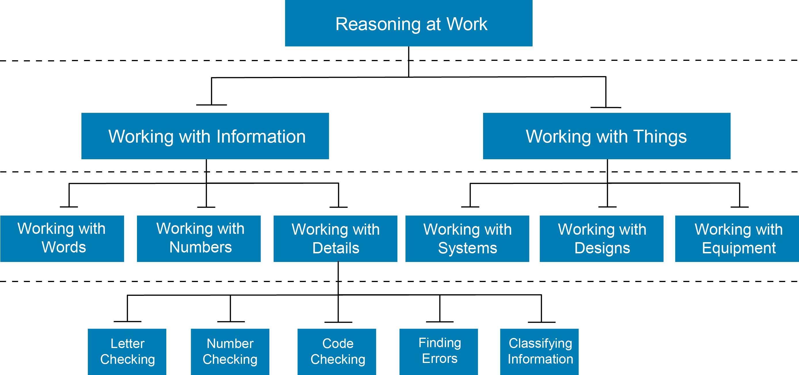
B-A-G Framework:
Ability Aspects
1 - Cluster
2 - Sections
6 - Dimensions
30 - Facets

Slide 13
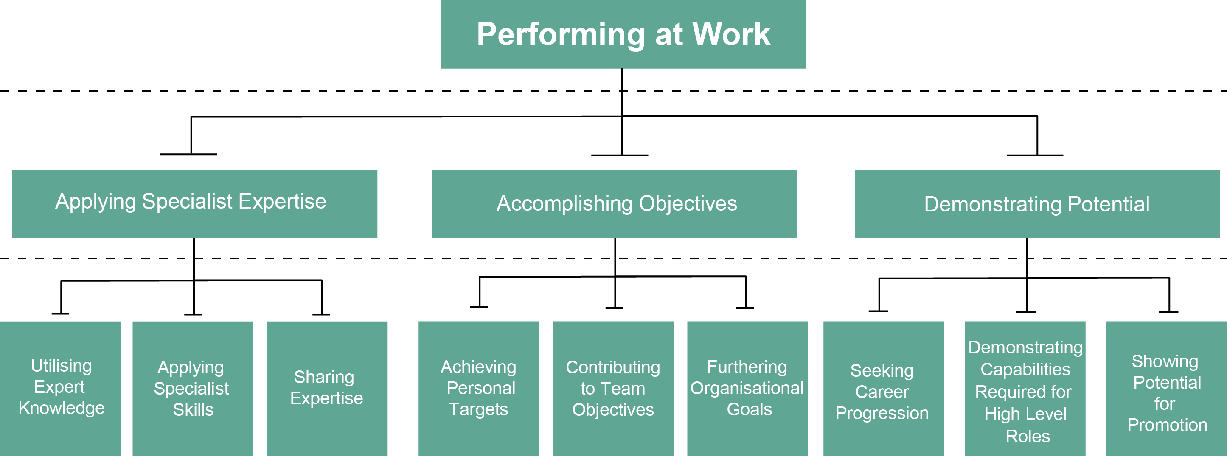
B-A-G Framework:
Global Aspects
1 - Cluster
3 - Sections
9 - Dimensions

Slide 14
Introducing Wave Performance 360

Slide 15
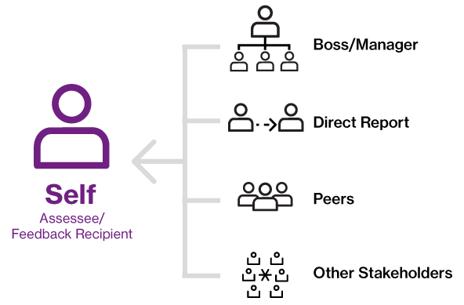
What is 360 Assessment?

Slide 16
Why Undertake 360 Assessments?
Feedback processes should affect self-awareness in a positive way
Bring ‘blind spots’ into open arena
Encourage learning and development through feedback from various sources that is compared with self-assessment
Have the capacity to explore performance and potential together
Build confidence in areas of strength
Audit skill areas
Improve Return on Investment (ROI) on development activities
Improve organisational leadership

Slide 17
What are the Benefits?
Culture change
Identifying potential
Create better leaders
Maximise performance
Insight into strengths & weaknesses
Realise potential
Identify development actions
Impact on career exploration
Organisational
Individual
Group/Team
Empowerment
Enhanced communication
Better understanding

Slide 18
Wave Performance 360
QUICK
VALID
VISUAL
CONFIGURABLE
FREE TEXT
10 minutes online
Based on the Wave Performance and Culture Framework™
Visual Reports
Can be tailored to organisational frameworks
Adds richness to numerical scores

Slide 19
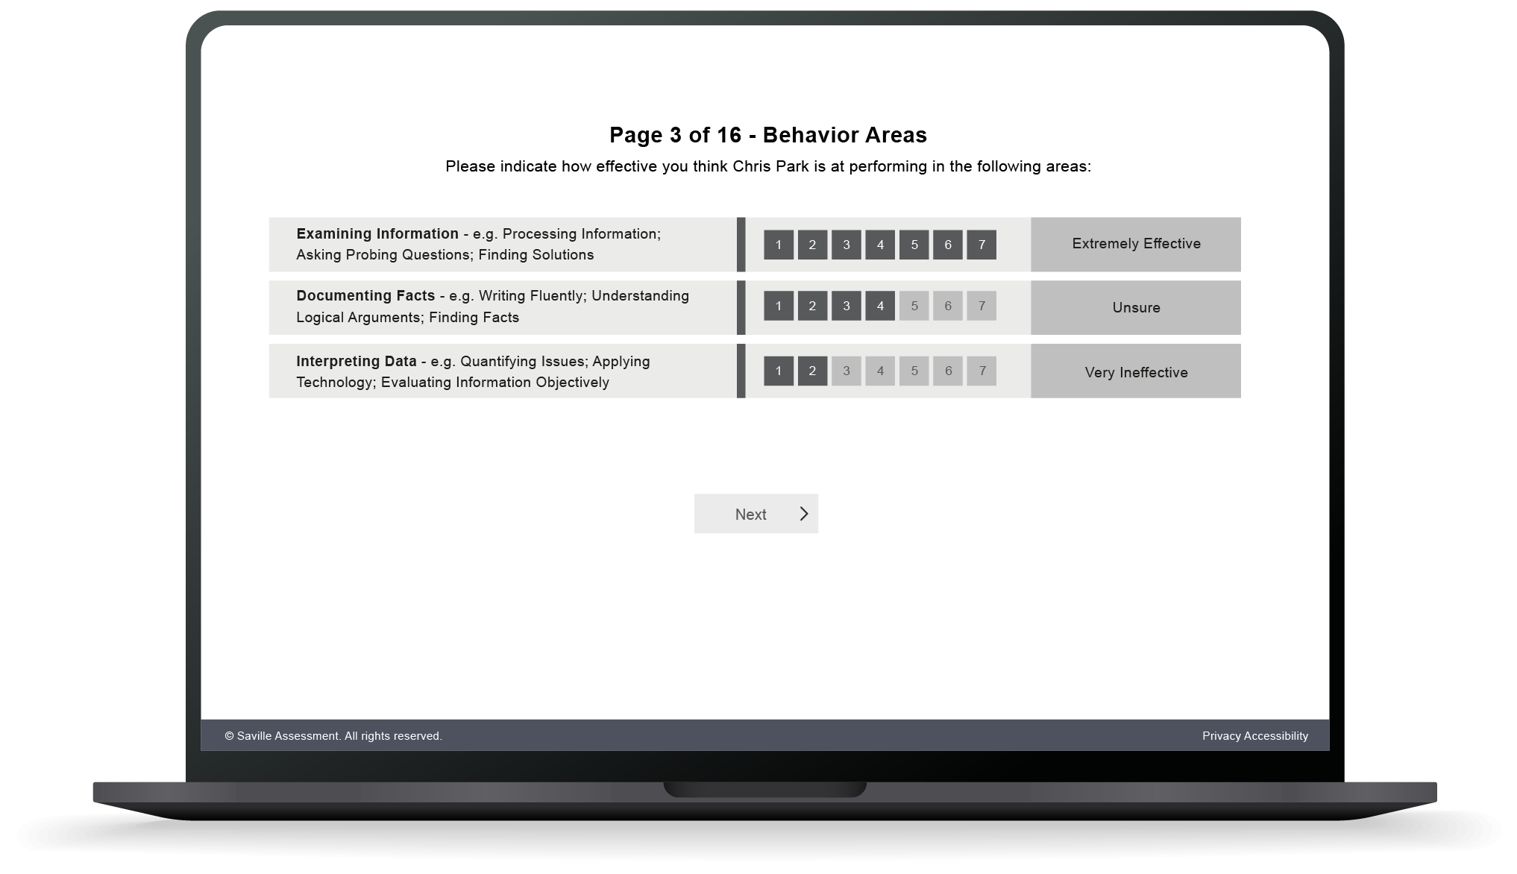
Completion Experience
10-minute online questionnaire completed by each rater
Seven-point normative ‘Effectiveness’ rating scale
Choose to include/exclude Ability Ratings at project outset

Slide 20
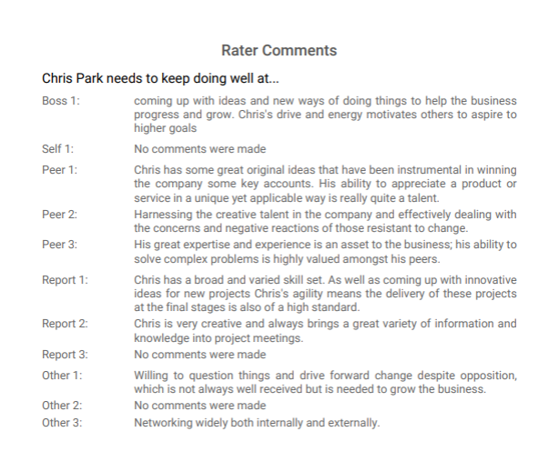
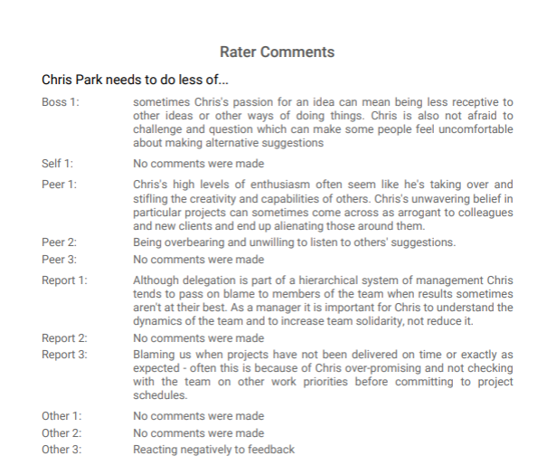
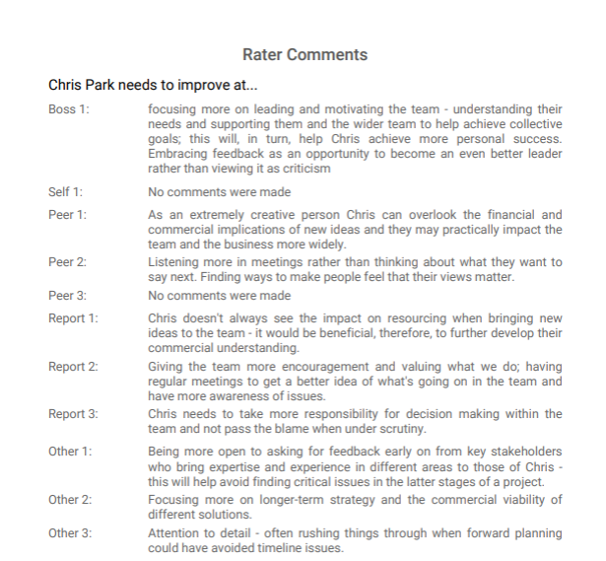
Free Text Option
Free text boxes add richness to numerical scores and identify strengths and development issues
For everyone (including self), there is an open narrative section at the end of the questionnaire which asks you to reflect on things that will help the individual to understand the impact that they have at work and to help them to think about their personal development.
The specific questions are:
“What to keep doing well?”
“What to do less of?”
“What to Improve?”

Slide 21
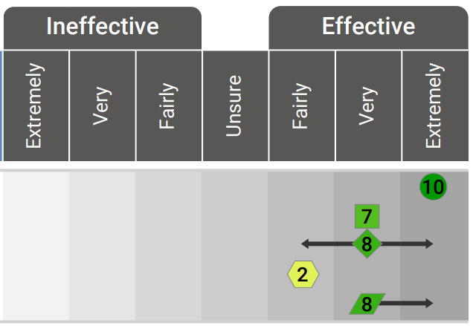
Dual Reporting
Primary Reporting
Seven effectiveness categories
Directly based on the online questionnaire scale
Performance-centric terminology
Easy and generally positive to feed back
Secondary Reporting
1-10 colour-coded Sten scale
Norm-referenced external benchmarking
Enables comparison with Styles self-report
Highlights extremes

Slide 22
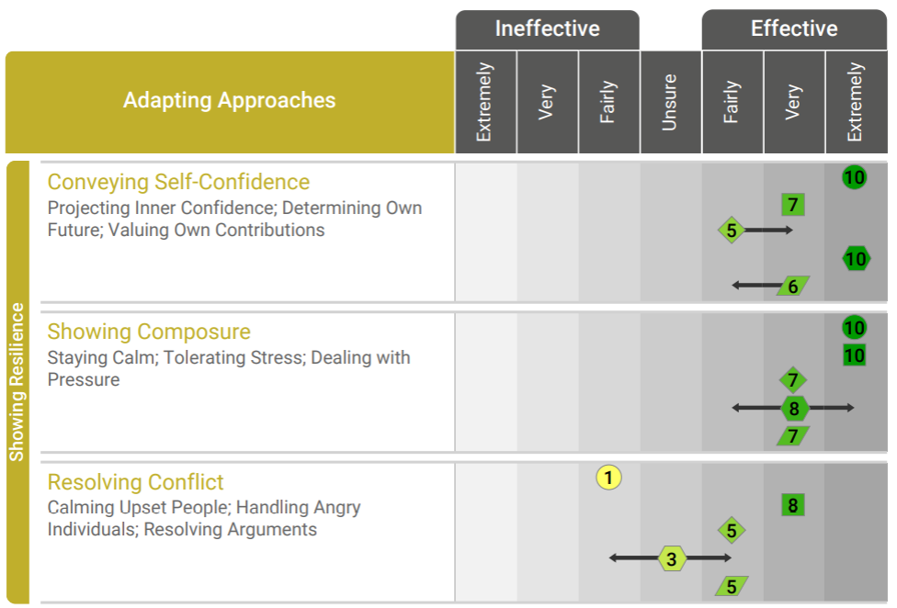

Dual Reporting

Slide 23
Performance 360 Dimensions
 | Performance 360 with Ability |  | Performance 360 without Ability
 | Dimension | Mean | Dimension | Mean
Top 3 | Upholding Standards | 6.05 | Upholding Standards | 6.05
 | Establishing Rapport | 5.91 | Establishing Rapport | 5.91
 | Producing Output | 5.87 | Producing Output | 5.87
Bottom 3 | Seizing Opportunities | 4.94 | Inviting Feedback | 5.12
 | Working with Design | 4.60 | Developing Strategies | 5.00
 | Working with Equipment | 4.58 | Seizing Opportunities | 4.94

Slide 24
Interpretation Exercise

Slide 25
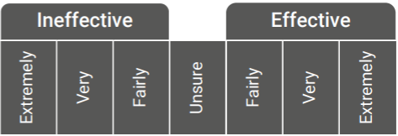
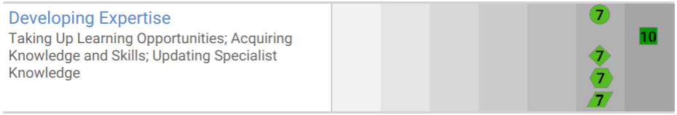
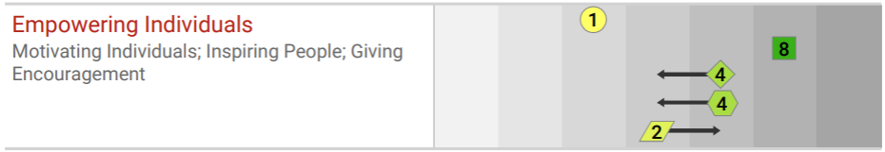
Interpretation Exercise
For each example provide a brief interpretation of how the assessee was rated by their boss, peers, reports, others and how they rated themselves.

Slide 26
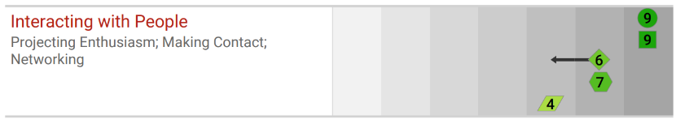
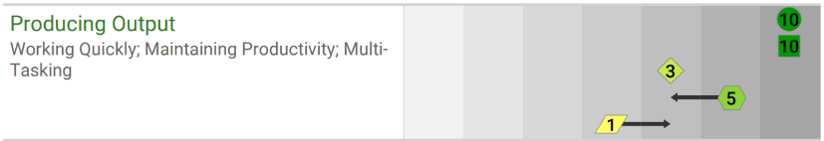
Interpretation Exercise
Provide a brief interpretation of how the assessee was rated compared to other individuals who have previously completed the assessment.
Provide a brief interpretation of the assessee’s performance taking into account 1) the different rater groups and 2) comparison to others.

Slide 27
Applying Wave Performance 360

Slide 28


Available Tools

Slide 29
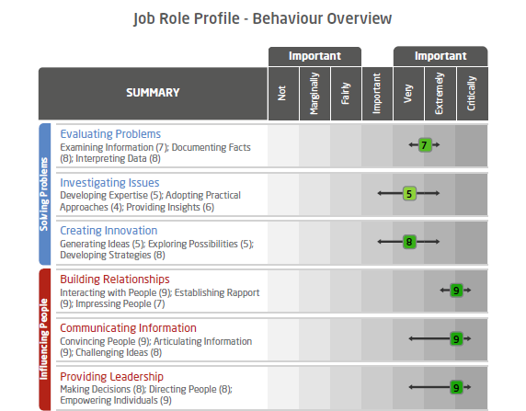
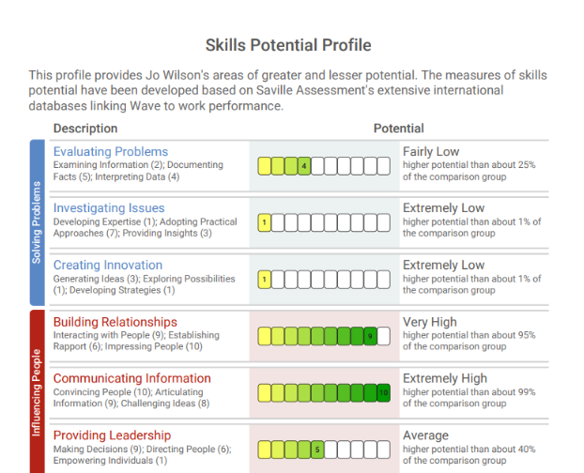
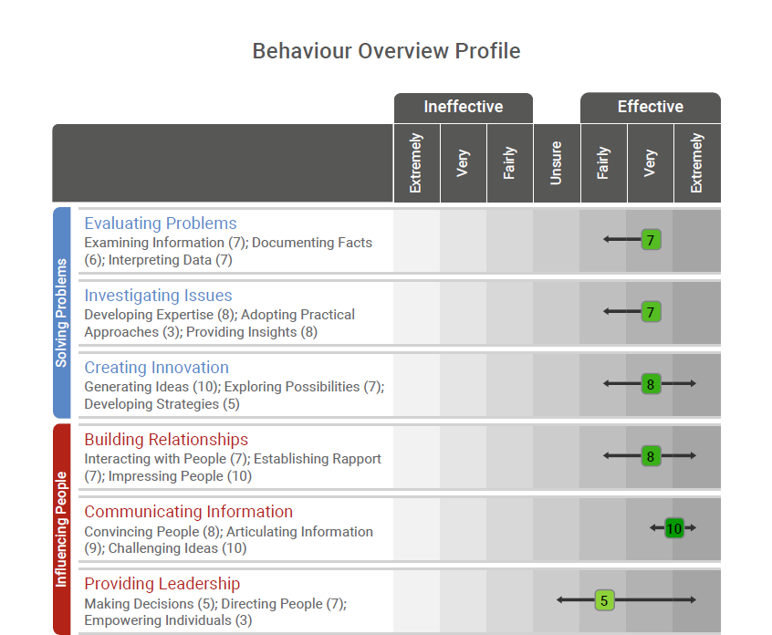
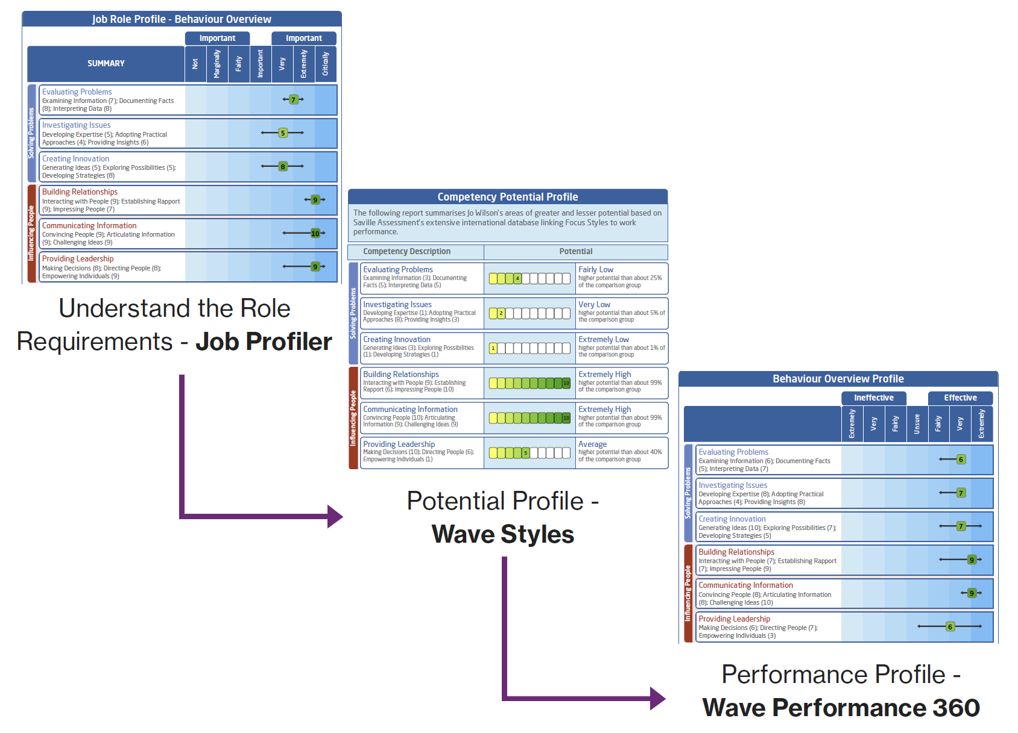
Matched Model

Slide 30
Performance Vs Potential
Performance 360 gives the raters aggregated assessment of an individual’s performance
Wave Styles questionnaires (Professional and Focus) indicate where an individual should or could be - given the combination of their motives and talents – or their skills potential
Putting the two questionnaires together allows not just performance coaching but coaching individuals to realise their potential
What does this look like?

Slide 31


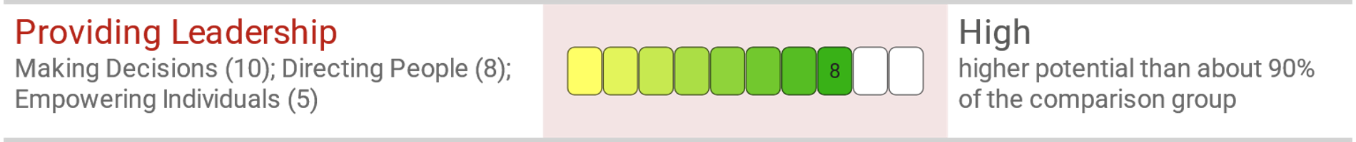
Performance Vs Potential
Use in conjunction with Wave Professional Styles or Wave Focus to explore possible gaps between performance and potential
Very effective overall but average when compared to others
Professional Styles
Indicates high potential

Slide 32
Performance and Potential
Professional/Focus Styles
Unrealised Potential
Realised Potential
(Low Performance, High Potential)
(High Performance, High Potential)
POTENTIAL
Predictable Limitation
Outperformed Potential
(Low Performance, Low Potential)
(High Performance, Low Potential)
PERFORMANCE

Slide 33
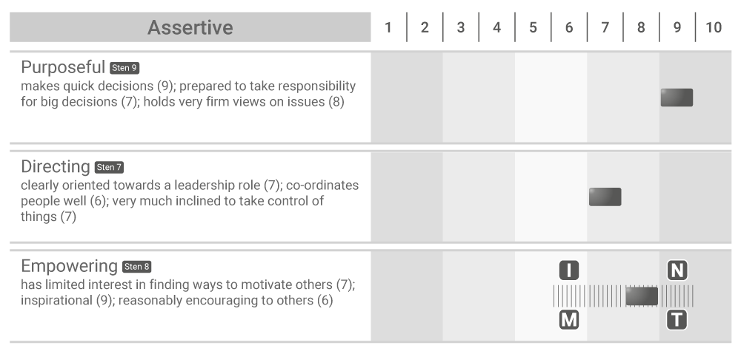
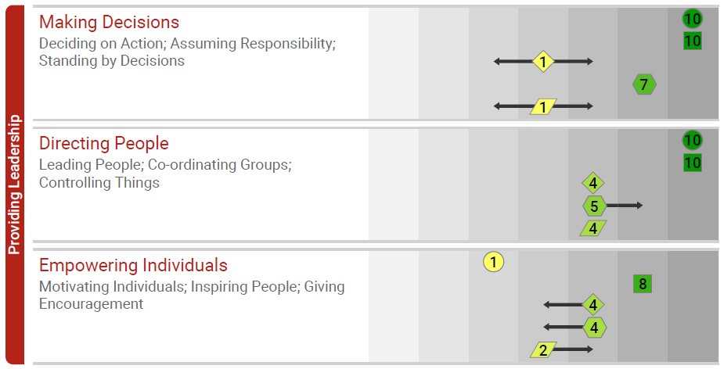
Incorporating Styles
What are the links?
Feels effective at empowering but less motivated in this area – impact on Performance?
Reports to place a strong emphasis on decision-making and directing and feels extremely effective in these areas
To explore…
How often do you empower your team?
How do you encourage your team?
When have you found empowering others more challenging?
How do you ensure your team are on-board with your direction?
What impacts on your motivation to empower?
How could you enhance your leadership style?

Slide 34
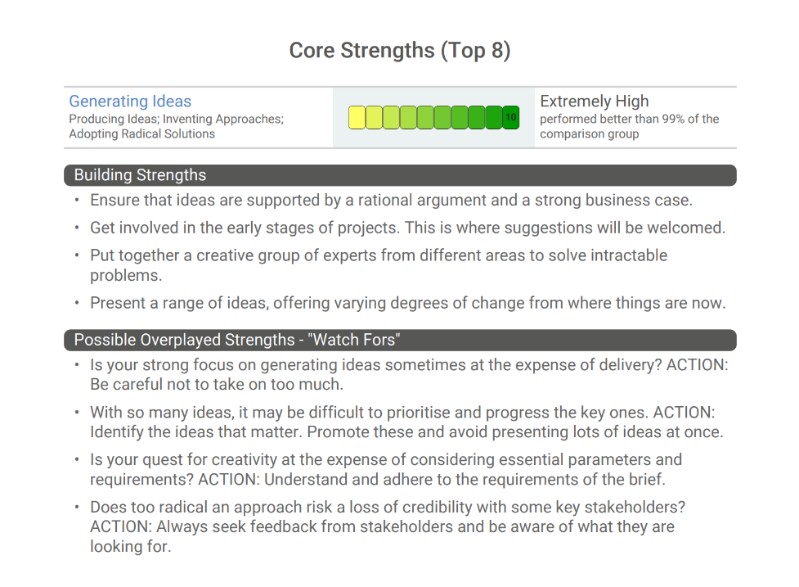
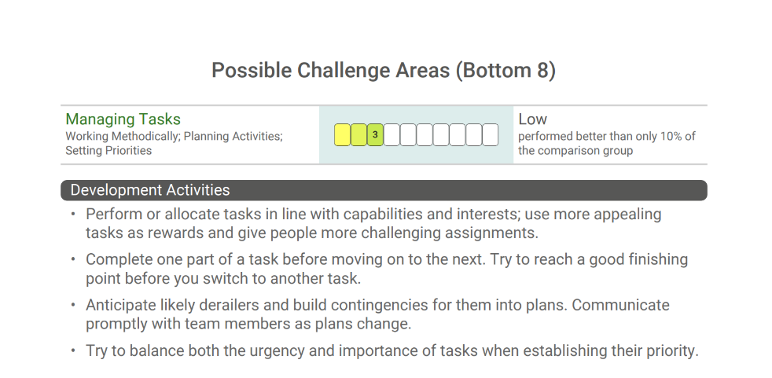
Incorporating the Development Report
The Development Report presents practical advice on how the individual could manage their areas of strengths and limitations.
The Wave Performance 360 Development Report provides advice on:
Building Strengths (for scores of 6-10)
Possible Overplayed Strengths - “Watch Fors” (for scores of 8-10)
Development Activities (for scores of 1-5)

Slide 35
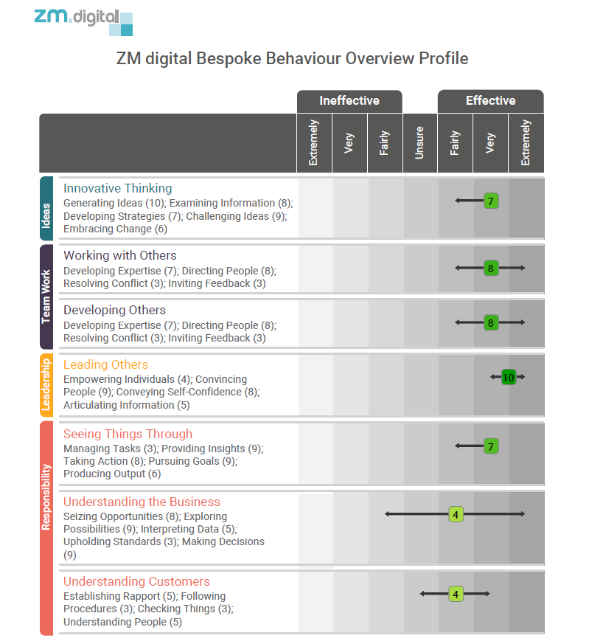
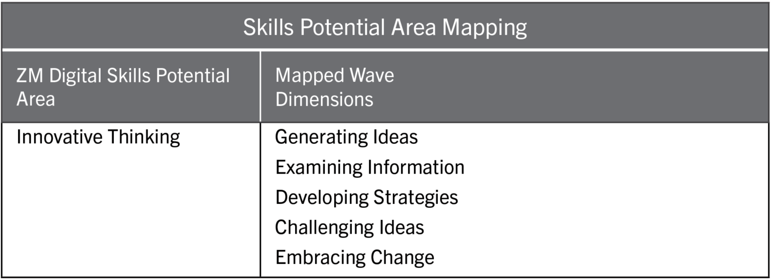
Configurable
Mapping of a client’s organisational framework to the Wave model allows for a bespoke report.

Slide 36
Interpretation Exercise
Notes:
For Wolseley – move to Chris Park examples
Creating Innovation – high potential, spread of effectiveness
Showing Resilience – Resolving dimension specifically
Providing leadership on Chris Park

Slide 37

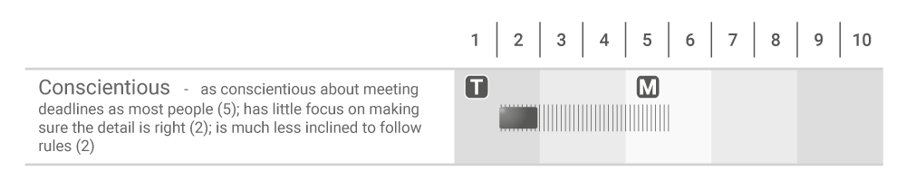
Example 1
Important
Important
Not
Marginally
Fairly
Important
Very
Extremely
Critically
Meeting Timescales (7); Checking Things (7);
Following Procedures (5)
5
Importance
Potential

Slide 38
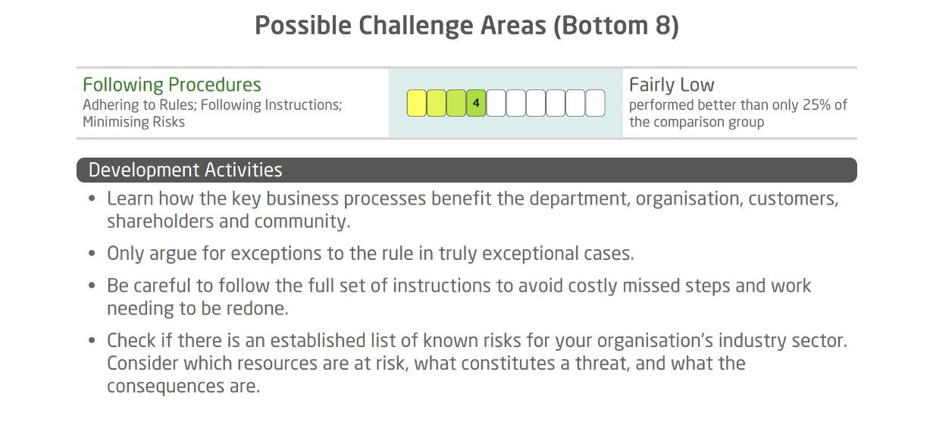
Example 1
Meeting Timescales (7); Checking Things (6);
Following Procedures (4)
5
Performance
Development Action

Slide 39
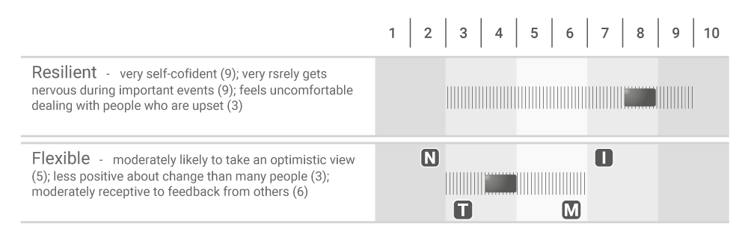
Example 2
Important
Important
Not
Marginally
Fairly
Important
Very
Extremely
Critically
Showing Resilience
Conveying Self-Confidence (8); Showing Composure (8); Resolving Conflict (7)
8
Importance
Adjusting to Change
Thinking Positively (8); Embracing Change (8); Inviting Feedback (6)
8
Potential

Slide 40
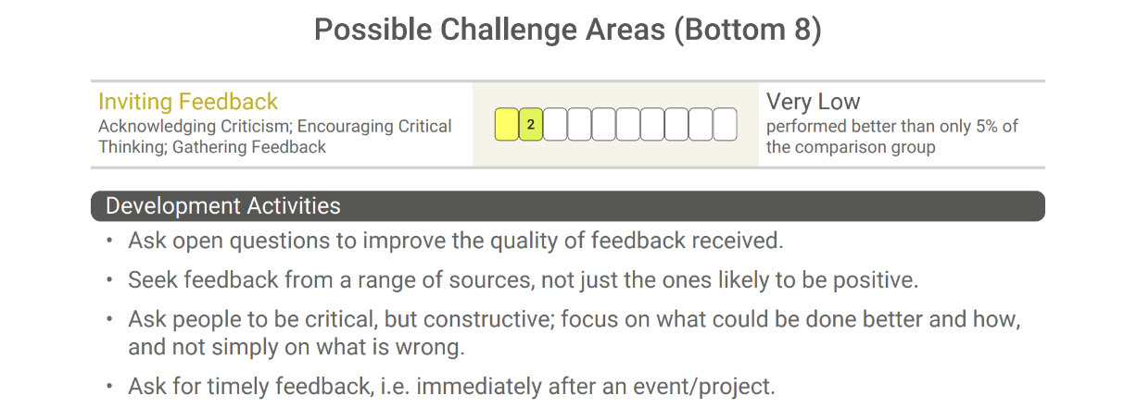


Example 2
Showing Resilience
Conveying Self-Confidence (8); Showing Composure (8); Resolving Conflict (4)
7
Performance
Adjusting to Change
Thinking Positively (5); Embracing Change (5); Inviting Feedback (3)
4
Development Action

Slide 41
Wave Performance 360 Report

Slide 42
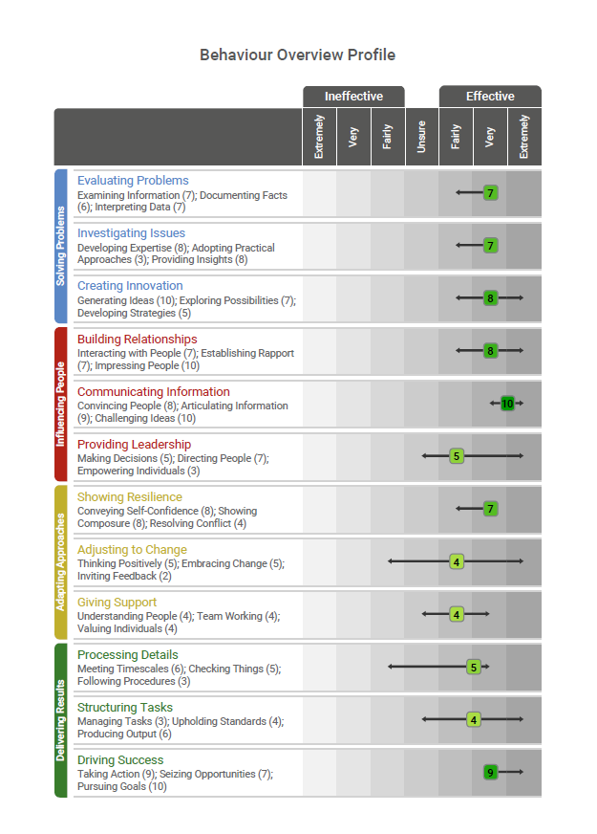
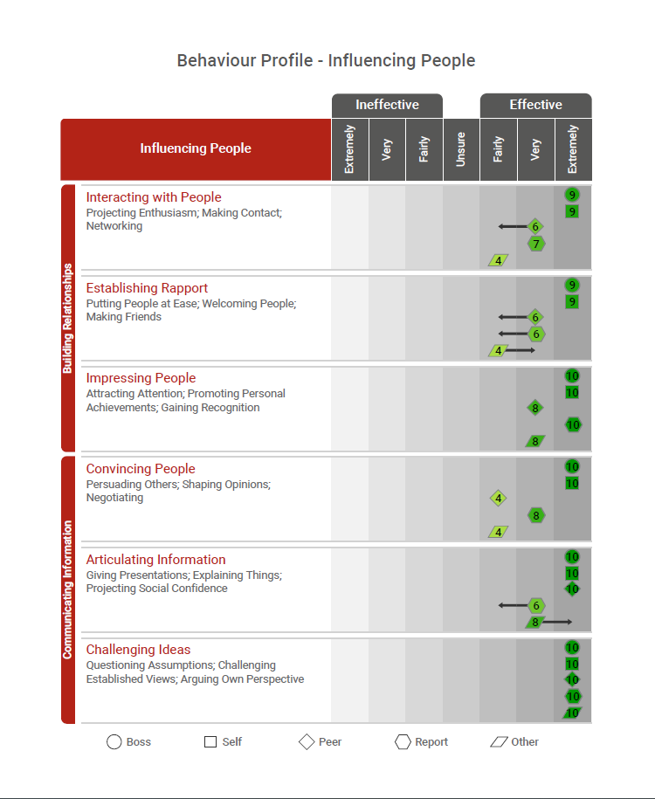
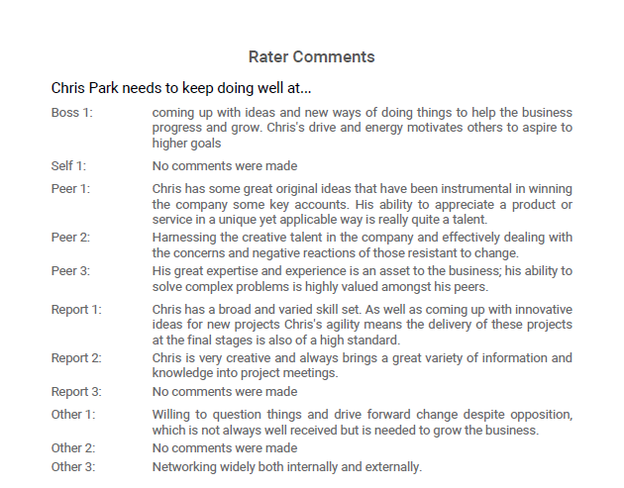
Wave 360 Report

Slide 43
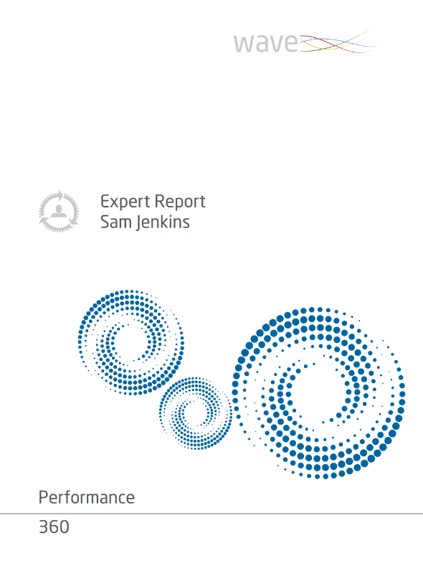
Case Study
Sam Jenkins
Sam Jenkins has been identified as high potential
Sam is due to begin a leadership development programme and has to choose which sessions to attend
Sam has completed the Wave Performance 360 questionnaire
You are conducting a one-to-one feedback session with Sam
Your task is to support Sam in creating a personal development plan and choose relevant leadership programme options

Slide 44
Practical Session: Feedback
Feedback Provider | Feedback Receiver | Section
Daniel | Serina | Giving Support
Serina | Daniel | Providing Leadership
Tutor: Karen
Feedback Provider | Feedback Receiver | Section
Emma | Helen | Giving Support
Helen | Molly | Adjusting to Change
Molly | Emma | Providing Leadership
Tutor: Isi | Tutor: Nikki | Tutor: Nikki

Slide 45
Feedback of Wave
Performance 360

Slide 46
Maximising the Benefits of 360 Feedback
Raise their self-insight
Relate back to the role requirements
Focus on action planning – how will they improve?
Recognise individual steps to behaviour change:
  Understanding the key messages
  Accepting the feedback
  Readiness to change
Focus on strengths but do not overlook development areas
Encourage them to follow-up with their Line Manager
Encourage a team follow-up group activity

Slide 47
Structure of Feedback
Introduction
Preparation
Scene setting – purpose, objectives, core behaviours, background, aspirations
About this report – comparison group, perceptions of performance, confidentiality, discuss raters, 360 model, explain dual reporting
Discuss Profile
review differences between raters, look for links and themes
differences between raters, areas of strength to build, potential limitations, link in comments
Conclusion
Summarise key points
next steps, action plan, development activities, follow up

Slide 48
Preparation for Feedback
When reviewing results, aim to focus on the following:
Difference in scores between the different groups providing feedback – how well does the person work with others?
Differences between self-perception and the viewpoints of other raters – indicator of self-awareness
Overall strengths and limitations – how do these relate to the person’s role?
Boss ratings – identify consistent messages as an indictor of their relationship or performance issue?
Look for differences in scores for Task (Solving Problems and Delivering Results) and People (Influencing Others and Adapting Approaches) performance areas
Links between skills potential areas – any patterns of strength or limitations?

Slide 49
Feedback Flow
Scene setting and clarifying
Relate to purpose/role
Discuss raters
Describe layout of report
Summarise strengths and development areas
Discuss trends and patterns, cross reference with open text
Agree action an follow up
Review skills potential areas

Slide 50
Question Style
Open questions
Follow-up questions
Impact of actions
“Tell me about…”, “How does that resonate with you?”
“Describe…” “What does that look like at work”
“What exactly did you do?” “What approach did you use?” “How effective was your response?”
What, where, which, who, why and how?
“What impact did that have on others?” “What are the implications of…on your team?”
“What feedback did you get from others?”

Slide 51
Action Planning
Maximising behaviour change:
Goal setting
Encouraging openness to change
Raising self-awareness
Encouraging ownership
Questions
What development areas do you feel will have the greatest impact on your performance?
What are you going to do differently?
What opportunities exist to support your development?
What are the perceived challenges? What could you do about these?
Who else will support?
When will you review progress?
How will you measure progress?

Slide 52
Example Action Plan
Skills Potential Area | Team Working
Behavioural description | Working Participatively, Encouraging Team Contributions, Involving others in Decisions
Reason for choosing this | Some negative feedback on 360, Personal dissatisfaction with team meetings
What others observe | Impatience, Closing discussion down, Time management seen as the overriding priority, Lack of action on difficult issues
Development Activities | Set clear timescales for consultation and decision making, Make sure that all relevant parties have been given the opportunity to make their views known, Work out who are the stakeholders impacted by a decision and use others to facilitate their input
Who/How others can help | Review meetings, Regular and open feedback, Pulse survey feedback
Target date measures | Quarterly reviews

Slide 53
Risks
Raters
Individuals
Lack of honesty in ratings
Lack of differentiation in ratings
Lack of real knowledge about individuals
Cultural differences
Defensiveness
Obsession with who said what
Lack of ownership
Cultural differences
Lack of follow-up

Slide 54
Dealing with Difficult Reactions
People who get emotional
People who stop talking
Let them work through their tears or anger
Listen and continually show you understand
Start asking open-ended questions
Ask open-ended questions
Give the person time to respond – do not interrupt
Encourage them to talk through their thoughts
People who argue
Give the feedback coolly and firmly
Underplay the anger with calm gestures
Paraphrase to show the impact their reactions have

Slide 55
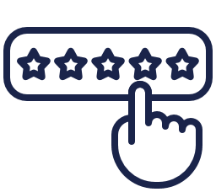






Feedback Flow
Effectiveness rating scale
Dual reporting format
Unsure rating
Comments
Strengths perspective
Global areas
Integrated model

Slide 56
Pop Quiz

Slide 57
What are some of the benefits of using the Wave 360 assessment?
Quick completion time of 10 minutes helps maximize completion rates
Appropriate for a range of job roles
Highly work relevant and internationally applicable
All of the above
57
Notes:
D

Slide 58

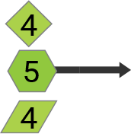
What does the primary reporting tell us?
Overall, the Reports have rated the assessee as fairly effective at Directing People, with at least one Report rating them as very effective
The Peer category has rated the assesee as slightly more effective at Directing People than most other professionals and managers
Half of the Reports have rated the assessee as fairly effective at Directing People and half have rated them as very effective
The Other category have rated the assessee as being extremely effective at Directing People.
Directing People
Leading People; Co-ordinating Groups;
Controlling Things
58
Notes:
A

Slide 59
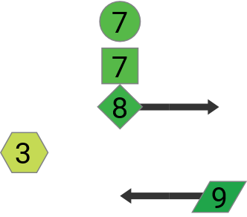
What does the secondary reporting tell us?
The ratings from the Peers are split between very and extremely effective at Interpreting data
The Report category ratings suggest the assessee is less effective than most people in the comparison group at Interpreting Data
All raters in the Peer category have rated the assessee as very effective at Interpreting Data
The Peer category ratings suggest the assessee is as effective as most people in the comparison group at Interpreting Data
Interpreting Data
Quantifying Issues; Applying Technology; Evaluating Information Objectively
59
Notes:
B – yes the ratings are about effectiveness and sten 3 is below average

Slide 60
During a feedback session, you should help the assessee to...
Understand who was responsible for each comment
Take ownership
Determine which areas to focus on
Talk through their thoughts
60
Notes:
BCD

Slide 61
Administration and Project Management

Slide 62
Setting up a 360 Project
Clarify purpose, population, timescales and communications
Brief individuals, raters, line managers and facilitators
Prepare email content and briefing sessions
Launch self rater questionnaires
organisational follow-up
project feedback and overview
feedback sessions
Reminder emails

Slide 63
Setting up a 360 Project
Understand role requirements
Assessee Briefing:
  Purpose of the exercise
  Outline of full process – administration to feedback
  Timescales
  Feedback outcomes
  Choosing raters – providing rater details
  Confidentiality
Rater selection:
  Who chooses
  Number of raters: aim for five (with a minimum of three) in peers and reports categories
  Work relationship with raters

Slide 64
Rater Briefing
Purpose
Questionnaire timings
Try to use the full range of the scale as much as possible
You may find some of the ratings difficult, but please try to respond to every area
If you really feel you cannot provide a rating on a particular area, please select the ‘Unsure’ option
Unless you are completing as “Self” or “Manager”, your responses will be aggregated with other peoples and will therefore be confidential
Please answer honestly and straightforwardly
Think about the individual in a work environment
Try to differentiate between those behaviours which you see as very strong/weak and those which are average
Support your ratings with examples in the open text boxes

Slide 65
Watch Fors
Positioning of the process
Completion rates – invite more than minimum
Raters using the scales incorrectly
Assessees have not been in the role for long
Raters do not work closely with assessee

Slide 66
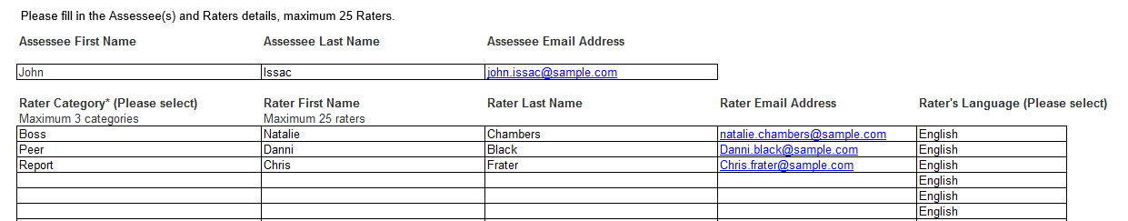
Project Set-up – Bureau
Step 1: You send out briefing emails and advice to assessees
Step 2: Assessees nominate their raters and send them information and guidance on the process
Step 3: You complete Performance 360 Bureau Request Form send to Saville Assessment’s Bureau team
Step 4: Bureau team set up project - Oasys emails and login details sent
Step 5: We can send updates and reminders
Step 6: If appropriate completions rates are achieved we generate and send you reports

Slide 67
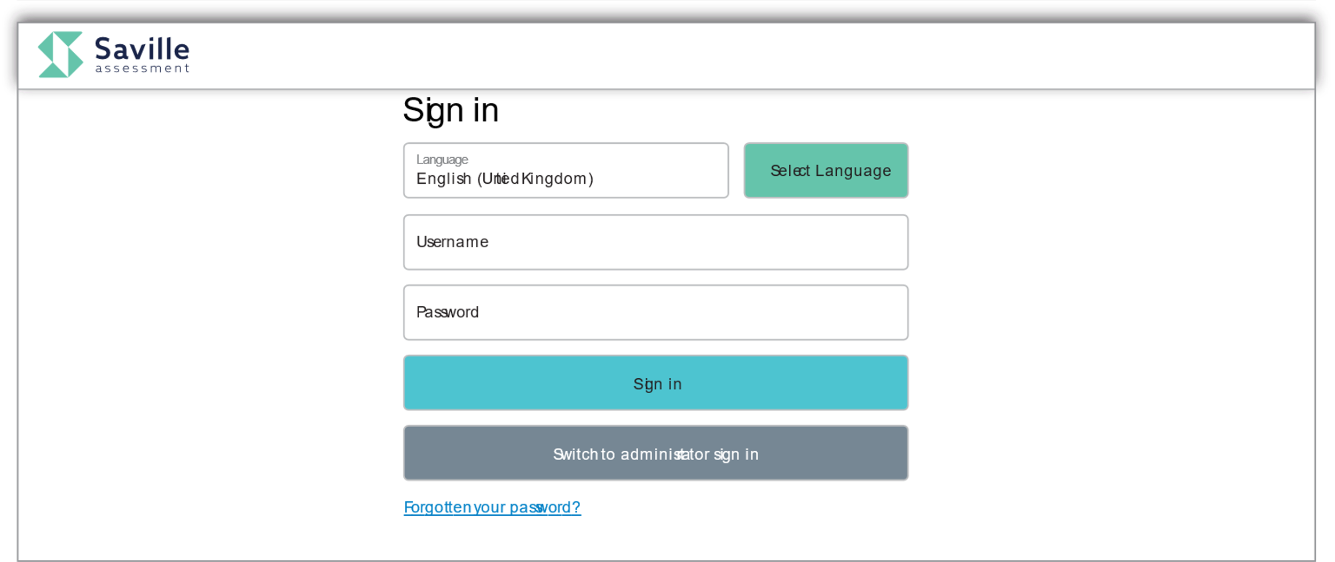
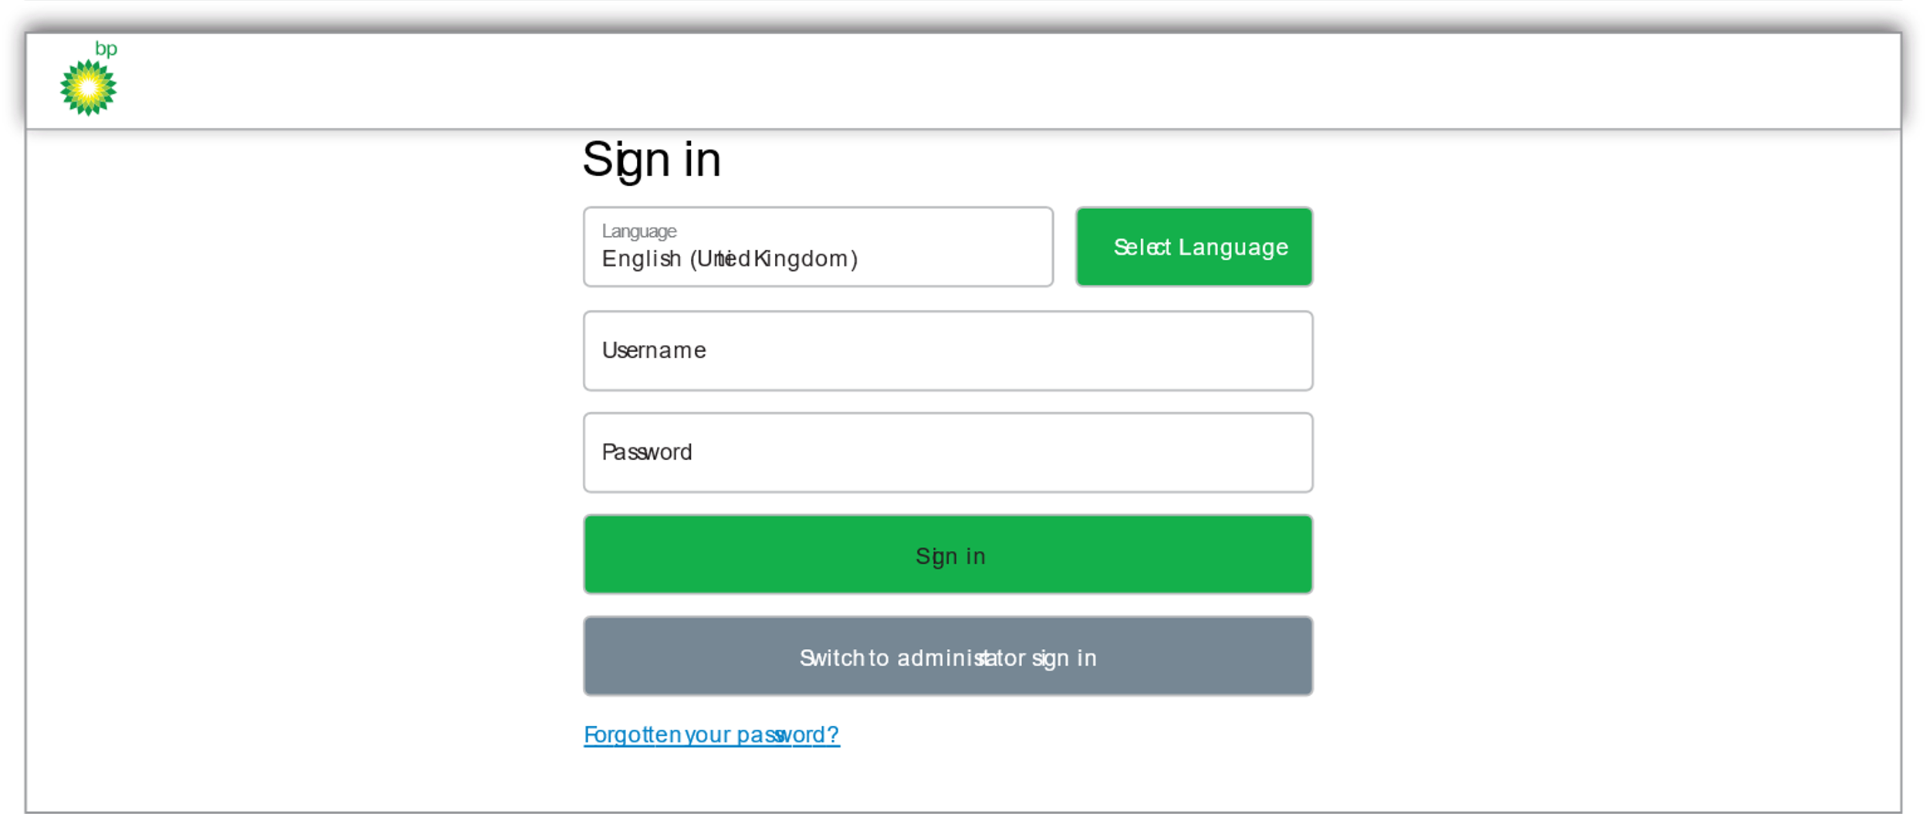
Oasys
One-off investment
Free training to use Oasys
Better value for larger numbers
You are in control of your own projects
Can be branded or non-branded
99.9% uptime

Slide 68
Leadership Impact Performance 360

Slide 69
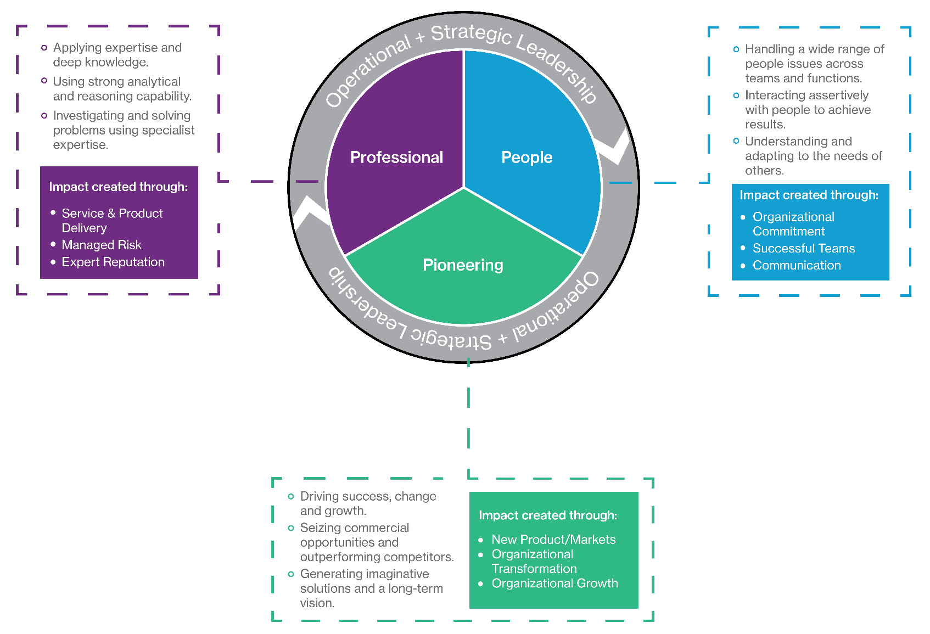
Leadership Impact Model

Slide 70
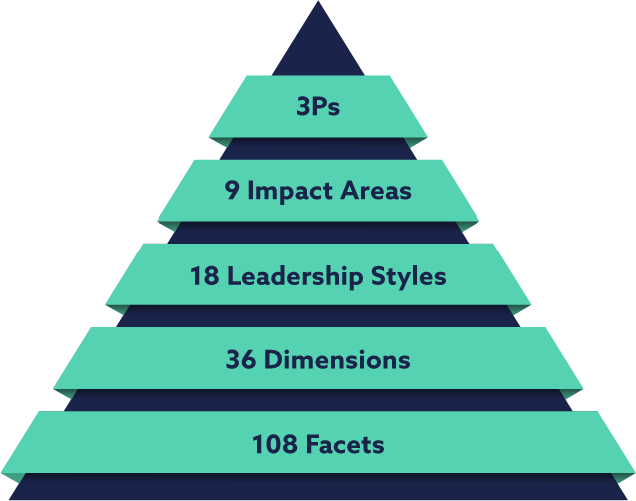



Leadership Impact Model
Service & Product Delivery
Managed Risk
Expert Reputation
Professional
People
Organizational Commitment
Successful Teams
Communication
New Products/ Markets
Organizational Transformation
Organizational Growth
Pioneering

Slide 71
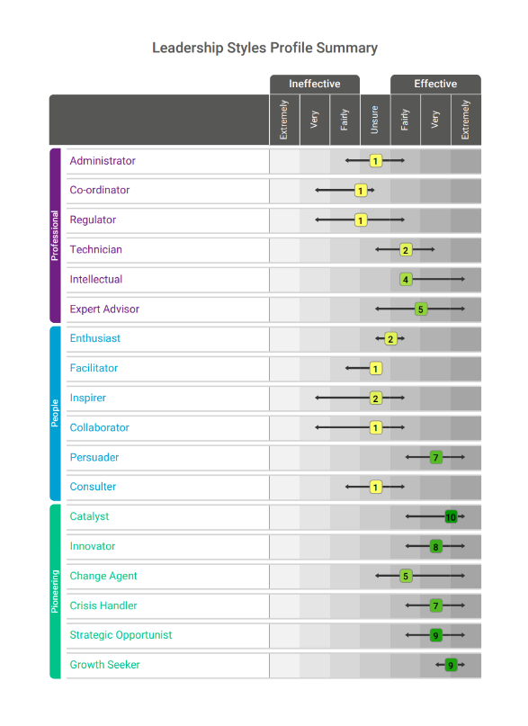
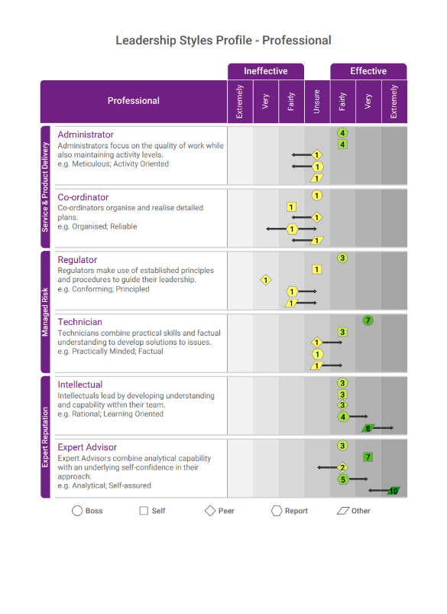
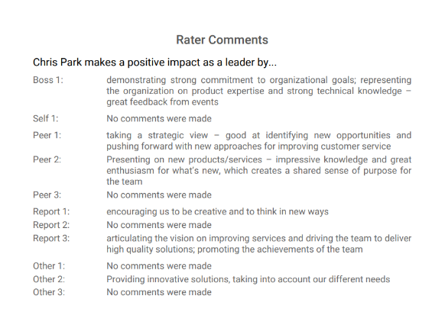
Leadership Impact Performance 360
Leadership Impact 360 gives users a valid and comprehensive way to assess impact in their senior managers and executives
Direct match to 3P model and Wave Professional Styles Leadership Impact Expert Report
Clearly differentiated from Wave Performance 360
Organisational perspective of leadership impact

Slide 72
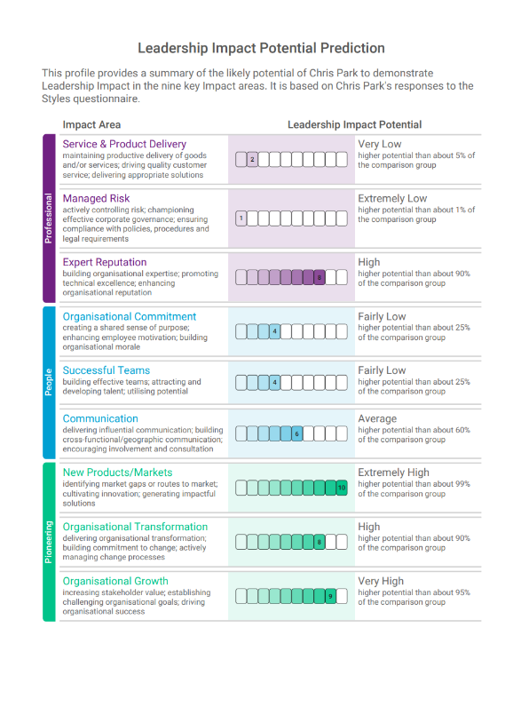
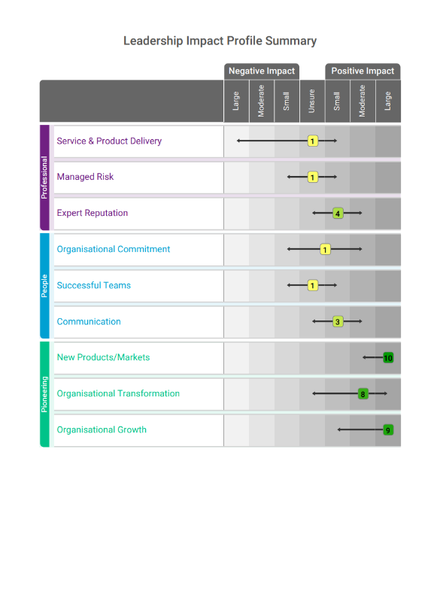
Impact Potential Prediction & Impact 360 Potential Summary
Potential Profile –
Wave Styles Leadership Impact
Performance Profile –
Wave Leadership Impact 360

Slide 73
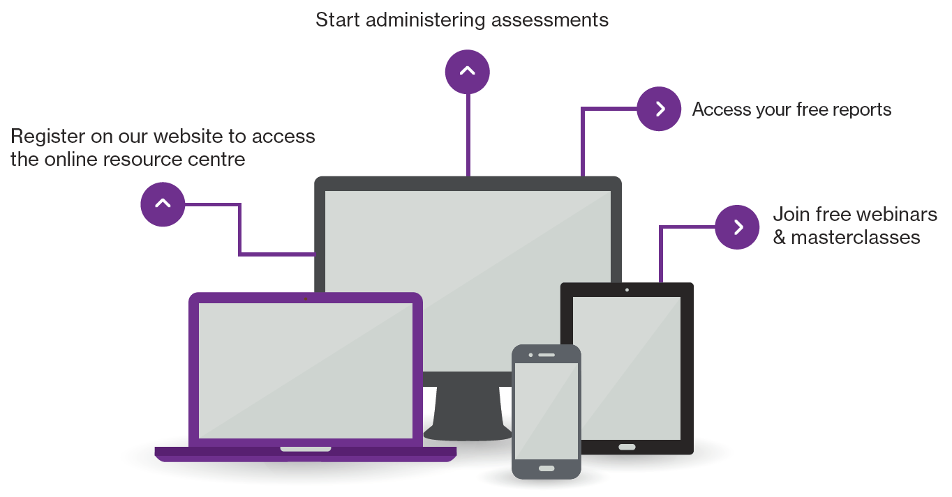
Next steps
Contact our Duty Consultant for additional support
Call: +44 (0)208 619 9000 Email: expert@savilleassessment.com

Slide 74




The Saville Assessment Community
What you can expect:
Invitations to webinars and practitioner masterclasses
Discussion on industry-specific news and topics
Networking opportunities with other professionals
Privileged offers
@savilleassess
@savilleassess
https://www.linkedin.com/company
/saville-assessment
www.facebook.com/SavilleAssess/

Slide 75
Performance 360 Norm Group Description Professionals & Managers (2011)
The sample consisted of 12,592 professionals employed in a range of job functions across a wide range of industry sectors.
Gender: 66% female / 34% male
Age: 24 to 67 years, median age 39 years
Cultural Background: 45% UK White and 35% from other White backgrounds (including European, American, Australian and New Zealander). 20% were of other (e.g. Indian, Hispanic, Black African) or mixed origin (e.g. White and Asian, White and Black African)
Education: 18% had a professional qualification, 34% had a postgraduate degree, 33% had a degree, 14% were educated to high school, and the remaining 1% of the group stated ‘Not applicable’ or ‘other’
Level of Responsibility: 35% at senior management level (including board or executive directors, vice-presidents and senior managers), 38% were managers, 13% were supervisors or team leaders and the remaining 15% were professional individual contributors
Work Experience: overall work experience of the group ranged from 1-2 years (2%) to more than 20 years (41%). 8% had 3-5 years of work experience, 13% had between 6 and 9 years, and 36% had between 10 and 20 years.

Slide 76
Performance 360 Norm Group Description Senior Managers & Executives (2011)
The sample consisted of 5,334 individuals employed in a range of job functions across a wide range of industry sectors.
Gender: 29% female / 71% male
Age: 27 to 63 years, median age 43 years
Cultural Background: 54% UK White and 31% from other White backgrounds (including European, American, Australian and New Zealander). 16% were of other (e.g. Indian, Hispanic, Black African) or mixed origin (e.g. White and Asian, White and Black African)
Education: 20% had a professional qualification, 40% had a postgraduate degree, 28% had a degree, 11% were educated to high school, and the remaining 1% of the group stated ‘Not applicable’ or ‘other’
Level of Responsibility: 9% of the sample were at board or executive level, 17% at director or vice-president level and the remaining 75% were senior managers
Work Experience: overall work experience of the group ranged from 3-5 years (1%) to more than 20 years (52%). 7% had 6-9 years of work experience, 40% had between 10 and 20 years.

